Slide 1
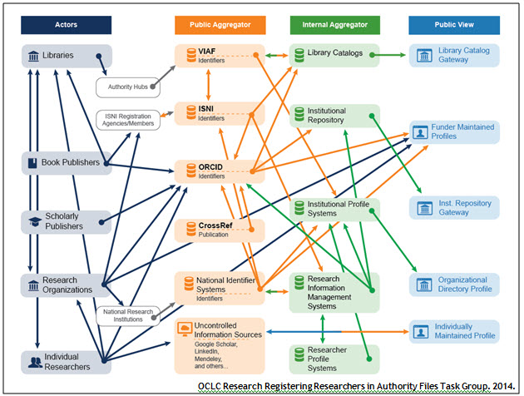
Researcher ID Information Flow
Notes:
This diagram depicts the flow of information describing researchers and identified researcher outputs such as publications among classes of actors and systems. Each category of actor is depicted with an icon and a caption. An arrow going from one entity to another is used to indicate that information flows from one entity to the other.
Specific entities (Crossref, ISNI, VIAF, ORCID) are indicated with bold text; all other entities represent a category of entity within the general types—public aggregator, internal aggregator or public view. The presence or absence of arrows is based on analyzing the detailed research networking systems characteristics profiles^{[1]}. Arrows are shown in the diagram wherever there is at least one pair of profiled entities of those categories transmitting information.
The researcher identifier information flow diagram reveals several patterns:
Information flow is quite complex overall, especially between public aggregators and private aggregators.
Most of the information flow is one way—there are few automatic or systematic channels for corrections or annotations at later stages to flow back up to public aggregator sources, or to the actors providing them. ISNI—which focuses on managing links between member identifier systems and databases—is an exception. It tracks all sources, and corrections are fed back to the source as they are made. The interoperability flows between ISNI and ISNI registration agencies, and between ISNI and VIAF, are indicated in the diagram by bidirectional arrows.
Many actors are contributing to multiple public views of Researcher ID information.
Information provided by the same class of actor may flow through multiple (possible concurrent) paths to internal aggregator systems and public views—suggesting the potential for duplication and inconsistency.
Individual categories of public views seldom represent more than one type of internal aggregator.
A key question is how corrections or updates can be communicated between systems. Researchers are frustrated when they see errors in their profile, works incorrectly assigned to them or works missing. Even if the information is corrected in the local instance, it often is not reflected in the aggregated databases or hubs.
^{[1]}. See the OCLC Research Registering Researchers in Authority Files report at http://www.oclc.org/content/dam/research/publications/library/2014/oclcresearch-registering-researchers-2014.pdf for more information.

