Slide 1
LD4 Workshop, Stanford University
Prototyping a Linked Data Platform
for Production Cataloging Workflows
May 2, 2018
Carl G. Stahmer Director of Data and Digital Scholarship Associate Director For Humanities, UC Davis Data Science Initiative Associate Director, English Broadside Ballad Archive www.carlstahmer.com @cstahmer | Bruce Washburn Principal Software Engineer OCLC Membership & Research @btwashburn

Slide 2
Our talk today …
Bruce:
Why another linked data project?
Who is building it?
What is it?
How are we building it?
Carl:
Why are we participating?
What use cases are we testing?
How could these services be potentially used?
Notes:
For more details on OCLC’s Linked Data efforts and strategy, see
http://oc.lc/linkeddatasummary

Slide 3
Why another linked data project?
OCLC LD efforts
Based on record-oriented bibliographic and authority data
Supported by machine-based clustering algorithms
VIAF
FAST
WorldCat as Schema.org
WorldCat Work entities
Notes:
Today, OCLC primarily offers services to support traditional and essential bibliographic data services for search and retrieval, copy cataloging, original cataloging, and authority control. OCLC is testing the viability of systems in support of linked data services to empower new workflows and entity management services, at web scale.
OCLC Research has a now well-established role in developing and providing systems in support of Linked Data services, including the VIAF which combines multiple name authority files into a single OCLC-hosted name authority service, and FAST which is derived from the Library of Congress Subject Headings (LCSH). The development of VIAF and FAST has been a collaboration of OCLC Research and many others, going back to the late 1990’s.
More recently, OCLC’s experimental work with entity descriptions for Works and Persons has delivered more lessons learned. The pilot project described in this presentation builds on this prior work, and focuses on an emerging web-scale software framework to support entity management and discovery services.
More recently

Slide 4
Why another linked data project?
OCLC LD efforts
Based on record-oriented bibliographic and authority data
Supported by machine-based clustering algorithms
VIAF
FAST
WorldCat as Schema.org
WorldCat Work entities
The Pilot Project
Evaluate OCLC’s role in providing usable linked data
Study new and future bibliographic workflows
Think holistically about entity management
Favor community-driven data modeling and curation
Notes:
Today, OCLC primarily offers services to support traditional and essential bibliographic data services for search and retrieval, copy cataloging, original cataloging, and authority control. OCLC is testing the viability of systems in support of linked data services to empower new workflows and entity management services, at web scale.
OCLC Research has a now well-established role in developing and providing systems in support of Linked Data services, including the VIAF which combines multiple name authority files into a single OCLC-hosted name authority service, and FAST which is derived from the Library of Congress Subject Headings (LCSH). The development of VIAF and FAST has been a collaboration of OCLC Research and many others, going back to the late 1990’s.
More recently, OCLC’s experimental work with entity descriptions for Works and Persons has delivered more lessons learned. The pilot project described in this presentation builds on this prior work, and focuses on an emerging web-scale software framework to support entity management and discovery services.
More recently

Slide 5
Who
Phase II Partners (May ‘18 – Sep ‘18)
American University
Brigham Young University
Cleveland Public Library
Harvard University
Michigan State University
National Library of Medicine
North Carolina State University
Northwestern University
Princeton University
Smithsonian Library
Temple University
University of Minnesota
University of New Hampshire
Yale University
Phase I Partners (Dec ’17 - Apr ‘18)
Cornell University
University of California, Davis
OCLC Research
OCLC Global Technolo-gies
OCLC Global Product Management

Slide 6
What
Develop an “Entity Ecosystem” for:
Creating and editing entity descriptions
Making connections to related entities on the wider Web
Work in a community that will:
Create and curate data in the ecosystem
Describe and rethink bibliographic data workflows
Provide services to:
Reconcile metadata strings to associated LD entities
Explore, import, export, and modify the entity descriptions

Slide 7
Pilot Project timeline
As of 2 May 2018
37%
Notes:
The first discussions about the Pilot Project began in December 2017 and the first version of the ecosystem platform was made available to the project’s first participants in January 2018, and the pilot is expected to conclude in September 2018. We’re no longer in the initial, formative stages, but still have much to learn and a ways to go.

Slide 8
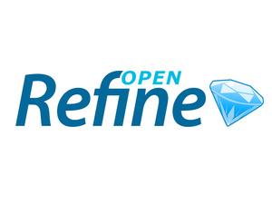
How: A few key technologies
Pywikibot
Notes:
Wikibase – The wikibase extension to MediaWiki provides the primary user interface for creating and editing items and properties.
Mediawiki API – Search and retrieval based on keyword searching or via entity identifiers.
SPARQL Query Service – A SPARQL Endpoint combined with a user-friendly Query Service interface supports complex and granular queries based on items, properties, and their relationships.
OpenRefine API – OpenRefine is an application for cleaning and reconciling data, using Reconciliation APIs and SPARQL endpoints. We're testing an OpenRefine-optimized API, to make it easier for those who use that application to connect to the system and reconcile their data.
Pywikibot – A Python library of tools for batch data creation, editing, and deletion (though we are also evaluating Wikidata Quickstatements as a potential replacement or alternative.

Slide 9
How: Disambiguating Wiki*
Wikipedia – a multilingual web-based free-content encyclopedia
Wikidata.org - a collaboratively edited structured dataset used by Wikimedia sister projects and others
Notes:
Most are familiar with Wikipedia, and many with Wikidata.org.
OCLC has developed close connections to the Wikipedia community through the Wikipedia + Libraries project (https://www.webjunction.org/explore-topics/wikipedia-libraries.html) and other collaborative work.
While we’ve been coordinating similarly with the Wikidata effort, including establishing links across VIAF, FAST, and Wikidata, we’ve more recently begun evaluating the software that supports the Wikipedia and Wikidata projects in a bibliographic data management and discovery context.

Slide 10
How: Disambiguating Wiki*
Wikipedia – a multilingual web-based free-content encyclopedia
MediaWiki - a free and open-source wiki software
Wikidata.org - a collaboratively edited structured dataset used by Wikimedia sister projects and others
Wikibase - a MediaWiki extension to store and manage structured data
Notes:
Mediawiki is the software that supports the various Wikipedia’s and many other wikis.
Wikibase is an extension to the Mediawiki platform that enables storage, management, and discovery for structured data.

Slide 11
How: MediaWiki Features
Search/Autosuggest/APIs
Multilingual UI
Wikitext editor
Change history
Discussion pages
Users and rights
Watchlists
Maintenance reports
Etc.

Slide 12
How: MediaWiki+Wikibase Features
Search/Autosuggest/APIs/Linked Data/SPARQL
Multilingual UI
Structured data editor
Change history
Discussion pages
Users and rights
Watchlists
Maintenance reports
Etc.

Slide 13
How: Wikibase advantages
Open source
An all-purpose data model that takes knowledge diversity, sources, and multilingual usage seriously
Collaborative – can be read and edited by both humans and machines
User-defined properties
Version history
Notes:
One more: the system supports complexity, but doesn’t insist on it.

Slide 14
USE CASES + RELATED SOFTWARE

Slide 15
Use case: Manual data entry
For manual creation and editing of entities,
Wikibase is the default technology.
It has a powerful and well-tested set of features that speed the data entry process and assist with quality control and data integrity.

Slide 16
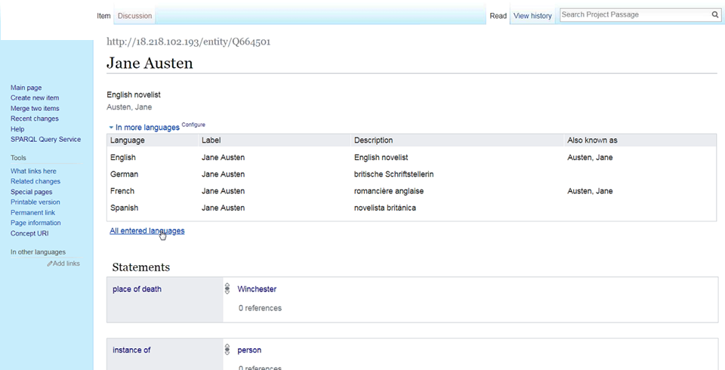
Use case: Manual data entry
Notes:
This example screenshot of an item entity describing a person, Jane Austen, there are two death dates listed. The Wikibase UI provides a way to include both dates but … [click]

Slide 17
Use case: Manual data entry
Notes:
Indicate that one of the dates is deprecated in rank, and can include one or more references to source the provenance of the statement and indicated, for the deprecated statement, why (in its source the date is a misprint). This can be a powerful capability for managing entity data with statements from a variety of sources, and for quality control remedies.

Slide 18
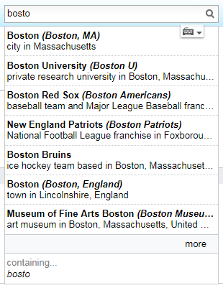
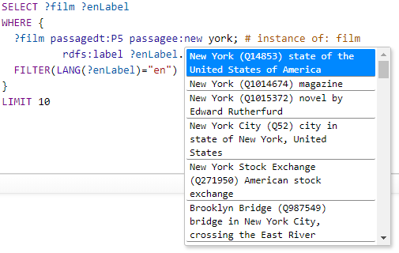
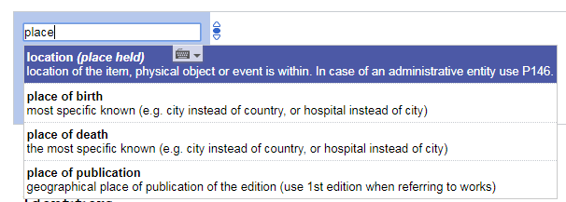
Use case: Autosuggest
Searching for entities as you type is supported by the Mediawiki API.
Notes:
Autosuggest is an important feature in a variety of circumstances …
When editing item entities and adding statements, when creating SPARQL queries in the Query Service user interface, and when searching in the Wikibase UI.

Slide 19
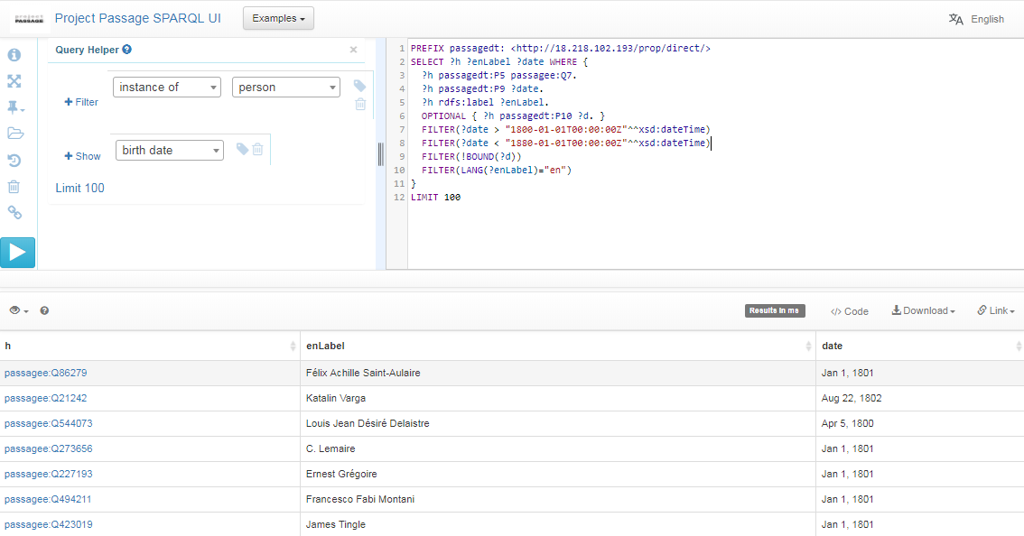
Use case: Complex queries
This project provides a SPARQL endpoint, including a user-friendly interface for constructing queries.
With SPARQL you can extract any kind of data with a query composed of logical combinations of triples.
In this example SPARQL query, items describing people born between 1800 and 1880, but without a specified death date, are listed.
Notes:
SPARQL (pronounced “sparkle”) is an RDF query language … a semantic query language for databases.
From the Query UI, things to demo:
From the examples list select the simple query to search for people
Use the autosuggest to show how to change the query to search for dogs, or cats
Use the autosuggest to show QA uses (people born between 1800 and 1880 that lack a death date)

Slide 20
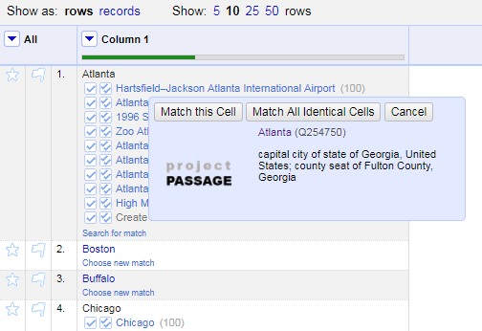
Use case: Reconciliation
Reconciling strings to a ranked list of potential entities is a key use case to be supported.
We are testing an OpenRefine-optimized Reconciliation API endpoint for this use case.
The Reconciliation API uses the prototype’s Mediawiki API and SPARQL endpoint in a hybrid tandem to find and rank matches.
Notes:
Why OpenRefine? Because it is popular, powerful, and ubiquitous. Though it might not be as commonly used with those managing MARC data? Something for us to learn more about.

Slide 21
Use case: Batch loading
For batch loading new items and properties, and subsequent batch updates and deletions, OCLC staff use Pywikibot.
It is a Python library and collection of scripts that automate work on MediaWiki sites. Originally designed for Wikipedia, it is now used throughout the Wikimedia Foundation's projects and on many other wikis.
Notes:
Nothing to demo here but taking a look at the ClaimAdder updates is a way to also show Wikibase UI history pages, undo options, etc.
Note that we are also beginning to evaluate Wikidata Quickstatements as an alternative or replacement.
Note that we have not yet investigated, but plan to look at, other batch loading processes, including OpenRefine and QuickStatements

Slide 22
Lessons Learned and concerns so far | Next Steps
The Mediawiki-based API is not sufficient for reconciliation | Provide an OpenRefine API for matching by class and properties
The prototype data model for dates is capable but not user friendly | Document techniques for entering dates, mapping to LC's EDTF patterns
The prototype UI doesn't highlight connections to more information on the web | Prototype a UI that uses system data to connect to Dbpedia, Geonames, etc.
Autosuggested links aren't working well for personal names in indirect order | Add more aliases to the Wikibase to improve autosuggest matching, based on headings in VIAF
It's not yet clear how to handle creative works and editions in the prototype | Provide guidance and examples, beginning with works and translations
Will Wikibase / Wikidata scale to billions of entities? | Fruitful discussions with Wikimedia Deutschland started
Notes:
This table reflects the iterative nature of the project
We’re offering services and features as soon as we think they are functional enough for a quick evaluation, gathering feedback, refactoring and rethinking, and trying again … not unlike the Lean Startup cycle.
Conversation is continual regarding how we do things now, how we could do things, and moving away from current constraints/Endeavor like this represents a paradigm shift and requires adaptive change (everyone gets to change their behavior) -a small project with potentially transformative results.

Slide 23
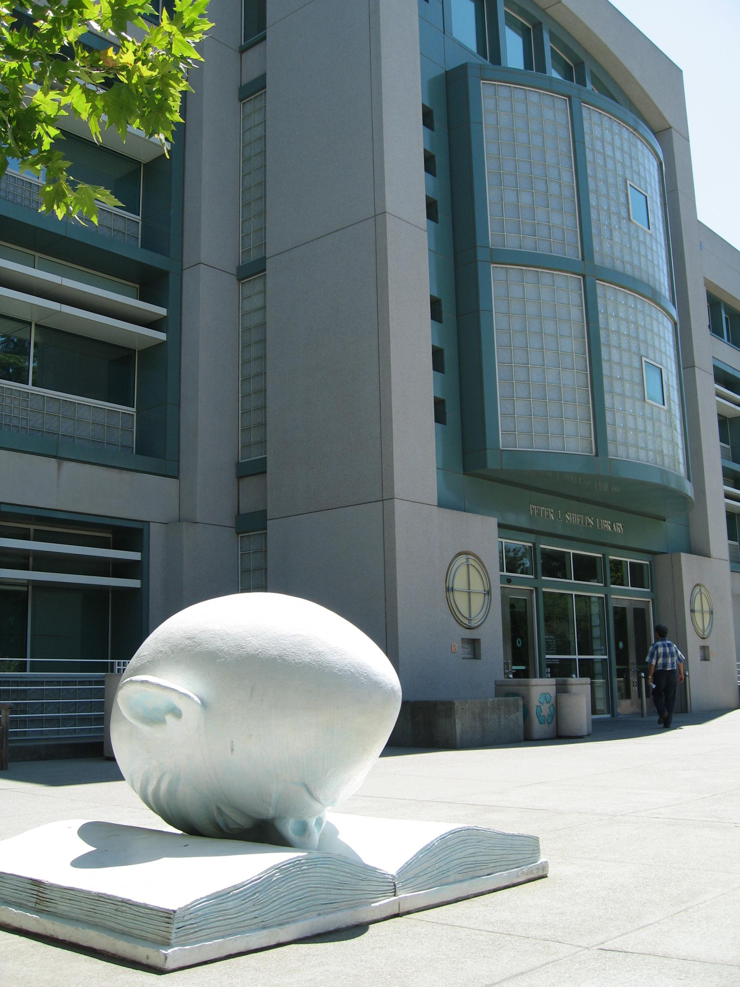
Thank You
Carl G. Stahmer
Director of Data Digital Scholarship, UCD Library
Associate Director, UCD Data Science Initiative
Associate Director, English Broadside Ballad Archive
www.carlstahmer.com
Prototype LD Discovery and Cataloging Operations by Fall, 2018
@cstahmer
LD4P / LD4L Labs Community Input Meeting
2/24/2017

Slide 24
Sparse Local
Contributor URIs
Notes
Associated OCLC Work ID
Instance URI
Pub Date
Resource Type URI
Pub Place Geocode
Subject URIs
@cstahmer

Slide 25
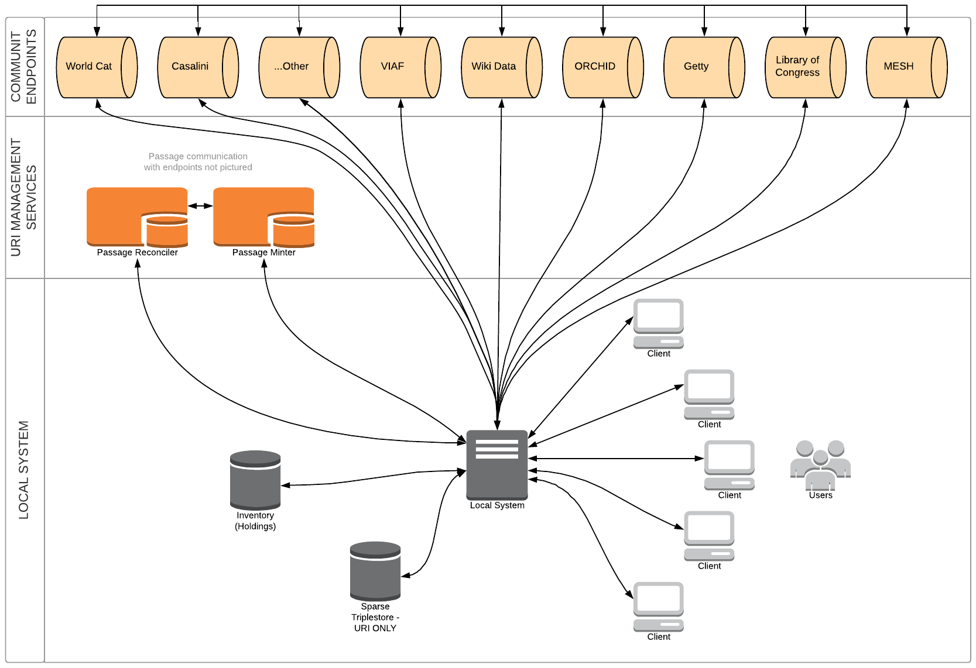
UC DAVIS LINKED DATA ECOSYSTEM
@cstahmer

Slide 26
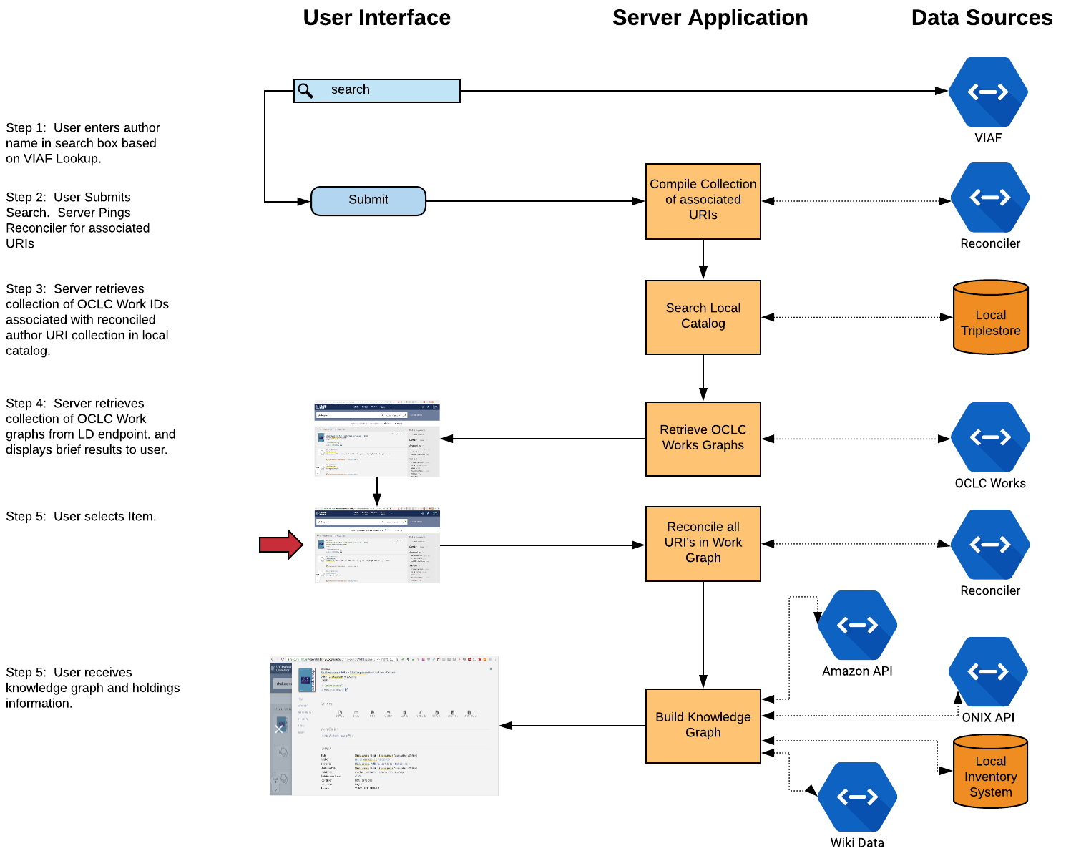
Discovery Use Case
@cstahmer

Slide 27
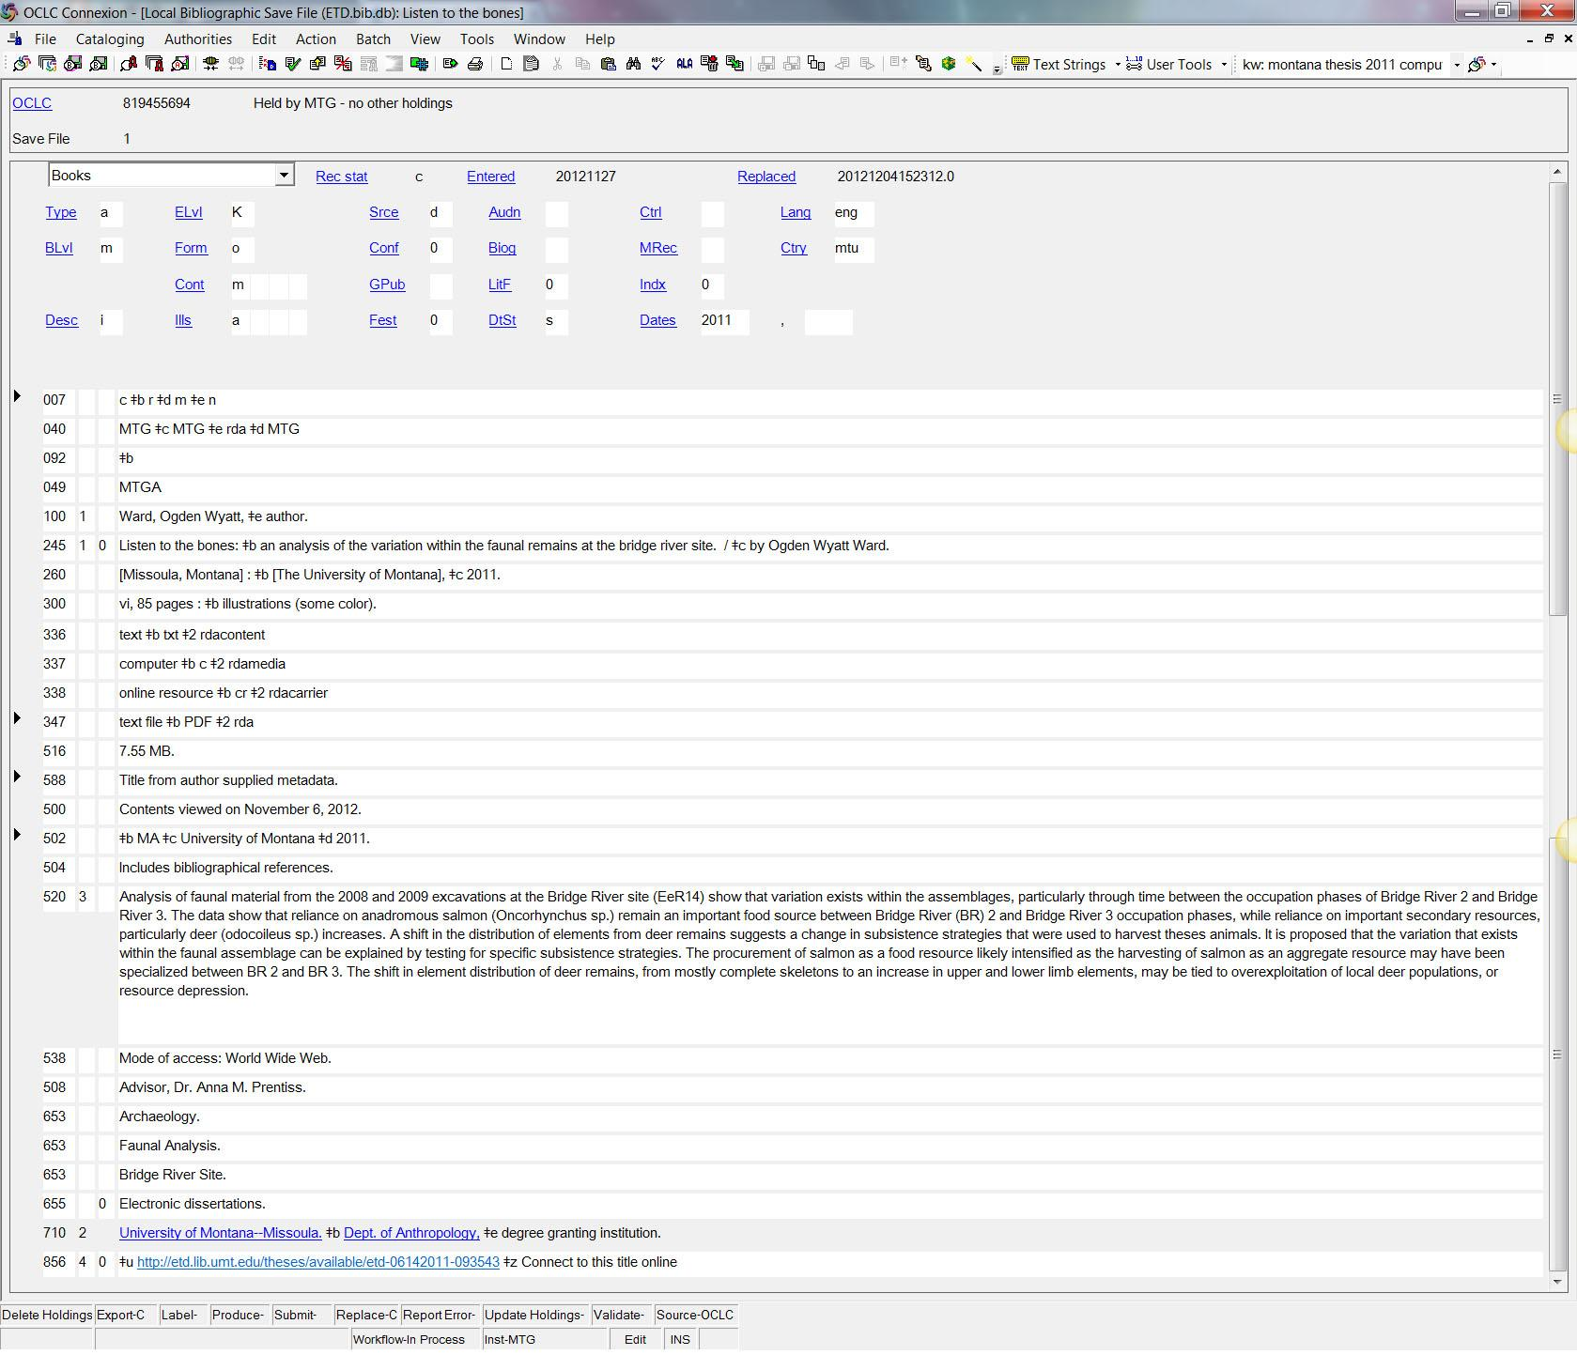
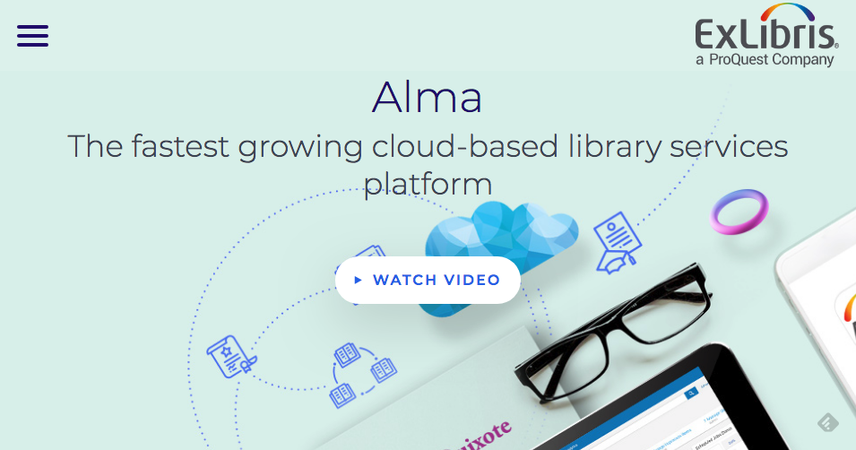
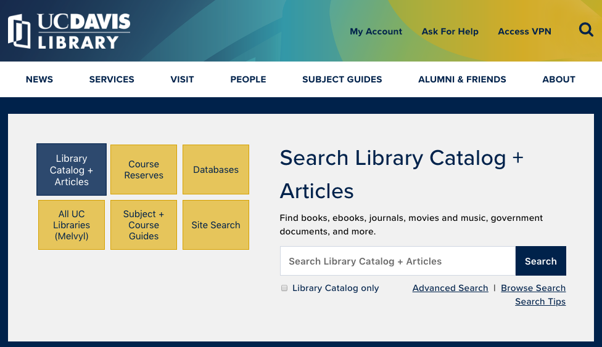
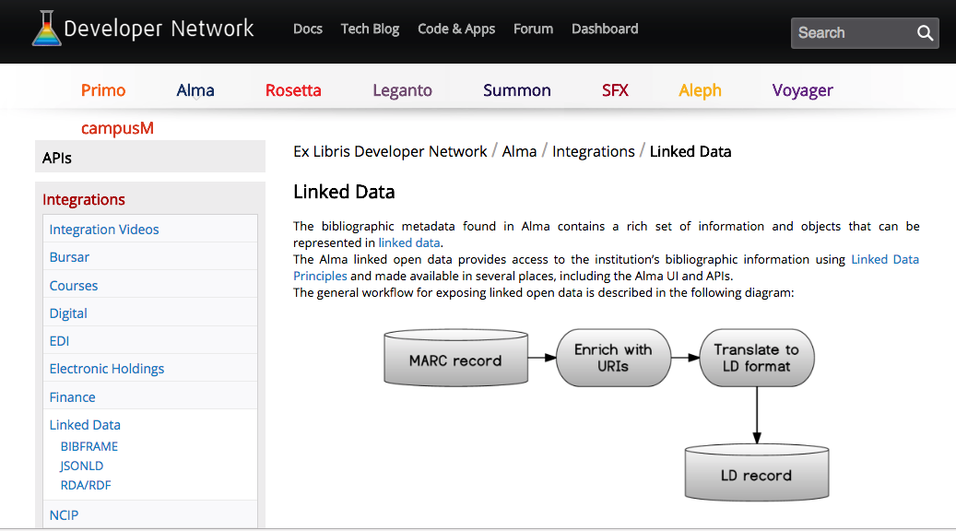
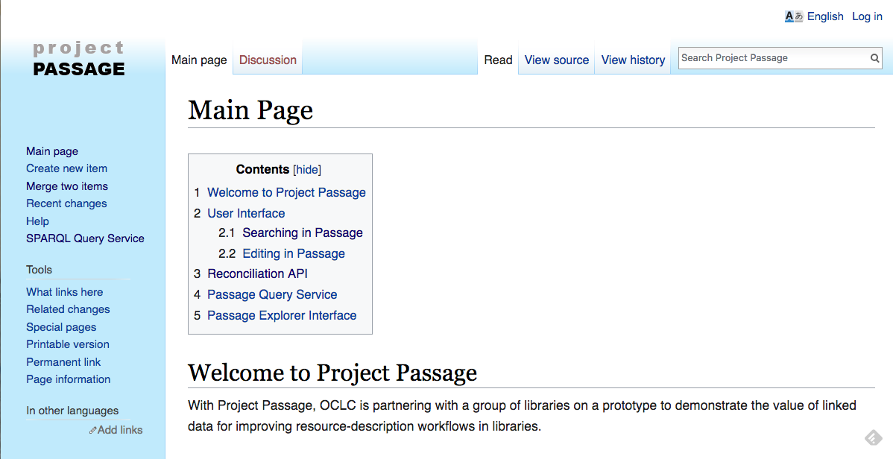
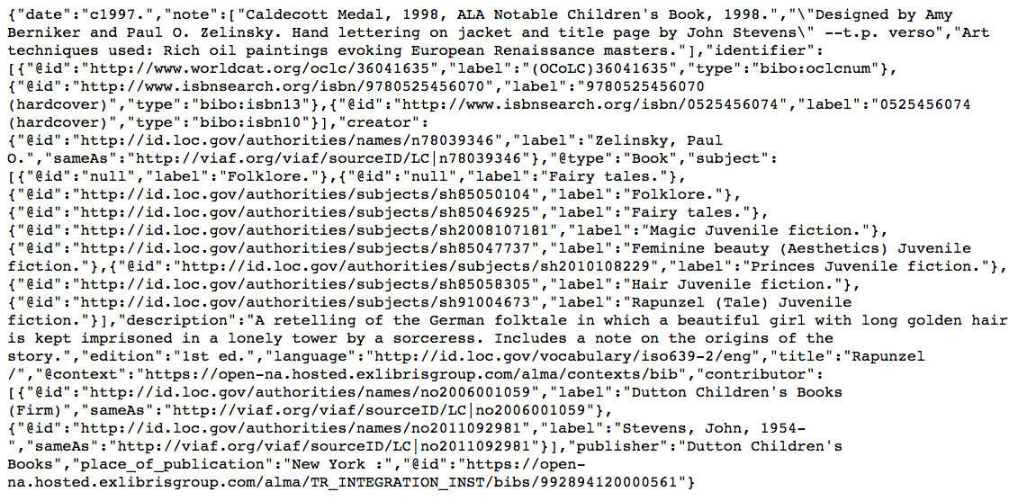
Cycle not Quite Complete
Connexion MARC to ALMA
@cstahmer

Slide 28
Hybrid MARC/LD Solution
Connexion MARC to ALMA
@cstahmer

Slide 29
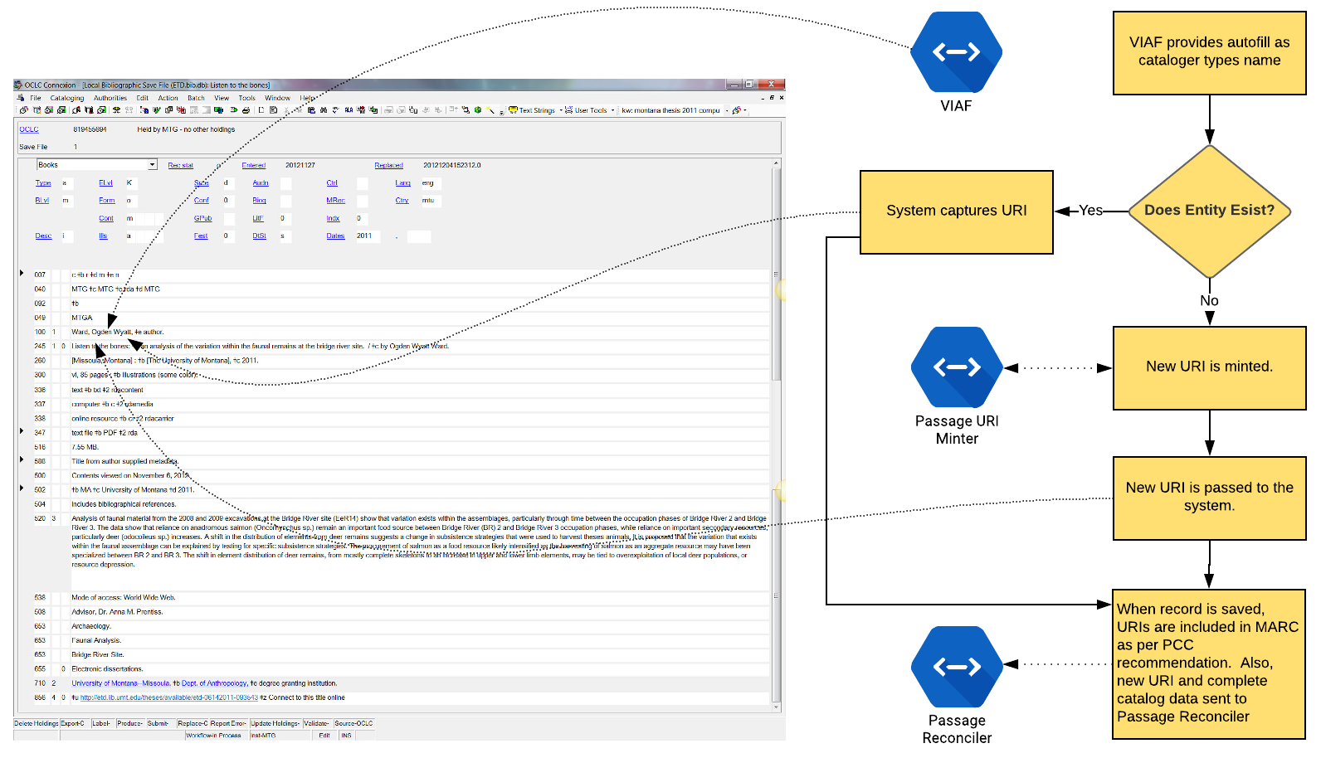
Cataloging Use Case
@cstahmer

Slide 30
Cataloging Use Case
@cstahmer

Slide 31
Discussion
Carl Stahmer
@cstahmer
Bruce Washburn
washburb@oclc.org
@btwashburn
Notes:
Thank you for your time and attention today.
If you would like additional details about my presentation today, please feel free to download our new “OCLC and linked data” paper at oc.lc/linkeddatasummary

