Slide 1
Collecting and exploiting library data to inform strategy: the shift to data-driven approaches.
Dublin, June 21, 2013
SCONUL annual conference 2013
Titia van der Werf
Senior Program Officer OCLC
Notes:
Thank you for inviting me. I feel very privileged. This is a great topic: working smarter with data– especially NOW.
Now that libraries need to demonstrate institutional excellence and distinctiveness.
And, now that data-driven strategic planning is becoming the standard.
So, I propose to explore with you what’s involved for libraries to make the shift.

Slide 2
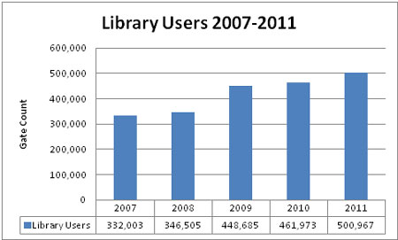
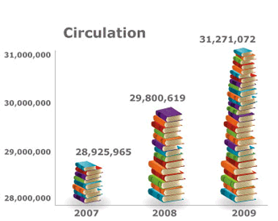
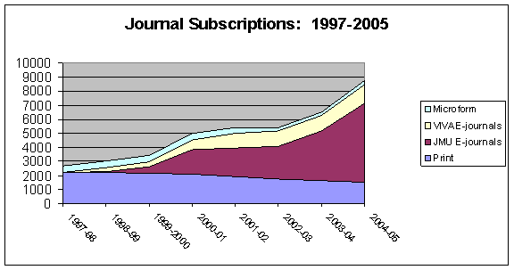
Measuring performance: libraries
Notes:
Over the past decades, libraries have developed extensive measurement practices: lots of figures and charts to show growth and trends, which are dutifully reported every year in annual reports and every 5 years or so, in strategic plans.
But in how far have these statistics been used to improve library services and user satisfaction?
In all honesty, the growth figures, the charts and user satisfaction surveys have been used for a very different purpose: to justify budget expenditure, to justify the need for more resources, the need for more library shelving space, to justify the continuation or closing down of existing services or the development of new services.
We (and I say we because I have been a library manger for 10 years and done a lot of this performance measurement stuff), we have not used these measurements to fundamentally understand our users and their behaviour – especially since they moved to the web. We kind of lost track of them, without being aware.
And the growth figures of the collections and of the personnel costs did not trigger any alarm bells either: we were proud of growth because we perceived this as evidence of success.
In short we collected the data as evidence, and not to analyse and act upon.

Slide 3
An exemplar of data-driven decision making
Thinking the unthinkable: a library without a catalogue -- Reconsidering the future of discovery tools for Utrecht University library
Simone Kortekaas at the
LIBER Conference 2012
Notes:
I would like to introduce the concept of data-driven decision-making with an example: the case of the Utrecht university Library.
At LIBER last year, Simone Kortekaas explained why her library had decided not to buy a local discovery tool for their collections.

Slide 4
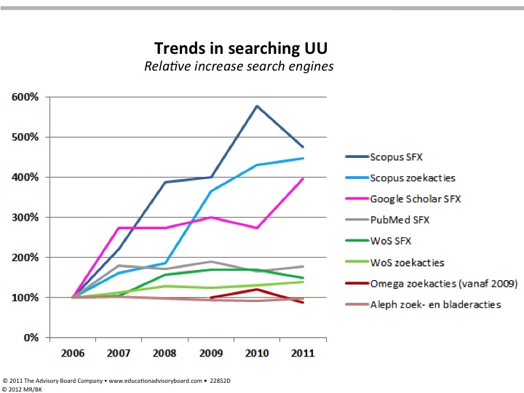
Source: http://bit.ly/Sf09Ix
Notes:
They had collected and analysed extensive usage data and they found that:
discovery via their local OPAC and their local e-journals search system Omega was stagnating since 2007;
but that the usage of their licensed journals was still growing;
So discovery and delivery via the local systems started to grow apart and were no longer closely related.
This was a trigger to start looking for the reason why the pattern was changing. The reason was that discovery was increasingly happening elsewhere:
The data showed an increase in the discovery of e-journals via Scopus, Google Scholar, Web of Science and PubMed.
The library acted upon this, not by trying to force a return to the normal pattern, but by adapting to the new pattern – and to reposition their local systems as delivery systems only.

Slide 5
Patterns, sensors and triggers
Source: http://www.drivingnews.net/wp-content/uploads/2011/04/car-dashboard-icons.jpg
Notes:
What this example shows is that data-driven decision making is about patterns, sensors and triggers.
Sensors and triggers are important if you want to know what is happening under the hood.
Data-driven decision making is all about wanting to know what is happening under the hood and acting upon it.

Slide 6
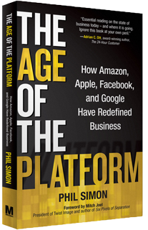
Learning from the platforms
Understanding user behaviour
… interacting with the user
… improving the user experience
Notes:
Amazon, Microsoft, Facebook, Google, and many other companies continuously make data-driven decisions.
So we can learn from them.
They have platforms that attract millions of users and they collect huge amounts of data about the demographics and behaviour of their users.
And these data are core to their business strategy. They use the data to drive customer engagement.
How do they do this? By continuously collecting data from user transactions with the platform and reacting on it.
It is all about turning the opportunity of a transaction into a service experience and establishing a long-term relationship with each user.

Slide 7
Source:http://www.guardian.co.uk/commentisfree/cartoon/2013/jun/10/william-hague-statement-gchq-cartoon
Notes:
Well, I am not sure if anyone would be happy to engage with the mightiest of all platforms...

Slide 8
Learning from the platforms
Understanding user behaviour
… interacting with the user
… improving the user experience
Notes:
But, let’s stick with the more familiar platforms … and learn from them.
Let’s learn about data-driven customer engagement.
It is not as if libraries do not have a long tradition in customer engagement. Libraries, as physical spaces, have been excellent in nurturing highly personalized customer relationships. Librarians used to know their visitors by name, what their subject expertise was, what they were looking for. They would do their utmost to get them the information they needed.
But, in the Web space, librarians seem to have lost this ability. They do not know their online users, because libraries don’t do data-driven user engagement – they do not know what is happening under the hood – they do not have sensors and triggers in place to recognise usage patterns and act upon insights in agile ways.

Slide 9
Source: http://www.exp-platform.com/Pages/2012RecSys.aspx
Notes:
The way in which the platforms act in agile ways is with so-called “online controlled experiments”.
I recommend everyone to look at Ron Kohavi’s presentation. He works at the Online Services Division of Microsoft and has worked previously for Amazon.
Controlled experiments are a means to evaluate an idea for improving a service.

Slide 10
Source: http://www.exp-platform.com/Pages/2012RecSys.aspx
Notes:
Controlled experiments work with real users, in 2 groups: a treatment group and a control group.
They only change one feature at a time to the system and run statistical tests.
They try several variations on one feature and collect the data and compare.
The statistics only work if the experiments are done at scale: large numbers of experiments and with large groups of users.

Slide 11
Source: http://www.exp-platform.com/Pages/2012RecSys.aspx
Notes:
This is an example of an experiment with the Search Box of Bing where they found that the magnifying glass as an icon is less clear than the word Search itself.
The whole point is that every idea of a feature needs to be tested. Ideas should not “just” be implemented. Because it turns out from the statistics that our intuition is poor. In his book “Web Analytics: an hour a day” Digital Marketing Evangelist for Google Avinash Kaushik asserts that “80% of the time we are wrong about what a customer wants”. So it is hard to assess the value of an idea if you don’t test it on users.
On real users, not personas!

Slide 12
Learning from the platforms
The information broker
becomes
a broker of the users’ knowledge
Notes:
One more thing we can learn from the platforms.
Google, Amazon and the other big information brokers make use of the knowledge of their users: with rankings, recommendations and reviews based on user input, feed back from usage data and crowdsourcing.
The platform providers do not interfere with or add to this user-generated knowledge: basically they do not behave as information specialists.
Unlike libraries who have knowledge about their collections and who base their rankings, recommendations and reviews on their own subject classification systems and subject expertise. Librarians tend not to rely on the expertise of their users.

Slide 13
Learning from the platforms
Data-driven approach:
Not only collect data, but also analyse and act upon it;
Understand what is happening under the hood:
put a system in place of sensors, triggers and
controlled experiments;
It is all about mass: deployment and mining at scale
Learn from continuous interactions with users;
Feed user-knowledge back into the system.
Notes:
So what have we learned from the platforms?

Slide 14
Aggregating data for more impactful strategy planning
Aggregate level
Leveraging user activity data in “discovery ecosystems” => improving the user experience
User behaviour data in “delivery eco-systems” => improving fulfillment
Business intelligence about the “collective collection” => realising efficiencies
Notes:
There are good reasons for libraries to start aggregating their data so as to become more platform-like and to enable more impactful strategy planning.
Not only because the data-driven approaches I talked about thrive better at the aggregate level.
But also, because in the networked environment, libraries are no longer self-contained units.
Their local users are increasingly using other discovery services to find information. To restrict the collection of data to local OPAC and local website logfile data severely limits the insight in user behaviour. Thinking system-wide really means thinking at web-scale.
Obviously, it is not realistic to believe all user data across all web discovery platforms can be aggregated.
But we can start thinking in terms of “discovery ecosystems” of library networks, such as the Europeana ecosystem or WorldCat ecosystem - where users leave their traces behind: data which can help enhance the user experience.
Also, on the fullfilment side, we can start thinking in “delivery eco-systems” where libraries have become increasingly interdependent in terms of user services (eg. ILL-networks, the Hathi-Trust eco-system).
Libraries are also becoming increasingly interdependent in terms of collection management.
Thinking in terms of the “collective collection” is becoming commonplace in different countries (UK, NL) = thinking system-wide to coordinate the management of print materials across library holdings and to realise efficiencies. Setting-up mass storage initiatives at the regional and national levels. Think of WEST (the Western Regional Storage Trust) in the US, for example, or the UK Research Reserve in the UK. Such initiatives require sharing of data (holdings, circulation data, retention copies, digitised copies, etc.) to build good intelligence about the collective collection.

Slide 15
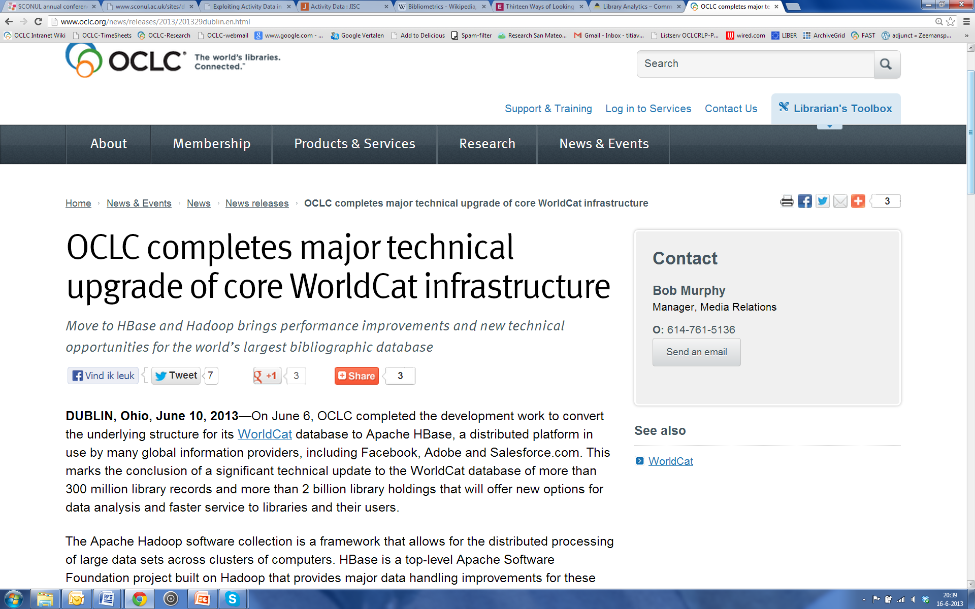
Notes:
OCLC aggregates data, so it can do certain things…
This is a recent OCLC News Release from June 10th announcing the migration of WorldCat to Hadoop, making data processing much more powerful and offering new opportunities for data analysis and data-driven service improvement.

Slide 16
OCLC Research: making the data work harder
To support:
Better end user experiences (recommendation, kindred works, identities network, …)
Better intelligence about the collective collection (print management at mega-scale, cloud library, …)
Notes:
At OCLC Research we have been working with Hadoop in the past years, and have been making the data work harder for libraries.
To support:
Better end user experiences (recommendation, kindred works, identities network, …)
Better intelligence about the collective collection (print management at mega-scale, cloud library, …)

Slide 17
OCLC Research: making the data work harder
Building blocks:
Virtual Authority File - VIAF
Faceted Application of Subject Terminology -FAST
Workset algorithm (based on modeling work such as FRBR)
Notes:
We have built VIAF and FAST headings and assigned them across the whole of WorldCat and we have built worksets by bringing editions and translations of the same title together. This has enhanced the data quality across the dataset enormously. We can now start asking relevant questions to the data and looking for meaningful patterns.

Slide 18
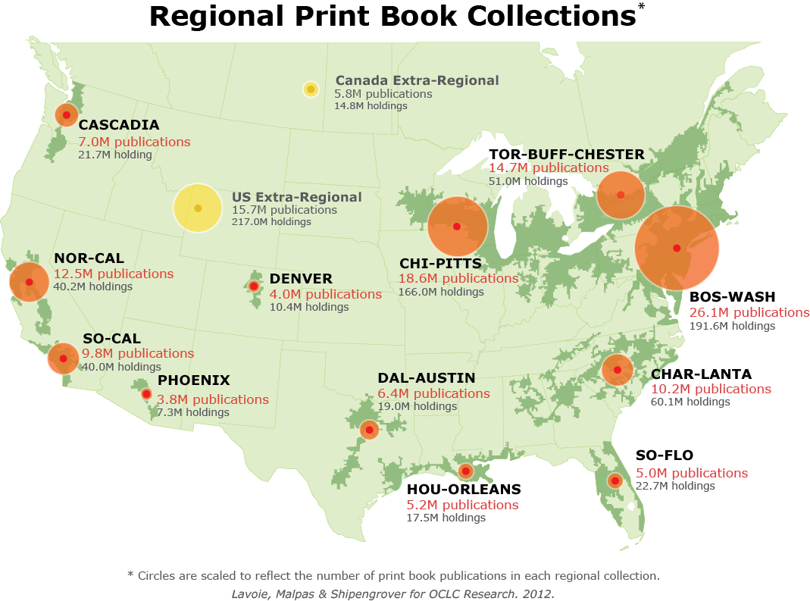
North American print book resource:
45.7 million distinct publications
889.5 million total library holdings
http://www.oclc.org/content/dam/research/publications/library/2012/2012-05.pdf
Notes:
Depending on what libraries want to know, we can make all kinds of comparisons and extract patterns according to different variables, such as geographic distribution.
This data analysis (the Megaregions) addresses the challenge of managing down the collective print collection in North America.

Slide 19
OCLC Research Library Partnership: individual partner reports.
Notes:
This is an example of a comparison with Hathi Trust titles, showing the proportion of digitised titles in copyright and out-of-copyright. This may help the library make informed decisions about its digitisation strategy.

Slide 20
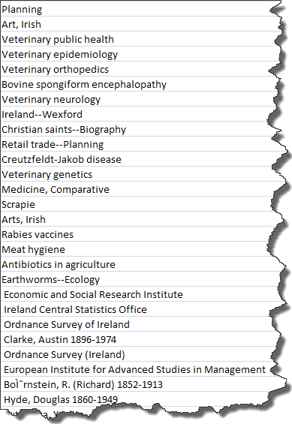
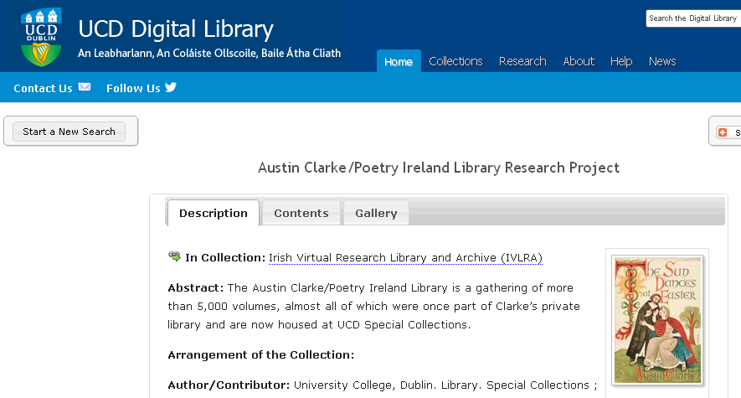
Topics for which UCD ranks first in WorldCat in number of title-holdings
Centers of institutional attention & library investment
Notes:
Here is a listing showing which institutions hold most titles in any given subject.
It is significant that the Univ. College Dublin ranks first in title holdings related to the Creutzfeldt-Jakob disease and Bovine spongiform encephalopathy, because UCD has a major research interest in this area – and this is well reflected in WorldCat. Such rankings might be useful to demonstrate institutional reputation.

Slide 21
Mining other datasets
We are also mining other large datasets for data-driven approaches:
Pilot with the Europeana dataset => to improve the user experience
Pilot with the preservation metadata set of the Bibliothèque nationale de France => to build sensors and triggers for enable the library to act upon digital preservation threats
Notes:
We are also mining other large datasets for intelligence and data-driven approaches, namely:
The Europeana dataset => to improve the user experience
The preservation metadata set of the Bibliothèque Nationale de France => to place sensors and triggers that will enable the library to act upon digital preservation threats.

Slide 22
Asking the right questions
Notes:
22
22
22
Although large data aggregations and large institutional datasets hold massive amounts of valuable collection data to be mined – and valuable data about user behaviour as well - it is up to the libraries to ask the right questions to the data.
I hope I have made a clear statement that institutional excellence and distinctiveness is not based on growth and ranking figures, but on data-driven approaches achieving effective user engagement and realising efficient collection management.

Slide 23
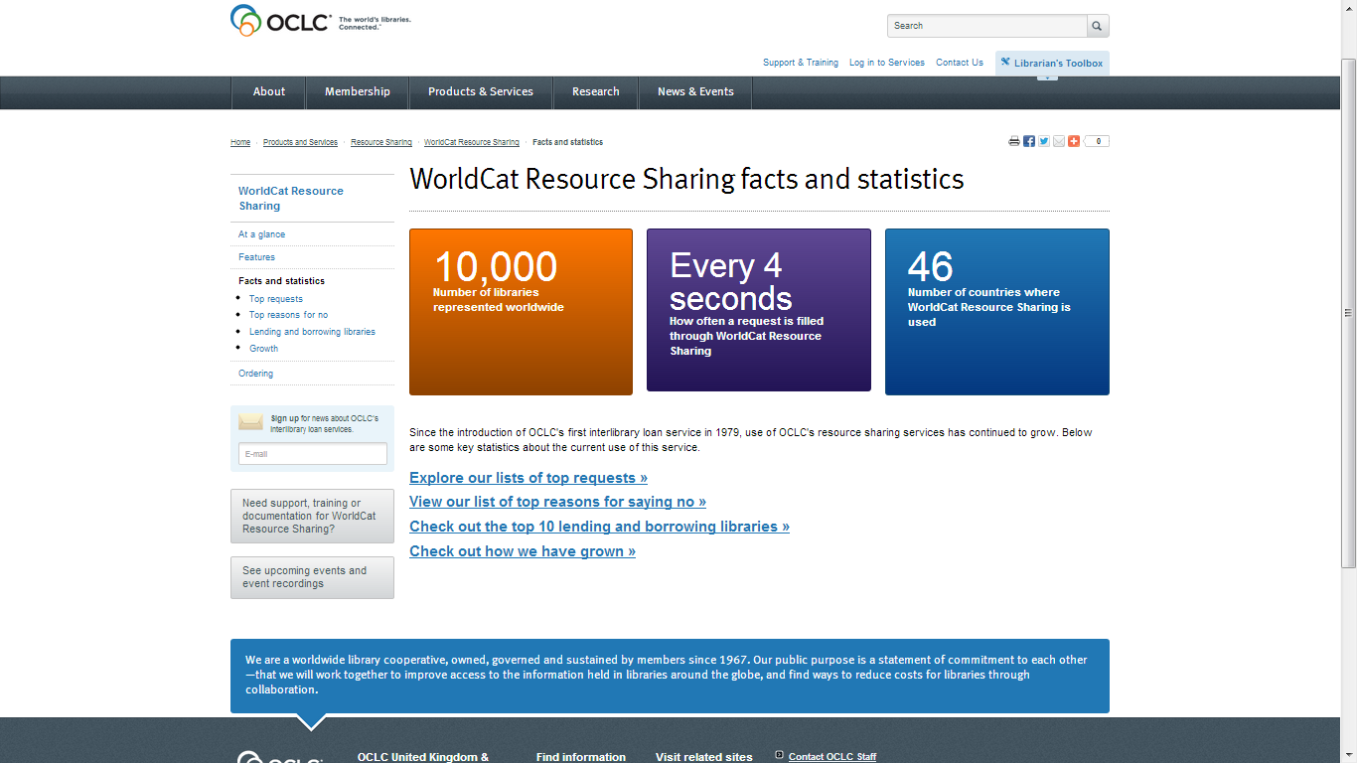
Notes:
And I couldn’t help inserting this last minute slide, look at it: it is all about growth figures as evidence of success...
Obviously, we need to change the culture at OCLC as well, together with our member libraries – what a challenge!
I am inviting you all to partner with OCLC Research to address this challenge, THANK YOU.

