Slide 1
The system-wide library in 2025
SCONUL Summer Conference and AGM 2-3 July 2015
Southampton, UK
Titia van der Werf
Senior Program Officer
OCLC Research
vanderwt@oclc.org

Slide 2
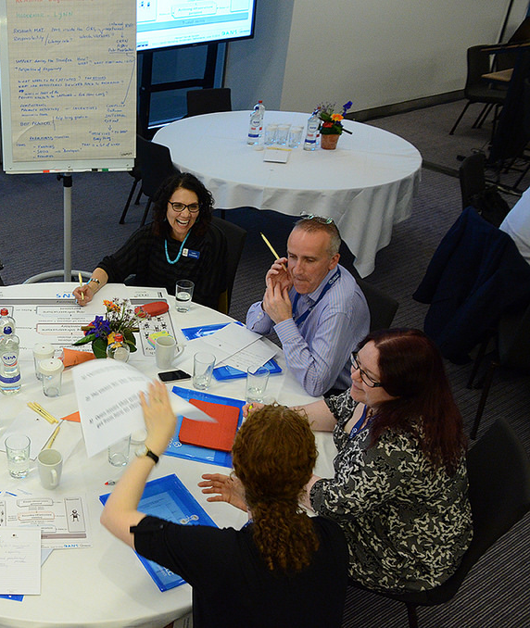
OCLC Research Themes
Research collections and Support
Understanding the System-wide Library
Data Science
User Studies
Notes:
Images: https://www.flickr.com/photos/oclcpar/14415067756/
OCLC Research’s four strands of activities.
Research support is about the new roles and services that research libraries are developing as research and university support requirements are changing – for example with data management and research assessment.
Understanding the system-wide library is about how libraries share resources to achieve efficiencies and more impact.
Data Science is the processing of WorldCat data and other bibliographic datasets, in order to clean the data, improve its quality and remodel it into linked data, etc.
User Studies is about following library users and studying their information seeking and learning behaviors inside and outside the library.

Slide 3
Understanding the system-wide library
Notes:
http://www.oclc.org/research/themes/systemwide-library.html
This presentation will be based on the work Constance Malpas and Brian Lavoie are doing in the area of the system-wide library.
The system-wide library is the collective enterprise of libraries that work together in some way, through sharing resources and responsibilities, with the aim to improve their services, achieve efficiencies and economies of scale.
The research aims to improve our understanding of the factors that guide institutions in their choices for sourcing and scaling as they form partnerships.
We observe that libraries are embedded in an increasingly complex network of information supply and demand and that they are continuously adapting to this evolving environment.

Slide 4
The system-wide scholarly library
Notes:
So let’s take a closer look at this system-wide library in the scholarly environment.
The number of networks of cooperation that exist between academic libraries and partnerships with other stakeholders in this ecosystem is overwhelming.
And it seems to be ever growing. Why is this happening?
If we trace back the reason for collaboration to the origins of each network, we find that collaboration usually starts to solve a problem/to benefit from an opportunity.

Slide 5
The system-wide scholarly library
Reasons for cooperation
Sharing cataloguing effort
More effective use of local collections through ILL
Negociating and licensing of e-journals
Authority control (national/union catalogues)
Pooling low-use print journals
Sharing the storage and access to digital collections
Securing permanent access to e-journals and e-books
Sharing online reference service
Notes:
A quick analysis of the networks from the previous slides yields this list of reasons for collaboration.
When we look at this list more closely, we see that the reasons for collaboration are all related to sharing tasks in areas where there was duplication of effort, because each institution did exactly the same at the local level.

Slide 6
The system-wide scholarly library
General observations
purpose is mostly to reduce waste (duplication of effort) and optimize impact
operate at different scales: regional, national, international
operate as a distributed network or as a centralised service
mostly non-profit operations: with a mix of cost recovery through membership-fees and commercial pricing of products and services for non-members
Notes:
We can characterize these networks of cooperation and make some generalized statements about them:

Slide 7
The system-wide scholarly library
General trends
networks of cooperation tend to grow in numbers and in scale
offerings of products and services tend to grow and diversify
original focus and reason to exist tends to disappear as purpose and target audience evolve and become more diffuse
competitiveness slips in as networks tend to expand
…
Notes:
We can even distill trends in collaboration over time and make some generalized statements about trends:
These insights are very high-level and general.
As academic libraries, we would like to better understand the dynamics of collaboration within the context of the larger ecosystem from which they originate, not only to discover trends after the fact but to anticipate on trends and make it our competitive advantage.
Indeed there seems to be a growing realisation that we can gain competitive advantage through collaboration …

Slide 8
Gaining competitive advantage through collaboration
“Our ability to collaborate should be seen as a Darwinian survival strategy: we are competitors. Collaboration is not for the good of all; some of us will not exist anymore; some of us, who succeed in proving to be distinctive, will survive.” [LIBER-2015: Caroline Brazier)
Notes:
This is what Caroline Brazier said, at LIBER in London last week during a session where panelists where asked to make provocative statements about the future of academic libraries:
It is evidence of a growing realisation that libraries might need to become more competitive; in an academic environment where universities are increasingly competing for students, and operating like businesses. Those who succeed will be those that get rid of unnecessary costs, that partner to achieve high-rankings and that drive new opportunities to increase their revenue.
This is why libraries need to be smart about their collaboration efforts and be mindful of the sometimes conflicting interests of their university’s short-term growth strategies on the one hand and the longer-term mission of scholarship to advance the world’s knowledge on the other hand.

Slide 9
Trends in collaboration?
“Unbundling and re-bundling, at-scale solutions, collaboration and cooperation, efficacy and efficiency…themes that keep resurfacing.” [LIBER-2015: Elliot Shore]
Notes:
Growing and nurturing successful partnerships is therefore top of mind for many academic libraries.
That is also what Elliot Shore (the executive director of the ARL association) found when he did his tour of visits to ARL member institutions.
He also said that “we need to look externally—not just at the library sector—and we will not succeed unless we collaborate widely”.
So making the right choices to partner is becoming more and more important for libraries.
And that calls for libraries to get smart in making sourcing and scaling choices.
Part of the answer lies in gathering intelligence. And a way to do this is through analytics.

Slide 10
Trends in collaboration?
“As we move toward being more analytical, we’re beginning to knit together experiences, to come together into a union that will ultimately create a new environment to support scholars.”
[Symposium on Sustainable Models for Print Storage in 21st-Century Libraries – Oct. 2014: Sarah Thomas]
Notes:
This is how Sarah Thomas (Vice president of the Harvard Library) put it:
A very high-level projection of the system-wide library, driven by analytics …
She said this at a symposium she organized on sustainable models for print storage, where my colleague Constance Malpas, presented the work OCLC Research is doing on shared print.
This work is informed by data analytics: extracting intelligence from the holdingsdata in WorldCat. Constance was able to inform the audience at this symposium that
“more than half the books from 3,000 American research libraries are in the Northeast corridor, and Harvard holds a quarter of them, or about 15% of books in academic libraries in North America. Any action Harvard takes has a significant effect nationwide.”
This introduces the concept of interdependency which will become a centrepiece of collaboration in the future.

Slide 11
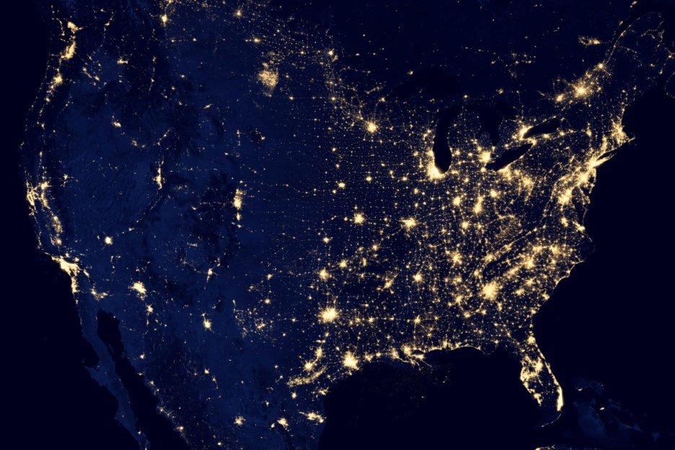
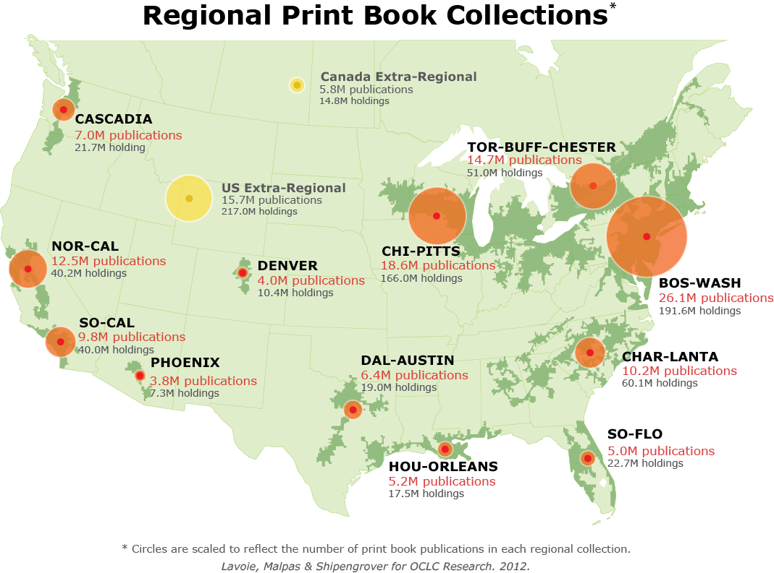
North-American Mega-regions
North American print book resource:
45.7 million distinct publications
889.5 million total library holdings
Geographic area defined by high level of economic integration, underpinned by robust supporting
infrastructure (transportation, logistics, etc.)
Notes:
The shared print thinking of Constance and Brian started with the Mega-regions Report. Mega-regions is a concept developed by urbanist Richard Florida. Mega-regions are geographical regions defined by high level of economic integration, underpinned by supporting infrastructures.
OCLC Research proposed a North American network of regional shared print book collections, based on this model, using WorldCat data.

Slide 12
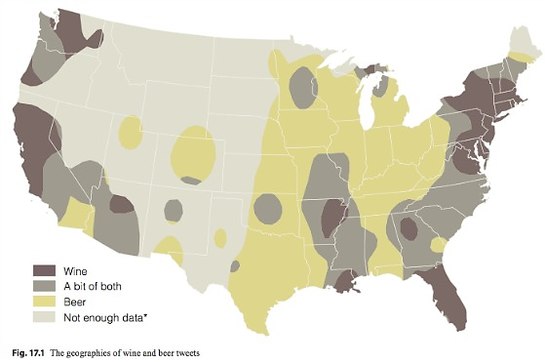
http://www.psmag.com/navigation/nature-and-technology/geography-beer-78105
Notes:
This is how it would look like if you used twitter data on wine and beer, instead…

Slide 13
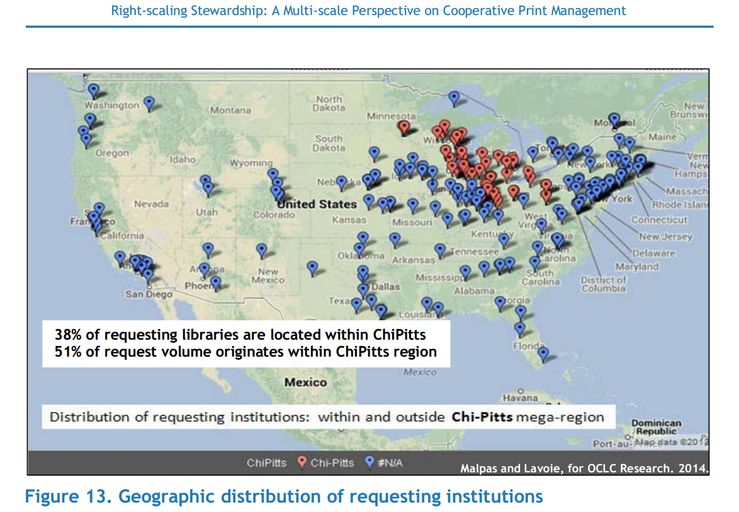
Notes:
But back to shared print: What the data reveal is that the Chi-Pitts mega-region represents more than 40% of titles held in North America. 50-92% of titles held by other regions are also held by Chi-Pitts. Thus investments in the preservation of print books in the Chi-Pitts region benefits libraries throughout North America. Conversely, there are relatively few regional collections that duplicate a significant share of the Chi-Pitts collection, which suggests that the burden of print preservation responsibilities (and investments) will be largely shouldered by institutions within the region.

Slide 14
The collective collection: key insights
Collective resource offers great breadth and diversity while exhibiting patterns of internal coherence and complementarity => scale adds scope and depth
Even the largest institutional collections are far from comprehensive => coverage requires cooperation; preserving the ‘collective collection’ will require coordination on a large scale
Aggregate print book resource is rich and varied; supports thousands of libraries across North America
=> decisions at institutional scale / regional scale about print retention will affect larger library system
Overlap between collective collection with HathiTrust;
=> strong incentives to coordinate shared print strategy with HathiTrust strategy
Notes:
This data-analysis work on the collective collection of research libraries in the US provides some interesting insights.
There is interest in Europe to do similar investigations in their regions. OCLC is investing in a service that can support library consortia in gaining such insights in their collective collections.
This is a nice example how research leads to a professional service development.

Slide 15
Trends in collaboration?
The ‘collaborative collection’:
“By 2027, your collections will be mine, and mine will be yours.”
[LIBER-2015: Caroline Brazier]
Notes:
So the collective collection is a trend that is here to stay. Here is another “provocative” statement Caroline Brazier made at LIBER.

Slide 16
Scholarly communications, 1981
Library-based stewardship covered
~ 80%?
S. Curl “Subramanyam Revisited: Creating a New Model for Information Literacy Instruction”
http://crl.acrl.org/content/62/5/455.full.pdf
Notes:
As a collaborative enterprise, the system-wide library, we have always been pretty confident that we could collect/could lay hands on most of the scientific outputs produced world-wide and the documentation of scientific knowledge.

Slide 17
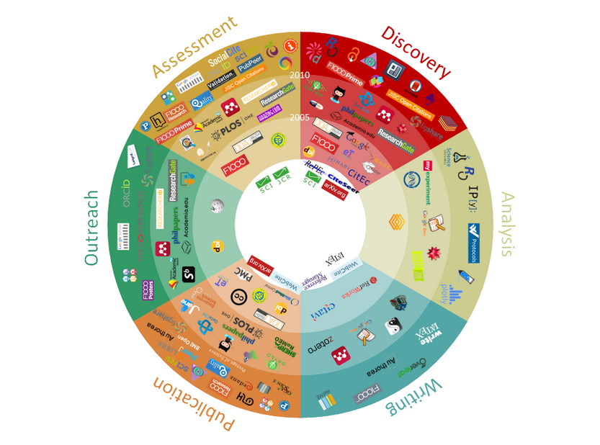
Scholarly communications, 2015
Library-based stewardship covers
???
J. Bosman, B. Kramer “101 Innovations in Scholarly Communication”
University of Utrecht Library
http://innoscholcomm.silk.co/
Notes:
But this is changing.
We are increasingly becoming less confident that in the digital age we will be able to do the same.
We are half-way the presentation now – and I hope i have put you in the right frame of mind to introduce you to the new OCLC Research report, which just came out this week, and that is looking at the evolving scholarly record in the digital environment and the new stewardship challenges. As we will see these challenges will force libraries to engage in multi-stakeholder partnerships – moving away from the “safe” practice of interlibrary collaboration.

Slide 18
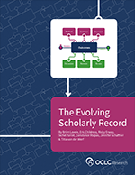
Towards the conscious coordination of stewardship
Notes:
“Stewardship of the Evolving Scholarly Record: From the invisible hand to conscious coordination”, by Brian Lavoie and Constance Malpas.
http://www.oclc.org/research/publications/2015/oclcresearch-esr-stewardship-2015.html

Slide 19
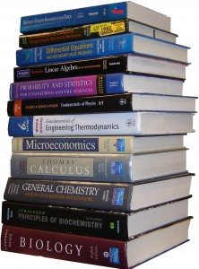
A “weightless” scholarly record?
As scholarly practice becomes anchored in digital,
networked spaces …
… scholarly outputs move from bookshelf to network
Notes:
Scholarly practice moves to the network: tools for creating, consuming, curating
As a result, the outputs of scholarly work also are moving to the network
Broadly speaking, this can be seen as a move from print to digital:
Traditionally: Users congregated around the library stacks where the (print) scholarly record resided
Today: users congregate on the network where a greater and greater portion of the scholarly record now resides
But much more nuanced than that: the digital scholarly record is far from being just a digital copy of print books and journals; in fact the scholarly record is evolving to encompass a wide range of scholarly outputs

Slide 20
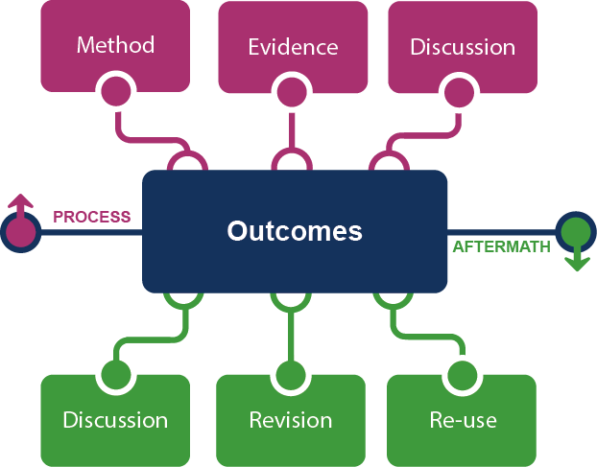
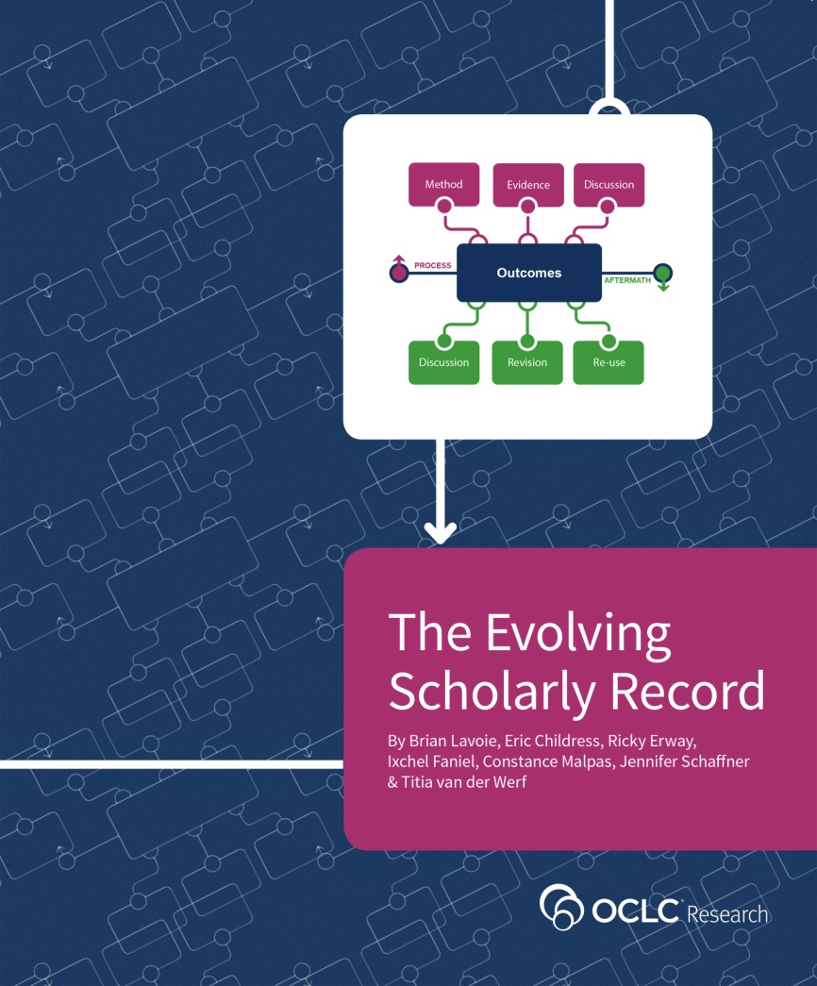
The evolving scholarly record
http://oc.lc/esr
Notes:
We capture the evolution of the scholarly record in this framework.
The SR evolves in concert with changes in the scholarly practice and communications
As we dig deeper into these digital practices and communications, we begin to see a much deeper, more complete record of the scholarly inquiry than what was captured in the past.
We see SW-tools that support the research methods, datasets that need to be kept with the SR as evidence (for accountability and replicability purposes), we see series of blogs appearing that discuss the outcomes before and after publication, sometimes such blog entries are consolidated into books, we see different publication versions of the outcomes (the pre-print, the conference proceeding articles, and revisions) and we see new research that re-uses the outcomes of previous research – we see all these manifestations appear on the web, dispersed across many platforms.

Slide 21
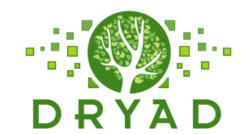
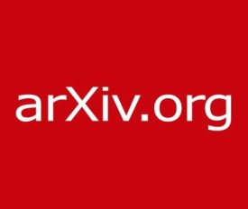
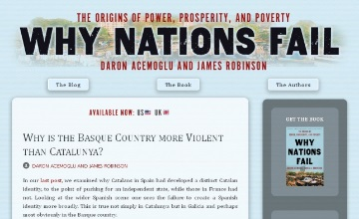
In practice …
Notes:
http://global.oup.com/uk/orc/busecon/economics/carlin/
We see more and more digital platforms and services appear that support the scholarly process.
Everyday you discover new ones. RefME, which is present at this conference is a nice example.
What characterizes these new services is speed and convenience.
They try to fit seamlessly in the research workflow and provide dissemination channels that bypass the formal publication process.
Researchers tend to use them, because they are convenient and effective. They might be aware that many such platforms are volatile and not sustainable on the long-term. But, as always, we find that convenience trumps everything … and concerns over integrity and sustainability lose out.

Slide 22
Framing the stakeholder eco-system …
Fix
Collect
Create
Use
Notes:
As the different parts of the Outcomes get dispersed across the web and take on very many forms and formats (think of SW, datasets, video, data-vizualisations, 3D-animations, etc.),
We need to identify these parts, establish relationships between them and insert the time element (the versioning and the is-anterior/is-posterior relationships).
All that is part of the FIX role – which publishers used to do traditionally.
As this FIXing of the SR is no longer done at one point in time in the form of a publication, the COLLECTing get harder to do.
We now need to locate and collect the heterogeneous parts of the outcomes, which are scattered across the web on many different platforms and appearing at different points in time.

Slide 23
How are differences in data models , provenance – maintained ?
LinkedIn
Mendeley
How do corrections, annotations, and conflicting assertions on public profile presentation propagate back ?
Aggregator: (Content Type)
Scope
Overlap among members of group actor types?
Google Scholar
Libraries
Aggregator: Internal/Private
Individually Maintained Profile
NACO
VIAF (Identifiers)
Individuals,
Pseudonyms, Organizations, Uniform titles, Fictional Names
Controlled
Information
Source
RERO
Book Publishers
GNL
…
Library Catalogs
Library Catalog
Gateway
Uncontrolled
Information
Source
Ringold (Org Names)
ISNI
Registration
Agencies/Members
ISNI (Identifiers) Individuals, Pseudonyms, & Organizations
Anonymous Pull
Bowker
Funder Maintained Profiles (e.g. ScienceCV)
Authenticated Pull
Authenticated Push
Individual
Researchers
ORCID: (Identifiers & Researcher outputs) Living Researchers
Actor Type
ORCID Member Research Orgs
Institutional Repository Catalogs
Institutional Repository
Gateway
CrossRef: (Publication) Journal Authors
Scholarly Publishers
Specific Actor
CRIS Instances
E.g. Symplectic, METIS
Organizational Directory Profile
National Research Institutions
National Identifier Systems
(Identifier)
E.g. DAI
Public View
Harvard Profiles/Other Institutionally Deployed Profile systems
VIVO
Member Research Orgs
VIVO: (Researcher Outputs) Researchers from Member Institutions
Question?
CAP
Notes:
This is an illustration of the complexity of the evolving stakeholder ecosystem.
This is a schematic illustration diagramed by Micah Altman (MIT) for one of our Research activities – when we looked into Researcher Ids -.
This is the Researcher ID information flow and it demonstrates the complexity of the current researcher information workflow ecosystem.
The ovals on the left show the various stakeholders: libraries, publishers, individual researchers, ISNI registration agencies, ORCID and VIVO members, national research institutions.
The dotted lines show the information flow among them, for example, book publishers provide information to libraries.
The drums in the centers represent various types of aggregated databases: Virtual International Authority File, ISNI, ORCID, CrossRef, National platforms, VIVO.
The lower right represents institutional-based databases such as Harvard Profiles, Stanford’s Community Academic Profiles, an institution’s CRIS or Institutional repository.
Note that these operate separately from the libraries’ work on authority records on the top left.
A key question is how corrections or updates can be communicated between systems.
Researchers are frustrated when they see errors in their profile or titles incorrectly assigned to them, or titles missing.
This is making it very clear that the web-ecosystem and cloud-ecosystem into which the scholarly process is transitioning still is basically an uncontrolled environment: with many stakeholders, new players and old ones. And we also see increased specialization. This diagram is only about Researcher IDs!

Slide 24
What is the scholarly record?
Scholarly Outputs
Scholarly Record
systematically identified, gathered, organized, curated, and made persistently accessible
Notes:
So there is a proliferation of specialities, but many of the new web-platforms and services are NOT equipped to assure the long-term preservation of the different parts and manifestations of the scholarly output.
What is the scholarly record? It is the portion of scholarly output that is placed under some form of stewardship (where stewardship is defined as above).

Slide 25
Stewardship … historically
Stewardship of scholarly record was byproduct of “uncoordinated”, highly distributed, and duplicative process of managing local print collections.
Sum of local stewardship efforts resulted in aggregate library resource that was relatively complete record of published (print) scholarly outputs
“Invisible hand” metaphor: uncoordinated local efforts lead to socially desirable outcome
Notes:
How has stewardship been undertaken historically? The invisible hand metaphor …
Collections managed as autonomous units, with little attention to broader system-wide conditions.

Slide 26
Stewardship … now
Scholarly record imperfectly approximated in aggregate library resource
Libraries not collecting full range of ESR
Portion of scholarly record that libraries can collectively capture and make available is diminishing
New stewardship models require conscious coordination.
The ‘owned’ collection
The ‘facilitated’ collection
‘borrowed’
‘demand-driven’
‘licensed’
‘shared print’
Notes:
But today, the evolution of scholarly record requires evolution of stewardship models – in particular, stewardship models designed around the principle of conscious coordination
Providing local access to the SR is less about accumulating large, representative local collections, and more about facilitating access to scholarly resources distributed across the network.
In the digital environment assembling a slice of the SR at the local level no longer makes sense and it is also no longer feasible.
Even the collective efforts of the system-wide library is no longer sufficient – simply because libraries are not collecting the full range of content-types.
We need to transition to collections built on networks of cooperation across many different stakeholders.

Slide 27
Conscious coordination
System-wide awareness
Explicit commitments
Division of labor
Reciprocal access
Notes:
Stewardship of the SR will need to be guided by “conscious coordination”.
Consciousness means, we need to
Be aware of the broader system-wide context – beyond campus and beyond libraries;
Make explicit commitments
Accept different division of labour of the stewardship roles
Foster reliable networks of reciprocal access
-

Slide 28
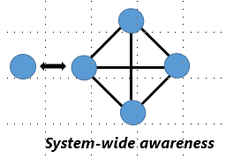
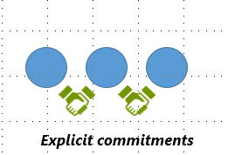
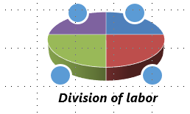
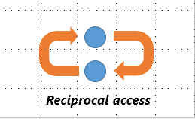
Examples
marc 583
Notes:
These examples are still very library centric. They demonstrate how little we actually partner with other stakeholders.
SWA:
Hathi Trust: measures overlap between its member libraries print collections and the digital surrogates in the Hathi shared repository.
COPAC: developing tools to help libraries identify rare/unique items in their collections (helps inform stewardship priorities)
SCS: allows comparison of local print holdings to the library system as a whole, as represented by WC.
EC:
MARC 583: allows you to register local preservation commitments in group catalogs to help coordinate cooperative collection management activities
PAPR: knowledge base of journal titles managed within print archiving programs (i.e., journal titles with archiving commitments)
UKRR: centralized registry of retained print holdings in the UKRR, which institutions can use to inform local print retention decisions
DOL:
Specialized or thematic collecting activities:
Columbia University’s Contemporary Composers Web archive (very specialized set of materials around a particular theme)
Dryad (data sets related to published articles in the life sciences)
Figshare: specializes in curating materials not easily accommodated in traditional publication platforms
RA:
Efforts to reduce frictions in traditional ILL networks (BorrowDirect, Ohio Link); also new initiatives like SHARE that aim to improve discoverability and accessibility to digital scholarly outputs that are widely distributed across the network.

Slide 29
Conscious coordination
Deliberate engagement
Growing dependence
Increased reliance on:
network-intelligence (identifiers, ontologies, versioning mechanisms, rights, etc.)
data-driven decision support
Diminishing incentives to maximize private benefits of stewardship – value of local SR-record depends on network connections
Notes:
These are my takeaways from our new Report.

Slide 30
Towards the conscious coordination of stewardship
Notes:
I would like to encourage you to read these reports for yourself and find what your takeaways are.

Slide 31
Titia van der Werf
Senior Program Officer
vanderwt@oclc.org

