Slide 1
THE EVOLVING SCHOLARLY RECORD: Framing the landscape
TITIA VAN DER WERF
Senior Program Officer
OCLC Research, Leiden
Notes:
This presentation was given at break-out session R of the OCLC EMEARC annual meeting in Florence, 11 February 2015. It was followed by 2 shorter presentations by Brian Schottlaender and John MacColl, who gracefully accepted to play the role of “reactors”. This presentation introduces the ESR-Framework, developed by OCLC Research to help stimulate the cross-stakeholder conversation about stewardship roles of the scholarly record in the digital domain. In addition to the Framework, OCLC Research also holds a series of 4 ESR-workshops across geographies to discuss ESR-issues with the OCLC Research Library Partnership : Amsterdam (June 2014), Washington DC (December 2014), Chicago (March 2015) and San Francisco (June 2015).

Slide 2
What is scholarly?
“Avoid activities that will distract you from research. Whatever you do, do not start a blog. That will only establish your lack of seriousness as a scholar.”
Greg Mankiw’s Blog [February 24, 2007]
“ … I wanted to officially announce some good news –
Savage Minds is now being archived at the University
of Texas at Austin … SM really has become the blog
of record for the sociocultural anthropological
internetosphere.”
Savage Minds Blog [October 24, 2014]
Notes:
The Scholarly Record is hard to pin down. The very definition of what is/what is not scholarly, is evolving.

Slide 3
What is the scholarly record?
Scholarly Outputs vs the Scholarly Record
Systematically gathered, organized, curated, identified, and made persistently accessible
Notes:
Moving outputs to records means organizing the recording tasks in consistent and reliable ways. But scientific outputs are multiplying on the web and what is considered as part of the record is constantly expanding. Remember what David Weinberger said yesterday during his keynote: “In the physical world containers have fixed sizes, you had to throw things out. On the web, nothing is filtered out. The web is a better shape to contain information.”

Slide 4
What is the scholarly record?
Scholarly Outputs vs the Scholarly Record
Systematically gathered, organized, curated, identified, and made persistently accessible
Notes:
So what belongs to the records? Do we need to keep ALL outputs? Or do we need to select? Jim Neals said in his keynote yesterday: “Researchers dump their outputs everywhere”. There is a lot of duplication and repetition going on. Does it make sense to keep all of it? What matters to the scientific community? And, at the end of the day: does money dictate how much we CAN keep?

Slide 5
Evolutionary trends …
Formats shifting:
Print-centric to digital, networked
Boundaries blurring/expanding:
Articles/monographs, but also data, computer models, lab notebooks, blogs, e-mail discussion, e-prints, interactives/executables, visualizations, etc
Characteristics changing:
Traditionally: static, formal, outcome-focused
Today: dynamic, blend of formal & informal, more focus on process, replicability, “leveragability”
Stakeholder roles reconfiguring:
New paths for the scholarly communication “supply chain”
Notes:
Formats shift, boundaries blur and characteristics change. Traditionally, the SR was outcome focused. Now, the focus is on process and context. That means metadata is becoming increasingly important. There is a high interest in replicability and re-usability (also called leverageability). The ecosystem of stakeholders engaged in recording is evolving as well.

Slide 6
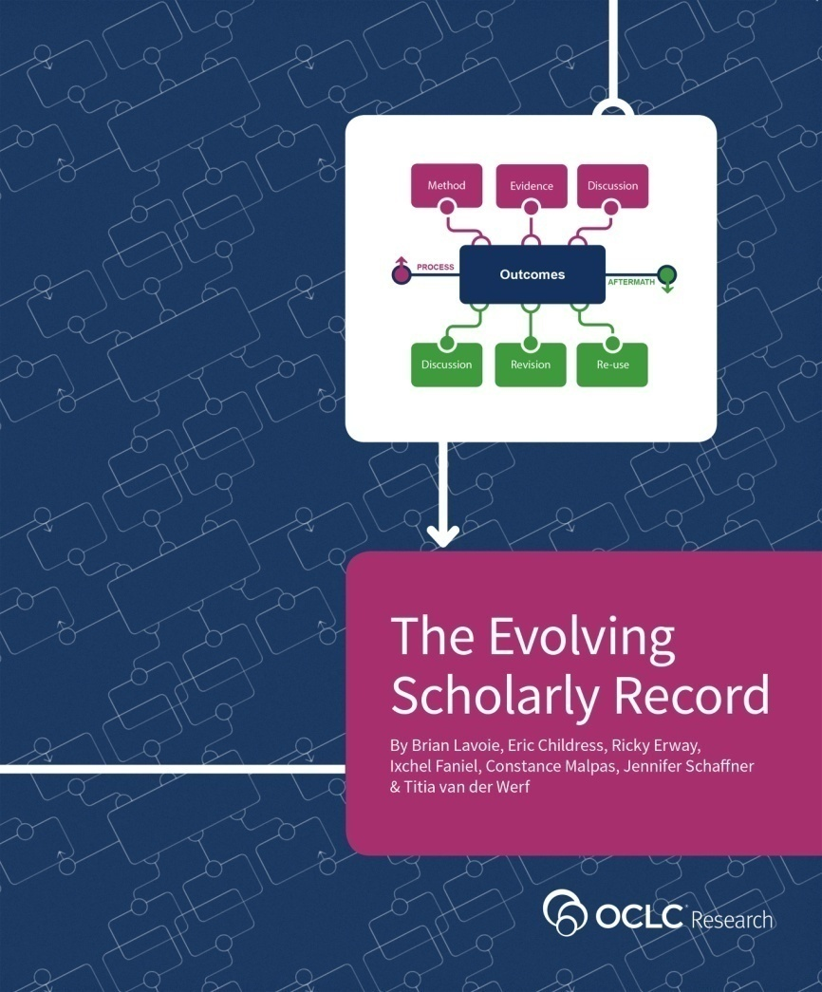
Framing the Evolving Scholarly Record
Organize/support/drive discussions about ESR
“Big picture” view of ESR
Define key categories of material and stakeholder roles
High-level; cross-disciplinary application; practical use
Common reference point for ESR within/across domains
Support strategic planning by libraries, funders, publishers, scholarly societies, etc.
http://oc.lc/esr
Notes:
So we developed a framework to support the discussion of roles across domains. You will find the report online.

Slide 7
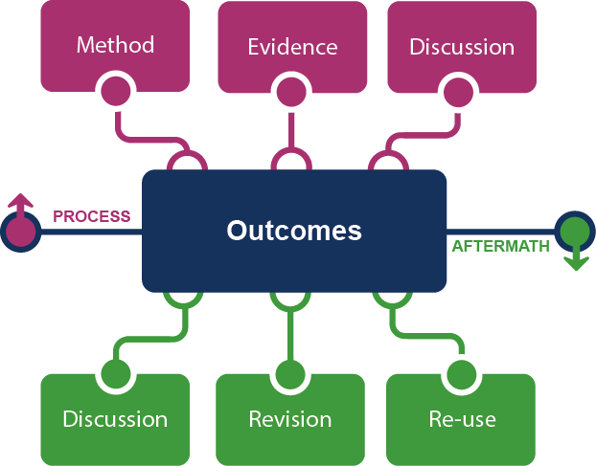
Framing the Scholarly Record …
Notes:
Traditionally the SR is about the outcomes. Now, there are 2 additional areas of focus: the process and the aftermath. The process leads up to the publication of the outcomes. Process is composed of method, evidence and discussion. Outcomes usually consolidate thanks to discussion with peers. Anchoring outcomes in process will help reproducibility. Scholarly activity continues in Aftermath: discussion after publication, reviews, commentaries; revision, enhancements with additional findings and clarifications; re-use, incl. repackaging for other audiences and repurposing for other domains.

Slide 8
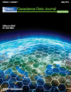
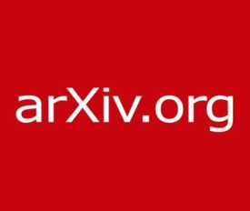
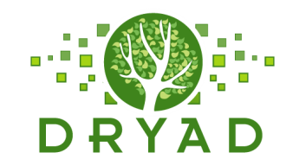
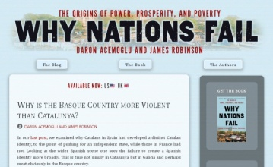
In practice …
Notes:
To illustrate what this means in practice, here are some examples:
MethodsX: is a facility offered by Elsevier to publish small changes/customizations a researcher makes to his method. It is a platform to share the technical details of the method.
Dryad: is a facility for researchers to make data underlying publications discoverable and reusable.
arXiv.org: is an archive for pre-prints to allow discussion around a research paper before publication.
PubPeer: is an online community platform for scientists to discuss and comment on published articles.
Oxford University Press: offers a facility for adding extra information by authors and making corrections (errata) to a published work.
F1000 and slideshare: are platforms for sharing posters and conference presentations to further disseminate research results.

Slide 9
Framing the stakeholder eco-system …
Fix
Collect
Create
Use
Notes:
This is a very high-level view of the traditional roles in the stakeholder ecosystem:
Create: typically what scholars/scientists do;
Fix: what publishers traditionally do: fix the outcomes of research in a citable and persistent form – e.g. the journal.
Collect: what libraries traditionally do as part of their remit to preserve the scholarly record
Use: what scholars and the wider public do.
These roles are not always clear cut distinctions but they are useful for thinking about how roles are recongigurating.

Slide 10
Evolving configurations in the eco-system …
Fix
Create
Collect
Use
Notes:
This is the traditional configuration of roles we are used from the print environment. In the digital, we see this is changing.

Slide 11
Evolving configurations in the eco-system …
Fix
Create
e-journals
Collect
Use
Notes:
For e-journals we have witnessed how the traditional Collect role of libraries has been dis-intermediated. But we also saw the emergence of new service providers like Portico and JSTOR who re-inserted the Collect role.

Slide 12
Evolving configurations in the eco-system …
Fix
Create
Social media (blogs, Twitter)
Social storage (SlideShare, YouTube, Flickr)
Collect
Use
Notes:
The new social media and social storage services are platforms which have emerged mostly outside the academy, and they widely used by scholars to share their work. Such platforms are now part of Create and Use and they are bypassing Fix and Collect. But, again, we see here Collect reappear with web archiving. Figshare for example takes on Fix and Collect roles. What this shows is that roles are constant, but configurations of the stakeholders beneath them are continuously changing.

Slide 13
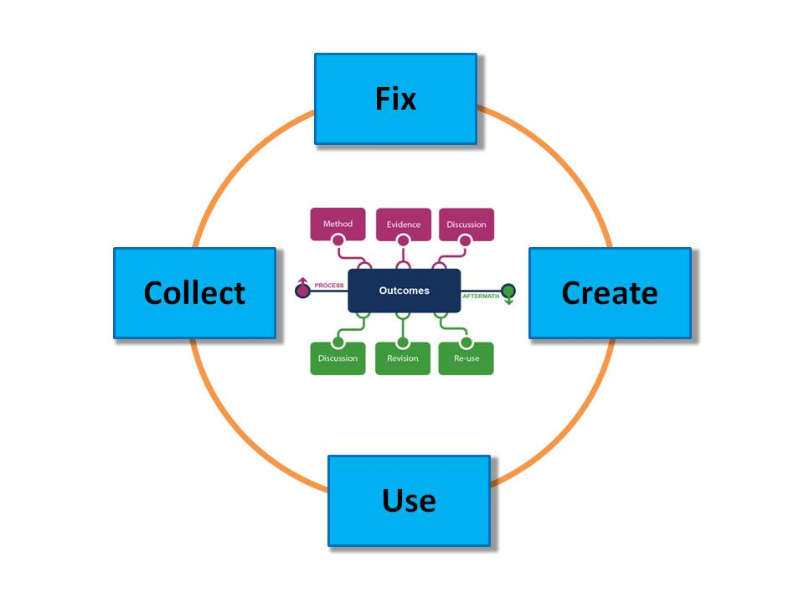
What is the scholarly record? (reprise)
A selection of
scholarly content …
… supported by stable
configurations of
stakeholder roles
Notes:
So, these are the 2 elements of the framework, with each their set of issues: 1) the scattering of outputs on the web and the expanding boundaries of the SR; and 2) the fast changing configurations of stakeholder roles, increased use of common web platforms by scholars for sharing their work – demonstrating a need for sharing in real-time at the risk of losing on scholarly integrity and persistence. The systematic disintermediation of Fix and Collect seems to become a trend – which Jim Neal denounced yesterday when he urged librarians to take up their Long-term preservation role in the digital environment.

Slide 14
THANK YOU!
Based on slides prepared by:
Brian Lavoie, research scientists at OCLC Research.
For the workshop on the Evolving Scholarly Record, Washington, DC
December 20, 2014

