Slide 1
Optional member session
Increasing connectivity and quality on the web

Slide 2
agenda
10:00 – 10:15 | Titia van der Werf, OCLC Senior Program Officer | Welcome Short briefing of current OCLC Research efforts.
10:15 –11:30 | Rémi Mathis, President of Wikimedia France and Max Klein, Wikipedian in Residence, OCLC | The new French SemanticPedia and its use by the BnF and other cultural institutions. Wikipedians-in-Residence’s involvement with Libraries Q&A session
11:30 – 12:00 | Shenghui Wang, Research Scientist, OCLC | Research investigations by OCLC and Europeana Q&A session

Slide 3
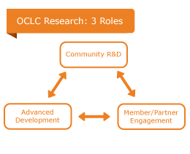
About OCLC Research
Mission: expand knowledge that advances OCLC's public purposes:
Furthering access to the world's information
Reducing library costs
One of the world's leading centers devoted exclusively to exploring the challenges facing libraries & archives

Slide 4
Shared Community R&D
Research activities: http://www.oclc.org/research/activities.html
Activities related to this session:
Wikipedians and Libraries
Webinars/events in the US
VIAFbot
Europeana Innovation Pilots

Slide 5
Advanced Development
OCLC’s “Proving Grounds”:
Develop/trial innovative processes & frameworks
First adopter of new standards & tools
Technology diffusion within OCLC and beyond
Economically processing data at scale with
OCLC Innovation Lab
Linked data technologies
Examples:
Addition of Schema.org mark-up to WorldCat.org pages
Release of a downloadable linked data file for the 1M most widely held works in WorldCat.

Slide 6
Member and partner engagement
Contact: Titia van der Werf
titia.vanderwerf@oclc.org

