Slide 1
LITA National Forum 2015
Data Designed for Discovery
Roy Tennant
OCLC Research

Slide 2
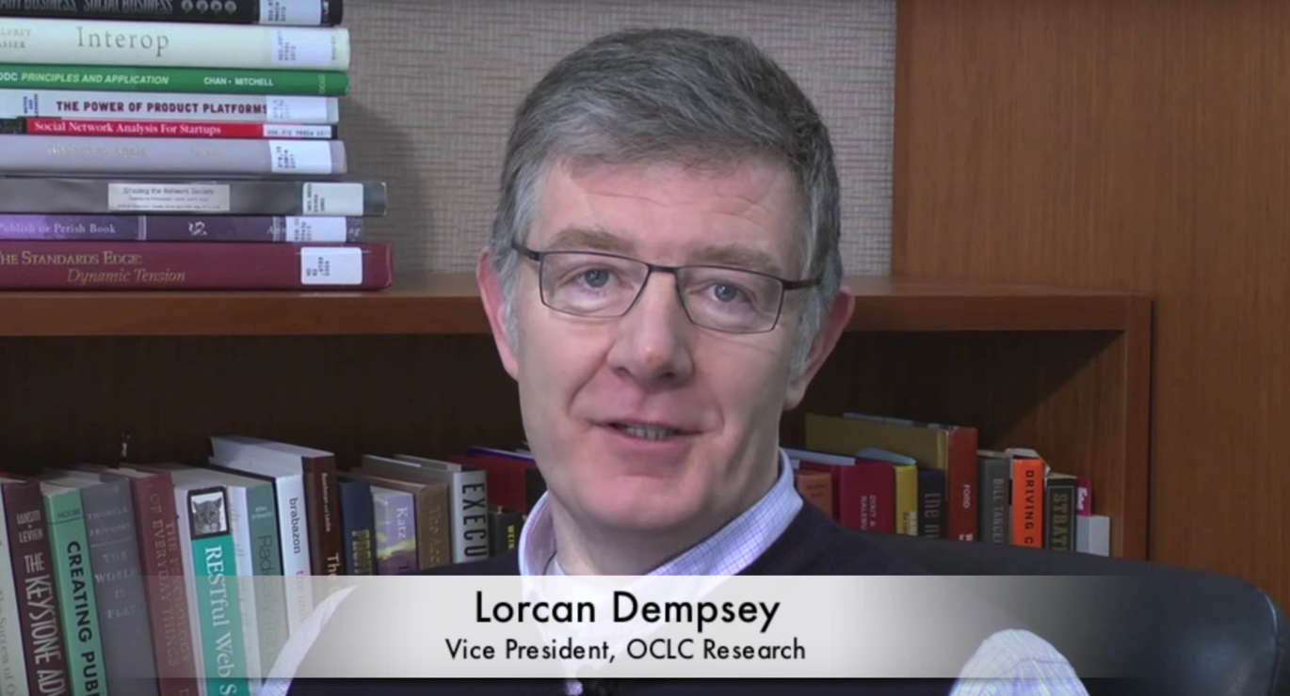
Cataloging Unchained!

Slide 3
The past and present situation

Slide 4
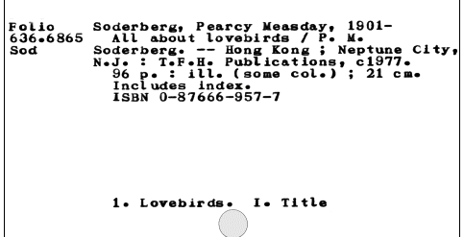
The Canonical Entity (of the past)

Slide 5
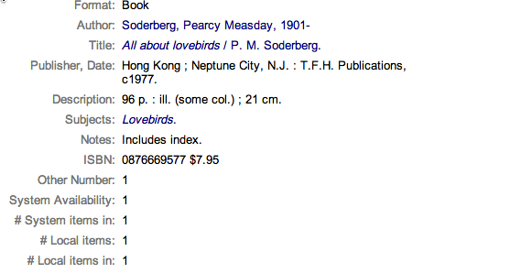
The Canonical Entity (of the present)

Slide 6
The Classic Bib Record
A collection of statements…
Taken from the piece itself…
Sometimes “enhanced” with inferred parentheticals (e.g., [1975] )…
Or additional statements not on the piece (e.g., subject headings)
Where punctuation, which may or may not be present, is used (inconsistently) for structure
Mostly uncontrolled text strings that are only loosely connected to anything else
MARC is machine readable, NOT machine understandable!

Slide 7
The Problem

Slide 8
Actually, A Number of Problems
Identification Problems:
“The Hamlet Problem” (titles aren’t enough)
“The Wang/Li/Zhang Problem” (names aren’t enough)
Linkage Problems:
“The Web Problem” (text strings aren’t enough, you need links)
“The Language Problem” (the right translation for a given user in a way they can understand)
Quality Problems:
“The Legacy Problem” (strings are not controlled terms; often, they cannot be turned into them)

Slide 9
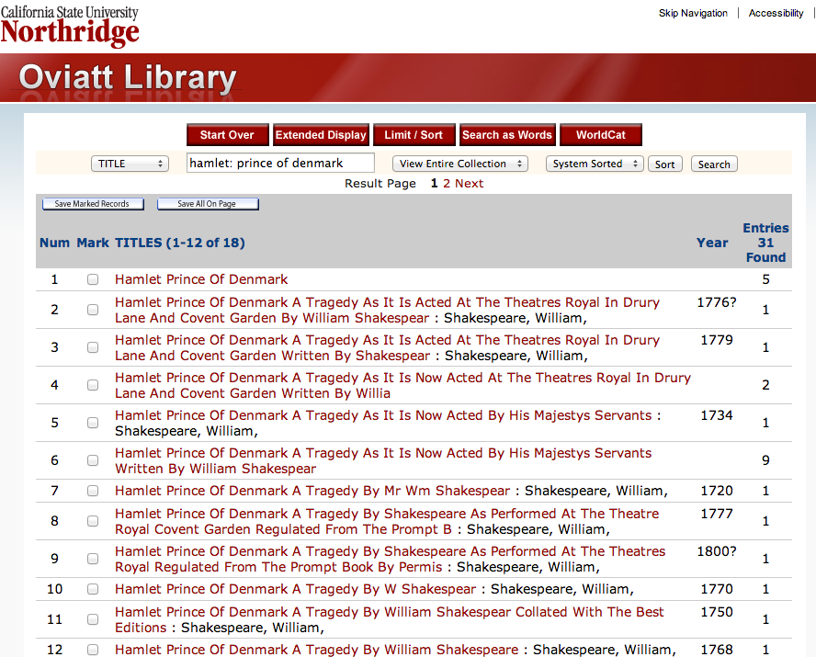

Slide 10
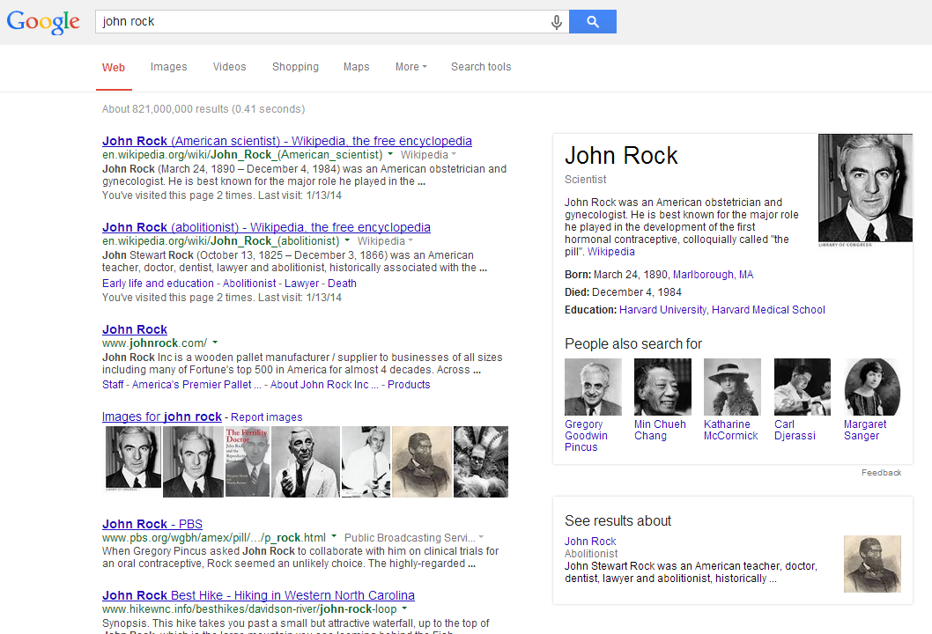

Slide 11
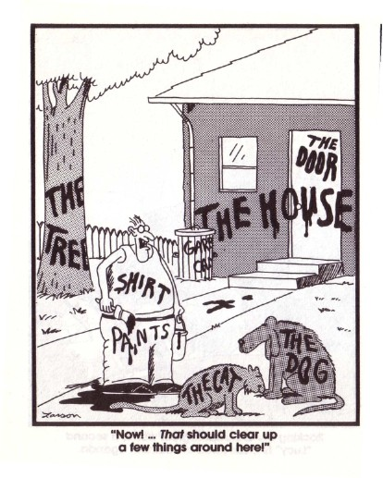
First, define ALL THE THINGS

Slide 12
entity
/ˈɛntɪti/
noun
a thing with distinct and independent existence.
relationship
/rɪˈleɪʃ(ə)nʃɪp/
noun
the way in which two or more people or things are connected

Slide 13
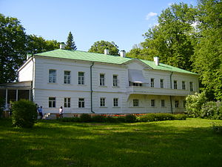
Record
Title: "War and Peace"
Author: "Leo Tolstoy 1828-1910"
ISBN: 0307266931
Entity (http://worldcat.org/entity/work/id/115206288)
Type: Work
Name: "War and Peace"
Author: http://worldcat.org/entity/person/id/1234
⤵︎
Entity (http://worldcat.org/entity/person/id/1234)
Type: Person
Name: "Leo Tolstoy "
Born: 1828
Died: 1910
Birthplace: http://worldcat.org/entity/place/id/8976
⤵︎
Entity (http://worldcat.org/entity/place/id/8976)
Type: Place
Name: "Yasnaya Polyana"
SameAs: http://geonames.org/468686
⟶
Notes:
In a record view you get bits of data [evidence] about an item.
Related entities provide descriptions of real things/entities enabling you to follow the relationships between them – inside and beyond the closed world of libraries

Slide 14
Entities of Initial Focus
person
person
place
object
concept
organization
work
work

Slide 15
Relationships between Entities are established
person
place
author
object
concept
item availability
subject
organization
work

Slide 16
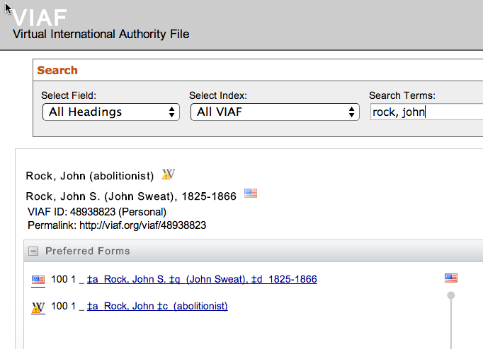
Using
authoritative sources whenever possible

Slide 17
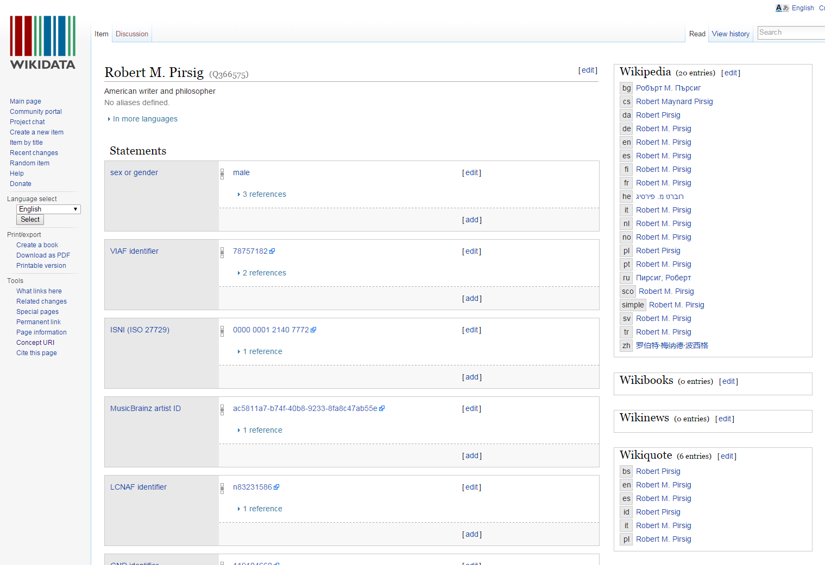
And linking to other authoritative data sources

Slide 18
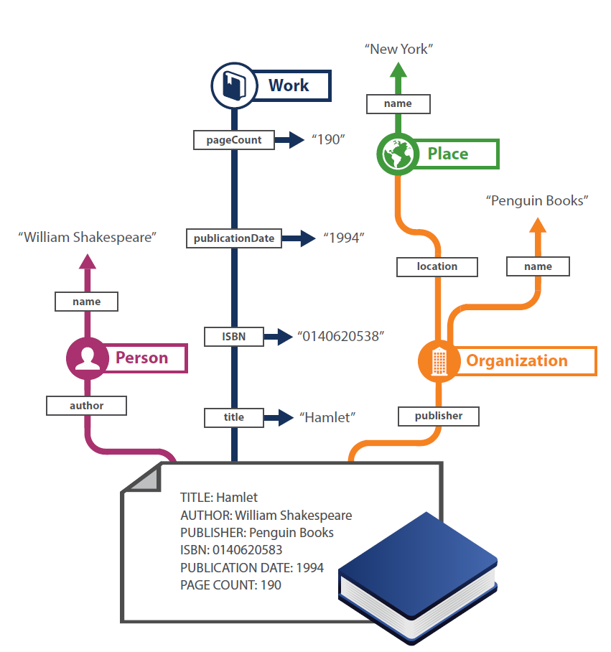
“Shredding”

Slide 19
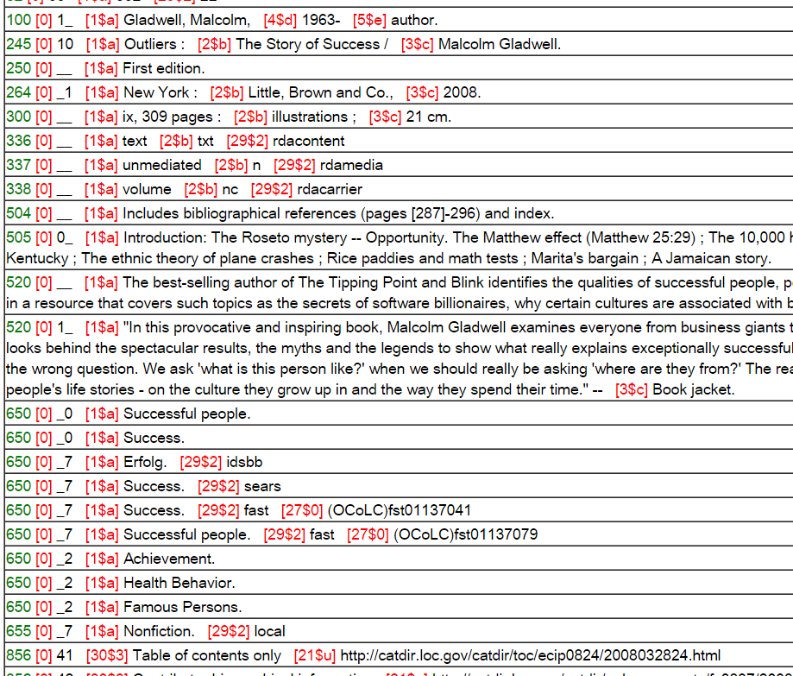
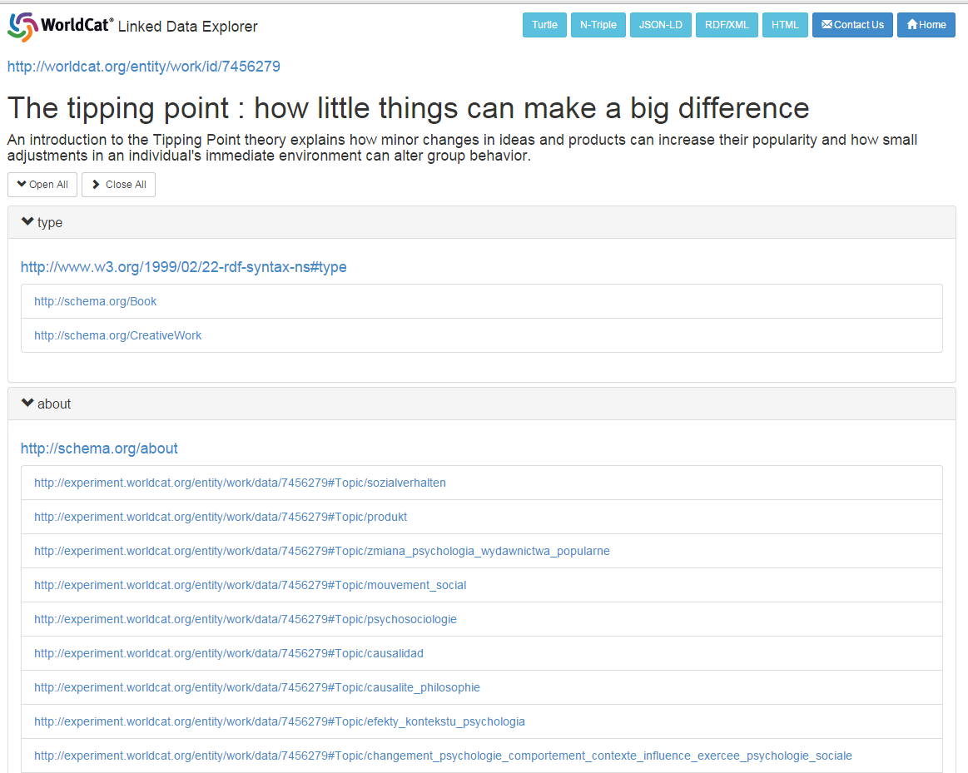
From Records to Entities: Works

Slide 20
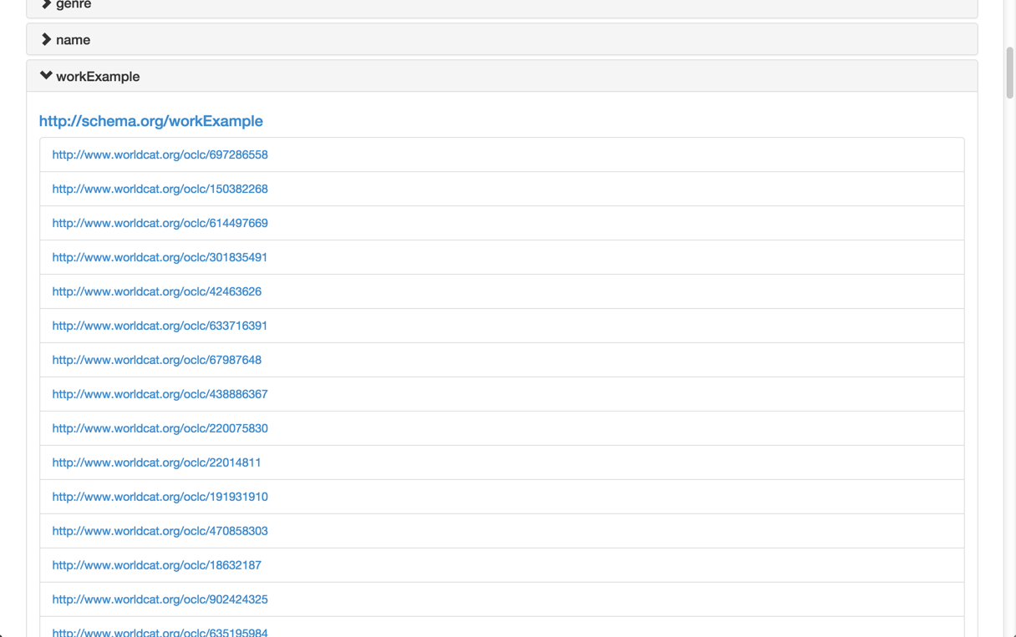
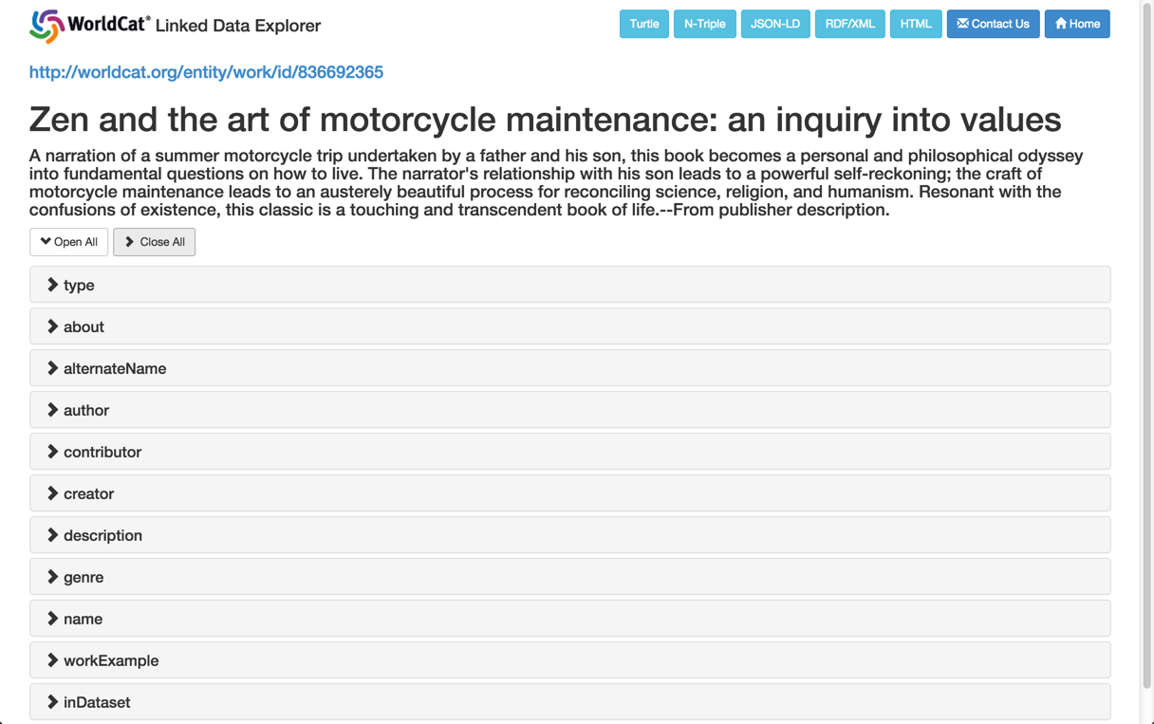

Slide 21
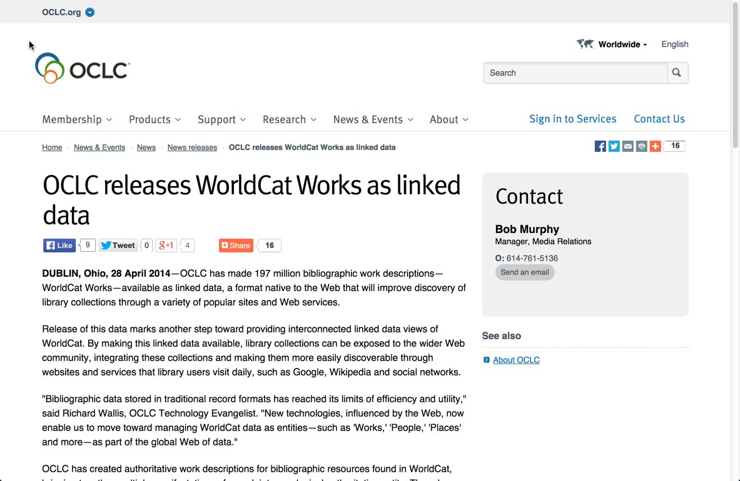

Slide 22
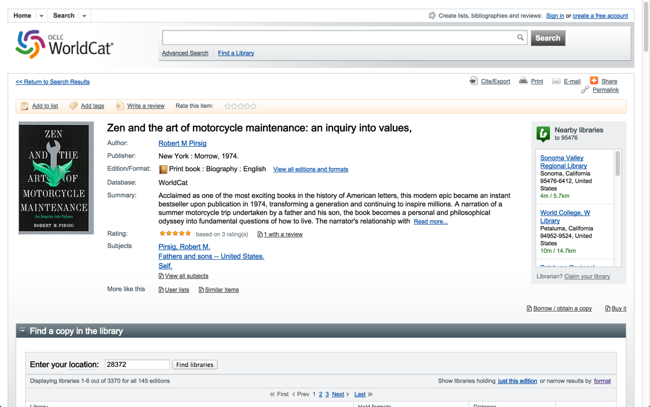

Slide 23
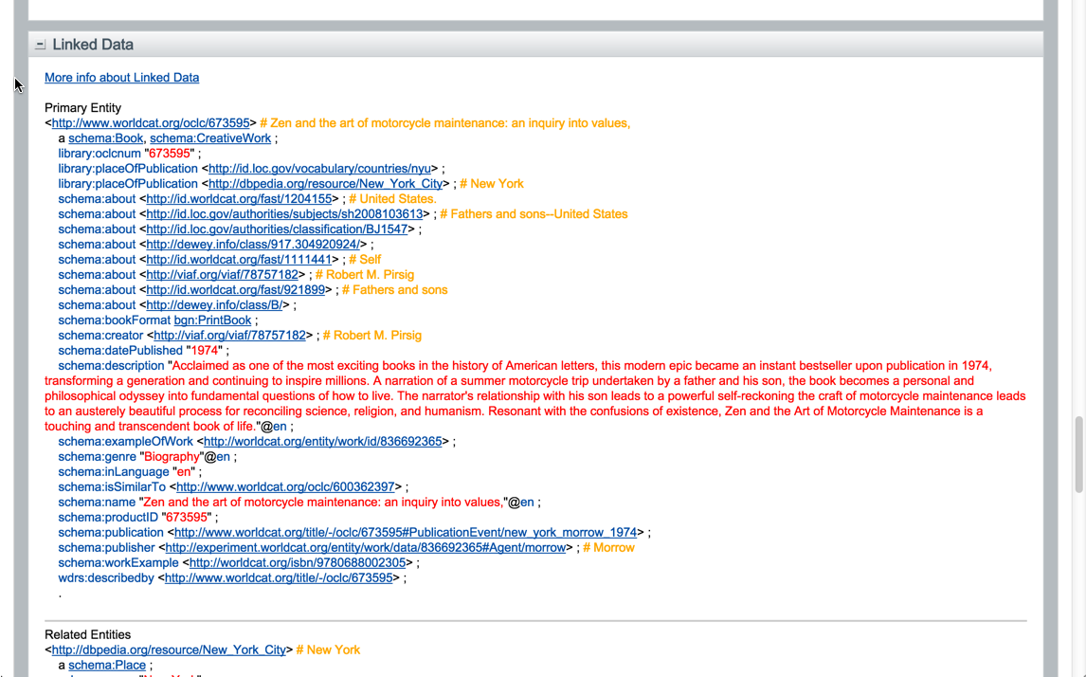

Slide 24
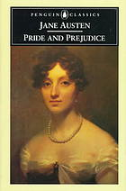
LCSH = Mixed entities
Headings before conversion
600 10 Bennet, Elizabeth (Fictitious character) $v Fiction.
600 10 Darcy, Fitzwilliam (Fictitious character) $v Fiction.
650 0 Gentry $z England $v Fiction.
650 0 Social classes $z England $v Fiction.
650 0 Young women $v Fiction.
650 0 Mate selection $v Fiction.
650 0 Courtship $v Fiction.
650 0 Sisters $v Fiction.
651 0 England $x Social life and customs $y 19th century $v Fiction.
Person/Character
Genre
Place
Topic
Time
Notes:
Designed for card catalog

Slide 25
FAST = Each entity in separate field

Slide 26
Creating linked data assertions from record-oriented data
MARC Records
MARC Record
Enhanced WorldCat MARC Record
FRBR Clustering
String matching with controlled vocabularies
Addition of standard identifiers
Notes:
For our experimental work, we begin with data that is record-oriented. MARC bibliographic and authority data.
As part of the normal operations of OCLC these records are clustered following the FRBR principles, and a significant amount of additional work goes into matching strings representing people, groups, places, events and concepts to corresponding authoritative headings in controlled vocabularies, with identifiers from those vocabularies (LCSH, VIAF, FAST, and others) assigned where possible.

Slide 27
OCLC Production Services
LCSH
Linked Data
Entities
VIAF
Internal OCLC Research Resources
FAST
enhanced
WorldCat
GMGPC
External OCLC Research Systems
WORKS
GSAFD
GTT
Kindred Works
FictionFinder
Identities
MeSH
LCTGM
Cookbook Finder
DDC
Classify

Slide 28
Creating linked data assertions from record-oriented data
MARC Records
RDF Entities
MARC Record
Enhanced WorldCat MARC Record
Persons
Organizations
Places
FRBR Clustering
String matching with controlled vocabularies
Addition of standard identifiers
Concepts
Events
Works
Notes:
Our next step is to reconstitute the record-oriented data to represent entities …
OCLC provides Work Entities as Linked Data now, and in our experimentation we’re testing these representations for a total of 6 types of entities.
The entity data is modeled using RDF … The Resource Description Framework … and for users of the data it can then be represented in a variety of Linked Data serializations, including JSON-LD, N-Triples, TTL, or RDF XML.

Slide 29
Creating linked data assertions from record-oriented data
MARC Records
RDF Entities
Triples
MARC Record
Enhanced WorldCat MARC Record
Persons
Subject
Predicate
Object
Subject
Predicate
Object
Organizations
Subject
Predicate
Object
Places
Subject
Predicate
Object
FRBR Clustering
String matching with controlled vocabularies
Addition of standard identifiers
Subject
Predicate
Object
Concepts
Subject
Predicate
Object
Subject
Predicate
Object
Events
Subject
Predicate
Object
Works
Subject
Predicate
Object
Subject
Predicate
Object
Notes:
And from those Entities we derive Triples representing the relationships between things that are described in the entity data.
This processing of records into entities and then into triples increases the granularity of the information objects … 4 million records are converted into about 40 million separate entity descriptions, which yield about 400 million triples.
This process includes an action that is similar to the “Graph-based Priors” application of existing Knowledge Bases to validate or extend data Google harvests from the web. The source MARC records include undifferentiated headings for people, places, etc., lacking standard identifiers, and sometimes taking alternative string representations. Using vocabularies like VIAF and FAST as Knowledge Bases, and taking into account other information in the record and related records in a FRBR cluster, these varying strings can be related to the same entity and inherit the richness of that entity description.

Slide 30
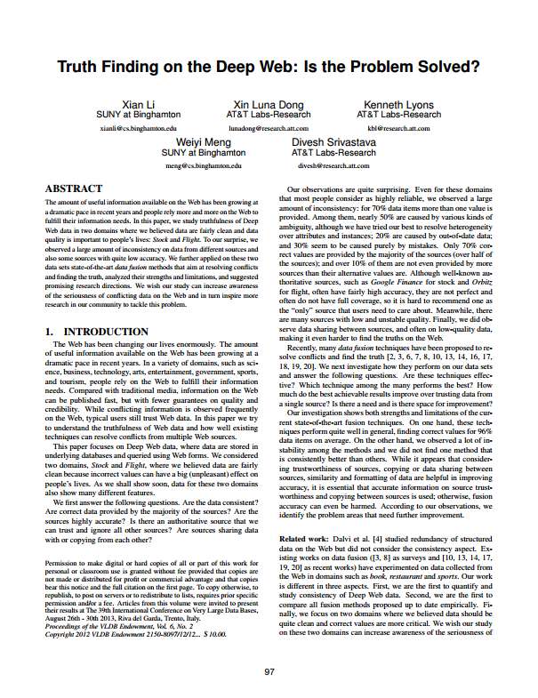
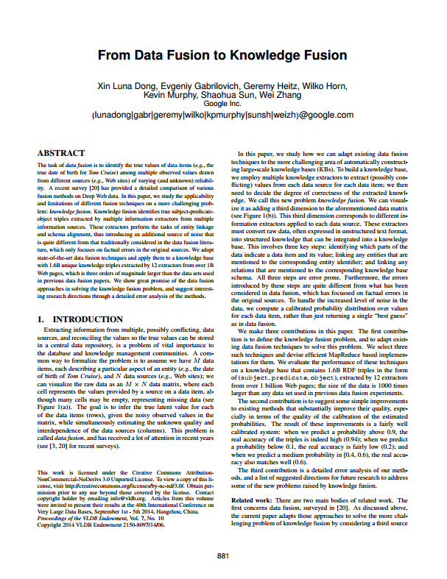
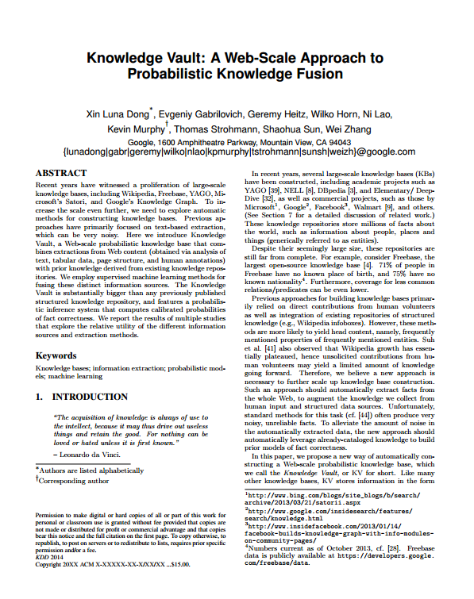
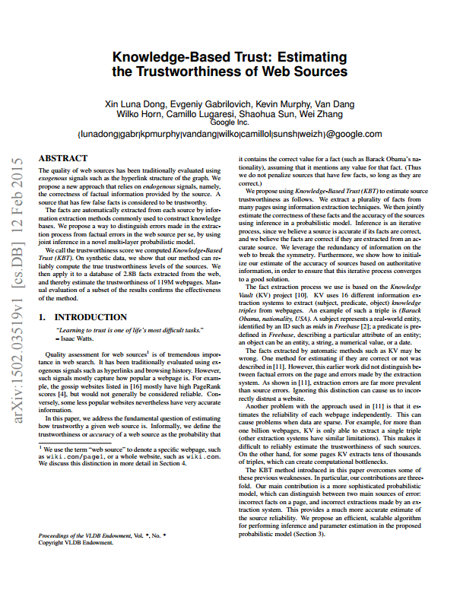
Estimating “Truthiness” of assertions
A series of recent Google Research papers describe the use of probabilistic models and machine learning to assess the truth of statements made by multiple sources.
Li, X., Dong, X. L., Lyons, K., Meng, W., Srivastava, D. (2013). Truth Finding on the Deep Web: Is the Problem Solved?
Dong, X. L., Gabrilovich, E., Heitz, G., Horn, W., Murphy, K., Sun, S., Zhang, W. (2013). From Data Fusion to Knowledge Fusion.
Dong, X. L., Murphy, K., Gabrilovich, E., Heitz, G., Horn, W., Lao, N., ... & Zhang, W. (2014). Knowledge Vault: A Web-scale approach to probabilistic knowledge fusion
Dong, X. L., Gabrilovich, E., Murphy, K. Dang, V., Horn, W., … & Zhang, W. (2015). Knowledge-Based Trust: Estimating the Trustworthiness of Web Sources
Notes:
Google researchers have recently published a series of papers describing how they use probabilistic models and machine learning to assess the truth in the statements made about things and their relationships, mined from the web.
Google researchers refer to this as the Knowledge Vault.
OCLC Research Scientists and engineers have been taking a close look at this work, and thinking about how it may apply to how we aggregate, extract, and fold together bibliographic and authority data from a wide range of sources, as we pursue the work of building linked data representations for the things and the relationships those sources describe.

Slide 31
Knowledge Vault data flow
EnhancedWorldCat
Extractor
Knowledge Triples
Scored Triples
VIAF
Extractor
Fusers
FAST
Extractor
Etc.
Data Sources
Extraction
Collective
Fusion
Knowledge
Vault
Notes:
The first step in the process is extract “triples” from record-oriented data.
Triples are simple statements that describe a relationship between a subject and an object. For example, the creative work Persuasion was created by Jane Austen.
Expressing those simple statements in RDF, the standard model for information interchange on the web, provides a way to aggregate and process triples provided by a wide range of sources.
The “Extractors” produce “Knowledge Triples” which can associate the statement with who produced the statement, when it was produced, and other properties that can be used later on to compare related claims.
The “Fusion” processes apply mathematics to the collective of Knowledge Triples, to produce Scored Triples in the Knowledge Vault.

Slide 32
OK…BUT So what?

Slide 33
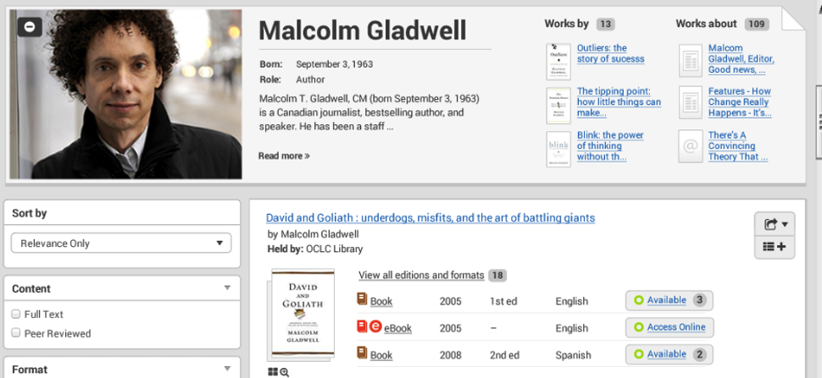
Improving Discovery
Mockup

Slide 34
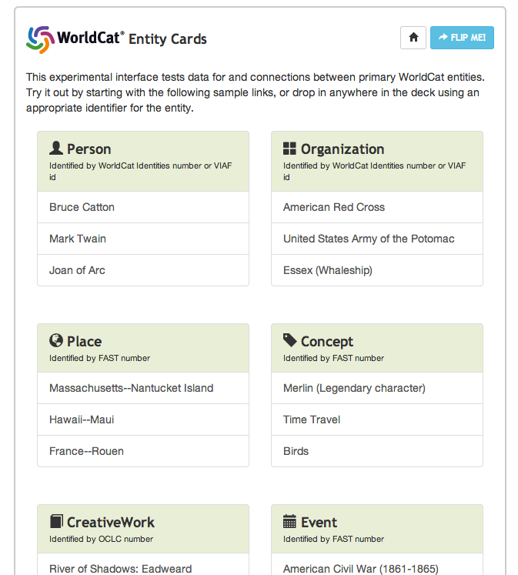

Slide 35
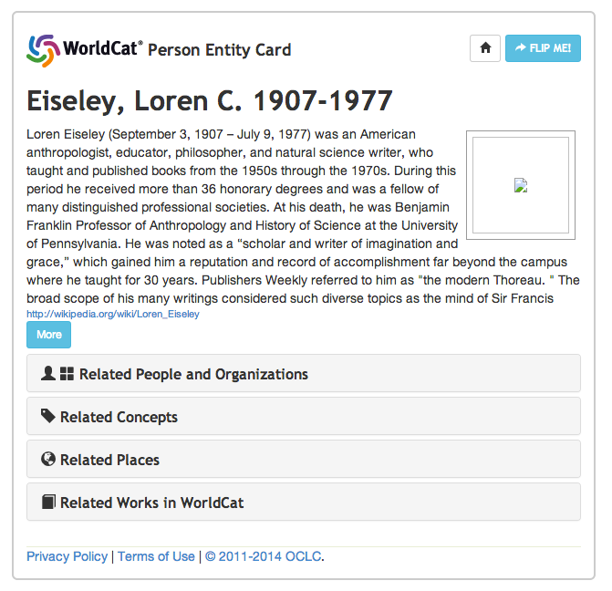
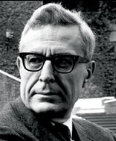

Slide 36
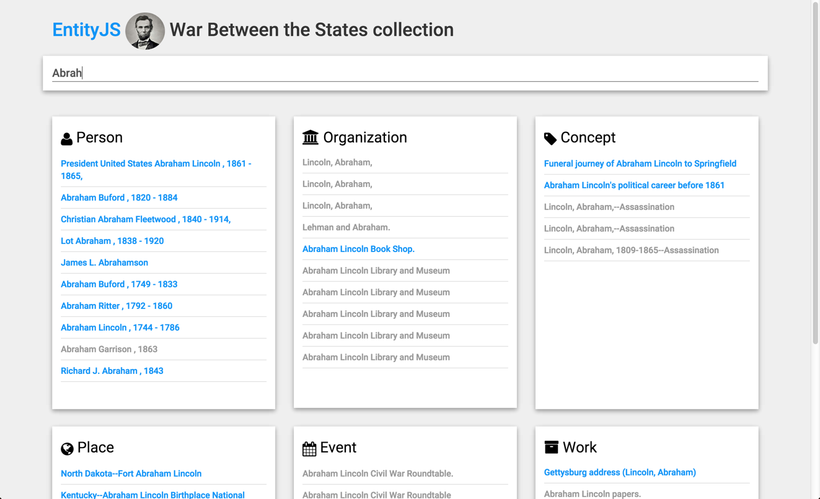

Slide 37
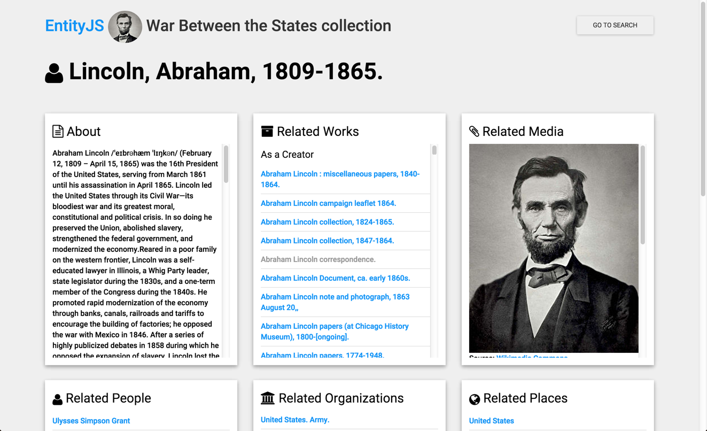

Slide 38
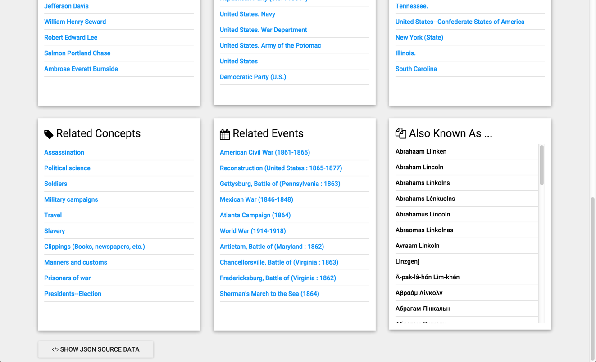

Slide 39
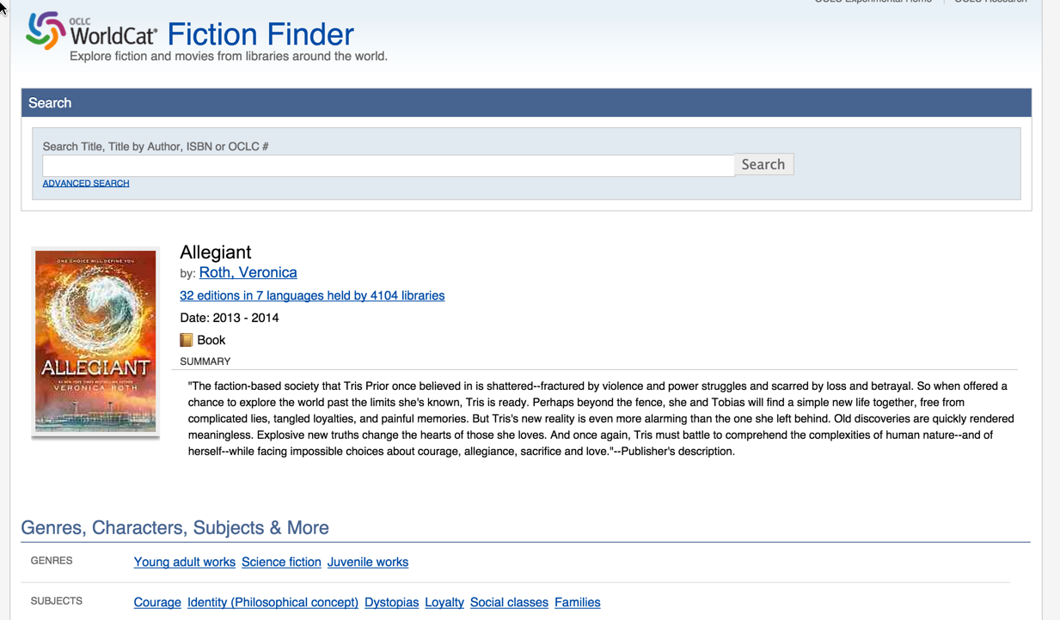
Solving the Hamlet Problem!

Slide 40
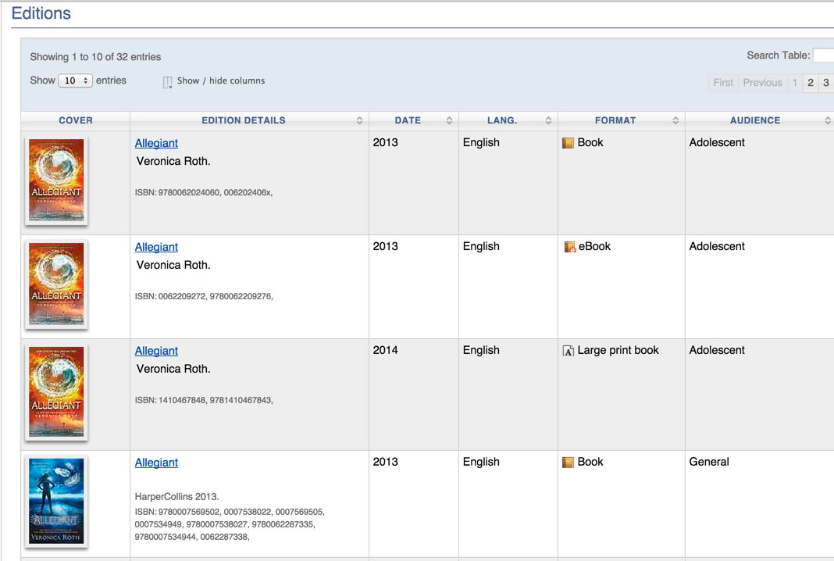

Slide 41
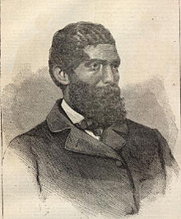
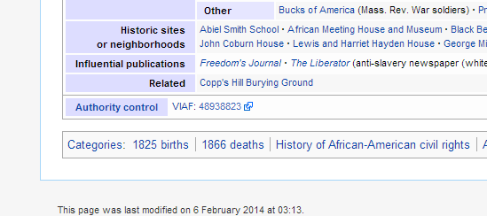
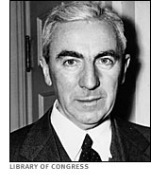
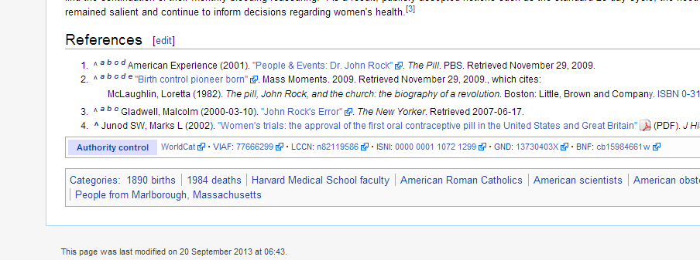
Embedding Authority Control
Solving the Wang/Li/Zhang Problem!

Slide 42
Title: 西遊記
Language: Chinese
Author: 吳承恩
Created: 1592
HasTranslation:
Title: Journey to the West
Language: English
Translator: Anthony C. Yu
Date: 1977
IsTranslationOf:
Title: Pilgerfahrt
Language: German
Translator: Georgette Boner Date: 1983
IsTranslationOf:
Title: Journey to the West
Language: English
Translator: W. J. F. Jenner
Date: 1982-1984
IsTranslationOf:
Title: 西遊記
Language: Japanese
Translator: 中野美代子
Date: 1986
IsTranslationOf:
Title: Tây du ký bình khảo
Language: Vietnamese
Translator: Phan Quân
Date: 1980
IsTranslationOf:

Slide 43
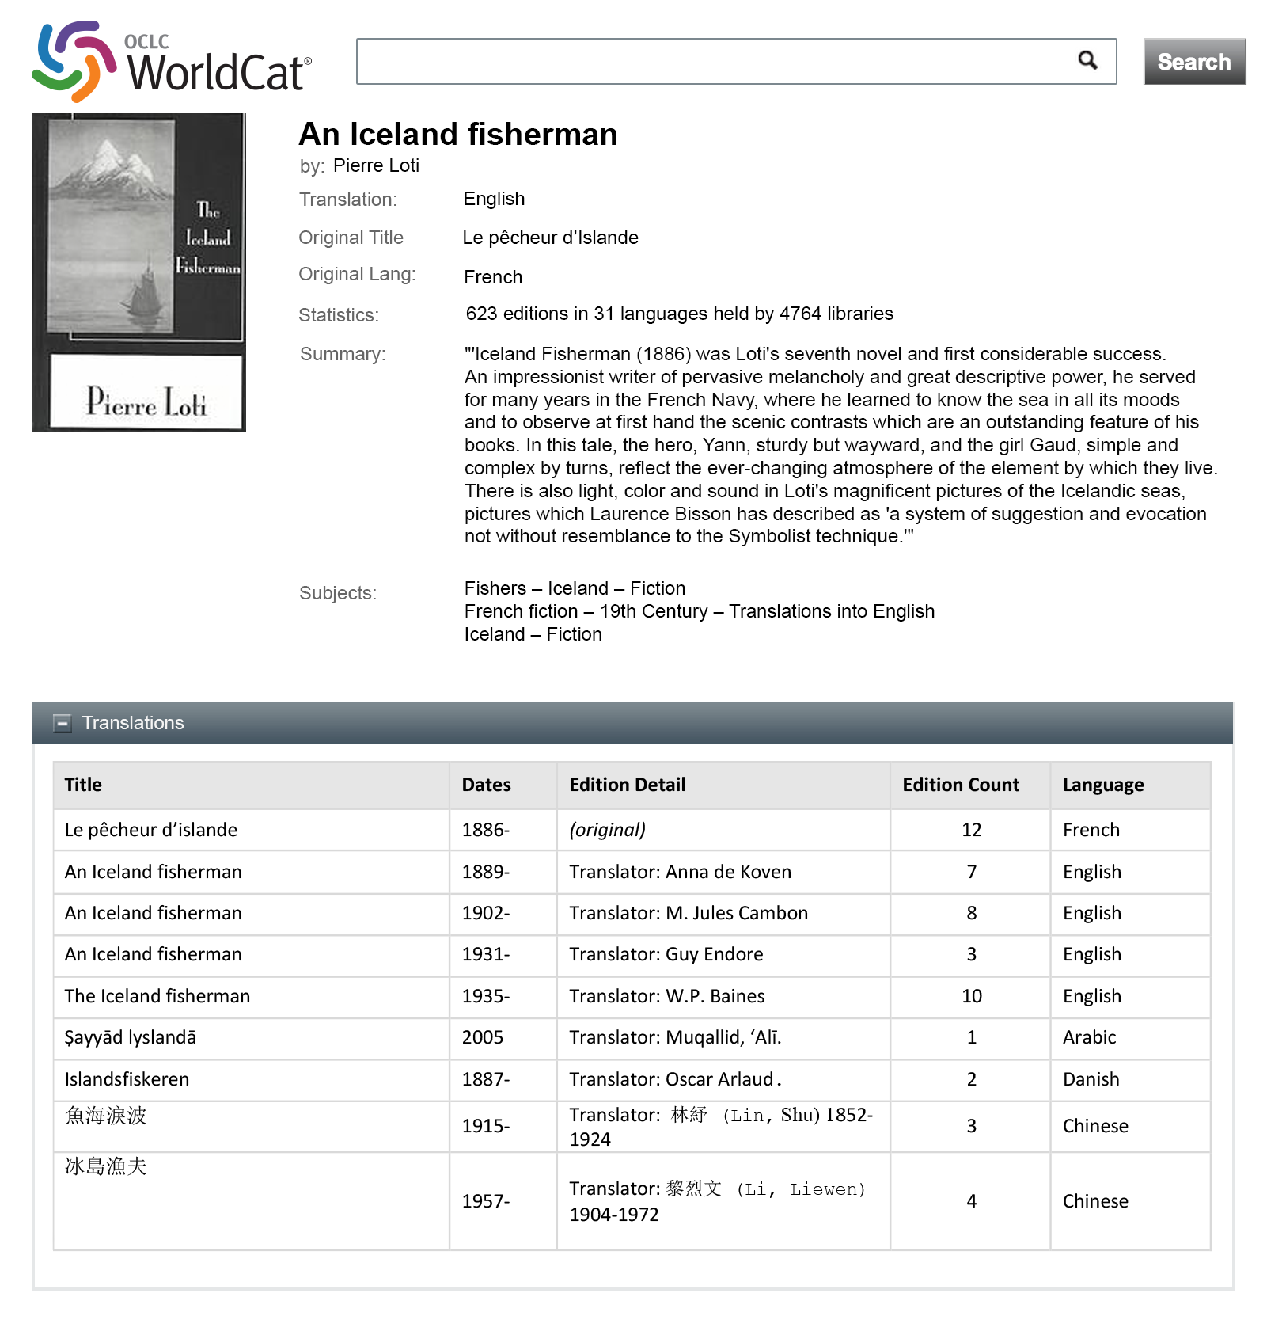
Mockup
Notes:
We have mocked up what a display could look like from the content of WorldCat records. Here, we take advantage that we have an English-tagged summary of An Iceland Fisherman, original in French, displayed in an English interface and with a table of translations and translators of the work.
Mockup designed by JD Shipengrover, OCLC Research

Slide 44
Mockup
Solving the Language Problem!
Notes:
This is the same record with a Chinese interface. Since we don’t have a Chinese-language summary, none would be shown.
Mockup designed by JD Shipengrover, OCLC Research

Slide 45
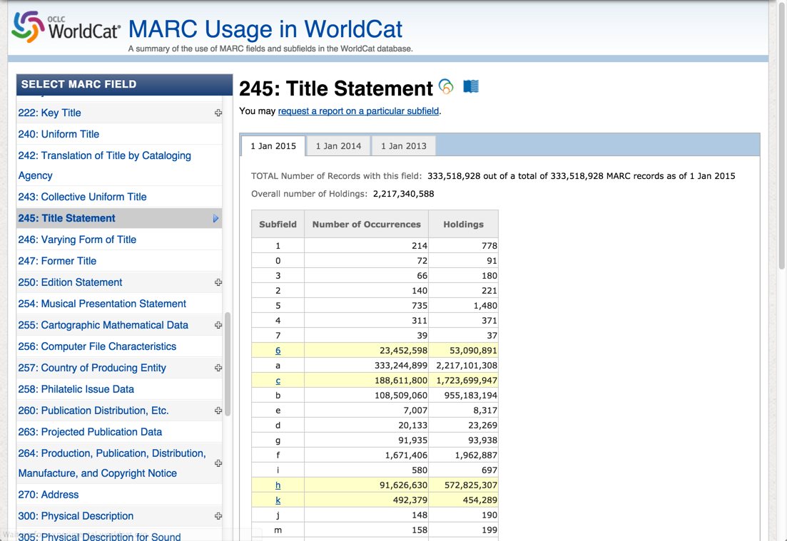
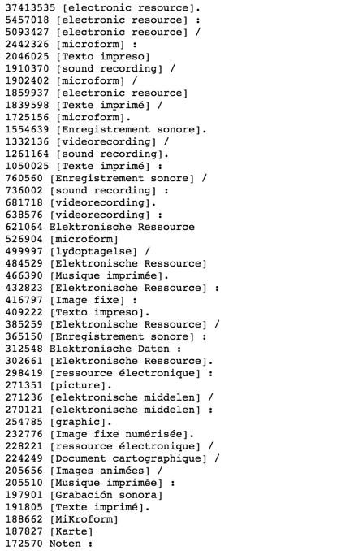
Exposing the Quality Problem

Slide 46
It’s Not the Record, It’s the Linkage
Requires a new kind of thinking: “sets of assertions about something” NOT a “record”
Requires much more than simply translating a record from MARC to a new format
There are things we can do now to make MARC “linked data ready”
Quality is a pursuit, not an achievable goal

Slide 47
Why OCLC wants to manage entities
Connectivity
Entity recognition helps to connect library data to the networked environment/web
e.g., Schema.org, BIBFRAME, etc.
Efficiency & Quality
Facilitates efficient creation of quality metadata
Creativity
Opens the door to creative reuse of library data

Slide 48
Piloting New Services
Person Entity Lookup service
Using EntityJS as one way for humans to interact with, and evaluate, and potentially correct linked data
Others as indentified…
Photo by drivethrucafe
https://www.flickr.com/photos/128758398@N07/
CC BY-SA 2.0
Notes:
DUBLIN, Ohio, September XX, 2015—OCLC is working with seven leading libraries in a pilot program designed to learn more about how linked data will influence library workflows in the future.
The Person Entity Lookup pilot will help library professionals reduce redundant data by linking related sets of person identifiers and authorities. Pilot participants will be able to surface WorldCat Person entities, including 109 million brief descriptions of authors, directors, musicians and others that have been mined from WorldCat, the world’s largest database of library metadata.
By submitting one of a number of identifiers, such as VIAF, ISNI and LCNAF, the pilot service will respond with a WorldCat Person identifier, descriptions and mappings to additional “same as” identifiers.

Slide 49
LITA National Forum 2015
Thank you!
Roy Tennant
@rtennant
facebook.com/roytennant/
©2015 OCLC This work is licensed under a Creative Commons Attribution 4.0 International License. Suggested attribution: This work uses content from “Data Designed for Discovery” © OCLC, used under a Creative Commons Attribution 4.0 International License: http://creativecommons.org/licenses/by/4.0/.

