Slide 1
IATUL • 20 June 2017
Data Designed for Discovery
Roy Tennant
Senior Program Officer, OCLC Research

Slide 2
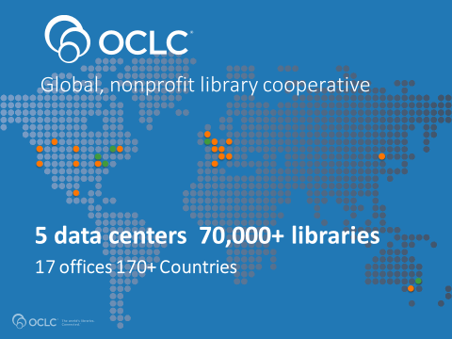

Slide 3
The world’s largest and most consulted bibliographic database
2.5 Billion holdings
400 Million bibliographic records
10 Million Italian records
57% non-English
Where librarians and library patrons search

Slide 4
A few introductory remarks
This is the Research view of linked data
We (OCLC) have experiments and prototypes, but no products or production services (yet)
We (OCLC Research) have been working with linked data for as long as anyone in the library world
Our (OCLC Research) playground is the entirety of WorldCat ( million records) and a parallel computing cluster
Stay tuned for more information on production services

Slide 5
Why linked data?

Slide 6
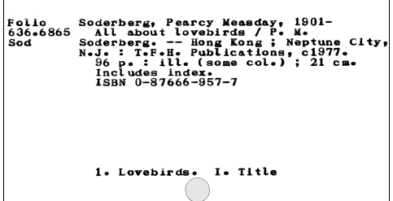
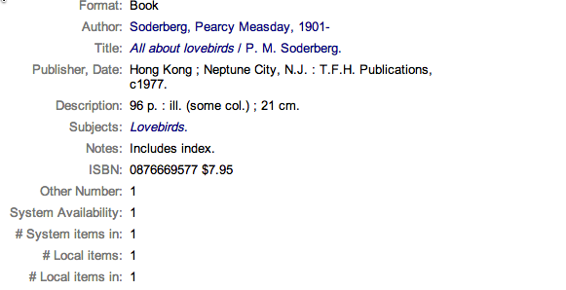
What we have to work with

Slide 7
What we have to work with
A collection of text strings…
Taken from the piece itself…
Sometimes “enhanced” with inferred parentheticals (e.g., [1975] )…
Or additional statements not on the piece (e.g., subject headings)
Punctuation, which may or may not be present, is used (inconsistently) for structure
Mostly uncontrolled and only loosely connected to anything else
Designed for description rather than discovery

Slide 8
The Problem

Slide 9
Actually, A Number of Problems
Identification Problems (two illustrated next):
The Title Problem
The Names Problem
Quality Problems (one illustrated next):
The Legacy Problem (strings are not controlled terms; often, they cannot be turned into them)
Linkage Problems (just two examples):
The Web Problem (records aren’t enough, you need links)
The Language Problem (showing the right translation for a given user)

Slide 10
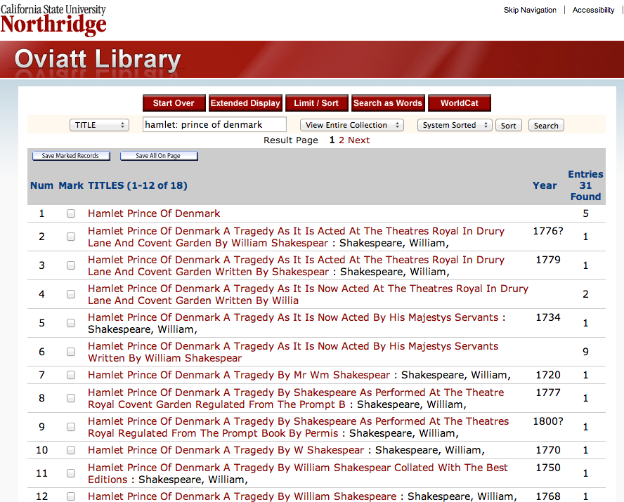
The Title Problem
Notes:
Having an entry for every specific manifestation of a work presents particular problems for users. Imagine you are a student with a paper due tomorrow (as it always is) and you must choose which entry to click on to find a copy of the book. This kind of screen display is no better than a “hunting license”.

Slide 11
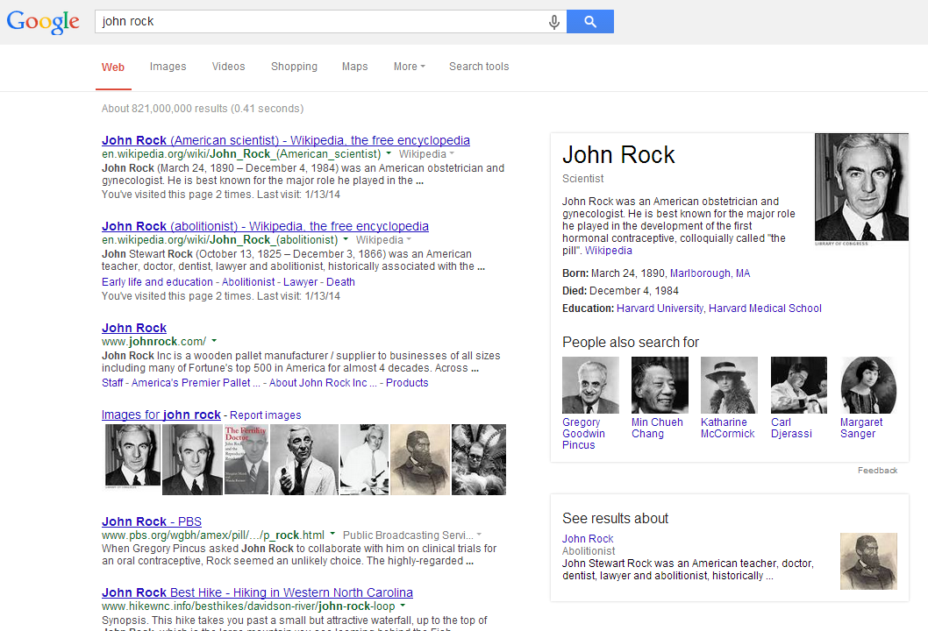
The Name Problem
Notes:
When two different people have the same name, how can you be sure you have the right person? Unambiguous identifiers are needed.

Slide 12
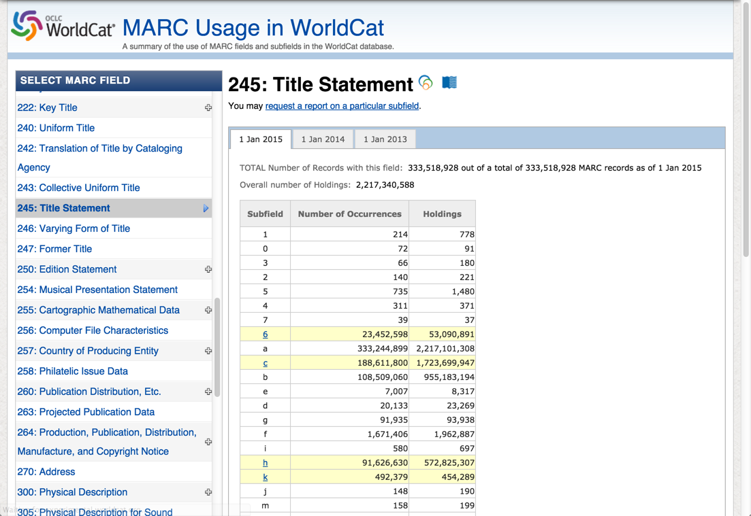
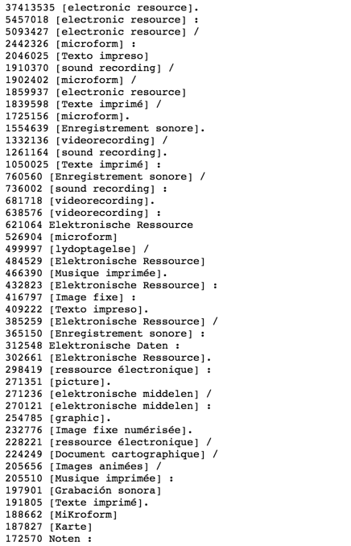
Data Quality Problems

Slide 13
The Solution

Slide 14
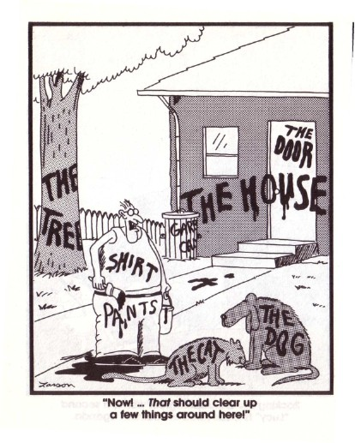
First, define ALL THE THINGS
THINGS = Linked Data “entities”

Slide 15
Quick Definitions
entity
/ˈɛntɪti/
noun
a thing with distinct and independent existence.
relationship
/rɪˈleɪʃ(ə)nʃɪp/
noun
the way in which two or more people or things are connected

Slide 16
…then establish relationships with other entities
Albert Einstein
Person
Relativity: The Special and General Theory
Work
Physics
Concept
author
Also known as “Triples”
about
Notes:
So the goal of linked data is to produce machine-understandable knowledge about things we are interested in.
As librarians, we can jumpstart this process by upgrading the descriptions of things that librarians have always collected information about…authors, works, subjects.

Slide 17
…with actionable links from authoritative data hubs
https://www.wikidata.org/wiki/Q937 and http://viaf.org/viaf/75121530
Wikidata and VIAF
http://experiment.worldcat.org/entity/work/data/369081611
WorldCat Works
http://id.loc.gov/authorities/subjects/sh85101653.html
Library of Congress Subject Headings
author
about
Notes:
What’s new and different about linked data.
URIs – a web location that is unique in the world and persistent.
When referenced, they provide information about things.
They may include links to other sources of information (VIAF & Wikidata both provide information about Albert Einstein…reinforcing and complementary.
Make machine-understandable statements that link the sources of information. “Triples” – <Albert Einstein> <is the author of> <The General Theory of Relativity>

Slide 18
A Real world example

Slide 19
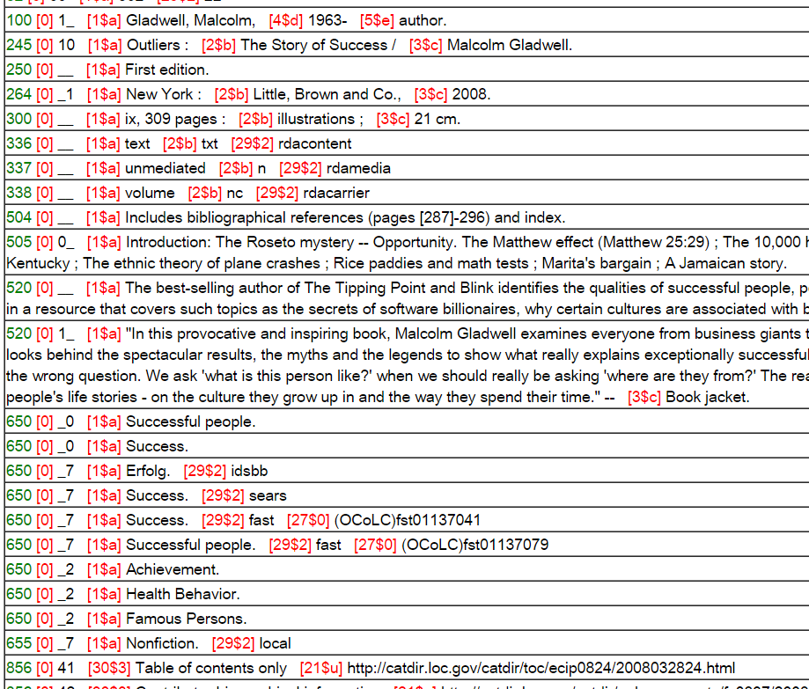
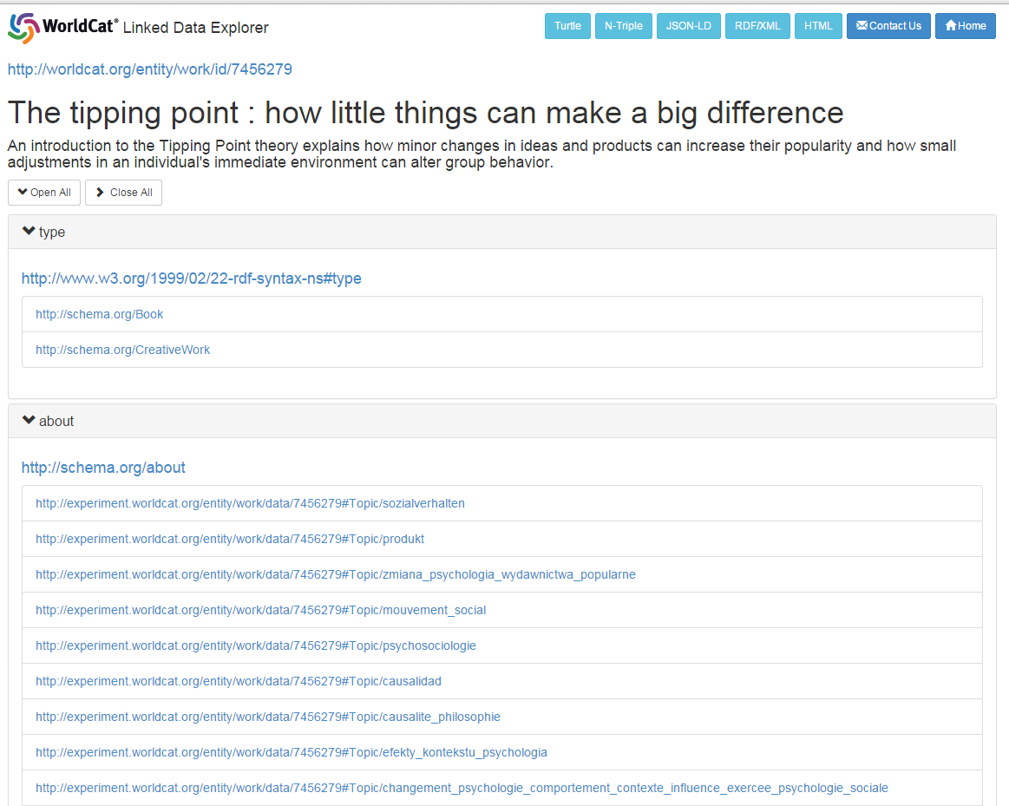

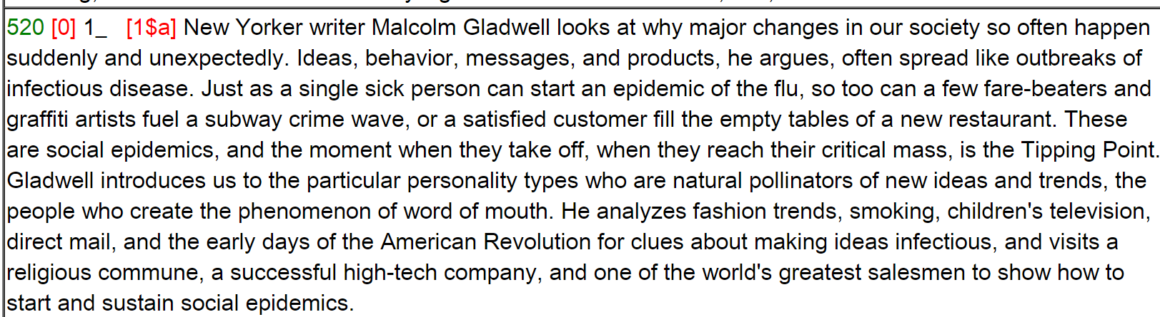

From Records to Entities: Works

Slide 20
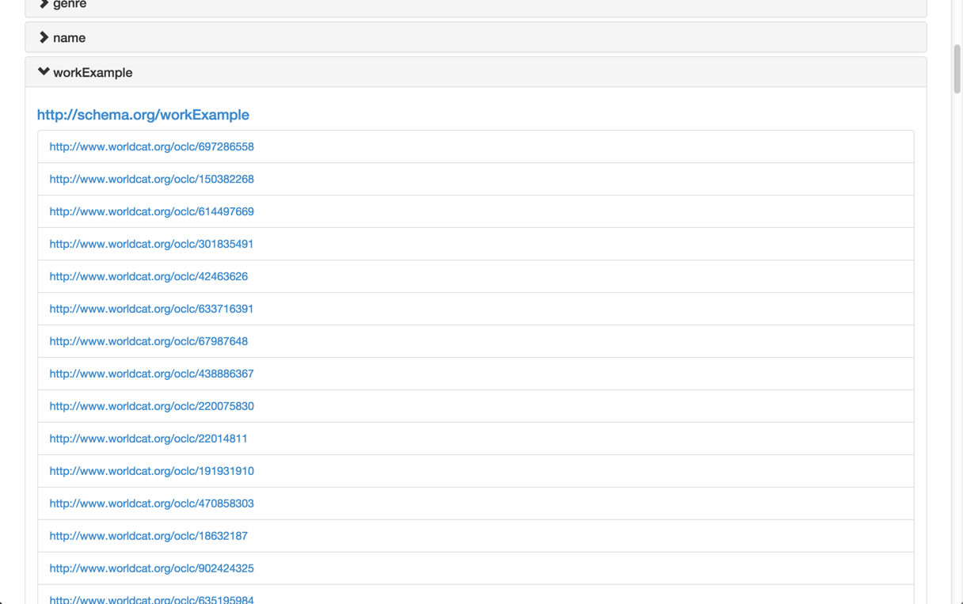
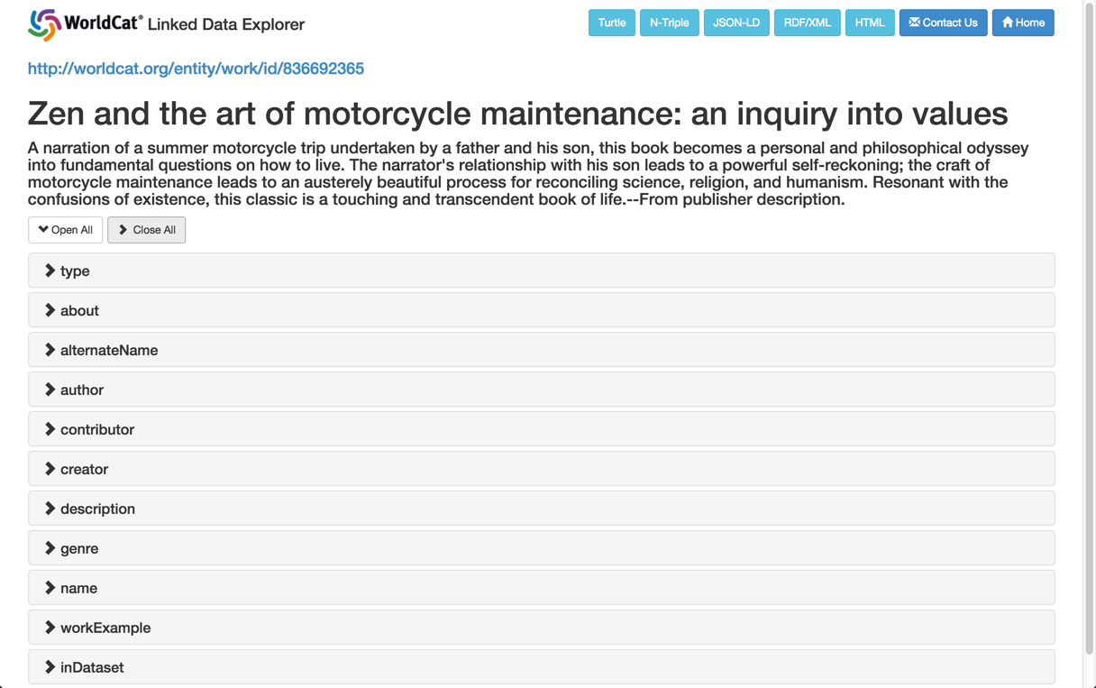

Slide 21
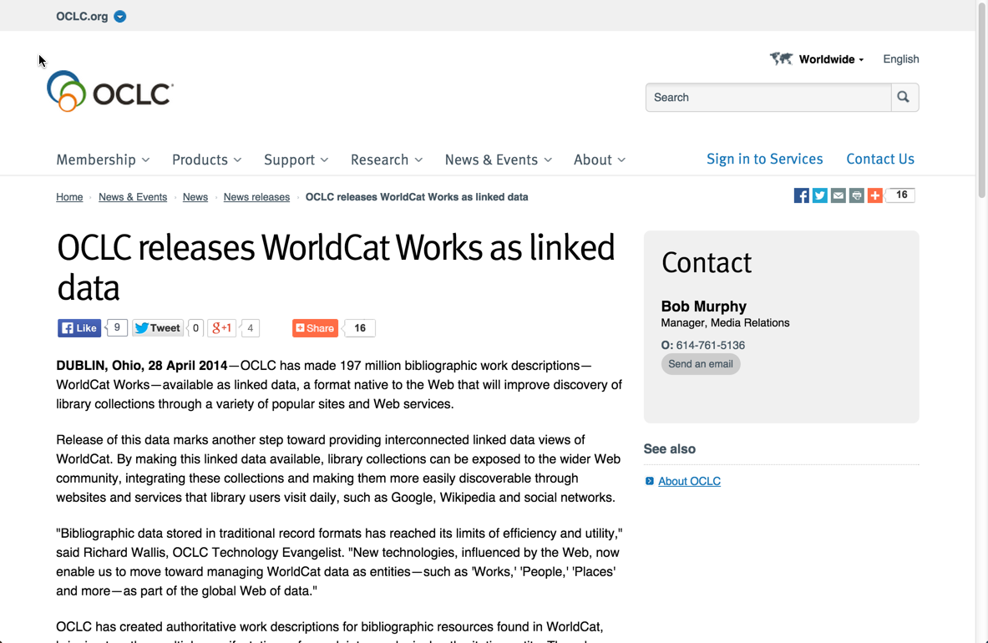

Slide 22
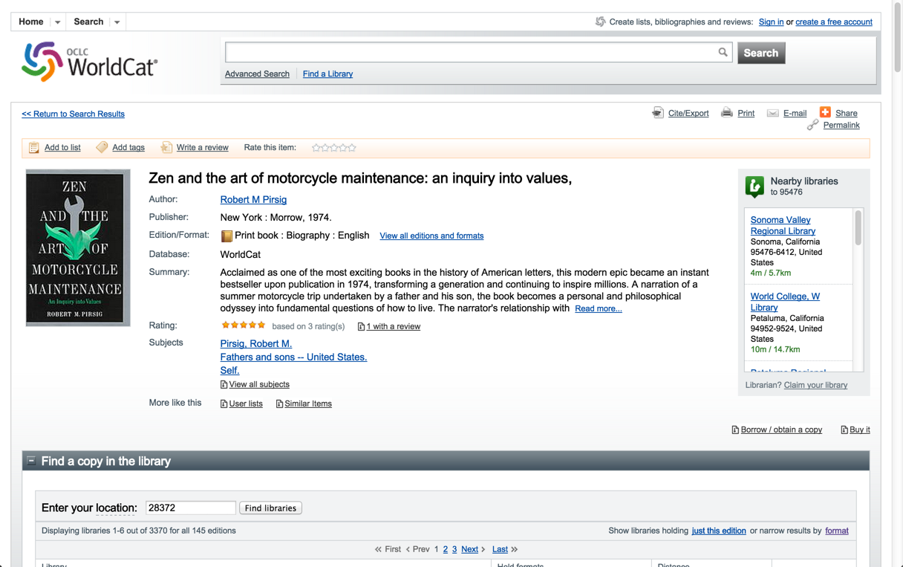

Slide 23
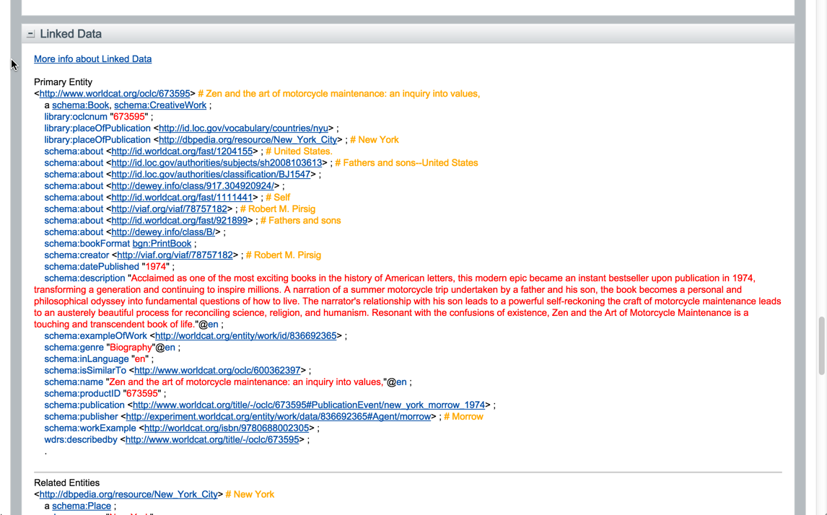

Slide 24




OCLC Production Services
LCSH
Linked Data
Entities
VIAF
Internal OCLC Research Resources
FAST
enhanced
WorldCat
GMGPC
External OCLC Research Systems
WORKS
GSAFD
GTT
Kindred Works
FictionFinder
Identities
MeSH
LCTGM
Cookbook Finder
DDC
Classify

Slide 25


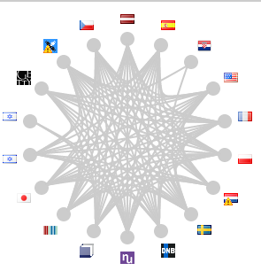

OCLC’s linked data resources
WorldCat Works:
5 billion RDF triples
ISNI: 10-50 million triples
VIAF: 2 billion triples
WorldCat Catalog:
15 billion triples
FAST:
23 million
triples
Notes:
As of August 2014, we can say that OCLC has published over 20 billion RDF triples extracted from MARC records and library authority files.

Slide 26
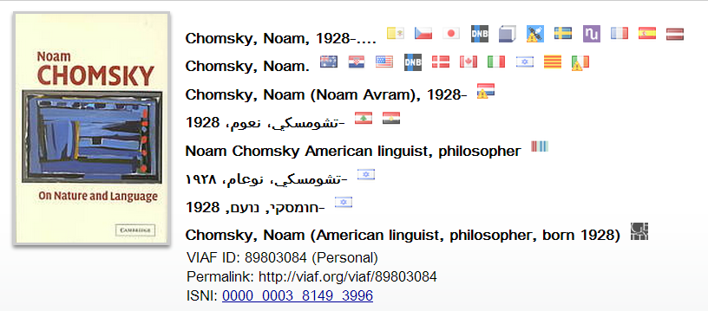
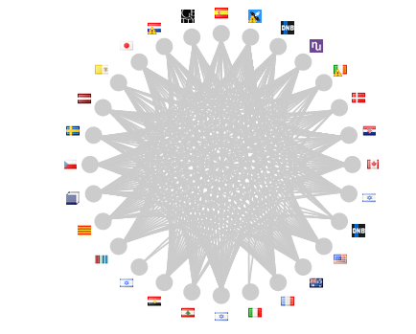

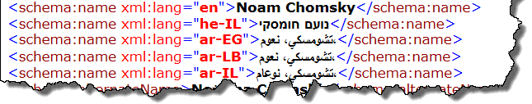
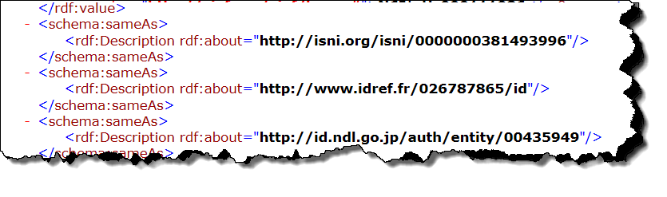
VIAF aggregates identifiers
Notes:
Each of the sources contributing to VIAF has its own identifier, so VIAF can be viewed as an “ID aggregator”. This is the VIAF cluster for Noam Chomsky. VIAF publishes this information as linked data. <Click> This RDF states this is for a person. <Click> This RDF shows the different languages representing this person – further annotated with a geographic location, in this case Arabic in Egypt, Lebanon and Israel. This can be useful when multiple countries use the same language and writing system but with variations. Think of the differences in British or Canadian English and American English. <click> And the RDF gives the “same as” property for the identifier in each of the VIAF contributing sources .

Slide 27

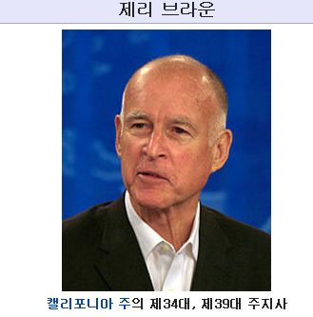
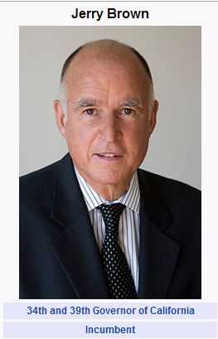



Wikidata disseminates identifiers
Notes:
Wikidata not only aggregates identifiers but also disseminates them. In this case, the VIAF identifier in Wikidata is also included in <click> the English Wikipedia and the <click> Korean Wikipedia page for Jerry Brown, our California governor.

Slide 28
OCLC’s 2015 International Linked Data survey
Source: Karen Smith-Yoshimura
Notes:
80 respondents; not a scientific sample; repeat of survey conducted in 2014. Karen will talk more about this at the CNI meeting in April. She will give a view of the tabulated responses.
I’m going to do something different and complementary. Look at the corpus of linked data sites mentioned to try to understand why linked data is interesting to the library community and how mature the efforts are.

Slide 29
2015 responding institutions by type
71 institutions total
Notes:
This is how I categorized the responding institutions, but others may do it differently.
National Libraries which responded (14): Biblioteca. Real Academia Nacional de Medicina, Bibliotheque nationale de France, British Library, German National Library, Koninklijke Bibliotheek, Library of Congress, National Diet Library, National Library of Malaysia, National Library of Medicine, National Library of Portugal, National Library of Spain, National Library of Sweden, National Library of Wales, National Széchényi Library [Hungary]
Categorized as “network” (10): ABES, BIBSYS, Consorci de Serveis Universitaris de Catalunya, Digital Public Library of America, Europeana Foundation, Haute école de gestion de Genève (SwissBib), North Rhine-Westphalian Library Service Center, OCLC, RERO - Library Network of Western Switzerland, and The European Library.
Government (7): Agencia Española de Cooperación Internacional para el Desarrollo (AECID). Biblioteca della Camera dei deputati (Italy), Biblioteca Valenciana Nicolau Primitiu, Biblioteca Virtual de Derecho Aragonés, Consejería de Educación, Cultura y Deportes Gobierno de Castilla-La Mancha, España, Diputación de Málaga. Cultura y Deportes. Biblioteca Cánovas del Castillo, Ministry of Defense (Spain)
Scholarly (based at one institution but multi-institutional on a theme/discipline) (6): Big Data Institute [Muninn Project, Canadian Writing Research Collaboratory]; Colorado State [datasets from the NSF-funded Shortgrass Steppe-Long-Term Ecological Research station in northern Colorado, for researchers in natural sciences]; Fundacción Ignacio Larramendi (Spain); Pratt Institute [Linked jazz]; University of Alberta Libraries [Canadiana, partners with Pan-Canadian Documentary Heritage Network]; University of Applied Sciences St. Poelten [encyclopedic music data for music magazines, legal information for publishers and semantic tagging/indexing for video files at community TV network.]
Public library/libraries (5): Anythink Libraries, Arapahoe Library District, Evansville Vanderburgh Public Library, New York Public Library, Oslo Public Library
Museum (3): British Museum, J. Paul Getty Trust, Smithsonian
Other: 1 publisher (Springer) and 3 societies (American Numismatic Society, Chemical Heritage Foundation, Minnesota Historical Society)

Slide 30
What is published as linked data
Notes:
Given the relatively large representation of libraries among respondents, no surprise that bibliographic and authority data are the most common types of data published, with descriptive metadata a close third.
Other: 5 of the 11 “other” were about organizational data; 2 were data about people (researchers, library staff). 1 about performance works (e.g., shows).

Slide 31

2015 linked data sources most consumed | 2015
VIAF (Virtual International Authority File) | 41
DBpedia | 36
GeoNames | 35
id.loc.gov | 35
Resources we convert to linked data ourselves | 17
Getty's AAT | 16
FAST (Faceted Application of Subject Terminology) | 15
WorldCat.org | 15
data.bnf.fr | 12
Deutsche National Bib Linked Data Service | 12
Notes:
These are the sources 12 or more of the 2015 survey respondents reported that they consumed. I’ve starred the ones which also responded to the survey. Note that “resources we convert to linked data ourselves” is one of the top linked data sources consumed. One advice from linked data implementers is to first consume the linked data you publish.
These could be considered successful publishers of linked data by the degree to which others consume the data provided.
Three of the twelve are OCLC linked data sources. VIAF is the #1 linked data resource consumed by the respondents, partially because so many more national libraries responded to the 2015 survey.

Slide 32
Solving problems & moving toward a linked data future

Slide 33
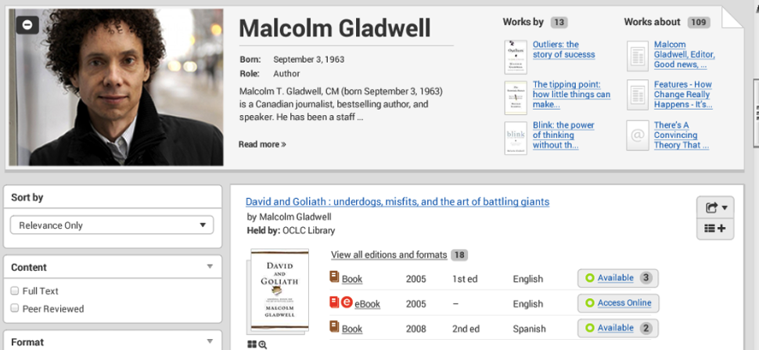
Improving the Discovery Experience
Mockup

Slide 34
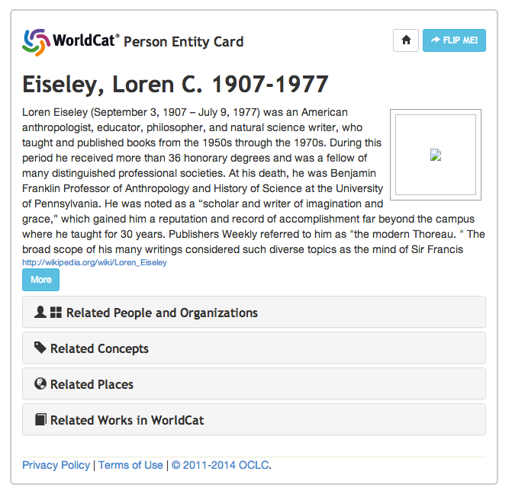


Slide 35
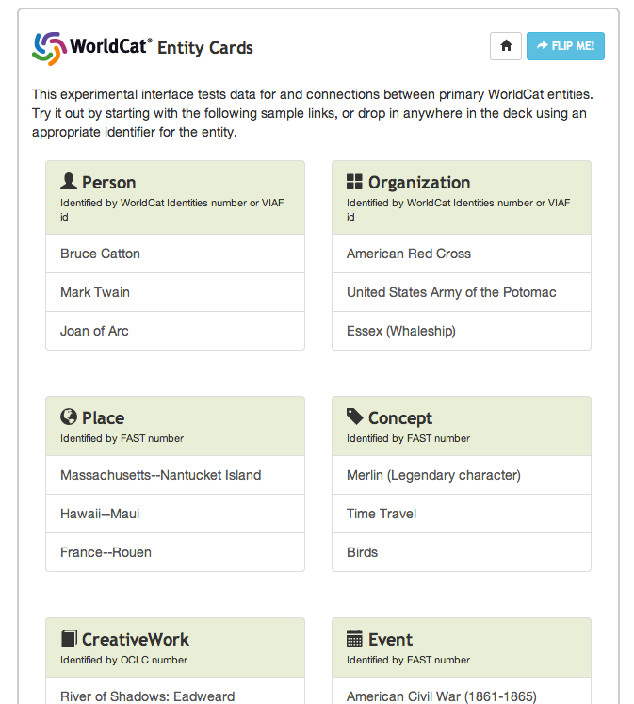

Slide 36
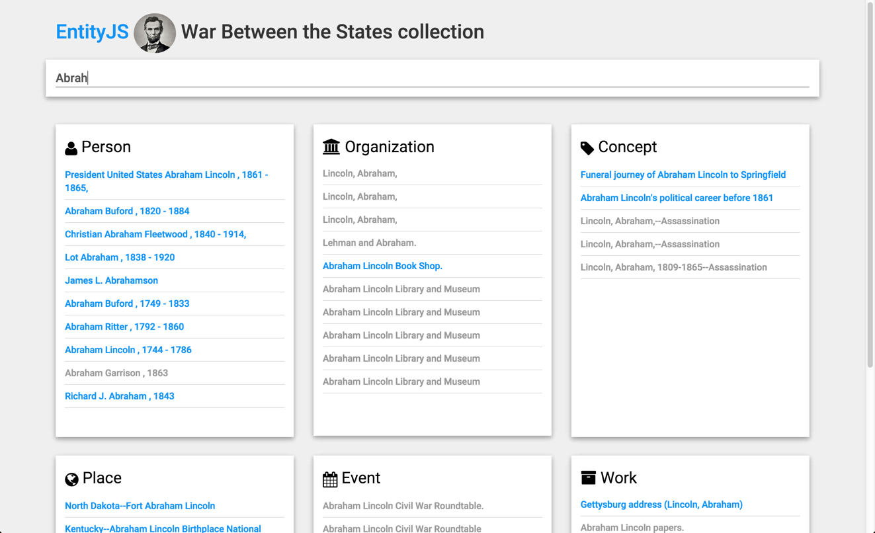

Slide 37
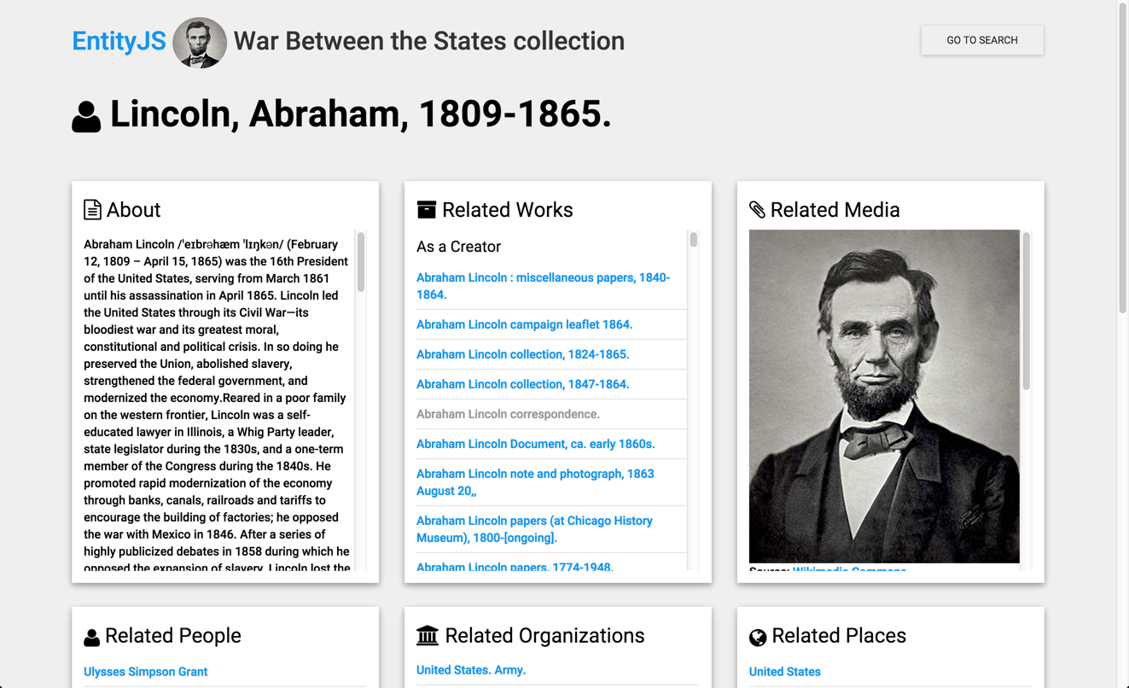
Exploring Ways to Use Linked Data

Slide 38
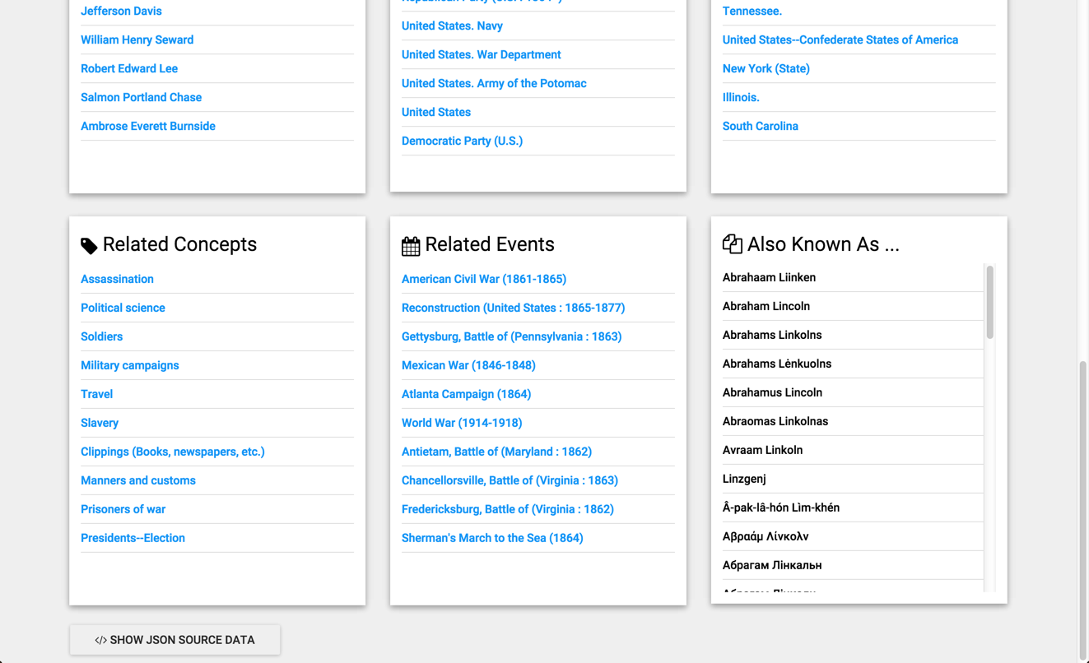

Slide 39
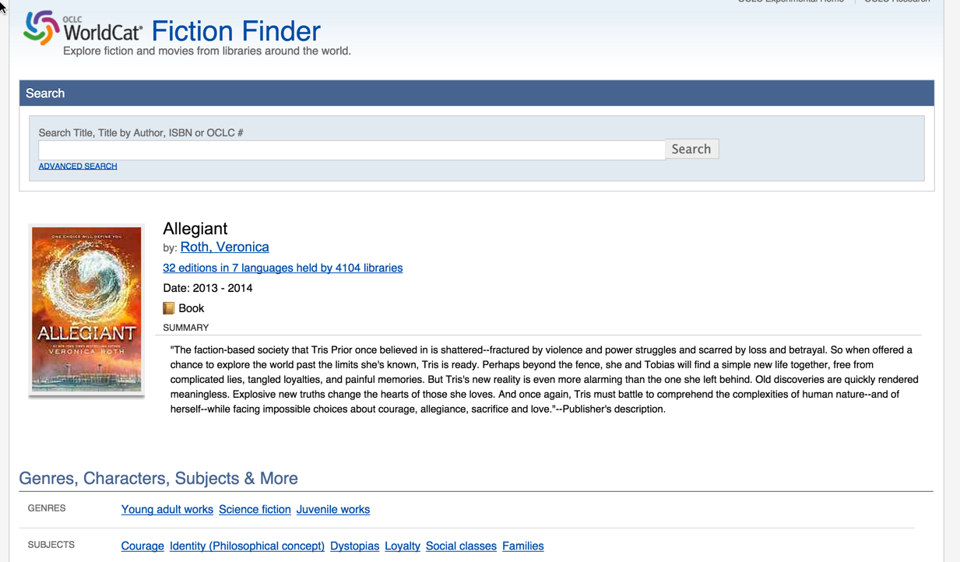
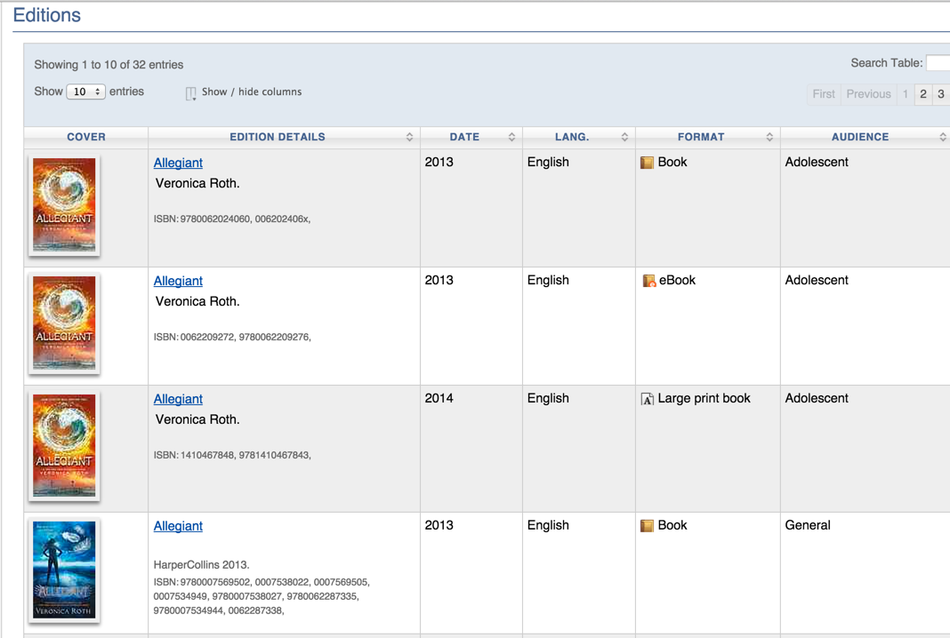
Solving the Title Problem!
Notes:
By using the concept of a “work” it is possible to aggregate all of the various manifestations of a title under one work depiction. This conceivably will allow users to use filters to locate the particular item they want, such as “show me only the books that are in English”, or “show me only the books that are on the shelf”.

Slide 40
Offering the right translation
Title: 西遊記
Language: Chinese
Author: 吳承恩
Created: 1592
HasTranslation:
Title: Journey to the West
Language: English
Translator: Anthony C. Yu
Date: 1977
IsTranslationOf:
Title: Pilgerfahrt
Language: German
Translator: Georgette Boner Date: 1983
IsTranslationOf:
Title: Journey to the West
Language: English
Translator: W. J. F. Jenner
Date: 1982-1984
IsTranslationOf:
Title: 西遊記
Language: Japanese
Translator: 中野美代子
Date: 1986
IsTranslationOf:
Title: Tây du ký bình khảo
Language: Vietnamese
Translator: Phan Quân
Date: 1980
IsTranslationOf:

Slide 41
Offering the right translation
Title: 西遊記
Language: Chinese
Author: 吳承恩
Created: 1592
HasTranslation:
Title: Journey to the West
Language: English
Translator: Anthony C. Yu
Date: 1977
IsTranslationOf:
Solving the Translation Problem!
Title: Pilgerfahrt
Language: German
Translator: Georgette Boner Date: 1983
IsTranslationOf:
Title: Journey to the West
Language: English
Translator: W. J. F. Jenner
Date: 1982-1984
IsTranslationOf:
Title: 西遊記
Language: Japanese
Translator: 中野美代子
Date: 1986
IsTranslationOf:
Title: Tây du ký bình khảo
Language: Vietnamese
Translator: Phan Quân
Date: 1980
IsTranslationOf:

Slide 42
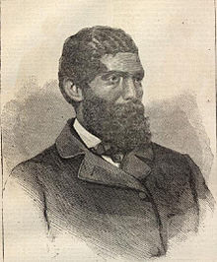
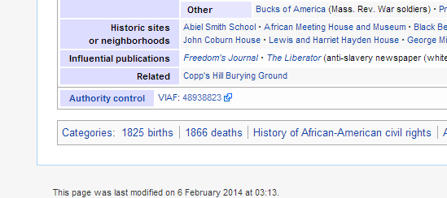
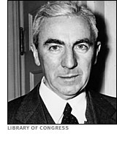
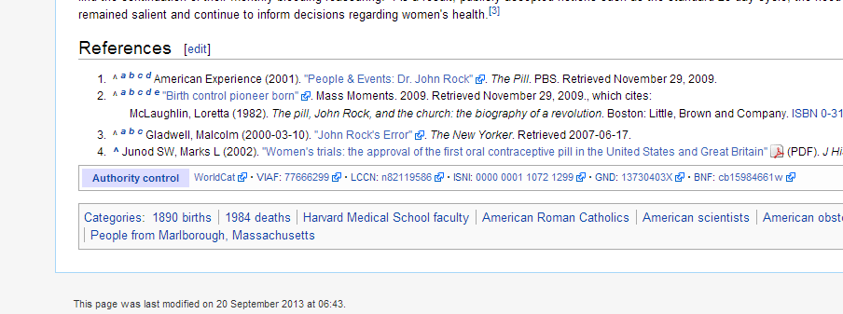
Bringing Authority Control to the Web
Solving the Name Problem!

Slide 43
Prototyping New Services
Person Lookup Service – An experimental service for looking up OCLC Person Entities
Scenario:
A library wants to disambiguate a name
It sends the name text string to our API
We check all of our aggregated authority files and send back the best match(es)
Each response comes with one or more URIs (e.g., to LCNAF, Wikidata, ISNI, etc.)
The library inserts this data into their record, turning a text string into an actionable link on the web
Notes:
The second is the Person Lookup Service. This was a prototype service, used in a pilot study, that provided a means for users to lookup People and pull back string labels and descriptions (across a wide range of languages) as well as sameAs links to outside resources that described the Person. A good example of this would be finding the Person Abraham Lincoln. The service could provide you names and descriptions for him in 15+ languages as well as links to URIs in other datasets for him (such as LAC, WikiData, DNB, BNF, etc.)

Slide 44



Prototyping New Services
Person Lookup Service – An experimental service for looking up OCLC Person Entities
Text String API
<text string>
Janet Adam Smith
Name Authority File 2
Janet Smith
Janet A. Smith
Janet B. A. Smith
Name Authority File 1
Name Authority File 3
Janet B. Adam Smith
Name Authority File 4
Notes:
The second is the Person Lookup Service. This was a prototype service, used in a pilot study, that provided a means for users to lookup People and pull back string labels and descriptions (across a wide range of languages) as well as sameAs links to outside resources that described the Person. A good example of this would be finding the Person Abraham Lincoln. The service could provide you names and descriptions for him in 15+ languages as well as links to URIs in other datasets for him (such as LAC, WikiData, DNB, BNF, etc.)

Slide 45
In Summary: Why Linked Data?
A better user experience
Greater Web visibility
Develop better models of resources not well served by current standards
Replicate existing library functions more cheaply and efficiently
Improve data integration
Improve internal data management
Notes:
From the survey participants
Triangle represents: level of effort; visibility of user-apparent benefit. Looks like an iceberg. Lots of invisible effort. But it accumulates.
Bottom tier:
Essentially a technology assessment exercise.
Using URIs, not strings. Understanding and using data produced by third parties. Most of the datasets were from within the library community. Respondents reported that third-party datasets were too small and too unstable; semantics too hard to understand.
BNF – connecting data resources that were in siloes before. Monographs + archives and digital descriptions.
Oslo Public Library – reports a success
Middle tier:
Europeana; Digital Public Library of America
Many smaller projects around digitization and archives—National Diet library
Top tier:
Scattered comments. Needs were met, but didn’t say how.
SEO improvements. Best example is BNF. Montana State University report at CNI in April.
Small-scale experiments with the user experience. Best example is Linked Jazz. Popular on the conference circuit in the U.S.

Slide 46
Easing the transition

Slide 47
Collaborating on BIBFRAME
Working with the Library of Congress and others to finalize the BIBFRAME standard
Beginning to explore what working with it at scale will mean

Slide 48
Working With the Web
Modeling bibliographic data using Schema.org
Collaborating on expanding the Schema.org with additional bibliographic elements at bib.schema.org
Syndicating WorldCat data to search engines using Schema.org markup

Slide 49
Learning About Changing Workflows
Photo by https://www.flickr.com/photos/sanjoselibrary/ - CC BY-SA 2.0
Notes:
Working with partners such as the UC Davis BIBFLOW project and the Linked Data for Libraries (LD4L) project to understand how linked data changes our work

Slide 50
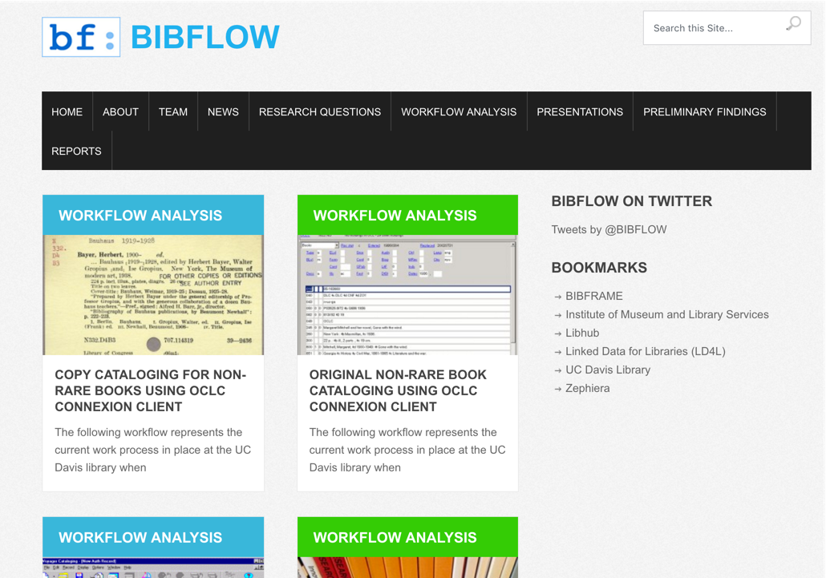

Slide 51
Making MARC “Linked Data Ready”
Least machine-processable
If you must use free text:
Use established conventions
Use standardized terms
Algorithmically recoverable
Use the most specific fields appropriate for a descriptive task
Minimize the use of 500 fields
Obey field semantics
Avoid redundancy
Most machine-processable
Use uniform titles
Use added entries with role codes (7xx and $4)
Use 041 for translations, including intermediate translations
Use indicators to refine the meaning
Notes:
The list of recommendations can be organized into a sort of metadata “food pyramid.” Those at the top may be necessary, but should be used sparingly. Those further down should form the foundation of practice, if the goal is improved machine understanding of MARC metadata.

Slide 52

Working With the PCC To Make MARC LD Ready
‘Work’ Task Force
Analyze the ‘Work’ definitions referenced in library linked data.
How are they similar or different?
How do they relate to the classic FRBR definition?
What are the use cases for ‘Work?’
How should Work URIs be represented in MARC records?
‘URI’ Task Force
What are the best practices for adding URIs to MARC records to ease the conversion to linked data?
How will cataloging or resource description workflows be affected?
Notes:
Both committees are due to deliver recommendations later in 2017.

Slide 53
Summary Remarks
We are in a major transition that will take YEARS to navigate
We don’t know yet exactly what the future holds…
...but we know that it will be more linked and machine actionable (not just readable) than ever before
And that’s a Good Thing

Slide 54
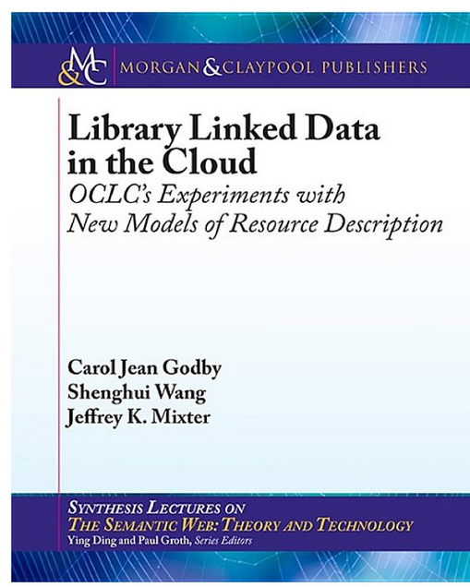
For More Information

Slide 55

IATUL • 20 June 2017
Thank you!
Roy Tennant
@rtennant
tennantr@oclc.org
facebook.com/roytennant
©2017 OCLC. This work is licensed under a Creative Commons Attribution 4.0 International License. Suggested attribution: “This work uses content from “Data Designed for Discovery” © OCLC, used under a Creative Commons Attribution 4.0 International License: http://creativecommons.org/licenses/by/4.0/.”

