Slide 1
14 May 2015, GILS User Group Meeting, Macon, GA
The Library Trifecta:
Collaboration, Innovation, and Empowerment
Roy Tennant

Slide 2
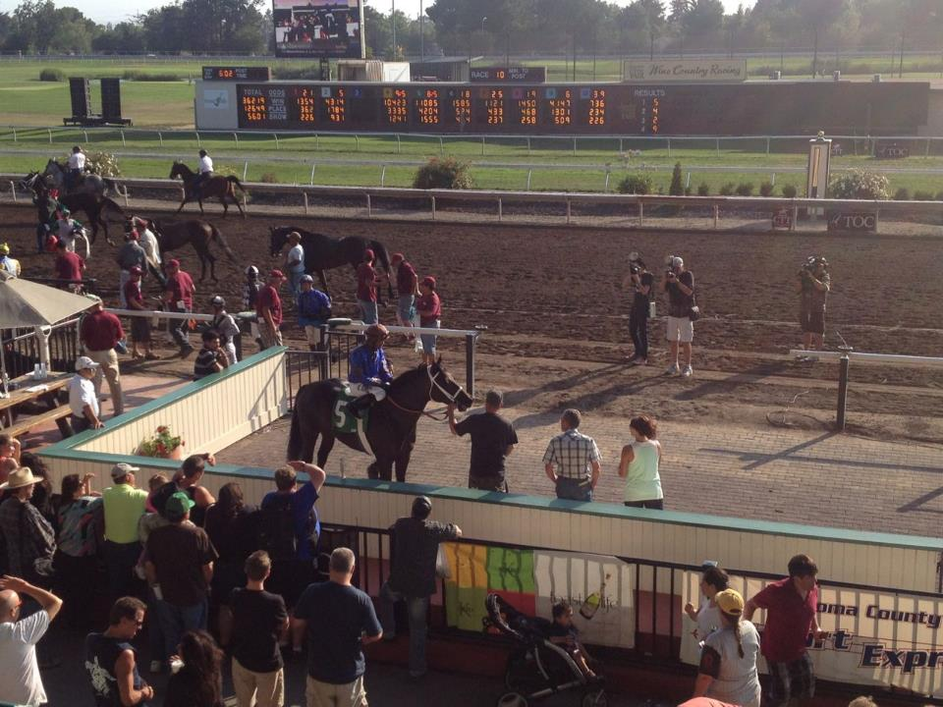
Trifecta: picking the top three winners in order.

Slide 3
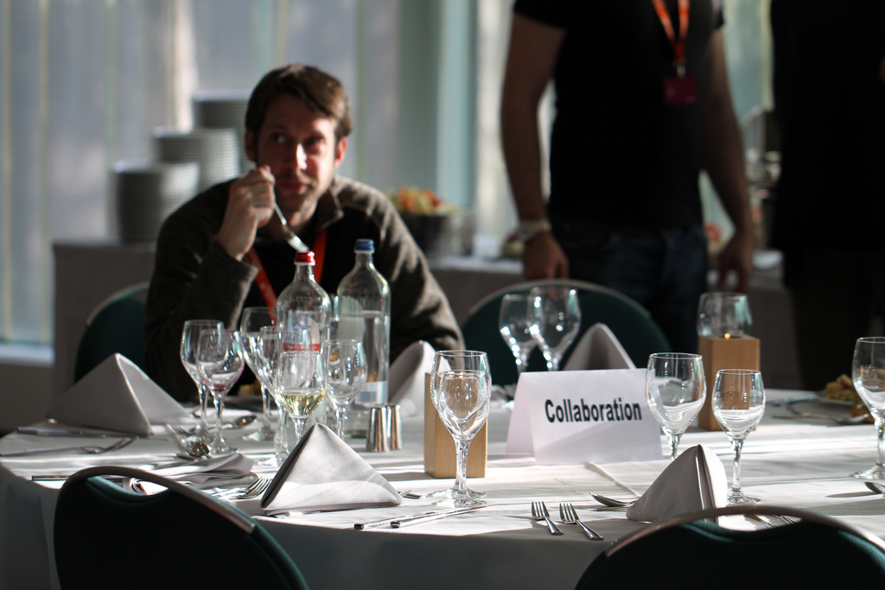
Part the First
Photo by Martin Pool, Creative Commons License CC BY 2.0

Slide 4
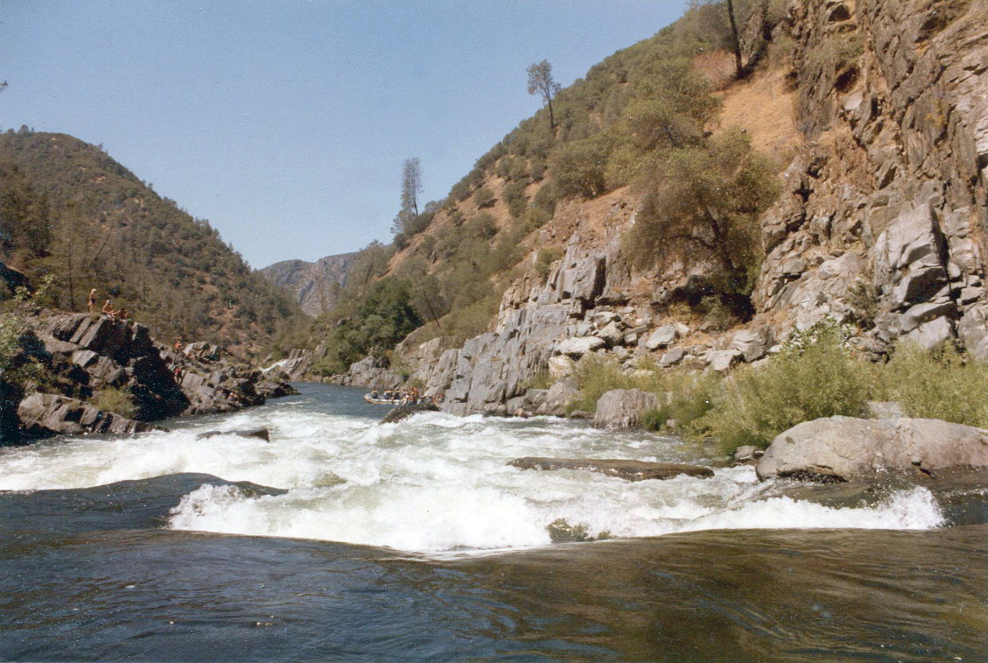
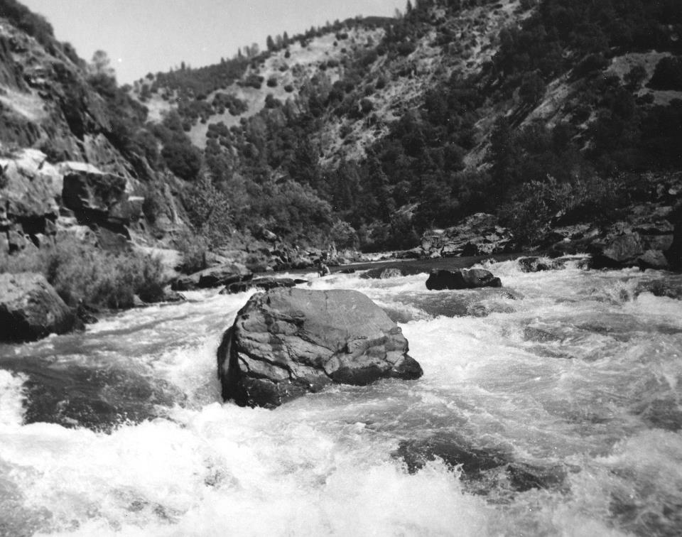

Slide 5
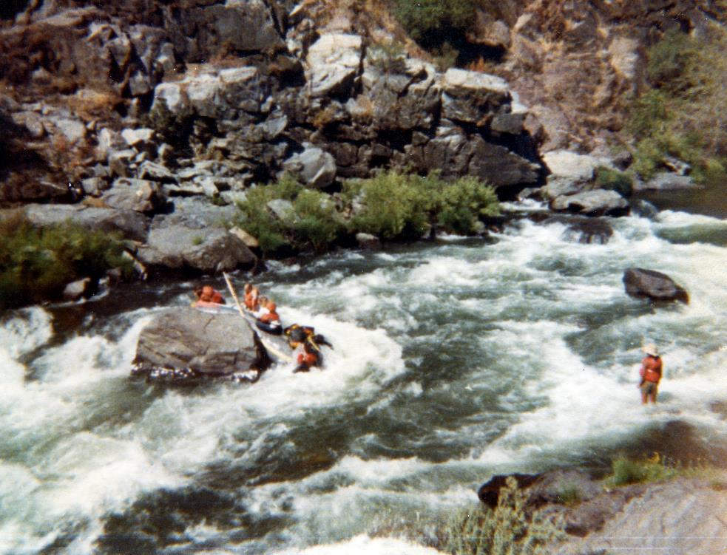
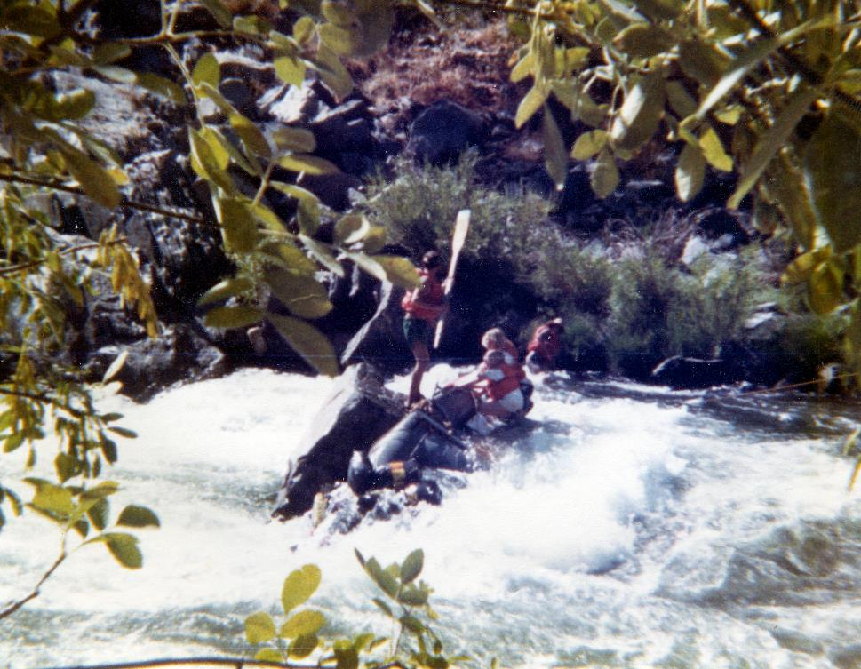
Me, AKA “The Idiot”

Slide 6
Creative Commons License BY-SA 2.0

Slide 7
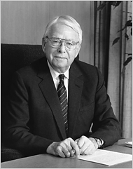
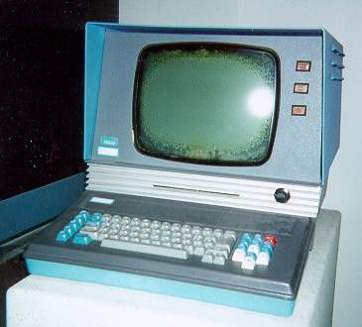
July 5, 1967 articles of incorporation signed to establish the non-profit Ohio College Library Center, OCLC.
Fred Kilgour, 1st Director
Photo by Michael Sauers, CC BY-NC 2.0

Slide 9
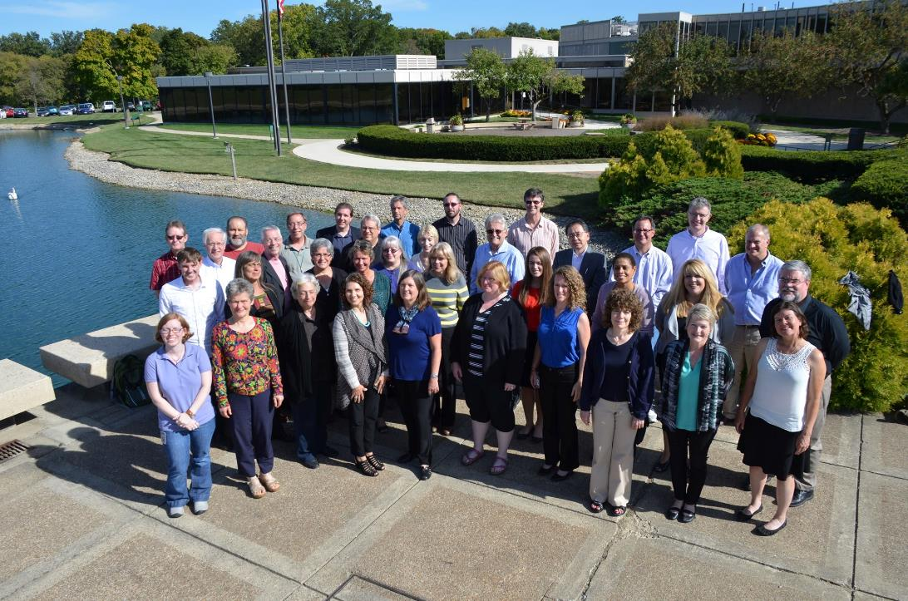

Slide 10
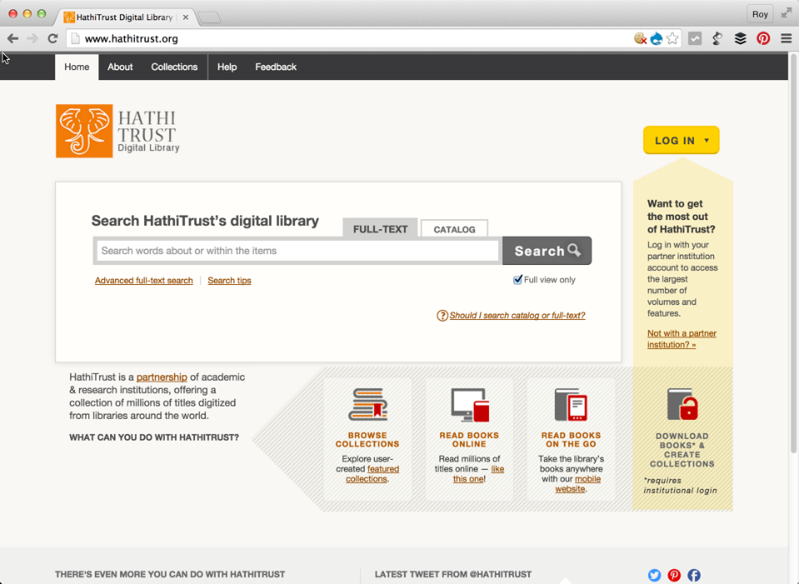

Slide 11
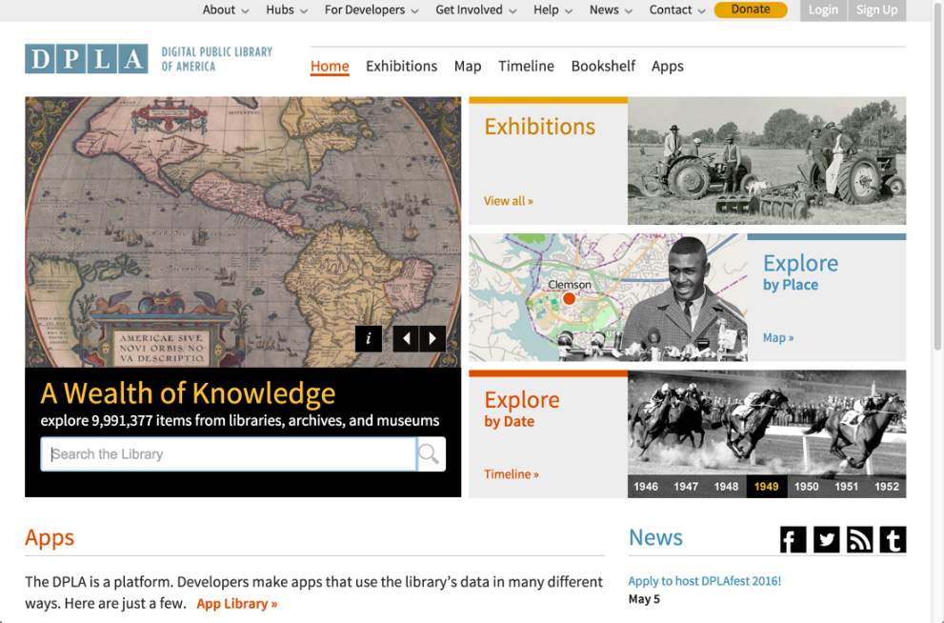

Slide 12
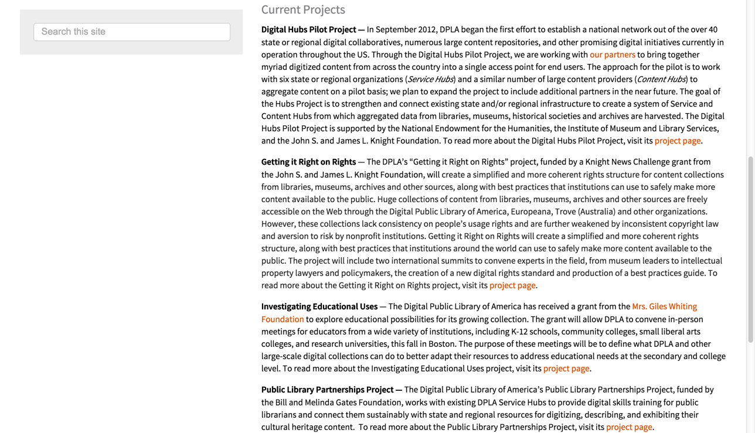

Slide 13
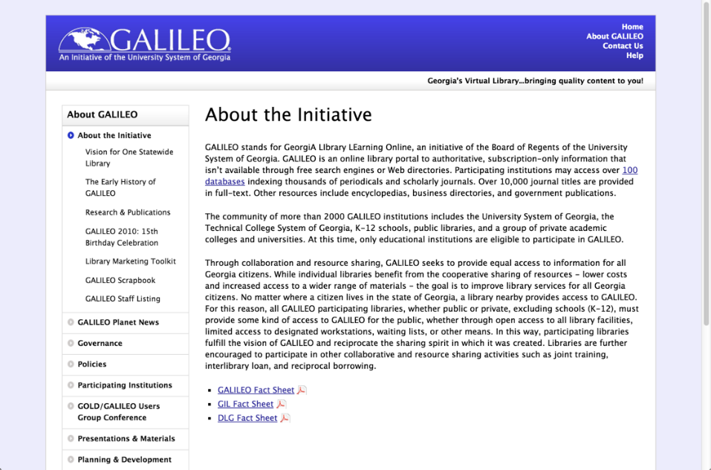

Slide 14
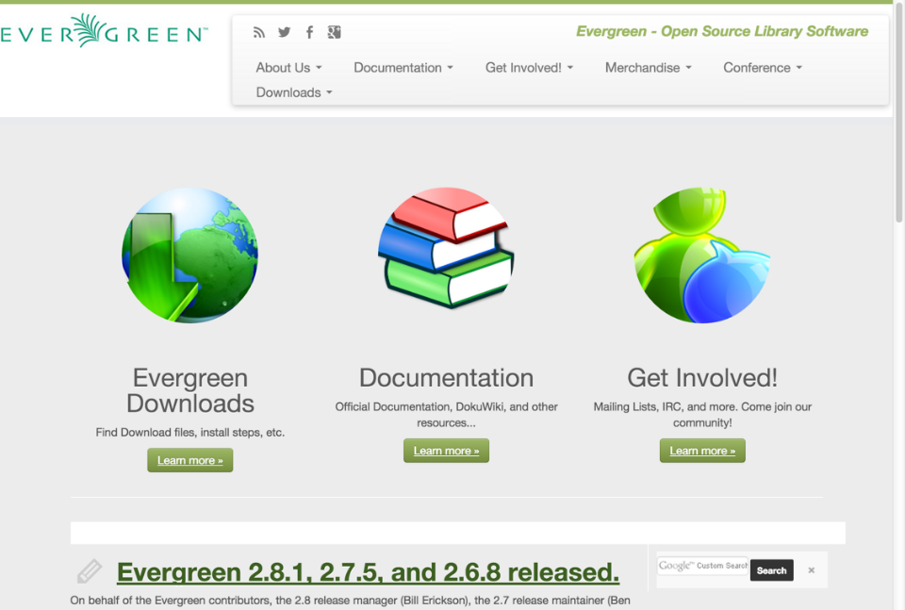
Over 1,200 libraries!

Slide 15
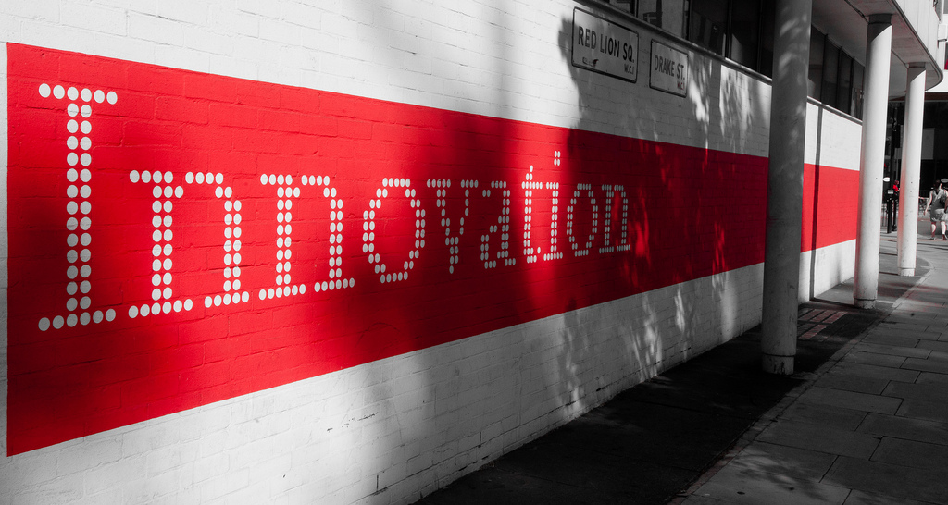
Part the Second
Photo by Boegh, https://www.flickr.com/photos/boegh/, CC BY-SA 2.0

Slide 16
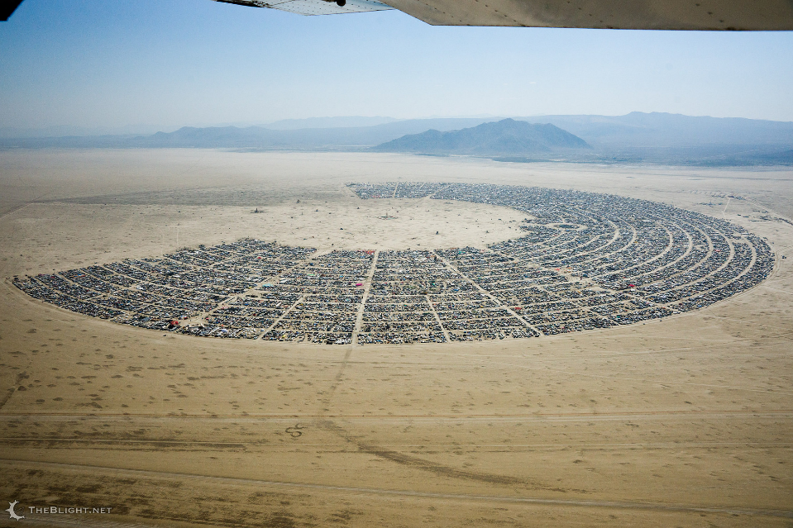
Photo by Neil Girling, https://www.flickr.com/photos/carnivillain/, CC BY-NC-ND 2.0

Slide 17
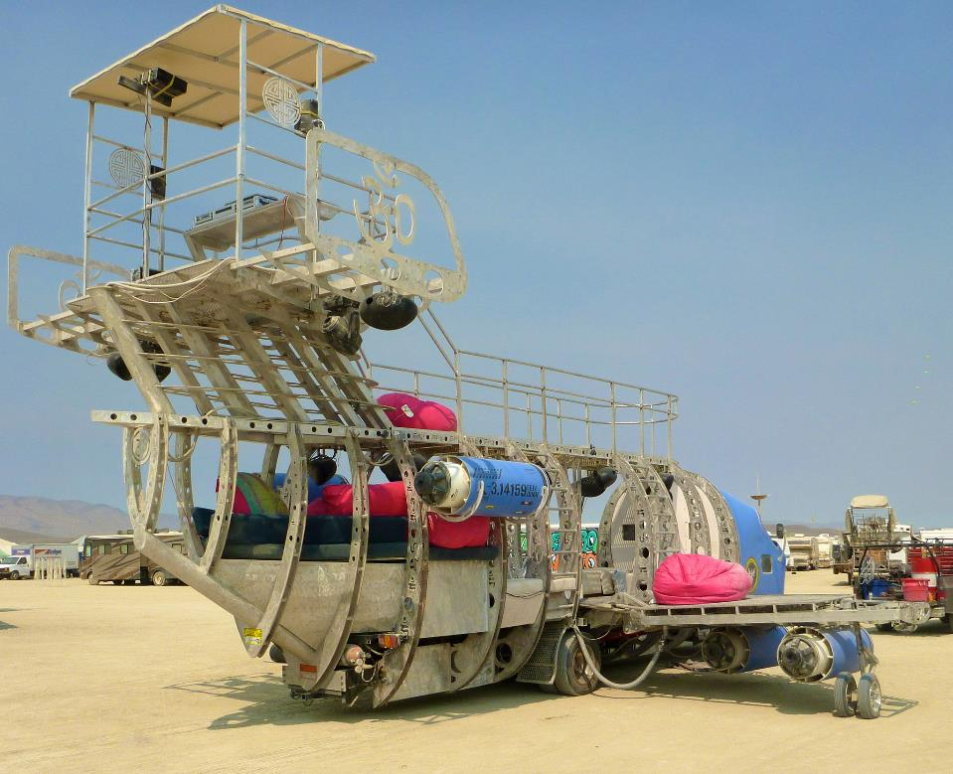
Photo by Steve Jurvetson, https://www.flickr.com/photos/jurvetson/, CC BY 2.0

Slide 18
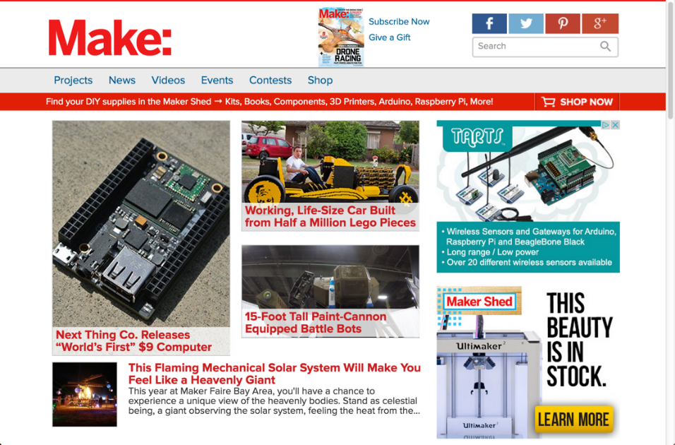

Slide 19
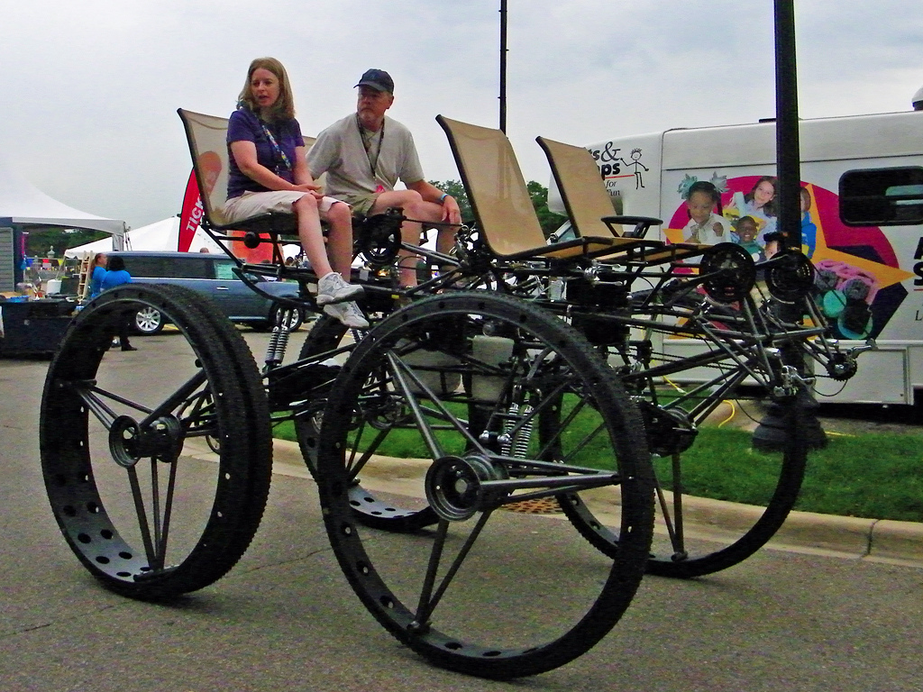
Maker Faire, San Mateo, CA
Image courtesy of Maia C, flickr.com/photos/maic/, CC BY-NC-ND 2.0 License

Slide 20
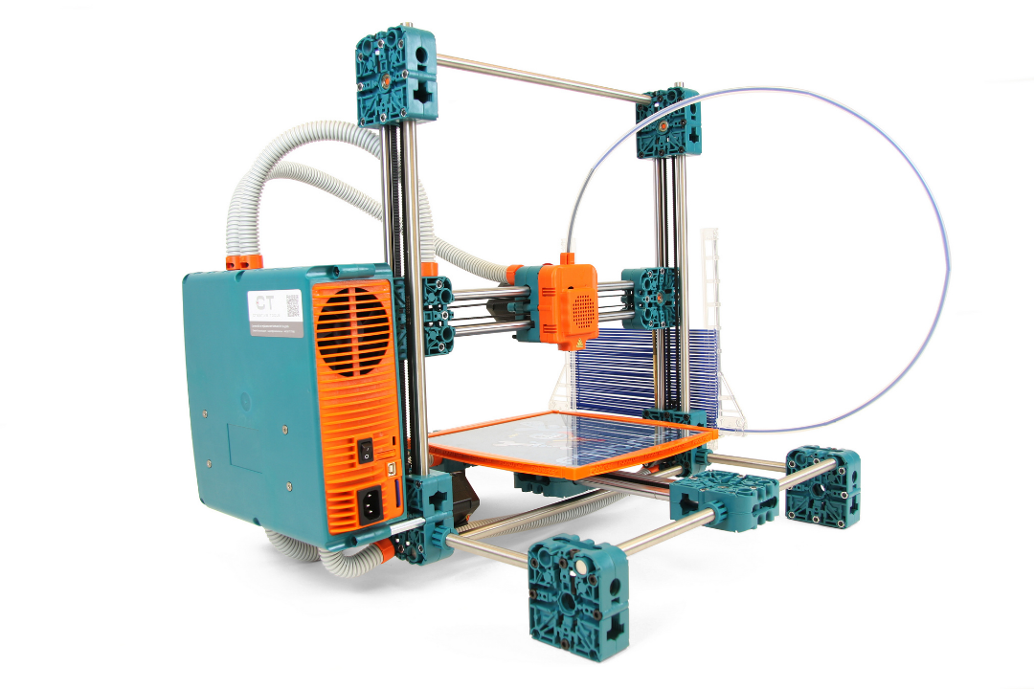
Photo by Creative Tools, https://www.flickr.com/photos/creative_tools/, CC BY 2.0

Slide 21
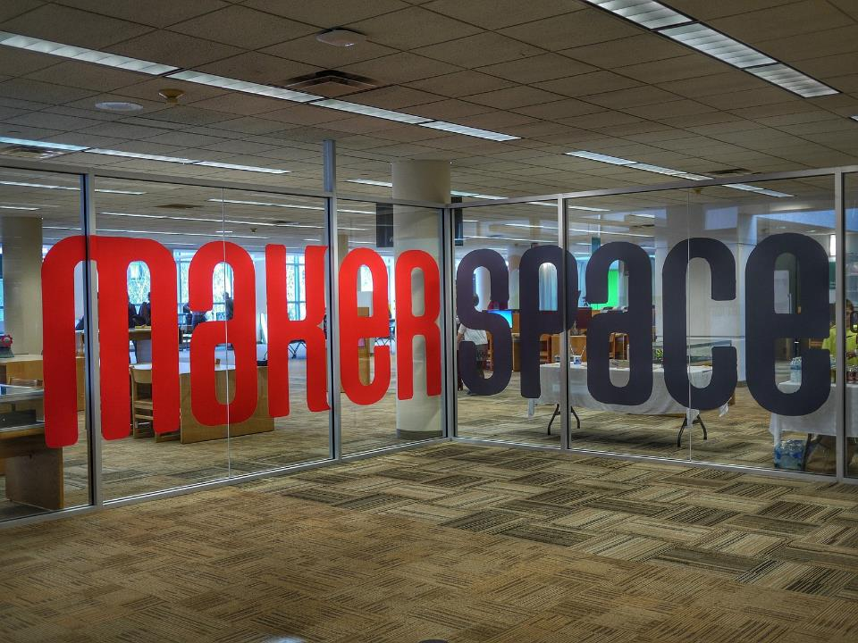
Photo by 5chw4r7z https://www.flickr.com/photos/5chw4r7z/ CC BY-SA 2.0

Slide 22
ALA Program on Makerspaces 2013

Slide 23
Empowering people to create things

Slide 24
Empowering people to create intelligent things

Slide 25
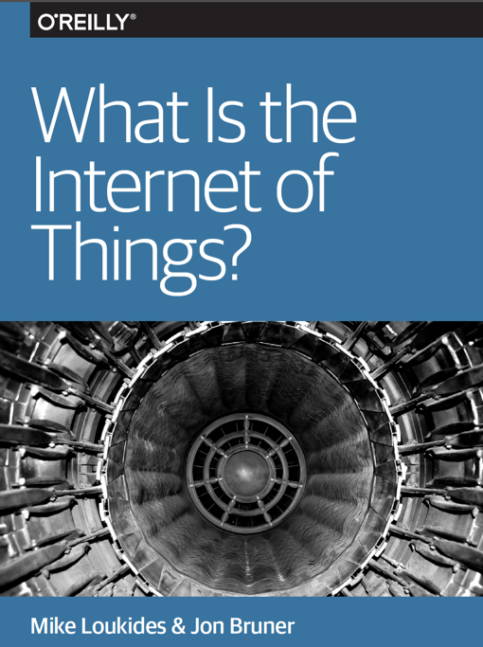
oreilly.com/iot/free/

Slide 26
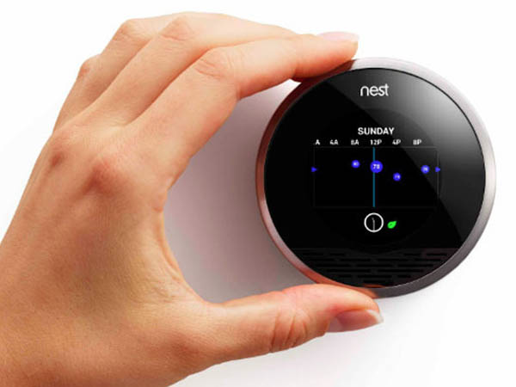
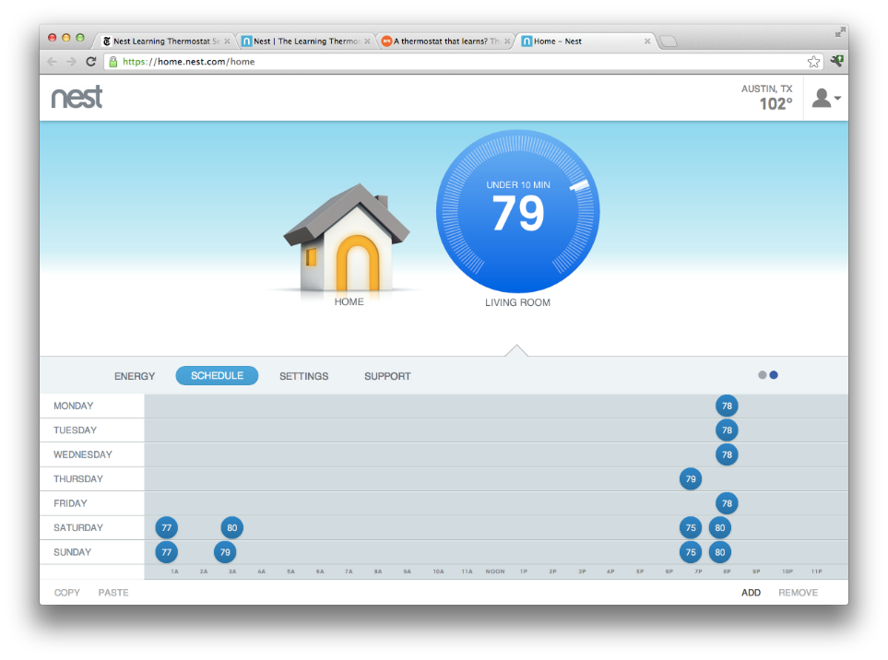

Slide 27
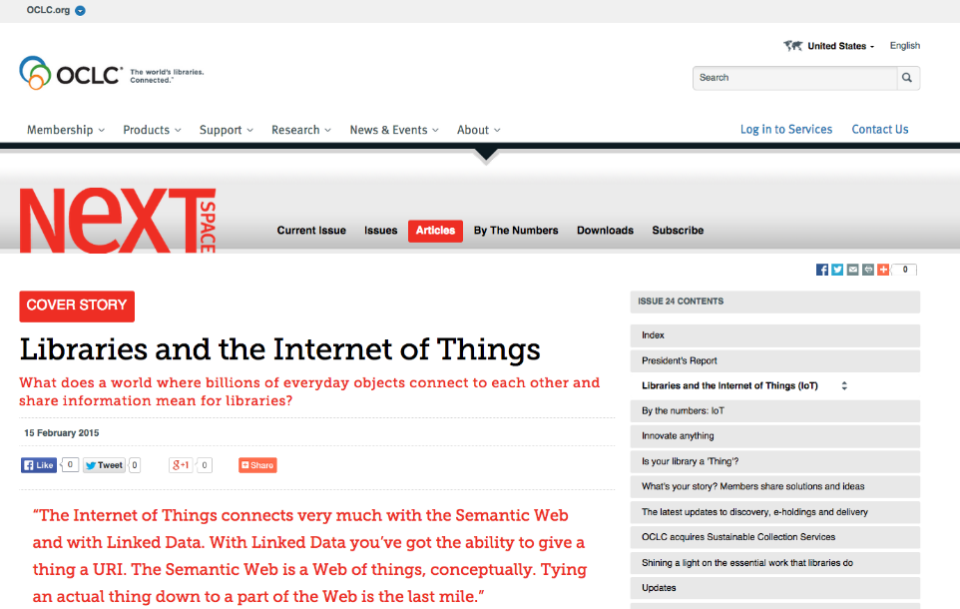

Slide 28
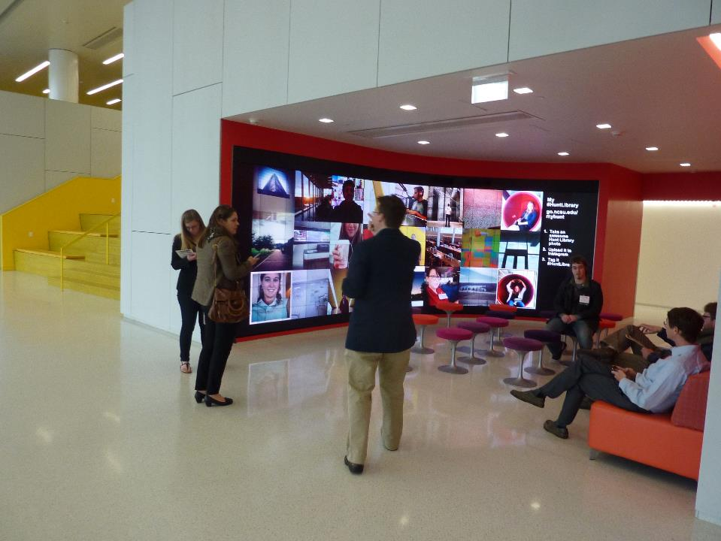
Repurposing space

Slide 29
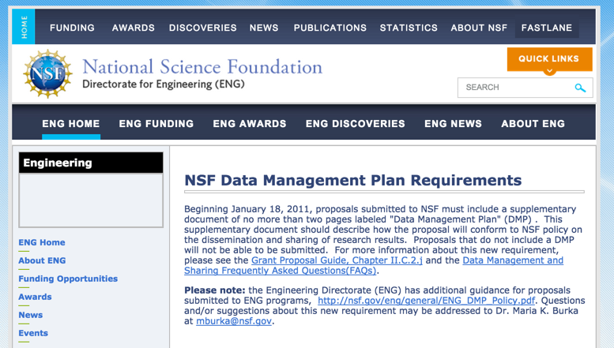
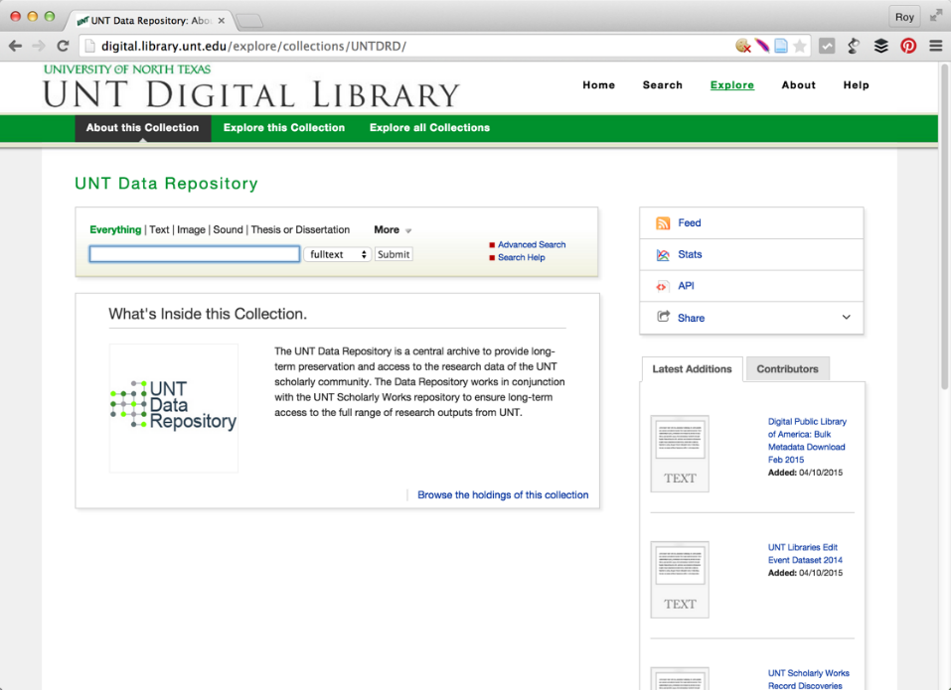

Slide 30
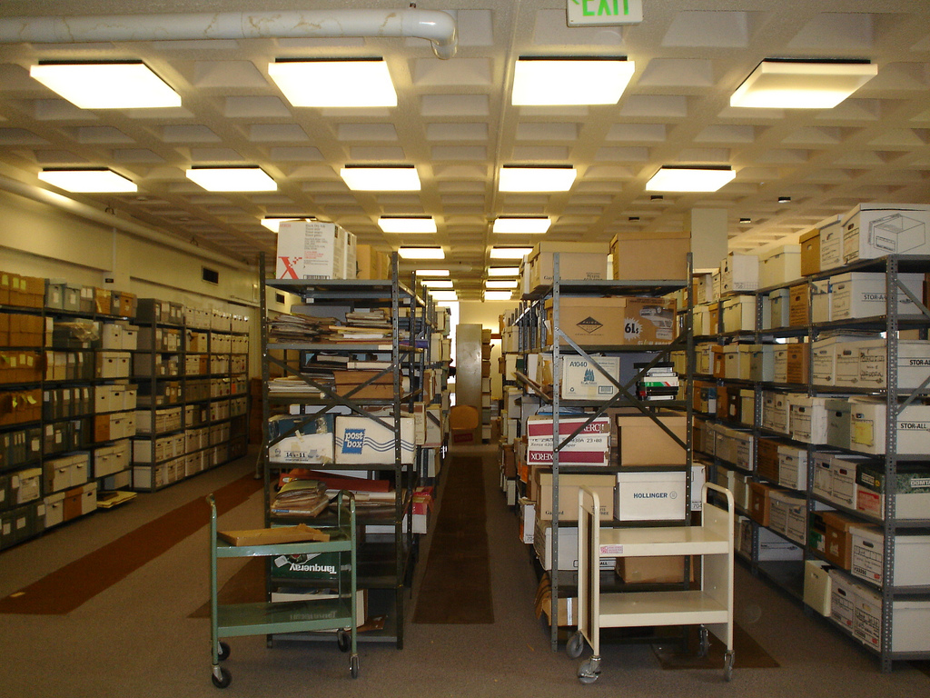
Maximizing the Impact of Special Collecitions
Photo by Langsdale Library, https://www.flickr.com/photos/langsdale/, CC BY-SA 2.0

Slide 31
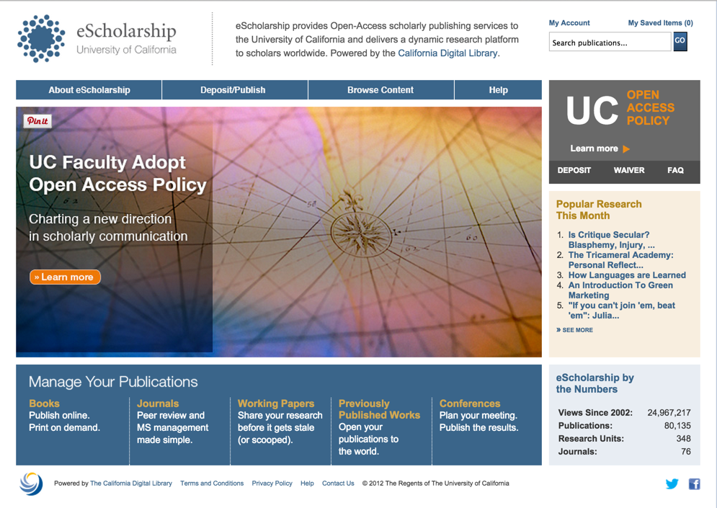
Participating in the Open Access Ecosytem

Slide 32
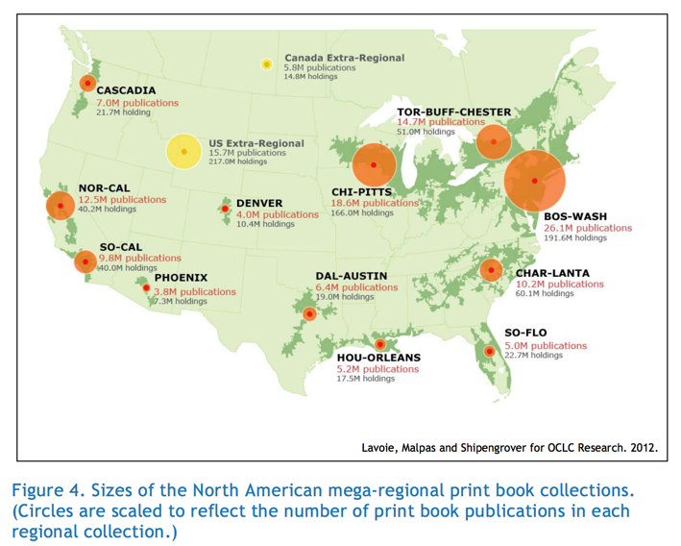
Managing Print Differently

Slide 33
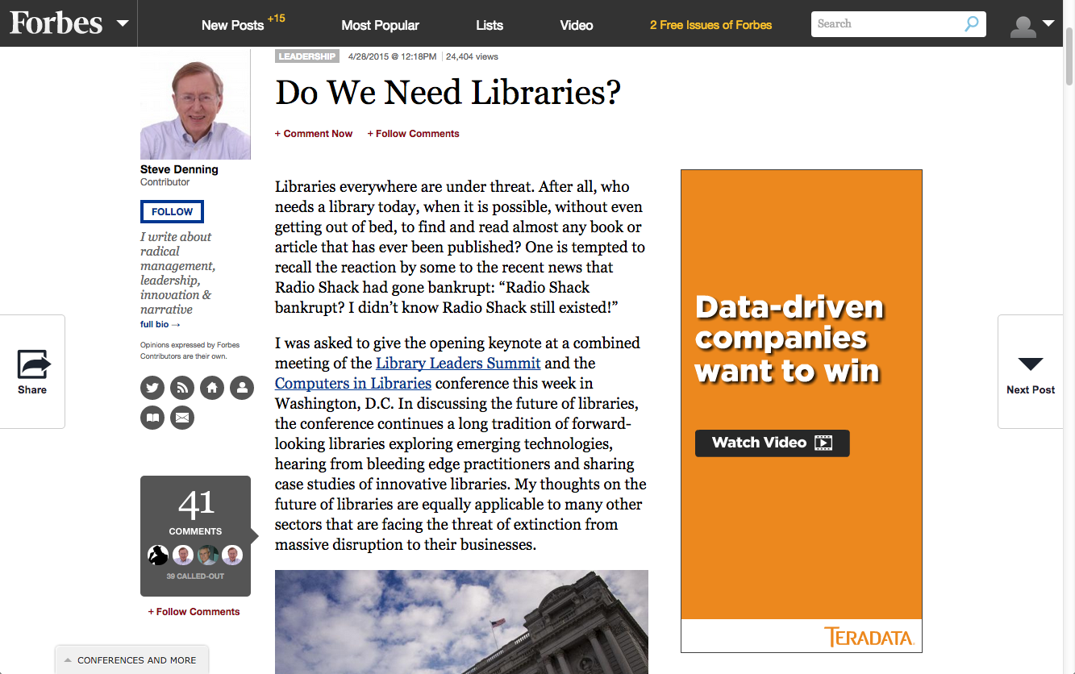

Slide 34
Five Questions
How can we delight our users and customers?
How can we manage the library to enable continuous innovation?
What will make things better, faster, cheaper, more mobile, more convenient or more personalized for our users?
What needs could libraries meet that users haven’t even thought of?
What are libraries currently doing that users already love?

Slide 35
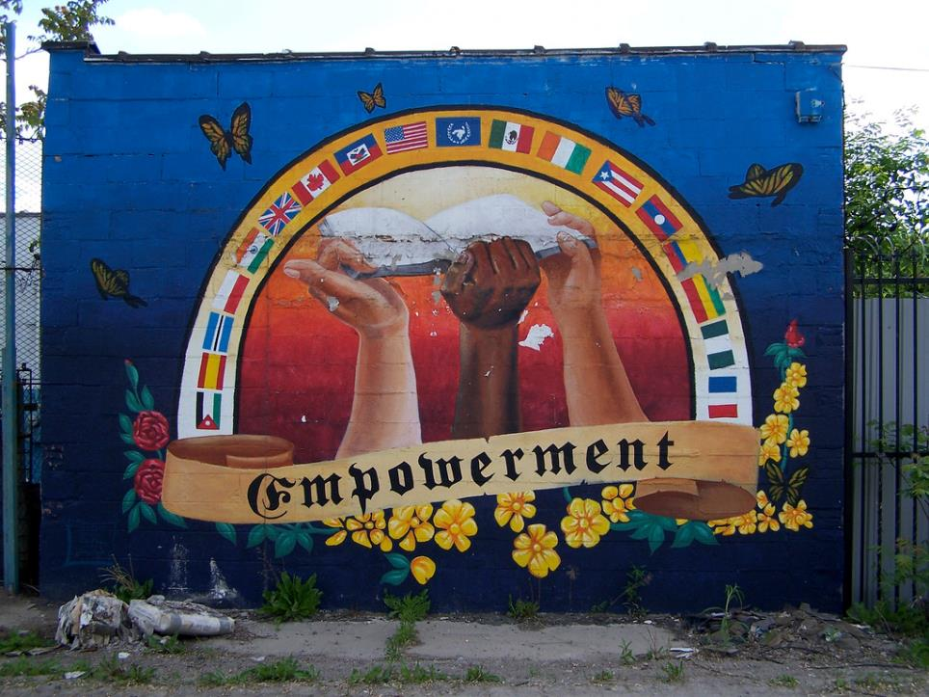
Part the Third
Photo by Tara, https://www.flickr.com/photos/taubuch/, CC BY 2.0

Slide 36
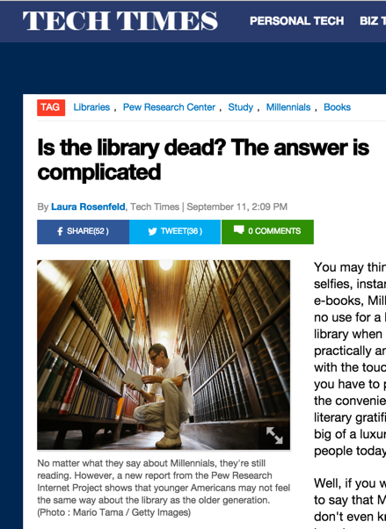
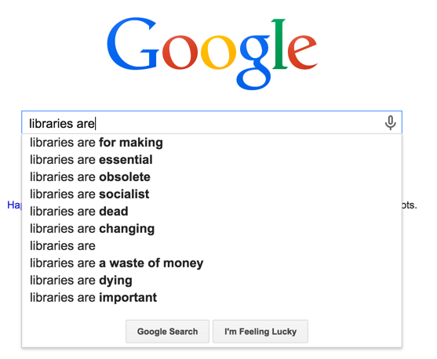
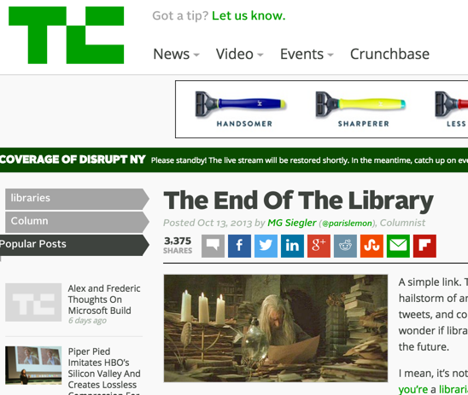
Rumors of Our Demise

Slide 37
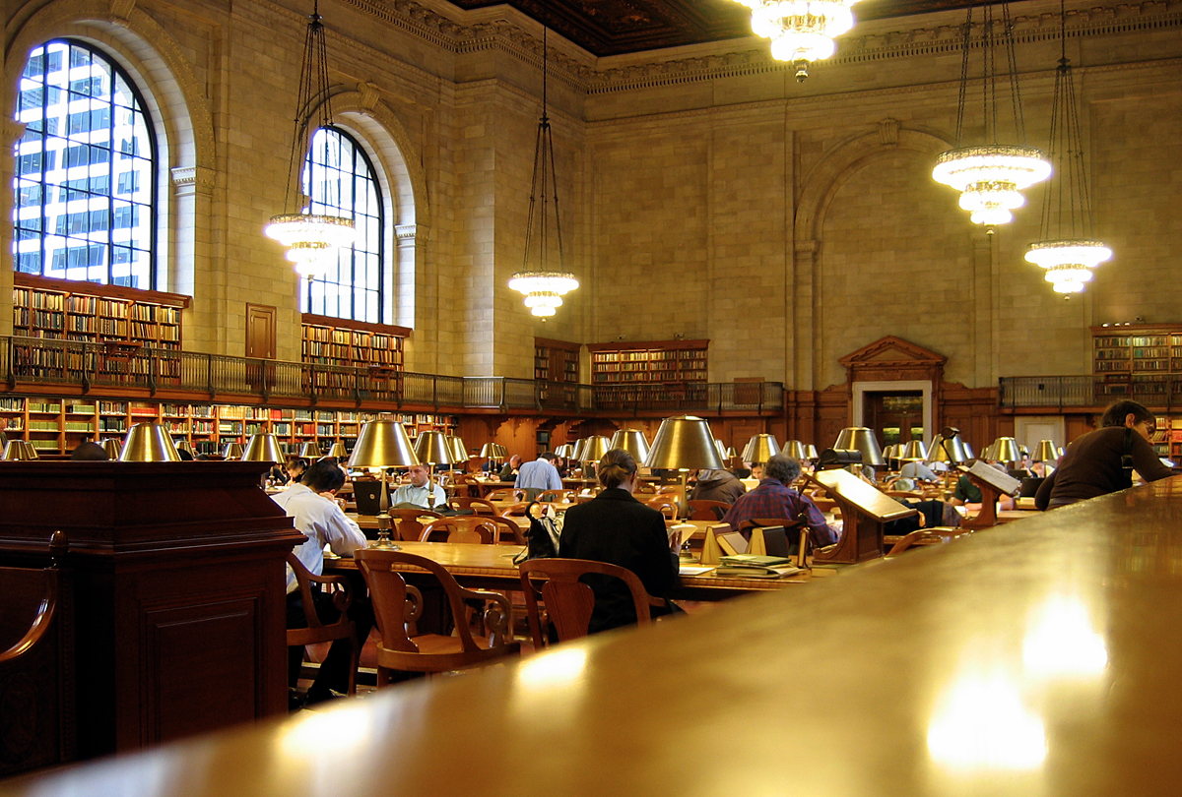
“…the city’s
libraries have more users than major professional sports, performing arts, museums, gardens and zoos — combined.”
The New York Times, 4/24/2015

Slide 38
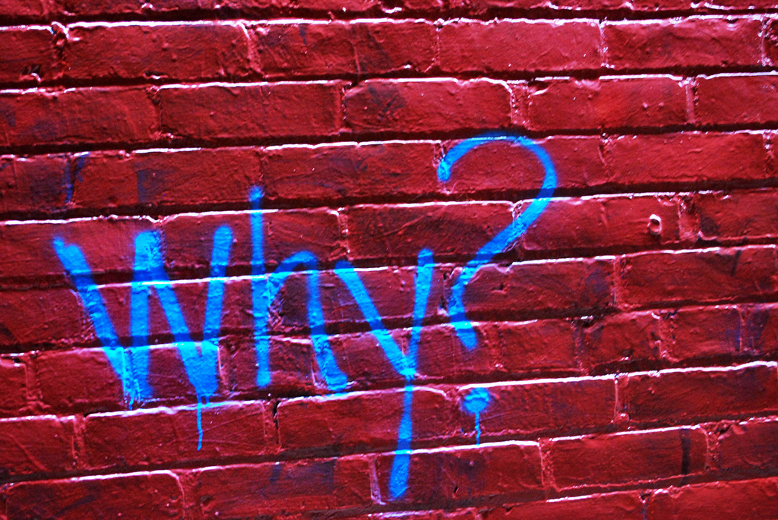
Photo by Katie Sayer, https://www.flickr.com/photos/ksayer/ CC BY-SA.20

Slide 39
The Birth of the American Free Library
Benjamin Franklin
Andrew Carnegie

Slide 40
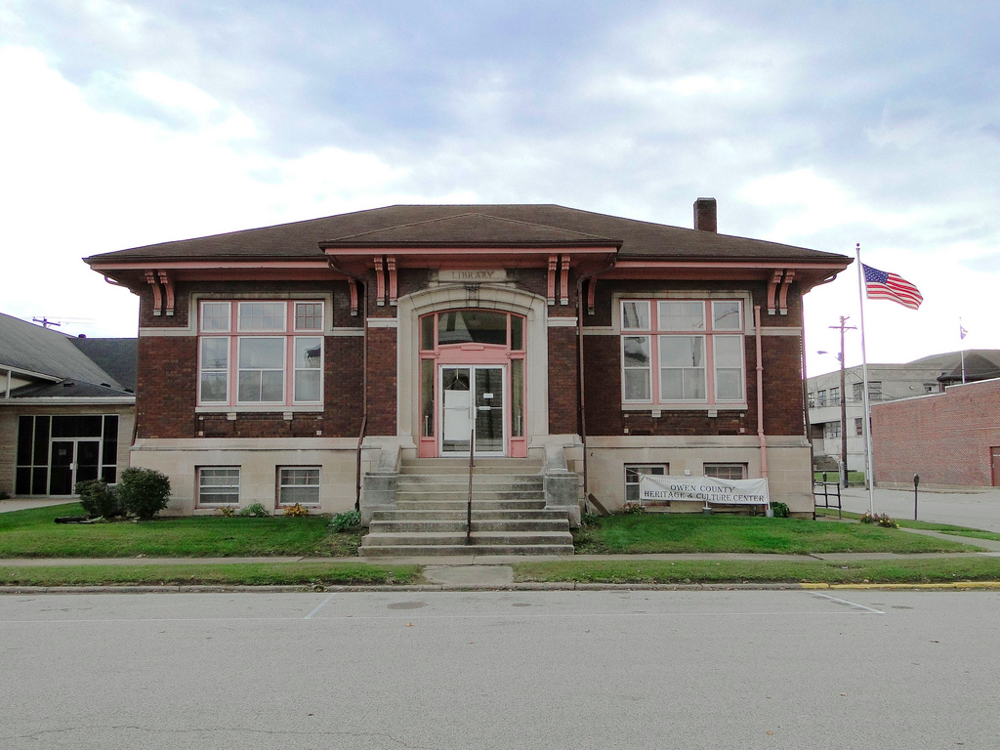
Photo by http://www.flickr.com/photos/w9ned/ License: CC BY-NC-ND 2.0

Slide 41
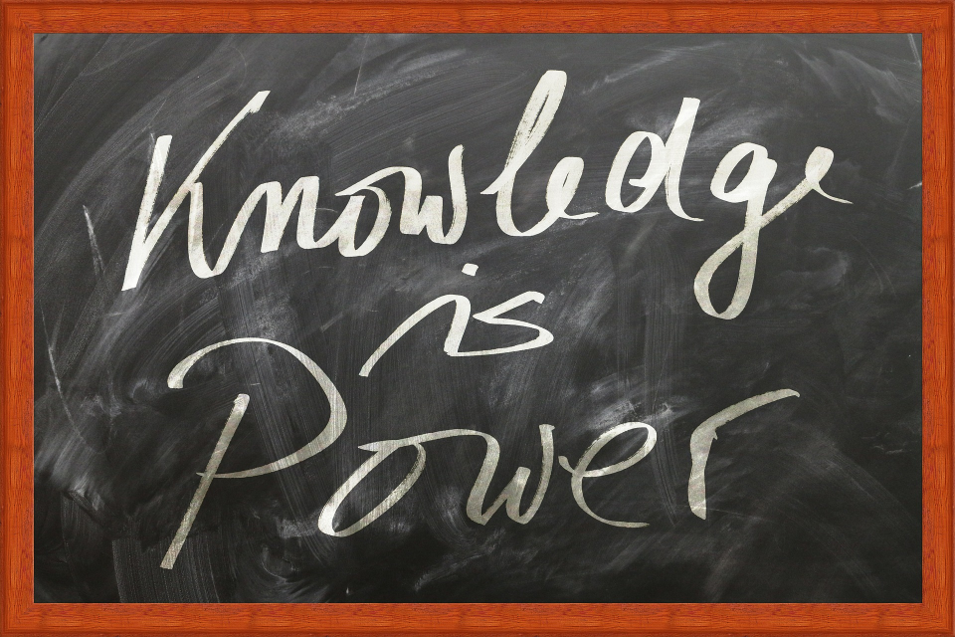

Slide 42
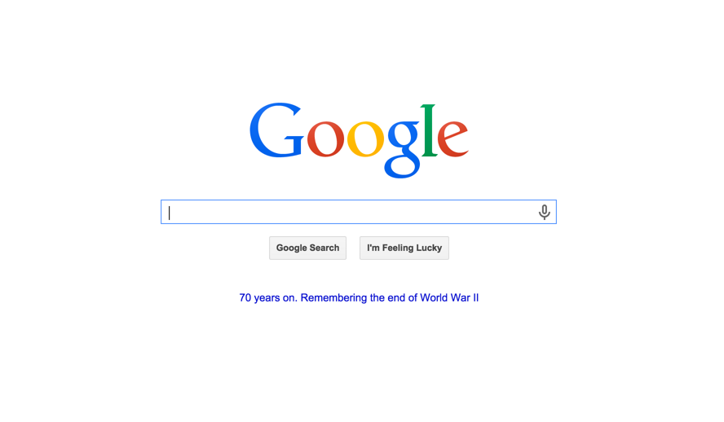
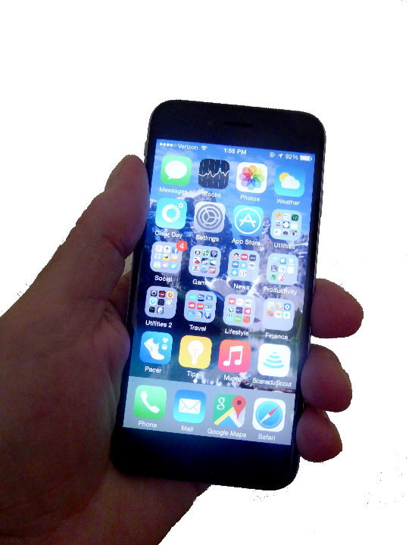

Slide 43
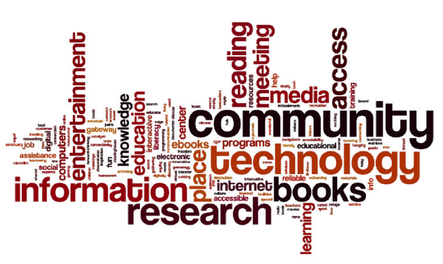
The Atlantic, October 6, 2014
Notes:
The Columbus Metropolitan Library first asked their users to describe the libraries of their youth, which produced the word cloud in the upper left. Then they asked them to describe the library twenty years from now, which produced the other word cloud. Notice how words like “community” and “technology” even trump the words “books” and “research” from the library of their youth.

Slide 44
Libraries empower individuals and the communities of which they are a part.

Slide 45
Roy Tennant
tennantr@oclc.org
@rtennant
facebook.com/roytennant/

