Slide 1
Leveraging WorldCat
Data Mining the Largest Library Database in the World
Roy Tennant
OCLC Research

Slide 2
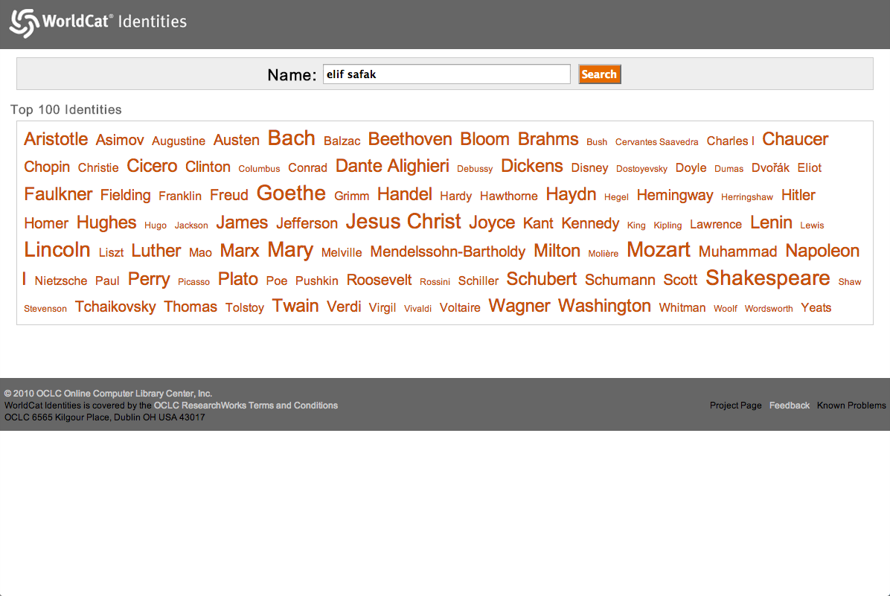
Algorithmically constructed
from WorldCat records
Worldcat.org/identities/

Slide 3
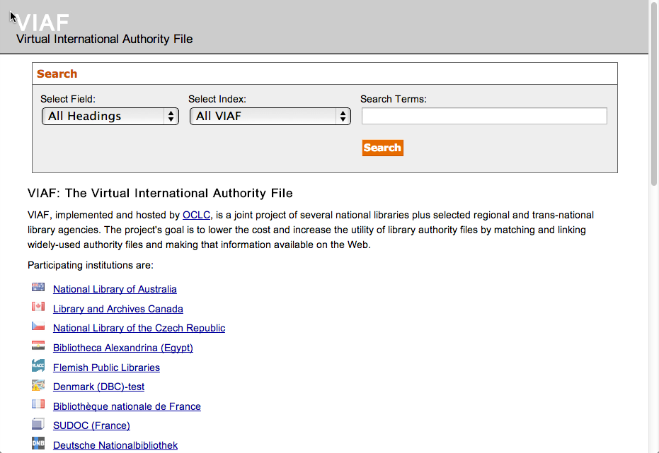
A Union database of
authority records
Viaf.org

Slide 4
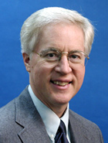
The Responsible Party
Thom Hickey
Chief Scientist
OCLC Research

Slide 5
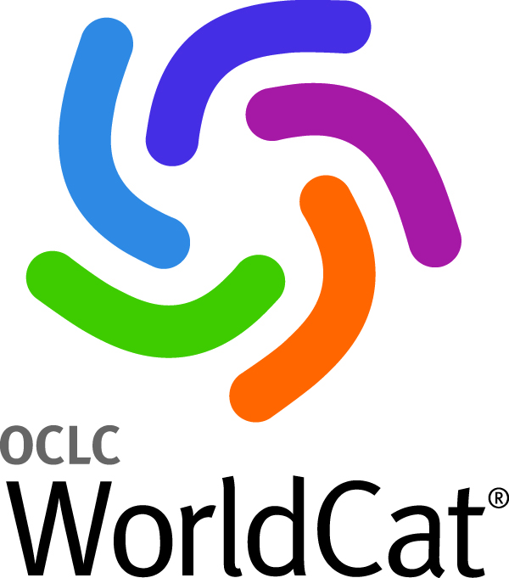
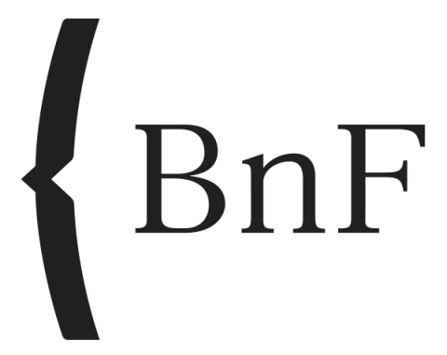
290+ million records

Slide 6
Language Coverage
274 million
36.5 million
25.5 million
11.3 million
4.7 million
4.3 million
3.6 million
3.5 million
Total
German
French
Spanish
Italian
Dutch
Russian
Latin
60.2%
30 June 2012

Slide 7
Worldcat.org/identities/

Slide 8
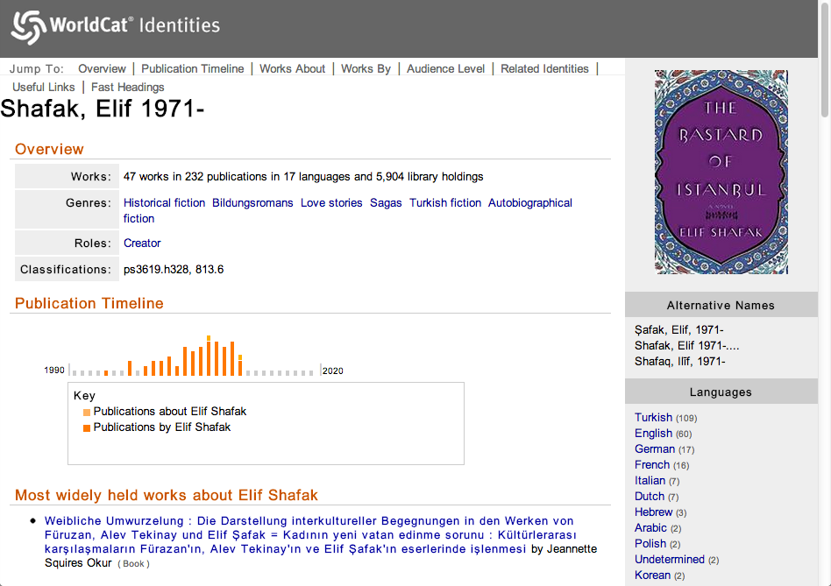
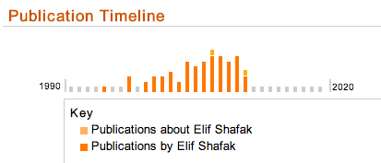
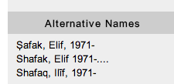
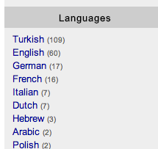

Slide 9
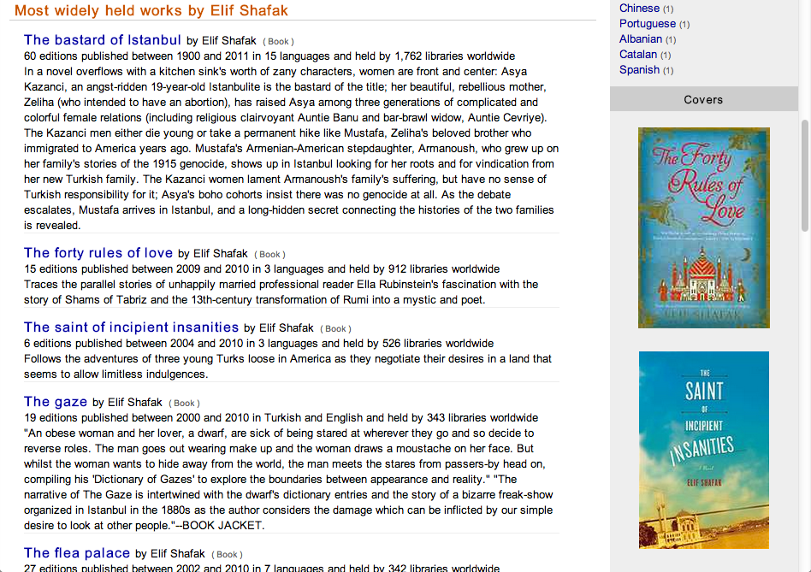

Slide 10
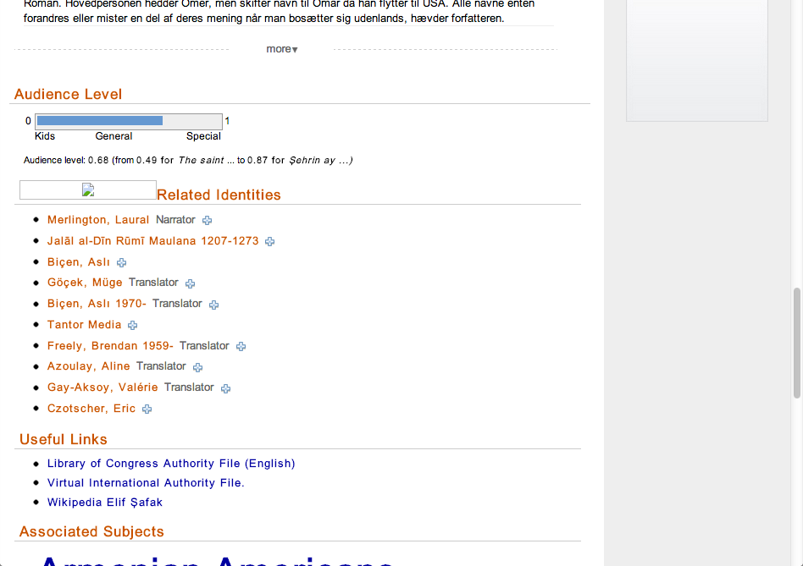
(J.K. Rowling)
(Diana Gabaldon)
(Galileo)

Slide 11
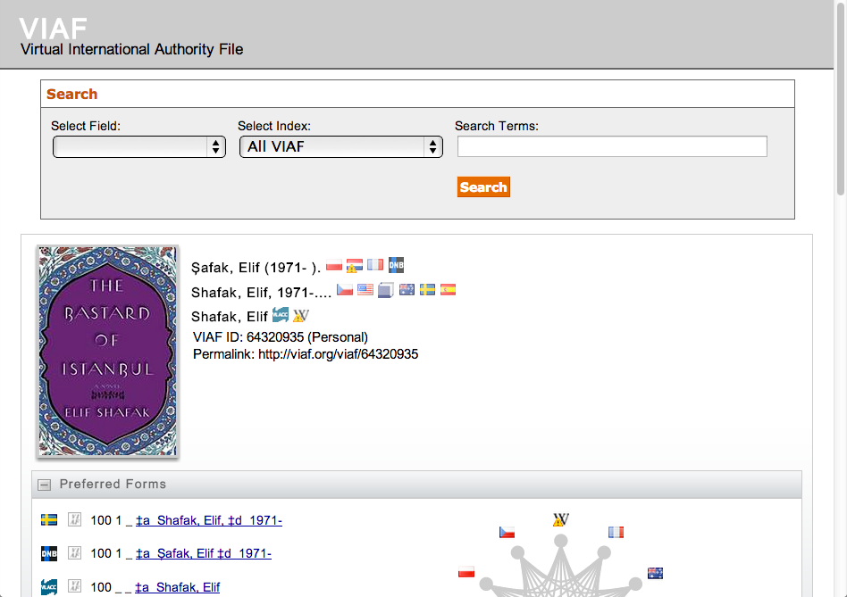
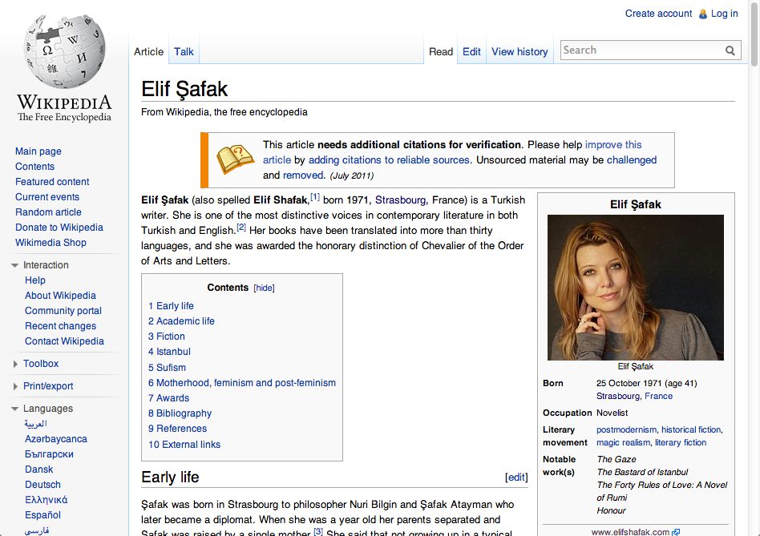

Slide 12
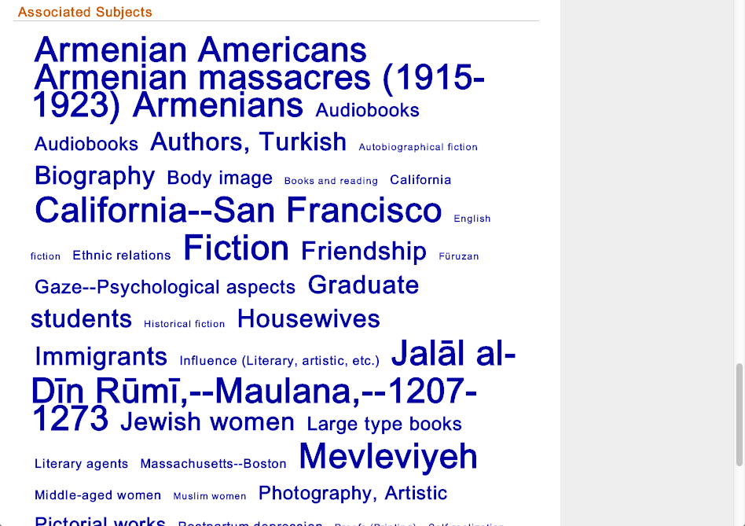

Slide 13
Viaf.org

Slide 14
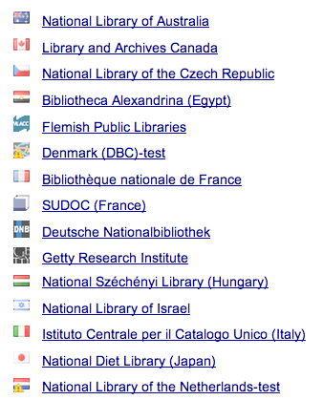
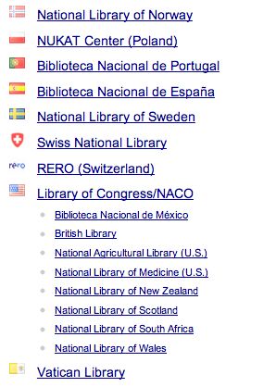
VIAF Participants

Slide 15
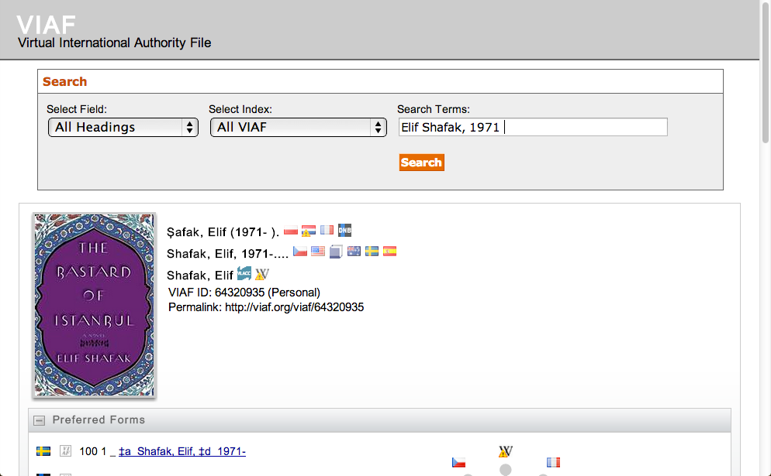
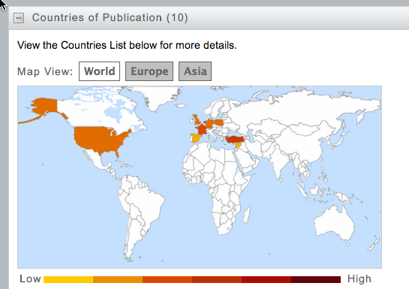
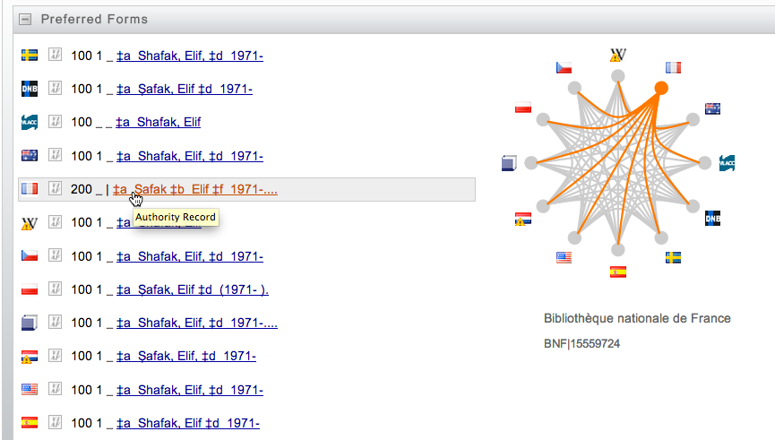
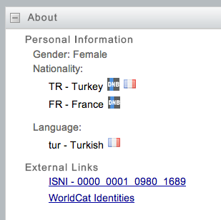

Slide 16
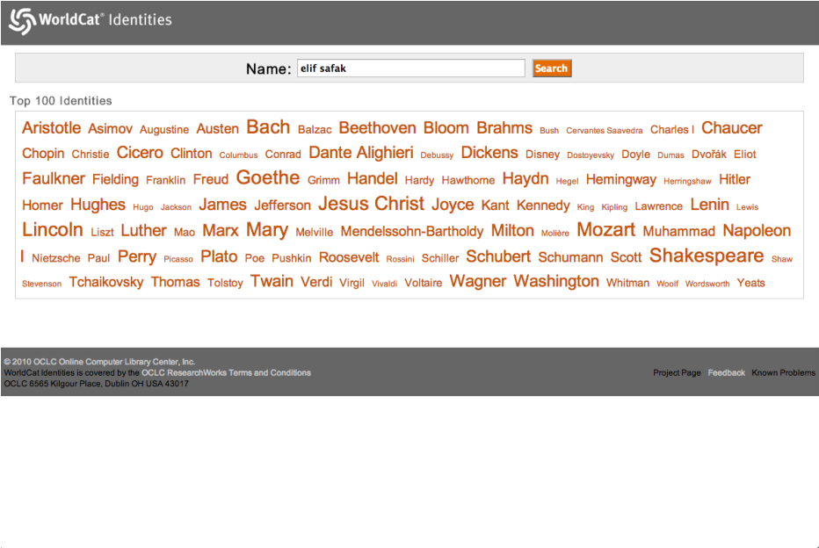
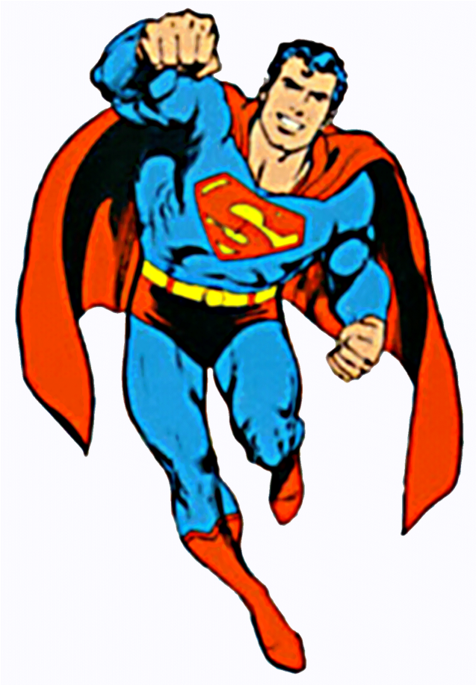
“Super” Authority File

Slide 18
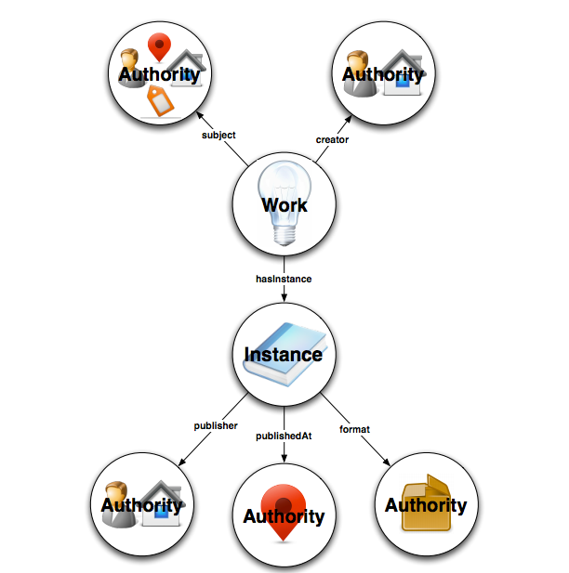

Slide 19
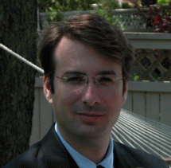
Our Cataloging Future
“Moving from cataloging to catalinking”
Eric Miller, Zepheira

Slide 20
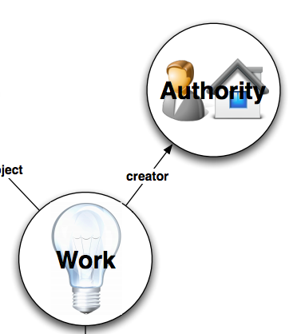

Slide 21
Some Lessons
Widespread collaboration is essential
Normalizing the data is essential
Normalizing the data is complicated
Everything is interrelated:
You can’t bring names together if titles don’t match
You can’t bring titles together if names don’t match
Batch mode processing still rules (but we’re getting better and faster at it)

Slide 22
Conclusions
Data mining isn’t just useful, it’s essential
Extracting data from MARC that is useful in other contexts is possible, but will require sophisticated processing
Only very large organizations (e.g., OCLC, national libraries) have the data and resources to do this work
Thankfully, we are doing it, but there is much more to be done

Slide 23
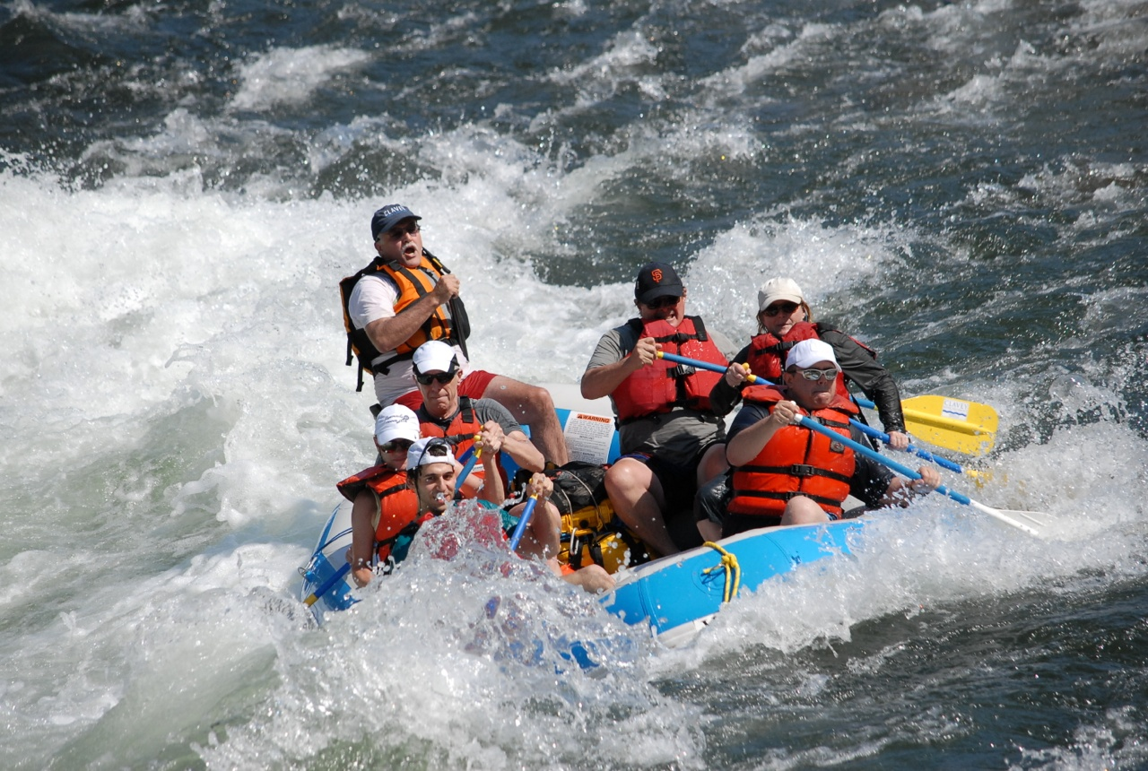
Roy Tennant
tennantr@oclc.org
@rtennant
roytennant.com

