Slide 1
MARC & The Trouble With Online
ALA Midwinder, January 2013
Or, Metadata Carnage and Where We Go From Here
Roy Tennant
Senior Program Officer OCLC Research
@rtennant

Slide 2
The Hierarchy of Desire
Offline, but can be acquired through delivery (ILL)
Damage
Offline, but easily acquirable
The Line of Damage
Online in part
Online in full, easily acquirable
SWEET
Online in full, licensed on my behalf
Online in full, open access

Slide 3
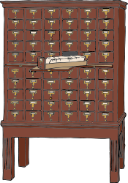
Where the Confusion Lies
The 856 URL applies to
“The item” (often a “born digital” item}
A digital “version” of the item
Often clear
Table of Contents?
Sample Chapter?
Full Text?
Etc.
Often unclear

Slide 4
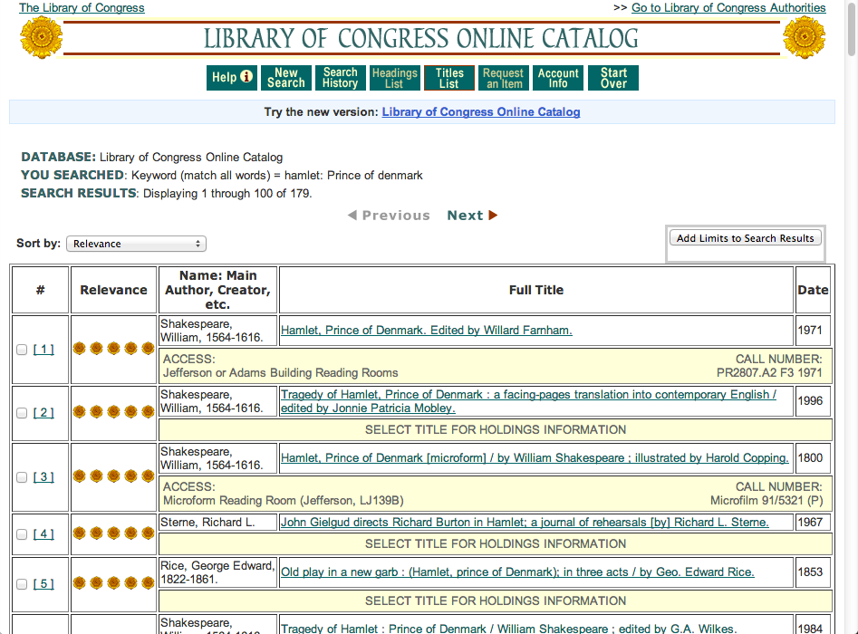

Slide 5
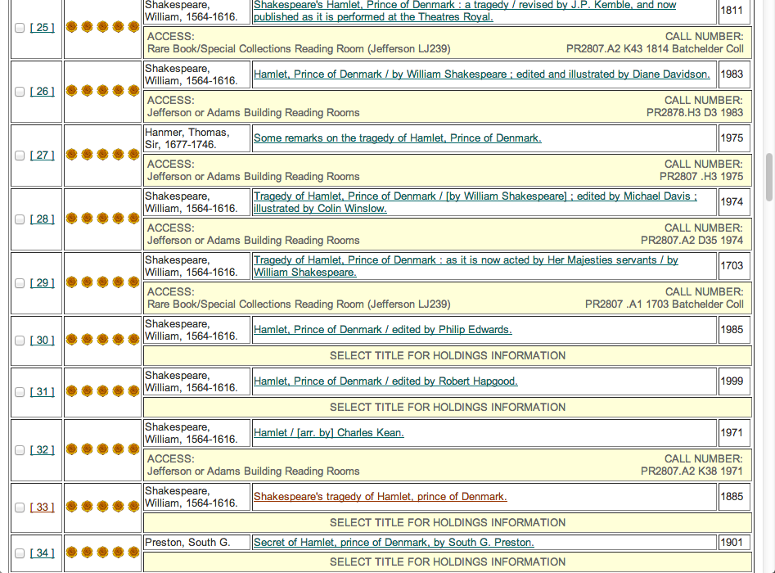

Slide 6
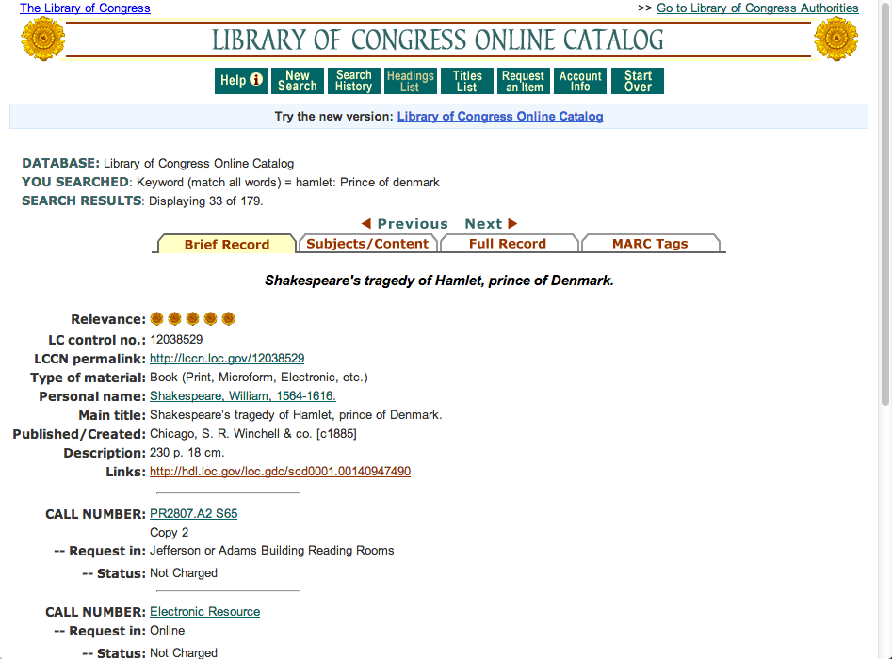

Slide 7
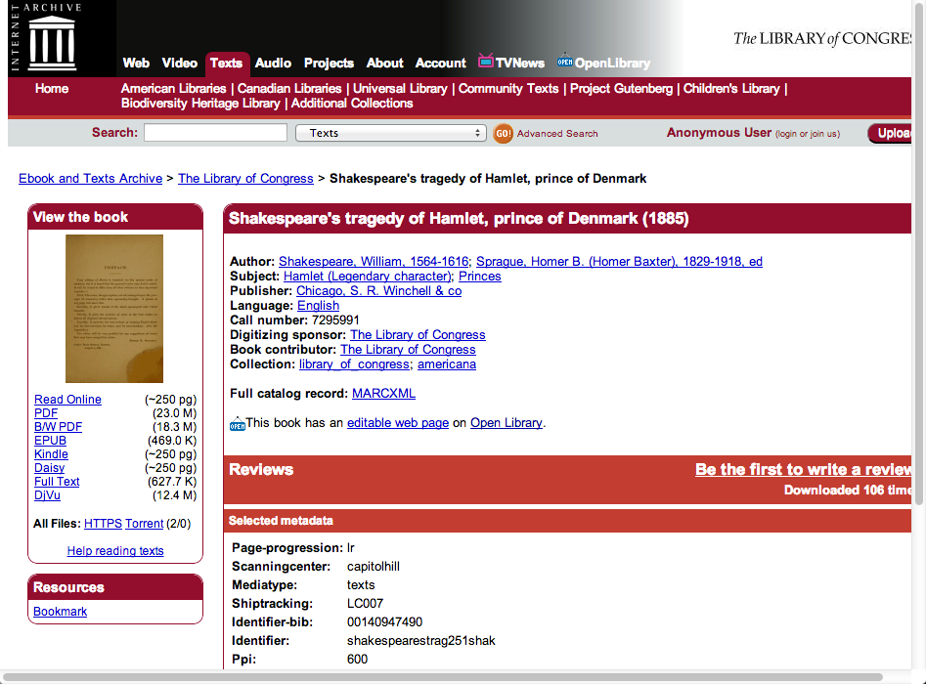

Slide 8
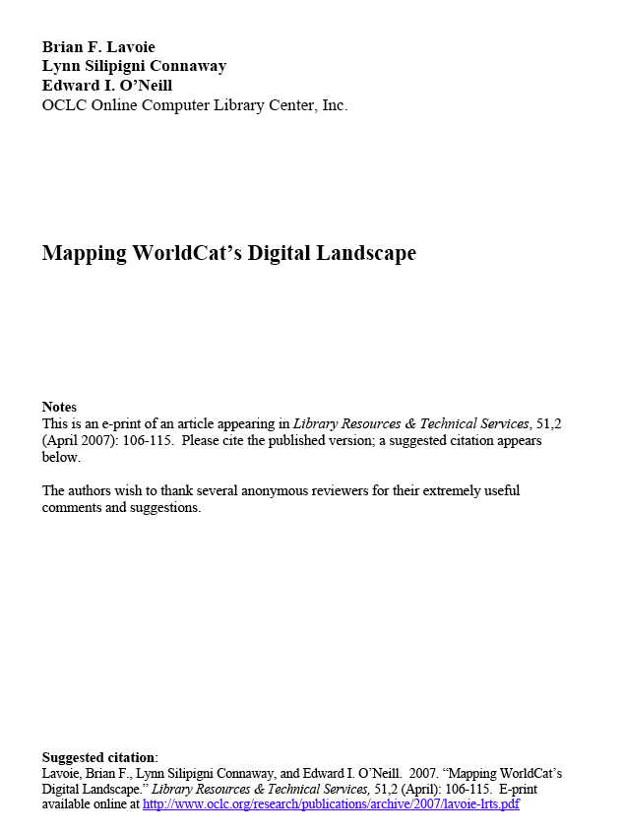
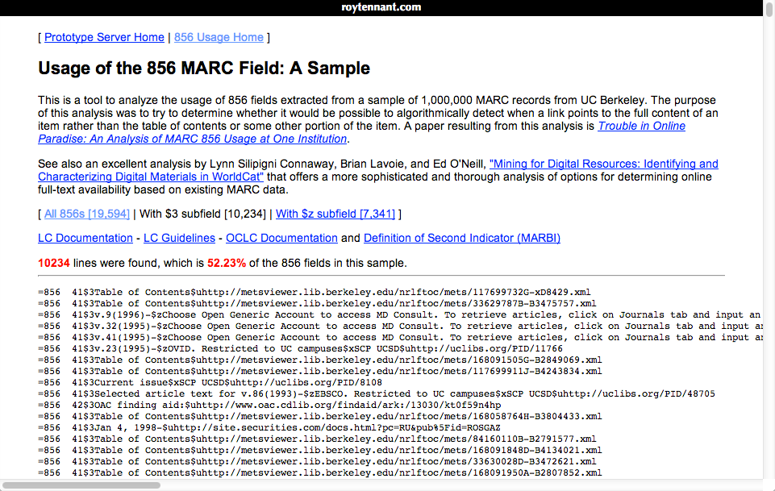
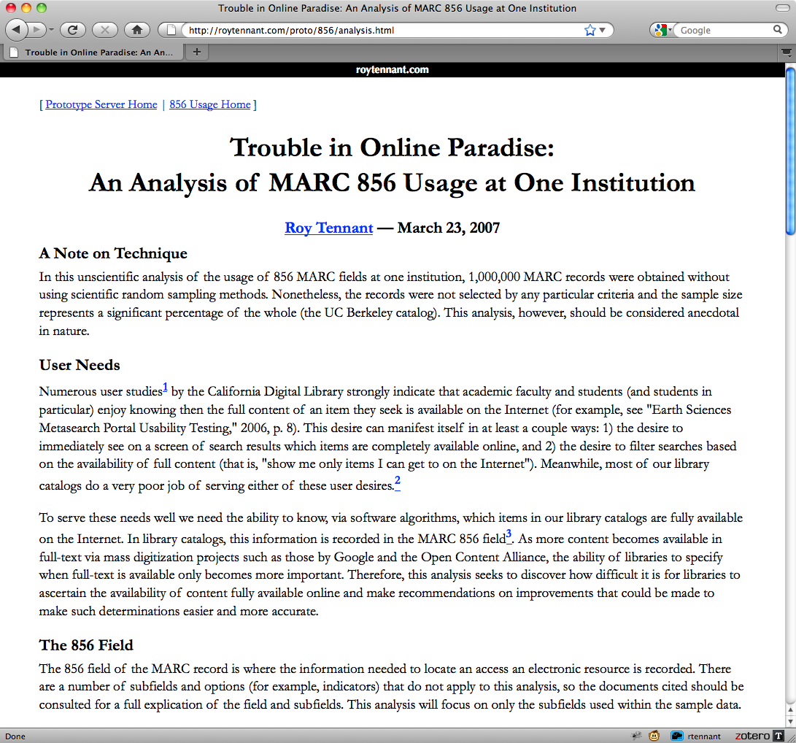
http://roytennant.com/proto/856/

Slide 9
Two Main Questions
What is online in full?
Of that, what is openly accessible?*
No time to discuss this aspect today
* Initially, for a US audience

Slide 10
Initial Investigations
OMG. I mean, srsly.

Slide 11
Number of URLs per host
(Oct 2010)

Slide 12
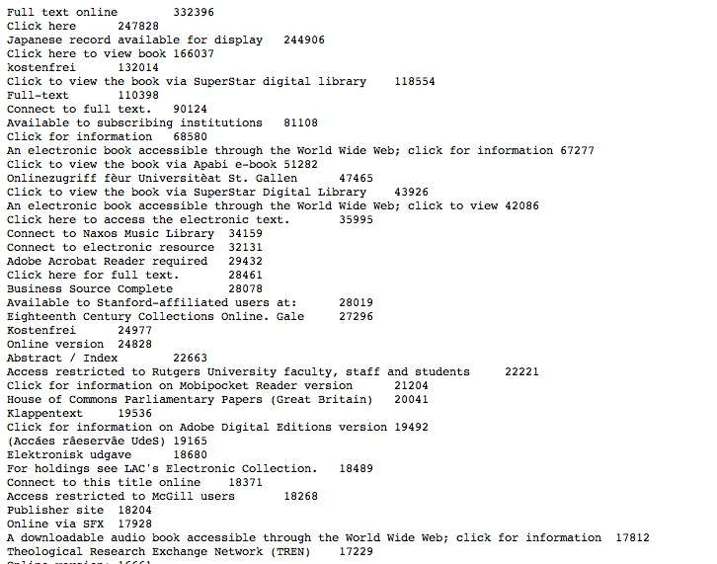
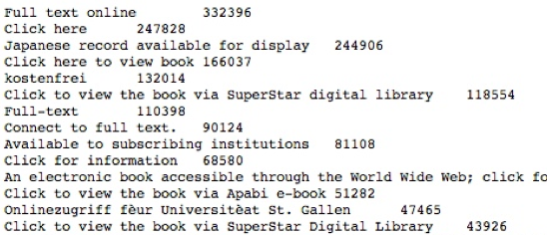
Values from 856 $z (public note)

Slide 13
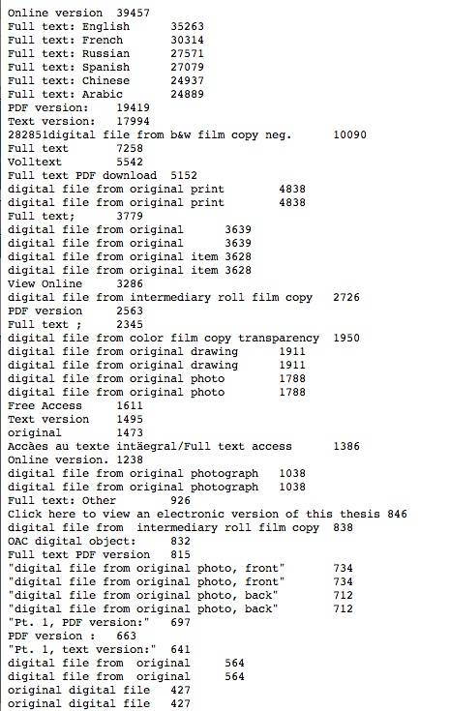
Values from the 856 $3 (materials specified)

Slide 14
Magic Happens Here
Sure thing. Whatever you say.

Slide 15
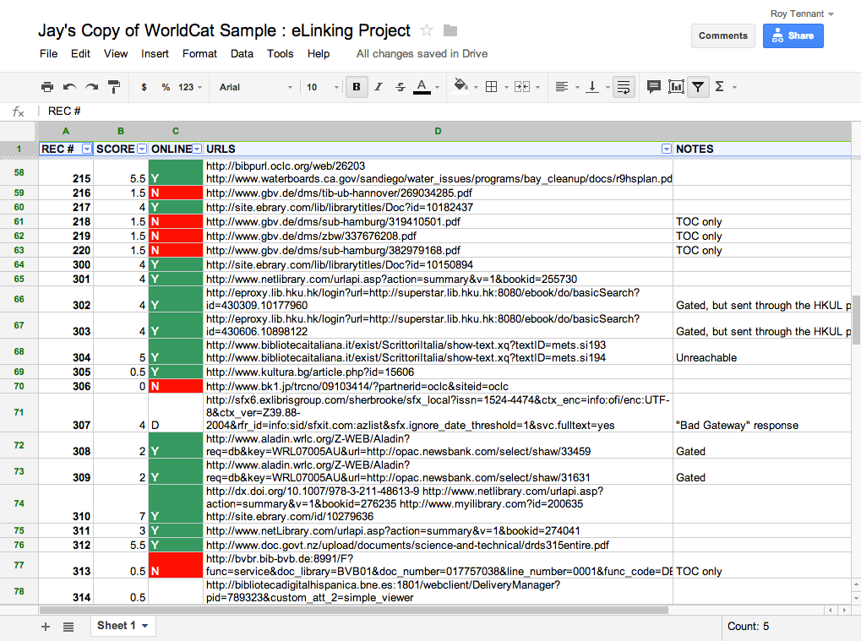

Slide 16
A Drafty Algorithm
I Can’t Make This Shit Up. Oh, Wait, I Did.

Slide 17
Algorithm: Info and Caveats
Based on assigning scores for certain field and/or value occurrences and/or their contents
We determined the scoring was good enough for our purposes
We DID NOT evaluate each individual score for its relevance (that is, some may not matter in the end)
We DID NOT identify all relevant uncontrolled text strings — especially foreign language terms
We implemented a final check to catch false positives

Slide 18
Plus 2 Scores
245 subfield $h has any of the following strings: “website”, “graphic”, “digital”, “internet”, etc.
530 has any of the following: “world wide web”, “digital”, “internet”, “electronic”, “online”, etc.
538 has any of the following: “world wide web”, “acrobat”, “internet”, etc.
856 has any of the following: “full”, “online”, “pdf”, “free access”, “electronic version”, etc.
ALL case insensitive

Slide 19
Plus 1 Scores
Byte 6 of the leader or 006 of ‘m’
Byte 23 or byte 29 of the 008 is ‘o’ or ‘s’
245 $h has any of the following strings: “electronic”, “elektronische”, “elecktronisk”, etc.
533 has any of the following strings: “world wide web”, “acrobat”, “internet”, etc.
856 second indicator 0

Slide 20
Final Check
If score is equal or greater to 2:
856 has any of the following strings: “table of contents”, “publisher description”, “biographical information”, “Inhaltsverzeichnis”, “sample text”, “book review”, “abstract”, etc., SET TO ZERO
Otherwise, declare the item to be ONLINE IN FULL

Slide 21
What Then?
There is no sanctioned method for encoding this information in a MARC record unambiguously and machine understandably
Our suggestions:
Short-term: We find an appropriate method to unambiguously record this information in MARC21
Long-term: Build into whatever replaces MARC the ability to unambiguously declare when an item is available in full, AND a set of unambiguous and controlled markers for varying levels of access

Slide 22
Main Take-Aways
We believe it is possible to algorithmically determine when a URL leads to the full item at a roughly 80/20 percentage of accuracy
We also believe it is possible to determine open access vs. gated access at roughly the same %
There is presently NO approved way to encode this unambiguously in MARC21
We MUST have the ability to encode these aspects now and into the future

Slide 23
Thank you for your time.
Roy Tennant tennantr@oclc.org
@rtennant
Facebook.com/roytennant/
Notes:
23
23
23

