Slide 1
Scaling the Impact of Libraries Through Learning Networks
Sharon Streams, OCLC
Jacinta Sutton, State library of queensland, Australia

Slide 2
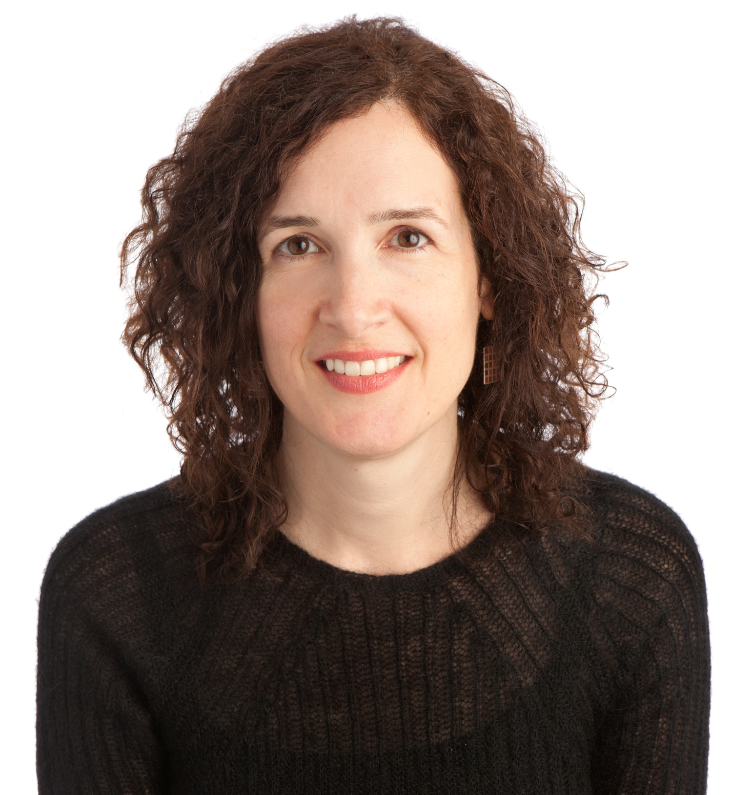
Sharon Streams
Director, WebJunction
OCLC

Slide 3
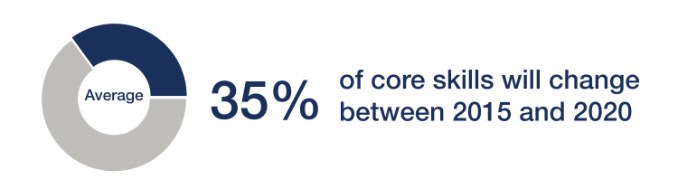
Workforce trends change learning needs
World Economic Forum: Future of Jobs Report – 2016
Notes:
According to the World Economic Forum, the accelerating pace of technological, demographic and socio-economic disruption is transforming industries and business models. These transformations are putting new and different skills into high demand, and increasing the speed by which others skills become outdated.
Some occupations now in high demand did not exist 10 or even five years ago. By one popular estimate, 65% of children entering school today will end up working in completely new job types that don’t yet exist.¹
In its Future of Jobs report published last year, the World Economic Forum predicts that, on average, by 2020,
35% of core skills will be different than what they were in 2015.
And the pace of change is set to accelerate.
This is affecting both what people need to learn and how they need to learn.

Slide 4








Learner needs have changed
Rate of reskilling | Frequency of learning | Lifespan | Time to learn
Access to learning | Motivation for learning | Relevance of learning
Notes:
Today’s workforce must develop new skills --- rapidly, frequently, and throughout out life.
In reality, the ability to continuously learn has become a new essential skill.
As workers, we must have time to learn, and have continuous access to up-to-date, relevant learning that will support our career and economic health.

Slide 5
How might learning ecosystem adapt?
Cross-sector coordination
Businesses become learning organizations
Online learning evolves and flourishes
Education offers alternate credentialing
Learning how to learn
Informal self-directed learning
Networked learning
Notes:
The World Economic Forum warns that there will be enormous economic and social cost if the demand for continuous learning is not addressed, and points out that it is not possible for one sector – either formal education, or business or government, to address the issue on its own – coordination is needed.
In the US. , the Pew Research Center – a nonpartisan thinktank-- canvassed technologists, scholars, practitioners, strategic thinkers and education leaders on the future of jobs and training. In terms of how the learning ecosystem will adapt, these experts predict that
More businesses will become “learning organizations” where continuous learning is recognized as being central to organizational health
Many expect online learning platforms will become more high-tech and more prevalent, which more businesses and employees will take advantage of.
Some say alternative credentialing will arise to emphasize skill development and practical application of those skills, over degrees received.
They also surmised that education programs will teach people how to be lifelong learners.
As we recognize and embrace our need to be lifelong learners, many of us will take charge of our own learning and pursue it in a self-directed manner, often through informal learning channels.
What I think these prognosticators underplay is how the networked world in which we now live is shaping how we learn. In our globally connected society, self-directed learning does not mean isolated learning.
One adaptation to the learning ecosystem that has grown enormously over the past decade is networked learning

Slide 6
Networked Learning
Forming connections with people and information, and communicating through those connections to support one another's learning.
“Our ability to learn what we need for tomorrow is more important than what we know today.”
“We derive our competence from forming connections.”
— George Siemens (2009)
Source: English-language Wikipedia article on Networked learning; accessed 30 October 2017
Notes:
While the idea of networked learning has been around for a long time, it is the birth of the Internet that ignited it.
In the 1970s, Silicon Valley futurists describes the internet as a way to connect experts who would collaborate to address complex problems.
And the World Wide Web was conceived as a globally linked information system. So together, the Internet and Web provided a platform on which networked learning could flourish.
And indeed is has. In 2009, a college instructor in Canada, George Siemens noted the impact of the technology on how we communicate and learn, and proposed a new learning theory for the digital age, which he called connectivism.
Connectivism stresses that our ability to continuous learn is essential, and that that forming connections is critical to how we learn.

Slide 7
traditional learning
student
student
information
student
teacher
information
information
student
information
student
Notes:
Here is a simplified view of a traditional learning structure. Here, a teacher collects information, and then communicates that information to students, who receive the information. The teacher is the one and only connector between information and learner.

Slide 8
networked learning
information
information
person
person
information
person
information
information
person
information
information
person
information
person
information
information
information
Notes:
In networked learning, those roles are not strictly defined. A person could seeking information or giving information or doing both. Each of us possesses information that could contribute to someone else’s learning, we communicate with one another to find out who has information we are seeking. We also may have access to outside knowledge that others might not, and can help connect the others to that knowledge. In this view of networked, each person who is participating is contributing to the whole network’s growth in learning.
Characteristics of networked learning
It’s not a pre-determined system or structure -- not bounded by rules or processes -
We each form the connections through which information can pass and learning can occur
And it is self-directed. We each decide how to build and grow and use our learning network
And, through these interconnections and the continuous sharing of information, new knowledge can be collaboratively created by the network

Slide 9
Benefits to the networked learner
More connections means more information
Fast and dynamic information exchange
Can be used throughout life
Can shape and co-create learning
Increased variety
More no-cost or low-cost options

Slide 10

Challenges for the networked learner
So much out there – how do I choose?
How do I connect?
How do I know that information is reliable?
It takes so much effort.
How can this fit into my formal education?

Slide 11
Facebook
LinkedIn
Google
Group
Group
Page
Page
Group
Page
Group
Page
Group
YouTube
News
Classmates
Co-workers
Twitter
Websites
learner
Websites
Websites
hashtag
Blog
Websites
hashtag
Blog
hashtag
Blog
Websites
follows
hashtag
Blog
Group of experts
Group of experts
Professional Association
lists
Wikipedia
Group of experts
Professional Association
Group of experts
Professional Association
Online course
Group of experts
Online course
Group of experts
Online course
Notes:
Whether someone is learning for school or for work, beyond their formal classwork or their formal training, they are trying to navigate through this vast Web space, searching for information-rich connections with which to build a personal learning network.

Slide 12

Facebook
LinkedIn
Google
News
Group
Group
Page
YouTube
Twitter
learner
Website
follows
hashtag
Blog
lists
Professional Association
Online course
Wikipedia
Group of experts
Notes:
But librarians serving as connectors in network can help filter out the noise, introduce and guide the learner toward high-quality information and expertise, both on and off the Web.

Slide 13
Libraries guide the networked learner
Libraries provide new connections to information.
Librarians teach me how to find and assess information.
Libraries help bridge to formal education or training.
Libraries are there for me throughout my life.
I trust the library.
Notes:
Another recent study from the Pew Research Center found that 87% of adults younger than the age of 35 say the library helps them find information that is trustworthy and reliable, 85% credit libraries with helping them learn new things.

Slide 14
Facebook
LinkedIn
Google
Group
Page
Group
News
Co-workers
Twitter
learner
Websites
hashtag
follows
Blog
Professional Association
list
Online course
Wikipedia
Group of experts

Slide 15

“empower and engage people around the world to collect and develop educational content under a free license or in the public domain, and to disseminate it effectively and globally.​”
Notes:
Why is Wikipedia so useful to networked learning?
First, it is online and free – which makes it very accessible and convenient.
It’s the 5th most visited website in world, and attracts up to 15 percent of internet traffic every day. English-language Wikipedia alone gets 15 billion pageviews each month. Japan provides the second-highest percentage of visitors (6.5%) after the U.S. (22%).
Second, it is an encyclopedia, with a mission to collect and disseminate as much educational information as possible. Built and maintained by a community of tens of thousands of volunteer editors, Wikipedia has accumulated 40 million articles in more than 250 languages since its launch in 2001.
Wikipedia has embedded into the daily lives of millions of people, who use it for school, for work, and for personal enrichment. Several recent studies have demonstrated just how much this is true:
For example, the Knight Foundation showed that in the U.S. , people spend more time on Wikipedia on their mobile device than any other information or news site. And YouGov showed that Britons trust the people who write Wikipedia more than they do professional news journalists.
The Institute for Healthcare Informatics showed that 50% of healthcare professionals use Wikipedia to research medical conditions and diagnosis for their patients.
And MIT University showed that when science topics are added to Wikipedia, the information spreads further and has a significance influence on new scientific research.

Slide 16
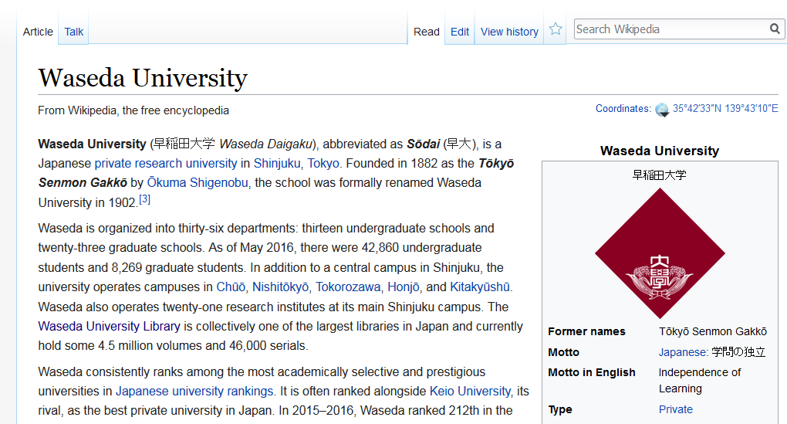
Notes:
While its encyclopedia pages are visited by millions of people each day, only a fraction of those visitors have clicked on the Talk, Edit, or View History tabs to see how its content is continually built, reviewed, and updated.

Slide 17
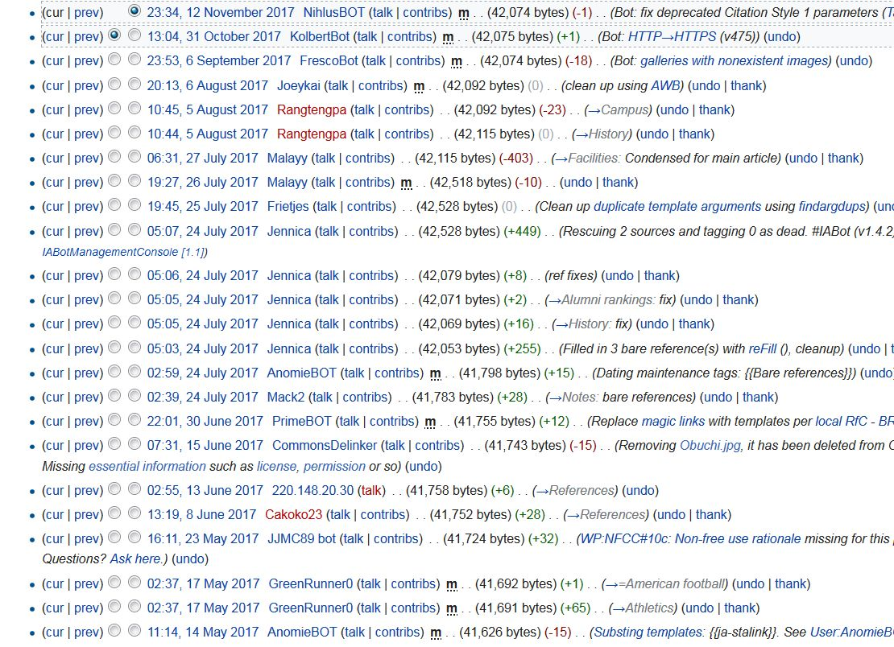
Community Review:
Notable?
Neutral?
Reliable?
Well-structured?
Well-written?
Notes:
Those tabs reveal how Wikipedia articles are subject to review by thousands of volunteer editors who assess whether the content is notable, reflects a neutral point of view, and is verifiable with credible sources.
Editors also improve the structure, style, spelling and grammar of the articles.
In a given month, there are about 75,000 people who actively edit Wikipedia.

Slide 18

Vision and values
“Imagine a world in which every single human being can freely share in the sum of all knowledge. That's our commitment.”
Open and transparent
Free to use and share
No ownership
Collaboration
No firm rules
“Be bold”
Notes:
Many of these volunteer editors feel part of a “movement” that is fueled by the Wikipedia Foundations’s vision of a world in which every single human being can freely share in the sum of all knowledge.
These volunteers have formed a community that has shared values.

Slide 19
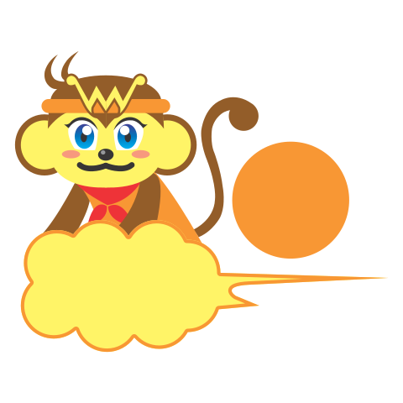
Networked learning in Wikipedia
Wikipedia Asian Month: improve articles relating to Asian countries.
Goal: “enhance understanding among Asian Wikipedia communities”
Wikimedia Commons. Image by B20180 - Own work, CC BY-SA 4.0
Notes:
This month is Wikipedia Asian Month, which is an invitation for people to improve the quality and quantity of articles relating to Asian countries. The goal is to “enhance understanding among Asian Wikipedia communities” – that is, to spread information across the connected network of Wikipedians.

Slide 20
Facebook
LinkedIn
Google
Group
Page
Group
News
Co-workers
Twitter
learner
Websites
hashtag
follows
Blog
Professional Association
list
Online course
Wikipedia
Group of experts
Notes:
Yet, despite its usage and prevalence, many educators, researchers and librarians have not yet recognized Wikipedia as a legitimate resource to support scholarship, research, and lifelong learning.
What we have found through our recent research at OCLC, is that when librarians understand the purpose of Wikipedia and how it works, they can guide and support patrons in its appropriate use.
With this understanding, librarians also can leverage Wikipedia as a teaching tool ---to build information literacy, critical thinking, collaboration, writing and other core skills.
They can use Wikipedia as a centerpiece for programs at the library that engage students’ and community members’ expertise and interests.
And, they can improve Wikipedia itself by evaluating, improving and contributing content, drawing on their expertise as information seekers and curators of local collections.

Slide 21
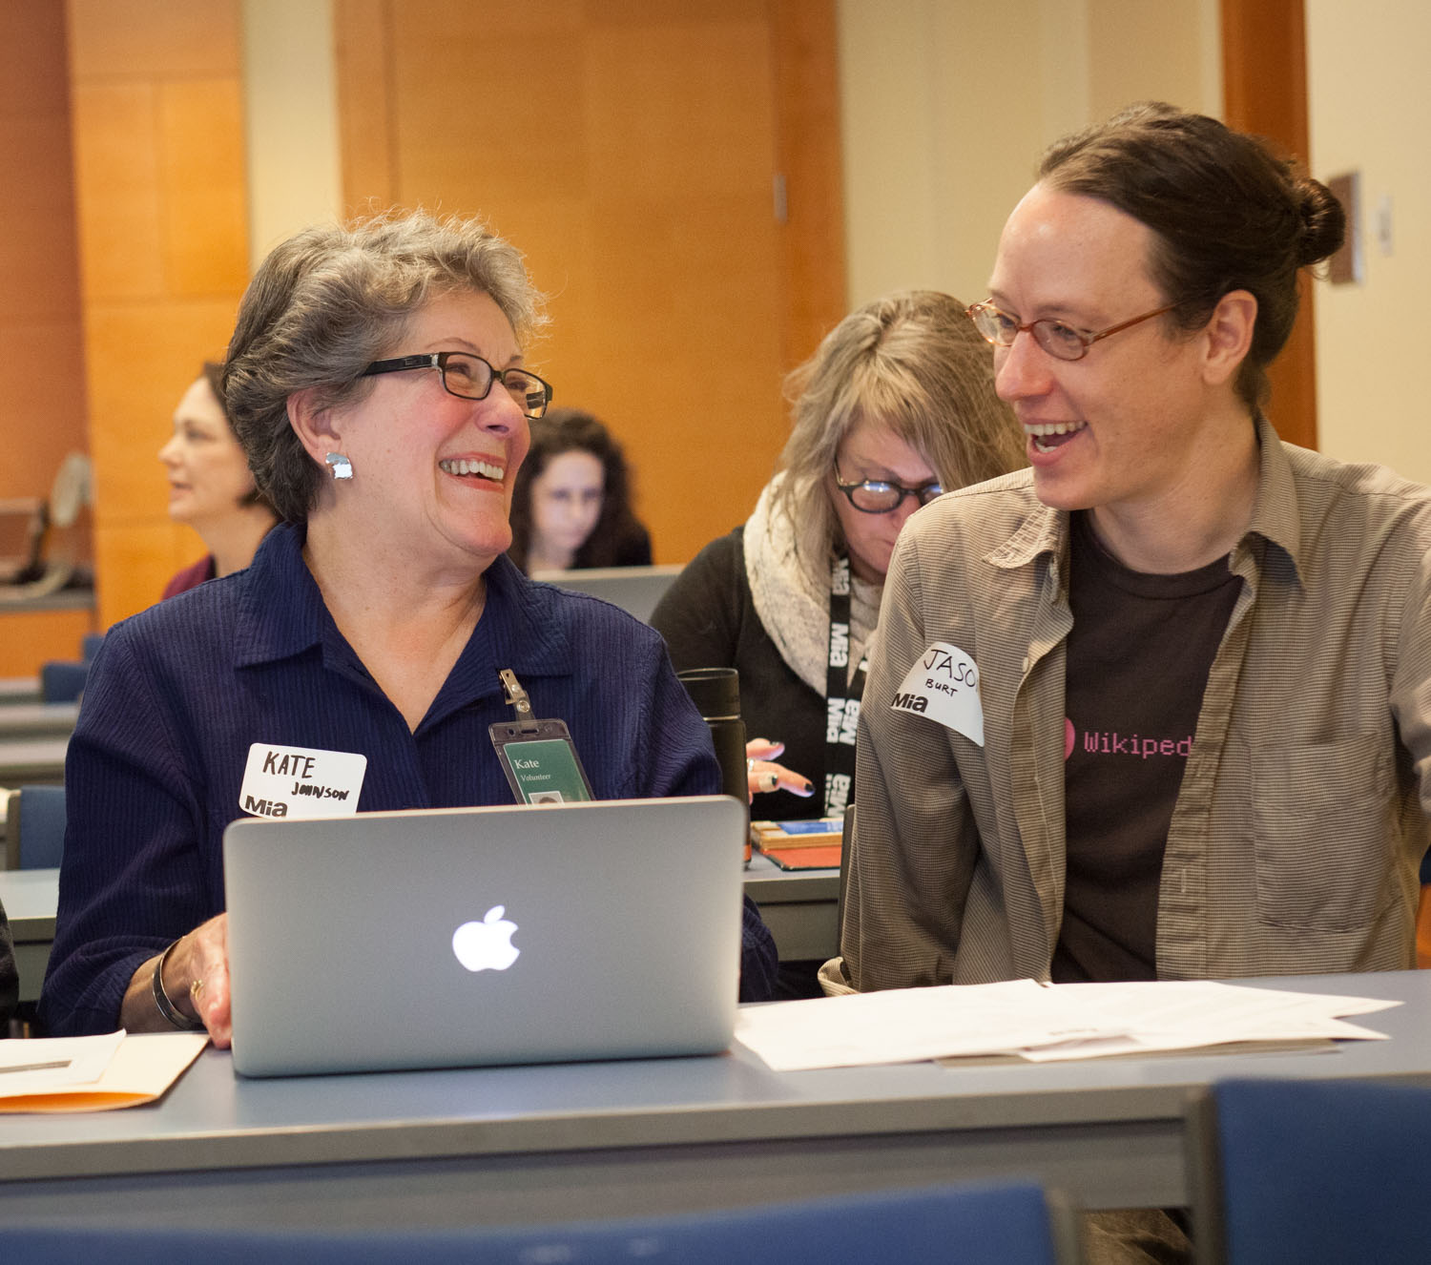

Wikipedia+Libraries: Better Together
Connections
Training
Action
Notes:
This research from OCLC is arising from a project that we started a year ago, which we call Wikipedia and Libraries: Better Together.
With funding the Knight Foundation and the Wikimedia Foundation, OCLC is building connections between librarians and Wikipedia editors. We have designed and delivered an online training program nearly 300 U.S. public librarians on the innerworkings of Wikipedia. And, we are observing how librarians are applying what they learn to support their patrons learning needs.
We have used the project to demonstrate to the Wikipedia community that libraries are ideal partners for the quest to nurture and spread learning.

Slide 22

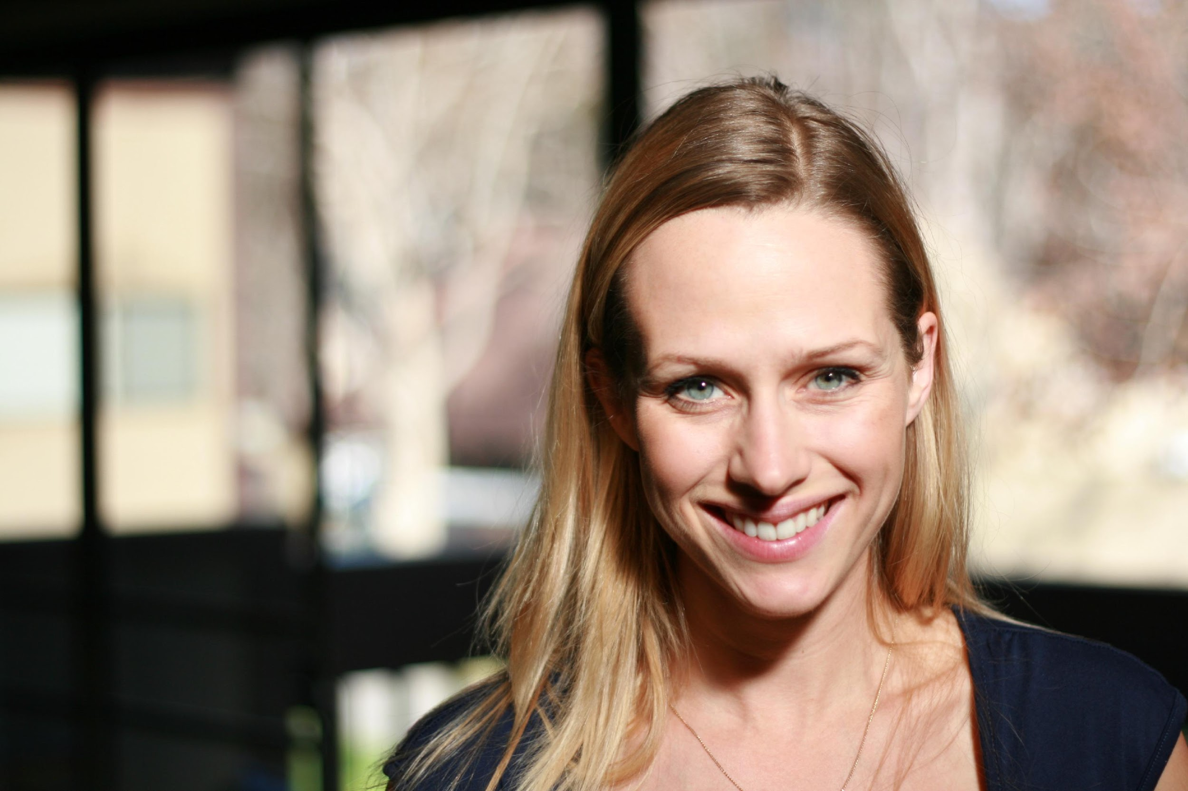
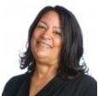
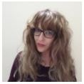
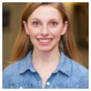

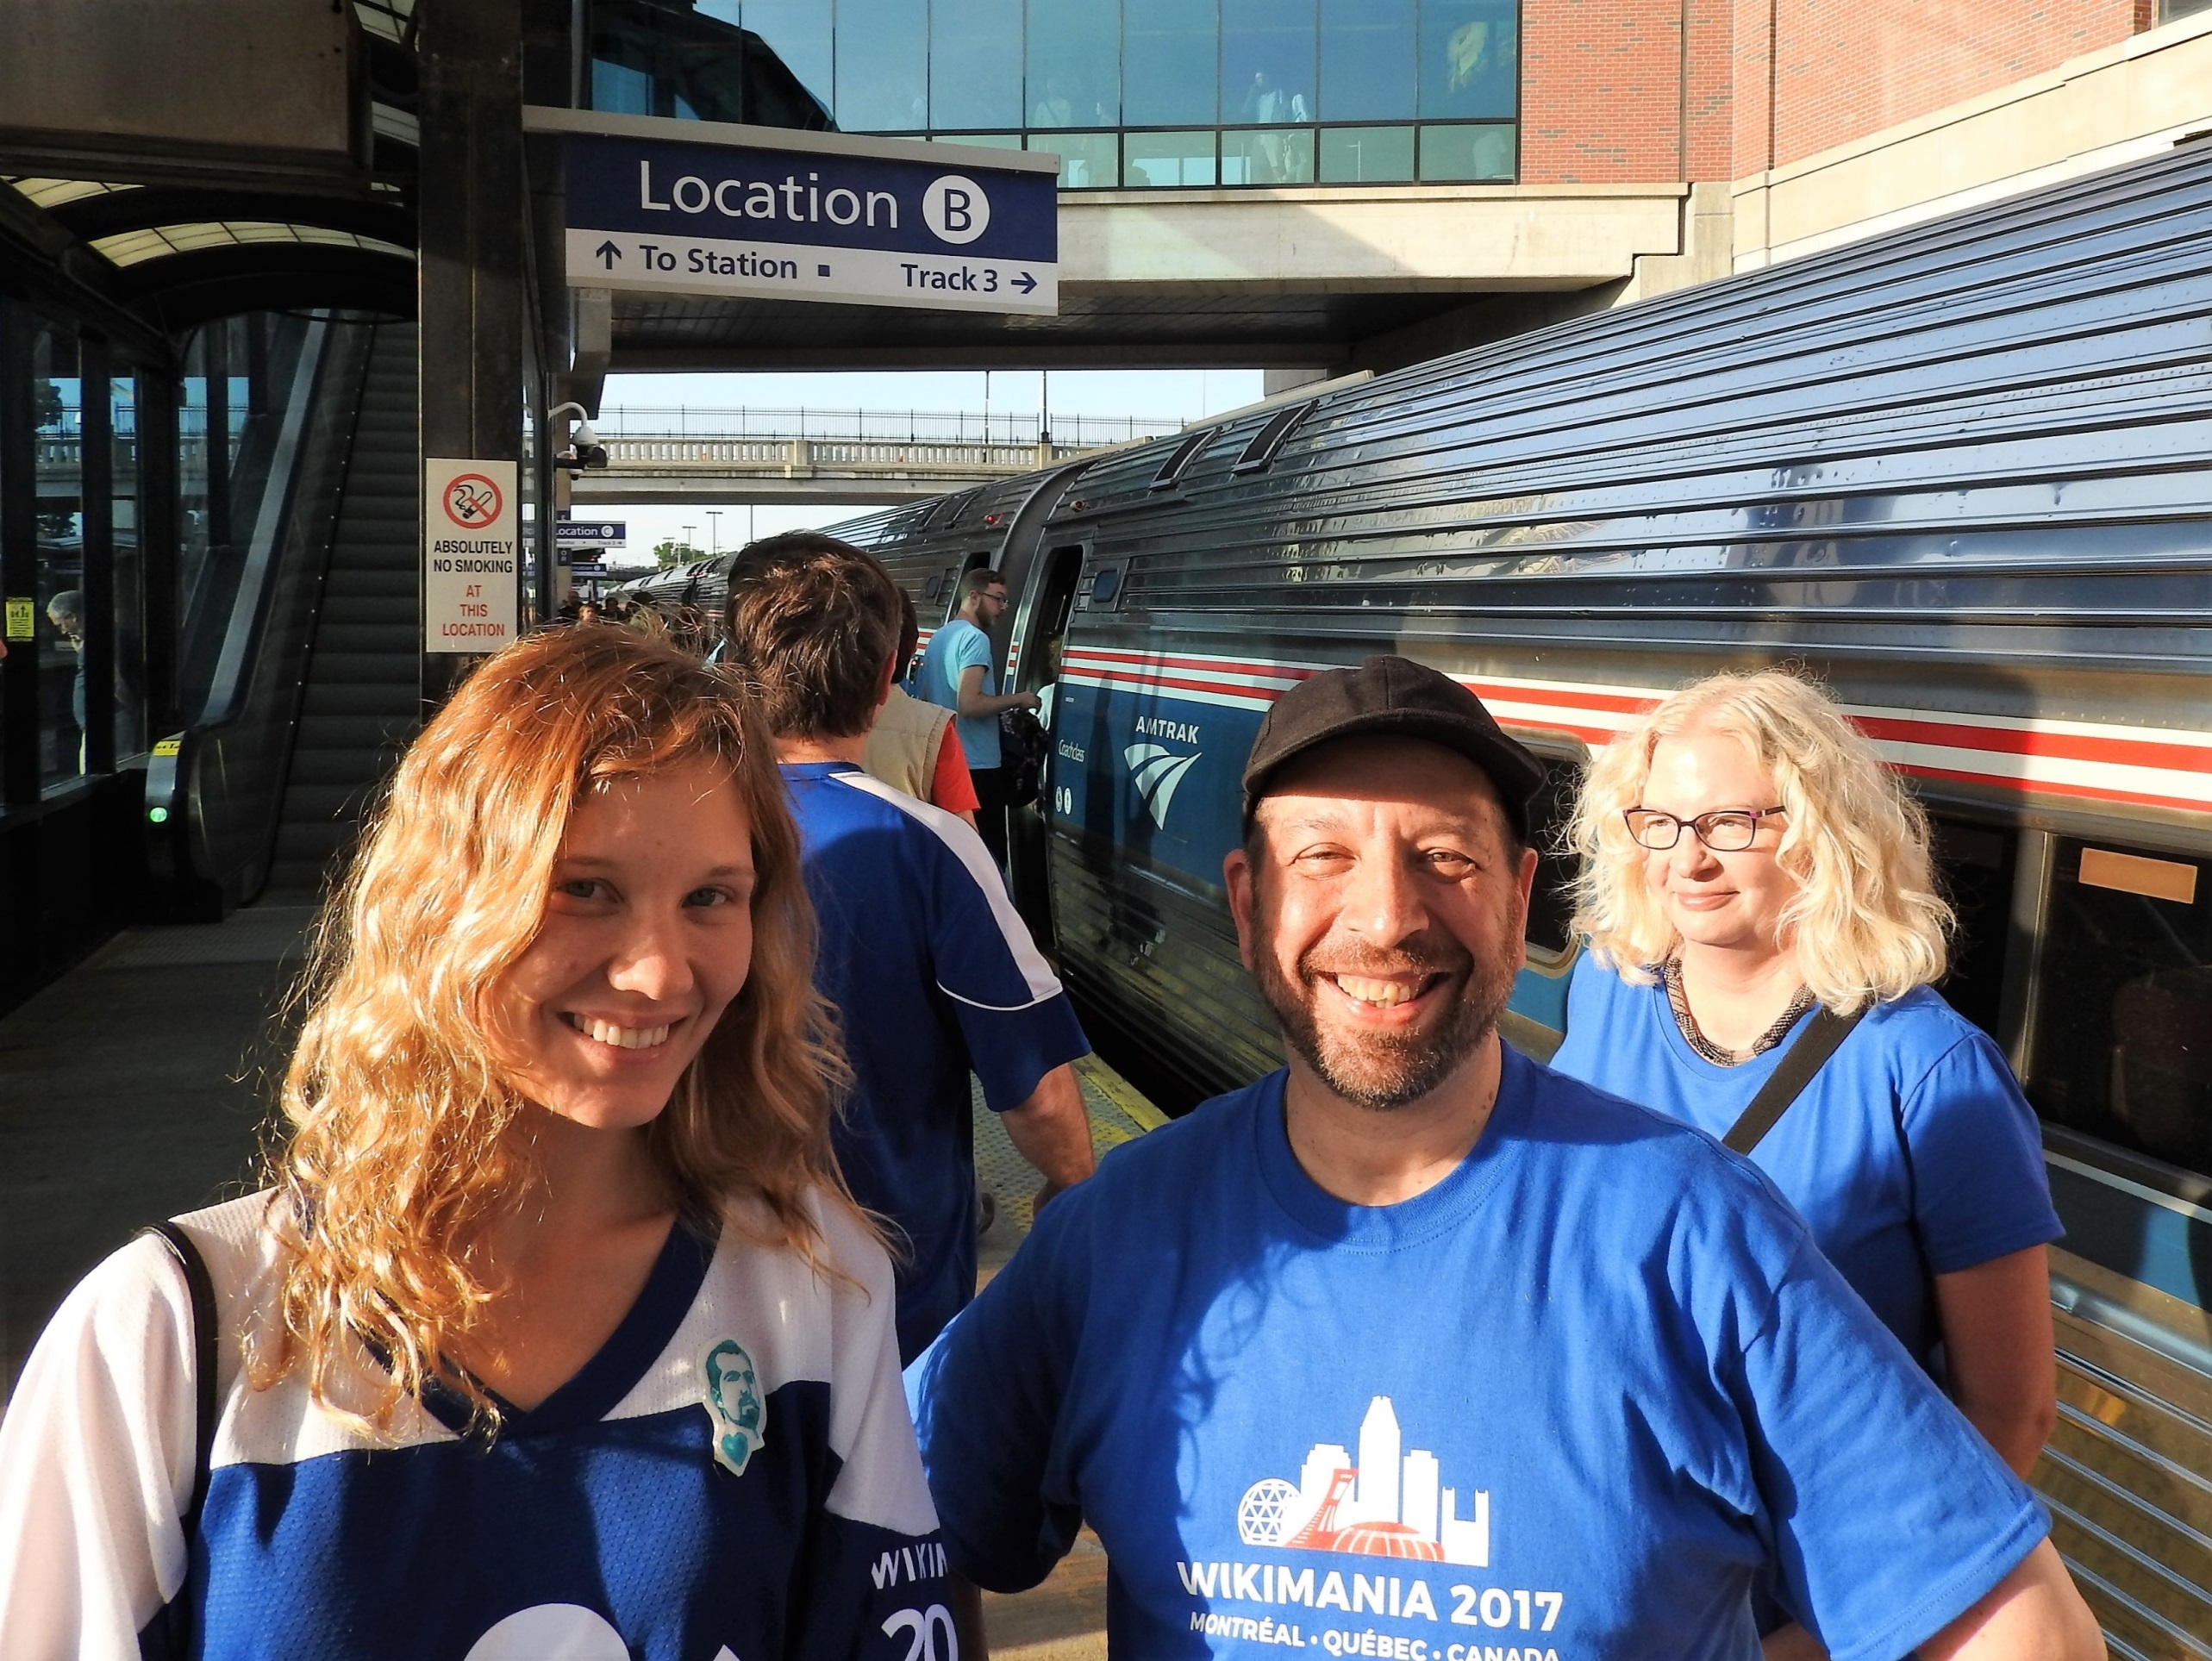
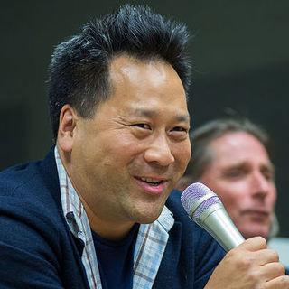
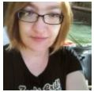
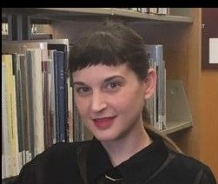
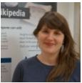
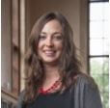
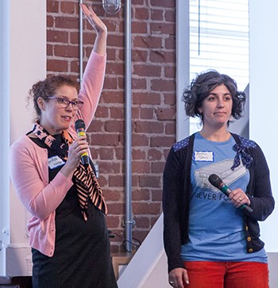
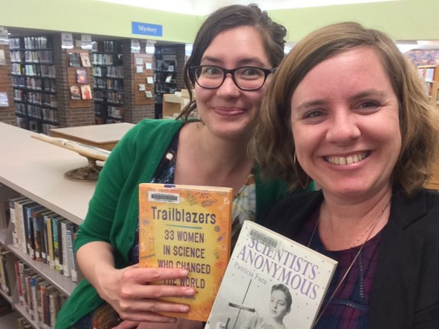
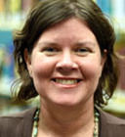
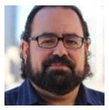
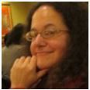
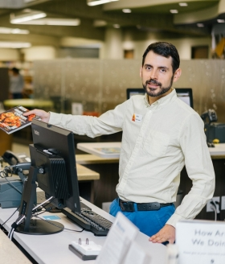
1. Build connections and awareness
Monika Sengul-Jones
OCLC Wikipedian in Residence
Merrilee Proffitt
Senior Program Officer
OCLC Research
Notes:
Led by OCLC Research Senior Program Officer Merrilee Proffitt and our Wikipedian-in-Residence Monika Sengul-Jones, we have been building a network of connections between the two affinity groups. In this outreach, we have surfaced perceptions and misperceptions of both libraries and of Wikipedia, and identified representatives who could serve as liaisons and guides to the different cultures and norms within the two communities.

Slide 23

2. Train librarians via WebJunction
Why Wikipedia is important
Wikipedia culture and community
How to assess Wikipedia articles
Using Wikipedia for research
How to edit Wikipedia
Wikipedia activities for your library
299 participants
6 live online sessions
17 September – 13 November
course available to reuse
Notes:
In the second phase of our project, my team at WebJunction designed a 9-week online course to provide a cultural and practical introduction to Wikipedia, and demonstrate its connections to librarianship and support for lifelong learning. Nearly 300 library staff – mostly from U.S. public libraries – enrolled in the course. Seventy percent of the course participants had never edited Wikipedia before.
This course was delivered over 6 live online sessions, which we completed earlier this month.
The sessions featured several guest presenters and had 15 Wikipedia editors on hand to answer questions and give guidance.

Slide 24
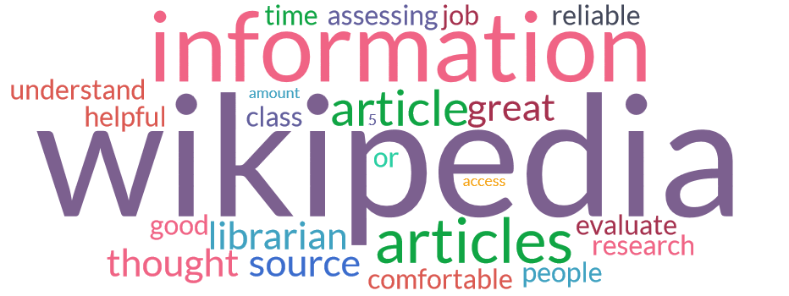
What are participants saying?
Notes:
The course increased the participants knowledge, skills, and confidence to work with Wikipedia. Here are some sample comments we have received so far from the participants:
“I felt comfortable assessing the reliability of information, but this course really emboldened me to look at Wikipedia in a different light. Whereas before I might not have bothered to use Wikipedia, now I am *willing* to look at it and see how it may be useful to me.”
This course taught me a lot of tips for examining an article and judging it based on rating, resources, number and experience of the editors.
Students come in all the time and want to use Wikipedia as a source for homework. now I understand the process of authoring articles, so I can do a better job of recommending Wikipedia and explaining its.
I am a frequent user of Wikipedia.. But, I was one of 99% users who think of Wikipedia as a less reliable source. I must say that this course was an eye opener and I could not help but share every session experience with my fellow librarians. I am a changed librarian now, one who feels the worth of Wikipedia, crowdsourcing and contributing to the larger community.

Slide 25
3. Participants take action
Practicing
  Editing Wikipedia
  Networking with other Wikipedia editors
Sharing
  Staff training
  Patron training
Applying
  Using Wikipedia for information literacy guidance
  Planning community programs that use Wikipedia
  Joining Wikipedia projects
Notes:
As their final assignment the participants have created an action plan for how they will apply what they learned in the course. These plans generally fall into three categories.
First, is practice. Many participants say they will work on editing Wikipedia articles to increase their comfort level with the process and the interaction with other Wikipedia editors. During the course itself, the participants made more than 4,400 edits to 462 Wikipedia articles
Second sharing. Our participants told us they are sharing what they learned with colleagues and with their library patrons, through formal and informal training sessions.
Third, is application. The participants were especially excited to use Wikipedia as an information literacy teaching tool to help people become critical consumers and evaluators of information. Others are planning programs at the library that use Wikipedia, many in partnership with local cultural organizations such as a history museum. Some will also coordinate their community’s participation in larger-scale Wikipedia projects.

Slide 26
Librarians need a learning network too
Notes:
Besides the connection between Wikipedia and librarianship, this OCLC project also demonstrates that librarians benefit from a learning network that helps them to continuously and rapidly update their skills.

Slide 27

Facebook
LinkedIn
Google
Group
Group
Group
Group
Co-workers
knowledge
Twitter
librarian
Other libraries
hashtag
Blog
knowledge
hashtag
Professional Association
hashtag
Online course
Wikipedia
Group of experts
knowledge
Notes:
In addition to formal professional development and continuing education, librarians also seek online courses, library Facebook groups, Twitter chats, discussion lists, associations, conferences, blogs, and so on, to build connections to people and information that support their learning.
But even information professionals can find it overwhelming to sort through the options.
Also, there are thousands of library staff who are isolated from their peers, working in small libraries in remote locations. Many just don’t know where to look or who to ask.
The Wikipedia +Public Libraries project is one example of how the WebJunction program works to build and support networked learning among librarians.

Slide 28
U.S. Public Libraries
www.webjunction.org
Notes:
With funding from the Bill and Melinda Gates Foundation, WebJunction was launched by OCLC in 2003 to be an online learning network for the 138,000 staff working more than 16,000 public libraries across the United States.
Many US libraries are small and geographically isolated, and we do not have a national library to coordinate the creation and exchange of knowledge and learning across the system.
Therefore, WebJunction’s mission is to identify promising innovations and practices happening in exemplar libraries, and share their staff’s knowledge and expertise broadly so that other libraries can learn from them. We do this online, so that the knowledge can spread further, faster, and more efficiently.

Slide 29
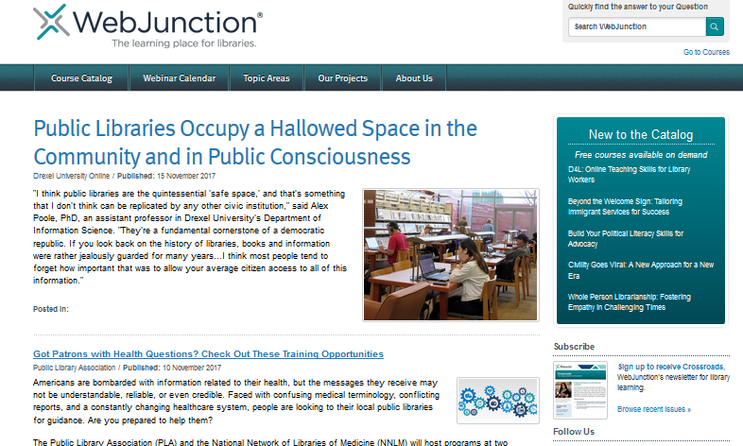
www.webjunction.org
Notes:
The learning resources provided by WebJunction are available for anyone the library profession to use.
These resources include a catalog of courses on topics related to library practice
Monthly webinars that feature presentations by library practitioners
Articles and resources on library management, library programming, technology, and continuous learning
And, also, large-scale training programs like I featured today.
The resources are all in English language.

Slide 30
The WebJunction Way
meet people where they are
show rather than tell
confidence is key
learning + application → transformation
www.webjunction.org
Notes:
Over our 15 years of being a library learning network, WebJunction has developed some shared values of its own. These include:
Meet people where they are. In other words, we construct learning programs that are designed with the learners’ needs and perspectives in our minds.
Show, don’t tell – We see library staff as the experts, and draw upon them to present practical information to their peers.
We don’t just build skills and knowledge, we build confidence. To do this, we provide support and guidance for library staff as they learn.
We don’t believe in stopping at just acquiring new knowledge or skills; we want that learning to be applied. For it is then that transformation – for librarians, their libraries, their patrons and their communities – can happen.
These values inform the design and delivery of our training courses, webinars, and resources.

Slide 31
Bibliography
Dirckinck-Holmfeld, L., Jones, C., and Lindström, B. (2009) Analysing Networked Learning Practices in Higher Education and Continuing Professional Development. Rotterdam: Sense Publishers, BV.
Dron, J. and Anderson, T., Teaching Crowds: Learning and Social Media (2014). Edmonton: AU Press. doi:10.15215/aupress/9781927356807.01
Siemens, G., “Connectivism: A Learning Theory for the Digital Age,” in International Journal of Instructional Technology and Distance Learning, vol. 2, no. 1, January 2005.

Slide 32
Sharon Streams
Jacinta Sutton
OCLC
State Library of Queensland
streamss@oclc.org
Twitter: @thinktower

