Slide 1
What’s in a Name? Managing Researcher IDs & the Library’s Role
Karen Smith-Yoshimura
OCLC Research
ARL Research Library Leadership Fellows, OCLC Visit
5 May 2014
Notes:
I’m Karen Smith-Yoshimura, program officer in OCLC Research in our San Mateo office in California. I will summarize work over the past year on researcher identifiers.

Slide 2
Scholarly output impacts the reputation and ranking of the institution
We initially use bibliometric analysis to look at the top institutions, by publications and citation count for the past ten years…
Universities are ranked by several indicators of academic or research performance, including… highly cited researchers…
Citations… are the best understood and most widely accepted measure of research strength.
Notes:
First, some background and the problem statement. These are three university rankings issued annually, rankings that are of particular importance to research libraries. Some universities even incorporate raising their ranking in their strategic plans. All three use citations as a factor in determining the rankings, which skews the results towards universities focusing on the sciences rather than the humanities. It also puts added weight to authors of journal articles, which are usually not represented in national authority files.

Slide 3
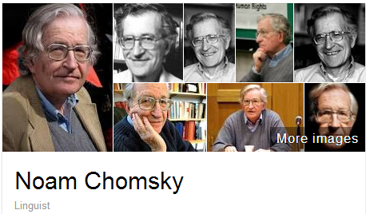
A scholar may be published under many forms of names
Works translated into 50 languages
(WorldCat)
Νόαμ Τσόμσκι
নোম চম্‌স্কি
ནམ་ཆོམ་སི་ཀེ།
નોઆમ ચોમ્સ્કી
नोआम चाम्सकी
Նոամ Չոմսկի
ノーム・チョムスキー
ნოამ ჩომსკი
Ноам Чомски
ನೋಅಮ್ ಚಾಮ್ಸ್ಕೀ
노엄 촘스키
നോം ചോംസ്കി
ਨੌਮ ਚੌਮਸਕੀ
Ноам Хомский
诺姆·乔姆斯基
Also published as:
Avram Noam Chomsky
N. Chomsky
نعوم تشومسكي
נועם חומסקי
Journal articles
Notes:
Noam Chomsky is a scholar widely translated. WorldCat has records for his works in fifty languages. But only some of the forms of his name are represented as “preferred forms” in national authority files (shown on the left). The forms on the right are from wikidata. The Library of Congress/NACO authority file can support only a few of the scripts shown, representing these scripts with romanizations.
Note that the “N. Chomsky” form used in journal articles is generally not included in national authority files. Chomsky happens to have a rather unique name, but for many others it would be a challenge to match up the abbreviated journal citation form with the fuller forms of name. This illustrates the futility of relying on text string matching to determine if two authors represent the same person or not.

Slide 4
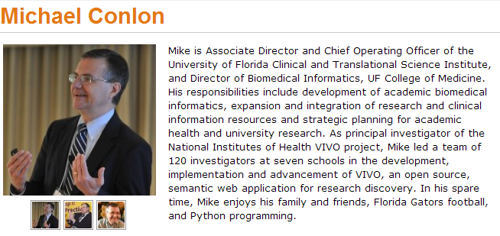
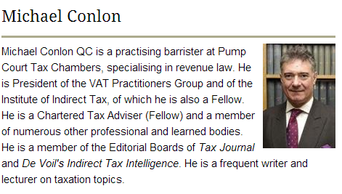
Same name, different people
Conlon, Michael. 1982. Continuously adaptive M-estimation in the linear model. Thesis (Ph. D.)--University of Florida, 1982.
Notes:
Michael Conlon is a member of our task group, an expert in biomedial informatics at the University of Florida. There is another Michael Conlon in the UK who writes articles on European taxes. Obviously two different people. Then there’s an article on microbiota in the Australian journal Microbiology written by a Michael Conlon. The same Michael Conlon as the U. Florida one or a different one based in Australia? Without other metadata, it is difficult to tell. (“Our” Michael Conlon, at U. Florida has confirmed that the one in Australia is not him.)
Michael Conlon is a rather uncommon name. But consider that in China 275 million people have the surname of Li, Wang or Zhang. And that’s not including the millions of overseas Chinese. The chances ethnic Chinese having the same name—especially in the abbreviated form used in journal articles– is high. We need other identifying attributes such as institutional affiliation and discipline (if not photos) to disambiguate names.

Slide 5
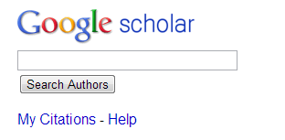
One researcher may have many profiles or identifiers…
(from an email signature block)
Profiles: Academia / Google Scholar / ISNI / Mendeley / MicrosoftAcademic / ORCID / ResearcherID / ResearchGate / Scopus / Slideshare / VIAF / Worldcat
Notes:
Some researchers already have multiple identifiers. This is an example from a signature block in an email. The researcher includes twelve different identifiers or profiles he’s represented in. This also fragments his Web presence.
To recap the problem statement:
Citations are a factor in assessing the impact of scholarship but journal article authors often are not represented in authority files.
A given scholar can be represented by different forms of the name, all of which may not be included in authority files.
Two or more researchers may have the same name, and we need other attributes to disambiguate them.
Some researchers already have multiple identifiers.

Slide 6
Authorship Trends, Issues, & Questions
Trend | Potential Authorship Issues | Questions
Increase in number of coauthors | ‘honorary’ authorship ‘ghost’ authorship disputes | How to disambiguate author names? How to communicate attribution in citation? How to describe contributions to work? How to evaluate and predict impact? Who is responsible?
Shift from academic publishing in books to journals | loss of sole-author-book as a evaluation measure | How to integrate name authority and researcher identifier systems?
Decreasing granularity of publications | persistence of “nano” publication vs. authorship | How to document authorship over substructure of work?
Dynamic documents | version misattribution | How to document authorship over time?
Increasing diversity in citable scholarly outputs | citation cannibalization, overrcounting | How to cite data, software, presentations(?), blogs (?), tweets (?)

Slide 7
Registering Researchers in Authority Files Task Group
How to make it easier for researchers and institutions to more accurately measure their scholarly output?
Challenges to integrate author identification
Approaches to reconcile data from multiple sources
Models, workflows to register and maintain integrated researcher information

Slide 8
Registering Researchers in Authority Files Task Group Members
Micah Altman, MIT - ORCID Board member
Michael Conlon, U. Florida – PI for VIVO
Ana Lupe Cristan, Library of Congress – LC/NACO trainer
Laura Dawson, Bowker – ISNI Board member
Joanne Dunham, U. Leicester
Amanda Hill, U. Manchester – UK Names Project
Daniel Hook, Symplectic Limited
Wolfram Horstmann, U. Oxford
Andrew MacEwan, British Library – ISNI Board member
Philip Schreur, Stanford – Program for Cooperative Cataloging
Laura Smart, Caltech – LC/NACO contributor
Melanie Wacker, Columbia – LC/NACO contributor
Saskia Woutersen, U. Amsterdam
Thom Hickey, OCLC Research – VIAF Council, ORCID Board
Notes:
These are the members of the OCLC Research Registering Researchers in Authority Files Task Group which I facilitate. The members represent different perspectives from three countries – the U.S., The Netherlands, and the UK. We have members who are librarians, those who contribute to the LC/NACO authority file or train others to do so and who are members of the Program for Cooperative Cataloging. We have ORCID and ISNI Board members, and representatives from VIVO, a Current Research Information System (Symplectic), and a publisher (Bowker). My colleague Thom Hickey is the chief scientist responsible for creating the Virtual International Authority File and is on both the VIAF Council and the ORCID Board.

Slide 9
Stakeholders & needs
Researcher | Disseminate research
 | Compile all output
 | Find collaborators
 | Ensure network presence correct
Funder | Track research outputs for grants
University administrator | Collate intellectual output of their researchers
Journalist | Retrieve all output of a specific researcher
Librarian | Uniquely identify each person
Identity management system | Associate metadata, output to researcher
 | Disambiguate names
 | Link researcher's multiple identifiers
 | Disseminate identifiers
Aggregator (includes publishers) | Associate metadata, output to researcher
 | Collate intellectual output of each researcher
 | Disambiguate names
 | Link researcher's multiple identifiers
 | Track history of researcher's affiliations
 | Track & communicate updates
Notes:
The first thing the task group did was write up 18 use case scenarios from the perspective of different actors or stakeholders. I’ve consolidate the needs identified here; some overlap.

Slide 10
Some functional requirements
Librarian as a stakeholder
Create consistent and robust metadata
Associate metadata for a researcher’s output with the correct identifier
Disambiguate similar results
Merge entities that represent the same researcher and split entities that represent different researchers
Notes:
From the use case scenarios we derived functional requirements, again linked to the stakeholders. These are the functional requirements for librarians – we need consistent and robust metadata to allow for successful integration with other researcher’s output and various types of sorting.

Slide 11
More functional requirements
Researcher and university administrator as a stakeholder
Link multiple identifiers a researcher might have to collate output
Associate metadata with a researcher’s identifier that resolves to the researcher’s intellectual output.
Verify a researcher/work related to a researcher is represented
Register a researcher who does not yet have a persistent identifier
Funder and university administrator as a stakeholder
Link metadata for a researcher’s output to grant funder’s data
Notes:
These are some functional requirements for the researcher, university administrator and funder. Other requirements are targeted for other stakeholders.

Slide 12
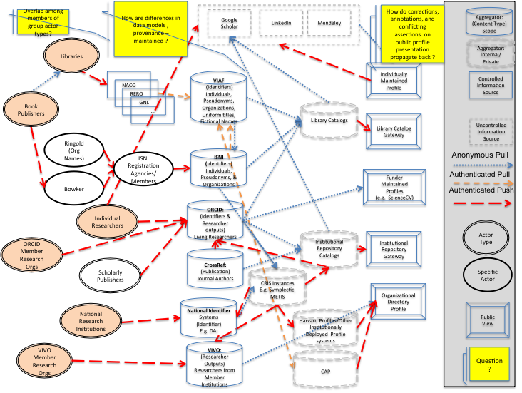
The Landscape of Researcher Identification

Slide 13
Systems profiled (20)
Authority hubs:
Digital Author Identifier (DAI)
Lattes Platform
LC/NACO Authority File
Names Project
Open Researcher and Contributor ID (ORCID)
ResearcherID
Virtual International Authority File (VIAF)
Current Research Information System (CRIS): Symplectic
Identifier hub: International Standard Name Identifier
National research portal: National Academic Research and Collaborations Information
System (NARCIS)
Notes:
We started with a list of over 100 different research information/identifier systems. Criteria used to select systems to profile: 1) have significant mind-share/take-up by researchers and 2) researchers are represented by a persistent, unique, and publicly accessible URI. We wanted to end up with a representative sample of different research information/identifier systems. For some system types we profiled only one system to represent a category.

Slide 14
Systems profiled (20)
Online encyclopedia: Wikipedia
Reference management:
Research & collaboration hub: nanoHUB
Researcher profile systems:
Community of Scholars
Google Scholar
LinkedIn
SciENcv
VIVO
Subject author identifier system:
Subject repository: arXiv

Slide 15
Partial overview: Authority & identifier hubs
Digital Author Identifier | Researchers in all Dutch CRIS & library catalogs | 66K
Lattes Platform | Brazilian researchers and research institutions | 2M people, 4K inst.
ISNI | Data from libraries, open source resource files, commercial aggregators, rights management organizations. Includes performers, artists, producers, publishers | 7M total; 720 K researchers
LC/NACO Authority File | Persons, organizations, conferences, place names, works | 9M total; ? researchers
ORCID | Individual researchers plus data from CrossRef/Scopus, institutions, publishers | 200K
ResearcherID | Researchers in any field, in any country | 250K
VIAF | Library authority files for persons, organizations, conferences, place names, works | 26M people; ? researchers
Notes:
Each profile contains many characteristics; I’m showing only a partial overview, of the scope and size, for the systems characterized as authority or identifier hubs. Some focus only on researchers, while others are broad with millions of people represented. It is often impossible to tell how many researchers are represented in these larger databases.
The Lattes Platform is the largest of the researcher-only databases; it includes Brazilian researchers in all disciplines plus those outside Brazil who work with them.
ISNI’s focus is to consolidate the data from multiple sources and assign then diffuse identifiers to support machine matching and disambiguation of name identities. ISNI can be assigned to all individuals and organisations that create, perform, produce, manage, distribute or feature in creative content including natural, legal, or fictional identities. Note that ISNI is a VIAF contributor and Digital Author Identifiers are being loaded into ISNI.

Slide 16
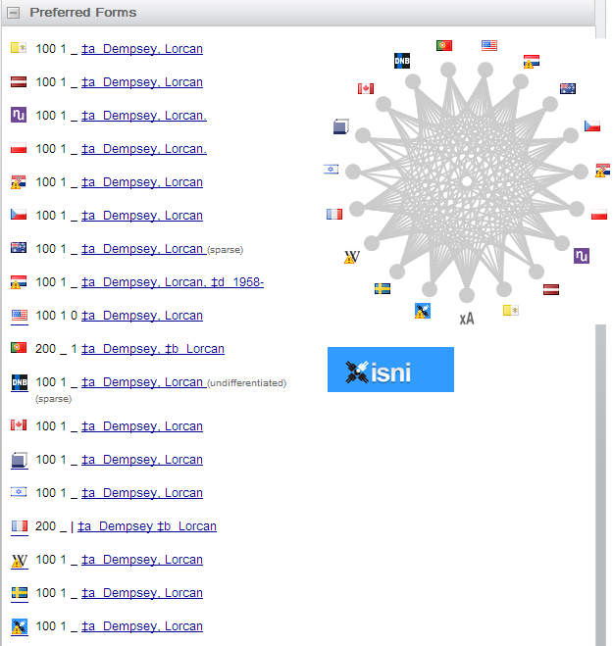
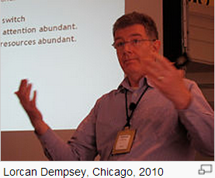
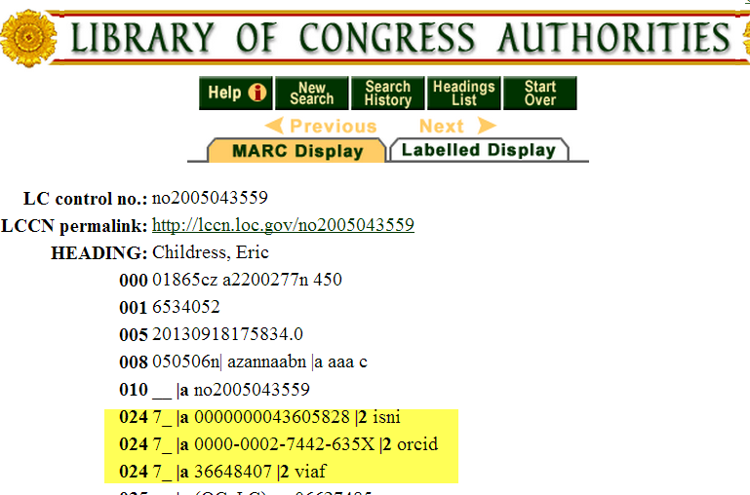
Some overlaps
Notes:
There are overlaps. Here, Lorcan Dempsey’s VIAF cluster shows he is represented in 16 national authority files as well as by a Wikipedia article and the ISNI database. My OCLC colleague Eric Childress has an authority record with his ISNI, ORCID, and VIAF identifiers.

Slide 17
ISNI & ORCID
Complementary systems with two different approaches
ISNI: Consolidate data from multiple databases
ORCID: Researchers self-register
Share two goals:
Assign and share identifiers so both databases have only one identifier for a specific person.
Share publicly available metadata.
Coordination:
ISNI allocated range of identifiers for ORCID’s exclusive use
ORCID using ISNIs for organizations
Developing interoperation: consult ISNI database during ORCID registration
From: ISNIs for researchers 2013-09 http://www.isni.org/filedepot_download/126/345
Notes:
ISNI’s main goal is to establish & diffuse reliable identifiers and links (regardless of the purpose); ORCID’s purpose is for researchers to submit identifiers with their papers for publication.

Slide 18
Where is Everyone?

Slide 19
Where are researchers?
Wild Guesses

Slide 20
Changing Scholarly Landscape … Books vs. Journals
 | Books | Journals
Read by | All disciplines | Most Disciplines
Tenure & promotion driver | Humanities, some Social Sciences (e.g. Political Science) | Some Humanities, Social Sciences, Life Sciences, Physical Sciences
Robust system of name and subject | Yes | No
Robust system of citation tracking | No | Yes
Robust system of full-text indexing | No | Yes, although fragmented

Slide 21
Researcher Identifier ≠ Name Authorities
 | Traditional Name Authorities | Researcher Identifier Systems
Primary Stakeholders | Libraries | Publishers, Researchers, Funders, Libraries
Internal standardization/integration | Standardized and well integrated within libraries but new models are emerging | Fragmented. Some well-integrated communities of practice.
Organization | Primarily top-down, careful controlled entry from participating organizations | Varies: top down, bottom-up, middle out; often individual contributors
External integration | Very limited: High barriers to entry, few simple API’s | Varies, but more open. Some services offer simple open API’s; integration with web 2.0 protocols (e.g. OpenId)
Works Covered | Primarily Books & other works traditionally catalogued by libraries | Journal articles; Grants; Datasets
People covered | Authors and people written about represented in the library catalog of the community | Authors of research articles, fundees, members of research institutions – international
Key record criterion | Persistent and unambiguous identifier with a preferred label for the community served | Persistent and unambiguous identifier for an individual contributor

Slide 22
Complex Environment
Types of Systems
Authority hubs: providing a centralized location of records for multiple institutions
Current Research Information System (CRIS): stores and manages data about research conducted at an institution and integrates it with data from external sources:
Identifier hubs: providing a centralized registry of identifiers
National research portal: providing access to all research data stored in a nation’s network of repositories
Online encyclopedia: a compendium of information divided into articles which includes references to the works by scholars
Reference management: a system to help scholars organize their research, collaborate with others, and discover the latest research
Research and collaboration hub: a centralized portal where scholars in a particular discipline can work together
Researcher profile systems: networks that facilitate professional networking among scholars
Subject author identifier system: a registration service to link scholars with the records about the works they have written
Subject repository: a discipline-based centralized repository to facilitate scholarly exchanged in the fields covered
Roles
Systems overlap – Google Scholar combines reference management, profiles, ids
Systems can have both producers and consumers relationships with each other
Institutional members/maintainers overlap systems, but do not necessarily coordinate
How disputed information is resolved is often unclear

Slide 23
How are differences in data models , provenance – maintained ?
LinkedIn
Mendeley
How do corrections, annotations, and conflicting assertions on public profile presentation propagate back ?
Aggregator: (Content Type)
Scope
Google Scholar
Libraries
Aggregator: Internal/Private
Individually Maintained Profile
NACO
VIAF (Identifiers)
Individuals,
Pseudonyms, Organizations, Uniform titles, Fictional Names
Controlled
Information
Source
RERO
Book Publishers
GNL
…
Library Catalogs
Library Catalog
Gateway
Uncontrolled
Information
Source
Ringold (Org Names)
ISNI
Registration
Agencies/Members
ISNI (Identifiers) Individuals, Pseudonyms, & Organizations
Anonymous Pull
Bowker
Funder Maintained Profiles (e.g. ScienceCV)
Authenticated Pull
Authenticated Push
Individual
Researchers
ORCID: (Identifiers & Researcher outputs) Living Researchers
Actor Type
ORCID Member Research Orgs
Institutional Repository Catalogs
Institutional Repository
Gateway
CrossRef: (Publication) Journal Authors
Scholarly Publishers
Specific Actor
CRIS Instances
E.g. Symplectic, METIS
Organizational Directory Profile
National Research Institutions
National Identifier Systems
(Identifier)
E.g. DAI
Public View
Harvard Profiles/Other Institutionally Deployed Profile systems
VIVO
Member Research Orgs
VIVO: (Researcher Outputs) Researchers from Member Institutions
Question?
CAP
Notes:
Micah Altman (MIT) diagramed this Researcher ID information flow which demonstrates the complexity of the current researcher information workflow ecosystem. The ovals on the left show the various stakeholders: libraries, publishers, individual reserachers, ISNI registration agencies, ORCID and VIVO members, national research institutions. The dotted lines show the information flow among them, for example, book publishers provide information to libraries. The drums in the centers represent various types of aggregated databases: Virtual International Authority File, ISNI, ORCID, CrossRef, National platforms, VIVO. The lower right represents institutional-based databases such as Harvard Profiles, Stanford’s Community Academic Profiles, an institution’s CRIS or Institutional repository. Note that these operate separately from the libraries’ work on authority records on the top left. The information flows to either controlled information sources on the far right, or uncontrolled information sources on the Internet shown on the top (Google Scholar, LinkedIn, Mendeley).
A key question is how corrections or updates can be communicated between systems. Researchers are frustrated when they see errors in their profile or works incorrectly assigned to them, or works missing. Even if the information is corrected in the local instance, it often does not get reflected in the aggregated databases or hubs.

Slide 24
Observations
“It’s tough to make predictions, especially about the future!”
- Attributed to Woody Allen, Yogi Berra, Niels Bohr, Vint Cerf, Winston Churchill, Confucius, Disreali [sic], Freeman Dyson, Cecil B. Demille, Albert Einstein, Enrico Fermi, Edgar R. Fiedler, Bob Fourer, Sam Goldwyn, Allan Lamport, Groucho Marx, Dan Quayle, George Bernard Shaw, Casey Stengel, Will Rogers, M. Taub, Mark Twain, Kerr L. White, etc.

Slide 25
Some emerging trends:
Widespread recognition that persistent identifiers for researchers are needed
Registration services rather than authority files as a solution for researcher identification
Interoperability between systems is increasing:
ISNI & VIAF interoperability.
ORCID and ISNI coordination
CRIS system integration with ORCID, ISNI, VIVO
Adoption trends …

Slide 26
Adoption Trends: Publishers − Early Adopters
Major scholarly journal publishers with US presence now integrate ORCIDs (ACM, Elsevier, Hindawi, IEEE, NPG, PLOS, Springer, Taylor & Francis, Thomson Reuters, Wiley)
Integration of ORCIDs with manuscript subscription systems
MacMillan integrating ISNIs in Digital Science family of systems
Integration of ORCIDs with CrossRef platform for DOI indexing and interlinking services

Slide 27
Adoption Trends: Funders -- National Adoption & Beyond
FCT, the Portuguese national funder, requires ORCIDS for their national evaluation system
DAI, the Netherlands national funder, has created ISNIs for each researcher
SNSF, the Swiss national funder, has created ISNIs for each researcher
Wellcome Trust has integrated ORCIDs into grant submission and evaluation.
NIH integrated ORCIDs into the inter-agency biosketch platform SciENcv.
U.S. D.O.E. integrated ORCIDs into grant submission

Slide 28
Adoption trends: Increasing number of universities assigning identifiers to researchers
Assigning ORCIDs to authors when submitting electronic
dissertations in institutional repositories
Pilot to automatically generate preliminary authority records
from publisher files (Harvard U. press, one other)
Assigning ISNI identifiers to their researchers.
Assigning local identifiers to researchers
Using UUIDs (Universally Unique identifiers) to map to other identifiers like ORCID.
Integrating ORCID into VIVO open source
research profiling system, used by over 100
institutions
Notes:
We have started identifying some “possibly emerging trends”. The field is changing so quickly it is hard to tell whether a couple of examples are isolated occurrences or indicative of an emerging trend.
Note that the four universities shown here are taking five different approaches to assigning identifiers to researchers.

Slide 29
Recommendations
Notes:
29. The task group has targeted recommendations to a particular audience or stakeholder – I’m focusing on the ones most relevant to you here.

Slide 30
Prepare to Engage
Adoption of researcher identifiers has been rapid within scholarly publishing
Funders see clear benefits, and are engaged
It is time for universities to transition from watchful waiting to engagement

Slide 31
Starting to engage
Develop outreach and educational materials for researchers, stakeholders
Future-proof systems:
Authors are not a string
Identifiers are multi-valued, with multiple authorities
Demand more than PDF’s …
Many publishers are already associating each article with:
Multi-valued author list
Identifiers – author, funder, institution
Contribution/COI statements
Prepare for more complex measurement & reporting of usage

Slide 32
Choosing identifiers
Broad Researcher Identifiers: Compare ORCID & ISNI
National mandates
Capabilities
Usage patterns
Retain traditional identifiers: VIAF, NACO
Well supported in library systems
Primarily describe authors of books and similar works
Be aware of community identifiers for local integration (e.g. ArXiV )

Slide 33
Possible library role
Encourage researchers to obtain a persistent identifier before submitting any output and disseminate their identifiers in all external communications
Assign persistent identifiers to authors at point of submission if don’t already have one
Electronic dissertations in institutional repositories
Papers, datasets to research websites
Articles to journal aggregators

Slide 34
Manage Risks
Environment is evolving
Funder mandates and policies are incomplete
No dominant business model
Incomplete adoption, no single comprehensive data source
Integration between classic and new name authority is lacking
Researchers …
will not drive change alone;
are sensitive to who controls their profile, and how information can be “corrected”;
Incentive mechanisms, well-timed nudges, setting norms with junior scholars, and establishing information feedback loops are critical.

Slide 35
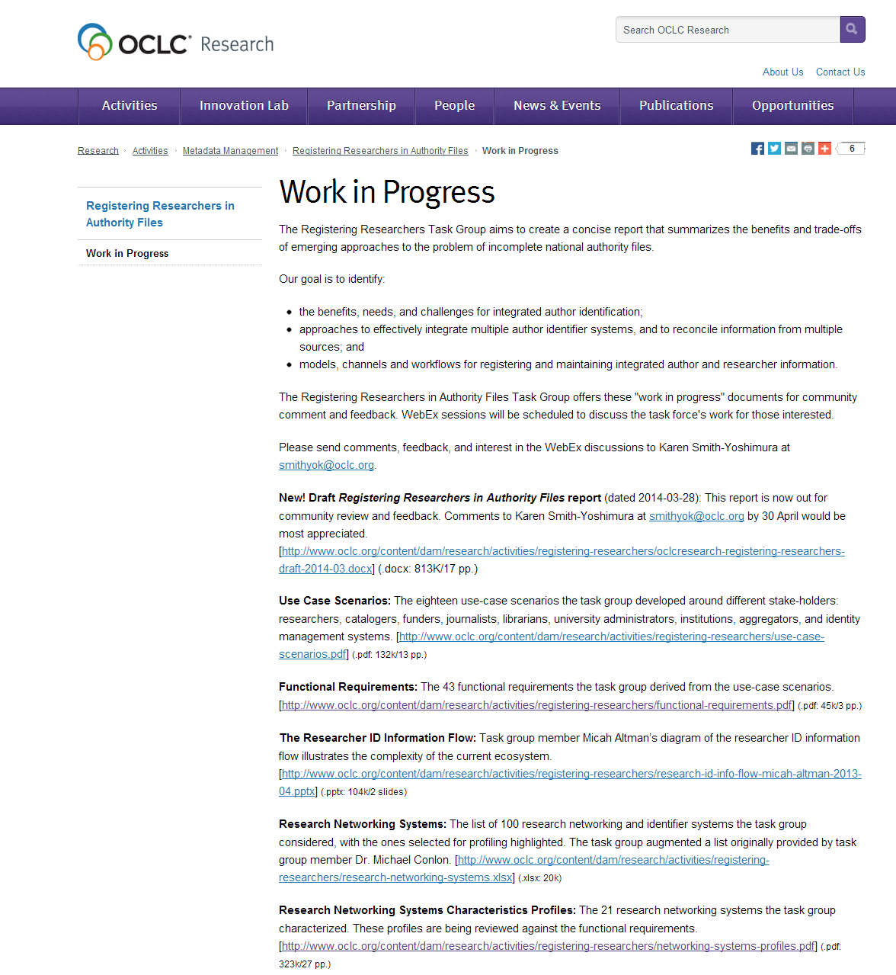
http://www.oclc.org/research/activities/registering-researchers/progress.html
Notes:
You can see in more detail our “works in progress” at the URL given here. Our draft report was issued for community review and comment on 28 March.

Slide 36
smithyok@oclc.org
@KarenS_Y
viaf.org/viaf/72868513
http://www.oclc.org/research/activities/registering-researchers.html

