Slide 1
DLF Forum, Atlanta GA 27 October 2014
Researcher Identifiers−
What’s in a Name
(or URI)?
Karen Smith-Yoshimura
Program Officer

Slide 2
Authorship Trends, Issues, & Questions
Trend | Potential Authorship Issues | Questions
Increase in number of coauthors | ‘honorary’ authorship ‘ghost’ authorship disputes | How to disambiguate author names? How to communicate attribution in citation? How to describe contributions to work? How to evaluate and predict impact? Who is responsible?
Shift from academic publishing in books to journals | loss of sole-author-book as a evaluation measure | How to integrate name authority and researcher identifier systems?
Decreasing granularity of publications | persistence of “nano” publication vs. authorship | How to document authorship over substructure of work?
Dynamic documents | version misattribution | How to document authorship over time?
Increasing diversity in citable scholarly outputs | citation cannibalization, overrcounting | How to cite data, software, presentations(?), blogs (?), tweets (?)
Notes:
First, some context – we’re defining “researcher” as anyone who produces or is in the process of producing scholarly output. This output is increasingly journal articles, with co-authors – as well as other forms of scholarly outputs (datasets, presentations, blogs, etc.) A key question is how we integrate name authority and researcher identifier systems.

Slide 3
Scholarly output impacts the reputation and ranking of the institution
We initially use bibliometric analysis to look at the top institutions, by publications and citation count for the past ten years…
Universities are ranked by several indicators of academic or research performance, including… highly cited researchers…
Citations… are the best understood and most widely accepted measure of research strength.
Notes:
These are three university rankings issued annually, rankings that are of particular importance to research libraries. Some universities even incorporate raising their ranking in their strategic plans. All three use citations as a factor in determining the rankings, and puts added weight to authors of journal articles, which are usually not represented in national authority files.

Slide 4
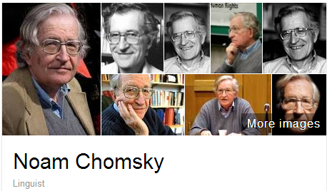
A scholar may be published under many forms of names
Works translated into 50 languages
(WorldCat)
Νόαμ Τσόμσκι
নোম চম্‌স্কি
ནམ་ཆོམ་སི་ཀེ།
નોઆમ ચોમ્સ્કી
नोआम चाम्सकी
Նոամ Չոմսկի
ノーム・チョムスキー
ნოამ ჩომსკი
Ноам Чомски
ನೋಅಮ್ ಚಾಮ್ಸ್ಕೀ
노엄 촘스키
നോം ചോംസ്കി
ਨੌਮ ਚੌਮਸਕੀ
Ноам Хомский
诺姆·乔姆斯基
Also published as:
Avram Noam Chomsky
N. Chomsky
نعوم تشومسكي
נועם חומסקי
Journal articles
Notes:
Noam Chomsky is a scholar widely translated. WorldCat has records for his works in fifty languages. But only some of the forms of his name are represented as “preferred forms” in national authority files (shown on the left). The forms on the right are from wikidata. The Library of Congress/NACO authority file can support only a few of the scripts shown, representing these scripts with romanizations.
Note that the “N. Chomsky” form used in journal articles is generally not included in national authority files. Chomsky happens to have a rather unique name, but for many others it would be a challenge to match up the abbreviated journal citation form with the fuller forms of name. This illustrates the futility of relying on text string matching to determine if two authors represent the same person or not.

Slide 5
Same name, different people
Conlon, Michael. 1982. Continuously adaptive M-estimation in the linear model. Thesis (Ph. D.)--University of Florida, 1982.
Notes:
Michael Conlon is a member of our task group, an expert in biomedial informatics at the University of Florida. There is another Michael Conlon in the UK who writes articles on European taxes. Obviously two different people. Then there’s an article on microbiota in the Australian journal Microbiology written by a Michael Conlon. The same Michael Conlon as the U. Florida one or a different one based in Australia? Without other metadata, it is difficult to tell. (Turns out, it’s yet another Michael Conlon.)
Michael Conlon is a rather uncommon name. But consider that in China 275 million people have the surname of Li, Wang or Zhang. And that’s not including the millions of overseas Chinese. The chances ethnic Chinese having the same name—especially in the abbreviated form used in journal articles– is high. We need other identifying attributes such as institutional affiliation and discipline (if not photos) to disambiguate names.

Slide 6
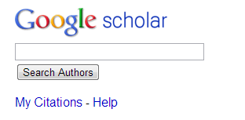
One researcher may have many profiles or identifiers…
(from an email signature block)
Profiles: Academia / Google Scholar / ISNI / Mendeley / MicrosoftAcademic / ORCID / ResearcherID / ResearchGate / Scopus / Slideshare / VIAF / Worldcat
Notes:
Some researchers already have multiple identifiers. This is an example from a signature block in an email. The researcher includes twelve different identifiers or profiles he’s represented in. This also fragments his Web presence.
To recap the problem statement:
Citations are a factor in assessing the impact of scholarship but journal article authors often are not represented in authority files.
A given scholar can be represented by different forms of the name, all of which may not be included in authority files.
Two or more researchers may have the same name, and we need other attributes to disambiguate them.
Some researchers already have multiple identifiers.

Slide 7
Registering Researchers in Authority Files Task Group Members
Micah Altman, MIT - ORCID Board member
Michael Conlon, U. Florida – PI for VIVO
Ana Lupe Cristan, Library of Congress – LC/NACO trainer
Laura Dawson, Bowker – ISNI Board member
Joanne Dunham, U. Leicester
Amanda Hill, U. Manchester – UK Names Project
Daniel Hook, Symplectic Limited
Wolfram Horstmann, U. Oxford
Andrew MacEwan, British Library – ISNI Board member
Philip Schreur, Stanford – Program for Cooperative Cataloging
Laura Smart, Caltech – LC/NACO contributor
Melanie Wacker, Columbia – LC/NACO contributor
Saskia Woutersen, U. Amsterdam
Thom Hickey, OCLC Research – VIAF Council, ORCID Board
Notes:
These are the members of the OCLC Research Registering Researchers in Authority Files Task Group which I facilitate. The members represent different perspectives from three countries – the U.S., The Netherlands, and the UK. We have members who are librarians, those who contribute to the LC/NACO authority file or train others to do so and who are members of the Program for Cooperative Cataloging. We have ORCID and ISNI Board members, and representatives from VIVO, a Current Research Information System (Symplectic), and a publisher (Bowker). My colleague Thom Hickey is the chief scientist responsible for creating the Virtual International Authority File and is on both the VIAF Council and the ORCID Board.

Slide 8
Stakeholders & needs
Researcher | Disseminate research
 | Compile all output
 | Find collaborators
 | Ensure network presence correct
 | Retrieve other’s scholarly output to track a given discipline
Funder | Track funded research outputs
University administrator | Collate intellectual output of their researchers to fulfill funder or national mandates, internal reporting
Librarian | Disambiguate names
Identity management system | Associate metadata, output to researcher
 | Disambiguate names
 | Link researcher's multiple identifiers
 | Disseminate identifiers
Aggregator (includes publishers) | Associate metadata, output to researcher
 | Collate intellectual output of each researcher
 | Disambiguate names
 | Link researcher's multiple identifiers
 | Track history of researcher's affiliations
 | Track & communicate updates
Notes:
The first thing the task group did was write up 18 use case scenarios from the perspective of different actors or stakeholders. I’ve consolidate the needs identified here; some overlap.

Slide 9
Systems profiled (20)
Notes:
We started with a list of over 100 different research information/identifier systems. Criteria used to select systems to profile: 1) have significant mind-share/take-up by researchers and 2) researchers are represented by a persistent, unique, and publicly accessible URI. We wanted to end up with a representative sample of different research information/identifier systems. For some system types we profiled only one system to represent a category.

Slide 10
Notes:
We’ve extrapolated from World Bank statistics that the total number of researchers worldwide was 9 million in 2012. Slide prepared by Dr. Micah Altman, MIT, for CNI presentation March 2014.

Slide 11
Now is More

Slide 12
Where are researchers?
Wild Guesses
Notes:
Slide prepared by Dr. Micah Altman, MIT, for CNI presentation March 2014.

Slide 13
Researcher Identifier ≠ Name Authorities
 | Traditional Name Authorities | Researcher Identifier Systems
Primary Stakeholders | Libraries | Publishers, Researchers, Funders, Libraries
Internal standardization/integration | Standardized and well integrated within libraries but new models are emerging | Fragmented. Some well-integrated communities of practice.
Organization | Primarily top-down, careful controlled entry from participating organizations | Varies: top down, bottom-up, middle out; often individual contributors
External integration | Very limited: High barriers to entry, few simple API’s | Varies, but more open. Some services offer simple open API’s; integration with web 2.0 protocols (e.g. OpenId)
Works Covered | Primarily books & other works traditionally catalogued by libraries | Journal articles; Grants; Datasets
People covered | Authors and people written about represented in the library catalogs | Authors of research articles, fundees, members of research institutions – international
Key record criterion | Persistent and unambiguous identifier with a preferred label for the community served | Persistent and unambiguous identifier for an individual contributor
Notes:
From slide prepared by Dr. Micah Altman, MIT, for CNI presentation March 2014.

Slide 14
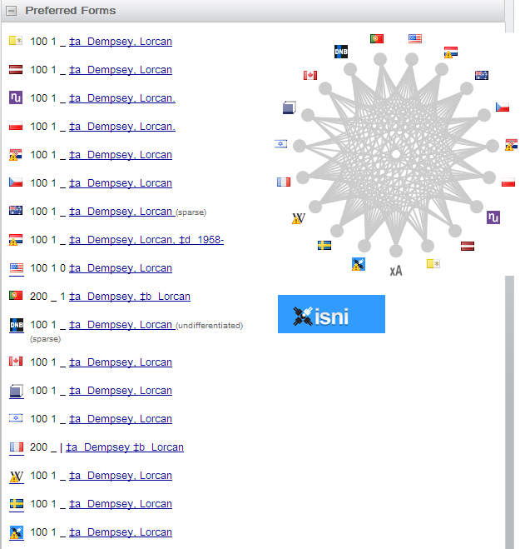
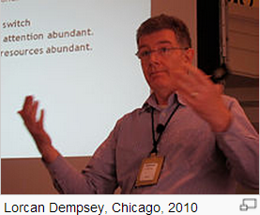
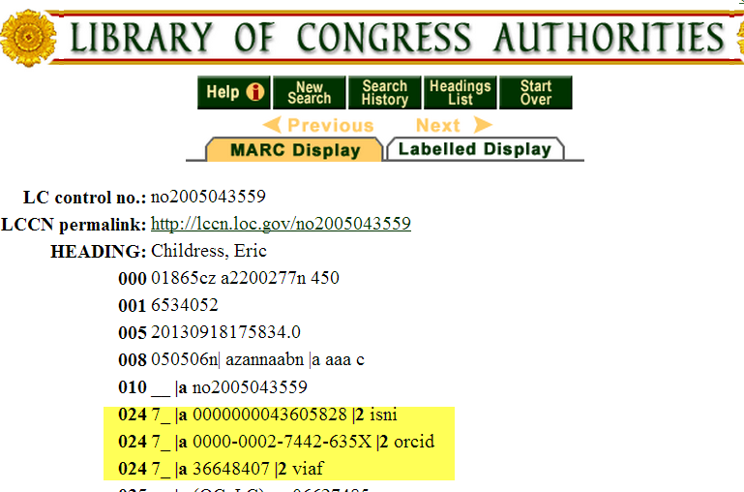
Some overlaps
Notes:
There are overlaps. Here, Lorcan Dempsey’s VIAF cluster shows he is represented in 16 national authority files as well as by a Wikipedia article and the ISNI database. My OCLC colleague Eric Childress has an authority record with his ISNI, ORCID, and VIAF identifiers.

Slide 15
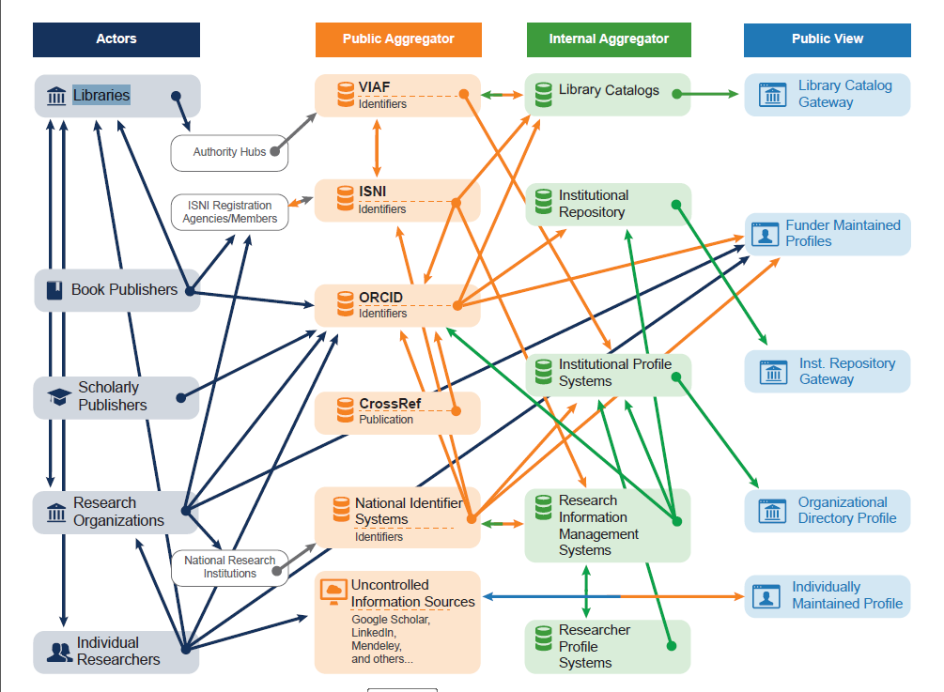
Researcher Identifier Information Flow
Notes:
The same information about a specific researcher may be represented in multiple databases, and only a subset interoperates with each other. We’ve diagrammed the flow of information describing researchers and identified researcher outputs such as publications among classes of actors and systems. Each category of actor is depicted with an icon and a caption. An arrow going from one entity to another is used to indicate that information flows from one entity to the other.
This researcher identifier information flow diagram reveals several patterns:
Information flow is quite complex overall, especially between public aggregators and private aggregators.
Most of the information flow is one way—there are few automatic or systematic channels for corrections or annotations at later stages to flow back up to public aggregator sources, or to the actors providing them. ISNI—which focuses on managing links between member identifier systems and databases—is an exception. It tracks all sources, and corrections are fed back to the source as they are made. The interoperability flows between ISNI and ISNI registration agencies, and between ISNI and VIAF, are indicated in the diagram by bidirectional arrows.
Many actors are contributing to multiple public views of Researcher ID information.
Information provided by the same class of actor may flow through multiple (possible concurrent) paths to internal aggregator systems and public views—suggesting the potential for duplication and inconsistency.
Individual categories of public views seldom represent more than one type of internal aggregator.
A key question is how corrections or updates can be communicated between systems. Researchers are frustrated when they see errors in their profile, works incorrectly assigned to them or works missing. Even if the information is corrected in the local instance, it often is not reflected in the aggregated databases or hubs.

Slide 16
Some emerging trends:
Widespread recognition that persistent identifiers for researchers are needed
Registration services rather than authority files as a solution for researcher identification
Interoperability between systems is increasing:
ISNI & VIAF interoperability
ORCID and ISNI coordination
Research information system integration with ORCID, ISNI, VIVO
Notes:
We identified some “possibly emerging trends”. The field is changing so quickly it is hard to tell whether a couple of examples are isolated occurrences or indicative of an emerging trend.

Slide 17
Early adopters
“More than a third of contributors in Books In Print have an ISNI” (ProQuest press release, 4 May 2014)
Notes:
Major scholarly journal publishers with US presence now integrate ORCIDs (ACM, Elsevier, Hindawi, IEEE, NPG, PLOS, Springer, Taylor & Francis, Thomson Reuters, Wiley)
Integration of ORCIDs with manuscript subscription systems
MacMillan integrating ISNIs in Digital Science family of systems
Integration of ORCIDs with CrossRef platform for DOI indexing and interlinking services

Slide 18
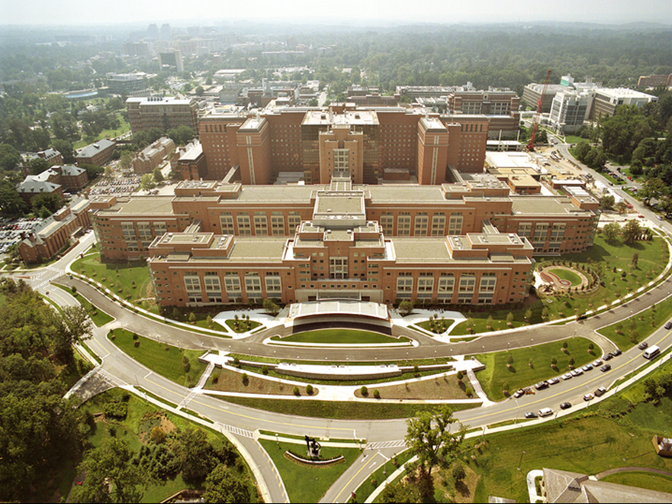
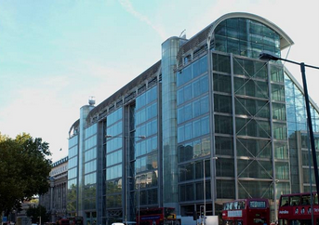
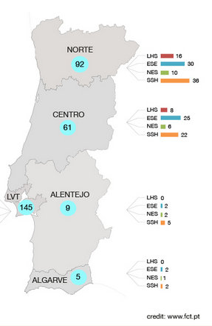
Adoption trends: Funders
Notes:
Wellcome Trust has integrated ORCIDs into grant submission and evaluation.
NIH integrated ORCIDs into the inter-agency biosketch platform SciENcv.
U.S. D.O.E. integrated ORCIDs into grant submission ; OSTI (Office of Scientific and Technical Information) is an ORCID member.
FCT, the Portuguese national funder, requires ORCIDS for their national evaluation system

Slide 19
Adoption trends: Universities
Assigning ORCIDs to authors when submitting electronic
dissertations in institutional repositories
Pilot to automatically generate preliminary authority
records from publisher files
Assigning ISNI identifiers to their researchers.
Assigning local identifiers to researchers
Enabling ORCIDS to be
linked to university personnel profiles
Integrating ORCID into VIVO open source
research profiling system, used by over 100
institutions
Notes:
Some different approaches to assigning identifiers to researchers by universities. Oxford is part of a JISC-ARMA (Association of Research Managers and Administrators) pilot with 8 UK higher education institutions to develop effective adoption models for ORCID.

Slide 20
Key recommendations
Researcher: Get persistent identifier (earlier in career the better) and use it on all external communications.
Librarian/University Administrator: Assign persistent identifiers to authors if they don’t already have them.
Retain traditional identifiers (e.g., VIAF IDs)
Ensure ISNI or other ID for organization is accurate
Advocate benefits and reasons for using and disseminating identifiers
Notes:
Recommended practices for librarians, researchers, university administrators

Slide 21
Manage risks
Environment is evolving
Funder mandates and policies are incomplete
No dominant business model
Incomplete adoption, no single comprehensive data source
Integration between classic and new name authority is lacking
Researchers …
will not drive change alone.
are sensitive to who controls their profile, and how information can be “corrected”.
Incentive mechanisms, well-timed nudges, setting norms with junior scholars, and establishing information feedback loops are critical.

Slide 22
Choosing identifiers
Broad Researcher Identifiers: ORCID & ISNI
National mandates
Capabilities
Usage patterns
Retain traditional identifiers: VIAF, NACO
Well supported in library systems
Primarily describe authors of books and similar works
Be aware of community identifiers for local integration (e.g. ArXiV )

Slide 23
ISNI & ORCID
Complementary systems with two different approaches
ISNI: Consolidate data from multiple databases
ORCID: Researchers self-register
Share two goals:
Assign and share identifiers so both databases have only one identifier for a specific person.
Share publicly available metadata.
Coordination:
ISNI allocated range of identifiers for ORCID’s exclusive use
ORCID using ISNIs for organizations
Developing interoperation: consult ISNI database during ORCID registration
From: ISNIs for researchers 2013-09 http://www.isni.org/filedepot_download/126/345
Notes:
ISNI’s main goal is to establish & diffuse reliable identifiers and links (regardless of the purpose); ORCID’s purpose is for researchers to submit identifiers with their papers for publication.

Slide 24
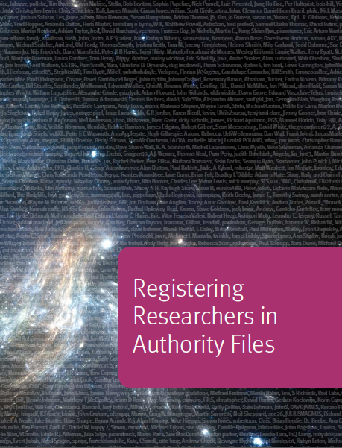
Report just published!
Plus supplementary datasets:
Use case scenarios
Functional requirements
Links to 100 researcher networking and identifier systems
Characteristics profiles
Mapping of profiles to functional requirements
Researcher identifier information flow diagram
http://www.oclc.org/research/publications/library/2014/oclcresearch-registering-researchers-2014-overview.html

Slide 25
Questions? Your plans?
http://oclc.org/research.html

Slide 26
Karen Smith-Yoshimura
Program Officer
smithyok@oclc.org
@KarenS_Y

