Slide 1
OCLC Research Webinar, 13 November 2014
Registering Researchers
in Authority Files
Karen Smith-Yoshimura, OCLC Research
Laura Dawson, Bowker
Andrew MacEwan, British Library
Philip Schreur, Stanford University
Daniel Hook, Symplectic LTD
#rrafreport

Slide 2
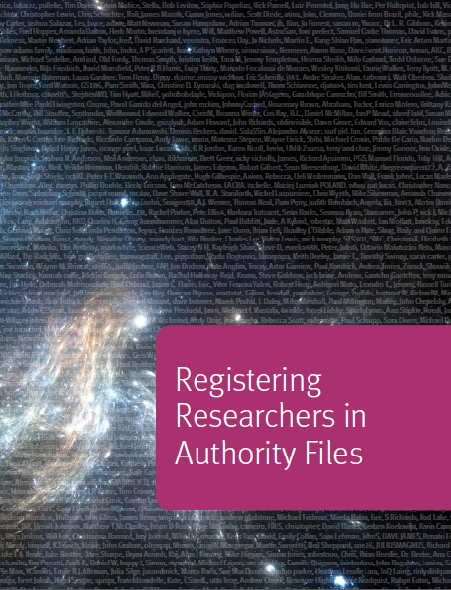
We’re summarizing…
Plus supplementary datasets:
Use case scenarios
Functional requirements
Links to 100 researcher networking and identifier systems
Characteristics profiles
Mapping of profiles to functional requirements
Researcher identifier information flow diagram
http://www.oclc.org/research/publications/library/2014/oclcresearch-registering-researchers-2014-overview.html
Notes:
This webinar will summarize the work just completed to investigate researcher identifiers. The report itself can be considered an “executive summary” of the research documented in supplementary datasets which are also available for download at the link shown here.

Slide 3



Scholarly output impacts the reputation and ranking of the institution
We initially use bibliometric analysis to look at the top institutions, by publications and citation count for the past ten years…
Universities are ranked by several indicators of academic or research performance, including… highly cited researchers…
Citations… are the best understood and most widely accepted measure of research strength.
Notes:
First, an overview of the challenges we’re all facing. These are three university rankings issued annually, rankings that are of particular importance to research libraries. Some universities even incorporate raising their ranking in their strategic plans. All three use citations as a factor in determining the rankings, and puts added weight to authors of journal articles, which are usually not represented in national authority files.

Slide 4
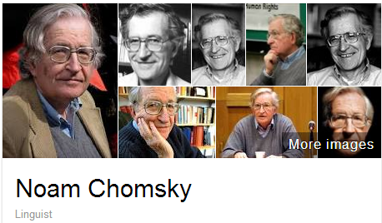
A scholar may be published under many forms of names
Works translated into 50 languages
(WorldCat)
Νόαμ Τσόμσκι
নোম চম্‌স্কি
ནམ་ཆོམ་སི་ཀེ།
નોઆમ ચોમ્સ્કી
नोआम चाम्सकी
Նոամ Չոմսկի
ノーム・チョムスキー
ნოამ ჩომსკი
Ноам Чомски
노엄 촘스키
നോം ചോംസ്കി
ਨੌਮ ਚੌਮਸਕੀ
Ноам Хомский
诺姆·乔姆斯基
Also published as:
Avram Noam Chomsky
N. Chomsky
نعوم تشومسكي
נועם חומסקי
Journal articles
Notes:
Noam Chomsky is a scholar widely translated. WorldCat has records for his works in fifty languages. But only some of the forms of his name are represented as “preferred forms” in national authority files (shown on the left). The forms on the right are from wikidata. The Library of Congress/NACO authority file can support only a few of the scripts shown, representing these scripts with romanizations.
Note that the “N. Chomsky” form used in journal articles is generally not included in national authority files. Chomsky happens to have a rather unique name, but for many others it would be a challenge to match up the abbreviated journal citation form with the fuller forms of name. This illustrates the futility of relying on text string matching to determine if two authors represent the same person or not.

Slide 5




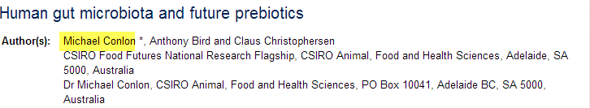
Same name, different people
Conlon, Michael. 1982. Continuously adaptive M-estimation in the linear model. Thesis (Ph. D.)--University of Florida, 1982.
Notes:
Michael Conlon is a member of our task group, an expert in biomedial informatics at the University of Florida. There is another Michael Conlon in the UK who writes articles on European taxes. Obviously two different people. Then there’s an article on microbiota in the Australian journal Microbiology written by a Michael Conlon. The same Michael Conlon as the U. Florida one or a different one based in Australia? Without other metadata, it is difficult to tell. (Turns out, it’s yet another Michael Conlon.)
Michael Conlon is a rather uncommon name. But consider that in China 275 million people have the surname of Li, Wang or Zhang. And that’s not including the millions of overseas Chinese. The chances ethnic Chinese having the same name—especially in the abbreviated form used in journal articles– is high. We need other identifying attributes such as institutional affiliation and discipline (if not photos) to disambiguate names.

Slide 6

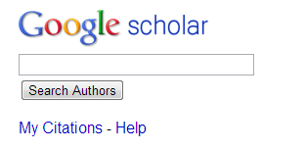











One researcher may have many profiles or identifiers…
(from an email signature block)
Profiles: Academia / Google Scholar / ISNI / Mendeley / MicrosoftAcademic / ORCID / ResearcherID / ResearchGate / Scopus / Slideshare / VIAF / Worldcat
Notes:
Some researchers already have multiple identifiers. This is an example from a signature block in an email. The researcher includes twelve different identifiers or profiles he’s represented in. This also fragments his Web presence.
To recap the challenges:
Citations are a factor in assessing the impact of scholarship but journal article authors often are not represented in authority files.
A given scholar can be represented by different forms of the name, all of which may not be included in authority files.
Two or more researchers may have the same name, and we need other attributes to disambiguate them.
Some researchers already have multiple identifiers.

Slide 7
Registering Researchers in Authority Files Task Group Members
Micah Altman, MIT - ORCID Board member
Michael Conlon, U. Florida – PI for VIVO
Ana Lupe Cristan, Library of Congress – LC/NACO trainer
Laura Dawson, Bowker – ISNI Board member
Joanne Dunham, U. Leicester
Amanda Hill, U. Manchester – UK Names Project
Daniel Hook, Symplectic Limited
Wolfram Horstmann, U. Oxford
Andrew MacEwan, British Library – ISNI Board member
Philip Schreur, Stanford – Program for Cooperative Cataloging
Laura Smart, Caltech – LC/NACO contributor
Melanie Wacker, Columbia – LC/NACO contributor
Saskia Woutersen, U. Amsterdam
Thom Hickey, OCLC Research – VIAF Council, ORCID Board member
Karen Smith-Yoshimura, OCLC Research – Facilitator
Notes:
These are the members of the OCLC Research Registering Researchers in Authority Files Task Group which I facilitate. The members represent different perspectives from three countries – the U.S., The Netherlands, and the UK. We have members who are librarians, those who contribute to the LC/NACO authority file or train others to do so and who are members of the Program for Cooperative Cataloging. We have ORCID and ISNI Board members, and representatives from VIVO, a Current Research Information System (Symplectic), and a publisher (Bowker). My colleague Thom Hickey is the chief scientist responsible for creating the Virtual International Authority File and is on both the VIAF Council and the ORCID Board.

Slide 8
Stakeholders & needs
Researcher | Disseminate research
 | Compile all output
 | Find collaborators
 | Ensure network presence correct
 | Retrieve other’s scholarly output to track a given discipline
Funder | Track funded research outputs
University administrator | Collate intellectual output of their researchers to fulfill funder or national mandates, internal reporting
Librarian | Disambiguate names
Identity management system | Associate metadata, output to researcher
 | Disambiguate names
 | Link researcher's multiple identifiers
 | Disseminate identifiers
Aggregator (includes publishers) | Associate metadata, output to researcher
 | Collate intellectual output of each researcher
 | Disambiguate names
 | Link researcher's multiple identifiers
 | Track history of researcher's affiliations
 | Track & communicate updates
Notes:
The first thing the task group did was write up 18 use case scenarios from the perspective of six different actors or stakeholders. I’ve consolidate the needs identified here; some overlap. For example, the need to disambiguate names is common to several stakeholders.

Slide 9














Systems profiled (20)
Notes:
We started with a list of over 100 different research information/identifier systems. Criteria used to select systems to profile: 1) have significant mind-share/take-up by researchers and 2) researchers are represented by a persistent, unique, and publicly accessible URI. We wanted to end up with a representative sample of different research information/identifier systems. For some system types we profiled only one system to represent a category.

Slide 10


Notes:
We’ve extrapolated from World Bank statistics that the total number of researchers worldwide was 9 million in 2012. Slide prepared by Dr. Micah Altman, MIT, for CNI presentation March 2014.

Slide 11
Now is More

Slide 12
Where are researchers?
Wild Guesses
Notes:
We can’t tell where all of those researchers are. We do know that there is no one system that includes *all* researchers. Slide prepared by Dr. Micah Altman, MIT, for CNI presentation March 2014.

Slide 13
Researcher Identifier ≠ Name Authorities
 | Traditional Name Authorities | Researcher Identifier Systems
Primary Stakeholders | Libraries | Publishers, Researchers, Funders, Libraries
Internal standardization/integration | Standardized and well integrated within libraries but new models are emerging | Fragmented. Some well-integrated communities of practice.
Organization | Primarily top-down, careful controlled entry from participating organizations | Varies: top down, bottom-up, middle out; often individual contributors
External integration | Very limited: High barriers to entry, few simple API’s | Varies, but more open. Some services offer simple open API’s; integration with web 2.0 protocols (e.g. OpenId)
Works Covered | Primarily books & other works traditionally catalogued by libraries | Journal articles; Grants; Datasets
People covered | Authors and people written about represented in the library catalogs | Authors of research articles, fundees, members of research institutions – international
Key record criterion | Persistent and unambiguous identifier with a preferred label for the community served | Persistent and unambiguous identifier for an individual contributor
Notes:
Although both name authority files and researcher identifier systems both represent researchers by persistent and unambiguous identifiers, researcher identifier systems include researchers cited in journal articles, who have received grants, or have created datasets all of which may not be represented in authority files. In addition, authority files provide a “preferred label” for the researchers based on the community they serve while identifier systems are agnostic about forms of names.
From slide prepared by Dr. Micah Altman, MIT, for CNI presentation March 2014.

Slide 14
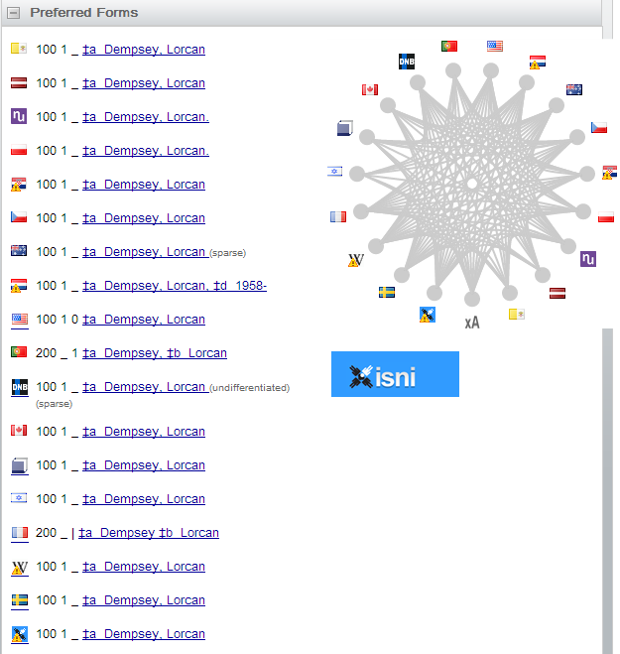
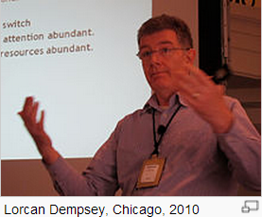
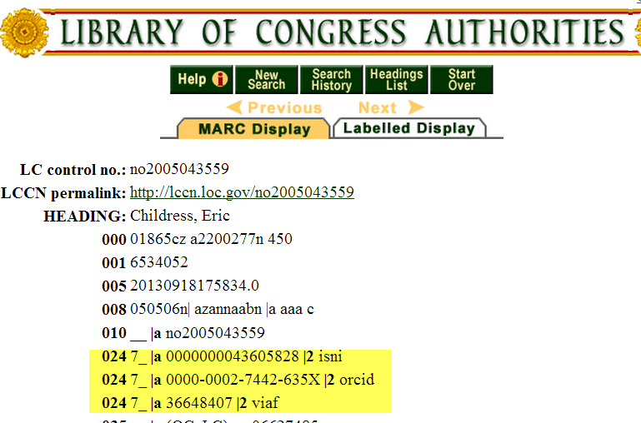
Some overlaps
Notes:
There are overlaps. Here, Lorcan Dempsey’s VIAF cluster shows he is represented in 16 national authority files as well as by a Wikipedia article and the ISNI database. My OCLC colleague Eric Childress has an authority record with his ISNI, ORCID, and VIAF identifiers.

Slide 15
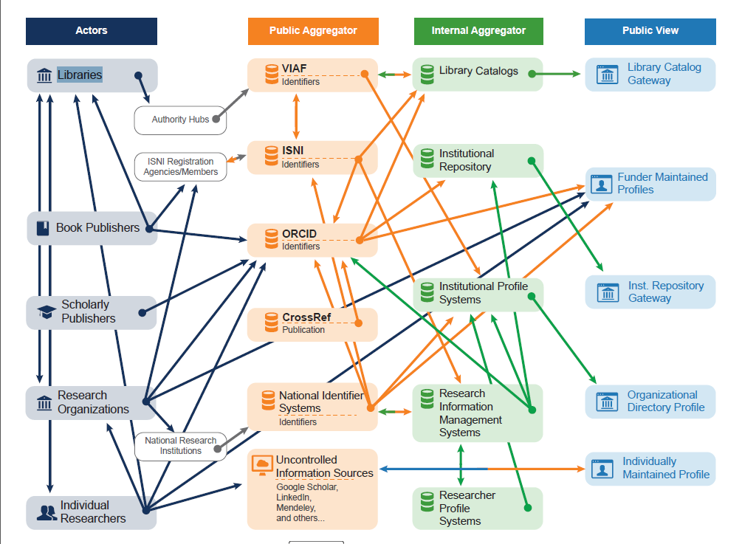
Researcher Identifier Information Flow
Notes:
The same information about a specific researcher may be represented in multiple databases, and only a subset interoperates with each other. We’ve diagrammed the flow of information describing researchers and identified researcher outputs such as publications among classes of actors and systems. Each category of actor is depicted with an icon and a caption. An arrow going from one entity to another is used to indicate that information flows from one entity to the other.
This researcher identifier information flow diagram reveals several patterns:
Information flow is quite complex overall, especially between public aggregators and private aggregators.
Most of the information flow is one way—there are few automatic or systematic channels for corrections or annotations at later stages to flow back up to public aggregator sources, or to the actors providing them. ISNI—which focuses on managing links between member identifier systems and databases—is an exception. It tracks all sources, and corrections are fed back to the source as they are made. The interoperability flows between ISNI and ISNI registration agencies, and between ISNI and VIAF, are indicated in the diagram by bidirectional arrows.
Many actors are contributing to multiple public views of Researcher ID information.
Information provided by the same class of actor may flow through multiple (possible concurrent) paths to internal aggregator systems and public views—suggesting the potential for duplication and inconsistency.
Individual categories of public views seldom represent more than one type of internal aggregator.
A key question is how corrections or updates can be communicated between systems. Researchers are frustrated when they see errors in their profile, works incorrectly assigned to them or works missing. Even if the information is corrected in the local instance, it often is not reflected in the aggregated databases or hubs.
In brief, There is no one system that includes *all* researchers nor meets *all* the functional requirements of all stakeholders.
Assigning persistent identifiers to researchers early in their careers will help both researchers and their institutions compile their scholarly output more comprehensively and accurately.

Slide 16

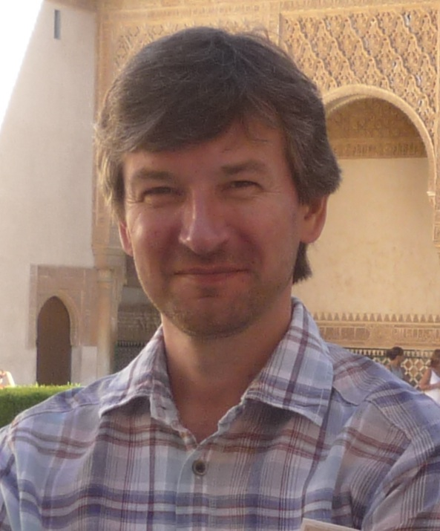


Task group presenters
Laura Dawson
Bowker
Andrew MacEwan
British Library
Philip Schreur
Stanford University
Daniel Hook,
Symplectic
Notes:
We will now hear from four of the task group members, each with a different perspective.
Laura Dawson is Product Manager, Identifier Services at Bowker, focusing on ISNI, ISBN, and web-related identifiers and standards in the book value chain.
Andrew MacEwan is the Head of Content and Metadata Processing at The British Library and has been involved in authority control over networked databases; he is a Board member of the ISNI International Agency and the BL’s representative on the Program for Cooperative Cataloging’s Policy Committee.
Philip Schreur, the new Interim Head of Technical Services at Stanford University, is focused on the transition of all technical services workflows to linked data as the next, logical infrastructure to engage and embed library data into the semantic web.
Daniel Hook is co-founder of Symplectic Limited, a research information management system, director of research metrics at Digital Science and interim chief operating officer of figshare; he holds visiting academic positions in theoretical physics at Imperial College London and Washington University in St. Louis.

Slide 17

A publisher’s perspective:
ISNI for author disambiguation
Laura Dawson
Laura.Dawson@bowker.com

Slide 18
What Is ISNI
ISO Standard, published in 2012
International Standard Name Identifier
Numerical representation of a name
  16 digits
  Assigned to contributors of content – researchers, authors, musicians, actors, publishers, research institutions – and subjects of that content (if they are people or institutions).
Notes:
Brand new – just getting off the ground.

Slide 19
Who is ISNI
Founding members
  IFRRO (International Federation of Reproduction Rights Organizations)
  CISAC (International Confederation of Authors and Composers Societies)
  SCAPR (Societies’ Council for the Collective Management of Performers’ Rights)
  OCLC
  CENL (Conference of European National Librarians), represented by the British Library and the National Library of France
  ProQuest, represented by Bowker
Notes:
These members serve as the board of directors for ISNI

Slide 20













ISNI Organizational Structure
Board of Directors
Quality Team
ISNI Assignment Agency
Registration Agencies
Ongoing assignments/general public
Members
Notes:
The way ISNI is organized, the Board of Directors oversees operations and policy. The Assignment Agency, OCLC, is responsible for actually assigning the ISNI numbers to the names. They work in partnership with the Quality Team, made up of employees at the British Library and BnF who are specifically tasked with working on ISNI data quality.
ISNI Members are organizations who contribute a data set for assignment on a one-time basis. If an organization wants continued updates for a data set that is expanding regularly, they have to work with a Registration Agency. Right now there are two Registration Agencies – Bowker and Ringgold. Ringgold primarily registers organizational names, while Bowker does everything else.

Slide 21
How Does ISNI Registration Work
Publisher submits names for assignment through a Registration Agency (RA)
RA works with the publisher to ensure the data feed is well-formatted, and sends that feed to the Assignment Agency (AA)
AA assigns as many ISNIs to the names in the feed as it can, using complex algorithms and business rules that evolve with each feed
AA returns a file of names with ISNIs attached to them
  This may not be the full file of names
  Ambiguous names are held for review by Quality Team
  QT assignments and other exceptions (assignments as a result of improvements to the algorithm) are returned to RA quarterly
  Process is not instant. Assignment may be immediate if the name and other information is unique, but frequently assignments take a week or two.
Notes:
ISNI registration is not straightforward. Names are much more complicated than books. It’s useful to not compare the ISNI assignment process to that of the ISBN. At these beginning stages, it’s much more manual; as we see patterns emerging, we can code towards them, but of course at the beginning of any process, patterns are not easy to predict.

Slide 22
Stage One
Publisher submits data to Registration Agency
Registration Agency sends file to Assignment Agency
Assignment Agency assigns as many ISNIs to the names as it can

Slide 23
Stage Two
Assignment Agency sends assigned file to Registration Agency
Registration Agency sends assigned file to Publisher
Publisher reviews, QAs, ingests

Slide 24
Stage Three
Assignment Agency sends updates on a quarterly basis
Registration Agency disperses files to appropriate Publishers
Publishers ingest updates

Slide 25
Display
Only minimal metadata is displayed
Not meant as a comprehensive profile
ISNI is a tool for linking data sets, collocation, and disambiguation
Enhancements to the record can be made but not required

Slide 26
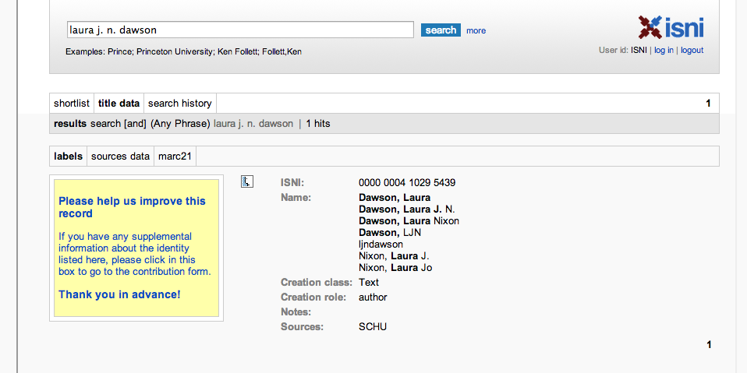
Sample Public ISNI Record
Notes:
Notice how little data is publicly available. On the back-end, the database has my birth date, the ISBNs of my publications, links to my Twitter feed and blog – so the database can distinguish me from the other Laura Dawsons that are out there. But none of that gets displayed publicly unless Bowker, as the publisher, says it can. And Bowker is not going to do that without agreement from the author. We have millions of authors in Books in Print, so getting their agreement to something like this is just prohibitive.

Slide 27
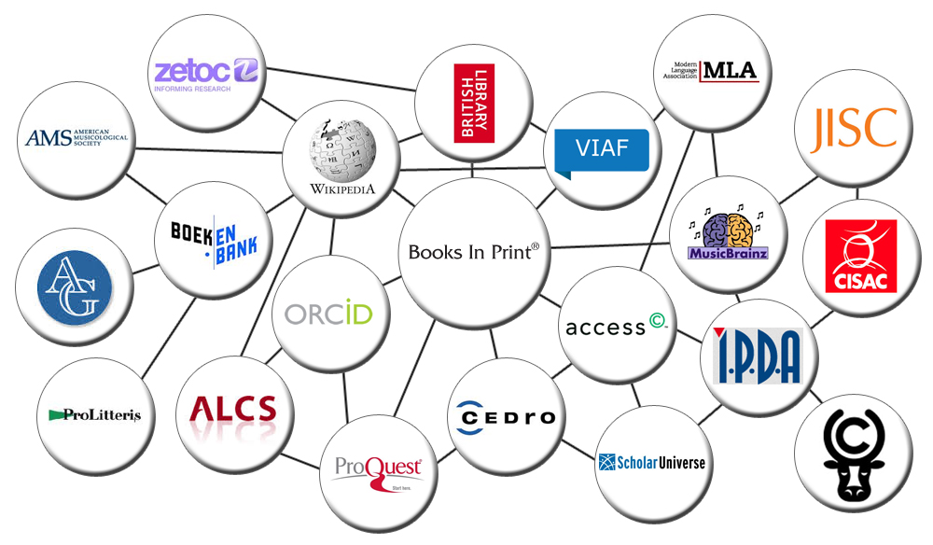
ISNI links
Standard identification of researcher names
Bridge identifier linking disparate data sets
Notes:
Notice that ORCID is a data set that is linked to other data sets via ISNI. This is because ORCID is using ISNIs to identify research institutions.

Slide 28
Who is using ISNIs?
Wikipedia/Wikidata
VIAF
Access Copyright
Community of Scholars
Pivot
JISC
Musicbrainz
Digital Science
Booknet Canada (piloting)
Authors Guild (piloting)

Slide 29
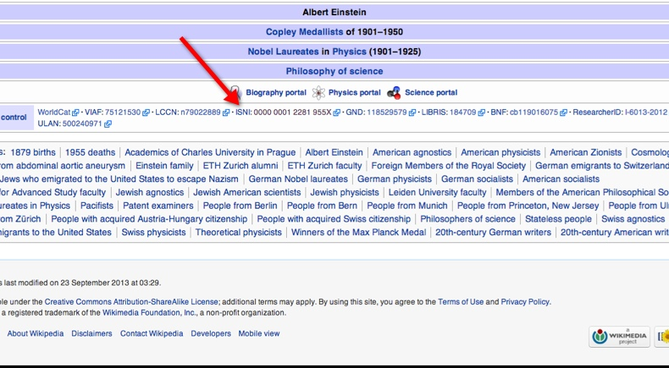
Einstein’s Wikipedia Page

Slide 30
How many names in the ISNI database?
Over 8,000,000 ISNIs assigned
10,112,931 provisional (awaiting a match from another data set for corroboration)
Your author names may well already have ISNIs. http://www.isni.org/search.

Slide 31
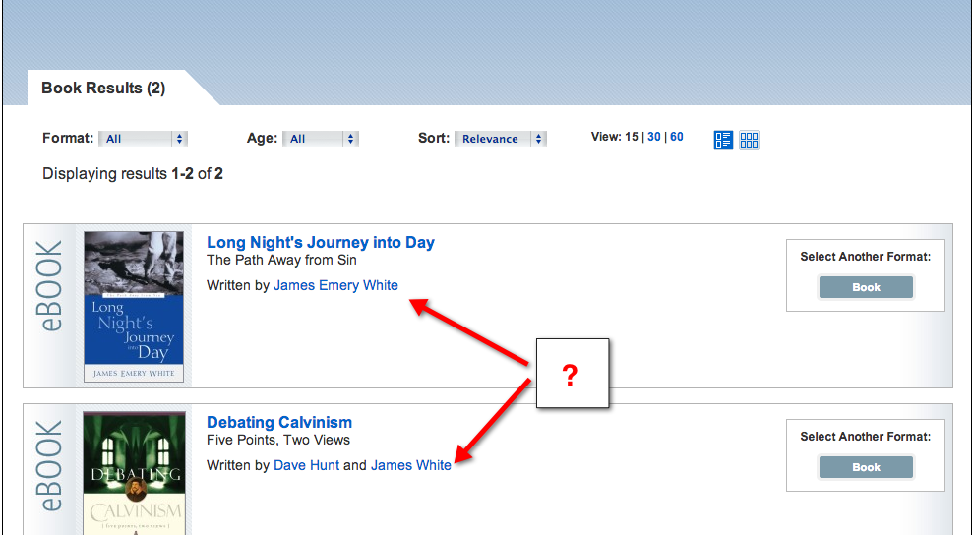
Use Case: Publisher
Notes:
These are two different theologians. But Random House is publishing both of them. They must make sure that they are getting the appropriate royalties to the correct author. The subject matter is not enough to distinguish the two, and middle names are not always consistently listed – how do we know for certain that these are two different individuals? The ISNI helps the publisher definitively disambiguate the two, and pay correctly.

Slide 32
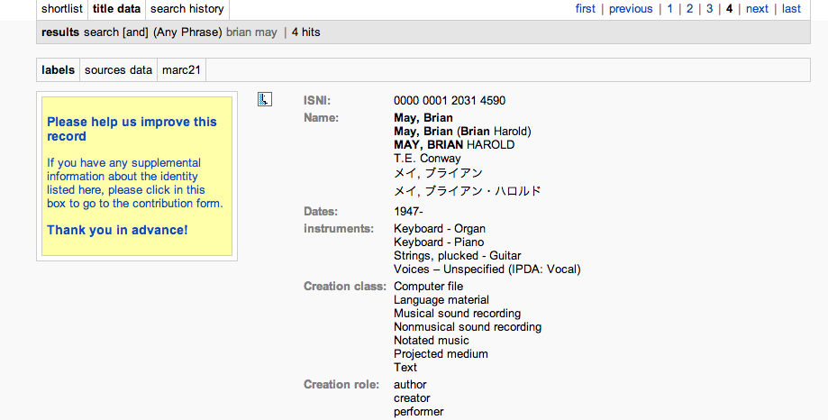
Use Case: Cross-Domain Linking
Notes:
Here we have the ISNI record for Brian May. As you can see, he’s done a few things – as an author, a creator, and a performer.

Slide 33
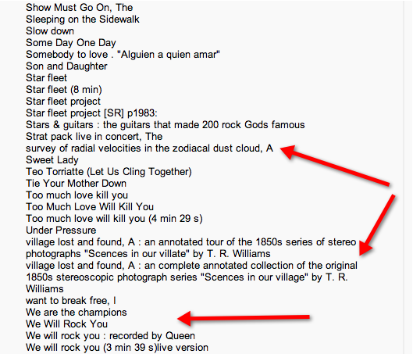
Use Case: Cross-Domain Linking
Notes:
As you can see, the ISNI links together disparate types of data. Brian May, noted guitarist for the band Queen, is also an astrophysicist who has published his dissertation “A survey of radial velocities in the zodiacal dust cloud”. He has ALSO annotated a seminal collection of stereoscopic photographs. A true Renaissance man – and the ISNI allows for these works to be linked together under his unique, persistent identifier. So that if someone sees his dissertation or his photograph collection, and questions whether or not this is the same Brian May that played “Bohemian Rhapsody”, they can confirm that yes, this is the same (rather unusual) person.

Slide 34
Data Quality
Based on matching names to existing records in database (over 18 million names)
Strict criteria for assigning ISNIs to names
Quality team oversight (manual edits)
  British Library
  National Library of France
  LaTrobe University

Slide 35
Assignment Criteria
If on the common surname list:
  Birth date
  Death date
  ISBN(s)
  Title(s)
  Co-authors or institutional affiliation
If not on the common surname list
  Title(s)
  Birth date
  Death date
  Any other distinguishing factors (“is not”)
If unique
  Immediate assignment

Slide 36

NACO and the future of authority control:
Why the BL is working with ISNI
Andrew MacEwan
The British Library &
ISNI International Agency
andrew.macewan@bl.uk

Slide 37
Outline
PCC and the future of authority control
Diffusion of ISNIs into NACO records
Maintaining ISNI – NACO
  Role of BL ISNI Quality Team
Extending ISNI assignment to NACO
ISNI models for cooperation – some examples
BL experiences with theses, articles
Can ISNI be the new NACO for libraries?

Slide 38

PCC and the future of authority control
Policy Committee strategic discussions on NACO
Authorities beyond LCNAF?
Use of VIAF?
NACO participation via “NACO lite” for non- NACO members?
Local authority files?
How do we get more done with diminishing resources to do it?

Slide 39
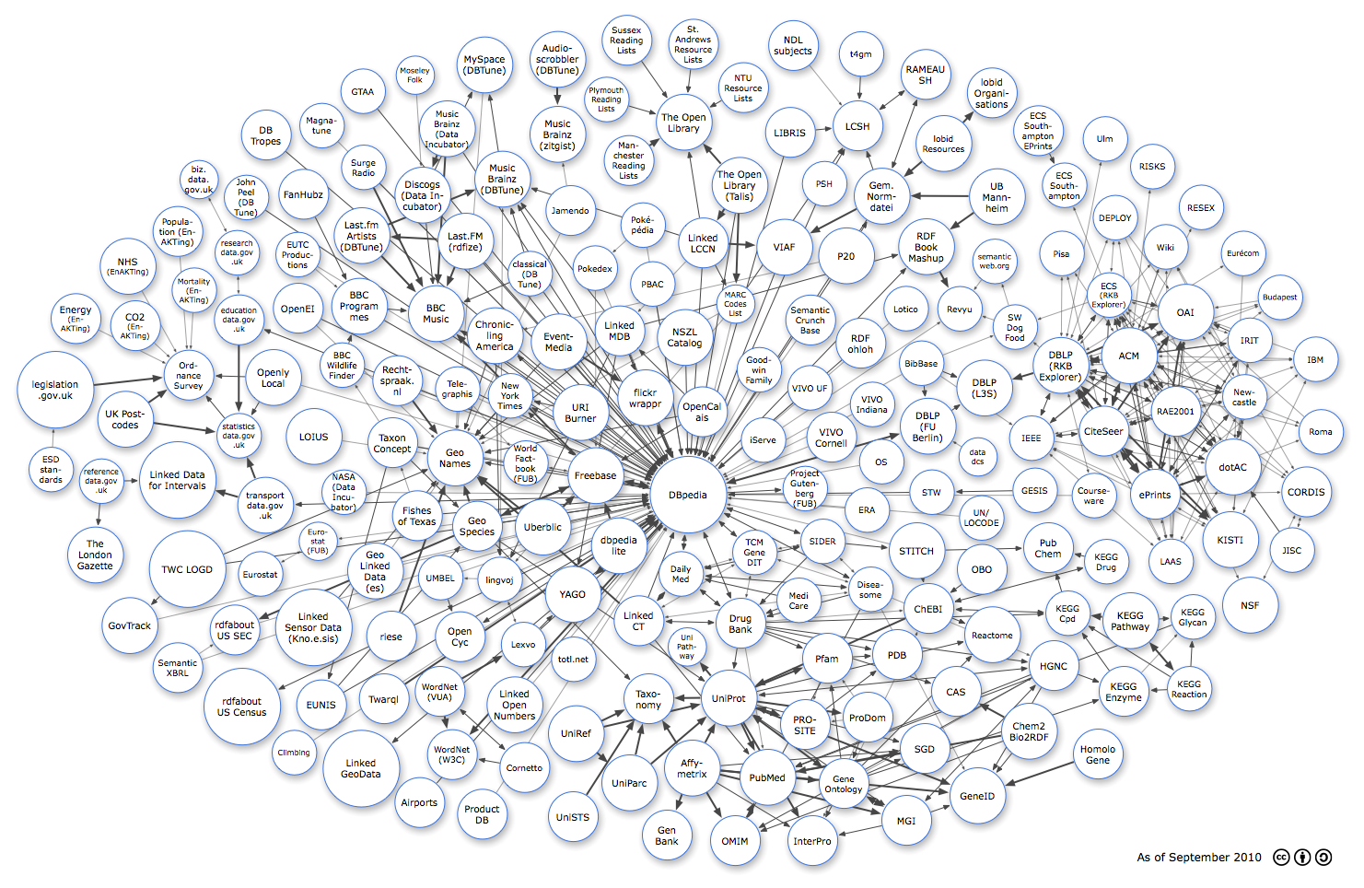

How can NACO make a difference to this?
Diagram by Richard Cyganiak and Anja Jentzsch. http://lod-cloud.net/
Notes:
39

Slide 40
















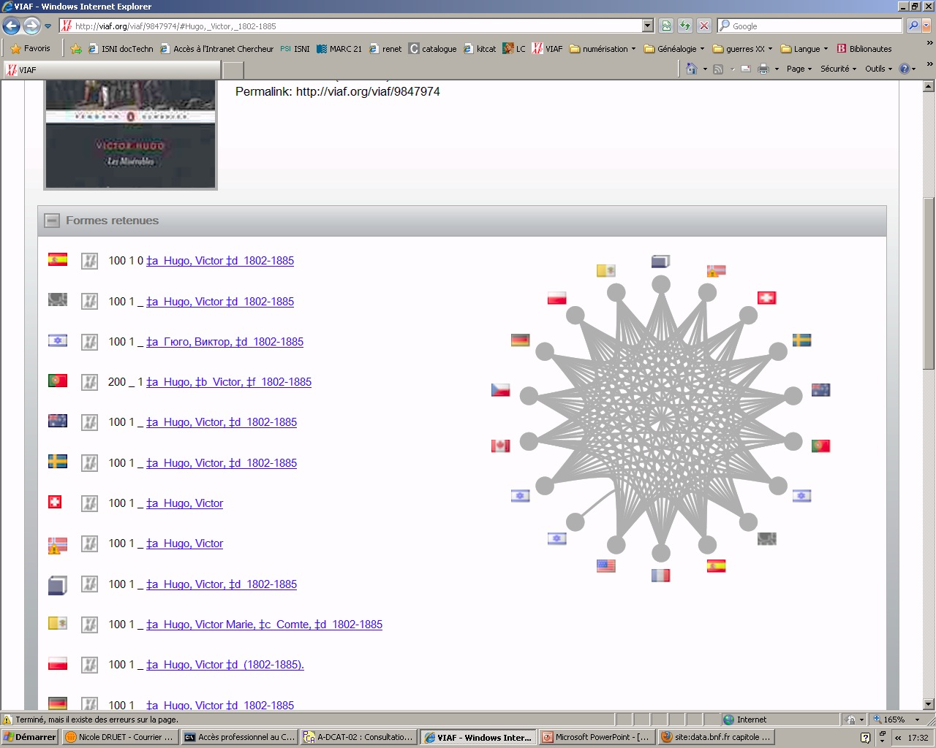











The problem the PCC wants to solve?
Text Rights
Trade Sources
Music Rights
Other future cultural heritage sources
Encyclopaedias
Libraries
Researchers & Professional
Notes:
ISNI is not just about researchers
This universality fits a national libraries needs for identity management

Slide 41

Diffusion into NACO
Scale and the need for collaborative scheduling have delayed diffusion
Now scheduled for Summer 2015
3-4 million ISNIs will be loaded to their corresponding NACO records
Ongoing updates and maintenance will be scheduled

Slide 42
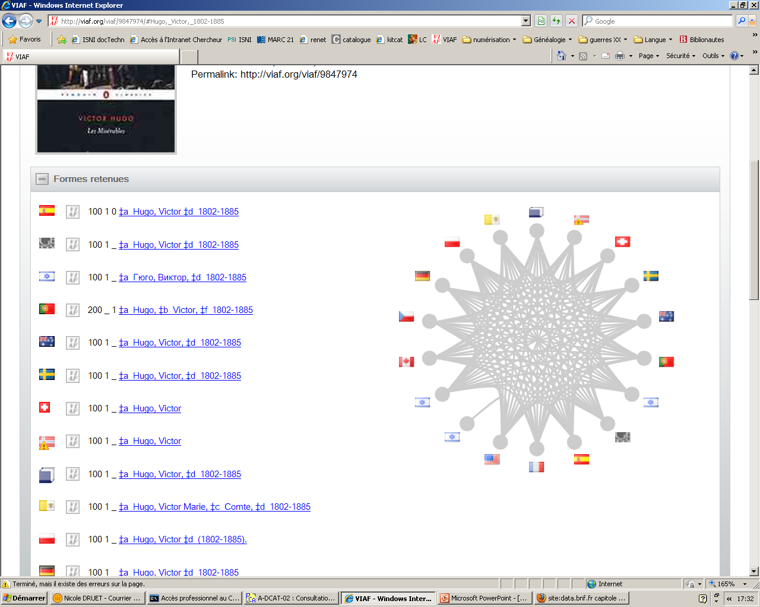

NACO-VIAF-ISNI inter
-relationship
-operability
VIAF → seed database for ISNI
 Error notifications
 ISNIs
Reprocessing after notification
matching
Assignment
Error detection
Quality control
Quality Team
◆ Monthly updates
ISNIs will be notified directly into NACO
◆ BL will monitor/fix changes to NACO records containing ISNIs
◆ Merges, splits, errors – dual monitoring of NACO and ISNI incorporated into QT
Systems and interfaces for managing the ISNI all in place
New NACO to ISNI will continue through VIAF

Slide 43
Extending ISNI assignment in NACO
Ongoing batch processes in ISNI continually increase levels of assignment
Manual assignment by ISNI members from the unassigned status NACO records in the ISNI database
Targeted projects?
NACO members define their own projects and reasons to join ISNI?

Slide 44
ISNI models for cooperation
“There is a burden of effort in information storage and retrieval that may be shifted from shoulder to shoulder, from author, to indexer, to index language designer, to searcher, to user. It may even be shared in different proportions. But it will not go away.” (D. Batty)
ISNI offers new ways of sharing the burden of effort for name authorities
Managing identities and links is a problem shared more widely than ever before
From Programmers to Registration Agencies to Members to End User Input
Notes:
Quotation from an article in 1990s – cannot trace source any more but it still seems releveant to at least this problem of authority control/identity management
The point is that participation in ISNI is a strategic decision – to move the effort expended on authority control into a broader arena
At the BL, as for many NACO participants, we have been here before: Joining NACO was a strategic decision to make the same effort count for more and to reap the benefits of the work others are doing

Slide 45

British library experiences
344,313 authors of British theses loaded
74, 129 assigned ISNIs through data matching algorithms
Working to increase assignment by system
Pending load into EThOS system
Plans for ongoing assignment to new authors as an ISNI Registration Agency
Collaboration with ORCID through EThOS to promote researcher engagement
Notes:
Note assignment in all cases means that an author has been associated with data held in other organisations

Slide 46

British library experiences
29,000 journals / 30 million articles / 90 million author lines
228, 666 assigned ISNIs through data matching algorithms
Pending load into ETOC in house system & exposure on PRIMO
R&D in Leiden to improve clustering of articles/authors
Future improvements to database required to re-load un-assigned ETOC data
Ongoing assignment?
  Further batch processes
Notes:
We have never had any means of controlling author IDs within our ETOC services and exports
Currently ETOC is searchable via an integrated PRIMO search alongside our authority controlled catalogue – creating vast amounts of noise in search results

Slide 47

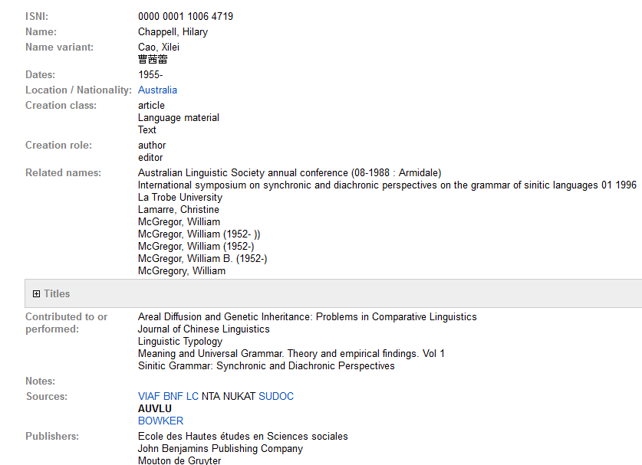
La Trobe University
3,553 records contributed
  Sourced from La Trobe Institution Repository
  1,707 assigned, 1846 provisional (101 flagged as possible matches)
Cross links with library authority file sources

Slide 48
Importance of working with other ID systems
ISNI signs MoU with ORCID January 2014
  API lookup from ORCID to ISNI
  Pilot projects to link ORCID-ISNI IDs
  ISNI can provide institutional IDs
ORCID model: researcher self-registration and management of their ID
ISNI is focussed on existing datasets, batch assignment
  Linking up databases
  Bridging the data silos
  ORCID bridges the link to researchers themselves

Slide 49
Can ISNI be the new NACO for libraries?
For the BL this is our strategic goal
Ideal for data not covered by NACO
Is there scope for loading ISNI to expand coverage of NACO and become integrated with it?
  PCC’s NACO lite?
  Non-RDA headings but good IDs
Or do they just live side-by side for now?
ISNI needs more libraries and a cooperative model to begin to answer these questions
  More national libraries are joining ISNI

Slide 50
ISNI Assignment Agency
A sustainable infrastructure…
Processes data algorithmically
R&D to “get the best of the data”
Notifications, reports changes to sources
Centrally managed hub for diffusion of the ISNI
Sources of all data elements tracked and used in reporting/maintaining integrity of the diffused ISNIs
Visit: http://www.isni.org
Notes:
Web interface for error reporting, enriching, detecting duplicates for data contributors
Web interface for public
Client for full maintenance including streamlined procedures* for Quality Team
Notifications to data contributors
Data Sampling*
Data Anomaly checks (dates, pseudonyms)*
Fixes to incoming data (pre and post load)*
Data enrichment to increase matching (Dewey)*

Slide 51

A research library’s perspective
Philip E. Schreur
Assistant University Librarian
for Technical and Access Services
Stanford University
pschreur@stanford.edu

Slide 52
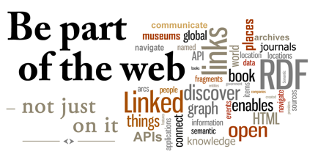
Notes:
There’s been a tremendous shift towards putting our library data on the web but this approach is far too simplistic
Often we approach this by making our materials available to the web but the web doesn’t understand our data or its semantics and it ends up by being used as free text
We must shift our mindset to learning to embed our data in the web, not just making it available
Developments in the last number of years such as schema.org and BIBFRAME are allowing us to finally encode our data in such a way that the web can understand its semantics
Academic libraries, as the home of many of the researchers with which we’re concerned here, have data that is particularly rich in semantics and have a big stake in how their data is absorbed into the web, both internally for its faculty and staff but more and more how its data can be successfully integrated into data from other research libraries

Slide 53
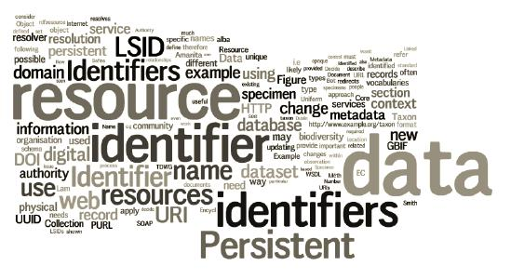
Identifier vs Authority
Notes:
One key change in thinking will be a shift from authorities to identifiers
In our traditional work, we have focused on the creation of unique text strings to differentiate the researchers that surface in our cataloging
As we shift towards creating web friendly, linked data to represent these entities two changes must occur
Shift from the creation of authorities as text strings to a representation of the researcher themselves as in a FOAF or schema.org person
Shift from the requirement of the creation of a complex authority record to the rapid assignment of identifier
But where is this pressure to assign identifiers coming from? In the past, our metadata departments have focused on the cataloging of monographs and we have been more or less successful in creating authorities for a high percentage of these authors
But as our portfolios explode with the need to manage authors of articles (ie, researchers) and anything else the university throws at us, this labor intensive process of authority record creation must be modified
By shifting to the use of identifiers we solve the double dilemma of needing to make our data more web friendly and being able to create these control structures expeditiously

Slide 54
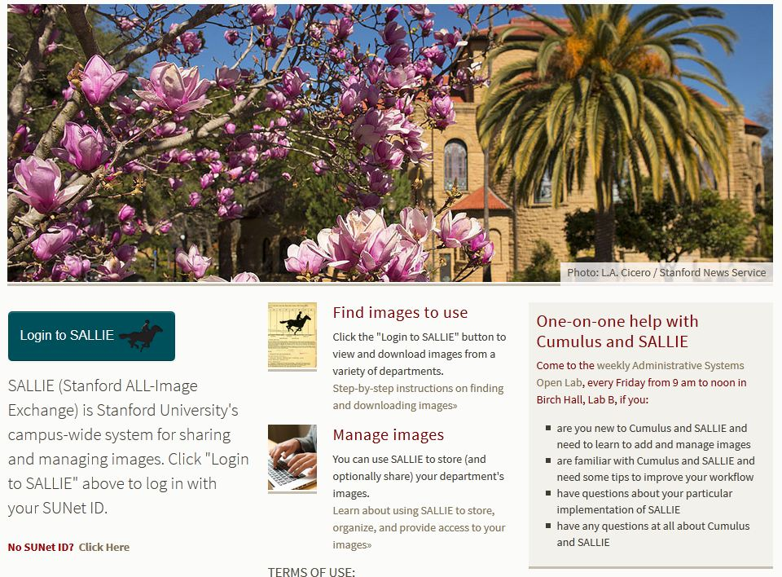
SALLIE
Notes:
A great example at Stanford for this exploding role in identity management is SALLIE or the Stanford All-Image Exchange.
At least 200 Stanford departments, as well as the university photographer, take part in this exchange,
The photographs may include any number of inanimate objects such as buildings but also include a great number of faculty and departmental guests, that is, all those researchers from Stanford and other institutions that we’d like to register!
There has been no systematic control over the headings used for the people and buildings in these photographs and the group has recently come to Stanford’s Metadata Department, as the place where linked data is taking off, to take control of all this metadata
It all makes sense but is a tremendous increase to the number of people the department normally has to control

Slide 55
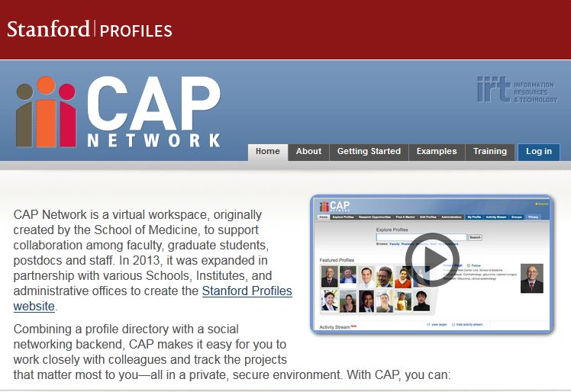
Stanford Profiles
Notes:
A second great example is CAP Network or the Stanford Profiles
CAP Network is a virtual workspace, originally created by the School of Medicine, to support collaboration among faculty, graduate students, postdocs and staff. In 2013, it was expanded in partnership with various Schools, Institutes, and administrative offices to create the Stanford Profiles website.
Combining a profile directory with a social networking backend, CAP makes it easy for you to work closely with colleagues and track the projects that matter most to you—all in a private, secure environment
But of course, for this to work, each faculty member, or researcher, needs to have an identifier set up
The library has considered various methods of identification but in the end will be establishing a local identifier for each faculty member
Again, the need here will be for speed. In order for the system to work each faculty member would need an identifier immediately

Slide 56
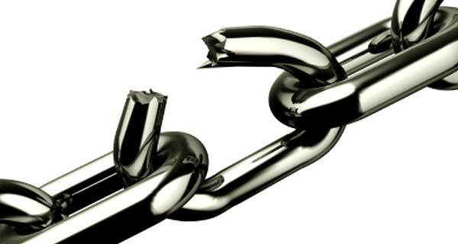
Reconciliation
Notes:
This brings me to my final slide – reconciliation
Identifiers may be easy to assign but there is little doubt that the same researcher has the strong possibility of being assigned multiple identifiers both with and across institutions, and this, of course, defeats the whole purpose of having an identifier
It’s why I think of this process as semi-linked data
A reconciliation engine would merge those multiple identifiers for the same researcher into one master identifier, closing the break in the partial link.
But this engine has yet to be developed for researcher identifiers at this level
Services such as VIAF do a great job in reconciling traditional catalog data, which is based in monographic cataloging, but something new is needed reconcile this growing sea of researcher identifiers

Slide 57

A research information management system perspective
Daniel Hook
Symplectic LTD
daniel@symplectic.co.uk
0000-0001-9746-1193

Slide 58

Institutional pressures are increasing
A diversity of internal and external stakeholders are changing the way
that institutions and researchers need to behave…
Government / Transparency
Funder Mandates
Collaboration
Competition

Slide 59
More data and more varied data are available
An underlying pressure is that in the era of “big data” there is an expectation
of greater transparency not only of research outputs themselves but also
around the process of doing research…
The number of articles indexed in PubMed for which free fulltext is available within 3 years of publication is now over 800,000
-- Imaginary Journal of Poetic Economics
PLOS >100,000 articles
arXiv >900,000 articles
figshare exceeds >1,500,000 datasets
12,000 new mentions each day on social media.
Each week 20,000 new articles shared…
…that’s 1 mention every 7 seconds!
-- Altmetric

Slide 60
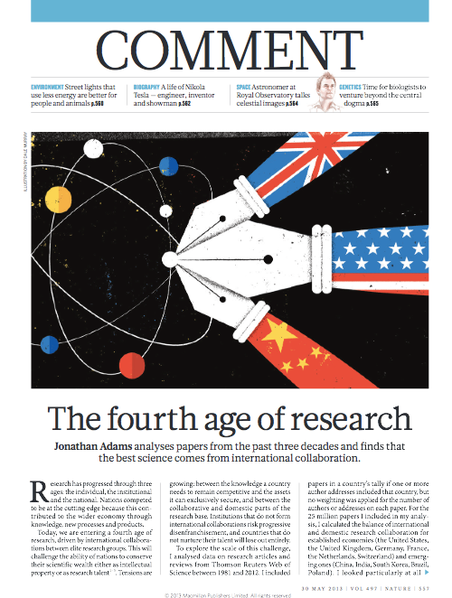
Increased collaboration poses interesting challenges
First age - Individual
Second age - Institutional
Third age - National
Fourth age - International
DOI: 10.1038/497557a

Slide 61

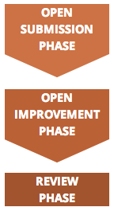
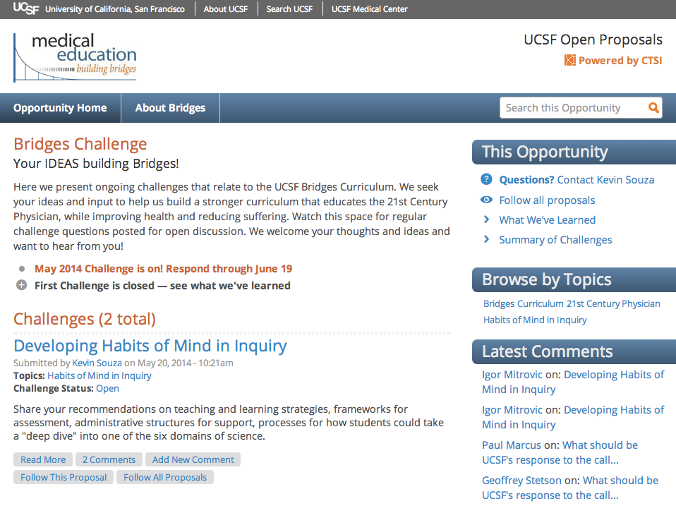
Open proposals
Source: https://open-proposals.ucsf.edu/

Slide 62
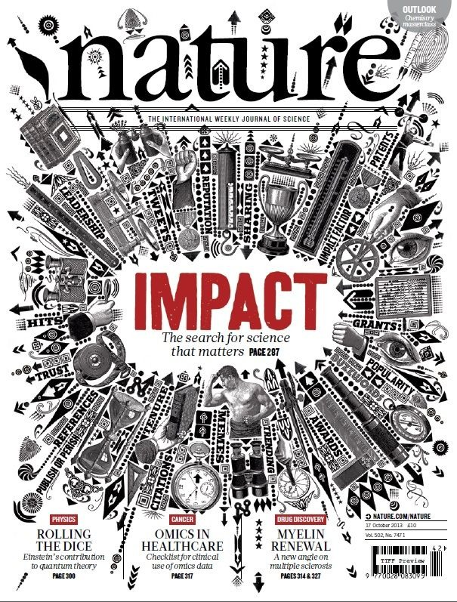
Impact
The new vogue in research evaluation is
“impact”…
Funder/government-led initiatives to
ensure that we are getting value
for the research that gets funded
In many cases extremely hard to
quantify
Difficult to track / classify
Challenging to get underlying data to
map the pathway to impact

Slide 63

Identifiers are glue for institutions and funder systems
There are now many systems that researchers interact with both inside an
institution and externally.
Systems like VIVO and Profiles RNS make linked open data available
– identifiers become critical if these systems are to realise their full potential as
trusted assertion authorities.
The shear volume of data that’s now available means that machine readable
data structure and unique identifiers are critical for:
  Authentication
  Validation
  De-duplication
Identifiers provide: the capacity for data to be authenticated, trusted and re-used
at a scale needed for contemporary use cases.

Slide 64

Questions? Your plans?
Laura Dawson: Laura.Dawson@bowker.com
Andrew MacEwan: andrew.macewan@bl.uk
Philip Schreur: pschreur@stanford.edu
Daniel Hook: daniel@symplectic.co.uk
Karen Smith-Yoshimura: smithyok@oclc.org
http://oclc.org/research.html

Slide 65
Karen Smith-Yoshimura
Program Officer
smithyok@oclc.org
@KarenS_Y

