Slide 1
ALIA Information Online • 15 February 2017
Linked Data—Bringing the World Closer Together
Karen Smith-Yoshimura
Senior Program Officer, OCLC Research

Slide 2
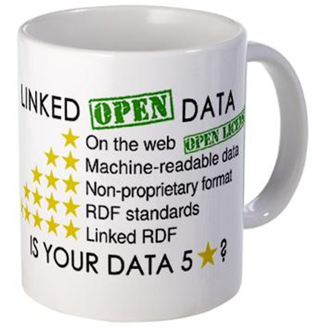
“The Semantic Web isn’t about putting data on the web. It is about making links, so that a person or machine can explore the web of data.”
- Tim Berners-Lee, 2006-07-27
Notes:
In 2006, Tim Berners-Lee published a blog post in the w3c web space. It featured an image that became an icon of the linked data movement: the coffee cup with the five stars. It’s also cryptic, but it touches on deep insights about how information is delivered and consumed.
*The text: make links to things. Use a special kind of identifier [called a URI] to name things; include more URIs so people can discover other things. URIs: Identifiers that are persistent, unique, resolved with existing web protocols.
*The insight: This appears to be describing hypertext, but it is different from the web we know. It is about things in the world. URIs are collection points for information about them. By interacting with the web, we are getting information about objects, and not just reading documents.
Slide courtesy of OCLC colleague Jean Godby.

Slide 3
What we have to work with
A collection of text strings…
Taken from the piece itself…
Sometimes “enhanced” with inferred parentheticals (e.g., [1975] )…
Or additional statements not on the piece (e.g., subject headings)
Punctuation, which may or may not be present, is used (inconsistently) for structure
Mostly uncontrolled and only loosely connected to anything else
Designed for description rather than discovery
Notes:
Slide courtesy of OCLC colleague Roy Tennant

Slide 4
Making library data linkable: principles
Data, not text
Identifiers, not strings
Statements, not records
Machine-readable schemas
Machine-readable lists
Source: Karen Coyle
Notes:
Karen Coyle presented in a 2011 NISO the milestones the library community must achieve to meet Tim Berners-Lee’s 5 stars.
The principles illustrated on the coffee cup describe the show progression to get to better and better linked data.
But in the library community, data has to attend a “preschool” to get ready for linked data. The milestones that have to be achieved are shown on the right.
Slide courtesy of OCLC colleague Jean Godby.

Slide 5
Top Websites
Global
Google.com
Youtube.com
Facebook.com
Baidu.com
Yahoo.com
Wikipedia.org
Australia
Google.com.au
Youtube.com
Google.com
Facebook.com
Ebay.com.au
Wikipedia.org
nla.gov.au #502
Source: alexa.com
Notes:
Libraries just don’t have the same traffic in the worldwide web. The National Library of Australia ranks fairly high among library-specific sites (#25, compared to Library of Congress #8), but overall, within just Australia, it’s #502. Globally, it’s #14,152 (as listed on 2017-01-08).

Slide 6
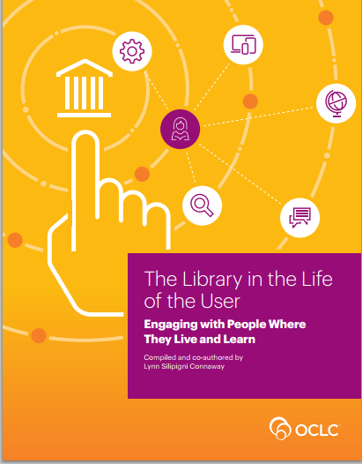
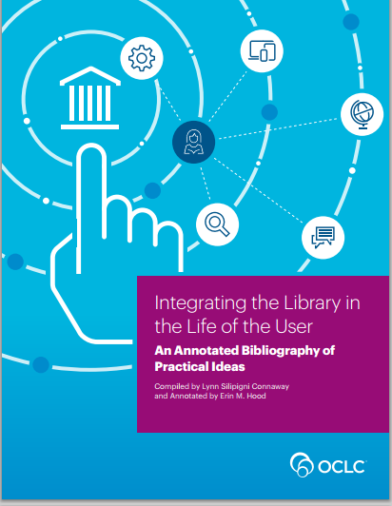
“
“Many information seekers, regardless of
demographics, make heavy use of … Wikipedia and
Google.”
Notes:
My colleague Lynn Connaway has conducted and synthesized much research in user studies. From The Library in the Life of the User: Engaging with People Where They Live and Learn
Students’ information searches have evolved from browsing books in the stacks to submitting online queries to Google because is quicker.”
“Google is the first choice of Millennials and screenagers.”
“Many information seekers, regardless of demographics, make heavy use of Web information sources, such as Wikipedia and Google.”
“…students’ use of Wikipedia has been compared to a ‘covert, underground learning Black Market’ as its use often is not acknowledged…students reported citing references in Wikipedia articles, but not the actual Wikipedia articles, because they believed instructors did not value them as much as traditional information sources.”

Slide 7
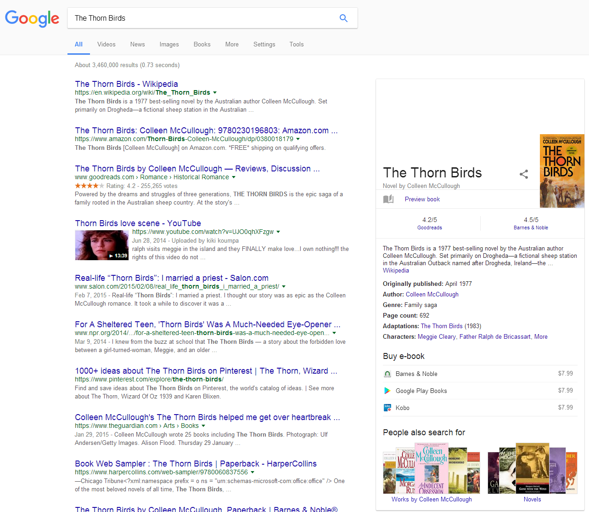
Embed library option here
Notes:
On the left is a search result from Google for ‘The Thorn Birds’. It is a list of documents that contain the phrase ‘the Thorn Birds.’
On the right is a Google knowledge Card. It is something fundamentally different. It is a description of a ‘thing’ called “The Thorn Birds” compiled from a dataset that Google now calls the Knowledge Vault. The result is put into the Knowledge Card we see on the right and contains attributes we might care about – a short synopsis from Wikipedia, publication date, author, genre, the adaptation (TV series), reviews by Good Reads and Barnes and Noble and links to previewing and buying the book. This information is present in the web of documents, too, but the user has to dig for it, and often for a long time. It
The Google knowledge vault now contains billions of entities, integrating information from multiple sources. What’s missing is availability in one’s own local library. Options are presented to buy and not to borrow.

Slide 8
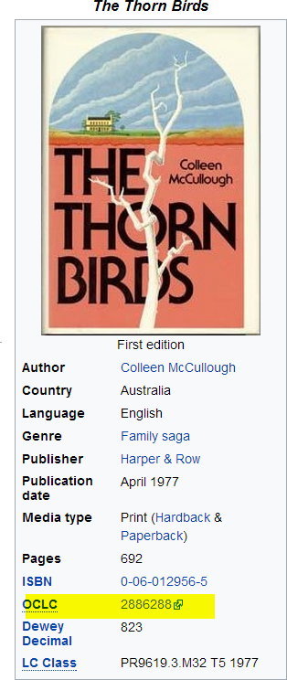
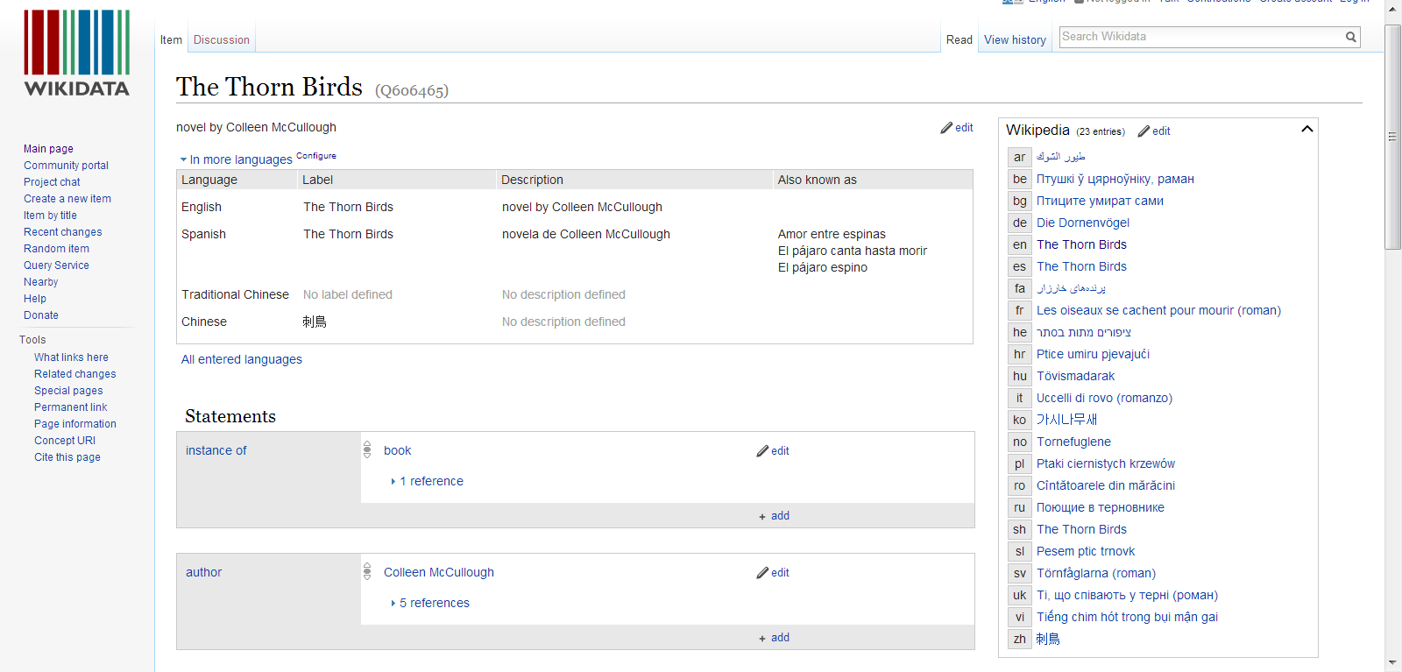
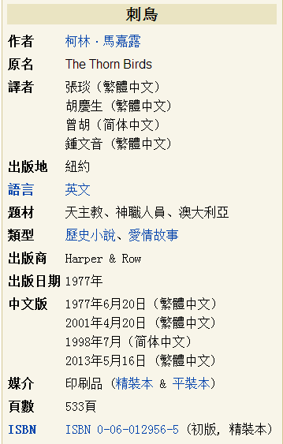
Translators
Notes:
The Thorn Birds “quick facts” shown here is from following the Wikipedia link from the Google Knowledge card. Note it also offers a link to the OCLC WorldCat record for this title. From Wikipedia <click> you can go to the Wikidata page – the source for Wikipedia’s in different languages. Here you see there are 23 Wikipedia articles in different languages on The Thorn Birds. The one in Chinese <click> shows the Author as Colleen McCulough (but transliterated in Chinese characters), the original title, and then four translators of this work, three in traditional characters and one in simplified characters. I like the way it highlights the translators of this work. Much of my work is focused on translations, as that’s how our culture is disseminated to non-English speaking cultures, and how we learn about non-English cultures. And some translators are better than others.
Going back to the Wikidata page <click> we see the identifiers again list the same OCLC WorldCat record number shown in the English “Quick facts.”

Slide 9
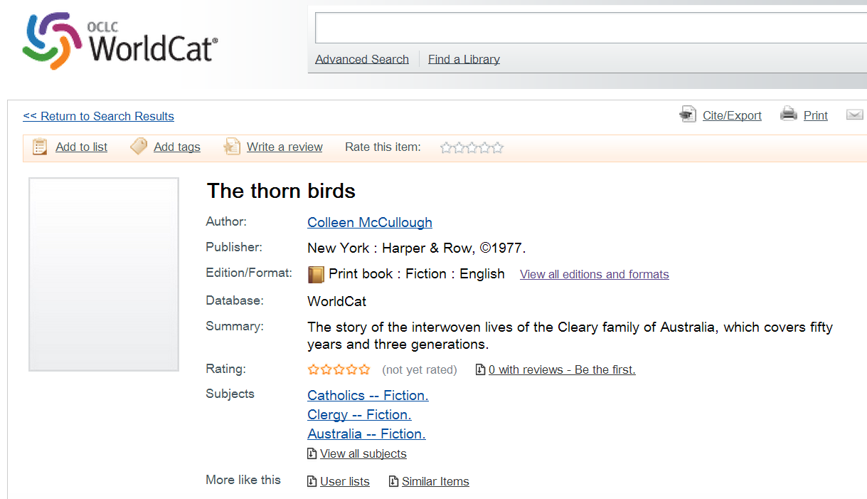
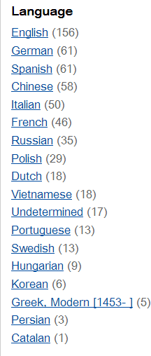
Notes:
This is the WorldCat record we see when clicking on the Wikidata or English Wikipedia “quick facts”. We can also access different translations of the work from here – it shows there are 58 Chinese translations of this work in WorldCat, for example.

Slide 10
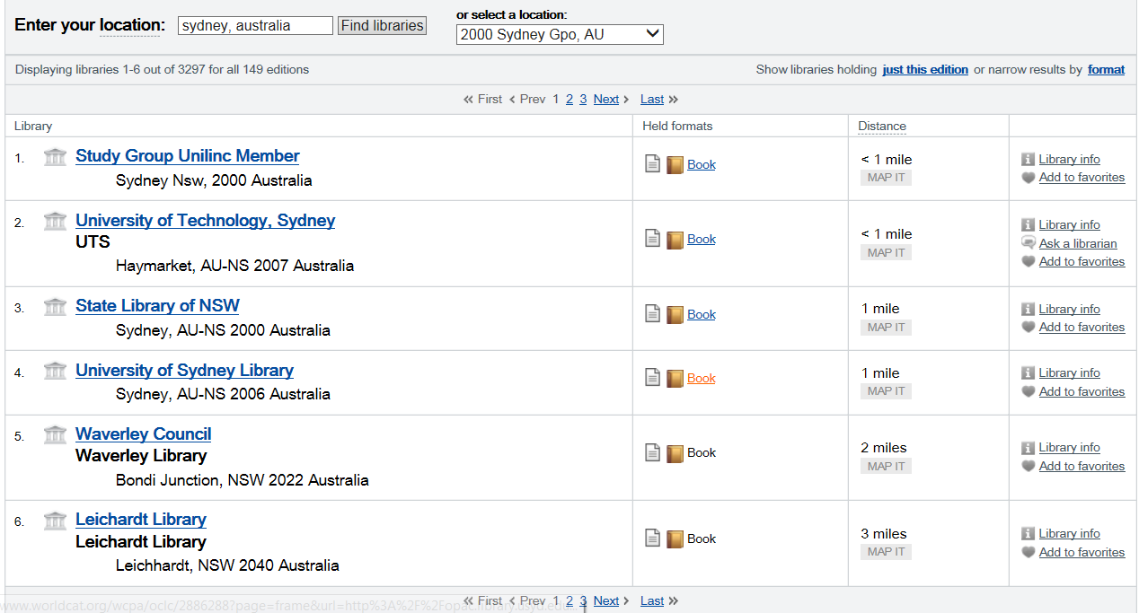
Notes:
And yes, we could borrow this work from a number of libraries located here in Sydney.
But it takes quite a few clicks to get here. How much more convenient it would be if the Google Knowledge card offered this option to begin with!

Slide 11
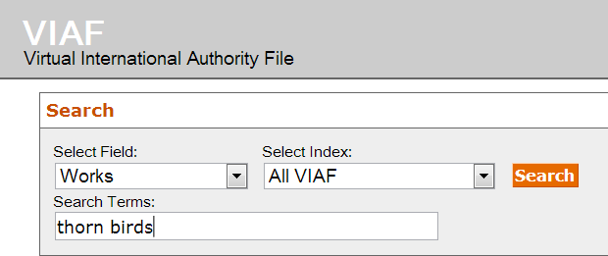
Notes:
The Virtual International Authority File is the linked data resource consumed most often by respondents to the OCLC Research International Linked Data survey for implementers. It’s also bringing the world “closer together” by aggregating the authority files from 44 different sources in 35 countries. <click> 47 “expressions” or translations are listed here – you see quite a few Australian flags as the source of the title information. We’ve supplemented the information about translations of The Thorn Birds from information extracted from WorldCat (the xR’s you see here).

Slide 12
Offering the right translation
Title: 西遊記
Language: Chinese
Author: 吳承恩
Created: 1592
HasTranslation:
Title: Journey to the West
Language: English
Translator: Anthony C. Yu
Date: 1977
IsTranslationOf:
Title: Pilgerfahrt
Language: German
Translator: Georgette Boner Date: 1983
IsTranslationOf:
Title: Journey to the West
Language: English
Translator: W. J. F. Jenner
Date: 1982-1984
IsTranslationOf:
Title: 西遊記
Language: Japanese
Translator: 中野美代子
Date: 1986
IsTranslationOf:
Title: Tây du ký bình khảo
Language: Vietnamese
Translator: Phan Quân
Date: 1980
IsTranslationOf:
Notes:
Linked data provides a relatively simple means to establish the relationship of a work (with an author) and its associated translations (with their respective translators). This diagram captures the relationship in two reciprocal links, one from the original Chinese book (blue box) through its property HasTranslation pointing (with blue arrows) to each translation (red boxes), and one from each translation back to the original Chinese work (red arrows) through the property IsTranslationOf . A work can have any number of translations, and there can be multiple translations into the same language which is why identifying the translator is so important.

Slide 13
OCLC’s 2015 International Linked Data survey
Notes:
Let’s look at a few of the linked data sites mentioned in our International Linked Data Survey for Implementers to try to understand why linked data is interesting to the library community and how mature the efforts are.

Slide 14
Geographic breakdown of 90 responding institutions
20 countries
represented
Notes:
These are the countries represented by the 90 institutions which have implemented or are implementing at least one linked data project or service. US respondents numbered 39, or 43% of the total.
Spain: 10 (11%)
UK: 9 (10%)
Netherlands: 6 (7%)
Australia – 2 (Australian War Memorial and Public Record Office in Victoria)
In the 2015 survey respondents reported a total of 168 linked data projects/services of which 112 were described.

Slide 15
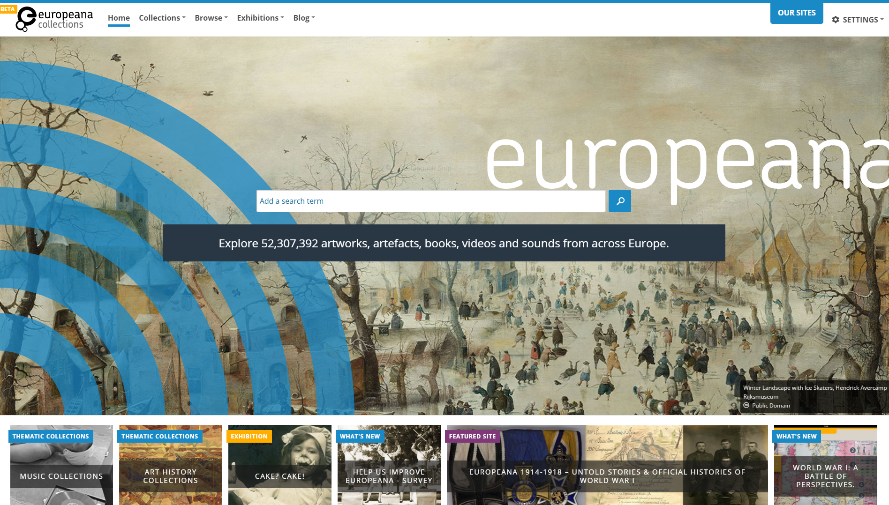
Notes:
Data integration
Aggregates metadata for digital objects from libraries, museums, archives, services across Europe. Built on the Europeana data model , based on semantic web principles. Contextually enriched data.
Success of end-user services such as better support of multilinguality.
Slide courtesy of OCLC colleague Jean Godby.

Slide 16
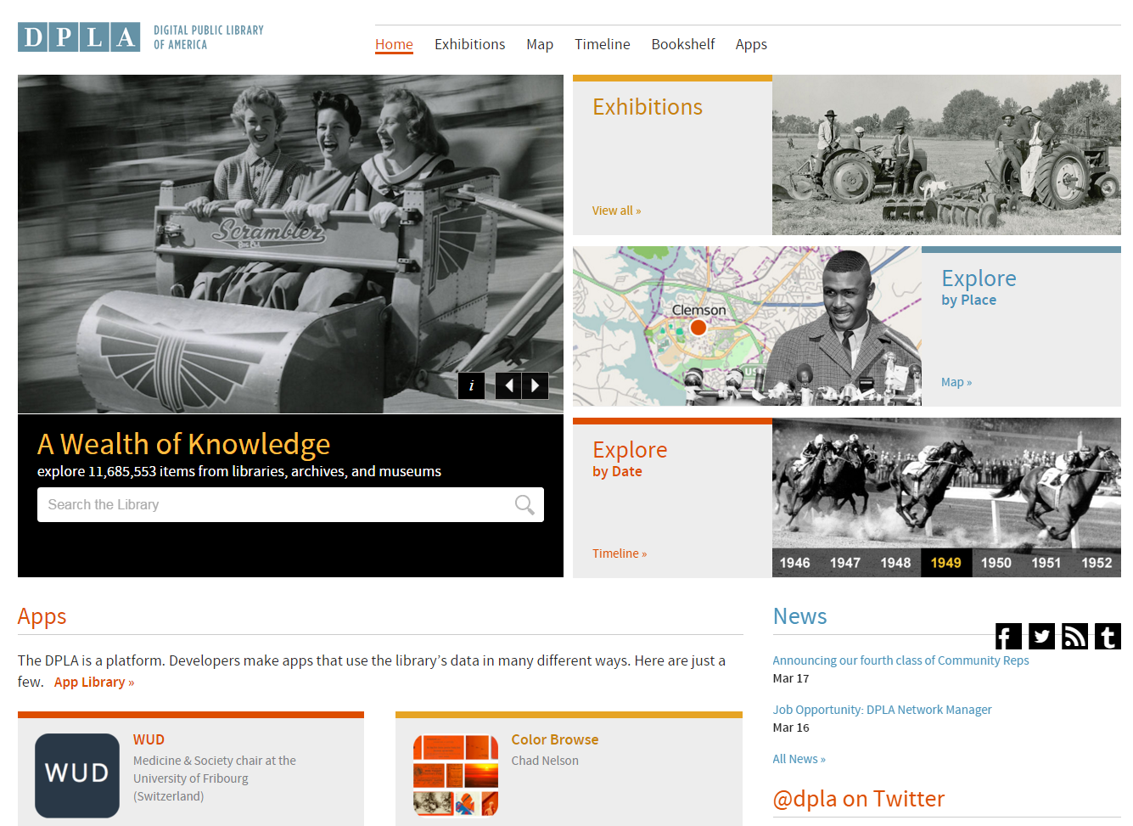
Notes:
Useful for integration of resources – still experimenting
Began 6 years ago started by Harvard University'sBerkman Center for Internet & Society Grant funding by Alfred P. Sloan foundation, US NEH, Gates Foundation
A union catalog for public domain and openly licensed content held by the nation's archives, libraries, museums, and other cultural heritage institutions.[It aims to unify such disparate sources as the Library of Congress, the Internet Archive, various academic collections, and presumably any other collection that would be meaningful to include. ...
Slide courtesy of OCLC colleague Jean Godby.

Slide 17
Notes:
The National Diet Library reported on 5 different projects in the 2015 survey. One was for publishing bibliographic data as linked data, another on publishing authority data as linked data. Another: International Standard Identifier for Libraries and Related Organizations (ISIL) for Japan, and one on Nippon Decimal Classification”, the Japanese standard classification system. This one is to enable comprehensive searching of sounds videos, images, web information and other resources related to the Great Kanto earthquake of 2011.

Slide 18
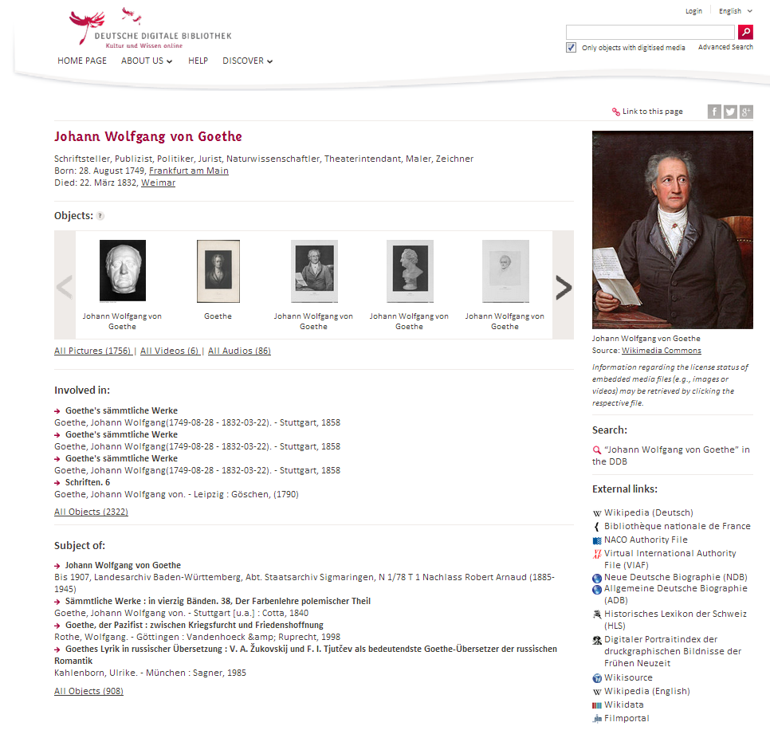
http://www.dnb.de/EN/entityfacts
Notes:
The German National Library described 4 projects that publish linked data: German National Bibliography, German Integrated Authority File (GND), its BIBFRAME prototype, and Entity Facts, shown here. Entity aggregates information about entities from various sources. The information provided is based on the Integrated Authority File (Gemeinsame Normdatei, GND) and merged with other sources such as Wikipedia, VIAF and IMDb. The data model was designed to facilitate reuse by developers without domain knowledge. Its Web interface provides information in German and English

Slide 19
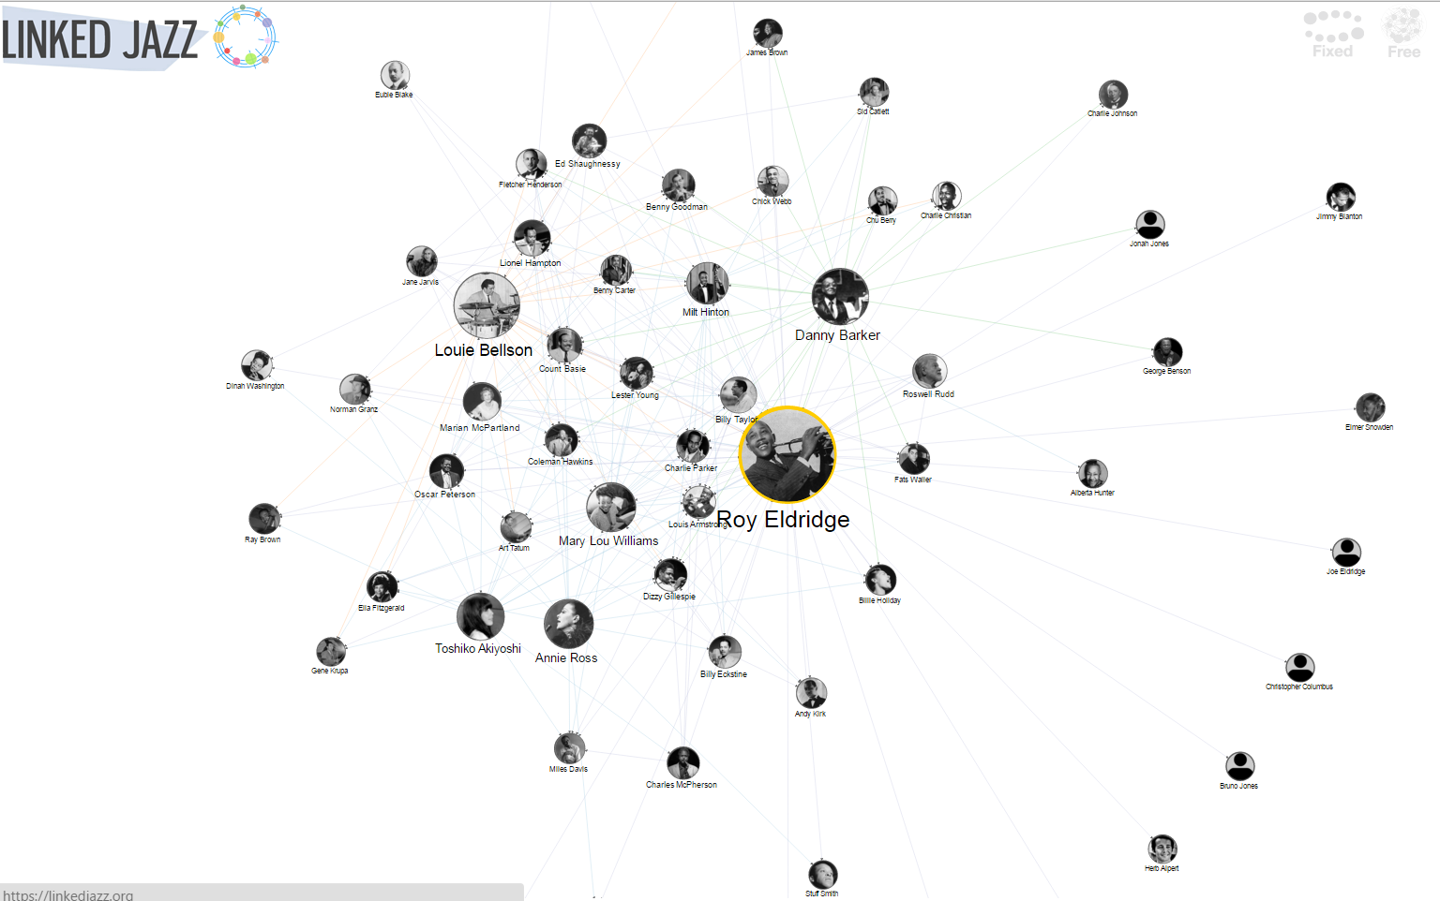
https://linkedjazz.org/
Notes:
The Pratt Institute reported its Linked Jazz project, which applies Linked Open Data technologies to digital heritage materials and explores the implications of linked data in the user experience. It exposes relationships between musicians and enables jazz enthusiasts to make more connections.
It generated new triples from the content of interview transcripts – from the data rather then converting existing metadata. Transcripts came from Rutgers Institute for Jazz Studies Archives, Smithsonian Jazz Oral Histories, the Hamilton College Jazz Archive, UCLA’s Central Avenue Sounds series, and the University of Michigan’s Nathaniel C. Standifer Video Archive of Oral History. The first phase of the project was funded through an OCLC/ALISE Library and Information Science Research grant
Slide courtesy of OCLC colleague Jean Godby.

Slide 20
Summary Remarks
Linked data can bring the world closer together through a worldwide web of data
It will likely take years for library data to be ingested in the websites where information seekers live and learn
Library data can help bridge the world across both domains and languages through more linked and actionable data
And that’s a Good Thing

Slide 21
ALIA Information Online • 15 Feb 2017
Thank you!
Karen Smith-Yoshimura
@KarenS_Y
smithyok@oclc.org
©2017 OCLC. This work is licensed under a Creative Commons Attribution 4.0 International License. Suggested attribution: “This work uses content from ‘Linked Data - Bringing the World Closer Together”’ © OCLC, by Karen Smith-Yochimura, used under a Creative Commons Attribution 4.0 International License: http://creativecommons.org/licenses/by/4.0/.”

