Slide 1
Visualizing Digital Humanities • 21 June 2017
Challenges of Multilingualism
Karen Smith-Yoshimura
Senior Program Officer, OCLC Research

Slide 2
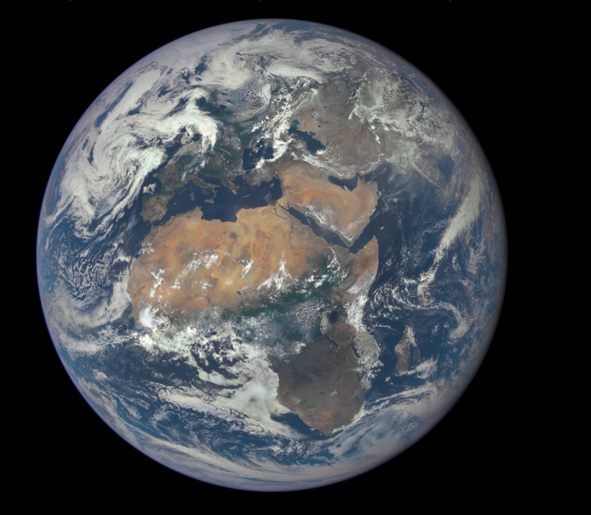
Challenges
Different writing systems, different transliterations
Metadata not always good enough
Linked data opportunities
https://www.nasa.gov/image-feature/africa-and-europe-from-a-million-miles-away
Why focus on translations?

Slide 3
Why focus on translations?
For Developers:
Present information in the preferred language &
script of the user
For Academics:
Understand information sharing across cultures
Notes:
We have been focusing on the content that is most likely to be of interest to the most people – translations.
The cream of the world’s cultural and knowledge heritage is shared by being translated – it’s how we learn about other cultures and how other cultures learn about us. WorldCat contains many rich cataloguing records for these translations

Slide 4
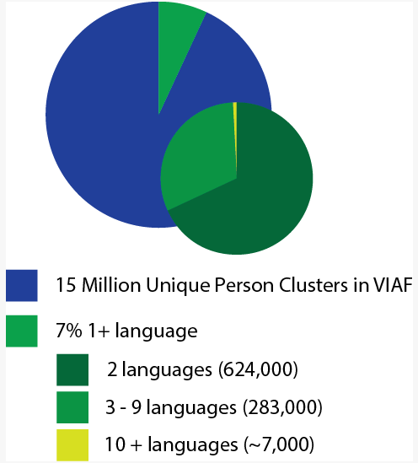
Translations
Leo Tolstoy: 97 languages
Rabindranath Tagore: 93
Homer: 84 languages
Mahatma Gandhi: 52 languages
Isaac Bashevis Singer: 52
Najīb Maḥfūẓ: 47 languages
Cao Xueqin: 27 languages
Murasaki Shikabu: 21 languages
HangingTogether, 2013-11-12
[By January 2017, person clusters
have increased to 45 million]
Notes:
The Virtual International Authority File, an aggregation of authority records from over 40 agencies worldwide, identifies 45 million unique persons. When we datamined WorldCat in 2013, only 7% had written works that have been translated into at least one other language. Only 7,000 have had their works translated into 10 or more languages. This is the “short head” of works that have the most impact on readers worldwide. The numbers may well have changed over the last four years, but it’s still likely that fewer than 10% of all written works have been translated into at least one language.
I’ve listed here a few sample authors of classics and Nobel Prize laureates of literature and the number of languages their works have been translated into.

Slide 5
源氏物語
Ιλιάδα
紅樓夢
The Iliad
Dream of the Red Chamber
زقاق المدق
Midaq Alley
ঘরে বাইরে
The Home and the World
The Tale of Genji
Война и миръ
דער בעל-תשובה
War and Peace
The Penitent
સત્યના પ્રયોગો અથવા આત્મકથા
The Story of My Experiments with Truth
[Gandhi autobiography]
Notes:
And here’s one title written by each of those authors – in the original language and script. Likely you’ve heard of all or most of them? But probably in English (click).

Slide 6
René Descartes, 1596-1650
worldcat.org/identities
[24K publications in 24 languages]
Martin Heidegger, 1889-1976
[26K publications in 17 languages]
Notes:
WorldCat Identities offers profiles of individual authors represented in WorldCat. I’m showing here the publication timelines for four of the authors we included in our multilingual dataset. These represent all works by and about the author in all languages, including reprints and editions published after the author’s death. These give an indication of the impact an author has across time.

Slide 7
Michel Foucault, 1926-1984
worldcat.org/identities
[14K publications in 15 languages]
Stephen Hawking, 1942-
[4K publications in 28 languages]

Slide 8
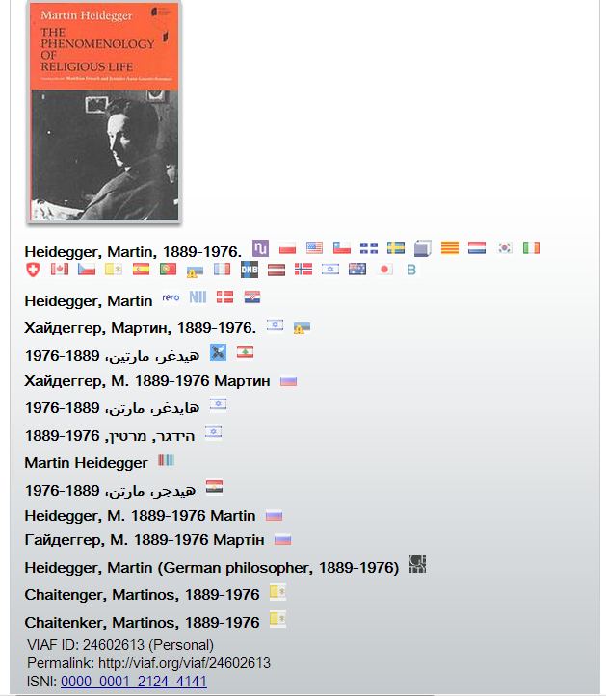
Things not strings
One VIAF identifier clusters over 40 sources for the same entity
Notes:
Given the multiple languages an author’s work may is published in, no surprised that the way the author’s name is represented in text strings will vary. The Virtual International Authority File, aggregating the preferred forms of names from over 40 different resources, provides a unique identifier for each entity. In a linked data environment, we can refer to Martin Heidegger with a VIAF identifier, and the label displayed can be according to local preferences.
VIAF was listed as the top linked data resource used by libraries in the 2015 International Linked Data Survey for Implementers, conducted by OCLC Research.

Slide 9
WorldCat today
Resources in nearly all languages
More than 2.5 billion holdings contributed by libraries worldwide
More than half the database is for works not in English
Languages
April 2017
Notes:
Thanks to the contributions of OCLC members world-wide, we have rich multilingual content in WorldCat that we can leverage. There are almost 400 million records in WorldCat today representing holdings of the world’s libraries. – and more than half (61%) are in languages other than English.

Slide 10
UNESCO Translation Database
Notes:
UNESCO has also been interested in identifying and aggregating translations world-wide for an “international bibliography of translations” – they have been at it for 85 years! Their database represents entries contributed from UNESCO members since 1979 and contains 2 million entries.

Slide 11
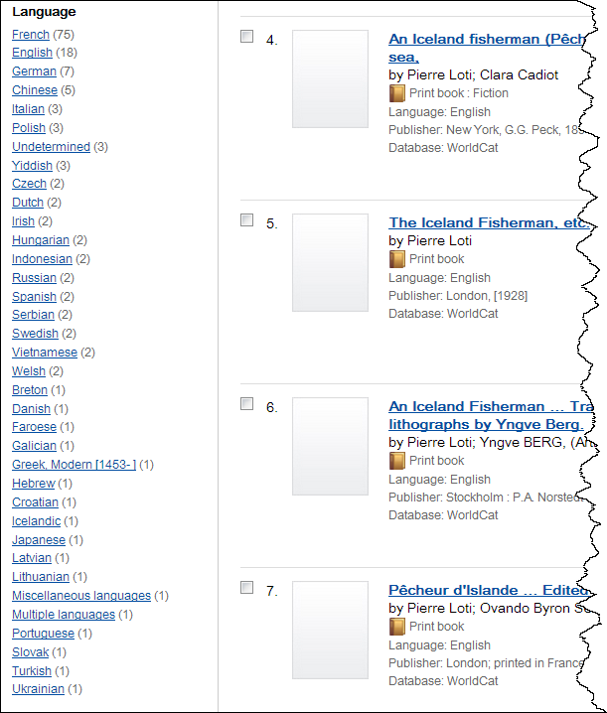
The UNESCO database has translations in only 5 languages of Loti’s Pêcheur d’Islande
Notes:
Yet when we compare the results for a specific work, like Pierre Loti’s Pêcheur d’Islande we can see that the contributions OCLC member libraries have made, through WorldCat, are far greater that all the work invested so far by the UNESCO member states. The UNESCO database shows translations of Loti’s work in only give languages, English, German, Spanish, Swedish and Ukranian –libraries’ contributions to WorldCat have documented translations in 34 languages.

Slide 12
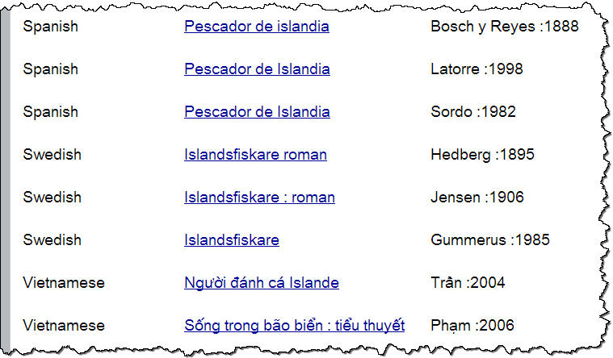
Distinguishing
translations
into same
language
Notes:
Works containing the world’s cultural and knowledge heritage are shared by being translated. The most important works will have multiple translations into the same language. Some translations are better than others and so it is very important to identify the translator of each.
When we datamine WorldCat records, we often have to parse the information in the statement of responsibility to identify the translator. We can then distinguish translations into the same language by translator, as shown in this excerpt from a VIAF display for Loti’s Pêcheur d'Islande, with multiple translations into Spanish, Swedish and Vietnamese (the translator is in the column on the right).

Slide 13
Language of cataloging

Slide 14
Language of cataloging and subject headings
Sein und Zeit by Martin Heidegger
Filosofía alemana [@es, Spanish]
Fundamentalontologie.
Ontologie. [@de, German]
哲学思想 [@zh, Chinese]

Slide 15
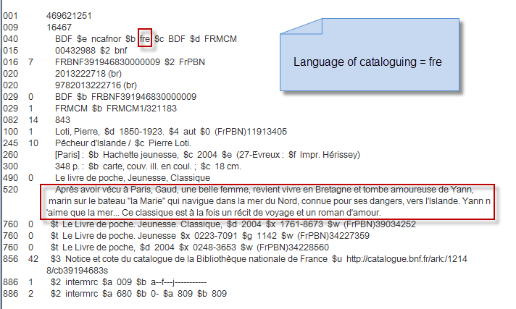
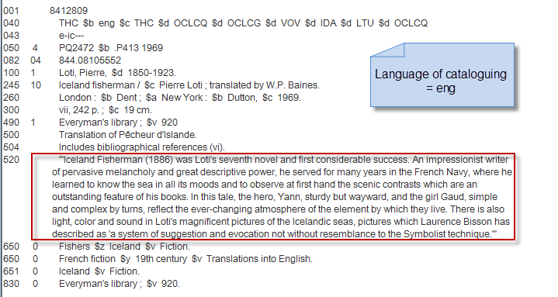
Leveraging language
of cataloging
Notes:
The language of cataloging in a record also can indicate the language of the free-text fields such as summaries.
Slide from Janifer Gatenby, OCLC

Slide 16
@fr
@en
Notes:
So when we transform these summary text strings into linked data we can provide language tags, allowing us to present information in the preferred language and script of the user.

Slide 17
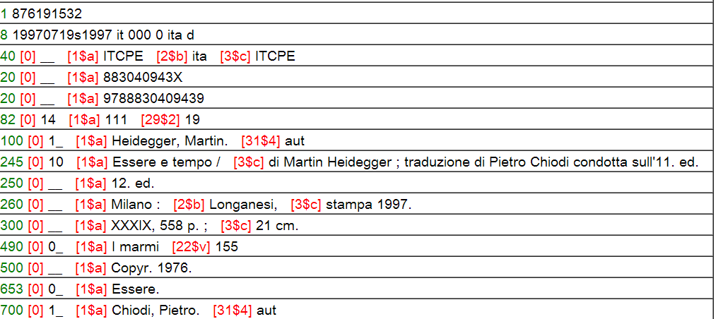
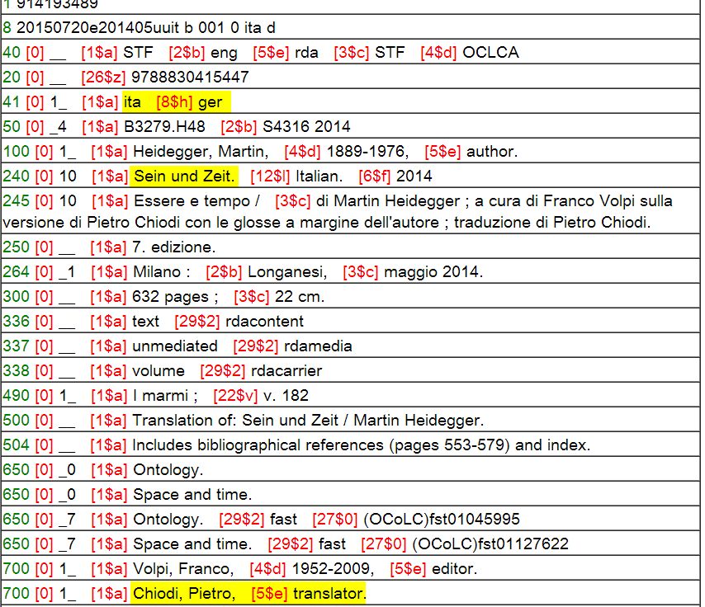
No original language
No original title
Chiodi translator, not author
Notes:
We rely on the metadata in WorldCat to identify translations of works. But it’s often not easy. In this first record, there is no indication what the original language was, or the original title. And although Chiodi is identified as a translator in the statement of responsibility, the added entry incorrectly identifies him as an author. <click> This is a much richer record for a later translation, also by Chiodi. Here the original language is identified, as well as the original title. There is an added entry for Chiodi, correctly identified as the translator.
As long as some records accurately reflect this information, then we can assert the correct relationships for the records that lack the information. However, there are many translations where we are not able to do this from WorldCat alone.

Slide 18
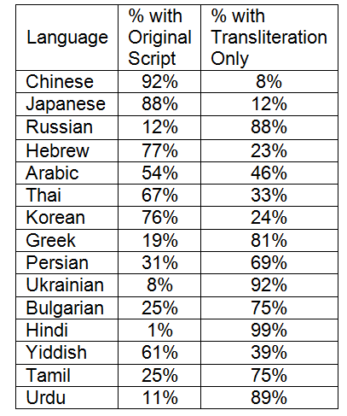
Many languages in WorldCat written in non-Latin scripts
홍길동전
源氏物語
Ιλιάδα
زقاق المدق
Война и миръ
דער בעל-תשובה
紅樓夢
พระอภัยมณี
Notes:
Many of the non-English languages are written in different character sets. For some of the top languages represented in WorldCat, we have good representation of that language’s writing system such as for Chinese and Japanese. But for others, like Russian and Hindi, the works are represented only by transliterations which can hinder the ability of readers of those languages to find and identify the works they’re interested in.
[Titles displayed in original script:
Korean hangul: Hong Kiltong chŏn or The Story of Hong Gildong
Greek: The Iliad
Arabic: Midaq Alley
Russian: Voyna i mir or War and Peace
Yiddish: Der baʻal-tšwbah or The Penitent (by Isaac Bashevis Singer)
Chinese: Hongloumeng or Dream of the Red Chamber
Thai: Phra Aphai Mani
Japanese (kanji): Genji Monogatari or The Tale of Genji

Slide 19
As of 2017-05-31
Notes:
As of 31 May 2017, there were just under 45 million Wikipedia articles in total. English-language articles are #1 – but still only 12% of the total. Cebuano is number 2 followed by Swedish, German and Dutch. After the top 15 languages listed here, the other 279 languages represent 33% of all Wikipedia articles. Although Wikidata (the source of all the different Wikipedia languages) has only 180K book titles represented, the ones that are there are the ones that have multiple translations – and record the original scripts of works and translations that may be represented in WorldCat only by romanization.

Slide 20
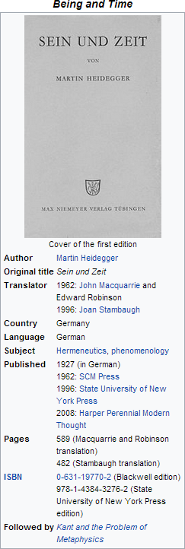
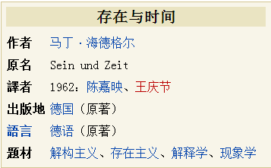
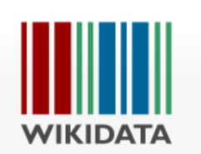
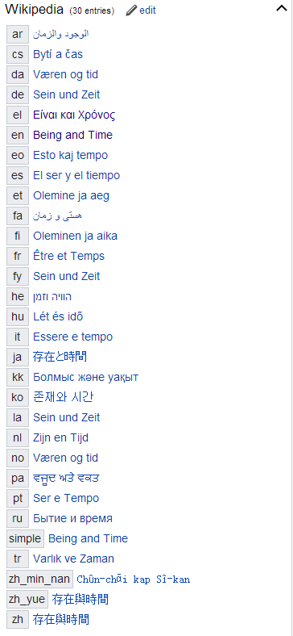
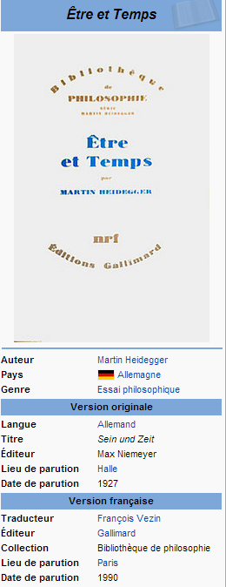
Translators
Notes:
The Wikidata page for Heidegger’s Sein und Zeit includes the labels for each translation in the writing system of that language. The “quick facts” are included in some of the Wikipedia pages, including the date of the original publication, the original title (in the original script) and sometimes a few translators.
We can enrich the information we extract from WorldCat by including the original scripts of translations that are in WorldCat only in romanized form, and find translations that lack the original title but are represented on the Wikidata page. But WorldCat has far more titles – and more translators identified – than Wikidata does.

Slide 21
Title: Sein und Zeit
Language: German
Author: Martin Heidegger
Created: 1927
HasTranslation:
Title: 존재 와 시간 Language: Korean
Translator: 전 양범
Date: 1989
IsTranslationOf:
Title: 存在와時間
Language: Korean
Translator: 鄭明五, 鄭淳喆
Date: 1972
IsTranslationOf:
Title: Being and Time
Language: English
Translator: Joan Stambaugh
Date: 2010
IsTranslationOf:
schema:translationOfWork
Title: Время и бытие
Language: Russian
Translator: Владимир Вениамович
Бибихин
Date: 1993
IsTranslationOf:
Title: 存在と時間
Language: Japanese
Translator: 細谷貞雄
Date: 1997
IsTranslationOf:
Notes:
The relationship of a work (with an author) and its associated translations (with their respective translators) is relatively straight-forward. This diagram shows the original German book in the blue box and each translation in the red boxes. Each translation points back to the original German work (red arrows) through the property IsTranslationOf . A work can have any number of translations, and there can be multiple translations into the same language which is why identifying the translator is so important. In this case, we see two Korean translations, a 1972 translation, with two translators, written in both hangul and hanja, and a later 1989 translation written in hangul only.

Slide 22
Markup for the semantic web
# Original Work (in Chinese)
<http://worldcat.org/entity/work/id/1215997>
a schema:CreativeWork;
schema:creator <http://viaf.org/viaf/102266649> ; # "Gao, Xingjian”
schema:inLanguage "zh";
schema:name "靈山"@zh-hant .
# Translated Work (in English)
<http://worldcat.org/entity/work/id/145209748>
a schema:CreativeWork;
schema:creator <http://viaf.org/viaf/102266649> ; # "Gao, Xingjian“
schema: translator <http://viaf.org/viaf/81663420> ; # "Lee, Mabel"
schema:inLanguage "en";
schema:name "Soul Mountain"@en ;
schema:translationOfWork <http://worldcat.org/entity/work/id/1215997>
Notes:
To leverage all the work done by the OCLC cooperative we want to share the relationships we’ve established between original works and their associated translations with the semantic Web. Here is a sample markup of an original Chinese work written by Gao Xingjian, a Chinese Nobel Prize laureate for literature, and one of the translations of his work into English. We marked this up with schema.org; there were two new terms we proposed, since accepted as a bib extension, shown here: translator and translationOfWork. We are also exploring using ISO-defined script differentiators for simplified and traditional Chinese characters, “hant” here for traditional and “hans” for simplified.

Slide 23
Multilingual labels
Other identifiers
Common descriptions
Original scripts
Work sets
Book instances
Series
Editions
Translations
Publishers
Subjects
Classifications
Materials
Library holdings
…
Multilingual labels
First publication date
Original language and script of work
First line
Freebase ID
MusicBrainz work ID
…
Work ID
Richer bibliographic descriptions
Translations
Library related identifiers
Courtesy of Shenghui Wang
Notes:
Linked data offers us not only the opportunity to represent authors, translators, and titles by identifiers rather than by text strings but also take advantage of other linked data resources to enrich our own datasets. We see a mutual benefit between WorldCat and Wikidata.

Slide 24
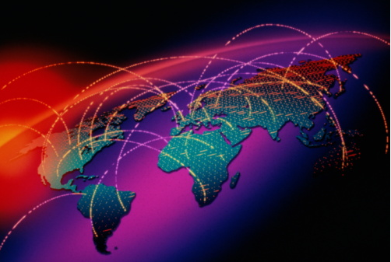
Meeting the challenges
WorldCat has more translations than any other resource.
We can tag data elements from different languages of cataloging.
We can ingest data from other linked data sources to present information in the preferred language and script of the user and associate translations to the original work.

Slide 25
Challenges of Multilingualism
Visualizing Digital Humanities• 21 June 2017
Thank you!
Karen Smith-Yoshimura
@KarenS_Y
smithyok@oclc.org
©2017 OCLC. This work is licensed under a Creative Commons Attribution 4.0 International License. Suggested attribution: “This work uses content from “Data Designed for Discovery” © OCLC, used under a Creative Commons Attribution 4.0 International License: http://creativecommons.org/licenses/by/4.0/.”

