Slide 1
CNI Spring 2015 Membership Meeting, Seattle WA
Challenges Presented by Organizational IDs
Karen Smith-Yoshimura
Program Officer

Slide 2
Organizational Identifier: A unique, persistent
and public URI pointing to an organized body.
Examples:
id.loc.gov/authorities/names/n79054596
isni.org/isni/0000000122986657
viaf.org/viaf/154911632
wikidata.org/wiki/Q219563
Identify:

Slide 3
Scholarly output impacts the reputation and ranking of the institution
We initially use bibliometric analysis to look at the top institutions, by publications and citation count for the past ten years…
Universities are ranked by several indicators of academic or research performance, including… highly cited researchers…
Citations… are the best understood and most widely accepted measure of research strength.
Notes:
These are three university rankings issued annually, rankings that are of particular importance to research libraries. Some universities even incorporate raising their ranking in their strategic plans. All three use citations as a factor in determining the rankings, and thus rely on correctly identifying the affiliations of the authors. National authority files generally include organizations as authors or subjects, not as affiliations of researchers.

Slide 4
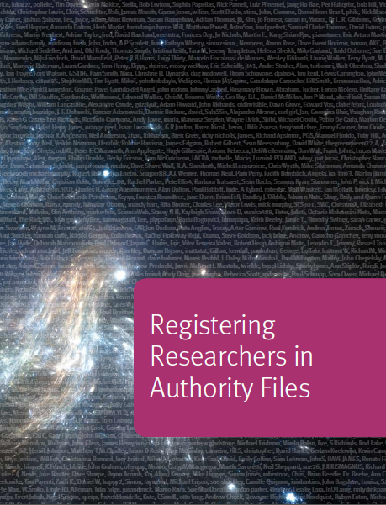
Organizational IDs: Use cases
Institutions want to track all their scholarly output
Track research groups which may comprise staff from multiple institutions
National reporting
Funding tracking
Disambiguate researchers’ names by affiliation
Correctly identify researchers’ affiliations in publications
Many institutions unaware they already have an identifier assigned
Notes:
The current work on organizational identifiers is an outgrowth of the previous work we did with another OCLC Research Library Partners task group on researcher identifiers. That report, Registering Researchers in Authority Files, was published last year. In discussing the report with the Partnership, it became clear that organizational identifiers were equally important to fulfill some of the needs and use cases.

Slide 5
Why things not strings
English text may refer to:
Bibliothèque nationale de France
BnF
National Library of France
Texts in other languages may refer to:
法國國家圖書館
مكتبة فرنسا الوطنية
Εθνική Βιβλιοθήκη της Γαλλίας
הספרייה הלאומית של צרפת
フランス国立図書館
프랑스 국립도서관
Национальная библиотека Франции
Notes:
Relying on text strings is unreliable for matching. Even in English, we may refer to the BnF several ways. But text strings for the “thing”, will differ greatly across languages.
This is the same issue as we have with personal names (people may use initials, use middle names or not, have nicknames and may have their names represented in different languages.) But organizations are more complex...

Slide 6
Special challenges with organizations
They merge, they split
They acquire/are acquired
They can have multiple departments, schools
Have hierarchies that may change over time
May have multiple hierarchies
Branches in multiple locations or countries
Often unclear when a name change represents a new organization
Different stakeholders’ perspectives
Notes:
The locations or countries may also change names over time, adding to the complexity.
Publishers tend to focus on the units that subscribe to their publications, which can result in uneven representation of departments or schools within a university.

Slide 7
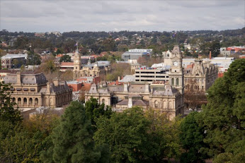
La Trobe University Restructuring
5 faculties:
Faculty of Business, Economics and Law
Faculty of Education
Faculty of Health Sciences
Faculty of Humanities and Social Sciences
Faculty of Science, Technology and Engineering
2 colleges:
College of Science, Health and Engineering
College of Arts, Social Sciences and Commerce
Notes:
La Trobe University is a current example of a massive restructuring. Here, the staff stay where they are but their affiliations are changing around them.

Slide 8
Jisc-CASRAI-UK Organisational Identifiers Working Group
…”it would be useful to separate the infrastructure element (the provision and maintenance of the OrgID itself) and the service element (the services offered both to registrants and to end users of the services).”
“ The most desirable vision for the future would be for ISNI to emerge as a strong, sustainable and internationally well supported baseline or… ‘bridging’ ID…”
“Institutions and others needing to register and use OrgIds should use a solution which relies on and feeds the minimum data set curated by ISNI.”
http://jisccasraipilot.jiscinvolve.org/wp/
Notes:
The Jisc-CASRAI-UK Organisational Identifiers Working Group did its investigation in around the same time frame as ours. The were tasked to look at which organizational IDs should be implemented in the UK higher education sector. They did a landscape review, a survey and developed “user stories” in lieu of use cases.
The full quotation:
The conclusion of the review was that while one single candidate would not fulfil all the
criteria, it would be useful to separate the infrastructure element (the provision and
maintenance of the OrgID itself) and the service element (the services offered both to
registrants and to end users of the services). The most desirable vision for the future would
be for ISNI to emerge as a strong, sustainable and internationally well supported baseline or,
in their own words, “bridging” ID with a few commercial players, and perhaps some
non-commercial ones such as the British Library and HEFCE, acting as registration agencies
and holding crosswalks or equivalence tables to their own IDs.
The Consortia Advancing Standards in Research Administration Information (CASRAI) is an international non-profit dedicated to reducing the administrative burden on researchers and improving business intelligence capacity of research institutions and funders.

Slide 9
ISNI for Organizational Identifiers
479,196 organizations represented by public ISNIs
ORCID uses ISNIs for organizations
Links to and from Virtual International Authority File (VIAF)
Links in Wikidata
Notes:
In one sense, working with organizational identifiers is easier than researcher IDs, where there are dozens of different identifiers in use. ISNI identifiers are already being diffused across different domains, including Wikidata (from which the identifiers are embedded in many different language Wikipedias.)

Slide 10
cross-domain
bridging-domains
Text Rights
Trade Sources
Music Rights
Encyclopaedias
Libraries, Archives and Museums
Researchers & Professional
Granting organisations
Professional Societies
Article databases
Theses databases
Notes:
ISNI sources are from multiple domains, not just the library/archives/museums sector that feed into national authority files.
ISNI Slides from Janifer Gatenby, OCLC-Leiden office

Slide 11
Current ISNI Sources …and growing
GENERAL SOURCES
Bowker Books in Print | BOWKER
The European Library (48 national libraries) | TEL
Virtual International Authority File (33 libraries) | VIAF
MUSIC
American Musicological Society | AMS
British Library Sound Archive | BLSA
International Performers’ Database Association | IPDA
MusicBrainz | MUBZ
RIGHTS MANAGEMENT
Access Copyright, Canada | ACCE
Authors’ Guild | AGLD
Authors’ Licensing and Collecting Society, UK | ALCS
Centrum Dienstverlening Auteurs- en aanverwante Rechten, Netherlands | CEDA
Centro Español de Derechos Reprográficos | CEDR
Irish Copyright Licensing Agency | ICLA
Prolitteris, Switzerland | PROL
VG WORT, Germany | VGWO
RESEARCHERS AND PROFESSIONALS
American Musicological Society | AMS
British Library Theses | BRTH
Digital Author identifier, Netherlands | DAI
Jisc Names Project, UK | JNAM
La Trobe University | AU:VLU
Modern Languages Association | MLA
OCLC Theses | OCLCT
ORCID and DataCite Interoperability Network | ODIN
AuthorClaim and RePec | OPENL
Proquest Theses | PROQ
Scholar Universe, Proquest | SCHU
Electronic tables of content | ZETO
ORGANISATIONS
Boekenbank, Belgium | BOEK
Bowker Publishers | BOWP
Publishers Licensing Society, UK | PLS
Ringgold | RING

Slide 12
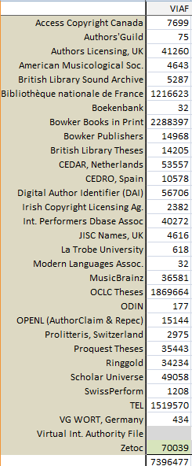
Links between ISNI and VIAF
Links from Current Non-VIAF sources to VIAF clusters =
7.4 million
VIAF source links to ISNI = > 27.7 million
Notes:
This is a list of non VIAF ISNI sources and the numbers of links from those sources to VIAF clusters = 7.3 million. The numbers of links from ISNI sources to VIAF sources is over 27.7 million.

Slide 13
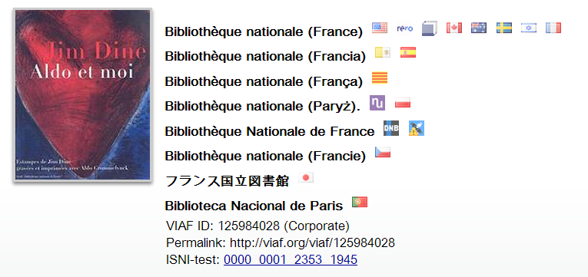
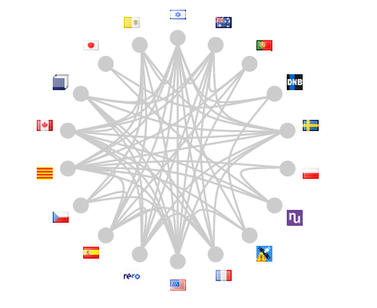
VIAF Aggregates IDs
Notes:
Each of the sources contributing to VIAF has its own identifier, so VIAF can be viewed as an “ID aggregator”.

Slide 14
Wikidata disseminates IDs
Notes:
The ISNI identifier is on the Wikidata page for the Bibliothèque nationale de France. That same identifier is then on the English Wikipedia page and the Korean one. This is an example of diffusing identifiers across both domains and languages.

Slide 15
Status as of March 2015
8.88 million assigned ISNIs (was 1 million 2 years ago)
27.71 million links; ISNI persistent URI
ORCID Registration process is accessing ISNI
Linked Content Coalition names ISNI as # 1 strategy
 |  | Databases | Assigned | Links
 | Research | 12 | 2,557,156 | 6,638,980
 | Text rights | 7 | 132,381 | 746,667
 | Music | 5 | 317,546 | 471,839
 | Libraries & trade | 3 | 7.5 million | 19.77 million
 | Organisations | 3 | 476, 196 | 108,772
ì
Notes:
ISNI makes available to the public 8.88 million identities. Among these identities it has created 27.71 million links. These links do not count the links between VIAF sub sources; i.e. they are really valuable links because they are likely to lead to different information
ORCID – is a self registering ID system for researchers. During the registration process researchers can access ISNI to import their ISNI and metadata.
The Linked Content Coalition http://www.linkedcontentcoalition.org/
LCC Forum Members
​Associated Newspapers​
Axel Springer​
Coordination of European Picture Agencies Stock​, Press and Heritage (CEPIC)
Common Rights
Copyright Clearance Centre
Copyright Licensing Agency
Criteria Media Exchange
Danish Producers Association
DDEX
Digimarc
EditEUR
MovieLabs
Microgen
EMI Music Publishing
Europa Distribution
European Magazine Media Association (EMMA)
European Newspaper Publishers Association (ENPA)
European Publishers Council (EPC)
European Visual Artists (EVA)​
European Writers Council (EWC)
​​Federation of European Publishers (FEP)
Organizações Globo​​
Gruppo Espresso
Hachette Livre
International DOI Foundation
International Federation of the Phonographic Industry (IFPI)
International Federation of Reproduction Rights Organisations (IFRRO)
International Press Telecommunications Council (IPTC)
International Publishers Association (IPA)
IPR License
ITV
Journaux Francophones Belges
Laurence Kaye Solicitors
Microsoft
News International
Newspaper Licensing Agency (NLA)
Pearson
PLS
Plus Coalition
Reed Elsevier
Rightscom
RTL group
International Association of Scientific, Technical & Medical Publishers (STM)
Universitat de Lleida
Unidad Editorial
Vivere Consulting

Slide 16
+ % confidence
Assigned
8.88 million
Authoritative,
Unique,
Trustful,
Persistent
8.41 million persons
476,196 organisations
Provisional: Possible
779,386
Assigned ISNIs March 2015
VIAF + non VIAF sources | 5,231,919
3+ VIAF sources | 294,954
2+ sources (not VIAF) | 304,326
Unique name | 2,635,417
Trusted single source (JISC, BOEK, RING) | 342,194
Total | 8,881,353
Provisional: Unassigned
9,544,260
- % confidence
Notes:
For batch loading, ISNI assignment is not guaranteed.
Criteria for assignment: 2 or more independent sources or 3 VIAF sources, or the name is unique. Unique name assignment requires the forenames to be complete (i.e. not initials), and the metadata to not be sparse. Some sources whose data is trusted to be fully differentiated and deduplicated are used as base data and single source assignment.
For online assignment applications ISNI assignment is assured providing that the data passes the sparseness test and an assertion is made that the database has already been searched.
Slide from Janifer Gatenby, OCLC-Leiden office

Slide 17
Representing Organizations in ISNI Task Group
Grace Agnew, Rutgers – former co-chair of NISO I2 Working Group
Christopher Brown, Jisc – chair of Jisc-CASRAI-UK Organisational Identifiers WG
Kate Byrne, U. New South Wales
Matthew Carruthers, U. Michigan
Chiat Naun Chew, Cornell
Peter Fletcher, UCLA – Co-leader of UCLA’s International Team
Stephen Hearn, U. Minnesota
Xiaoli Li, U. California, Davis
Shu Liu, U. California, Irvine
Marina Muilwijk, Utrecht University
John Riemer, UCLA – former chair, Program for Cooperative Cataloging
Roderick Sadler, La Trobe University
Jing Wang, Johns Hopkins University
Glen Wiley, U. Miami
Kayla Willey, Brigham Young University
Janifer Gatenby, Boaz Nadav Manes, OCLC-Leiden – ISNI team
Karen Smith-Yoshimura, OCLC Research – facilitator
Notes:
These are the members of the OCLC Research Representing Organizations in ISNI Task Group which I facilitate.

Slide 18
ISNI Organizational Relationships
IsMemberOf
hasMember
isUnitOf
hasUnit
isSupersededBy
supersedes
isAffiliatedWith (e.g. an institution, a band)
isRelatedTo
see also from
formerName
laterName
Recommendations to add:
“isHostedBy” and “Hosts” (e.g, Hathi Trust)
“Acquired” and “acquired by”
“isGovernedBy”, “governs” (e.g., state-wide repositories)
“isPartneredWith”
Notes:
ISNI has a set of organizational relationships recommended by the NISO Institutional Identifiers Working Group. In looking at the use cases, our working group recommended additional ones shown here.

Slide 19
Recommendations for ISNI
Indicate the organization’s own preferred form of name
Display relationship types
Create end user input form for organizations
ISNIs for Organizations outreach document
Engage organizations to maintain their public identity
Encourage organizations to collaborate with ISNI Quality Team to diffuse corrections

Slide 20
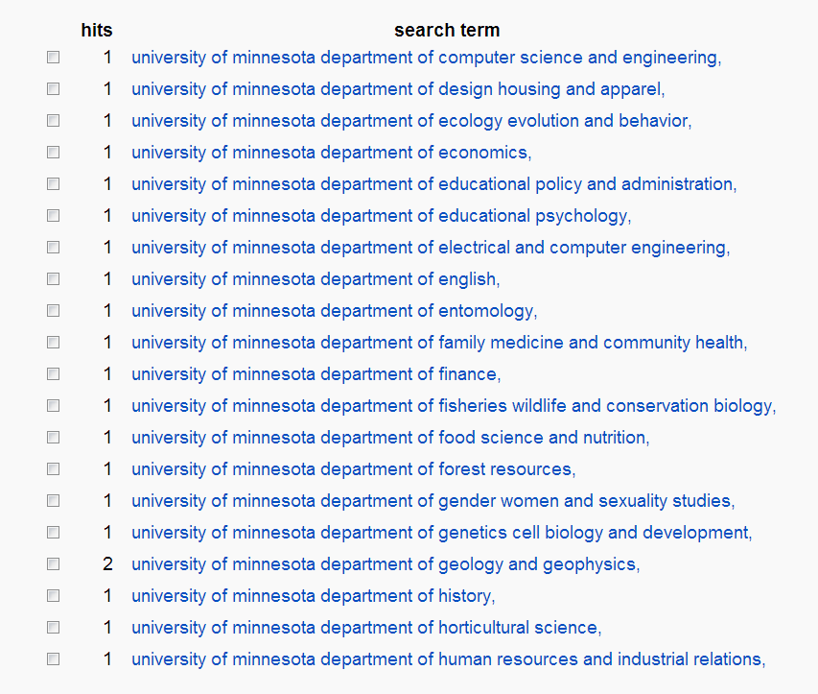
http://isni.org/search
Notes:
This is a partial ISNI database result set showing various departments at the University of Minnesota. Which departments are represented, and which ones are not, depends completely on the sources used. Departments are most likely to change over time – is this level of granularity needed? If so, will institutions invest the effort in maintaining them?

Slide 21
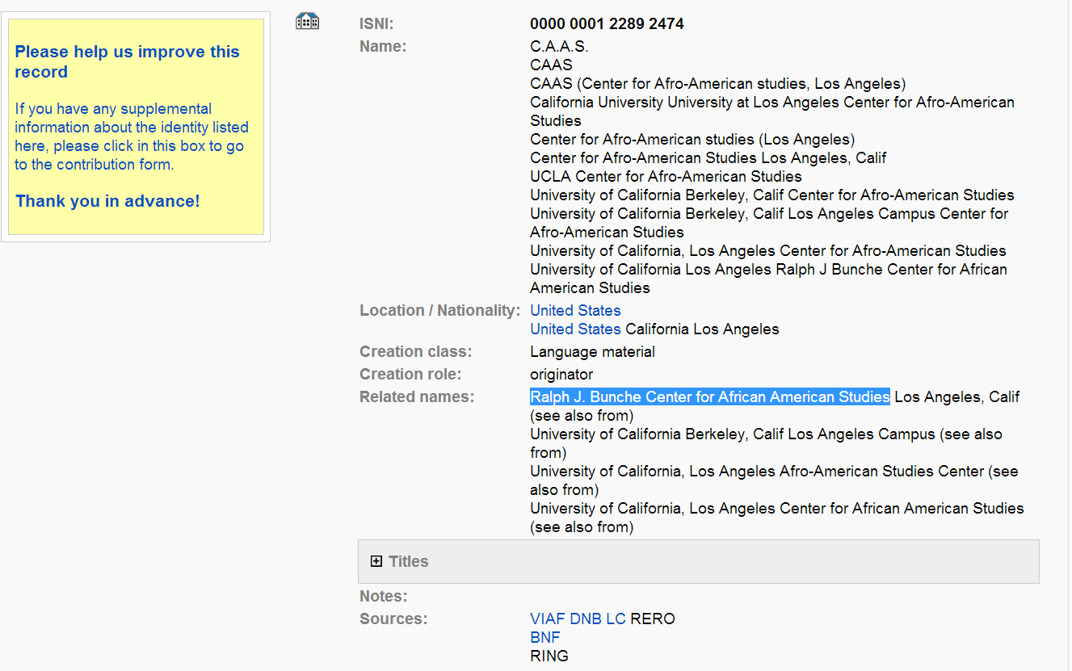
Notes:
From Peter Fletcher’s example for the use case of a metadata specialist adding ISNIs to authority records. In this case, the highlighted “related name” is most similar to the current form in the National Authority file is: Ralph J. Bunche Center for African American Studies at UCLA which is how the Center wishes to be identified according to: http://www.bunchecenter.ucla.edu/
This is a case where the key parts of the name in the current NAF heading and how the Center appears to the public, “bunche center”, are not apparent. This could interfere with quickly and efficiently enabling a cataloger or metadata specialist to readily identify the ISNI record with the actual Center and record the correct ISNI in an authority record.

Slide 22
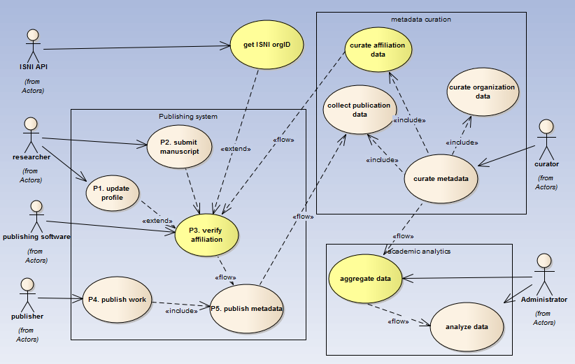
Need for verify affiliation service
Notes:
Diagram created by Jing Wang of Johns Hopkins, in support of a use case to identify researcher affiliations by ISNI organizational identifiers in publications. It illustrates the need for a verify affiliation service.

Slide 23
Issues
What level of granularity is needed?
Who has responsibility to indicate “preferred name” for an institution?
How to encourage use of organizational ISNIs by publishers?
How to better reconcile name variants and related identities from different perspectives?
How to encourage services to build on organizational ISNIs, or crosswalk to them?

Slide 24
Questions?
http://www.isni.org/content/oclc-research-partners-task-force-representing-organizations-isni

Slide 25
Karen Smith-Yoshimura
Program Officer
smithyok@oclc.org
@KarenS_Y

