Slide 1
Putting “Special” in the “Collective Collection”
New-York Historical Society
24 January 2013
facilitated by
Jennifer Schaffner
Program Officer
OCLC Research Library Partnership

Slide 2
Why would anyone in special collections care about the "collective collection"?

Slide 3
Environment of the “collective collection”
The "collective collection" is a term used to express increasingly widespread reliance on digital and shared print repositories, as well as interdependent approaches to collection management. Research libraries generally are developing an ecosystem focused on free and licensed digital materials, print collections (retention of which is being reevaluated), shared print agreements, regional consortia, and resource sharing.

Slide 4
Participate or sit it out?
How do comprehensive academic library collections and subject-specific collections—such as those of independent research libraries and their close kin—see themselves in the new collections environment?
Do library directors have changing expectations of special collections?
Should curators adapt their collecting policies to take collective approaches into account?
Should we formulate regional special collections collaborations?
Can special collections more effectively serve the research community through collaborative ?
When appetites are whet by surrogates, is it inevitable that more researchers will want to see the original materials?
Are new approaches to public services suggested?

Slide 5
Agenda
definition of ‘curating the collective collection’
2. data for curating…
…collective print collections
…collective discipline-specific or subject collections
…collective regional collections
…collective corpus of digitized books
academic library collections
academic special collections
independent research library collections
3. discussion

Slide 6
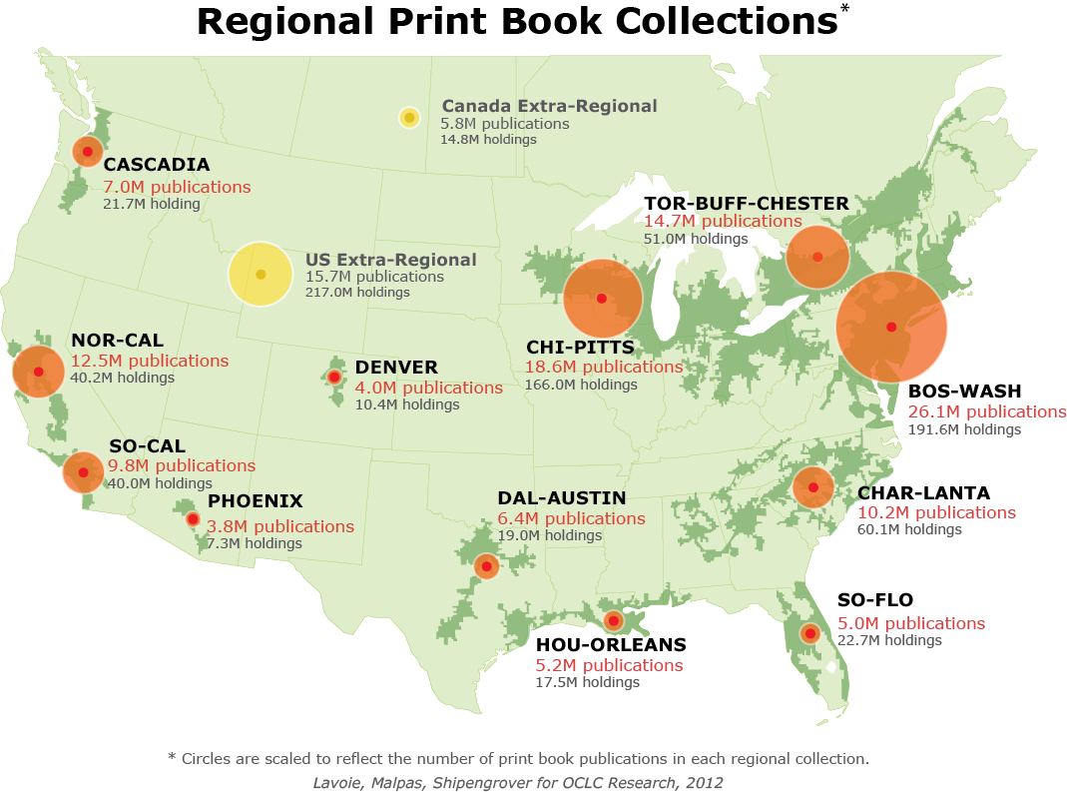
Definition?
Collective collection: The combined holdings of a group of institutions, excluding duplicate holdings.
This yields the virtual
collection of distinct
publications that are
held across the collections of the institutions in the group.

Slide 7
Curating the Collective Collection: Print

Slide 8
Print: Rareness is Common

Slide 9
Curating the Collective Collection: By Discipline or Subject

Slide 10
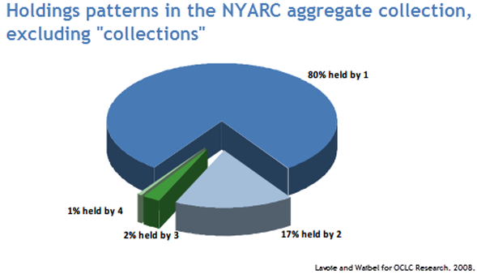
Print: Rareness is Common in NYARC
“One of the findings of the custom collection overlap studies we have done is that rareness is common: there are low overlap levels between collections.”

Slide 11
Curating the Collective Collection: By Geography

Slide 13
Curating the Collective Collection: Corpus of Digitized ‘Books’

Slide 14
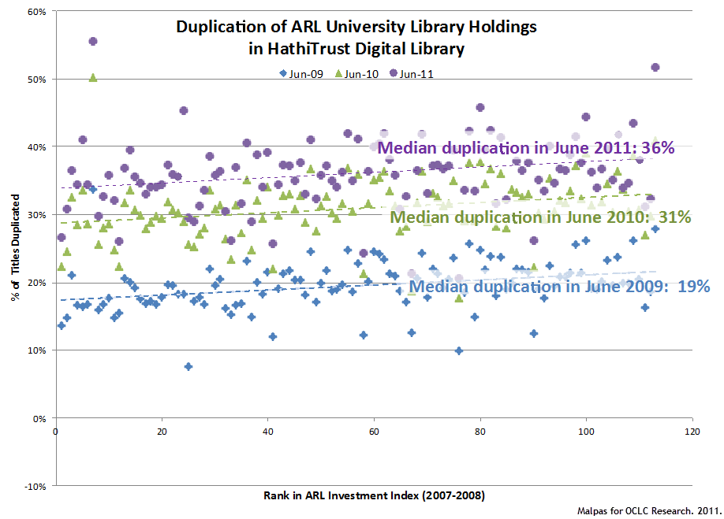

Slide 15
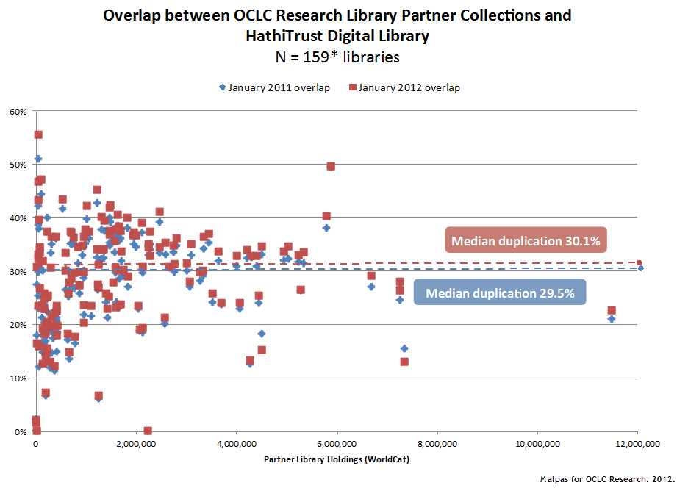

Slide 16
Curating the Collective Collection: Academic Libraries

Slide 17
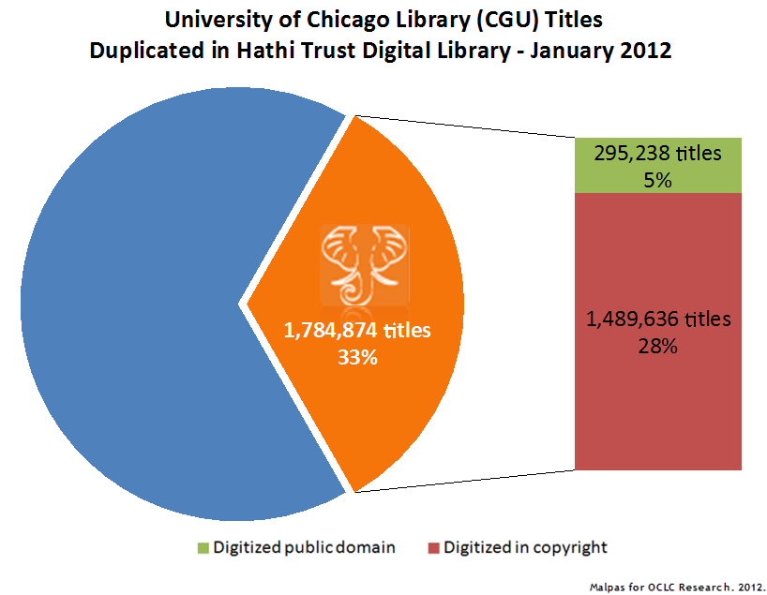

Slide 18
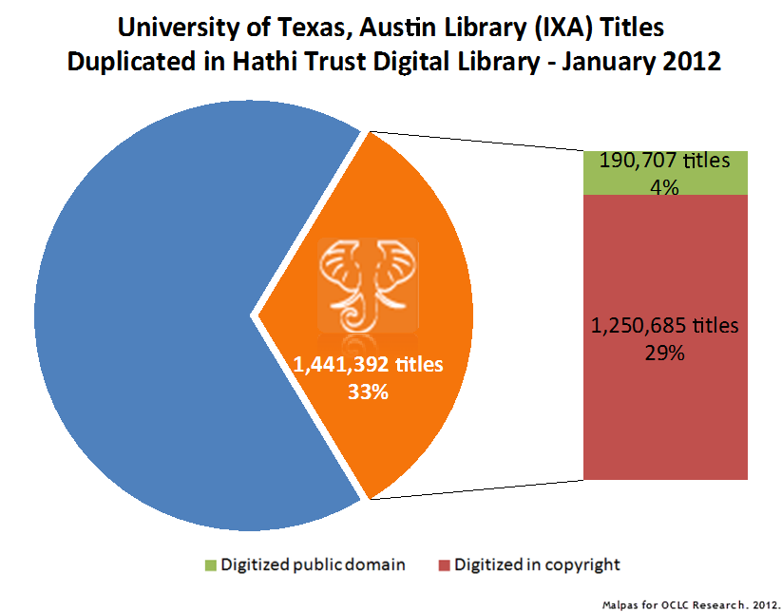

Slide 19
Curating the Collective Collection: Special Collections
In an Academic Institution

Slide 20
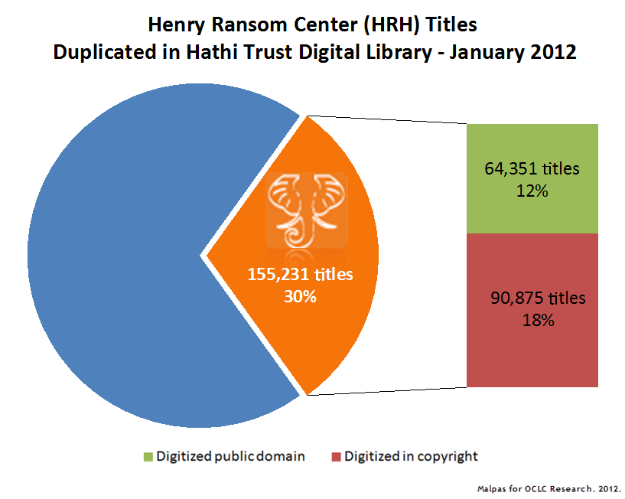

Slide 21
Curating the Collective Collection: Independent Research Libraries

Slide 22
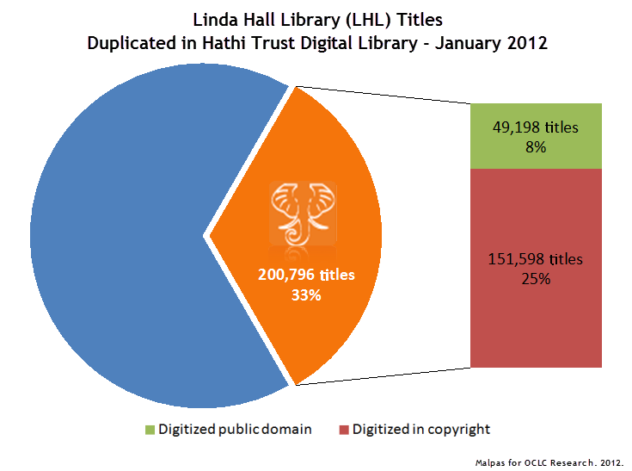

Slide 23
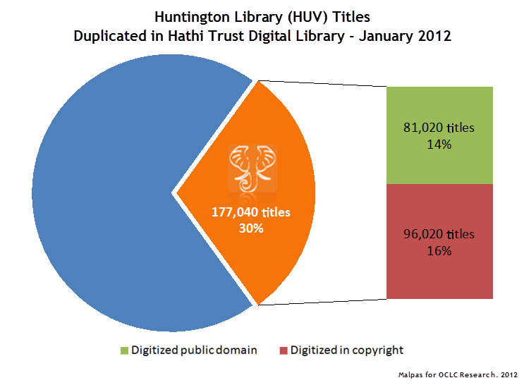

Slide 24
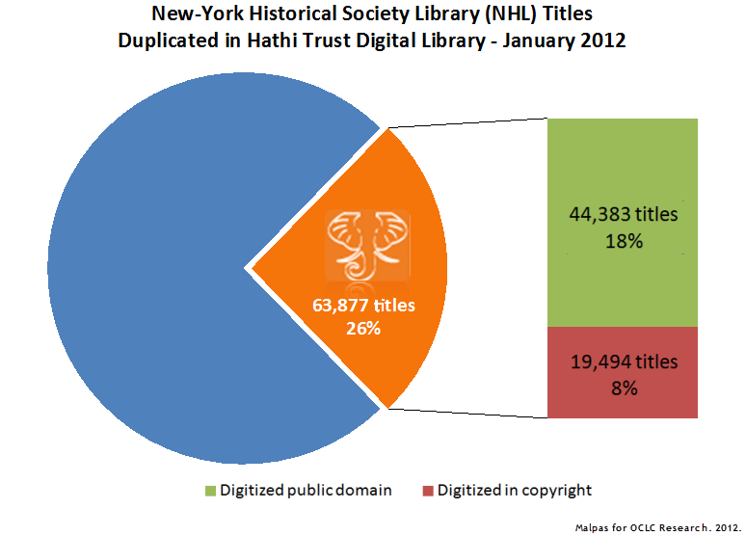

Slide 25
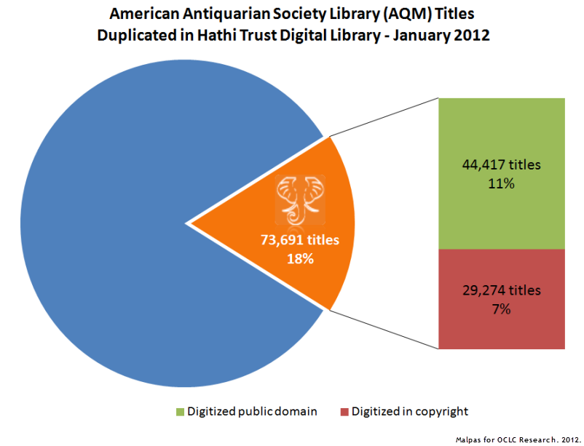

Slide 26
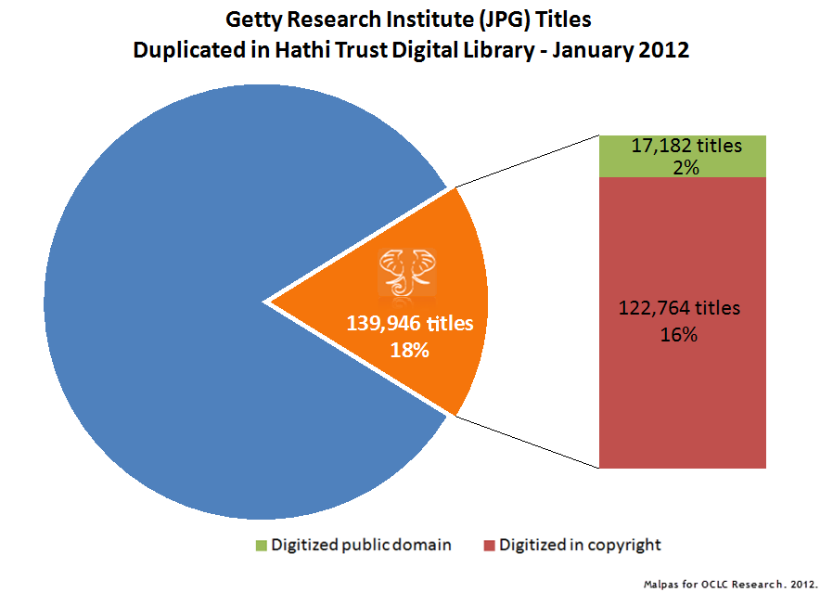

Slide 27
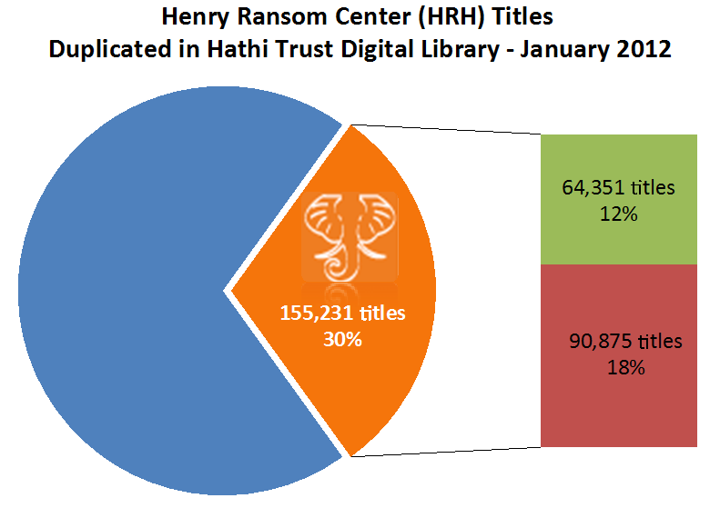
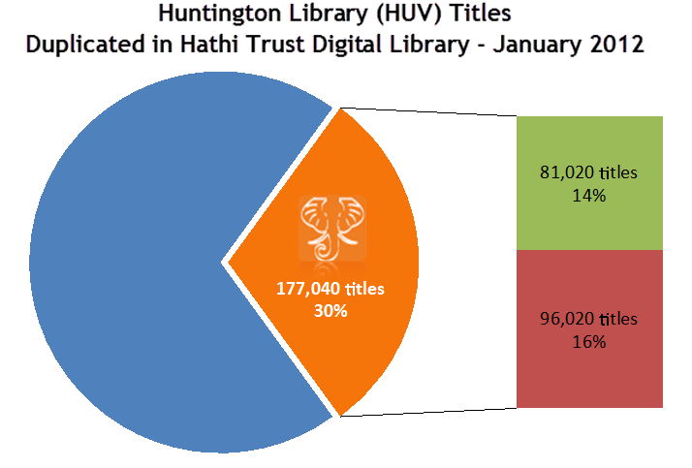
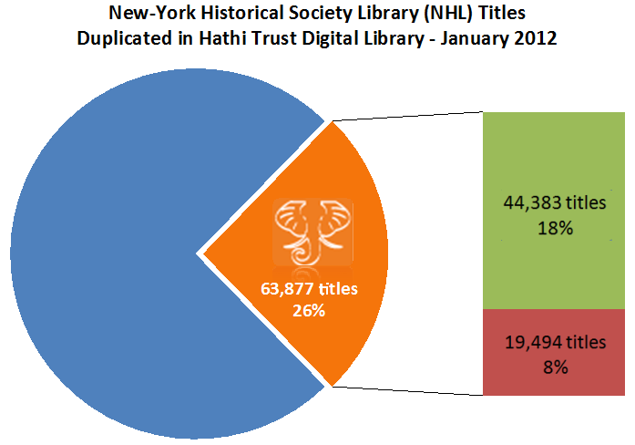
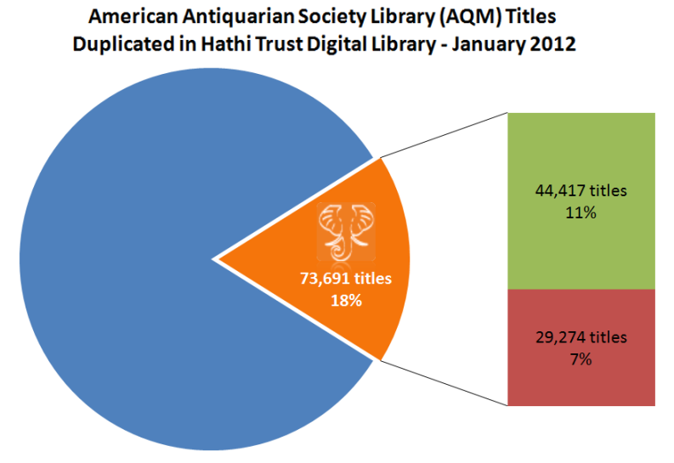

Slide 28
Thinking differently
the “collective collection” isn’t complete without special collections
how do comprehensive academic and research special collections see themselves in the new collections ecosystem?
collecting in the margins?
research (“I can get you whatever you need…”)
can special collections more effectively serve the research community through collaborations?
regional collaborations?
discipline-specific special collections management?
risks
do library directors have changing expectations of special collections?
what are the risks of sitting it out? of taking a seat at the table?

Slide 29
Sources Referenced
Brian Lavoie, Constance Malpas and JD Shipengrover. 2012. Print Management at "Mega-scale": A Regional Perspective on Print Book Collections in North America. Dublin, Ohio: OCLC Research. http://www.oclc.org/research/publications/library/2012/2012-05.pdf.
Brian Lavoie. 2007. Prospecting in the Library Data Mines. http://www.oclc.org/resources/research/presentations/lavoie/20070604-rlgpapm.ppt.
Brian Lavoie and Günter Waibel. 2008. An Art Resource in New York: The Collective Collection of the NYARC Art Museum Libraries. http://www.oclc.org/resources/research/publications/library/2008/2008-02.pdf

Slide 30
keep in touch…
jennifer_schaffner@oclc.org
merrilee_proffitt@oclc.org

