Slide 1
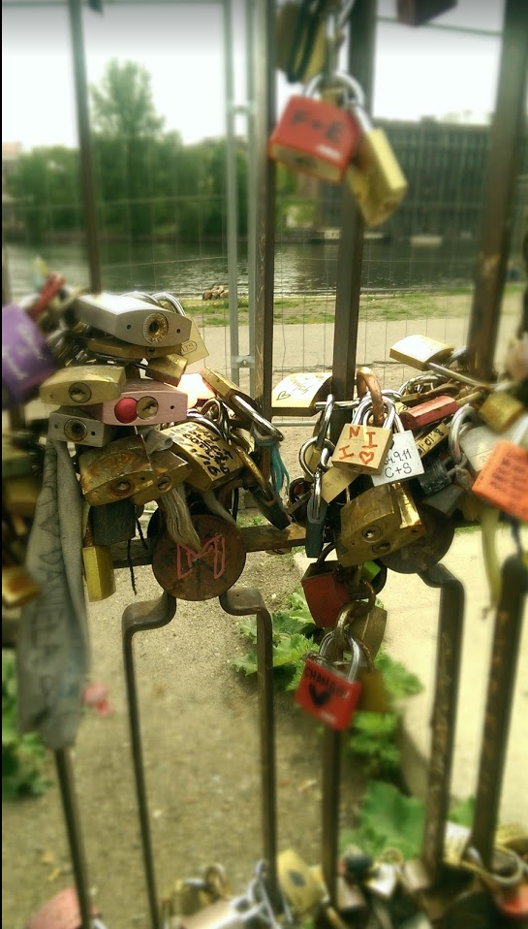
August 4, Archives & Records 2016
Open Up Your Finding Aids
Merrilee Proffitt @merrileeiam
Senior Program Officer, OCLC Research
Photo by Merrilee Proffitt

Slide 2
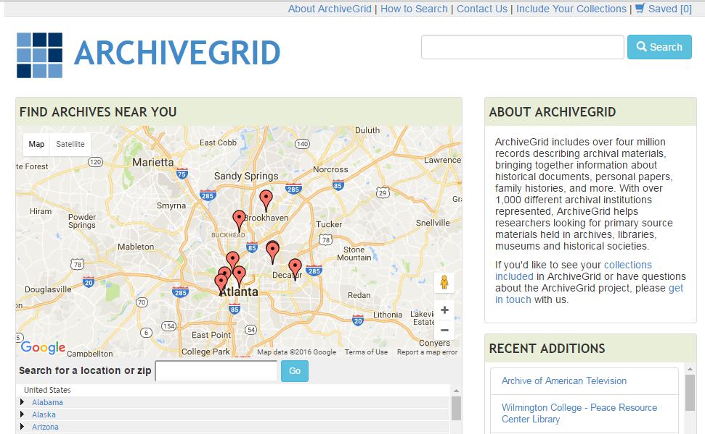
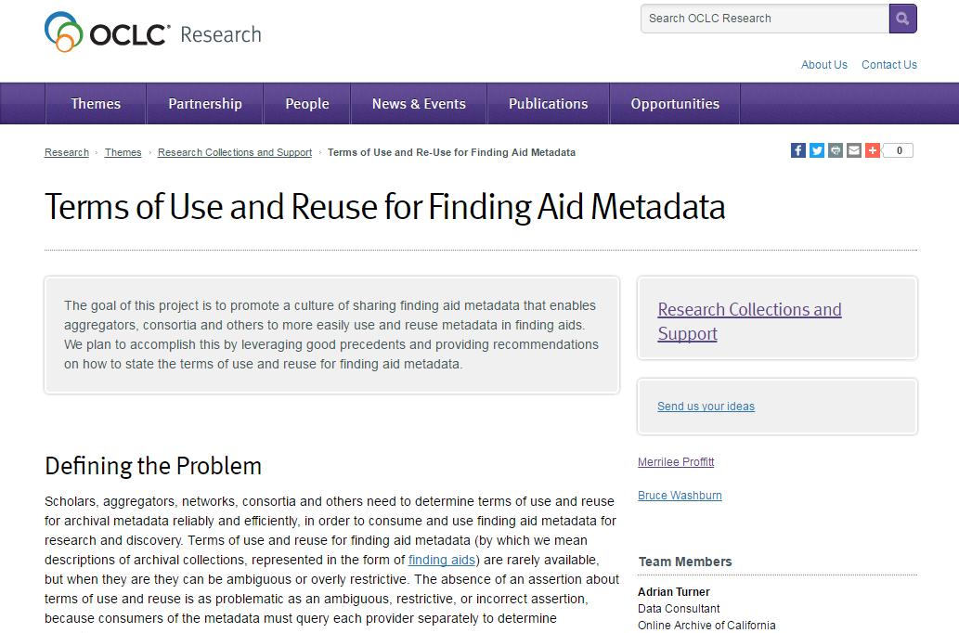
A problem for archivegrid
Formed a working group to look at the problem

Slide 3
Closed finding aids inhibit…
Reuse by aggregators or researchers
Obtaining permission for use of finding aids puts a burden both on those asking permission and gaining permission
Downstream reuse is also inhibited
Reuse of text in finding aids for other purposes (case in point: Wikipedia)
Discovery of collections
Wider use and reuse of our finding aids will lead to greater exposure of collection descriptions and downstream discovery

Slide 4
Challenges in “opening up”
Educating archivists about the problems of having finding aids without clear rights statements (and the problems of unopen finding aids)
If you want to “open up” – how? Talking points for colleagues / decision makers
Encoding rights statements in EAD
Need for machine readable rights statements and a place to put them (!)

Slide 5
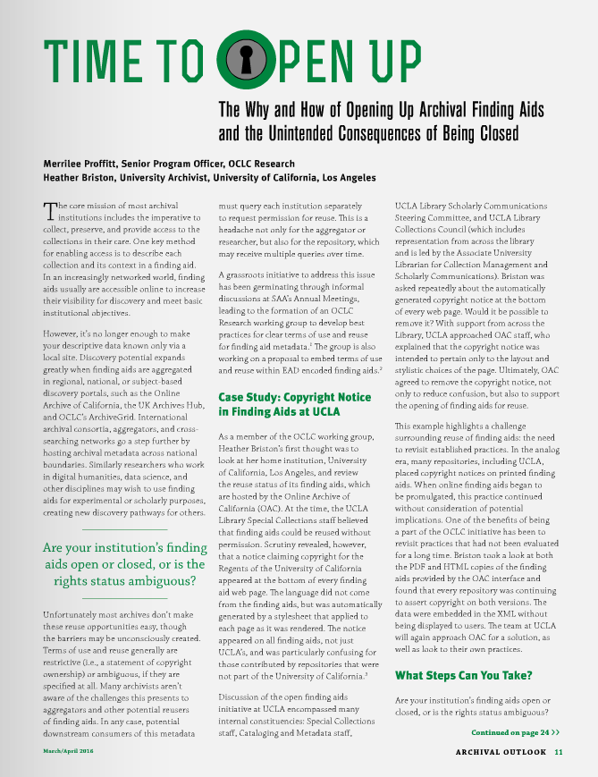
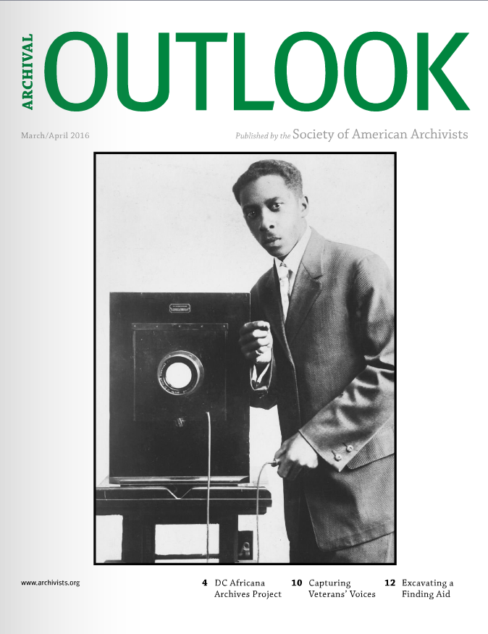
UCLA case study
http://www.bluetoad.com/publication/?i=293827

Slide 6
Fixing the problem
Get buy in from higher ups if needed
Work with technical staff to implement a solution
Remove copyright statements from website (usually generated by a stylesheet)
For finding aids, replace © with an open license statement
Creative Commons and for more exotic edge cases rightsstatements.org
There is no place for rights statements in EAD – be consistent and wait for a solution (EAD 3.1?)

Slide 7
Proposal
In <control> roughly parallel in structure with <languagedeclaration>
<rightsdeclaration> <rightsinfo> <p>...</p> </rightsinfo > <rightsinfo > <p>...</p> </rightsinfo> </rightsdeclaration>
Attributes:
IDENTIFIER with a URI
TYPE attribute (license vs copyright statements)

Slide 8
Fixing the problem
Not just words, but code
CC-BY
Attribution 2.0 Generic (CC BY 2.0)?
Attribution 4.0 International ?
http://creativecommons.org/licenses/by/3.0/

Slide 9
Fixing the problem
Professional statement on rights information
…for finding aids and other forms of metadata
…for digitized materials that are clearly out of copyright
…for our professional literature

Slide 10
Let’s unlock things together
Merrilee Proffitt
OCLC Research
@merrileeiam proffitm@oclc.org
https://pixabay.com/en/padlock-unlocked-lock-key-gold-166882/ cc-0
©2016 OCLC. This work is licensed under a Creative Commons Attribution 4.0 International License. Suggested attribution: “This work uses content from ‘Open Up Your Finding Aids’ © OCLC, used under a Creative Commons Attribution 4.0 International License: http://creativecommons.org/licenses/by/4.0/.”

