Slide 1
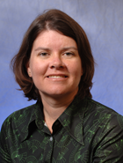
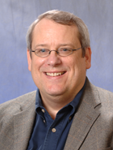
OCLC Research Library Partnership: how to engage?
Merrilee Proffitt and Dennis Massie
Program Officers, OCLC Research
December 2014
Notes:
Merrilee welcome
Dennis welcome.

Slide 2
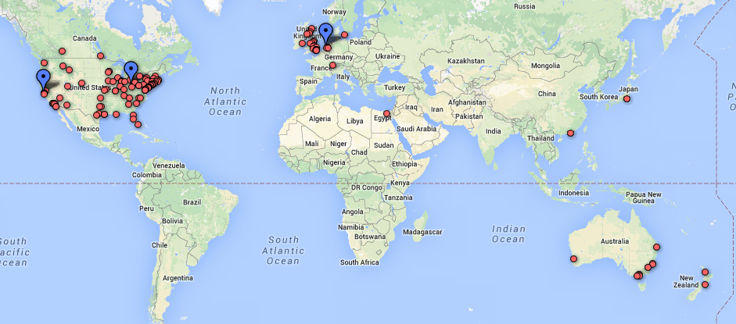
OCLC Research Library Partnership
November 2014
Notes:
Dennis
Locations and offices

Slide 3
OCLC Research Library Partnership
new affiliations (FY13-FY15)
 | FY13 | FY14 | FY15
Joined | DePaul University Fordham University Haverford College Memorial Sloan-Kettering Cancer Center Library University of California, Irvine University of New South Wales University of Queensland University of Wisconsin-Madison Washington University in Saint Louis | Australian National University Montana State University Occidental College University of California, Davis University of California, Riverside University of Illinois, Urbana Champaign University of Western Australia | Bryn Mawr College Case Western Reserve University Deakin University Vassar College University of Nevada, Las Vegas
Notes:
Dennis
Highlight many institutions from Australia (quickest growing segment), smaller schools (Occidental, Vassar, Haverford) as examples of diversity

Slide 4
How do we choose projects?
  Listening and participating
  Capacities
  Skills
How do we work?
  Working groups
  Task forces
  Communities of interest
  Web discussions
How do we filter?
  Impact
Notes:
Merrilee
One of the questions we get most frequently from partners and others is how do we come up with projects?
We spend a lot of time listening – as active professionals at meetings and conferences, reading listservs. We try to pay attention to what shared, high priority community needs are. When we do see a need, we don’t necessarily jump on board to provide a solution – we try to carefully choose projects where our skills are a good match.
Once we do launch a project, it can take a number of different forms. We may form a working group or launch a task group. We may poll the partnership to get further information. We may conduct a survey or do a literature review in order to refine a direction.
Of course like any organization with limited resources, we can’t do everything and we need to make choices. We always ask ourselves, will this project have impact.

Slide 5
Impact
Eliminates a redundant effort or process
Affects system-wide behaviors
Creates shared capacity
Changes community economics
Cuts across cultural sectors
Transforms something (process, standard, etc.) into a routine
Translates something (process, standard, etc.) into community terms
Responds to a known and shared need
Provides opportunities for engagement
Total Research investment does not substantially exceed community benefit
Notes:
Merrilee
These are the filters we use to determine whether and what kind of impact a piece of work might have.
A given project need not meet all these criteria for impact but when work rises to the level where we can say yes to more than a handful of these, we know we have a clear winner.

Slide 6
Examples of how we work
The birth of born digital
The Evolving Scholarly Record
Organizational Identifiers
Restructured, Reorganized?
SHARES
Shaping our annual meeting
6
Notes:
Merrilee
We are going to spend the reminder of our time giving some recent examples of our work, hoping to show some different patterns of both engagement and project lifecycle.

Slide 7
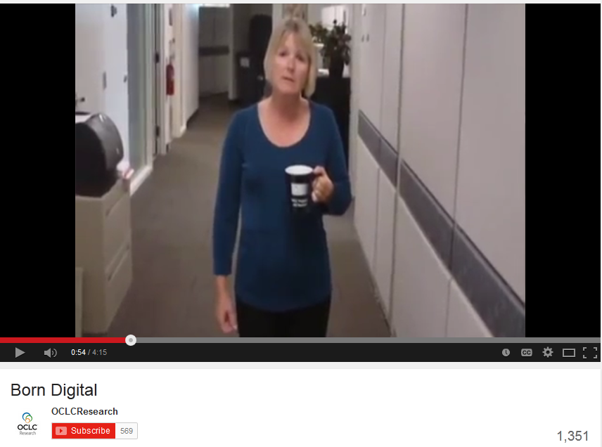
Notes:
Dennis
Our Born Digital cycle of work is a perfect example of how Research develops projects and collaborates with staff at Partnership institutions.
Back in 2010, our fellow program officer Ricky Erway noticed that the phrase “born digital” was being tossed around a lot in the libraries and archives community, and wasn’t all that clear what people were talking about when they said “born digital.” So Ricky and I shot a video where she wandered around our office asking colleagues what they meant when they used the phrase. Turns out that, to them, “born digital” could mean everything from electronic records to digital documents to harvested Web content to art, photos, and music.
The video was the first ever made for the OCLC Research YouTube channel and spawned blog posts and an informal position paper on the same topic.

Slide 8
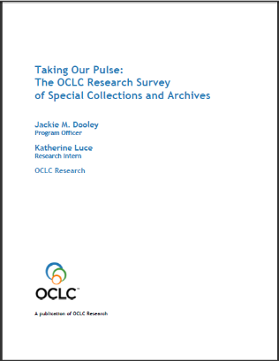
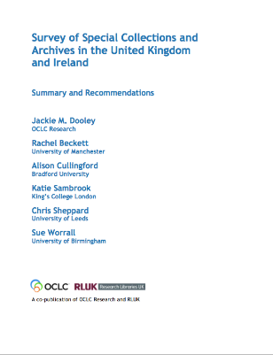
digitization
  develop models for large scale digitization
user services
  promote policies that facilitate (rather than inhibit) access
born-digital archival materials
  create a no-expertise-needed program for management
Notes:
Dennis
Around that same time another fellow program officer, Jackie Dooley, was writing up the results of an epic survey of North American archives and special collections, which soon after was re-done in the UK and Ireland. This survey was designed as a follow-up to the 1998 ARL survey that led directly to many high-profile efforts to expose hidden collections. Our 2010 survey results pointed toward three major action items having to do with digitization. Notice that third bullet point down there – create a no-expertise-needed program for management of born digital archival materials.

Slide 9
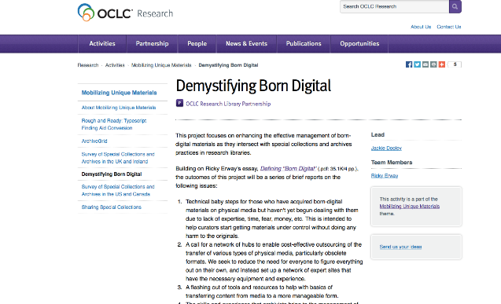
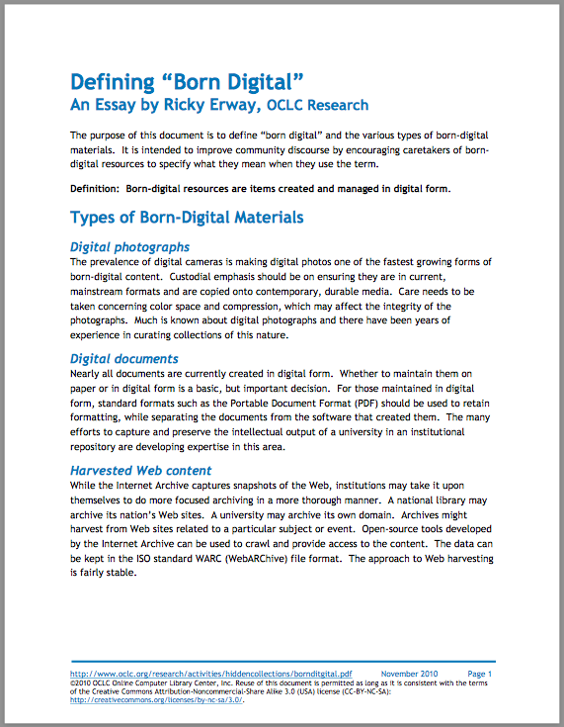
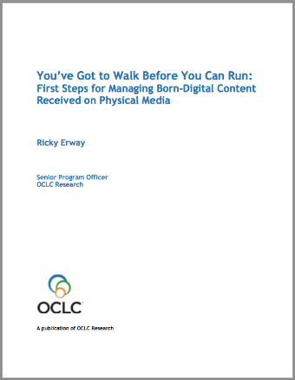
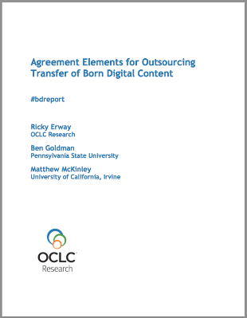
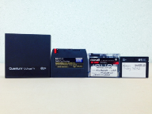
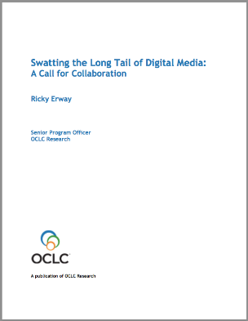
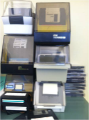
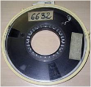
Notes:
Dennis
Back over to Ricky Erway, who knew of a few scattered experts who were already working in this area and saw an opportunity to bring them together with interested parties at Partnership institutions to create some baby steps for getting started on managing born digital archival materials.
Over the past three years, Ricky and her various working and advisory groups have created a body of work that guides practitioners from the absolute basics – inventorying and prioritizing – through accessing and preserving born digital material that arrives on media that can be read in-house – to envisioning a network of shared services where those with the necessary equipment take on the task of rescuing born digital content from obsolete media.
So, from humble beginnings -- a video wondering aloud what Born Digital actually means – we have ended up with a series of reports outlining a program for managing born digital materials.
Solid guidance for beginners and experts alike, brought to you by OCLC Research and expert staff at Partnership institutions.

Slide 10

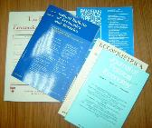
Evolving Scholarly Record
develop framework to:
  organize discussions about scholarly record
  get “big picture” view
  define materials and stakeholders
  find high-level cross-disciplinary application; practical use
Date $ bn
2012-01-01 16289.6
2012-04-01 16419.2
2012-07-01 16603.7
2012-10-01 16677.3
2013-01-01 16772.7
2013-04-01 16907.9
2013-07-01 17175.9
float gasdev(long *idum) {
static int iset = 0;
static float gset;
float fac, rsq, v1, v2;
if (iset == 0) {
do {
v1 = 2.0*ran1(idum) - 1.0;
v2 = 2.0*ran1(idum) - 1.0;
rsq = v1*v1 + v2*v2;
benefits:
organize conversations across domains
coalesce shared views
equip libraries, scholars, funders, publishers, scholarly societies, etc. with resource for strategic planning
10
Notes:
Merrilee
OCLC Research recently launched a project to explore trends and characteristics shaping the scholarly record as we know it today.
This project has developed a high-level framework that provides a “big picture” view of the scholarly record in terms of categories of materials and stakeholder roles.
It is intended to be useful for application in any disciplinary setting, and across a wide range of domains in terms of both strategic planning and policy discussions touching on the scholarly record.
The key benefit from the framework is that it can be used as a common reference point around which to organize discussions about the scholarly record and related issues, both within and across stakeholder domains. Of course, libraries are one of those important stakeholders.

Slide 11
Evolving Scholarly Record workshops
10 June 2014
Amsterdam, Netherlands
Completed – outcomes online
10 December 2014 George Washington University
Washington, DC
Standing room only!
23 March 2014 Northwestern University
Evanston, Illinois
Registration open
2 June, 2015 Sir Francis Drake Hotel
San Francisco, California
Registration open
11
Notes:
Merrilee
The report which I hope you’ve seen came out in June, and in order to get feedback on future directions, we are holding a series of free workshops. The first one was in June, in Amsterdam, and upcoming workshops co-sponsored by OCLC Research, the Coalition for Networked Information (CNI), and partner institutions, builds on the framework presented in the report.
In the Washington DC workshop. Brian Lavoie, Cliff Lynch, Herbert Van de Sompel, and Daniel Hook (figshare and Symplectic) will be speaking and OCLC Research staff will lead discussion groups. By June we hope to have developed a concrete list of next steps we can take within the research library community. I hope you will plan to attend one of these workshops, or look for outcomes soon.

Slide 12
Metadata Managers Focus Group
Meets at ALA and virtually
Discusses issues and works towards outcomes and solutions
Outputs include: Social Metadata for Libraries, Archives & Museums Report, Linked Data Survey, Registering Researchers in Authorities Files Report
Notes:
Merrilee
Longstanding and very active group ably lead by Karen Smith-Yoshimura with a long track record of notable and useful outputs. A short list of these includes…

Slide 13
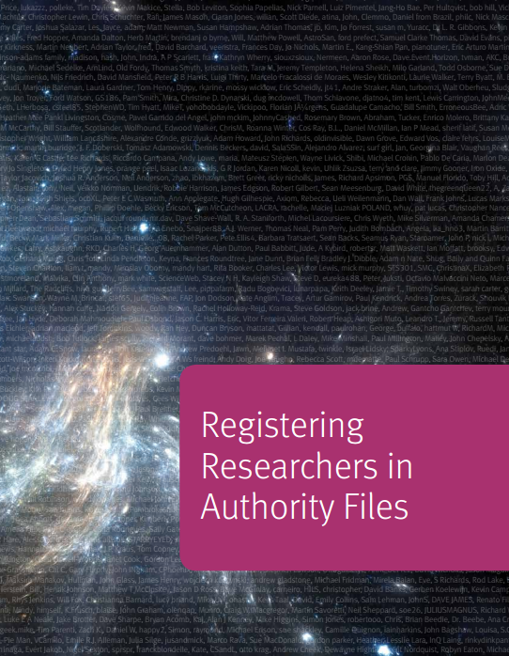
From Researcher Identifiers to Organizational Identifiers
Discussion of draft report and actions around researcher identification revealed issues with organizational identifiers
OCLC Research Organizations in ISNI Task Group
document how organizations should be represented in the ISNI database
Advise the OCLC ISNI team on improving record quality, encoding, completeness, user interface, diffusion and to help better engage the community.
Notes:
Merrilee
The OCLC Research Organizations in ISNI Task Group is a current example. It arose from the OCLC Research Library Partners Metadata Managers Focus Group’s discussions on researcher identifiers last June (the draft RRAF report was used as the basis of discussion along with a question set about focus group members’ plans for researcher identifiers) – which turned into concerns about the “institutional affiliations” of researchers, and how those institutions, and particularly their institutions, were represented in ISNI. The organizational identifiers are particularly important because ORCID also uses the ISNI organizational identifiers, and ISNIs show up in Wikidata, yet many institutions aren’t even aware that they have ISNI identifiers.
A call for volunteers went out on the OCLC Research Library Partners Metadata Management Interest Group and we are now holding regular WebEx sessions with our ISNI colleagues in Leiden.

Slide 14
Reorganized? Restructured? Process
Feedback from 65 Partner Institutions
Interviews with a subset
Presentation at Libraries & Research meeting (June 2014)
Blog postings coming soon
Notes:
Merrilee
If your organization has recently undergone a reorganization, you are not alone. Over the last few years, we thought we were seeing an uptick in reorgs and so decided to investigate. Jim Michalko took the lead on this work and gathered feedback from 65 institutions in the OCLC Research Library Partnership and conducted interviews with a subset of those, in order to find out if structure indeed follows strategy. Some highlights: Almost all institutions interviewed were undertaking restructuring based on a changes external to the library, such as new constituencies and expectations. Organizations are orienting themselves to be more user centered, and to align themselves with a new direction taken by the university. We see many libraries bringing in skill sets beyond those normally found in the library package. Many institutions charged a senior position with helping to run a portion of a regional or national service. Other similarities: all had a lot of communication about restructuring. Jim presented on his work at our June 2014 meeting and will do a series of blog posts as well as a webinar on this work and findings so stay tuned for that.

Slide 15
Basic SHARES facts and principles
87 institutions
118 libraries
9 countries
4 continents
Self-governing
Easy to get started
Academic, museum, law, medical, national, public
SHARES Agreement
  Consider each request
  No blanket restrictions
  Below market rates (via IFM)
  Expedited delivery
  Lending returnables overseas optional
  Reciprocal onsite access
Notes:
Dennis
SHARES is a resource sharing consortium made up exclusively of members of the OCLC Research Library Partnership. It’s a benefit of being a partner; there is no additional fee to be part of it. SHARES has been going strong for about 30 years now, in one form or another. It is like most resource sharing groups in that participants send library materials back and forth among themselves, and they also extend reciprocal onsite access benefits to each others’ staff and patrons. It’s also different from other resource sharing groups, in a number of ways. One, it’s quite diverse as far the as types, sizes, and locations of the types of libraries. The collections represented are some of the richest and deepest in the world. And the level of trust that has built up among this smallish band of institutions is quite extraordinary. The cornerstone of the SHARES agreement is that those who join will consider each and every request from a SHARES partner. They may decline to lend, but they will at least consider each request, even those for items not traditionally sent out through interlibrary loan. And they will make exceptions and do special favors when they can. It’s where you go to get the really hard-to-get stuff. For years SHARES members have been pushing the envelope, always striving for more sharing, wider access, fewer obstacles. SHARES is all about getting to yes as often as possible.

Slide 16
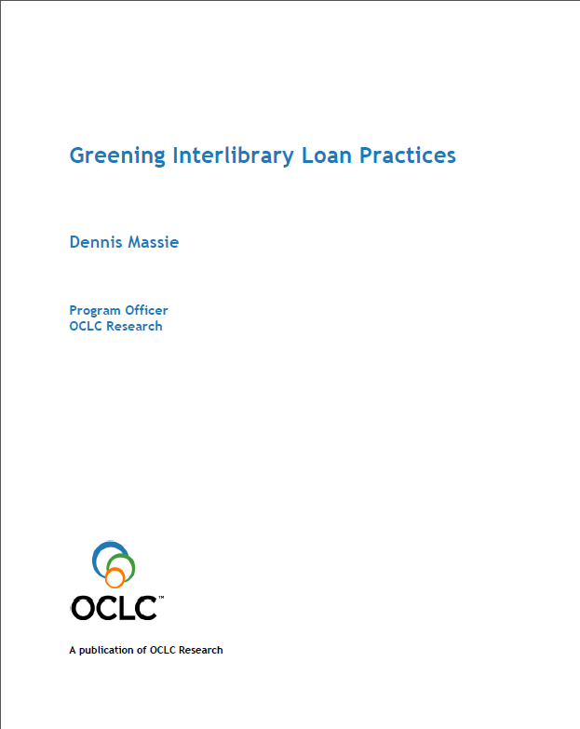
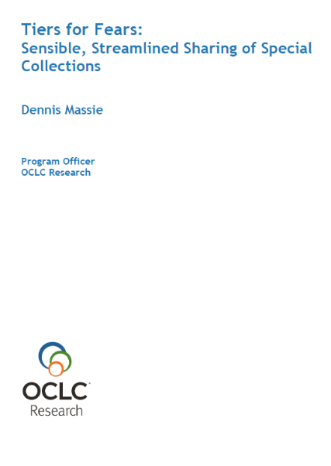
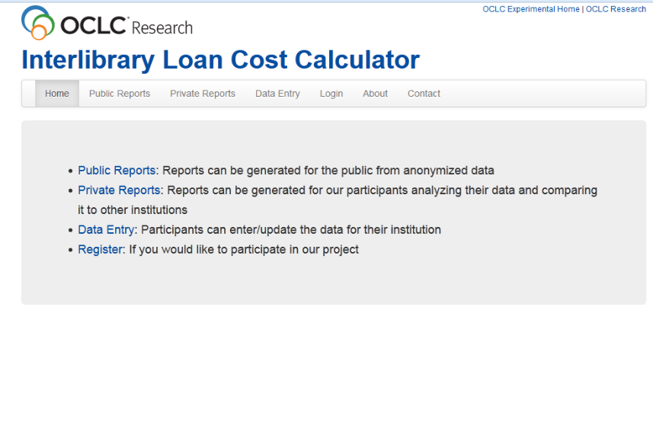
 | Routine Workflow | Cooperative Workflow | Exceptional Workflow
REVIEW
Request | Via ILL system | Collaboration between Special Collections (SC) and ILL | Directly to SC
Is material held in a special collection? | ILL staff | Collaboration between borrowing and lending institutions | Lending institution
Reference Interview | At borrowing institution—reference desk and ILL staff | Collaboration of ILL and SC staff in both institutions | By lending institution—SC staff
Inter-institutional communication how? | ILL system | ILL system and email/phone | Direct contact between two SC’s
Internal communication how? | ILL system | ILL system and email/phone | Direct contact between SC/ILL staff and other departments
Stipulate for Research Use? | Implicit | Consider emphasizing | Explicit criteria
Reviewing Infrastructure | Written guidelines | Collaboration between borrowing and lending departments | Elaborate decision tree, multiple staff, institutional level decision
Mutual disclosure of ILL and SC facilities | We trust you | Approved checklist | Facilities report
Forms | ILL transaction work form and IFM | Extra insurance and/or forms for special handling | Use agreement, insurance forms, art museums loan agreement, etc.
DECIDE
Decision Maker | ILL staff | ILL and SC consult when necessary | SC staff, curator, possibly director
Original or Surrogate? | Surrogate or predetermined originals | Prefer to lend surrogate, consider original | Case-by-case consideration
Published/unpublished? | Some published and predetermined unpublished material types | Some published OK. Unpublished material on a case-by-case basis | Consider lending published and unpublished materials
Use Rights | Borrower’s responsibility | What any reasonable SC staffer would do | Search, monitor and control thoroughly
Trust and Training | ILL training and expertise | ILL and SC cross-training on handling fragile materials | SC training and experience only
LEND
Oversees loan transaction | ILL staff | Staff in ILL and SC | SC specialists
Quality Control | Usual packager, usual shipper, mailroom or ILL | Special ILL or SC packager | SC/preserv staff prepare special supports and deliver with the material
RETURN
Deliver | Usual shipper, with use/handling conditions | Expedited shipper, extra insurance, special handling instructions | Deliver from SC to SC—call me when you get it
Notes:
Dennis
SHARES is also a working laboratory, where interlibrary loan experts come together with OCLC Research to help establish new and better ways of doing things. Research projects from recent years that have involved SHARES staff -- and that have benefited the library community beyond the Partnership and SHARES -- include a “greening ILL practices study” performed by environmental impact consultants. These consultants studied the ILL processes at several SHARES ILL units and, working with OCLC ILL lending data, were able to calculate the greenhouse gas emission per book loaned per mile for each of the units. From there it was a simple step to correlate specific processes with a larger or smaller impact on the environment.
We also did a project that brought together special collections and interlibrary loan staff within institutions to think about new ways of considering outside requests to borrow special collections material, leading some libraries to completely redesign some of their work flows and staffing patterns, cross-training staff and sharing high-end equipment. One outcome of that project was a decision-making guide that models work flows based primarily on an institution’s tolerance level for risk. Not everything in special collections is equally special, and some things can be processed and loaned with receiving the super deluxe treatment where every step is handled by a highly-trained specialist.
Most recently a group of SHARES experts is working with me and an OCLC Research scientist to create an interlibrary loan cost calculator. In a world where the most recent ILL cost studies are ten years old, this tool will allow folks to enter cost and transactional data from their own ILL operations, learn their own unit costs, compare the results with those of their peers, and see what impact belonging to s certain consortium or using a certain resource sharing model has on average unit costs. Our goal is to have libraries update their data year after year and use the tool as a sort of ongoing real-time ILL cost study. The tool should be open for business by April or so.

Slide 17
Examples of SHARES engagement opportunities
Advisory or Working Group | People | Institutions | Countries
SHARES Executive Group | 8 | 8 | 2
SHARES Best Practices Working Group | 11 | 10 | 3
SHARES Shipping and Packaging Task Force | 9 | 9 | 3
ILL Cost Calculator Working Group | 3 | 3 | 2
Notes:
Dennis

Slide 18
Annual meeting
3-4 June 2015 San Francisco
Meeting theme: Research Information Management
  Thanks for YOUR input!
Notes:
Merrilee
Each year we hold a meeting for our partners to gather together to discuss and learn about topics we think are of high interest to many of our colleagues. Past meeting topics have included the future of special collections and looking at a diverse range of emerging distinctive services in a research library context. This year we’ll be taking a look at Research information management which we see as a newly emerging suite of services offered by a variety of campus stakeholders who share a goal of collecting and making more visible intelligence about their institution’s research activity.
I’m giving you a heads up about this meeting because I hope you and your colleagues will attend but also because I wanted to tell you about our planning process. We came up with two proposed topics for this years meeting and we asked for input from the OCLC Research Library Partnership Representatives – those staff that are designated as the organizational contact for the OCLC RLP. We asked for feedback on date, location, and topic and the choice was clear – the majority of our partners wanted to hear about research information management. We are continuing to poll a subset of partners who are in the San Francisco Bay area on the meeting as it evolves, using them as a testbed for ideas about the program. If this is a topic that interests you, and if you would like to give us feedback, please let us know. And for those of you who have already contributed, thank you!

Slide 19
Volunteer; get involved
Advisory or Working Group | People | Institutions | Countries
Art Museum Library Advisory Group | 7 | 7 | 1
Born Digital Advisors | 17 | 17 | 2
Data Curation Building Blocks Working Group | 10 | 9 | 2
Data Curation Funding Working Group | 15 | 14 | 3
Metadata Managers Focus Group | 87 | 48 | 9
Organizations in ISNI Task Group | 14 | 13 | 4
Wikipedia Libraries Advisory Group | 15 | 10 | 2
19
Notes:
Merrilee
Here is a roster of our current working groups, advisory groups, etc.

Slide 20
Stay informed; discuss
OCLC RLP Announce
  Weekly announcements. Best way to stay abreast of broad topics
OCLC RLP Europe
  Similar to Announce, but with a European flair. Infrequent postings.
Metadata Management interest group
  Discussion list for all staff creating and using metadata; not just for technical services staff.
SHARES-L and SHARES-ILL- L
  Two discussion lists regarding the SHARES resource sharing consortium
  -- one of general interest, the other for practitioners and their managers
Research Information Management interest group
  Discussion list for staff with an interest in exploring ways that the library can better support scholarly research
Primary Sources
  Discussion list for staff with an interest in rare books, archives, and special collections.
Art & Architecture
  Discussion list for staff with an interest in – you guessed it! – art and architecture.
Notes:
Dennis

Slide 21
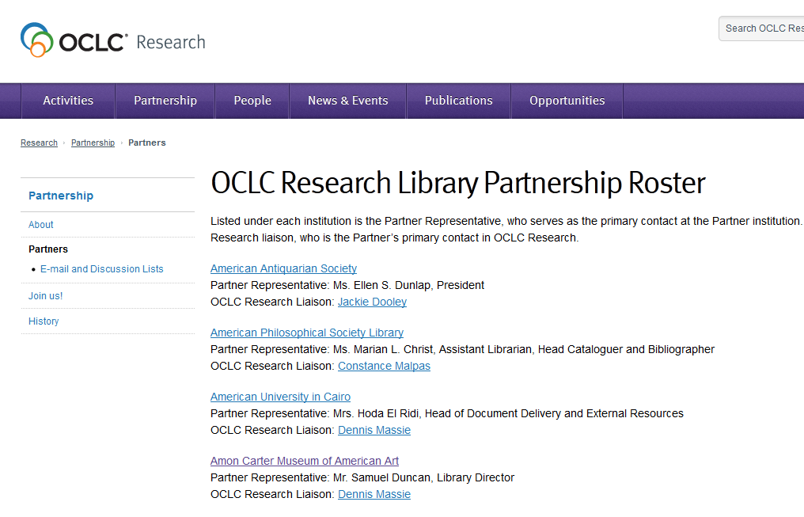
Notes:
Dennis

Slide 22
please reach us at:
massied@oclc.org
proffitm@oclc.org
Notes:
All together now!

