Slide 1
Merrilee Proffitt, OCLC Research @merrileeIam
MOOCs
& Libraries
An overview of the (current) landscape?

Slide 2
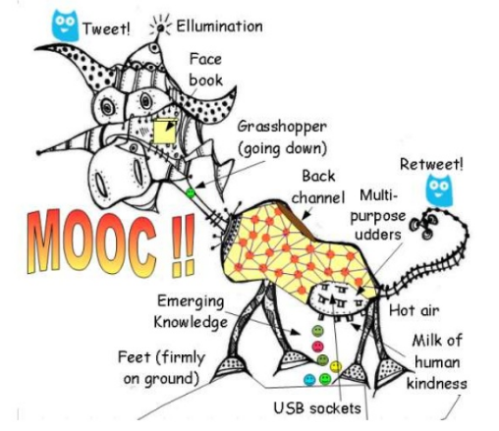
http://www.downes.ca/presentation/304
Notes:
This meeting is the result of an I was given in December, following interest on the part of the OCLC board for OCLC to “do something” about MOOCs and libraries. I’m hear to share my learning experience with you. As Jim has outlined, there has been quite a bit of flux and churn around MOOCs and online learning in the press, and in the academy. Of course, I am one of the people who has tried, since December when I got this assignment, to keep up with the issues and developments. In that time, I’ve enrolled in three MOOCs (and competed one!), made dozens of phone calls with those who are active in this area, exchanged hundereds of emails. And I’ve read a lot of articles.

Slide 3
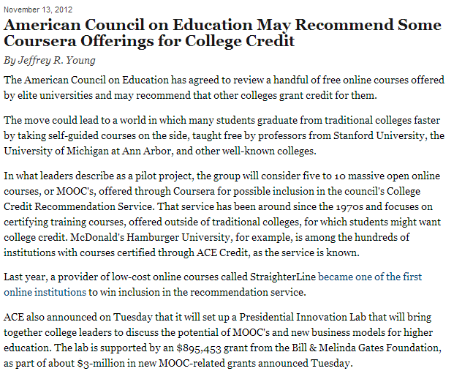
Notes:
So last year was full of news about MOOCs, and opinion pieces about MOOCs, both in the academic press

Slide 4
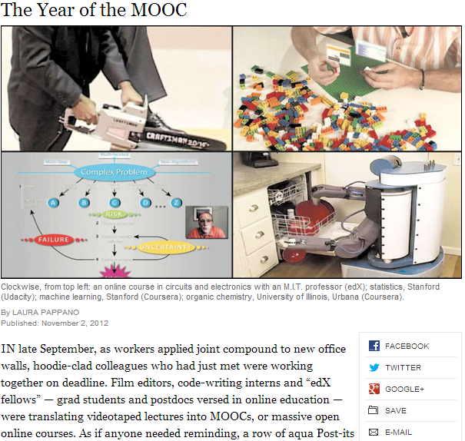
Notes:
And in the popular press. So much so that in November, the New York Times declared 2012 the year of the MOOC.
So why is this important? What’s all the fuss? There are many factors, but a primary attraction for institutions is the prospect of lowering the costs of higher education. As you are probably aware, the cost of college has been skyrocketing, and institutions are under fire to find a way to deliver a high quality education while reigning in costs. Online education may be one way of doing this.

Slide 5
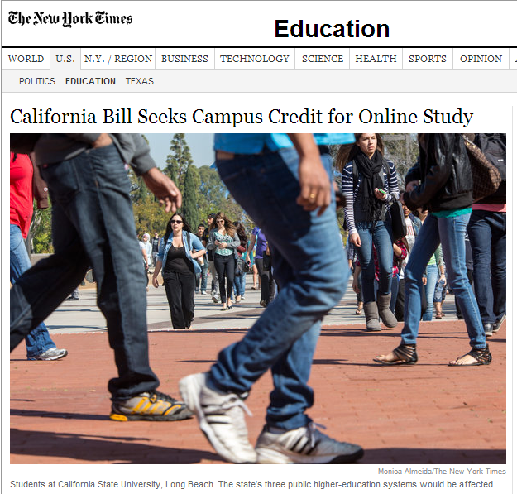
Notes:
As someone who has been trying to keep up, and as many of you no doubt know, it’s difficult to keep up with press on MOOCs and online education. Just last week, this story broke that the a bill has been introduced in the California Senate to require state funded schools to offer credit for students who have taken an online course if they are unable to take a course on campus because it is overenrolled. For those of you who were paying attention to the state of the union address, you will have noticed that online education got a moment in the sun as a solution to some of the problems plaguing higher ed –it’s a little nerve wracking when politicians start to get involved in higher education.

Slide 6
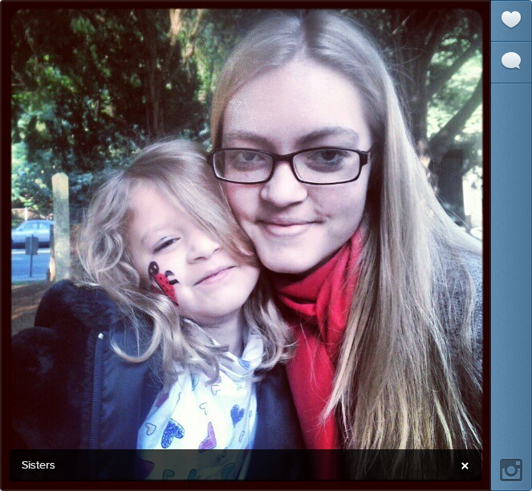
Notes:
But for me issues in higher ed, and particularly issues around rising tuitions costs is very personal. I’d like to share with you a tale of two girls, my oldest Anne, who is a freshman at NYU this year and my daughter Karydis, who just started Kindergarten. We are barely able to afford to send Anne to school (with scholarships and student loans) and I’m fearful about our prospects for our youngest. I was able to put myself through school by working part time in the library. The idea of doing this today is impossible. I will also say that looking at Anne’s residential experience as a humanties undergrad at NYU, it is not very different than mine in the 1980s. She emails her papers in and she registers for classes online – in a meeting last week someone observed the number of people in her classes have probably increased. But there’s not much about her residential college experience that’s very different than mine in the 1980s, which is almost shocking given how much other areas of life and work have changed substantially in that time.

Slide 7
MOOCs?
www.flickr.com/photos/thomashawk/12241420
ccby-nc 2.0
Notes:
So with that personal preamble, what is the connection between MOOCs and libraries? What’s happening now and where are the opportunities? We set out to find out.

Slide 8
MOOCs and Libraries
Contacted institutional partners represented in the OCLC Research Library Partnership
Coursera – 20 of 32 (now 62)
edX - 2 of 6 (now 12)
FutureLearn - 4 of 12 (now 17 plus the British Library)
Conversations with Public Libraries
Notes:
I started our investigation by attempting to make contact with librarians who are already involved in MOOCs, or who work at institutions who are engaged in partnership with the three main MOOC providers. To give you a sense of how quickly this space is moving, when I started this investigation in December, there were…. In the middle of my investigation, FutureLearn was launched by the Open University in the UK, and in February both Coursera and edX increased their numbers substantially.
Most of what I learned has been from the edX and Coursera cohort. FutureLearn was still getting underway, but those institutions were delighted that we are doing work in this area, and hope to be able to learn how libraries are already engaged with MOOCs, so this was a useful interaction (Gill Needham attending). I also learned that the edX group has a self-assembled group of librarians. There is nothing similar within the Coursera group.
I was also part of conversations with a handful of public libraries together with my colleague Chrystie Hill. These conversations were real eye openers for me – while many academic institutions at this point are concerned with issues around MOOC production, many public libraries are thinking creatively about MOOC consumption and how MOOCs may fit into the learning lives of the broad and diverse audience that public libraries serve, including home schoolers, those returning to college, and how MOOCs may fit into a broad portfolio of materials provided to support a variety of learning objectives.
I also visited the Coursera offices in Mountain View, very close to the office I work out of in San Mateo California.

Slide 9
MOOCs and Libraries
Notes:
Returning to academic institutions and what I learned. Some general impressions – first, online education is nothing new. All the institutions I spoke with had been engaged in online education or some form of distance education for years or even decades (gesture to Open University). However, previous partnering with MOOCs all online education had either been through extension courses or some programs designed to be given online (think library school!) all of which I would characterize as online ed for fees and degrees. In this case numbers were pretty small, and students were considered to be students and usually entitled, even if somewhat uncomfortably, to using campus resources. Other campuses posted recorded lectures online as sort of a public service, but these offered “as is” without attempting to adapt the course for an online audience. MOOC partnerships however are different from these other efforts, both due to numbers and audience, and in terms of working with an outside partner, and in some cases a for profit partner. Also different, I think due to the increasingly high wire nature of the courses – there are many eyeballs on these courses both in terms of students, but also other internal and external stakeholders, critics, etc.

Slide 10
MOOCs and Libraries
Notes:
I’m also going to make some observations about attitudes. There are a lot of grumpy librarians out there. They feel imposed on, the don’t see the value of MOOCs. Some have chosen to wait until they are called and are surprisingly, uninvolved, even in the most obvious areas like rights clearance, which I will get to in a moment. Many expressed doubts about the viability of the business models of the various commercial players.
There is good reason for grumpiness. People are being asked to engage with no additional funding, no relief from existing duties, and with no certainty about where new ventures are headed.
On the other hand, nearly everyone I spoke to acknowledged that the reason their institution was engaged with a partner was to learn by doing and to gain a leading position by being on the front lines experimenting with technology and pedagogy.
I also found some librarians who are embracing the challenge of engaging with online learning. In an environment where academic librarians are casting about for new services they can offer in order to maintain relevance on campus, there are those who are eager to experiment with faculty in new ways, are enthusiastic about the possibilities, eager to learn more, and who are getting engaged both with faculty but also with other service units on campus, such as instructional technology.
flickr.com/photos/
shanegorski/3070394453
cc by-nd 2.0

Slide 11
MOOCs and Libraries
Notes:
Not surprisingly due to the “open” nature of course offerings, most libraries are engaged around clearing copyrighted materials for use in classes. This is important not only because universities have partnerships with commercial entities but also because the courses are being offered to a geographically distributed audience, thus removing fair use as a fallback position. We learned during our visit with Coursera that 70 percent of their audience comes from outside the US – since everything that is in a class is made available online, both campuses and partners are acting with an abundance of caution and making sure that every image, media file, every learning object used in a lecture has been cleared. We also learned that Coursera’s ethos is to have everything that is required for course completion must be made freely available to Courserians (as they are known) during the duration of the class, so they have to be cleared. This means textbooks, articles, any required reading needs to be cleared. Coursera works with faculty where they are most comfortable and don’t encourage them necessarily to find open access substitutes for what they are accustomed to working with. In Coursera, the work of clearing materials and gaining permission happens on campus, either in the library or elsewhere. Although Coursera does not manage this process directly, they shared with us that on average, it takes 380 hours per class to clear materials. It’s important to note that when materials are cleared for use in Coursera, they are not made open access – use is limited to a Coursera company wide agreement. I don’t if FutureLearn or edX operate similarly but I look forward to finding out.
One question is, will continued use of MOOCs create opportunities for advancing the conversation on open access with faculty and underscoring the importance of creating both publications and learning objects that are available under open access licenses?

Slide 12
MOOCs and Libraries
flickr.com/photos/thorinside/
2517189403/
cc by-nc 2.0
Notes:
Other ways that libraries are getting engaged is to explore or at least think about how do library resources and research skills fit into MOOCs. One of the touted benefits of teaching courses online is the ability to test what is successful and what is not by evaluating the copious data that the providers can generate and analyze. What can librarians learn from this data? Are there opportunities to improve library instruction? As knowledge about pedagogy shifts, how can libraries support an improved teaching environment?

Slide 13
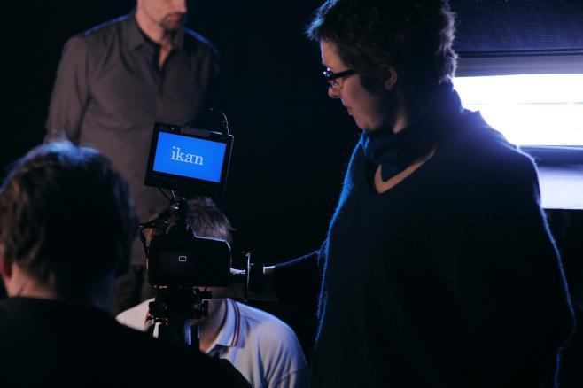
MOOCs and Libraries
flickr.com/photos/9619972@N08/
1350940605
cc by-nc-sa 2.0
Notes:
MOOCs also allow an opportunities for exploring partnerships on campus. Whether this is a new way to engage with faculty and understand their needs, or an chance to work closely with other units on campus, MOOCs allow others to see libraries in a new light. As part of this, libraries may become involved in the production of courses, as they are some institutions. Another obvious role for libraries is in stewarding the materials used in creating courses, from cataloging to preservation.

Slide 14
MOOCs and Libraries
Themes for this meeting
Copyright
Production
New opportunities for librarians
Audience
Opportunities for discussion, input, and interaction

Slide 15
THANK YOU!
Program benefitted from…
Martha Brogan, Anuradha Vedantham, Shawn Martin, Marjorie Hassen, and Karrie Peterson
Chrystie Hill
Organization stars
Jeanette McNicol, Anna Ryan, Aleta Arthurs, Melissa Renspie, Rich Skopin, Chris Martier, Dale Musselman, Cathy De Rosa
Notes:
Martha deserves some sort of a medal for her knowledge and creativity
Chrystie for conversations with public libraries and designing the interactive portion of our meeting

Slide 16
Notes:
In closing I’m going stretch an analogy for a minute and I hope you’ll bear with me. 3D Printers and Libraries are a topic that are a bit of a hot issue at the moment. People who’ve never even seen a 3D printer have very strong feelings one way or another. MOOCs are like that as well.

Slide 17
MOOC:
education on your time
Notes:
I think it’s worth remembering that these are really really early days with this form of online education. And (as I think we’ve all seen) this is a space in which things are evolving quite rapidly. I think it’s too soon for best practices, or declarations of success or failure. I think it’s a great time for experimentation, for trying things (and abandoning!), and also a great time for sharing the results of that experimentation. We are excited that this meeting is a step in that direction, towards sharing information with one another, and for hearing about how others are experimenting. I’d like to thank ALL of our speakers for being bold and taking those first steps, and for sharing their first impressions and knowledge with us today and tomorrow. We’ve built time into the schedule for discussion and networking, and we hope we’ve provided a space effectively learning and thinking together.

