Slide 1
Fall 2018
Project Passage Partner Meeting

Slide 2
Agenda
Enhancement review
Project outcomes
Research activities
From prototype to production
Next steps

Slide 3
Enhancement Review

Slide 4
Original List of Enhancements
Top 5 Phase 2 Enhancements
Top 5 Phase 3 Enhancements
Improve Indexing
Batchload
Partner entities
Require reference sources for statements
Offer property-based constraints
Search by
identifiers
Tool to provide missing data
Include dates for disambiguation
Input form for descriptive data
Taxonomy navigation
Include WorldCat data in the Explorer view

Slide 5
Build – Observe – Adjust
Retriever
Serialization API
Taxonomy navigation
Property-based constraints
Improved search experience
Explorer UI
OpenRefine API
Wikimedia commons links
PHASE 3
Entity editor
Reconciliation API
SPARQL endpoint
PHASE 2
PHASE 1

Slide 6
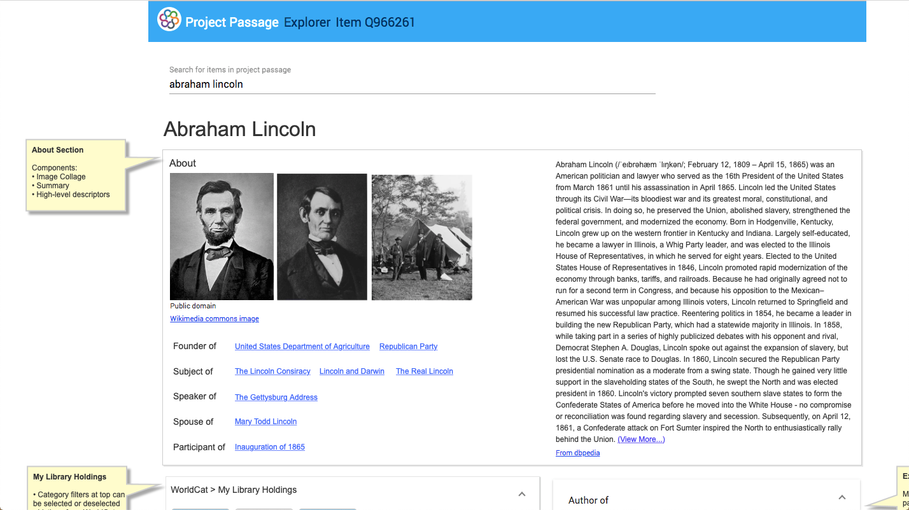
Incorporating WorldCat into the Explorer

Slide 7
Project Outcomes

Slide 8
Community Center prompts
What outcomes did you anticipate in joining Project Passage?
Please explain to what extent Project Passage was successful in meeting your anticipated outcomes.
Please explain to what extent Project Passage did not meet your anticipated outcomes.
What aspects of Project Passage did you find most useful, and why?
What aspects of Project Passage did you find least useful, and why?

Slide 9
… and the results are in!
“Project Passage was the very first Linked Data project that felt like it wholly encapsulated the values that we--as library catalogers and metadata folk--hold dear.”
“One aspect of Passage that is frustrating is the difficulty in searching for properties.”
“Project Passage was the first post-MARC production environment that has the look and feel of what I do with my existing workflow.”
“Given the existing internationalization of the MediaWiki software, I suggest we bring in non-English OCLC communities.”

Slide 10

We learned a lot
Created an entity ecosystem
Explored
  Minting entities
  Reconciling entities
  Relating entities
And more
  Expanded the data set
  Gathered guidelines
  Investigated batchloading
Notes:
Photo by rawpixel on Unsplash
OCLC wanted to achieve quick wins for libraries. We succeeded (as Kalan said: This is the first Linked Data project that has convinced me that the massive scope of our Library collections can be handled and can be implemented with those same core values.) … and we learned a lot!
Goal: Build OCLC’s operational understanding of building a system which supports the use of entities and determine how those entities provide services to our members.
When we started this project, our goals revolved around sharing entities within the community
Create an entity ecosystem
Explore minting entities
Explore reconciling entities
Explore relating entities
At the conclusion of the project, we have:
Shared entities within the community
Created an entity ecosystem
Found that off-the-shelf software is (mostly) fit-for-purpose
3. Explored minting entities
4. Explored reconciling entities
5. Explored relating entities
6. Developed an alternative UI to fully showcase those relationships
7. Expanded our data set to include more complicated entities and explored the requirements for those entities...
Including the fact that bringing in data requires a focus on quality.
8. Gathered guidelines for entity creation and editing for a variety of items (as stated in the feedback exercise, there are folks with a great deal of expertise still to weigh in here!)
9. Investigated the batchloading of partner data

Slide 11
Key Takeaways
Need to devote significant time to notability, property, and reference requirements and guidelines
Community input will determine the path forward
Additional consideration of technical aspects including reconciliation and scalability
Wikibase was an ideal software stack for our pilot
Much can be accomplished through partnership
Notes:
The all-purpose, flexible data model is conducive to conversation, debate, and design
Matching strings to entities worked well, but the entity store needs to be much more comprehensive, including relationships and mappings
1.2 million entities in the Prototype v. WorldCat could represent billions of entities

Slide 12
Project Passage by the Numbers
144
1,221,961
Listserv posts
Entities
324
12,489
OCLC Comm Ctr posts
28
Edits
Meetings
Notes:
Edits = Human edits since May

Slide 13



Notes:
As OCLC, we passionately believe that by sharing the world’s collected knowledge, we together fuel learning, research and information.
We all have “breakthrough” stories:
Breakthroughs within the library community, as together we overcome challenges or try new things.

Slide 14
Research activities

Slide 15
General
Consultation on production architecture, product roadmaps, project plans, etc.
OCLC Research reports
  Linked Data Survey: analysis of the “2018 International Linked Data Survey for Implementers,” to be published this year
  Linked Data Prototype: a full technical and functional report on the Linked Data Wikibase prototype
  Linked data landscape in Europe and the U.S.: synthesizing five years of the state of linked data in libraries
Identifying potential areas of new and additional research

Slide 16
Potential research areas
Data Ingest / Batchload
Data Quality
Data Mapping
Linked Data Applications
Notes:
We’ve identified four areas for further research, development, and prototyping
These are all only POTENTIAL areas that we could consider more research.
Detailed research agendas and capacity planning to undertake the research has not been completed.

Slide 17

Data Ingest / Batchload
  Workflow analysis
  Reconciliation of 3rd party data
  Alternatives to OpenRefine

Slide 18

Data Quality
Data validation
Improve duplicate detection
Machine Learning
Data Completeness

Slide 19

Data Mapping
Align linked data architecture with OCLC vocabularies
Continued consultation of OCLC ontology development

Slide 20

Linked Data Applications
New experimental UIs for staff and end users
Library partner and end-user application development

Slide 21
From Prototype to product

Slide 22
What's next for OCLC products/services?
  Currently in design phase
  Consultation and architecture work
  Initial priority on building entity ecosystem and services
  Will continue to develop thinking on interfaces

Slide 23
Guiding principles
  Mixed environment
  Persistence and quality
  Input/output
  Services paramount
  Web visibility
Notes:
We believe the mixed MARC-Bibframe environment will continue for a while
Need to leverage OCLC's scale and structure to create high-quality entity descriptions
AND stand behind their URIs for the long term – infrastructure provider
Need to deal with even more heterogeneous input/output
Need to build services to allow 3rd-party/library-built to engage with EE
Why do all of this – get discovered!!

Slide 24
Continued collaboration
Advisory group
Presentations
  DEVCONNECT: Using Wikibase as a platform for library linked data management and discovery (October 16)
  WikiConference North America: Creating a Linked Data Library Partnership Using Wikibase (October 21)
  Works in Progress Webinar: Lessons Learned from a Linked Data Prototype for Managing Bibliographic Data (October 30)
  OCLC Global Council Virtual meeting (November 7)
  Midwest Collaborative for Library Services meeting (November 7)
  MELA (November 13-15)
  CNI: From Prototype to Production: turning good ideas into useful library services (December 10-11)
  ALA Midwinter: OCLC LD Roundtable (January 26)

Slide 25
Next Steps

Slide 26

The end (sort of)
Project Passage Community Center
Passage Wikibase Accounts
Tools
Notes:
Photo by Steve Johnson on Unsplash
The Community Center space will become read-only fairly quickly as we remove the ability to post in the discussion boards.
The Wikibase UI will also be read only in the near future. We plan to switch participants’ accounts to read-only. We understand that using the application may be useful in the short term as you write and present on this project (and please share those presentation plans with us!). Please let us know if you need editing access for a longer stretch (with the end of the calendar year being a hard stop).
The Passage Query Service, the Explorer UI, and the Retriever will continue to be available through the end of the calendar year. Our expectation is that use will drop off but that screenshots of this functionality may serve our partners in future presentations and publications.

Slide 27


Notes:
Thank you for attending today’s presentation.

