Slide 1
CNI Spring 2018 Membership Meeting
Prototyping a Linked Data Platform
for Production Cataloging Workflows
April 13, 2018
Andrew K. Pace, Executive Director, OCLC Research
Jason Kovari, Director of Cataloging & Metadata Services, Cornell University

Slide 2
Agenda
OCLC: Why another linked data project?
OCLC: What is it?
OCLC: Who is building it?
OCLC: How are we building it?
Cornell: Why are we participating?
Cornell: What use cases are we testing?
Cornell: How could these services be potentially used?
http://oc.lc/linkeddatasummary

Slide 3
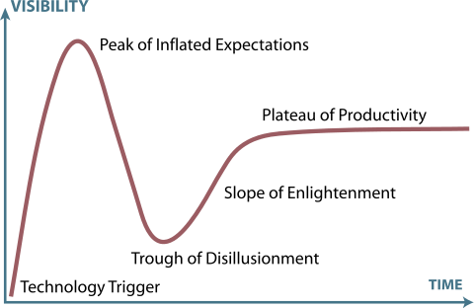
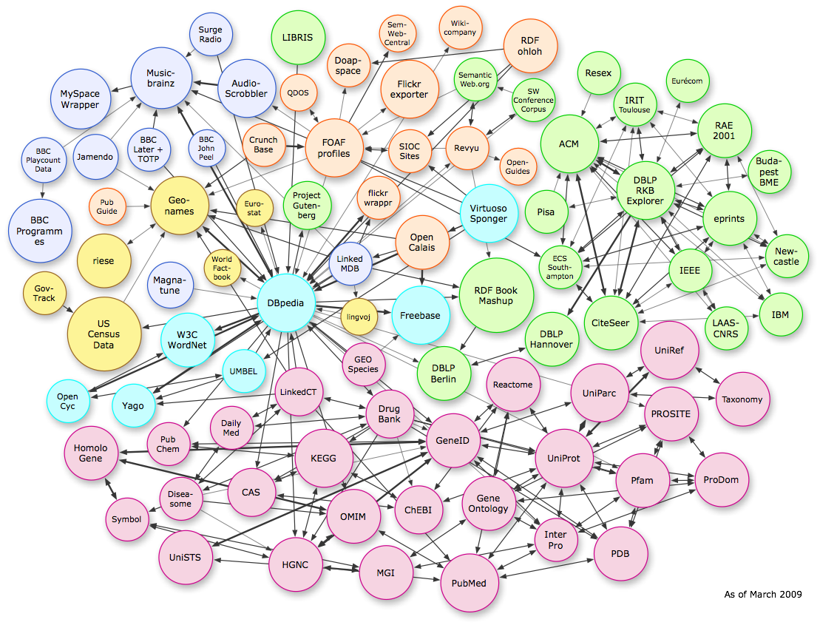
Gartner Hype Cycle of Emerging Technologies
Linked Data 2015
Linked Data 2020?
Linked Data 2018?
Linked Data 2017

Slide 4
Why?--Efficient, impactful workflows
Today
Searching
Copy cataloging
Original cataloging
Authorities
In the future
Amplified searching
Adding relationships
Entity management
Library-sourced vocabularies

Slide 5
A project vision statement
Work with our members through a foundational shift in the collaborative work of libraries, communities of practice, and end-users—dramatically improving efficiency, embracing the inclusive, diverse, and earnest OCLC membership, and empowering a new and trusted knowledge work enabled by the web.

Slide 6
Who
Phase II Partners (!!!!) (May ‘18 – Sep ‘18)
American University
Brigham Young University
Cleveland Public Library
Harvard University
Michigan State University
National Library of Medicine
North Carolina State University
Northwestern University
Princeton University
Smithsonian Library
Temple University
University of Minnesota
University of New Hampshire
Yale University
Phase I Partners (Dec ’17 - Apr ‘18)
Cornell University
University of California, Davis
OCLC Research
OCLC Global Technolo-gies
OCLC Global Product Management

Slide 7
What & HOW

Slide 8
What
Develop an Entity Ecosystem that facilitates:
Creation and editing of new entities
Connecting entities to the Web
Build a community of users who can:
Create/Curate data in the ecosystem
Imagine/propose workflow uses
Provide services to:
Reconcile data
Explore the data

Slide 9
RECONCILER
EDITOR
INDEX
DUPLICATE DETECTION
WORLDCAT CREATIVE WORK ASSOCIATION
RANKING BY
ENTITY
ECOSYSTEM
RECONCILIATION
API
MINTING / EDITING
API
ENTITY to ENTITY RELATOR
AUTHENTICATION & AUTHORIZATION
UI
BATCH
UI
External
Client Applications
Local Bibliographic and Authority Data
External
Client Applications
Notes:
What –
An Entity Ecosystem and associated services to:
Reconcile names for people, organizations, concepts, places, and events against an index based on entities, returning language-tagged headings and persistent identifiers
Create, share and edit entity descriptions while also allowing for the contribution of additional contextual relationships between entities, beyond those that can be found by mining structured data in bibliographic and authority data via an Editor

Slide 10
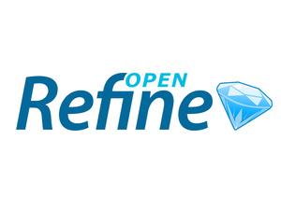
How: A few key technologies
Pywikibot
Notes:
Wikibase – The wikibase extension to MediaWiki provides the primary user interface for creating and editing items and properties.
Mediawiki API – Search and retrieval based on keyword searching or via entity identifiers.
SPARQL Query Service – A SPARQL Endpoint combined with a user-friendly Query Service interface supports complex and granular queries based on items, properties, and their relationships.
OpenRefine API – OpenRefine is an application for cleaning and reconciling data, using Reconciliation APIs and SPARQL endpoints. We're testing an OpenRefine-optimized API, to make it easier for those who use that application to connect to the system and reconcile their data.

Slide 11
How: Disambiguating Wiki*
Wikipedia – a multilingual web-based free-content encyclopedia
MediaWiki - a free and open-source wiki software
Wikidata.org - a collaboratively edited structured dataset used by Wikimedia sister projects and others
Wikibase - a MediaWiki extension to store and manage structured data

Slide 12
How: MediaWiki Features
Search/Autosuggest/APIs
Multilingual UI
Wikitext editor
Change history
Discussion pages
Users and rights
Watchlists
Maintenance reports
Etc.

Slide 13
How: MediaWiki+Wikibase Features
Search/Autosuggest/APIs/Linked Data/SPARQL
Multilingual UI
Structured data editor
Change history
Discussion pages
Users and rights
Watchlists
Maintenance reports
Etc.

Slide 14
How: Wikibase advantages
Open source
An all-purpose data model that takes knowledge diversity, sources, and multilingual usage seriously
Collaborative – can be read and edited by both humans and machines
User-defined properties
Version history

Slide 15
A few key terms
Entity – the content of a page in the system that represents an item or a property.
Item -- a real-world object, concept, or event that is given a unique system identifier together with information about it. E.g., the book titled “Sense and Sensibility” by Jane Austen is an item entity.
Items include an identifying "fingerprint" of labels, descriptions, and aliases. The main data part of an item is the list of statements about the item.
Property -- each statement on an item page links to a property, and assigns the property one or more values. E.g., “author” is a property entity.
Property entity pages specify the property's assigned datatype and other statements.

Slide 16
A few key terms
Statement -- a piece of data about an item, recorded on the item's page.
A statement consists of a claim, and may be augmented with references (giving the source for the claim) and a rank (used to distinguish between several claims containing the same property).
Claim -- a piece of data about the entity on whose page the claim appears.
A claim consists of a property (such as “author") and either a value (e.g., “Jane Austen") or one of the special cases "no value" and "unknown value". A claim can have qualifiers, such as temporal qualifiers saying that the claim is valid within a specific time frame.

Slide 17
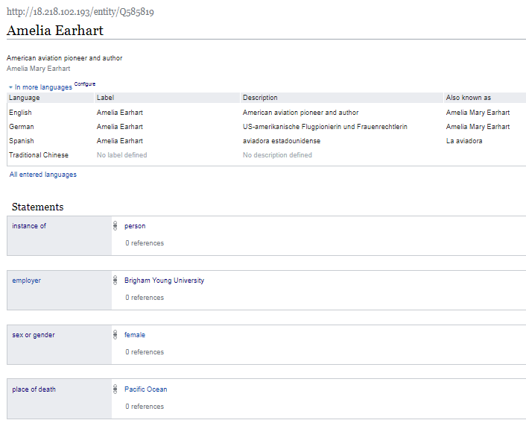

Slide 18
Item URL
Label
Item Identifier
Description
Additional labels, descriptions, and aliases, in other languages.
Aliases
Property
Statement
Rank
Value
Claim

Slide 19
Functional use cases

Slide 20
Use case: Manual data entry
For manual creation and editing of entities,
Wikibase is the default technology.
It has a powerful and well-tested set of features that speed the data entry process and assist with quality control and data integrity.

Slide 21
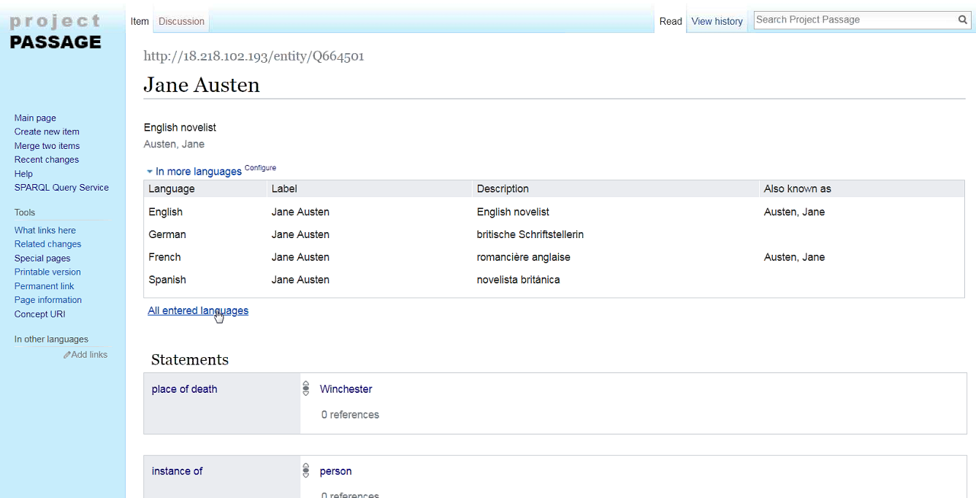

Slide 22
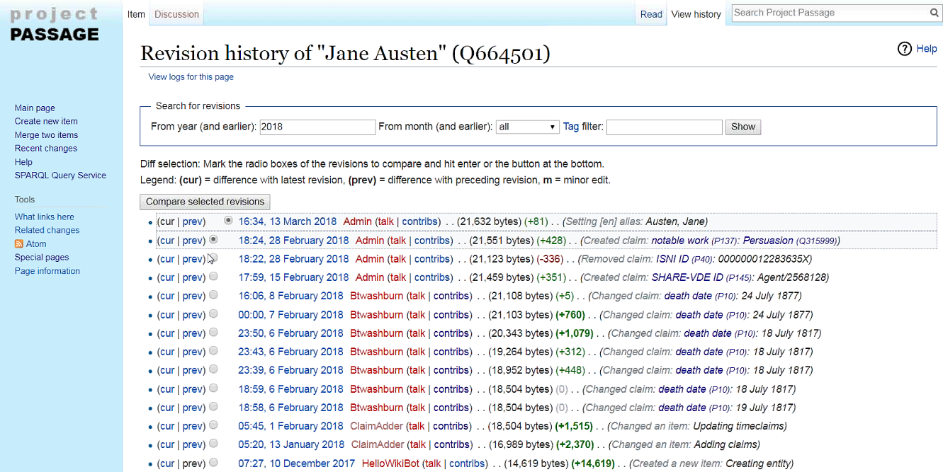

Slide 23
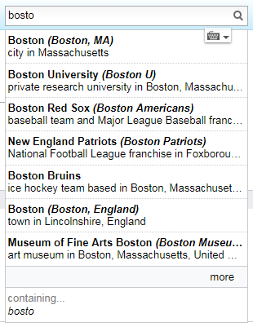
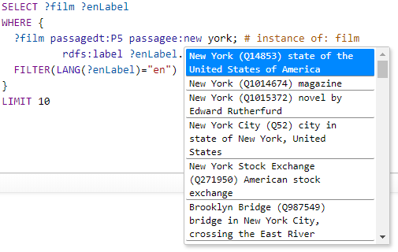
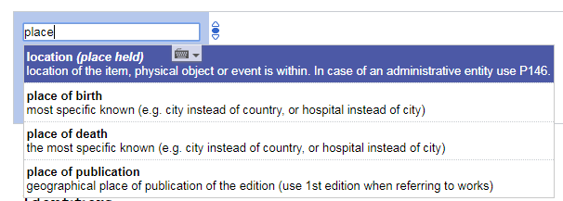
Use case: Autosuggest
Searching for entities as you type is supported by the Mediawiki API. This feature is found in both the prototype UI and in the SPARQL Query Service UI.

Slide 24
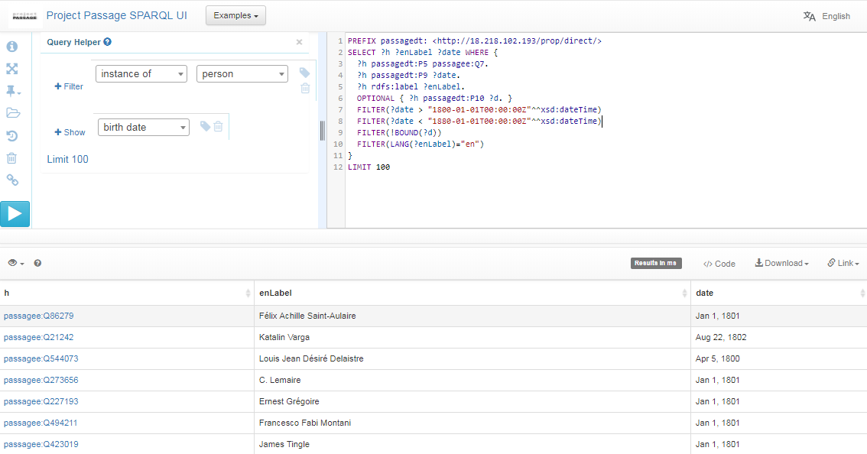
Use case: Complex queries
SPARQL (pronounced "sparkle") is an RDF query language … a semantic query language for databases. The prototype provides a SPARQL endpoint, including a user-friendly interface for constructing queries. With SPARQL you can extract any kind of data, with a query composed of logical combinations of triples.
In this example SPARQL query, items describing people born between 1800 and 1880, but without a specified death date, are listed.

Slide 25
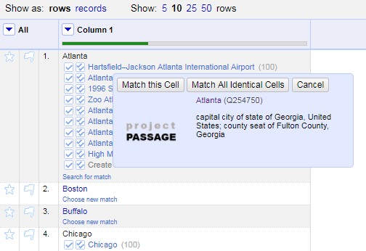
Use case: Reconciliation
Reconciling strings to a ranked list of potential entities is a key use case to be supported.
We are testing an OpenRefine-optimized Reconciliation API endpoint for this use case.
The Reconciliation API uses the prototype’s Mediawiki API and SPARQL endpoint in a hybrid tandem to find and rank matches.

Slide 26
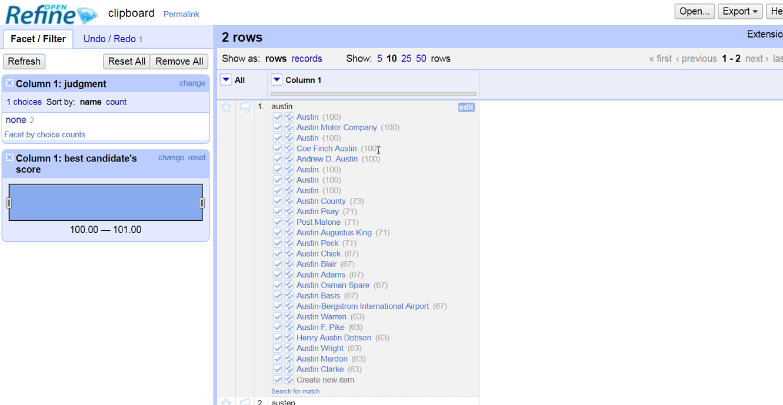

Slide 27
Use case: Batch loading
For batch loading new items and properties, and subsequent batch updates and deletions, OCLC staff use Pywikibot.
It is a Python library and collection of scripts that automate work on MediaWiki sites. Originally designed for Wikipedia, it is now used throughout the Wikimedia Foundation's projects and on many other wikis.

Slide 28
Lessons Learned and concerns so far | Next Steps
The Mediawiki-based API is not sufficient for reconciliation | Provide an OpenRefine API for matching by class and properties
The prototype data model for dates is capable but not user friendly | Document techniques for entering dates, mapping to LC's EDTF patterns
The prototype UI doesn't highlight connections to more information on the web | Prototype a UI that uses system data to connect to Dbpedia, Geonames, etc.
Autosuggested links aren't working well for personal names in indirect order | Add more aliases to the Wikibase to improve autosuggest matching, based on headings in VIAF
It's not yet clear how to handle creative works and editions in the prototype | Provide guidance and examples, beginning with works and translations
Will Wikibase / Wikidata scale to billions of entities? | Fruitful discussions with Wikimedia Deutschland started

Slide 29
The Why:
Cornell's Motivations and Potential Uses
Notes:
Framing in complementary projects…

Slide 30
Motivation : Complementary Effort #1
Local authority management system
National Strategy for Shareable Local Name Authorities National Forum
Local entities
Notes:
Many institutions have local authorities, including Cornell
These are needed in shared spaces… but there are thresholds for many
Cornell has invested heavily in these…
We've backburnered a project to support a local Vitro implementation for storing entities (of all sorts) to be used in creating MARC & non-MARC data
With funding from IMLS, we've hosted SLNA-NF, white paper for which is available and will be communicated broadly (http://hdl.handle.net/1813/56343)
SLNA-NF focus was on established services (ISNI, NACO, VIAF, etc.) but essentially it looks for solutions in the areas of Minimum Viable Specifications, Data Provider Obligations, Workflows and Reconciliation as a Service
Where can OCLC' Linked Data Prototype fit into this effort?
IF this Prototype sought to batch-create local authorities, we would not need to mount our own VitroLib instance for local entity needs
RaaS is a major need addressed / raised in the SLNA-NF -- this is in the roadmap for the Prototype

Slide 31
Motivation : Complementary Effort #2
&
Minting person and organization identities
Notes:
Engagement on PCC pilot for ISNI creation (think NACO lite)
NACO data creation demands more than we want to / can support for the variety of our metadata creation
Cornell is not alone in considering this…
"In initiating an ISNI Registration Agency Membership agreement, the Program for Cooperative Cataloging is undertaking a year-long ISNI pilot (July 2017-July 2018) to develop an understanding of ISNI tools and systems, to create PCC documentation and training for its members, and to put in place member supports for cost-effective scaling of broader PCC involvement in ISNI."
Some concerns about moving forward -- namely:
alignment of content standards with ISNI labels
workflows/tooling not as streamlined as we hoped initially
Where can OCLC' Linked Data Prototype fit into this effort?
In SOME ways, the Prototype could meet many of the use cases we have in mind for the ISNI pilot…
PARTICULARLY IF an integration happens between OCLC data creation tools & the LD prototype, could consider whether ISNI effort is worthwhile since person and org entities could be created in the Prototype… .
OR -- we could create ISNI but have confidence that reconciliation between ISNI and other aggregators/creators happens
Of course, there are advantages to ISNI…(e.g.: integration/data synching with other services AND brand recognition) -- however, our goal is to identify the most streamlined approach to creating and sharing data

Slide 32
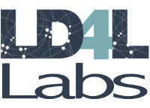
Motivation : Complementary Effort #3
Look-up services within cataloging environments
Notes:
Relevant work-items:
Native linked data creation -- demands creation of entities, including Works, Agents, etc.
Look-up services extending Question Authorities gem from the Samvera community
Contextual lookups within cataloging tools
LD4 looking well beyond traditional library datasets & authorities…
Future work likely to include examination of wikidata and, perhaps, other data sources
Where can OCLC' Linked Data Prototype fit into this effort?
OCLC prototype could provide an additional source for data in look-up services
Contextual look-up services could be extended for Works or other entities in the OCLC LD prototype

Slide 33
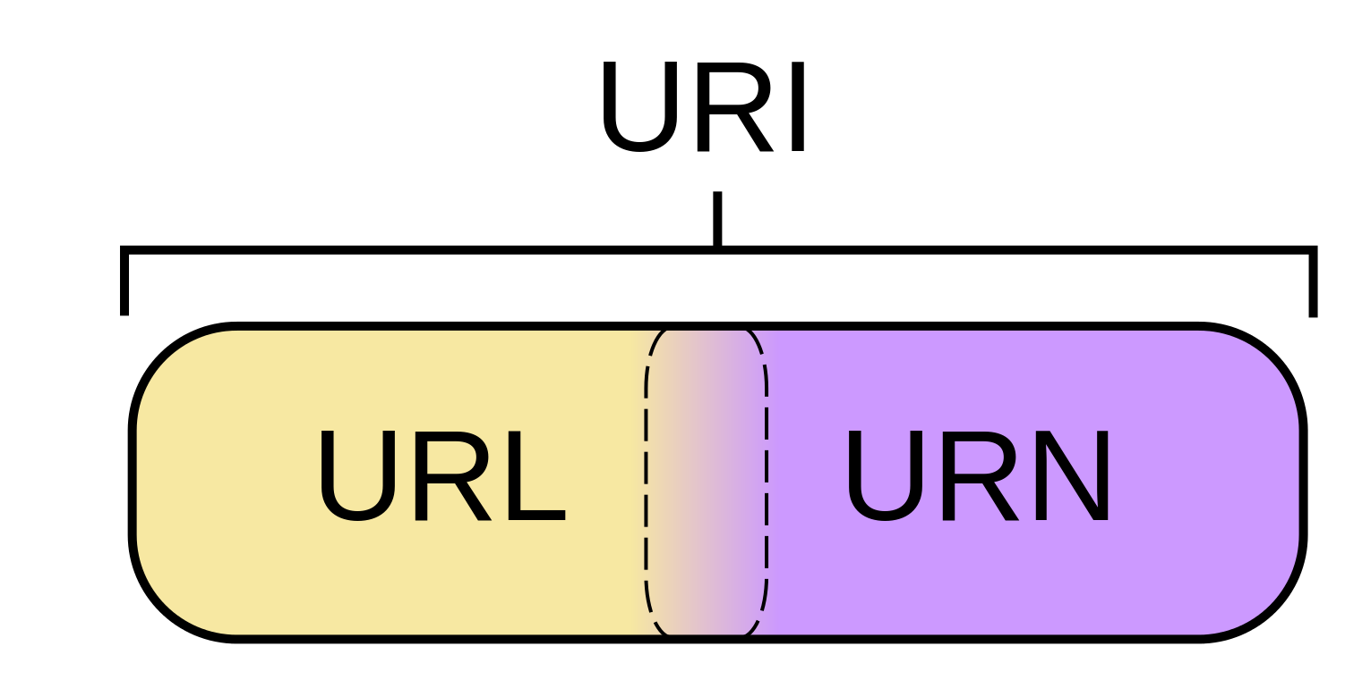
Motivation : Complementary Effort #4
&
URIs in MARC records
Notes:
LTS pilot to incorporate URIs in our MARC records
Intermediate steps toward LD
Facilitate conversion to RDF
Follows PCC recommendations
One aspect of what's involved:
Investigating a wider array of data sources for entities
Testing data exchange with OCLC -- interesting results, thus far
Where can OCLC' Linked Data Prototype fit into this effort?
Many of our questions for URIs in MARC surface around data exchange with OCLC
OCLC prototyping linked data services speaks well for the rest of their ecosystem
From CUL understanding: OCLC preferences id.loc.gov URIs; if they are in the business of URI minting and management, this could change -- exciting prospect for us

Slide 34
Motivation : Complementary Effort #5
New ILS affords new opportunities
Notes:
FOLIO presents new opportunities for creating and managing our authority data
FOLIO is coming together but much development is still underway so there is considerable opportunity here...
Where can OCLC' Linked Data Prototype fit into this effort?
It is unclear where FOLIO and the LD Prototype could fit together… however, if this is an entity creation/dissemination tool incorporated into OCLC services, this could influence workflows around FOLIO, which will all need to be reconsidered from what we do in Voyager

Slide 35
Hopes & Dreams
Low-threshold entity creation
Streamlining workflows across processes
Reconciliation services in MARC-2-RDF conversion
Data exchange questions in LD environment
Notes:
The aforementioned does not represent comprehensive overview of efforts in this space being enacted by Cornell and our partners institutions
What is the larger-picture of the aforementioned complementary efforts?
For both MARC and RDF environments, we need to lower the threshold for entity creation
want / need workflows that are as streamlined as possible… building services into existing/important tooling is one solution to this
In any data conversion, we need to reconcile entities… and we have high hopes / plans for data conversion
Since our efforts are raising questions that could be sobering long-term -- having OCLC deeply engaged in this space should smooth out issues in that area of the ecosystem
E.g.: Records Manager testing whereby only id.loc.gov URIs were retained if/when heading is 'authorized' following inclusion of ISNI URI

Slide 36
Finally...
What's in it for us (condensed)?
Notes:
Finally… why are we bothering with another LD investigation?
My opinion:
OCLC is such a major player in the library ecosystem -- and needed for data exchange at least at present and in any hybrid system, we need to engage with them if we want to ensure smooth transitions -- and services built that can leverage their computational and data power
As potential users of these services, it is important for more institutions to engage with OCLC -- convince them that this is wanted/needed

Slide 37
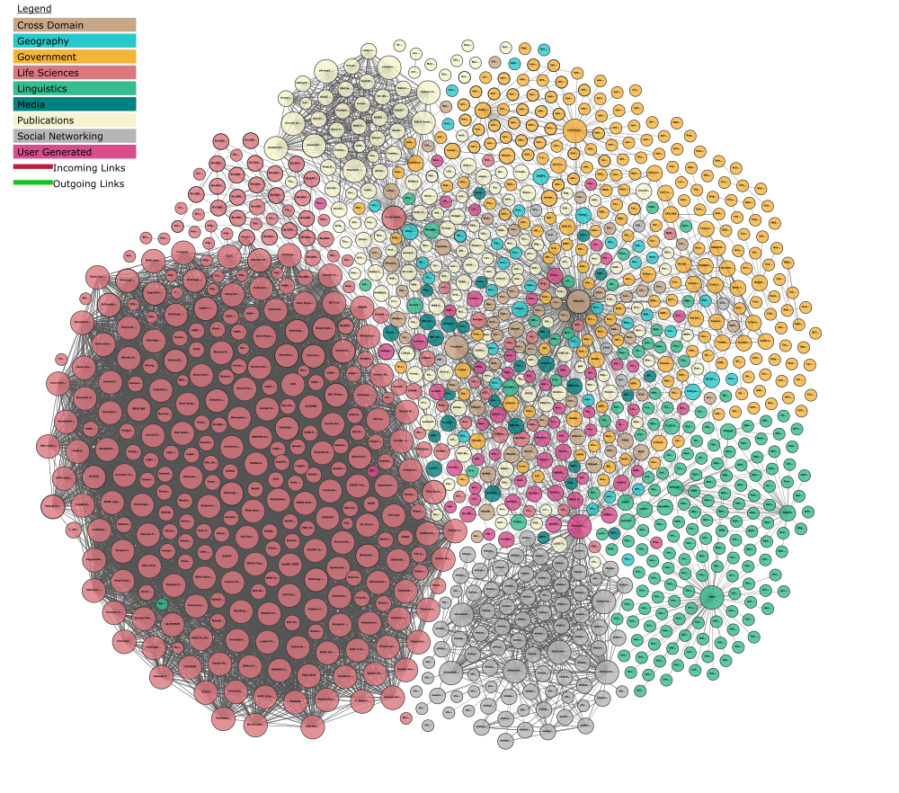
Questions?
Jason Kovari
jak473@cornell.edu
Andrew K. Pace
pacea@oclc.org
Massive Linked Open Data Cloud (Reference Database), under-exploited by Publishers. (Linking Open Data cloud diagram 2017–08–22, CC-BY-SA by Andrejs Abele, John P. McCrae, Paul Buitelaar, Anja Jentzsch, and Richard Cyganiak. http://lod-cloud.net/)
Notes:
Thank you for your time and attention today.
If you would like additional details about my presentation today, please feel free to download our new “OCLC and linked data” paper at oc.lc/linkeddatasummary

