Slide 1
CNI Spring 2018 Membership Meeting
Linked Data Reality Check
April 18, 2018
Andrew K. Pace, Executive Director, OCLC Research

Slide 2
Agenda
Linked Data Primer
Linked Data and OCLC
Linked Data and Libraries
Linked Data Reality Check
A New Linked Data Prototype—OCLC, Libraries, and Wikimedia: Why, Who, What, & How?

Slide 3
Linked Data

Slide 4
Problem statement
The library community’s foundational bibliographic standard is no longer sufficient to take advantage of the tremendous opportunities offered by the web.

Slide 5
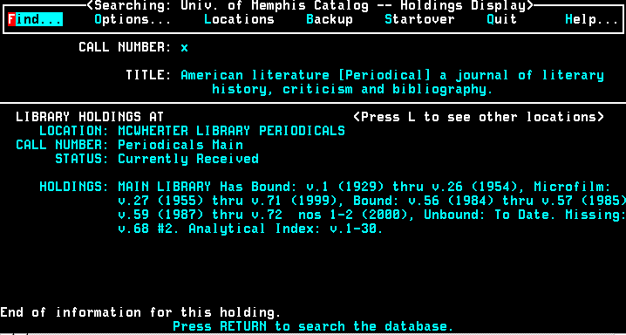
Libraries rock the world…but they also rest on their laurels

Slide 6
“The Semantic Web isn’t about putting data on the web. It is about making links, so that a person or machine can explore the web of data.”
- Tim Berners-Lee, 2006-07-27
Linked Data basics
First elaborated in a
2006 design document by Tim Berners-Lee
A set of common practices for exposing data on the Web in way that:
Allows many parties to participate in a Web of data
Fosters creating connections in a Web of data
Produces new knowledge and added value

Slide 7
Aspirations
work
place
person
event
organization
concept
Notes:
The information OCLC and libraries has about “works” is very useful in a lot of different contexts. A work, in this sense, represents the kind of natural, instinctual way we refer to books, articles, art, music, etc. When we say, “I need to read The Raven,” we know what that means. That’s a work. Because WorldCat has so much metadata on so many works, we can associate a work with people, places, events, organizations and concepts. When we do that, it makes that library data useful in a lot more contexts, for a lot more partners. Like publishers represented in libraries.

Slide 8
What we have to work with
A collection of text strings…
Taken from the piece itself…
Sometimes “enhanced” with inferred parentheticals (e.g., [1975])
Or additional statements not on the piece (e.g., subject headings)
Punctuation, which may or may not be present, is used (inconsistently) for structure
Mostly uncontrolled and only loosely connected to anything else
Designed for description rather than discovery
Notes:
Slide courtesy of OCLC colleague Roy Tennant

Slide 9
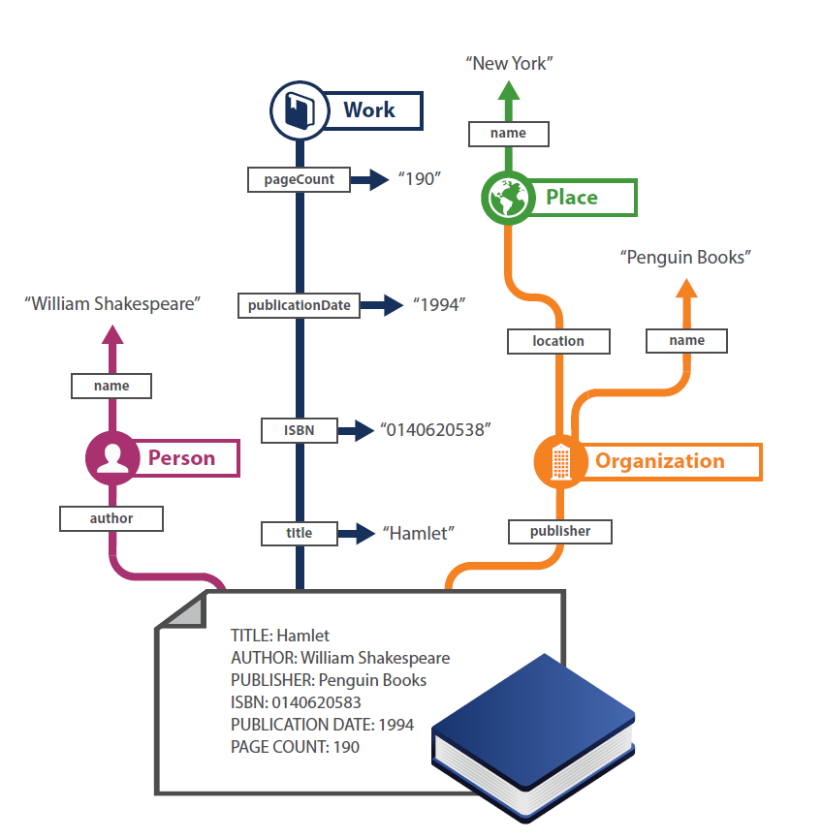
From records to Linked data

Slide 10
Quick Definitions
entity
/ˈɛntɪti/
noun
a thing with distinct and independent existence.
relationship
/rɪˈleɪʃ(ə)nʃɪp/
noun
the way in which two or more people or things are connected

Slide 11
Linked Data design principles
Linked data is a method for publishing data such that is can be interlinked with other data and use for semantic queries
Use URIs to name (identify) things.
Use HTTP URIs so that these things can be looked up (interpreted, "dereferenced").
Provide useful information about what a name identifies when it's looked up, using open standards such as RDF, SPARQL, etc.
Refer to other things using their HTTP URI-based names when publishing data on the Web.
Notes:
From: https://en.wikipedia.org/wiki/Linked_data
Principles are by Tim Berners-Lee (see source above for full citation)

Slide 12
Linked Data triples
Subject (URI or blank node)
Predicate (URI)
Object (URI, literal or blank node)
Subject
Predicate
Object
Andrew Pace’s blog is called Hectic Pace.
http://viaf.org/viaf/14128447
http://xmlns.com/foaf/spec/
http://www.hecticpace.com

Slide 13
Triples can.....establish relationships with other entities...
Albert Einstein
Person
Relativity: The Special and General Theory
Work
Physics
Concept
author
about
Notes:
So the goal of linked data is to produce machine-understandable knowledge about things we are interested in.
As librarians, we can jumpstart this process by upgrading the descriptions of things that librarians have always collected information about…authors, works, subjects.
Albert Einstein is the author of the book with the title Relativity: The special and general Theory
The book with the title Relativity: The special and general Theory is about Physics
These statements have the same form: [subject] [relationship] [object or predicate]
These are “triples,” which can be expressed in RDF, the language of linked data.

Slide 14
…with actionable links
https://www.wikidata.org/wiki/Q937 and http://viaf.org/viaf/75121530
Wikidata and VIAF
http://experiment.worldcat.org/entity/work/data/369081611
WorldCat Works
http://id.loc.gov/authorities/subjects/sh85101653.html
Library of Congress Subject Headings
author
about
Notes:
What’s new and different about linked data.
URIs – a web location that is unique in the world and persistent.
When referenced, they provide information about things.
They may include links to other sources of information (VIAF & Wikidata both provide information about Albert Einstein…reinforcing and complementary.
Make machine-understandable statements that link the sources of information. “Triples” – <Albert Einstein> <is the author of> <The General Theory of Relativity>

Slide 15
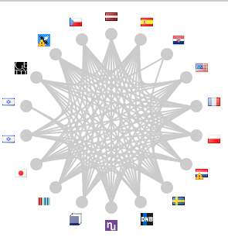
OCLC’s linked data resources
WorldCat Works:
5 billion RDF triples
ISNI: 10-50 million triples
WorldCat Catalog:
15 billion triples
VIAF: 2 billion triples
FAST:
23 million
triples

Slide 16
Triples, triples, everywhere!!!
Other library-related linked data resources
Library of Congress (id.loc.gov)
Enables developers to interact with vocabularies found in data & standards promulgated by LC as linked data.
100,000+ requests/day; 100-500 million triples
Getty Art & Architecture Thesaurus
A structured vocabulary for generic concepts related to art and architecture.
100,000+ requests/day 100-500 million triples
Bibliothèque nationale de France (data.bnf.fr)
Data produced by the Bibliothèque nationale de France more useful on the Web.
10,000 – 50,000 requests/day; 100-500 million triples
Deutsche National Bibliothek
Publishes authority and bibliographic data in RDF to make the data accessible to the semantic Web community with no need to know library-specific metadata schemes.
100-500 million triples
Linked Data for Libraries!! (https://www.ld4l.org/)

Slide 17
BIBRAME basics
schema.org basics
Schema maintained by the Library of Congress
General model for expressing and connecting bibliographic data
Foundation for the future of bibliographic description, both on the web, and in the broader networked world
Successor to MARC 21
Joint effort of major search engines
Provides a common schema for general use
Extensions for some types of resources
Communities can propose community-specific extensions
Enjoying rapid adoption

Slide 18
oc.lc/linkeddatasummary
“While we believe that linked data representations will eventually become the de facto standard, we also believe that MARC will continue to be used by the library community for many years to come.”
Notes:
This view is consistent with OCLC ‘s public position on linked data. In September 2017, OCLC published the strongest public statement in support of linked data to date. Because of our experience to date, we understand some of the challenges and have learned some important lessons. But because of the technical successes we have already witnessed, plus the sense that the library community’s current standards are bumping up against intractable problems, we at OCLC are formally committed to the view that linked data will become the de-facto standard. And we are working to make it so.
We now have a better understanding of the more nuanced environment required to move research to production. It’s much more complex than a set of legacy datasets that can be converted to a new format. That complexity includes the realization that MARC will be part of our data landscape for the foreseeable future.

Slide 19
Some examples In production

Slide 20
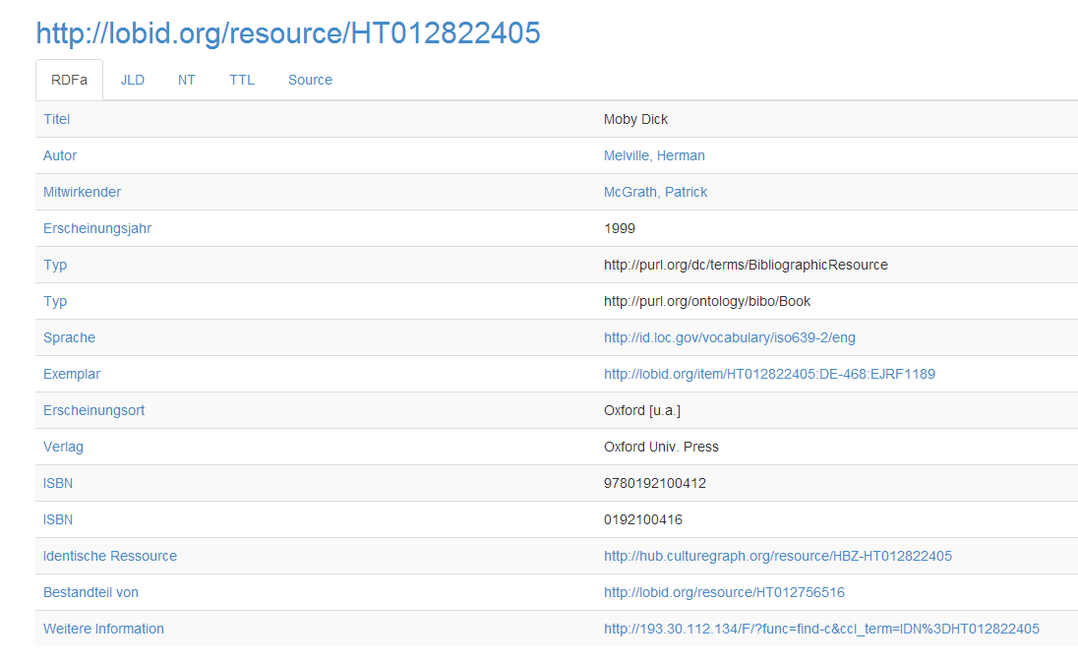
North Rhine-Westphalian Library Service Center
Bibliographic & Authority Data from Cologne-based libraries in Germany
Notes:
In March 2010 the hbz, several Cologne-based libraries and the Library Centre of Rhineland-Palatinate started an open data initiative as the first German institutions to release library catalog data into the public domain. ” In November 2013 the hbz launched a linked open data API via its service lobid. This API provides access to different kinds of data:
- _bibliographic data_ from the hbz union catalogue with 20 million records and 45 million holdings
- _authority data_ from the German Integrated Authority File (Gemeinsame Normdatei, GND) with subject headings, persons, corporate bodies, events, places and works
_address data_ on libraries and related institutions, taken from the German ISIL registry and the MARC organization codes data base.”
This is one of the larger published linked data sources with 1 – 5 billion triples.

Slide 21
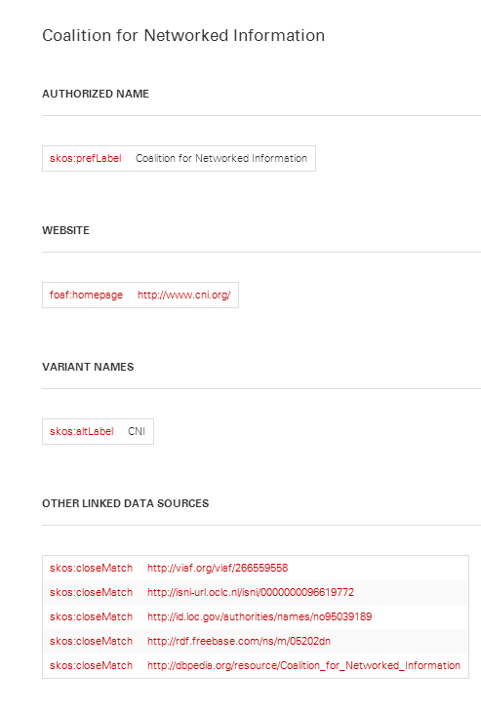
http://www.lib.ncsu.edu/ld/onld/
Organization name data presented as linked data from NCSU Libraries: brings together VIAD, LCNAF, ISNI, and Dbpedia Freebase
Notes:
This is from North Carolina State University’s “Organization Name Linked Data”. “Where possible, Acquisitions & Discovery staff created links to descriptions of the same organization in other linked data sources, including the Virtual International Authority File (VIAF), the Library of Congress Name Authority File (LCNAF), Dbpedia,Freebase, and International Standard Name Identifier (ISNI). ”

Slide 22
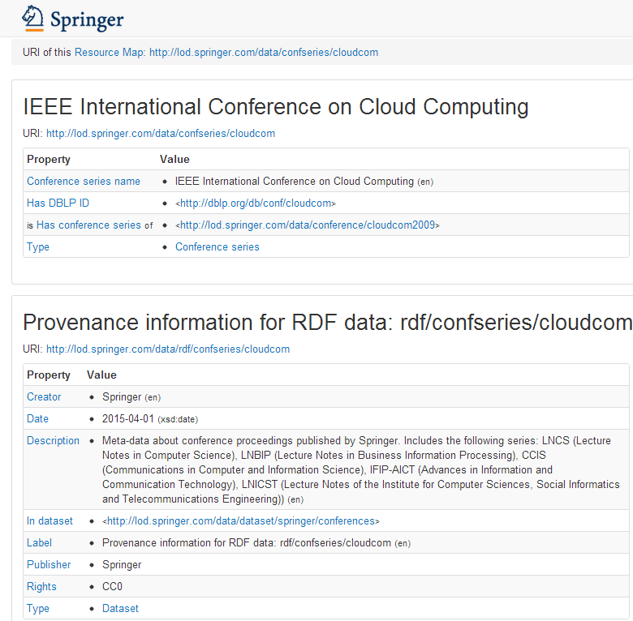
Springer: linked data related to scientific conferences
Notes:
Springer is the only publisher to respond to our survey. The description of its linked data project:
"In this project we make data about scientific conferences available as Linked Open data. The availability of such a dataset will contribute to the broader goals of publishing the scholarly data as LOD:
– accessible science: data about publications, authors, topics, and conferences should be easy to explore;
– transparent science: the data on productivity and impact of authors, research institutions, and conferences should be open and easy to analyze.”

Slide 23
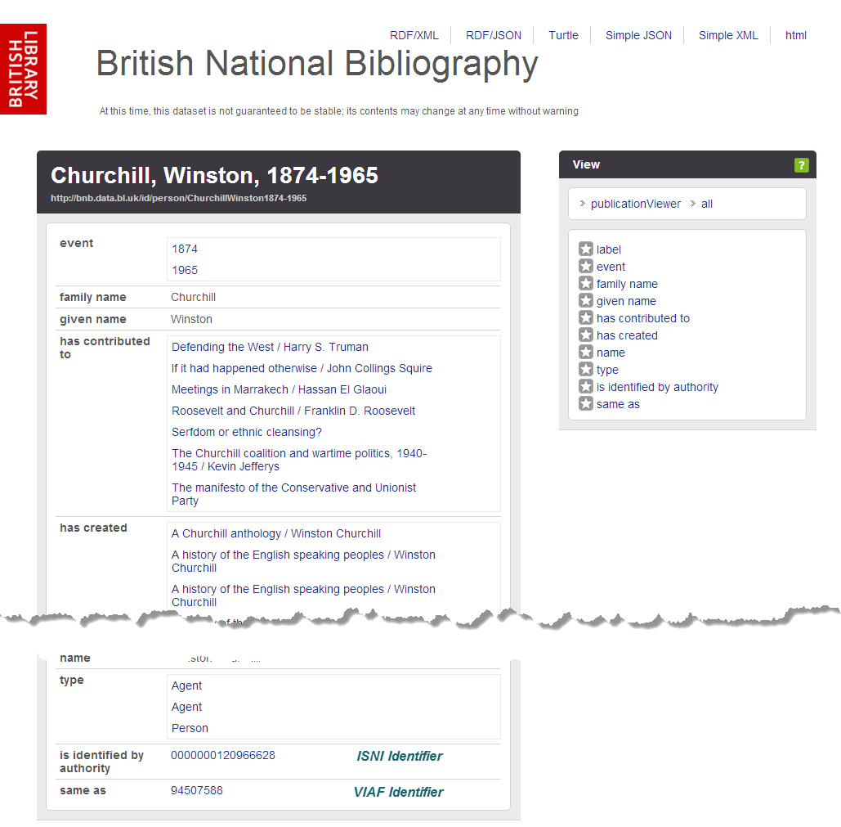
http://bnb.data.bl.uk
BL was among the first to make its national bibliography available as Linked Open Data
Notes:
The British Library was one of the first to make its national bibliography available as linked open data, exposing it in bulk. It is considered successful as it has been selected for the UK National Information Infrastructure and its data model has been influential.
Note that it includes links to both the ISNI and VIAF identifiers for this entity. The end of the page also shows the SPARQL query to retrieve the result that people can modify and re-run.

Slide 24
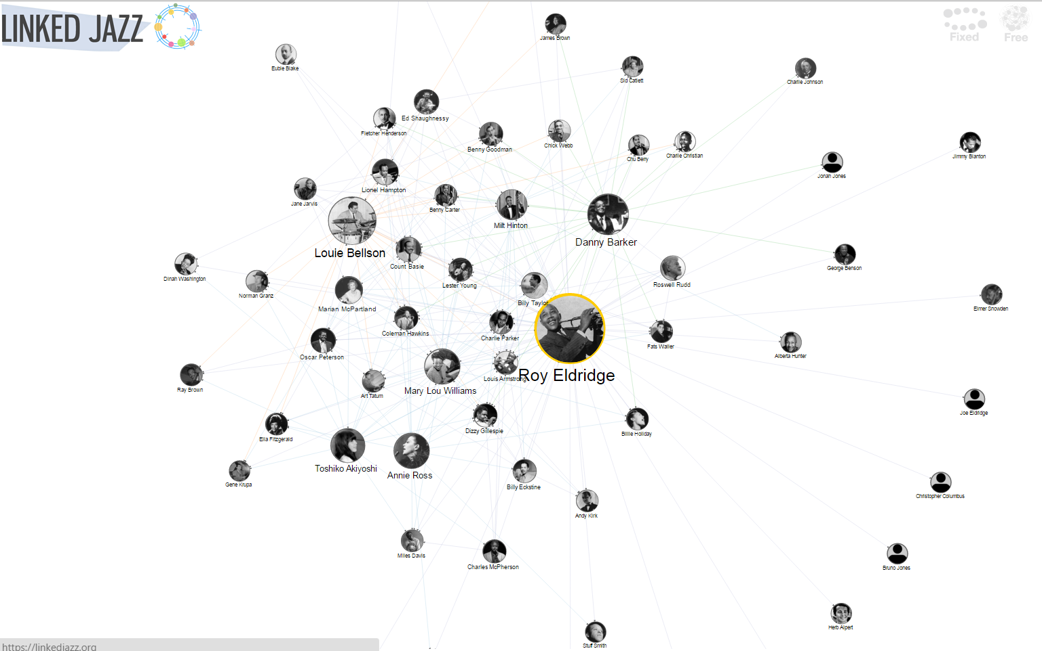
https://linkedjazz.org/
Pratt Institute: Linked Jazz
Digital heritage materials exploring the implications of linked data in end user experience.
Notes:
The Pratt Institute reported its Linked Jazz project, which applies Linked Open Data technologies to digital heritage materials and explores the implications of linked data in the user experience. It exposes relationships between musicians and enables jazz enthusiasts to make more connections.
It generated new triples from the content of interview transcripts – from the data rather then converting existing metadata. Transcripts came from Rutgers Institute for Jazz Studies Archives, Smithsonian Jazz Oral Histories, the Hamilton College Jazz Archive, UCLA’s Central Avenue Sounds series, and the University of Michigan’s Nathaniel C. Standifer Video Archive of Oral History.
Slide from Jean Godby, OCLC Research

Slide 25
So.. why again?
IMDB
It is NOT good enough to just be on the Web. You need to also be part of the Web
That means linking!!
Linked Data does just that – links your data to other data on the Web
Your Data
Music Brainz
Other Guy’s
Data
WikiData
Notes:
So at this point you are probably thinking “I have never heard of any of those datasets and I could barely even read the names of the ones on the periphery. So again, why?”. Let’s take a micro look at this Cloud. If you data is linked to other data which is linked back to your data you can create a “web” (pun intended). Linking allows your data to not just be on the Web but more importantly be OF the Web.

Slide 26
Reality check time

Slide 27
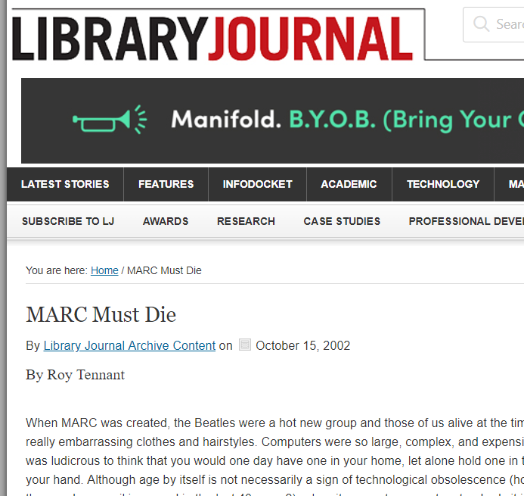
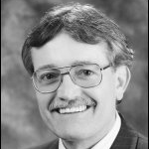
“MARC Must Die”
Rumors of MARC’s death are greatly exaggerated
Roy’s assertion is still correct!!!!

Slide 28
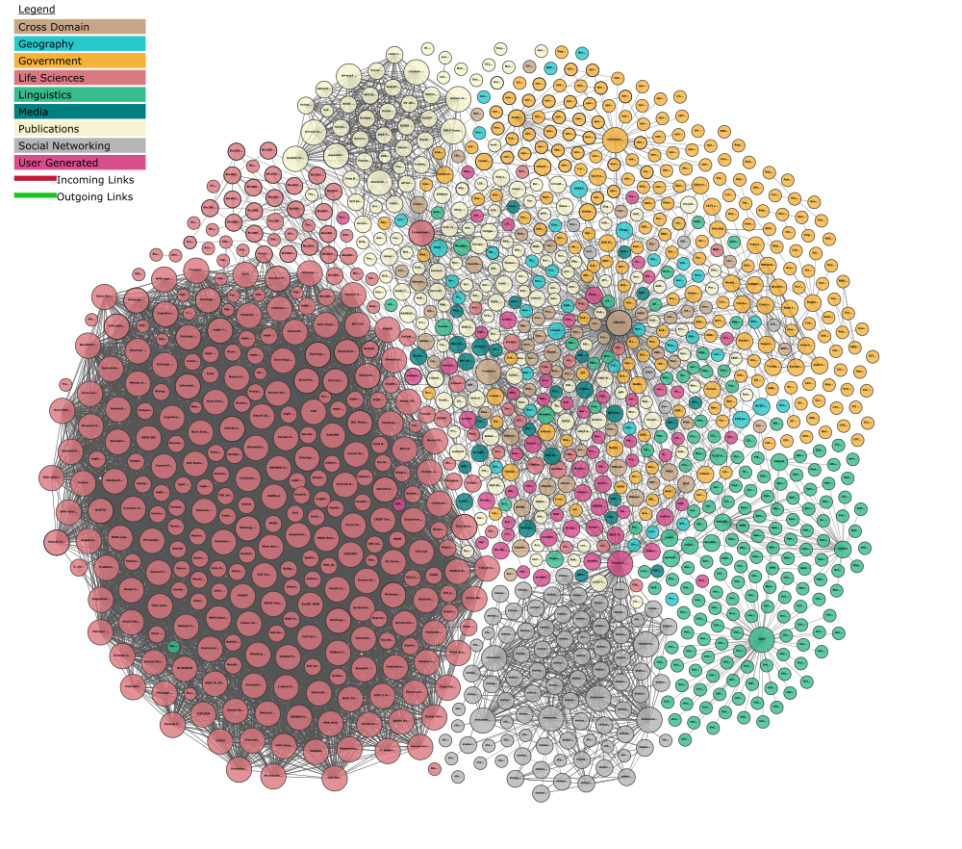
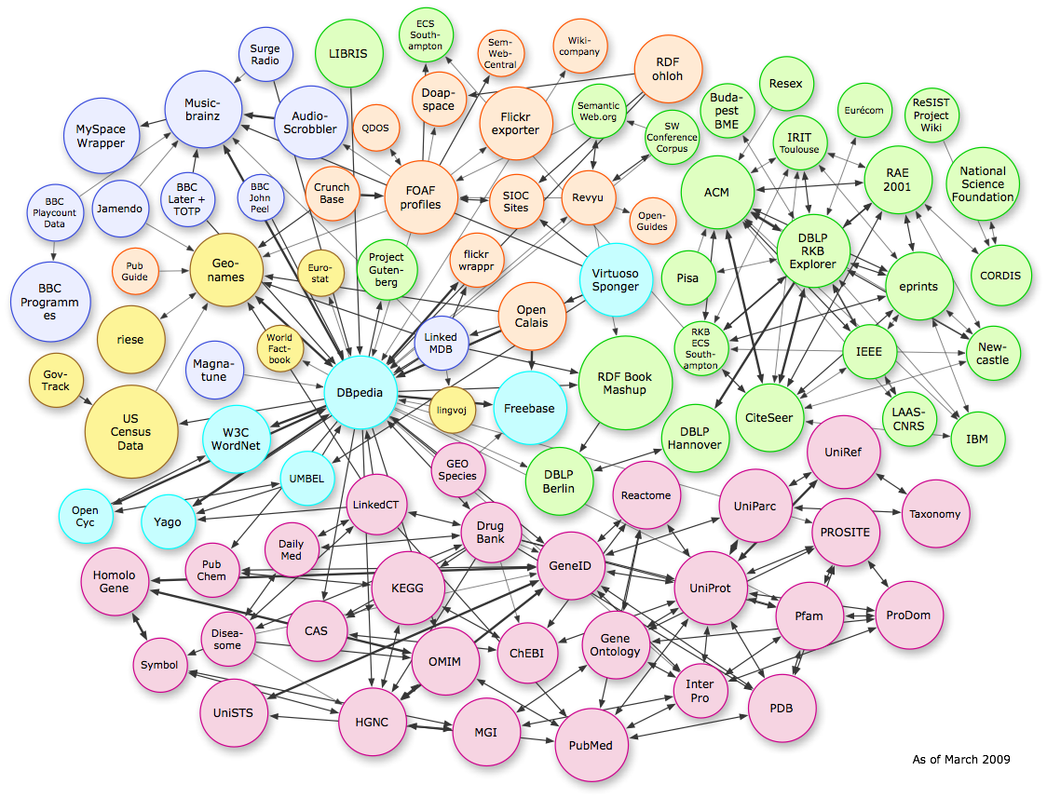
Relative Impact
Linked Data Diagram – 2014
Linked Data Diagram – 2017
Massive Linked Open Data Cloud (Reference Database), under-exploited by Publishers. (Linking Open Data cloud diagram 2017–08–22, CC-BY-SA by Andrejs Abele, John P. McCrae, Paul Buitelaar, Anja Jentzsch, and Richard Cyganiak. http://lod-cloud.net/)

Slide 29
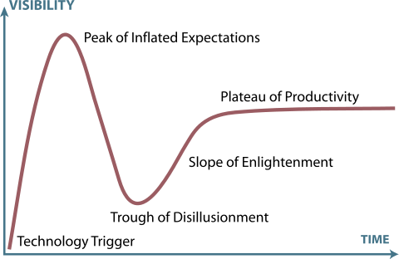
Gartner Hype Cycle of Emerging Technologies
Linked Data in Libraries (2015)
Linked Data in Libraries 2020?
Linked Data in Libraries 2018?
Linked Data in Libraries (2017)

Slide 30
A new Linked data prototype…

Slide 31
Why?--Efficient, impactful workflows
Today
Copy cataloging
Original cataloging
Authorities
Searching
In the future
Adding relationships
Entity management
Library-sourced vocabularies
Amplified searching

Slide 32
An project vision statement
Work with our members through a foundational shift in the collaborative work of libraries, communities of practice, and end-users—dramatically improving efficiency, embracing the inclusive, diverse, and earnest OCLC membership, and empowering a new and trusted knowledge work enabled by the web.

Slide 33
Who
Phase II Partners (!!!!) (May ‘18 – Sep ‘18)
American University
Brigham Young University
Cleveland Public Library
Harvard University
Michigan State University
National Library of Medicine
North Carolina State University
Northwestern University
Princeton University
Smithsonian Library
Temple University
University of Minnesota
University of New Hampshire
Yale University
Phase I Partners (Dec ’17 - Apr ‘18)
Cornell University
University of California, Davis
OCLC Research
OCLC Global Technolo-gies
OCLC Global Product Management

Slide 34
What & HOW

Slide 35
What
Develop an Entity Ecosystem that facilitates:
Creation and editing of new entities
Connecting entities to the Web
Build a community of users who can:
Create/Curate data in the ecosystem
Imagine/propose workflow uses
Provide services to:
Reconcile data
Explore the data

Slide 36
RECONCILER
EDITOR
INDEX
DUPLICATE DETECTION
WORLDCAT CREATIVE WORK ASSOCIATION
RANKING BY
ENTITY
ECOSYSTEM
RECONCILIATION
API
MINTING / EDITING
API
ENTITY to ENTITY RELATOR
AUTHENTICATION & AUTHORIZATION
UI
BATCH
UI
External
Client Applications
Local Bibliographic and Authority Data
External
Client Applications
Notes:
What –
An Entity Ecosystem and associated services to:
Reconcile names for people, organizations, concepts, places, and events against an index based on entities, returning language-tagged headings and persistent identifiers
Create, share and edit entity descriptions while also allowing for the contribution of additional contextual relationships between entities, beyond those that can be found by mining structured data in bibliographic and authority data via an Editor

Slide 37
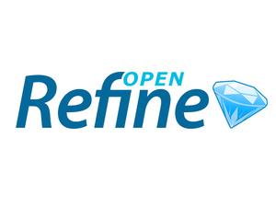
How: A few key technologies
Pywikibot
Notes:
Wikibase – The wikibase extension to MediaWiki provides the primary user interface for creating and editing items and properties.
Mediawiki API – Search and retrieval based on keyword searching or via entity identifiers.
SPARQL Query Service – A SPARQL Endpoint combined with a user-friendly Query Service interface supports complex and granular queries based on items, properties, and their relationships.
OpenRefine API – OpenRefine is an application for cleaning and reconciling data, using Reconciliation APIs and SPARQL endpoints. We're testing an OpenRefine-optimized API, to make it easier for those who use that application to connect to the system and reconcile their data.

Slide 38
How: Disambiguating Wiki*
Wikipedia – a multilingual web-based free-content encyclopedia
MediaWiki - a free and open-source wiki software
Wikidata.org - a collaboratively edited structured dataset used by Wikimedia sister projects and others
Wikibase - a MediaWiki extension to store and manage structured data

Slide 39
How: MediaWiki Features
Search/Autosuggest/APIs
Multilingual UI
Wikitext editor
Change history
Discussion pages
Users and rights
Watchlists
Maintenance reports
Etc.

Slide 40
How: MediaWiki+Wikibase Features
Search/Autosuggest/APIs/Linked Data/SPARQL
Multilingual UI
Structured data editor
Change history
Discussion pages
Users and rights
Watchlists
Maintenance reports
Etc.

Slide 41
How: Wikibase advantages
Open source
An all-purpose data model that takes knowledge diversity, sources, and multilingual usage seriously
Collaborative – can be read and edited by both humans and machines
User-defined properties
Version history

Slide 42
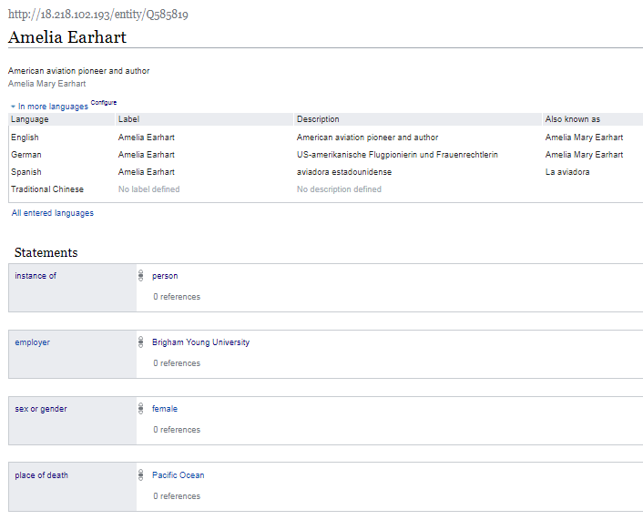

Slide 43
Item URL
Label
Item Identifier
Description
Additional labels, descriptions, and aliases, in other languages.
Aliases
Property
Statement
Rank
Value
Claim

Slide 44
Use case: Manual data entry
For manual creation and editing of entities,
Wikibase is the default technology.
It has a powerful and well-tested set of features that speed the data entry process and assist with quality control and data integrity.

Slide 45
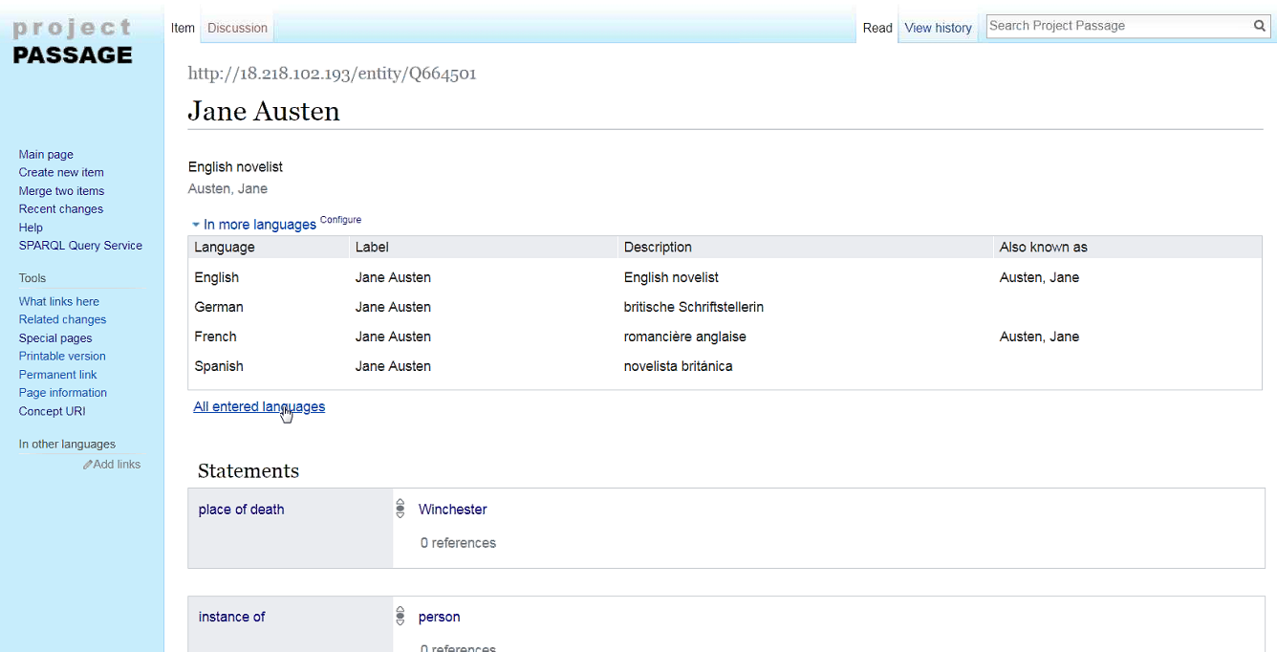

Slide 46
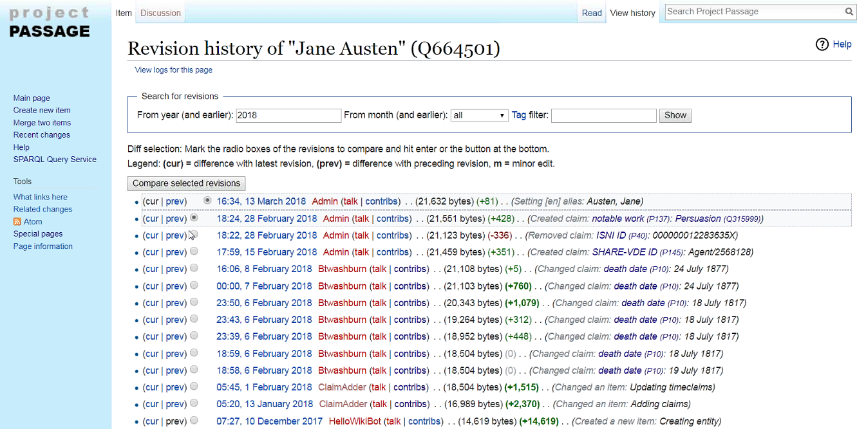

Slide 47
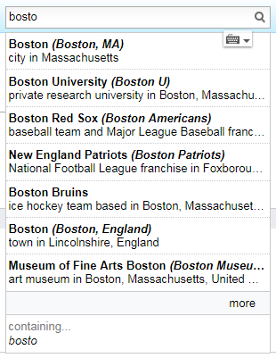
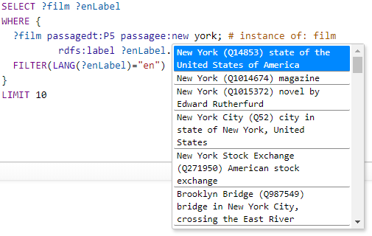
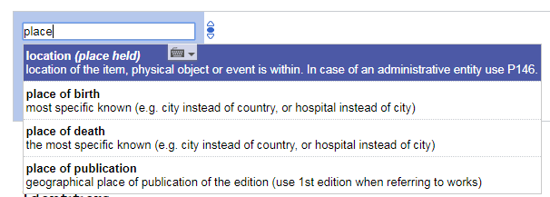
Use case: Autosuggest
Searching for entities as you type is supported by the Mediawiki API. This feature is found in both the prototype UI and in the SPARQL Query Service UI.
Notes:
Not necessary to demo this at this point. It would have been seen in the previous Wikibase UI demo and could be again in the SPARQL Query Service demo

Slide 48
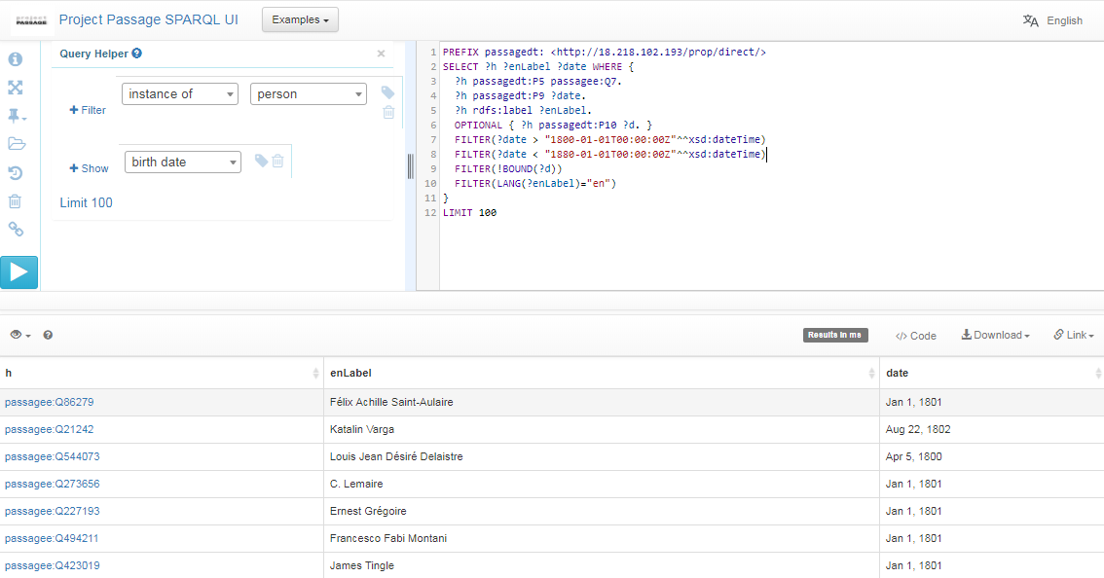
Use case: Complex queries
SPARQL (pronounced "sparkle") is an RDF query language … a semantic query language for databases. The prototype provides a SPARQL endpoint, including a user-friendly interface for constructing queries. With SPARQL you can extract any kind of data, with a query composed of logical combinations of triples.
In this example SPARQL query, items describing people born between 1800 and 1880, but without a specified death date, are listed.
Notes:
From the Query UI, things to demo:
From the examples list select the simple query to search for people
Use the autosuggest to show how to change the query to search for dogs, or cats
Use the autosuggest to show QA uses (people born between 1800 and 1880 that lack a death date)

Slide 49
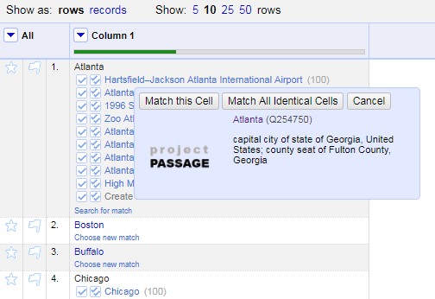
Use case: Reconciliation
Reconciling strings to a ranked list of potential entities is a key use case to be supported.
We are testing an OpenRefine-optimized Reconciliation API endpoint for this use case.
The Reconciliation API uses the prototype’s Mediawiki API and SPARQL endpoint in a hybrid tandem to find and rank matches.
Notes:
Why OpenRefine? Because it is popular, powerful, and ubiquitous. Though it might not be as commonly used with those managing MARC data? Something for us to learn more about.

Slide 50
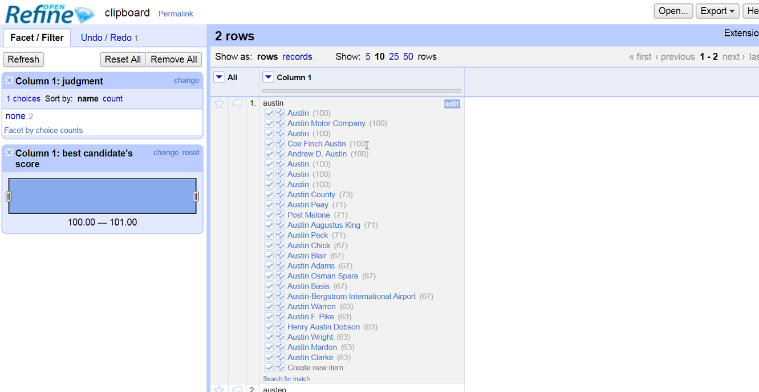

Slide 51
Use case: Batch loading
For batch loading new items and properties, and subsequent batch updates and deletions, OCLC staff use Pywikibot.
It is a Python library and collection of scripts that automate work on MediaWiki sites. Originally designed for Wikipedia, it is now used throughout the Wikimedia Foundation's projects and on many other wikis.
Notes:
Nothing to demo here but taking a look at the ClaimAdder updates is a way to also show Wikibase UI history pages, undo options, etc.
Note that we have not yet investigated, but plan to look at, other batch loading processes, including OpenRefine and QuickStatements

Slide 52
Lessons Learned and concerns so far | Next Steps
The Mediawiki-based API is not sufficient for reconciliation | Provide an OpenRefine API for matching by class and properties
The prototype data model for dates is capable but not user friendly | Document techniques for entering dates, mapping to LC's EDTF patterns
The prototype UI doesn't highlight connections to more information on the web | Prototype a UI that uses system data to connect to Dbpedia, Geonames, etc.
Autosuggested links aren't working well for personal names in indirect order | Add more aliases to the Wikibase to improve autosuggest matching, based on headings in VIAF
It's not yet clear how to handle creative works and editions in the prototype | Provide guidance and examples, beginning with works and translations
Will Wikibase / Wikidata scale to billions of entities? | Fruitful discussions with Wikimedia Deutschland started
Notes:
Library data is special
Conversation is continual regarding how we do things now, how we could do things, and moving away from current constraints/Endeavor like this represents a paradigm shift and requires adaptive change (everyone gets to change their behavior) - small project with transformative results.

Slide 53
OK, ANDREW…STILL, SO WHAT?

Slide 54
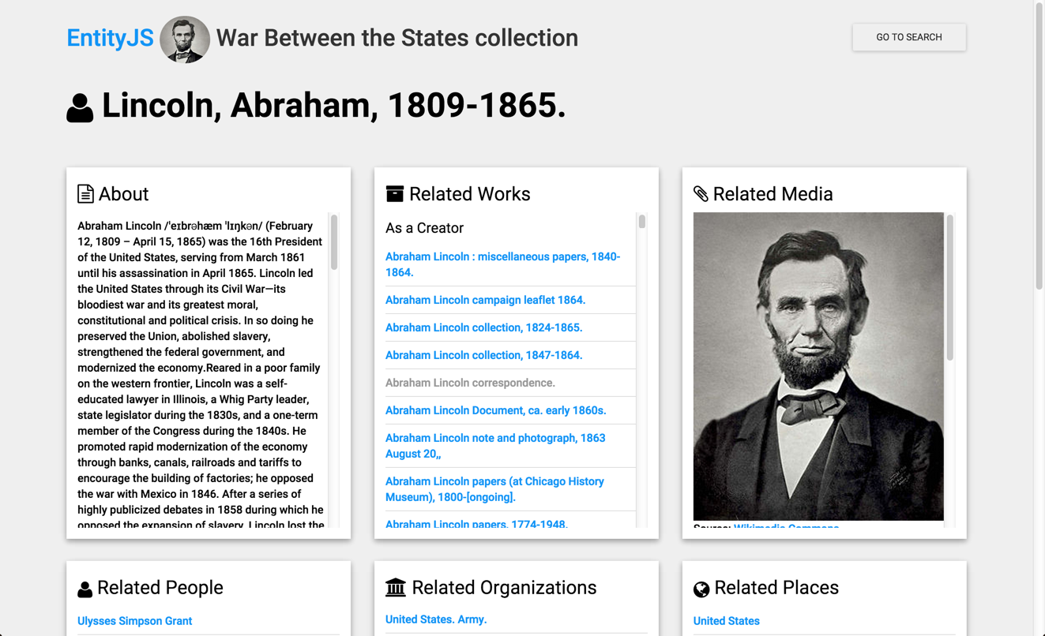
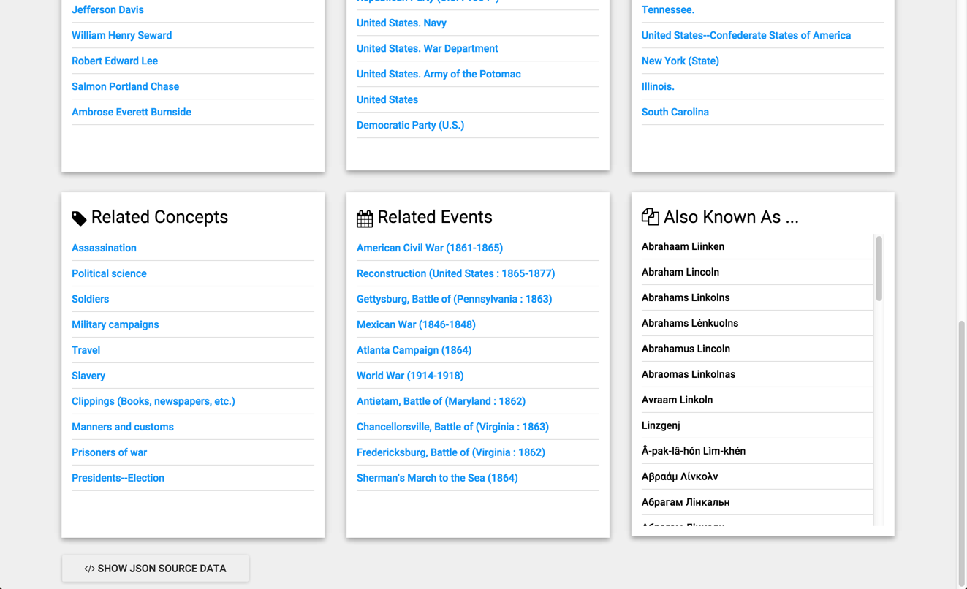
Linked Data Discovery

Slide 55
At the end of the day…
Evolving practices in knowledge work
Increasing the efficiency of library workflows
Next-generation search and discovery
Work with our members through a foundational shift in the collaborative work of libraries, communities of practice, and end-users—dramatically improving efficiency, embracing the inclusive, diverse, and earnest OCLC membership, and empowering a new and trusted knowledge work enabled by the web.

Slide 56
Questions?
Andrew K. Pace
pacea@oclc.org
@andrewkpace
Massive Linked Open Data Cloud (Reference Database), under-exploited by Publishers. (Linking Open Data cloud diagram 2017–08–22, CC-BY-SA by Andrejs Abele, John P. McCrae, Paul Buitelaar, Anja Jentzsch, and Richard Cyganiak. http://lod-cloud.net/)
Notes:
Thank you for your time and attention today.
If you would like additional details about my presentation today, please feel free to download our new “OCLC and linked data” paper at oc.lc/linkeddatasummary

