Slide 1
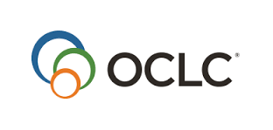
Indiana Memory DPLAfest
Advancing the National Digital Platform
Survey Findings
Kendra Morgan Senior Program Manager

Slide 2
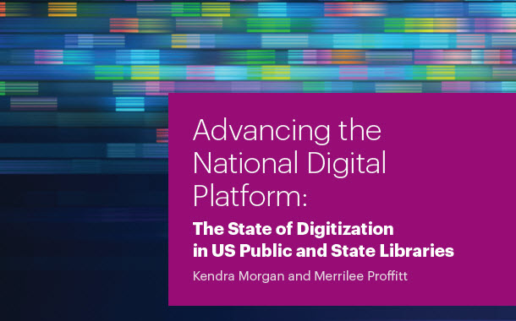
Report released, January 2017
http://oc.lc/advancing-national-digital-platform

Slide 3
Project Partners
DPLA
OCLC
Public Library Association
Association for Library Collections & Technical Services
Chief Officers of State Library Agencies
Funded by the Institute of Museum and Library Services (grant award LG-72-15-0197-15)

Slide 4
Project intent
identify the extent to which public libraries have or have not digitized unique collections,
the obstacles that prevent digitization,
and the opportunities and partnerships that can accelerate digitization activities

Slide 5
Survey overview
Public library survey:
Distributed to 3,800+ public libraries.
E-mail and direct mail requests to library directors.
Received 769 responses.
State library survey:
Distributed via COSLA mailing list to all chiefs.
Received 47 responses.
All raw data except for contact information for the respondents is publicly available.
Notes:
Randomly selected libraries from the IMLS dataset.
Received a 20% or higher response rate for all categories except for the Very Small libraries which was 18%
We had responses from all 50 states.
Let me offer my thanks up now for everyone who takes these surveys. It helps the field, the more we know and we can point to evidence about needs and barriers, the more we can tailor requests on behalf of entire groups to try and advance the field.

Slide 6
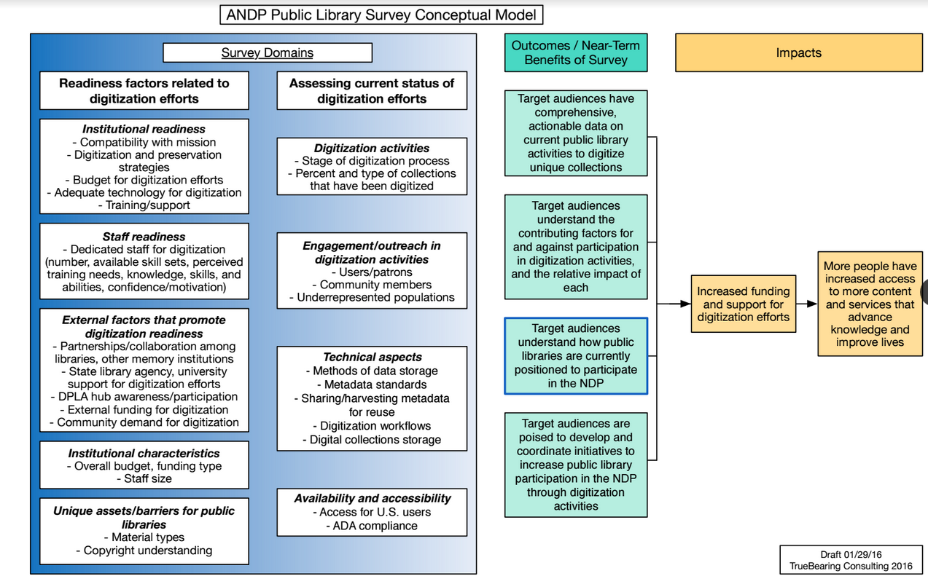
More people have increased access to more content and services that advance knowledge and improve lives.
Notes:
This conceptual model maps our project proposal through to what we ultimately want to see happen with the results of the survey. The domains capture two major categories, the “readiness of libraries to participate in digitization” and assessing the current status of digitization efforts. We used this model to inform the questions of the survey and to serve as a reminder for what we want to accomplish through the survey.
The impacts are that there is increased funding and support for digitization and more people have increased access to more content and services that advance knowledge and improve lives.

Slide 7
Survey category sizes
Library Size | Population LSA (IMLS data) | % of Libraries
Very small | 0 – 9,999 | 58%
Small | 10,000 – 24,999 | 19%
Medium | 25,000 – 99,999 | 17%
Large | 100,000 – 449,999 | 5%
Very large | 450,000+ | 1%

Slide 8
Status of Digitization Activities
 | Never and no plans to start | Never, but plan to start in the next 12 months | Currently engaged or have been in the last three years | Did some more than three years ago | Completed all digitization
Very small | 39% | 23% | 28% | 9% | .3%
Small | 24% | 23% | 42% | 10% | 1%
Medium | 19% | 19% | 53% | 8%
Large | 10% | 10% | 66% | 14% | 1%
Very large | 3% | 3% | 81% | 13%
Nationally | 31% | 22% | 38% | 10% | .3%
Notes:
For all but the Very Small libraries, the highest responses was that libraries are “Currently engaged in digitization activities or have been in the last three years”.
For the Very Small libraries, this was even higher than we expected to see, which may have also be related to who chose to respond to the survey. The idea of completing a survey on digitization may have skewed responses.
This is an example of the depth of information that we have, some of the other slides will just sum up the information at the national level, but the ability to show this at the library size is definitely there.

Slide 9
We have invested considerable funds and staff time to digitizing local collections and making them available to the public. This has heightened our profile in the community and generated additional donations of materials.
Public library currently digitizing.
Notes:
Reading through the comments in the survey was really interesting, and while much of it is anecdotal, it does help to tell more of the story of how library staff feel about digitization projects. This respondent really sees digitization as a positive activity, worth pursuing and that it has an impact in their community.

Slide 10
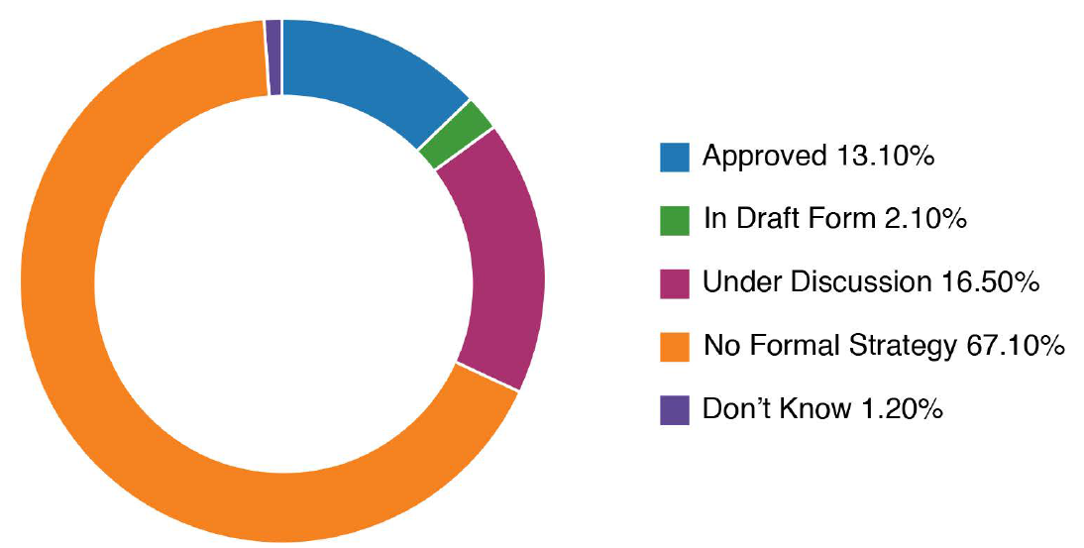
Status of Digitization Strategy
Notes:
This question about having a digitization strategy was only asked of libraries that are currently digitizing or have digitized in the past three years. Very few libraries have an approved strategy – they are just getting it done! Now, maybe that’s how they approach all projects in the library…no formal strategy in place. But formation of a strategy is clear way to help scope a project and your expectations, and I do recommend them for projects.

Slide 11
Is there a DPLA service hub…
Notes:
We’ll cover more about the DPLA service hubs in the state-level report, but of course, this was of interest to our partners at DPLA colleagues because it presents an opportunity both for education around participation, and also awareness and use of DPLA resources.

Slide 12
Materials in the collection
Photographs
Letters, diaries, scrapbooks
Newspapers (including clippings)
Official, local records
Audio recordings
Video recordings
Microfilm/fiche
Maps/cartographic materials
Books/monographics
Findings aids
Born-digital
Other
We have none of these items
Notes:
This is a question that we asked of every respondents – regardless of their digitization efforts. We tailored the question to say that we were interested in locally-significant materials, things that other libraries weren’t likely to have. We wanted to know if they even had things that could be digitized.
And 92% of libraries reported that they did have these materials in their collections.

Slide 13
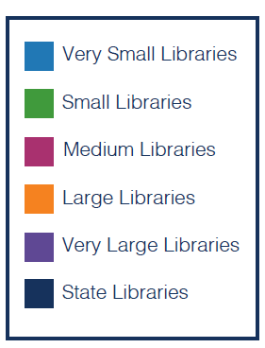
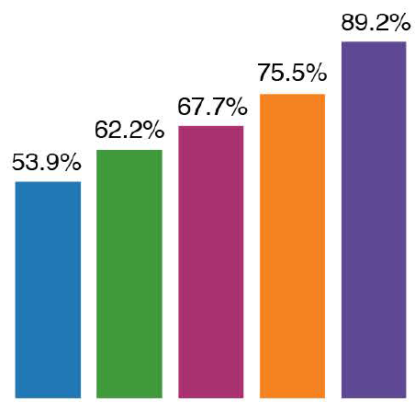
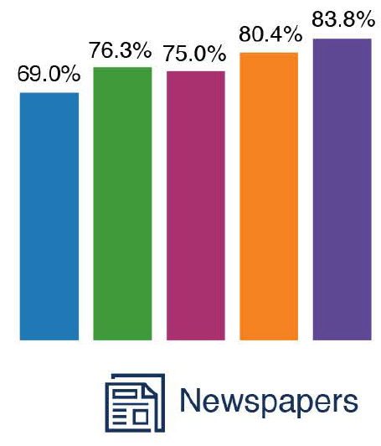
Materials in the collection
Notes:
The two most popular items, across library size were photographs and newspapers.

Slide 14
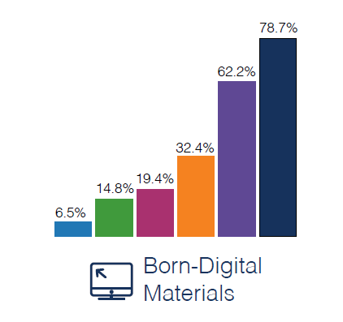
Materials in the collection
Notes:
Born-Digital materials is the one data category where the difference between state and public libraries is significant. The most popular item for state libraries in “born-digital materials”. Maps and Newspapers tied at 70.2%

Slide 15
Underrepresented populations
 | African American | American Indian/ Alaskan Native | Asian/Asian American | Hispanic/ Latino | LGBTQ | Native Hawaiian/ Pacific Islander
We have | 25% | 25% | 8% | 14% | 6% | 1%
Notes:
We also looked at content that might represent unrepresented populations. However, for the public libraries this question was only asked of those that said they were digitizing, so we missed an opportunity to find out more about collections and potential here.

Slide 16
Barriers to library efforts
 | Inadequate technology or equipment | Insufficient staff time | Insufficient training/ expertise | Lack of experience applying/ administering grants | Rights management issues | Insufficient ongoing funds (outside of grants)
Major | 54% | 75% | 57% | 24% | 24% | 67%
Minor | 30% | 20% | 32% | 42% | 51% | 24%
Not a barrier | 16% | 5% | 11% | 34% | 26% | 9%
Notes:
It won’t be a surprise to anyone that funding and staff time are seen as major barriers. Including them in the survey is a requirement because it’s going to come up, but I always want to say, “excluding funding and staff time…what are your biggest barriers.” But then we wouldn’t have the data that show these are As you’ll see later, similar concerns are raised at the state library level as well.
Rights management issues shows up as the most relevant minor barrier, but when we asked about the types of rights being assigned to digital content in a later question, 22% of the responders replied “Don’t know.”, which indicates that there is an opportunity here for education around rights and permissions for content.

Slide 17
This is a small, rural public library that could benefit from digitization services, but it is not financially feasible.
Public library not digitizing and no plans to start.
Notes:
This is one of the comments from a library that participated in the survey, they want to digitize, but it is not financially feasible.

Slide 18
Very Small Libraries – 42%
Very Large Libraries – 72%
Notes:
Training was one of those barriers and we looked more closely at the issue of the kinds of training that might be most beneficial. Best practices for Imaging and Metadata surfaced as training topics that could help libraries better digitize their collections.
I mentioned at the beginning that we looked at data from five different sizes of libraries and all of that information is provided in the data files that are available for you to download and review. Looking at the breakdown by size, there was a consistent growth in the interest in Copyright or risk assessment training as library size increased. And remember that issues around rights management was the largest minor barrier reported by libraries. Only 42% of the Very Small libraries selected that as an area that would be helpful, versus 72% of Very Large libraries. The larger the library, the more concerned they are with risk assessment.

Slide 19
“We are very interested, but are apprehensive, mostly due to copyright issues, which we are unsure of.”
Public library that has never engaged in digitization activities, but plans to start in the next 12 months.

Slide 20
What criteria has your library used when selecting which collections to digitize?
Patron demand
To weed physical item from the collection
Collection size
Historical significance
Preservation purposes
Ease of digitization
Rights issues
In-house expertise
Potential partnerships
Community outreach and engagement opportunities
Serving unique or underserved populations
Financial incentives/grants
Notes:
We wanted to understand how libraries choose to digitize their content and these are the options that we provided for them to choose from.

Slide 21
What criteria has your library used when selecting which collections to digitize?
Notes:
Historical significance for the win! This is true of both public and state library agencies. Patron demand was the second choice for state libraries, but fourth for publics.

Slide 22
Materials digitized
 | Libraries (n) | Digitized some | Digitized none
Photographs | 303 | 77% | 15%
Newspaper (including clippings) | 328 | 62% | 26%
Letters, diaries, scrapbooks | 244 | 60% | 35%
Official, local records | 210 | 34% | 47%
Books/monographs | 236 | 56% | 40%
Notes:
This is across all library sizes, for those that reported having the type of materials in their collections and also being involved with digitization efforts.
This just reflects the top responses for “digitized some”; there were many other content types provided as options.

Slide 23
Getting it done
Notes:
Overall, the least common staffing options are paid (6.9%) and unpaid (11.5%) students or interns.

Slide 24
Yes, approved | Yes, in draft form | Under discussion | Through our vendor | No | Don’t know
16% | 7% | 25% | 28% | 19% | 5%
Digital preservation strategy?
Notes:
Optional presentation of the same data. Just the weighted averages for publics and states.
Preference?
We also asked if those libraries that have recently been digitizing had a long-term digital preservation strategy that guards against the loss of data and files. This has surfaced as one of the biggest opportunities and needs – how do we get libraries to think about this and protect their investments. The smallest libraries are least likely to have a strategy in place – but “No”, was the most popular answer for libraries of all sizes. State libraries were more likely to be in the “under discussion” category. They are moving towards a strategy, but don’t have it in place.

Slide 25
State library survey
Notes:
For the state library survey, a total of 48 responses received.

Slide 26
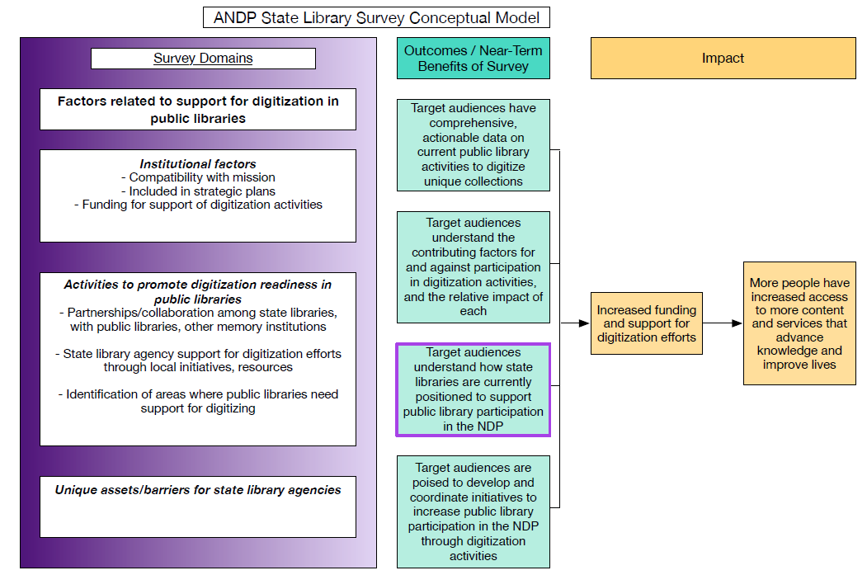
More people have increased access to more content and services that advance knowledge and improve lives.
Notes:
Again, to guide the state library survey, we worked with TrueBearing to develop a conceptual model to guide the survey development.

Slide 27
Digitization in the Strategic/LSTA Plan?
Response | SLA | LSTA
Yes, in the current plan | 29% | 33%
Yes, and we also plan to include them in the next plan | 44% | 48%
No | 10% | 6%
Not currently, but we plan to include them in the next strategic plan | 12% | 8%
Don’t know | 4% | 4%
Notes:
The responses regarding the inclusion of digitization activities in strategic and LSTA plans were very closely aligned. LSTA – Library Services and Technology Act funds are provided to the states through IMLS and the reason that we were interested in the inclusion of digitization in the LSTA plans is that those funds are often used for statewide initiatives or investments that have broad appeal or benefit. And now the states have access to this data and can see what their peers are doing and what models might work for them.

Slide 28
Roles that states play in digitization
Response | %
There is a division/department of the agency that digitizes unique, locally significant materials that are part of the state library’s collection. | 73%
We collaborate with another agency or organization on digitization efforts. | 73%
We advise and support public libraries in their efforts to digitize their unique collections. | 67%
There is a division/department of the agency that digitizes unique, locally significant materials that come from other organizations (county records, public libraries, etc.) | 44%
Notes:
The top responses for roles identified for state libraries in digitizing collections.

Slide 29
Is there a DPLA service hub….

Slide 30
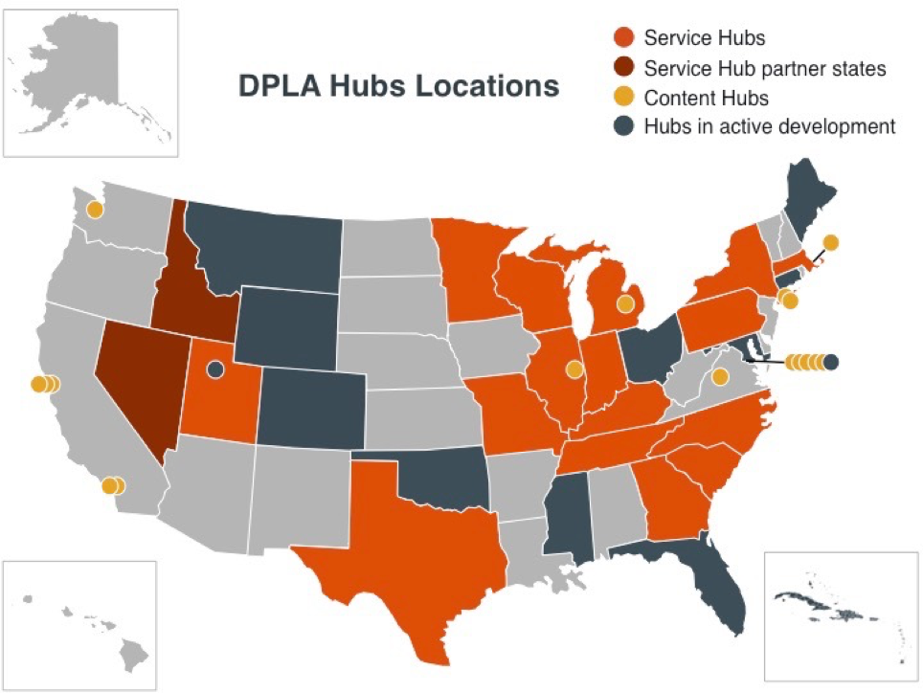

Slide 31
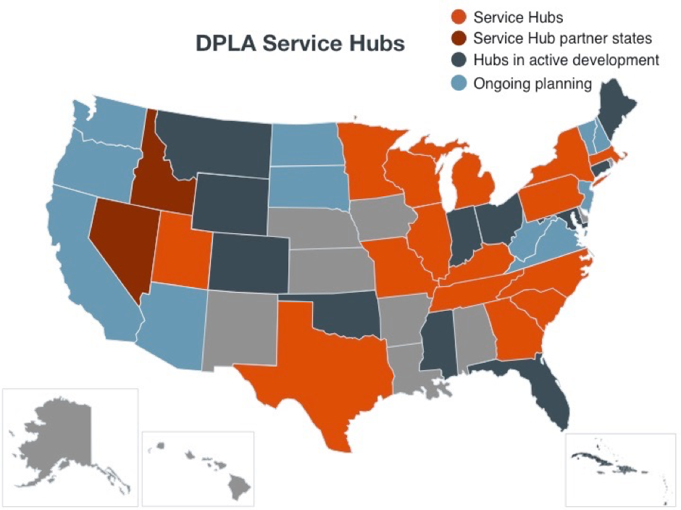

Slide 32
Barriers to library efforts
 | Inadequate technology or equipment | Insufficient staff time | Insufficient training/ expertise | Lack of experience applying/ administering grants | Rights management issues | Insufficient ongoing funds (outside of grants) | Lack of interest
Major | 20% | 69% | 20% | 9% | 2% | 61% | 0%
Minor | 46% | 24% | 44% | 28% | 66% | 30% | 7%
Not a barrier | 34% | 7% | 36% | 63% | 32% | 9% | 93%
Notes:
Similar to the public library reported barriers, funding and staff time are seen as major barriers.

Slide 33
Engaging the public in dig. activities
Notes:
This chart also compares the public and state library responses, and it looks at how the public is engaged in digitization activities. Let’s face it, we know that working with volunteers or the public in general isn’t always a slam dunk, easy win. I’ve heard the stories about wanting to pay them to stay away! BUT, there is a lot of opportunity to engage them in a range of activities. The vast majority of respondents in both public and state libraries are NOT engaging the public to help in these activities. If you have been doing this, and doing it successfully, let us know and we can share that experience to give other libraries the confidence to pursue this type of engagement with the public.

Slide 34
Marketing
Notes:
Finally – we wanted to see how state and public libraries were getting out the word about their collections. Most use their library website or a method like social media. But 7% of the state libraries and 19% of the publics are not publicizing the content at all. And this is not a case of, “if you build it, they will come.” You need to build it, promote it, share it, and keep tweaking it. There could be reasons that the library chooses not to promote, but we also think that some help in building awareness and marketing would be helpful.

Slide 35
recommendations

Slide 36
Recommendations
Look at your state data for specific findings that can support your local needs. The data can be sorted by state.
Increase sharing of digital content to national or regional repositories. Awareness.
Provide training opportunities. People need help on a range of skills, knowledge and abilities.
Promote content. Market and increase awareness.
Long-term strategic and digital preservation planning.

