Slide 1

Describing Theses and Dissertations Using Schema.org
Project Report Presentation and Update
DCMI 2014 Austin, Texas
October 10, 2014
Jeff Mixter - OCLC Research
Patrick OBrien - Montana State Univeristy
Kenning Arlitsch - Montana State University
Notes:
My name is Jeff Mixter and I work as a Research Support Specialist at OCLC. My colleagues on this IMLS grant funded project are Kenning Arlitsch, Dean of Montana State University Libraries, and Patrick Obrien, Semantic Web Researcher at Montana State University Library. Kenning and Patrick are not able to attend the conference but we would all like to thank DCMI for inviting me to present today.

Slide 2
Background
This project is based on an IMLS Grant that Kenning and Patrick were awarded in 2010
Initial scope was to improve indexing and visibility of digital collections in Search Engines
Since the release of Schema.org in 2011 the scope has expanded to include modeling IR material in a way that make them more visible to traditional search engines
Notes:
To start out I would like to provide a bit of background information about the project. As mentioned this project is part of an IMLS funded grant project entitled “Getting Found” that Kenning and Patrick were awarded in 2010. The initial scope of the project was to help improve the indexing and visibility of digital collections in search engines. Since the release of Schema.org in 2011, the project has expanded to include modeling Institutional Repository materials, specifically Theses and Dissertations, using terms that are understood and consumed by the major search engines.

Slide 3
Schema.org
Released in 2011 by Bing, Google, Yahoo and Yandex
Lingua franca for describing things on the web
W3C Working Group SchemaBibExtend was created to help make bibliographic recommendations and suggestions to Schema.org
Notes:
I am sure that everyone here is aware of what Schema.org is but just to give the 10,000 foot view of the vocabulary, here are a few important facts. Of particular importance to the library community is the W3C SchemaBibExtend working group that works to propose extension terms to Schema.org in order to allow for better description of bibliographic materials.

Slide 4
Data Sample
1,909 DC records from the Montana State University ScholarWorks IR
They had already undergone extensive metadata clean-up
Notes:
The data sample that we used for this project was taken from the Montana State University ScholarWorks database. It included 1,909 student theses and dissertations records cataloged using qualified Dublin Core. It should be noted that the metadata underwent rigorous clean-up prior to this study. This will be important when I talk about the process model that we used for converting the data into RDF.

Slide 5
Data Model
Started with Schema.org as the base
We created an extension vocabulary using the same mechanics and conventions used in Schema.org
  RDFS vocabulary
  It is published as RDFa
  http://purl.org/montana-state/library/
Notes:
The initial phase of the work involved developing a data model for the sample set. We chose to use Schema.org as the primary vocabulary for the project. In order to describe in adequate detail the theses and dissertations, we needed to develop a set of extension terms that could be used to further refine the terms already in Schema.org. This set of terms was published using the same conventions as the Schema.org vocabulary. Primarily it was published as an RDFS vocabulary.

Slide 6
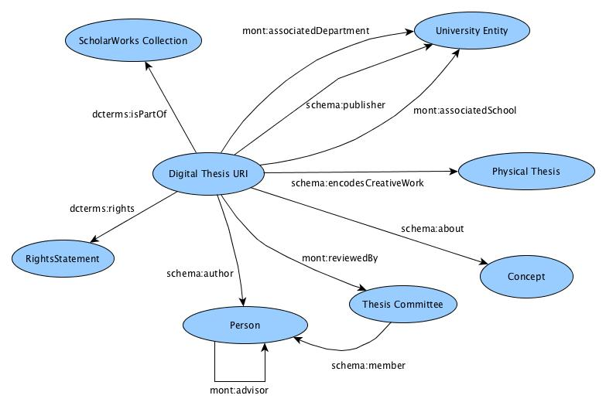
schema: http://schema.org/
dcterms: http://purl.org/dc/terms/
mont: http://purl.org/montana-state/library/
Notes:
This is a general conception of the model that we developed for the theses and dissertations.

Slide 7
Classes
There was a need to add more specificity to the existing Creative Work branch classes
  Mont:Thesis
  Mont:Concept
There was also a need to describe entities unique to IRs and Universities that are not covered in Schema.org’s current vocabulary
  Mont:InstitutionalRepository
  Mont:AcademicDepartment
Notes:
As we were developing the set of extension classes, they were grouped into two general categories. The first was those that were created to add more specificity to the existing CreativeWork branch Schema.org terms. For example, we wanted to describe an item as being not only a schema:Creative Work but more specifically a Thesis. The second category of classes were those that in essence did not exist within the Schema.org vocabulary. The Institutional Repository class was one such example. Although there are schema:Organization and schema:LocalBusiness classes (although some people might argue that an IR is not a 'business' per se), we felt that that the IR class was unique enough to warrant its inclusion in this category. That being said, we still positioned the IR class as a sub-class of schema:Organization. Also one should not read too much into the two categories, we simply used them as a means to help organize the modeling process and to help influence ideas for future work (which I will talk about briefly)

Slide 8
Properties
Create more granular relationships between classes
  Mont:committeeMember
Describe important attributes of Theses and Dissertations that were not included in Schema.org*
  Mont:firstPage**
Highlight and model unique relationships that were otherwise locked in the metadata records
  Mont:advisor
* Schema.org underwent an update following the publication of the project report
** This property has since been replaced by the schema:pageStart
Notes:
The development of the extension properties were also grouped into two general categories, those that added more granularity to existing schema.org properties and those that were needed (and did not already exist) to adequately describe Theses and Dissertations. So here I have listed mont:committeeMember. This property is listed as a sub-property of the schema:member property. In addition to this committee member relationship we also coined a mont:committeeChair property. So in the end, both properties are directly related to the generic schema:member property but each carries with it unique context and meaning that is important when describing theses and dissertations. As stated on the slides the mont:firstPage property was created to help account/model for all of the existing properties in the original DC metadata. It should be noted that since the model was developed, Schema.org has updated its vocabulary to include firstPage, lastPage properties along with other terms that allow for better descriptions of periodicals.

Slide 9
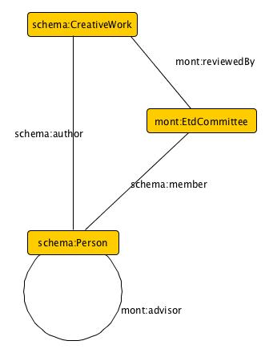
Inferring additional information from the record
This has the potential of allowing Universities to aggregate a large amount of data about Academic Output and use it for reviews/marketing
This highlights the idea of developing a graph of university entities
Notes:
We found after some of the initial modeling work that we were able to infer a lot of information that would otherwise require human reading and interpretation. The example here illustrates a few of these inferences. This type of information could be of huge potential to universities as a means to better understand the academic output and impact of their faculty staff and students. More specifically this could help university libraries better cement their role as the 'centers for university information and knowledge management'. I should say that while I present this idea as novel, it is, in essence, just developing a graph for university data. Its novelty lies in leveraging the library and library data to do so.

Slide 10
Process Model
Data was loaded into OpenRefine
Data was reconciled against Dbpedia.org, LCSH and VIAF
  Matching was made easier by the specific metadata fields that the records used
  dc:subjects.lcsh matched 78%
Generated our own internal URIs***
*** The URI pattern for the current production data differs from that used in the example data presented in the project report
Notes:
So I have gone on a bit now about the data model, the other major part of this project was developing a process model for creating and publishing the RDF. We began by loading the data in OpenRefine and used its features to reconcile the existing strings to entities in VIAF, LCSH and Dbpedia. Some stats are on the screen so I will not go over them. If there are specific questions about the reconciliation process or results, please feel free to ask me afterwards. This process has been well documented by Ruben Verborgh and Max De Wilde in their book “Using OpenRefine”. This process has also been used in various library projects to convert flat data into RDF. After the reconciliation process, we took all of the remaining 'strings' and created our own entities from them. This was particularly important for student and faculty names, and university departments, since there are very few repositories that have this type of data in them. With the rise in importance of services such as ISNI and ORCID, is makes a lot of sense for libraries to being to better understand and deal with the unique person entities that exist in their metadata. One could imagine theses entities becoming the type of data that a university library could aggregate and then submit to ISNI or ORCID for bulk upload. It is important to note that we also used OpenRefine to help identify and merge people that had variations in the spelling of their name. Again, this is a topic that I would love to talk about after the presentation if people are interested.

Slide 11
Syndication of RDF data
Data from three records was published online along with an HTML page that described all of the entities referenced in the CBDs
  Serialized at RDFa
Since then we have loaded all 1,909 RDF descriptions back into the ScholarWorks repository and tweaked the Dspace instance to pull over and display JSON-ld data
All newly created entities are loaded into a Triple Store with a Pubby front end
  http://54.191.234.158:8081/resource/department/7
Notes:
So the final step in the process was syndicating that data. As part of our initial study, we published three sample records as Concise Bounded Descriptions (or CBD) within html pages using RDFa. These were added to the ScholarWorks website. We then published descriptions for all of the referenced entities (that were not reconciled) on an HTML page using RDFa, differentiating each descriptions using hash URIs. Since then we have loaded CDB for all 1,909 sample records back into the Dspace database and are now delivering them using JSON-ld on the HTML pages. All of the newly created entity descriptions are stored in a triple store (Apache Fuseki) that is hosted on an Amazon Web Service (AWS) Elastic Compute Cloud (EC2) instance. We have set up a front end for display of the data in the triple store using Pubby, a simple Linked Data front end for SPARQL endpoints.

Slide 12
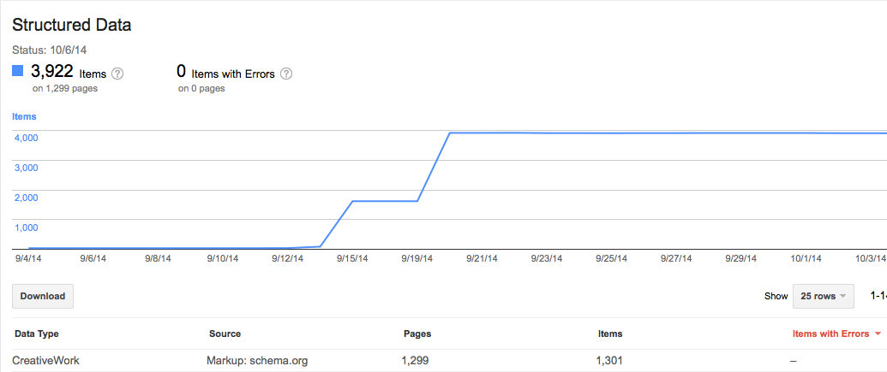
Google Webmaster Tools
Notes:
This slide shows the amount of structured data that Google Webmaster tools is now harvesting from the Montana State University ScholarWorks website. Note this does not serve as evidence of improved SEO but rather illustrates the initial transition from, what Eric Miller described as, the invisible web to the visible web.

Slide 13
Next Steps
Setup a more production ready Pubby interface
Make modifications to the ScholarWorks structured data
Make libraries visible on the Web
  Build the presence of the library and its sub-organizations on the Semantic Web
  Kenning, A., OBrien, P., Clark, J. A., Young, S. W. H. & Rossmann, D. (2014). Demonstrating Library Value at Network Scale: Leveraging the Semantic Web With New Knowledge Work. Journal of Library Administration, 54(5), 413-425.
Notes:
The immediate next steps that we will be working on will be to set up a more 'production-ized' triple store and Pubby interface. This primarily means positioning the services at standard port 80 locations and then making the necessary URI pattern changes in the sample data. We also plan to make some tweaks to the structured data that is being delivered to the Dspace html pages in order to improve how it is consumed and indexed by search engines. We might even abandon JSON-ld in favor of RDFa in order to allow users to 'interact' with the structured data (click on and follow links to external entities). The major next step that we plan to undertake as part of a follow-up grant that we were just awarded from IMLS will be to make libraries more visible on the web. This includes building the presence of libraries and library related organizations on the semantic web. An article recently published by my colleagues at Montana State in the Journal of Library Administration outlines the importance of this work and presents a sample that was done at Montana State University. In addition to making libraries present in the semantic web, this work will also help up in future projects that attempt to convert existing metadata into RDF by creating entity datasets that can be used for reconciliation.

Slide 14
Questions?
Notes:
Again, on behalf of everyone on our team, I would like to thank DCMI for the invitation to speak today and invite folks to ask any questions you might have.

Slide 15
Jeff Mixter
mixterj@oclc.org
@JeffMixter
614-761-5159

