Slide 1
Reconfigured and Unbundled
The research university and its library
-Trends, influences, and external factors-
For the University of Wisconsin Libraries
15 May 2013
Jim Michalko, OCLC Research
With ample borrowings from Lorcan Dempsey, Brian Lavoie, Constance Malpas of OCLC
AND all those in the concluding references

Slide 2
Disclaimers
Where I work
Outside in
Where you sit
You may know better…

Slide 3
Where
OCLC
  – non-profit membership organization serving 72,035 libraries in 171 countries
Serves as the USA national bibliographic infrastructure

Slide 4
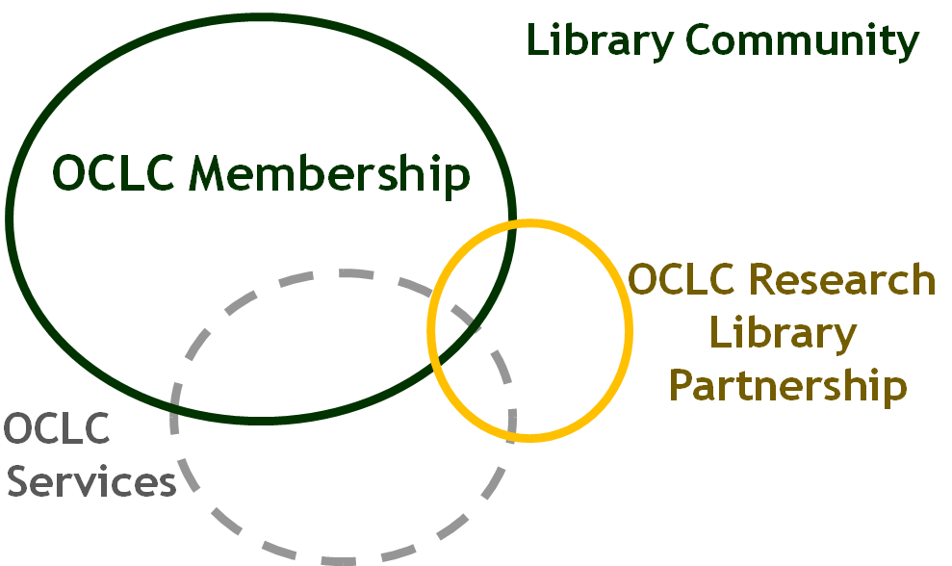
My work
Research Division within OCLC
  Provide internal research and development work to advance OCLC products and services
  Do work for the library community to deepen public understanding of the changing library system
  Work primarily with research libraries around the world in the OCLC Research Library Partnership on projects and process change
OCLC Research
Constituencies

Slide 5

Perspective
What you see depends on where you stand
What you see depends on where you sit

Slide 6

Where I sit
United States
Informed by Western European developments
System-wide view
Not inside of an operational library
Inform and lead library directions and future

Slide 7
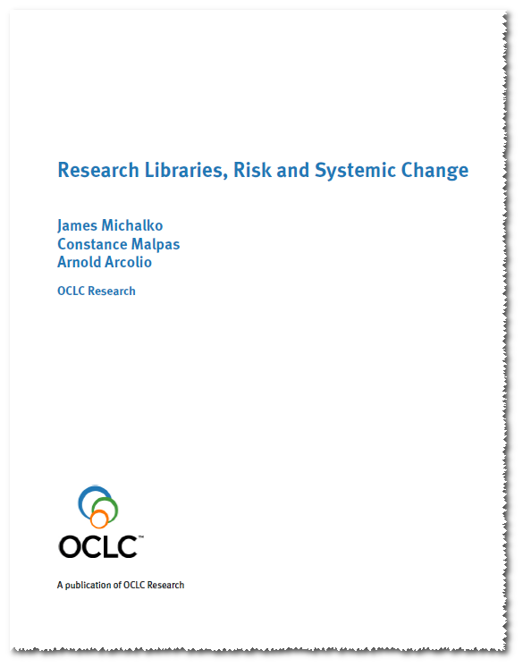
Then (five years ago)

Slide 8
Risk Clusters
Value Proposition
… a reduced sense of library relevance from below, above, and within
Human Resources
… uncertainties about adequate preparation, adaptability, capacity for leadership in face of change
Durable Goods
… changing value of library collections and space; prices go up, value goes down – accounting doesn’t acknowledge the change
Legacy Technology
… managing and maintaining legacy systems is a challenge; replacement parts are hard to find
Intellectual Property
… losing some traditional assets to commercial providers (e.g. Google Books) and failing to assume clear ownership stake in others (e.g. local scholarly outputs)

Slide 9
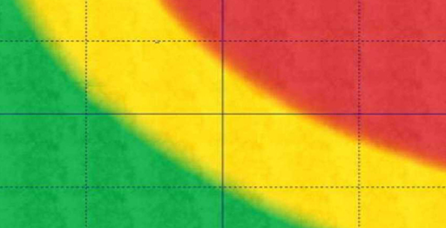
Inherent Risks: High Impact & Likelihood
1. Availability of online information resources (Google, etc.) weakens visibility and value of library.
2. User base erodes because library value proposition is diminished and marginalized.
11
19
20
14
10
1
12
21
2
9
Impact
11. Human resources are not allocated appropriately to manage change in the current environment.
12. Current human resources lack skill set for future needs (changing technology, etc.).
14. Conservative nature of library inhibits timely adaptation to changed circumstances.
9. Recruitment and retention of resources is difficult due to reduction in pool of qualified candidates.
Value Proposition
Human Resources
Durable Goods
Legacy Technology
10. Difficulty identifying candidates for evolving library management roles.
Likelihood
19. Library cannot adjust fast enough to keep up with rapidly changing technology and user needs.
20. Increased inefficiencies and expenses due to lack of functionality of legacy systems and IT support.
21. Due diligence and sustainability assessment of local or third party services is not completed, tracked or analyzed.

Slide 10
Residual Risks (High)
Availability of online information resources (Google, etc.) weakens visibility and value of library.
14. Conservative nature of library inhibits timely adaptation to changed circumstances.
14
Effective network disclosure
1
2
9
2. User base erodes because library value proposition is diminished and marginalized.
Impact
Move new services ‘into the flow’
14. Conservative nature of library inhibits timely adaptation to changed circumstances.
9. Recruitment and retention of resources is difficult due to reduction in pool of qualified candidates.
Value Proposition
Articulate compelling new vision to
atrract a new generation of library
professionals
Human Resources
Durable Goods
Legacy Technology
These risks will remain high. Can they be managed?

Slide 11
Residual Risks (High)
Availability of online information resources (Google, etc.) weakens visibility and value of library.
14. Conservative nature of library inhibits timely adaptation to changed circumstances.
14
Effective network disclosure
2. User base erodes because library value proposition is diminished and marginalized.
1
2
9
Impact
Move new services ‘into the flow’
Value Proposition
Articulate compelling new vision to
atrract a new generation of library
professionals
14. Conservative nature of library inhibits timely adaptation to changed circumstances.
9. Recruitment and retention of resources is difficult due to reduction in pool of qualified candidates.
Human Resources
Durable Goods
Legacy Technology
These risks will remain high. Can they be managed?

Slide 12
The Library is a Disrupted organization
Inside
an institution – the University –
that is being Reconfigured
Corollary:
The library has no destiny independent
of the organization (community) it serves

Slide 13
The way teaching happens,
learning occurs,
scholarship is practiced,
research produced and
new knowledge created
DETERMINES
whether a university needs a library
and what kind with what services

Slide 14
The Library is a Disrupted organization
Inside
an institution – the University –
that is being Reconfigured
The Reconfigured university
Conception of Higher Education
Mode of Pedagogy
Practice of Research

Slide 15
The Reconfigured university
Conception of Higher Education
What’s the crisis in higher ed?
(subset of culture and global crises)
What’s a university?
(Bologna/Paris, Nostalgia/History, Faculty Governance)
What’s an education? What’s it for?
(Newman vs. Utilitarians)
What do we know about teaching and learning?
(Metrics and assessment)

Slide 16
The Reconfigured university
Conception of Higher Education
Same questions with
the inclusion of women and minorities;
the advent of technical colleges, community colleges,
land-grant universities; and
the implementation of the G.I. Bill.
The running battle of abstract thinking and applied knowledge
Q. Is this time different?

Slide 17
A. Likely to be
State-based Public (Research) Universities
Consider the de-funding
of public higher education

Slide 18

A. Likely to be
State-based Public (Research) Universities

Slide 19
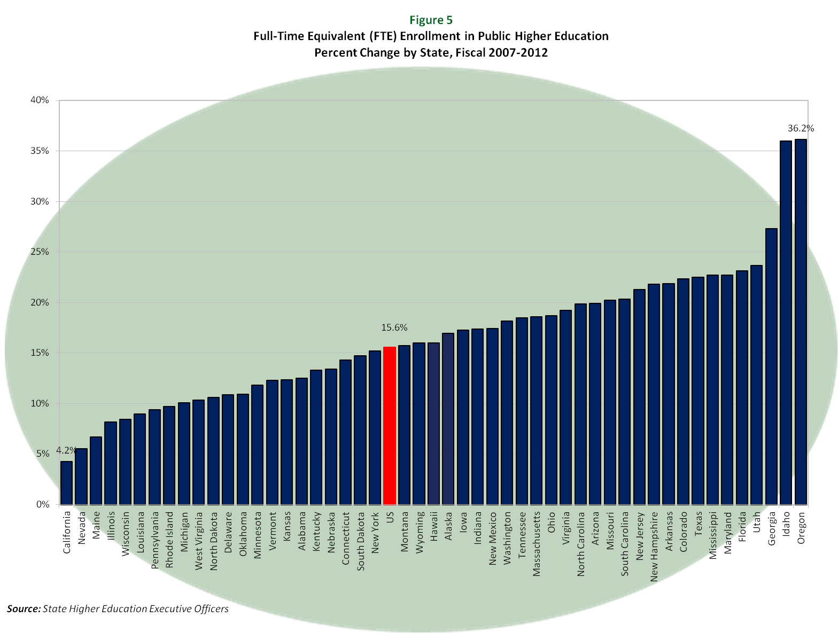
8.5%

Slide 20
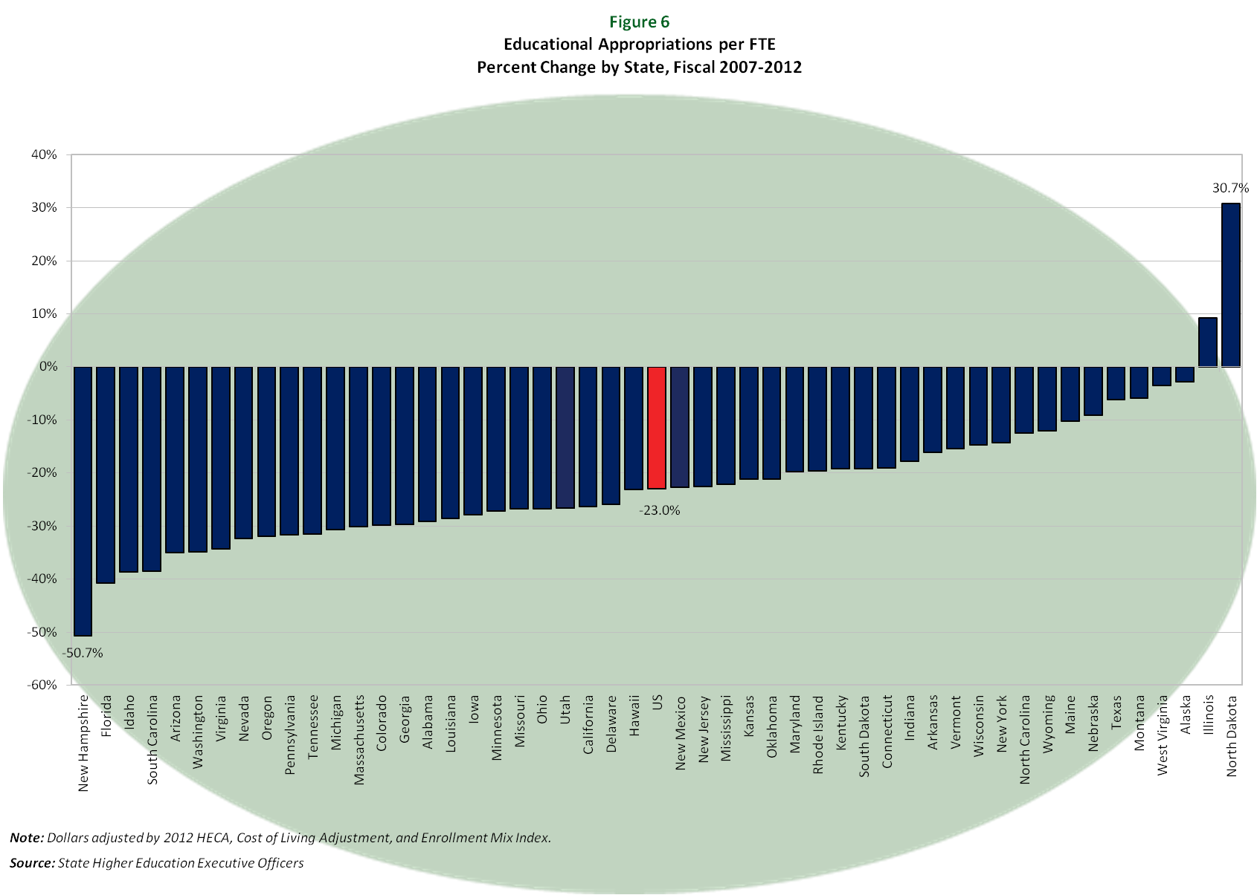
<14.6%>

Slide 21
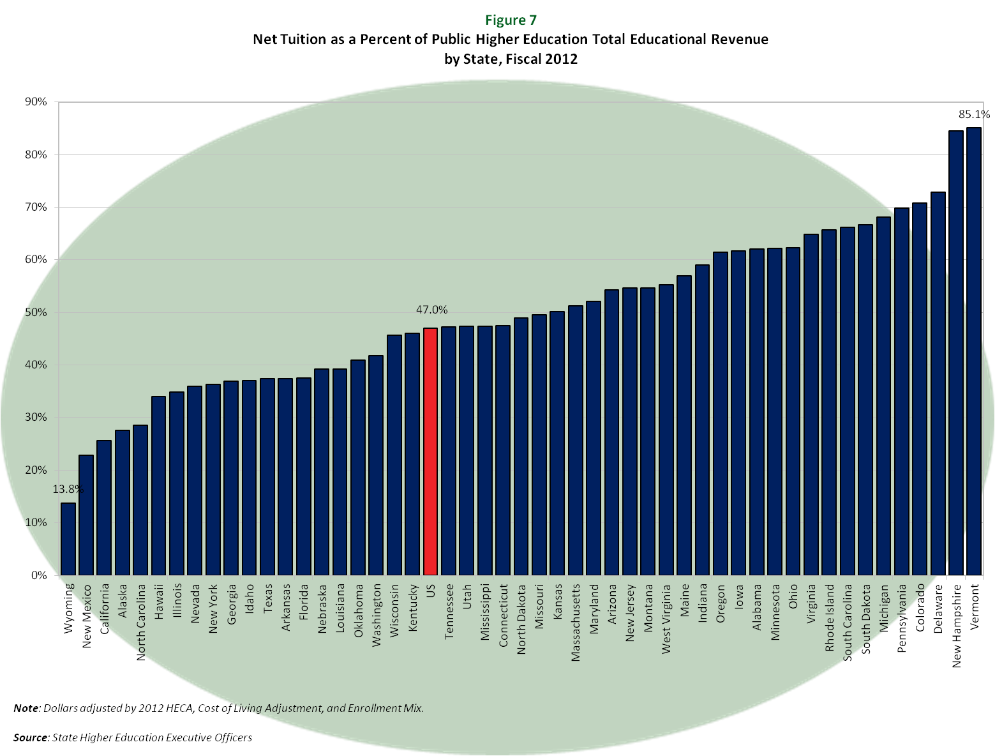
45.6%

Slide 22
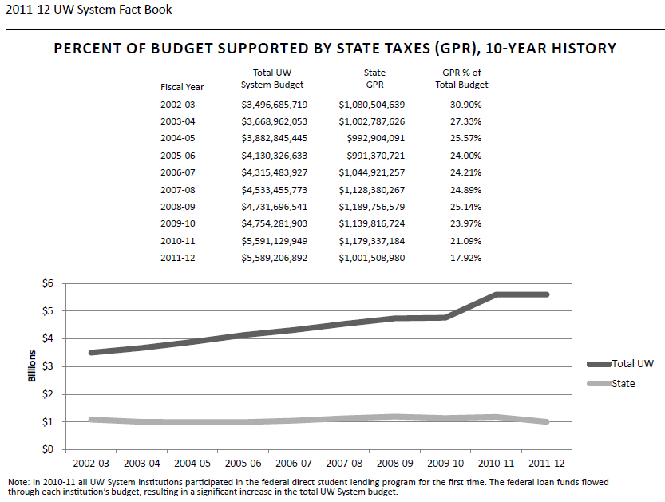
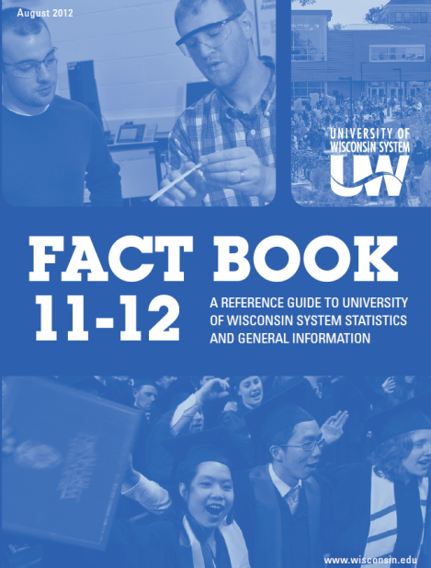

Slide 23
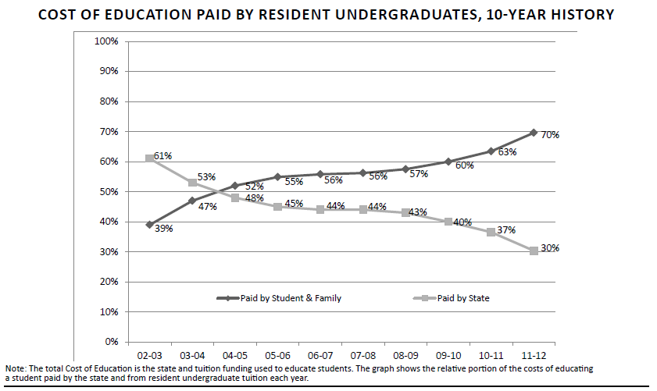


Slide 24
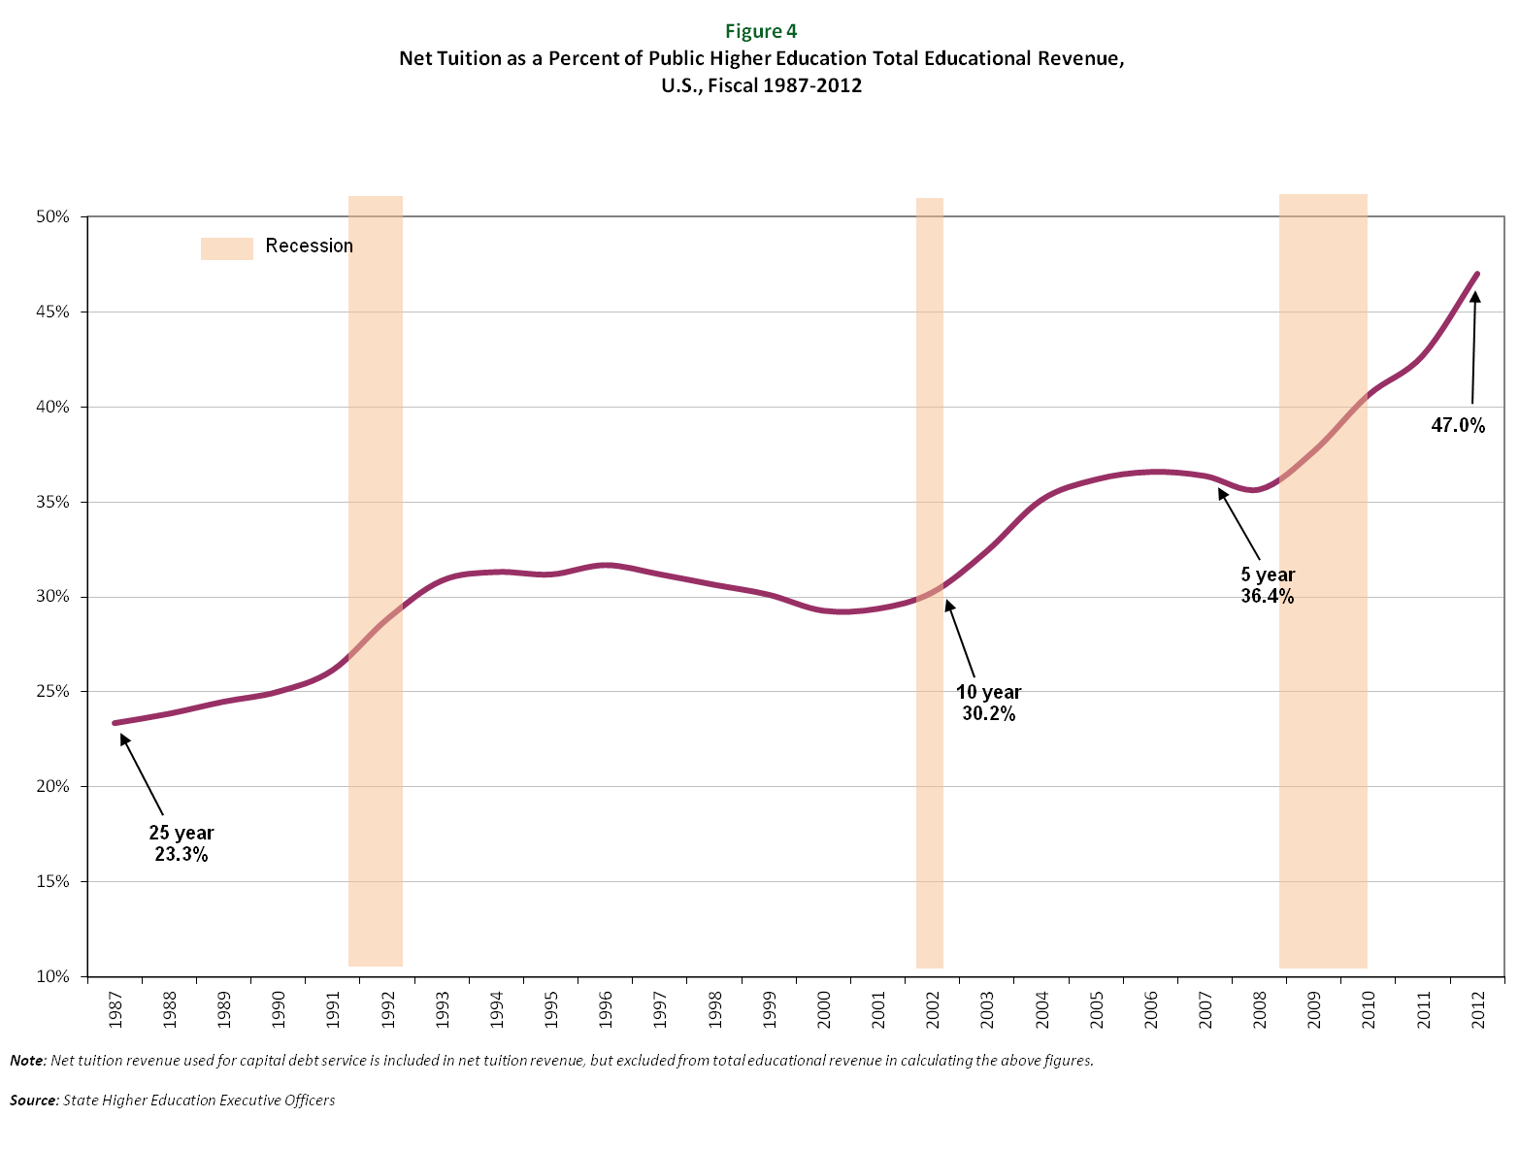

Slide 25
Colleges have three basic business models for attracting and keeping students. Two will continue to work in the next decade, and one almost certainly will not. Chronicle of Higher Education

Slide 26

Research/elite (Strong brand, connected to international network of science and scholarship; educate many of the political and business elite; flagship),
Struggling middle (broad education. Not kept up with distance and convenience agendas, high overhead, limited research funding).
Convenience (community colleges and for-profit providers, focused on preparation for further education or for a career)

Slide 27
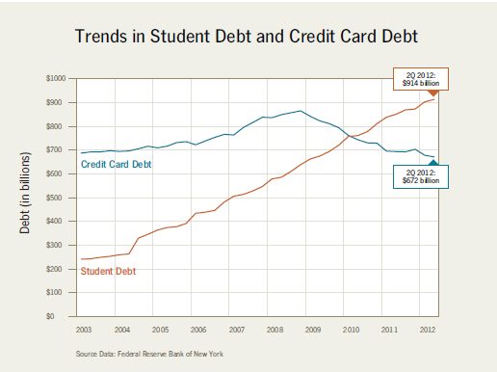
Student Debt
via The ‘Cost Disease’in Higher Education: Is Technology the Answer?
William G. Bowen The Tanner Lectures Stanford University October 2012

Slide 28
The Reconfigured university
Conception of Higher Education
De-funded
Shifting to private benefit
Too expensive
Made us worry about regulation when
the teaching and learning revolution really presents
the university with the specter of irrelevance

Slide 29
The Reconfigured university
Conception of Higher Education
Mode of Pedagogy
New models threaten both ends of the spectrum
Notes:
Charter universities, Venture philanthropists funding alternatives, non-traditional students to for-profit universities, traditional undergrads opting for community colleges, faculty going to ed tech start-ups

Slide 30
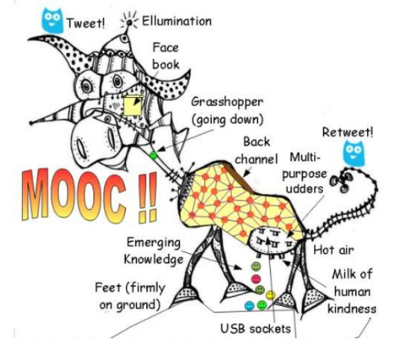
http://www.downes.ca/presentation/304 via Merrilee Proffitt

Slide 31
The Reconfigured university
Conception of Higher Education
Mode of Pedagogy
New models threaten both ends of the spectrum
MOOCs
are the network reconfiguration of teaching
Online Education not new so…

Slide 32
MOOCs have become a flashpoint for discussion
of higher ed because they represent an easily
graspable, almost parodic version of what was
previously invisible: elite university education.
They have a unique power to drive public
perception of the entire sector.
Alyson Byerly. Formerly known as students. Inside Higher Ed. October 29 2012.

Slide 33


Why now?

Slide 34

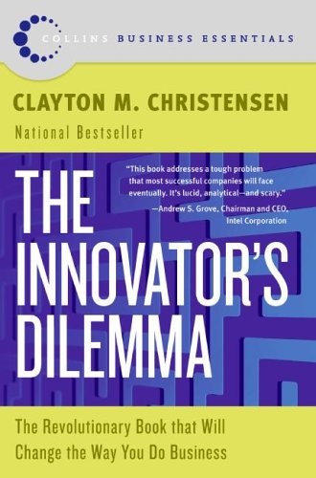
Broken University Business Model
plus
Disruptive Technologies

Slide 35
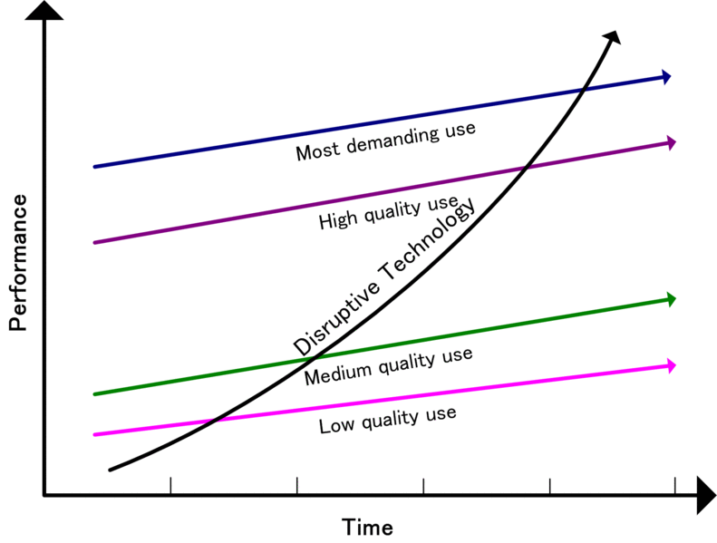
http://en.wikipedia.org/wiki/File:Disruptivetechnology.gif#file

Slide 36
Research/elite (Strong brand, connected to international network of science and scholarship; educate many of the political and business elite; flagship),
Struggling middle (broad education. Not kept up with distance and convenience agendas, high overhead, limited research funding).
Convenience (community colleges and for-profit providers, focused on preparation for further education or for a career)

Slide 37
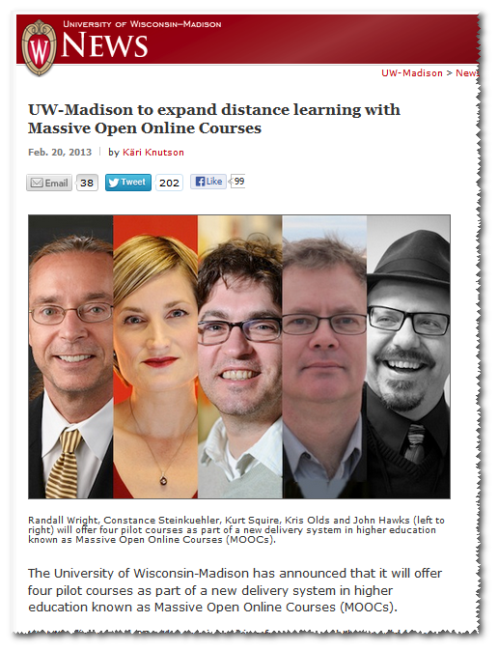
Research/elite

Slide 38
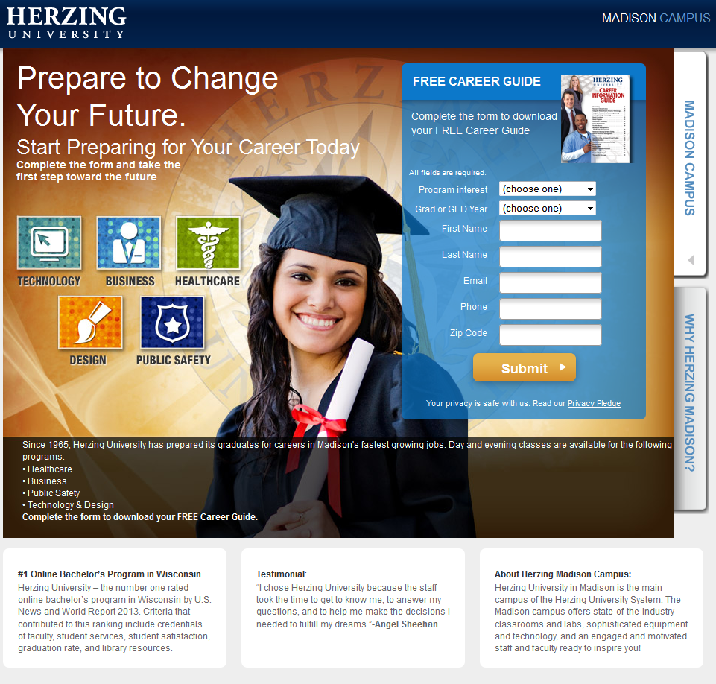
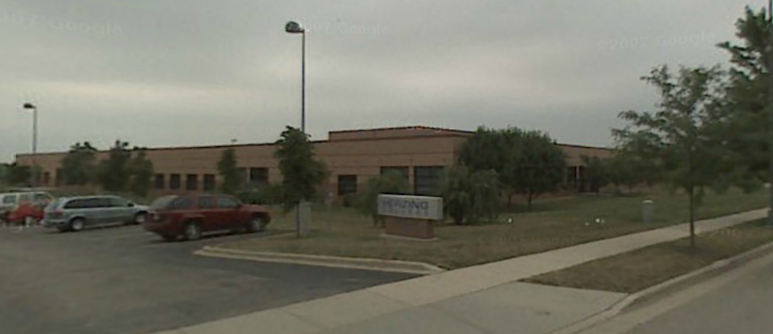
3. Convenience

Slide 39
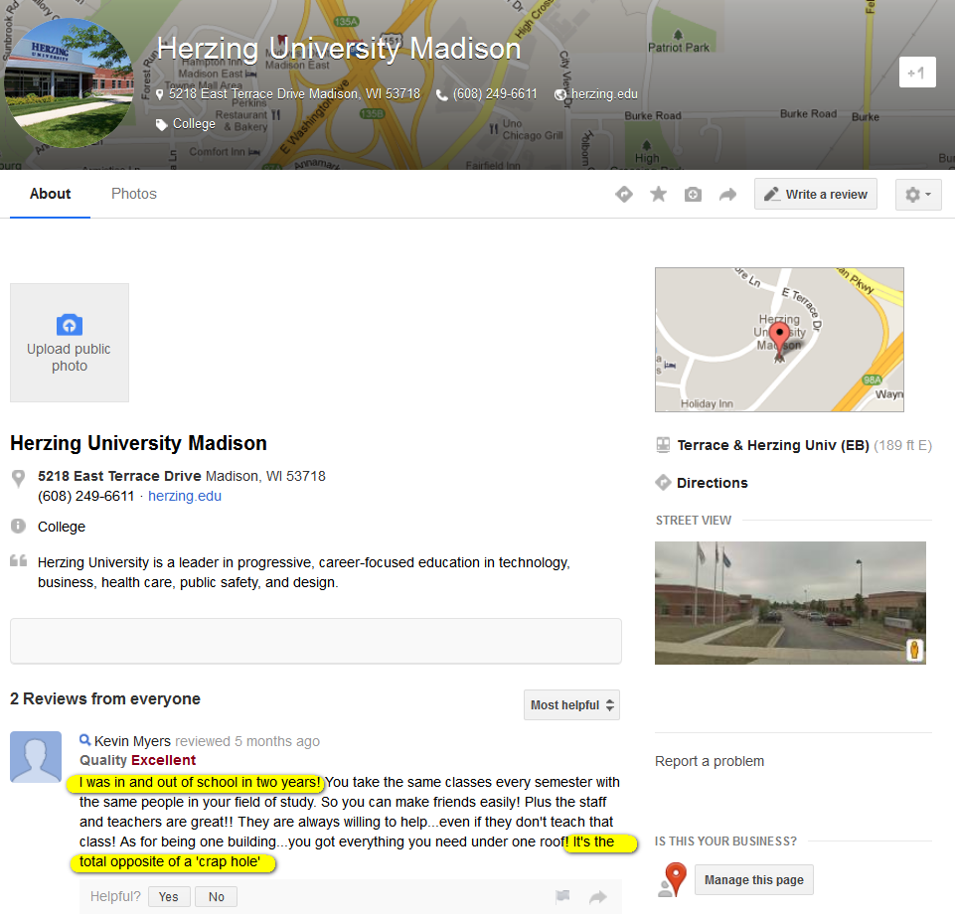

Slide 40
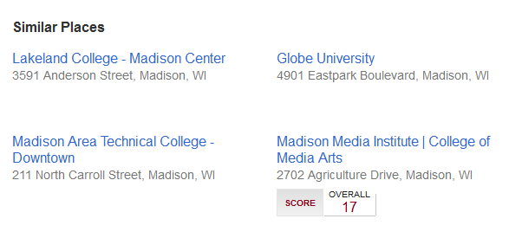

Slide 41
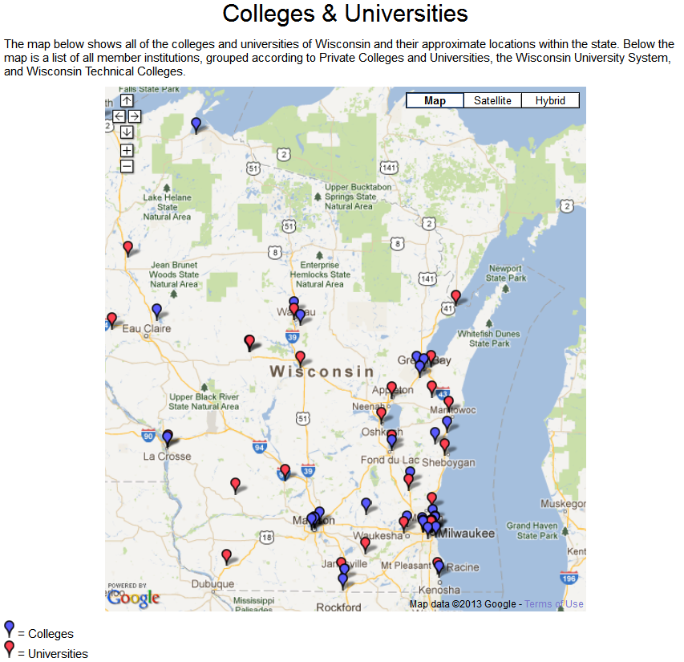
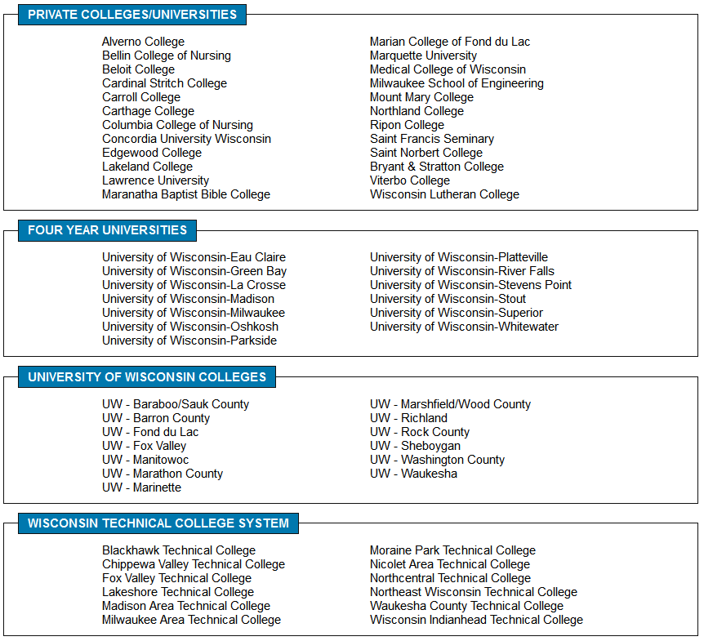
http://www.mywcpa.org/colleges_universities.php

Slide 42
1. Research/elite (Strong brand, connected to international network of science and scholarship; educate many of the political and business elite; flagship),
MOOCs = Quality separated from price, create global brand, celebrate faculty
2. Struggling middle (broad education. Not kept up with distance and convenience agendas, high overhead, limited research funding).
MOOCs = nothing but pressure
3. Convenience (community colleges and for-profit providers, focused on preparation for further education or for a career)
MOOCs = broad access, non-traditional credentials, no frills

Slide 43
The Reconfigured university
Conception of Higher Education
Mode of Pedagogy
Practice of Research
Shaped by Funding
by Type
by Mechanisms
US University-based research is in flux threatening the core of the research university
Reason to exist
Discover
Disseminate
Apply

Slide 44
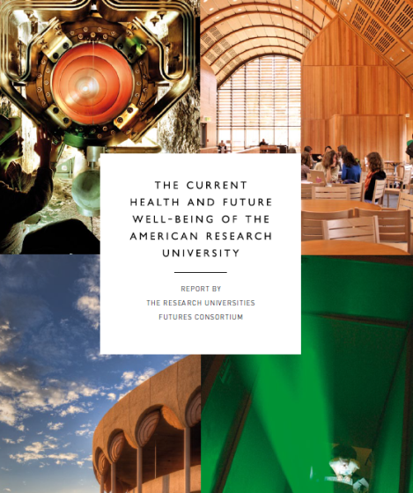
The Reconfigured university
Conception of Higher Education
Mode of Pedagogy
Practice of Research
Hyper-competition and complexity
Compliance and Indirect Cost Recovery
Research Quality and Impact
Planning and Decision Support
Value of the Research University
Fragility of Academic research enterprise

Slide 45
The Reconfigured university
Conception of Higher Education
Mode of Pedagogy
Practice of Research
The Library is a Disrupted organization
Inside

Slide 46
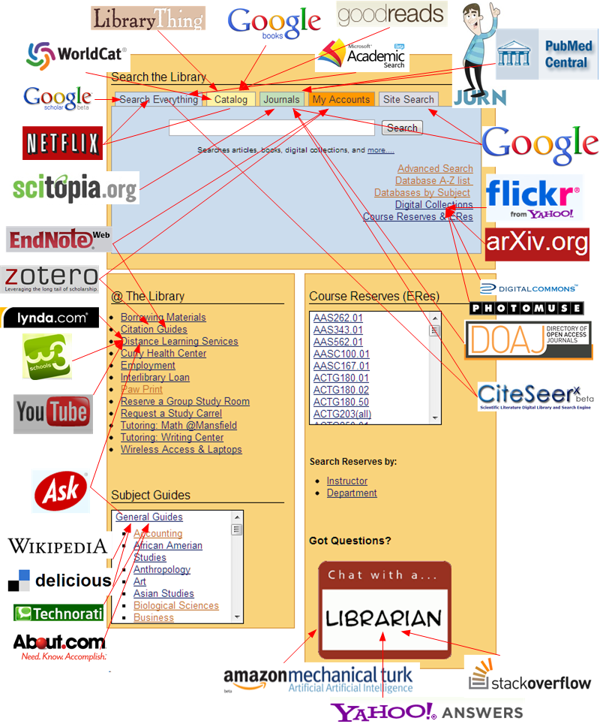
Library
has been
Disruption
Central
Far along
the disruption
timeline
http://librarydigitalprojects.com/2011/04/04/sources-for-disruption-of-library-services/

Slide 47
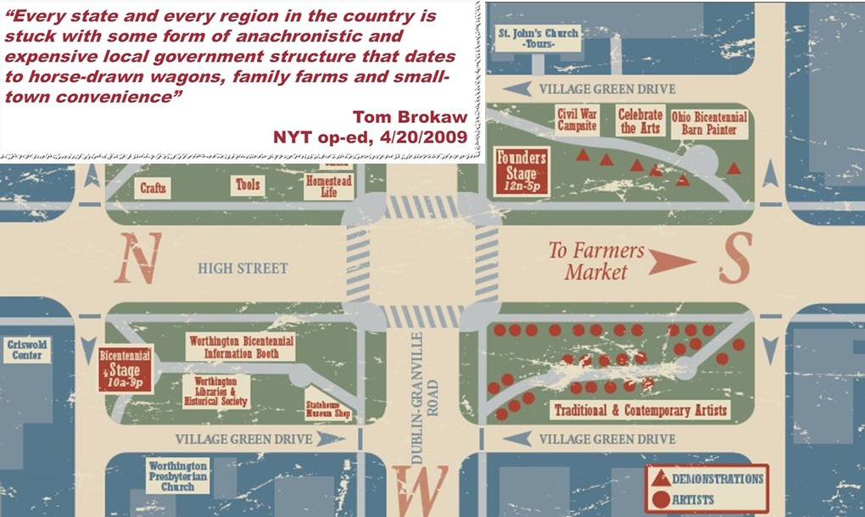
Place of the Library in University
Why do Universities have libraries?
  It was more economical to have a physical collection than to send researchers or students to the information.
  It was useful to locate all the needed information resources for research and learning physically close to the work.
  Local collections were assets and contributed competitively to scholarly output
Consider the town square
in the United States…

Slide 48
The network changes everything
The network has reconfigured whole industries
  Travel, News, Book Retailing
The network is now the first option for researchers and learners
Information environment is increasingly flat
  academic collections increasingly alike
  discovery is increasingly done outside of library
  information fulfillment comes to the desktop from many sources
Impact on the university library
  changed the value of physical book collections and library space
  changed the relevance of the library assets and services to the University’s outputs
    What will it mean to unbundle and reconfigure the library within the University?

Slide 49
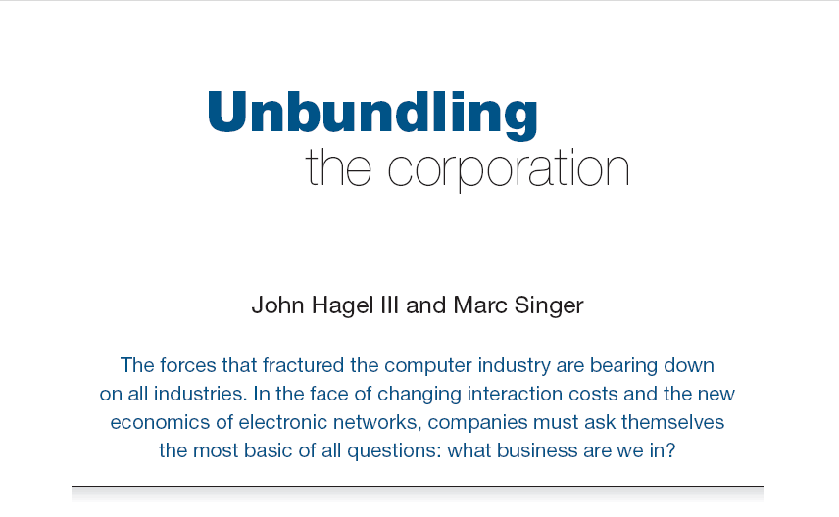
Harvard Business Review (1999)

Slide 50
CORE COMPONENTS
OF A FIRM
Attracting and building relationships with customers
“Service-oriented”, customization
Economies of scope important
Develop new products and
services and bring them to
market
Speed/flexibility important
Customer
Relationship
Management
Product Innovation
Infrastructure
Back office capacities that
support day-to-day operations
“Routinized” workflows
Economies of scale important

Slide 51
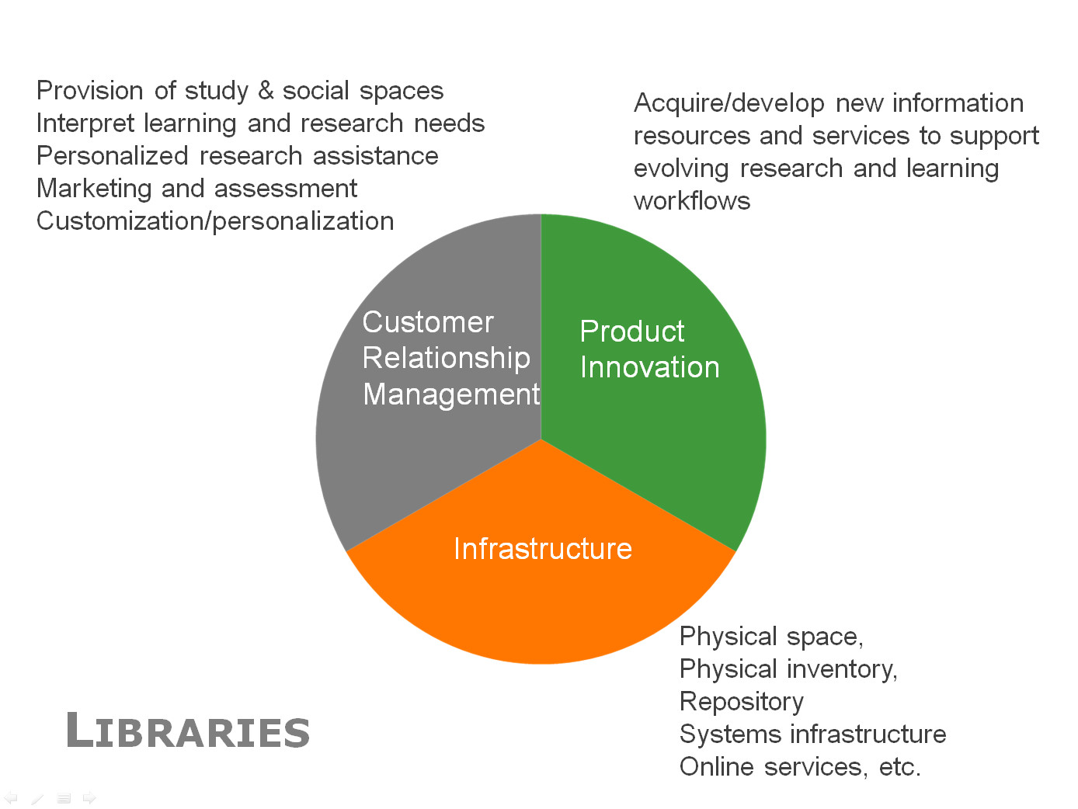

Slide 52
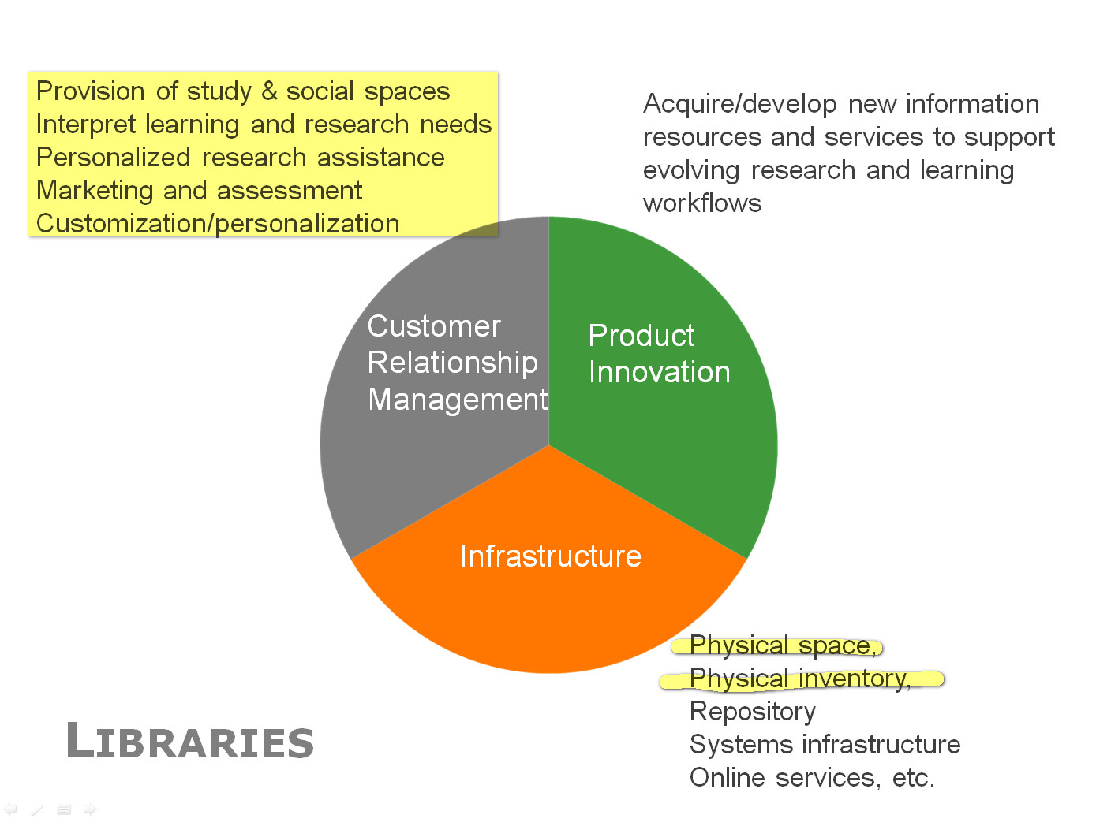

Slide 53
Reconfiguring libraries for the new environment – 3 imperatives
Shift to engagement
Institutional innovation
Rightscale infrastructure

Slide 54
Shift to engagement
Institutional innovation
Rightscale infrastructure
Engagement
Distinctive services
Build around university directions
Quality and Scale
Cost Competition
Academic vs. Career prep
Research Focus
Source: Education Advisory Board report to CIC CIOs August 2012

Slide 55
Making the Service Turn: Identifying, Supporting, and Sustaining Distinctive Services for the 21st-Century Research Library
Scott Walter
DePaul University
Presented at the OCLC Research
“Libraries Rebound” Conference, Philadelphia, PA
June 5, 2012

Slide 56

The Service Turn
“[In] an era when everything we know about how content is created, acquired, accessed, evaluated, disseminated, employed, and preserved for the future is in flux, the research library must be distinguished by the scope and quality of its service programs in the same way it has long been by the breadth and depth of its locally-held collections.”
Source: Walter, S. (2011). "Distinctive signifiers of excellence": Library services and the future of the academic library [Editorial]. College & Research Libraries, 72 (1), 6-8. Retrieved from http://crl.acrl.org/content/72/1/6.full.pdf+html

Slide 57

What Makes a Service “Distinctive”?
Does it represent a new approach to, or a new area of, library service that has served as a “lighthouse,” i.e., an innovation that has been broadly taken up by other libraries?
Does it represent a unique or unusual library service closely tied to a distinctive area of strength in the library’s collections or the campus academic program?
Does it represent a unique or unusual library service closely tied to a distinctive aspect of the campus mission, identity, or history?
University of Michigan Library MPublishing http://www.publishing.umich.edu/
Notes:
University of Southern California Leavey Library Information Commons http://www.usc.edu/libraries/locations/leavey/ic/
University of Illinois at Urbana-Champaign International and Area Studies Library http://www.library.illinois.edu/ias/
Kent State University Libraries High School Outreach Program http://www.library.kent.edu/page/10973
Open Folklore at Indiana (partnership around new scholarly forms)
Creating conversations around collections
Researcher identity
Data curation
Collaborating to create new resources

Slide 58
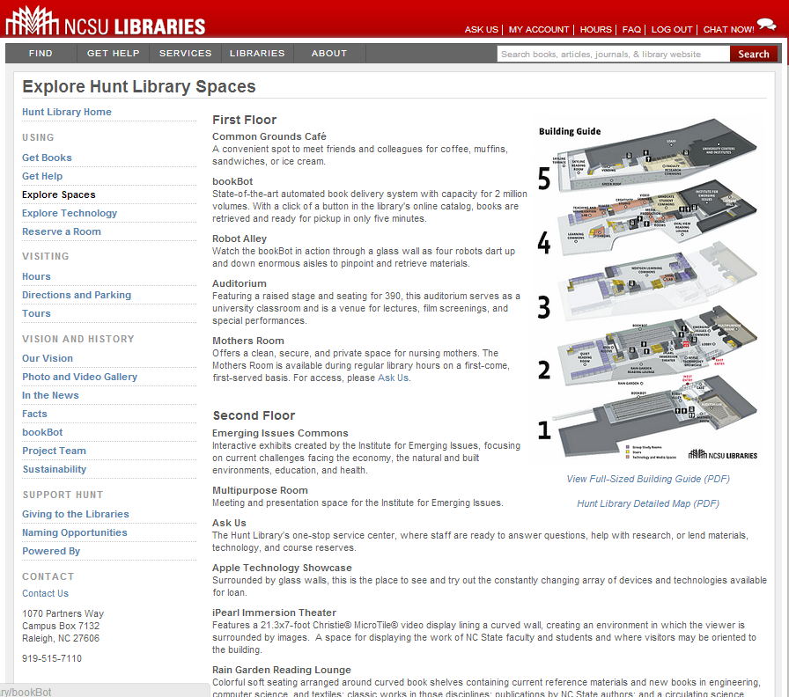
Space reconfigured
around experience,
expertise and
communication
rather than collections

Slide 59
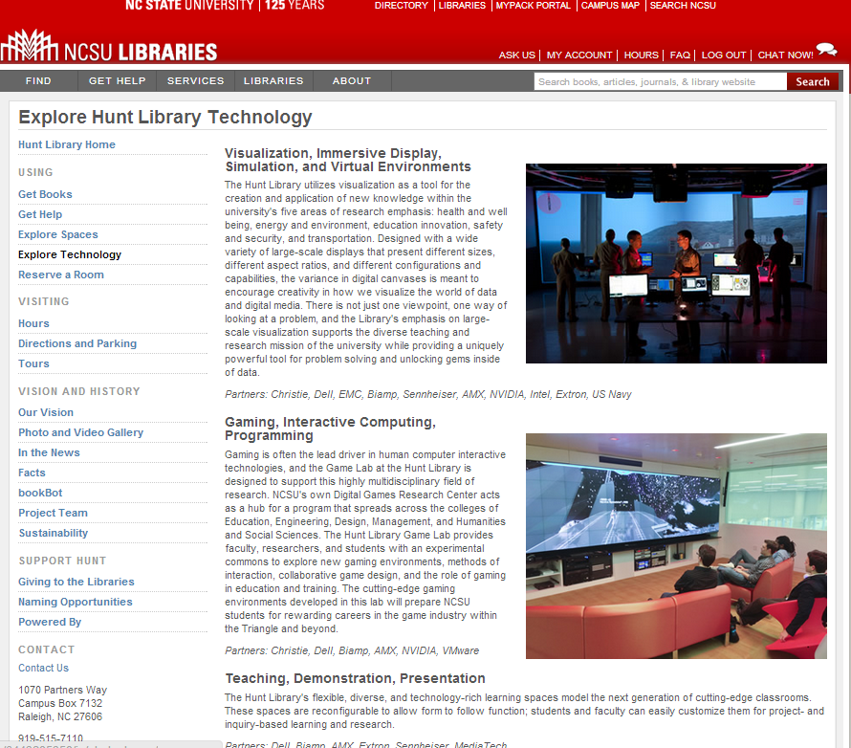

Slide 60
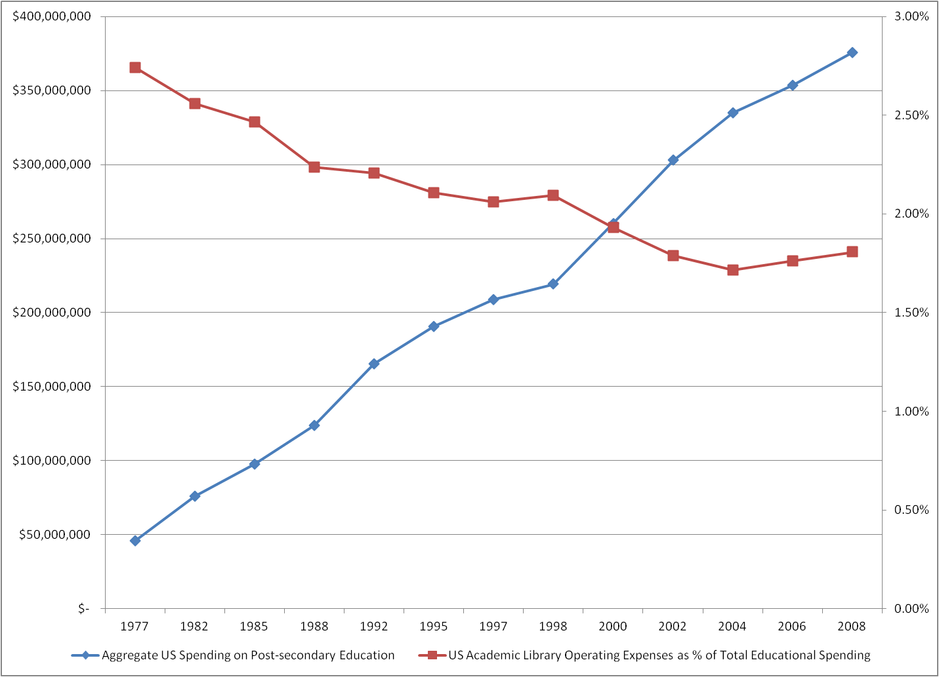
US Academic Library Expenditures as a percent of
Total Post-secondary Education Expenditures
$6.8 Billion in 2008
OCLC Research 2013 Digest of Education Statistics 2010 April 2011 Tables 29 and 430

Slide 61

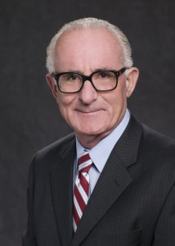
John Lombardi, President at October 2011 ARL meeting
When people ask him for money, he said, his first question is, “What will that project do to make the university more competitive?
“If you can’t persuade me that the work you’re doing is going to make us more famous, we’re not going to be interested in investing in you,” he said.
“Is that wise and profound and good? No. It’s stupid. But that’s the way it is.”
Notes:
Hunter R. Rawlings III
President, Association of American Universities
Presentation to Chancellor Holden Thorp and the Board of Trustees
University of North Carolina at Chapel Hill
September 27, 2012
As prepared for delivery
I was named president of AAU in March, 2011, 18 months ago. AAU has 35 public university members. Since I became president, 13 presidents and chancellors at those 35 schools have left their positions, most prematurely, some fired, some who resigned under pressure Lombardi is one of those who had to leave…
John Lombardi, the president of the Louisiana State University System, a system that has ten campuses in the state with the largest having nearly 29,000 students told the library adminstrators:
His concluding comment: “The football team is allowed to run a deficit of $3- to $7-million. And you’re not.”

Slide 62
Shift to engagement
Institutional innovation
Rightscale infrastructure
Innovation
... a more fundamental level of innovation, institutional innovation – redefining the rationale for institutions and developing new relationship architectures within and across institutions to break existing performance trade-offs and expand the realm of what is possible …
John Hagel III and John Seely Brown

Slide 63



A new architecture of relationships: rightscaling

Slide 64
A new architecture of relationships: engagement
University Press
Office of Research
IT
Learning and teaching support
E-research
Writing centre
Academic departments
….

Slide 65
Stakeholders Influencing Campus Libraries Strategic Framework
Project Charter Campus Libraries Strategic Framework
Updated 5/1/13 - Version 9.1

Slide 66
Shift to engagement
Institutional innovation
Rightscale infrastructure
Infrastructure
Physical space
Physical collections
Systems
Repositories
Online Services
Etc.
Print management example

Slide 67
Institution:
opportunity costs challenge
Growing misalignment between investment in print collections and practices of research and learning
Reconfigure space around engagement rather than around collections
Stewardship and efficient access still (variably) important

Slide 68
Systemwide:
balance contributions
Manage down institutional collections
Collectively managed – regional, national based on existing/emerging infrastructure
Include different obligations:
  Mid-level HEIs look for third party or collaborative solutions
  Research HEIs manage stewardship responsibility within broader framework of digital and cooperative

Slide 69

OPPORTUNITY

Slide 70
22% held by <10 libraries
20% held by 10-24 libraries
31% held by 25-99 libraries
27% held by >99 libraries
OCLC Research, 2013
Notes:
22% 20% 31% 27% 100%

Slide 71
37%
40%
30%
OCLC Research, 2013

Slide 72

OCLC Research, 2013

Slide 73
OCLC Research, 2013

Slide 74
14% held by <10 libraries
19% held by 10-24 libraries
33% held by 25-99 libraries
34% held by >99 libraries
OCLC Research, 2013

Slide 75

OCLC Research, 2013

Slide 76


A Master Plan for a Mega-region
“[Midwestern universities ] work together on both regional and national agendas, merging library and research resources, and sharing curricula and instructional resources with faculty and students. Aggregating these spires of excellence these institutions gives the Midwest region many of the world’s leading programs in a broad range of key knowledge areas.” (p. 37)

Slide 77
Shift to engagement
Institutional innovation
Rightscale infrastructure
Shift resource to engagement:
evolving information services which improve the student experience and enhance research.
Internal/external institutional innovation:
build new relationships within enterprise that support research, promote learning, and externally to create efficiencies.
Rightscale infrastructure services:
find appropriate level in the network.

Slide 78
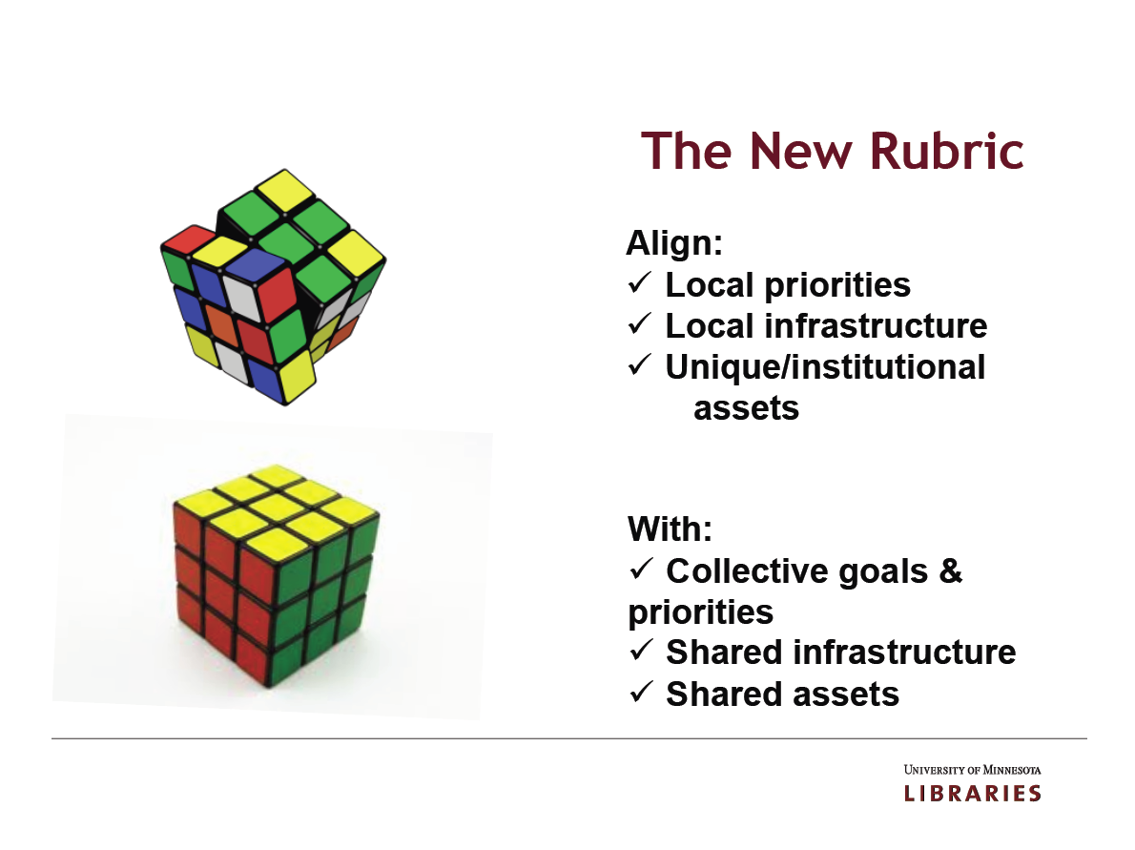
The new rules
http://www.arl.org/resources/pubs/mmproceedings/160mm-proceedings.shtml#colls
Wendy Lougee at the 4 May 2012 ARL Membership Meeting Chicago, IL

Slide 79
20th Century
21st Century
Library Organization
defined by
Local Collections
Local Stewardship
Local Discovery
Shared Collections
Cooperative Governance
Network Disclosure
supported by
Infrastructure
Warehouse of books
Preservation of what is ‘mine’
Local ILS
Collaboration spaces
Joint stewardship of what is ‘ours’
‘Cloud-based’ management svcs
assessed with
Metrics
Collection size
Gate count
Satisfaction
Support for research processes
Management of institutional IP
Impact
Constance Malpas, OCLC Research

Slide 80

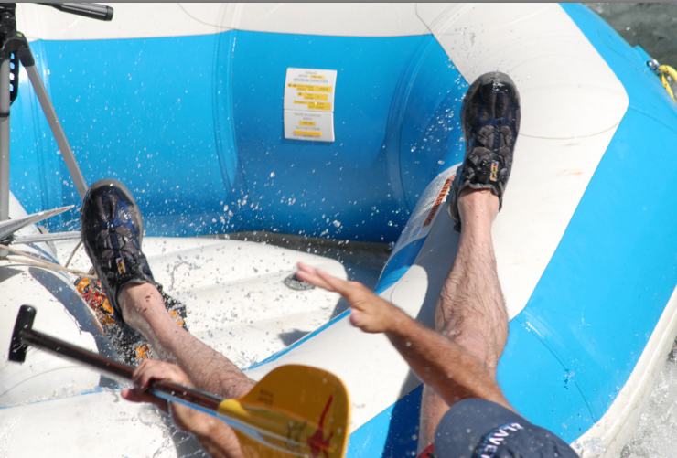


What you see depends on where you sit
And now for a
Notes:
A

Slide 81
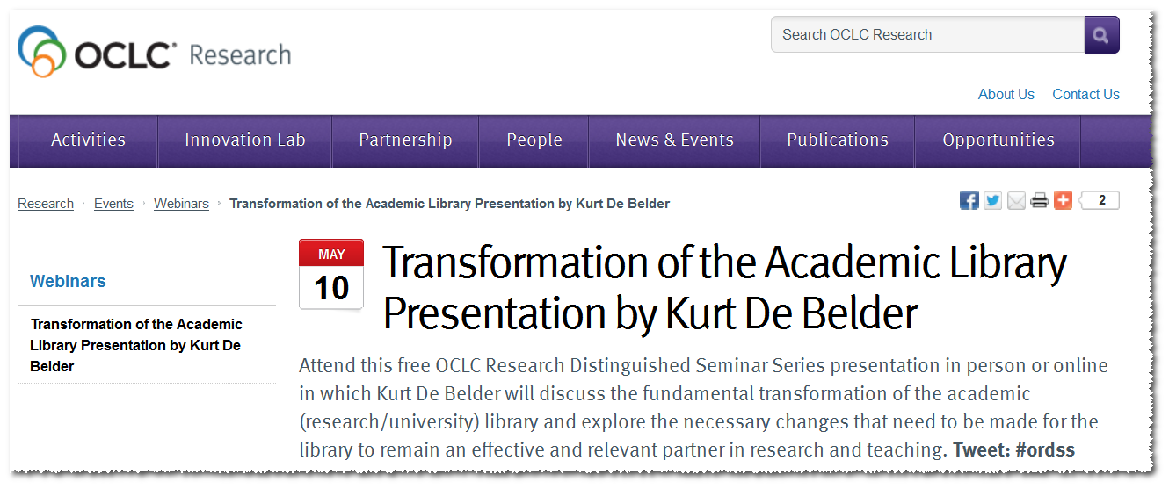
Organized around traditional activities
and emerging new services
Provides 3 and 5 year estimates of shifts and changes

Slide 82
Thank you.
!
?

Slide 83
Nostalgia sniff
Evidence request
Toddler Test

Slide 84
SOME SOURCES
Research Libraries, Risk and Systemic Change
State Higher Education Executive Officers Finance Report 2012
The Cost Disease in Higher Education
The current health and future well-being of the American Research University
Unbundling the Corporation
ARL Membership Meeting 2012 (Spring): Wendy Lougee, Content & Collections: Rubrics and Rubiks
My colleagues, Lorcan Dempsey, Constance Malpas,
and Tam Dalrymple in the OCLC Library

Slide 85
Thank you again.
michalkj@oclc.org

