Slide 1
New Haven, CT, 4-5June 2013 #pastfor
Past Forward!
Meeting Stakeholder Needs in 21st Century Special Collections
Welcome
Jim Michalko OCLC Research
An OCLC Research Library Partnership event co-sponsored by Yale University’s Beinecke Rare Book and Manuscript Library
This work is licensed under a Creative Commons Attribution 3.0 Unported License. http://creativecommons.org/licenses/by/3.0/

Slide 4
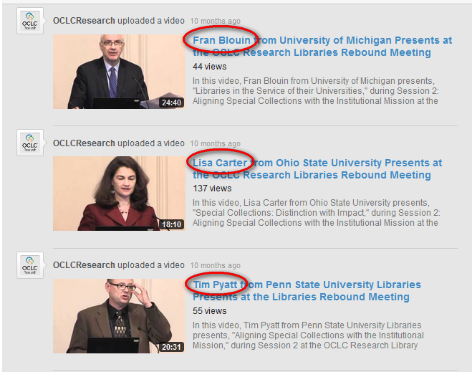

Slide 5
Aligning Special COLLECTIONS with the Institutional Mission
Tim Pyatt, Huck Chair
Eberly Family Special Collections Library
June 5, 2012
OCLC Research Library Partners
Libraries Rebound

Slide 6
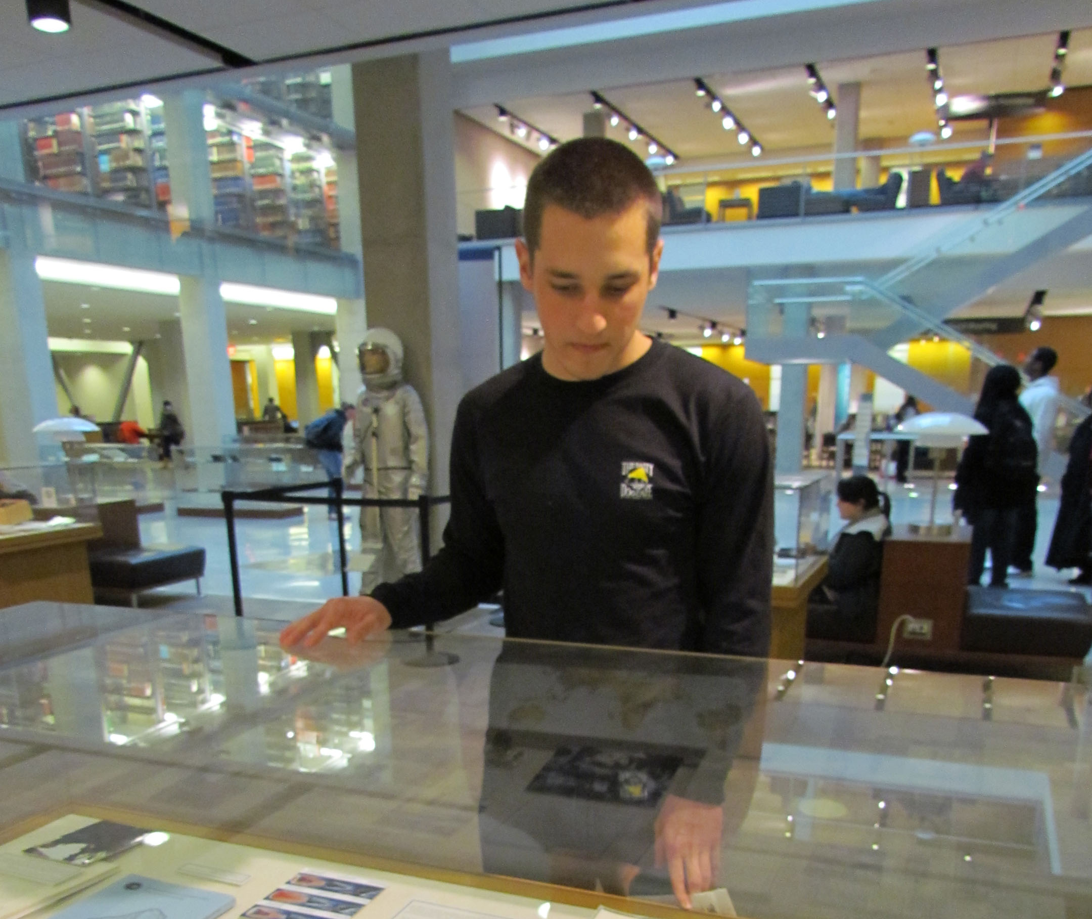
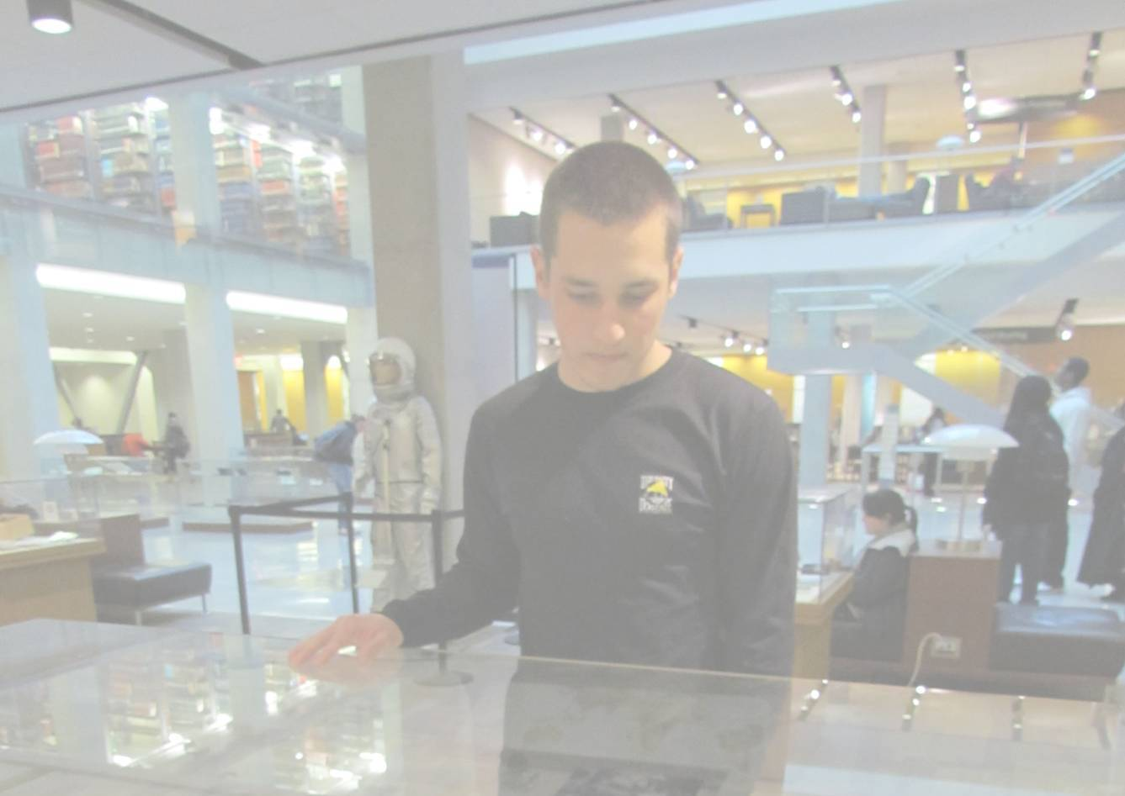
Special Collections:
Distinction with Impact
Lisa R. Carter
OCLC Research Library Partners
Libraries Rebound
June 5, 2012

Slide 7
Libraries in the Service of their Universities
Francis X. Blouin Jr.
Bentley Library, University of Michgian
June 5, 2012

Slide 8
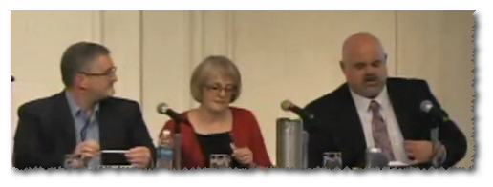

Slide 10
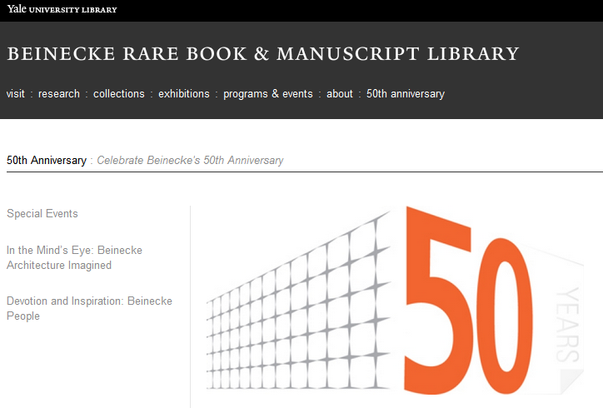
ENTHUSIASM AND AN INVITATION

Slide 11
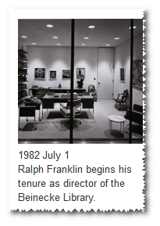
ENTHUSIASM AND AN INVITATION
A PERSONAL CONNECTION

Slide 12
Not just enthusiasm
Not just opportunity

Slide 13
Top of Mind (25) High Concern Medium Low
Special & Archival Collections
Data Management
Shared Print Management
Staff realignment, development
Research Support
Space Usage
Partnerships & Collaboration
Community Engagement
Digital Humanities
Distinctive Services
Born Digital
Collection Analysis
Shared Services
Social Media
Technology Infrastructure
Area Studies
Collaborative Collection Development
Curriculum Integration
Digital Aggregations
Digital Selection
Discovery Layer
E-resources
Embedded Librarians
Metadata Management
User Studies
Notes:
Here’s the 25 things that were top of mind. There were six that I would categorize as High Concern based on how often they were mentioned.
(click)
Special & Archival Collections
Data Management
Shared Print Management
Staff realignment, development
Research Support
Space Usage
If you look at these based on the number of mentions you see that the high concern areas stand out from the others.

Slide 14
Top of Mind (25) High Concern Medium Low
Special & Archival Collections
Data Management
Shared Print Management
Staff realignment, development
Research Support
Space Usage
Partnerships & Collaboration
Community Engagement
Digital Humanities
Distinctive Services
Born Digital
Collection Analysis
Shared Services
Social Media
Technology Infrastructure
Area Studies
Collaborative Collection Development
Curriculum Integration
Digital Aggregations
Digital Selection
Discovery Layer
E-resources
Embedded Librarians
Metadata Management
User Studies
Notes:
Here’s the 25 things that were top of mind. There were six that I would categorize as High Concern based on how often they were mentioned.
(click)
Special & Archival Collections
Data Management
Shared Print Management
Staff realignment, development
Research Support
Space Usage
If you look at these based on the number of mentions you see that the high concern areas stand out from the others.

Slide 15
Notes:
This shows that there are a small set of issues that are really getting the big majority of concern and attention. They change a bit in terms of their rank order but they are very tightly clustered and far ahead of other concerns like metadata management and user studies down at the end.
Now I want to look briefly at each of those top six concerns. Explain briefly why I think these are such important issues. Then I will conclude by suggesting the way these priorities and concerns point to a new conception of the research library in the twenty-first century.

Slide 16
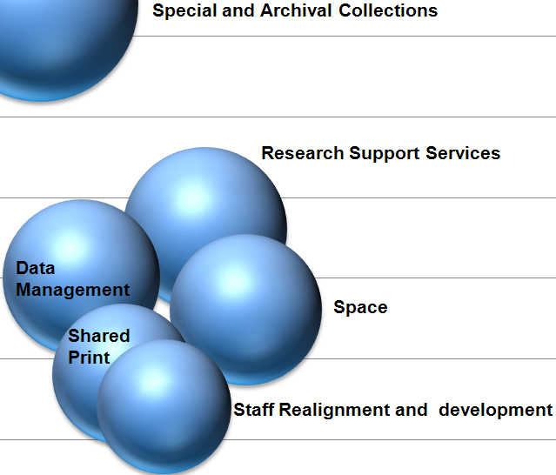
Priorities
1. Special Collections and Archives
Connected to support for new forms of scholarship in the humanities
Concerns
New formats
Discoverability
Not properly described or not indexed in search engines
Digitization
Scale is a challenge
No standard infrastructure
Usability locally
Support for a global audience
Notes:
The number one area for attention is special collections and archives. This seems logical. If the broad information environment has become flat these types of materials represent spikes of local institutional distinction. They are a means for the library to connect with new forms of scholarship in the humanities. (It could also be that folks knew they were talking with someone who cared about special collections.)
The concerns around special collections are that they are not discoverable by those who could make best use of them. They are either not properly described or indexed in search engines.
Librarians are worried about the digitization of these materials. It is a big challenge for an individual institution to do digitization at the scale necessary to make a critical corpus available. There is no standard technical infrastructure for managing the materials once they have been digitized.
Finally there is a tension between investing in making an institution’s special collections useful to the local teaching and research activities versus providing support for their use to a global audience.

Slide 17
Priorities
1. Special Collections and Archives
Connected to support for new forms of scholarship in the humanities
Concerns
New formats
Discoverability
Not properly described or not indexed in search engines
Digitization
Scale is a challenge
No standard infrastructure
Usability locally
Support for a global audience
Notes:
The number one area for attention is special collections and archives. This seems logical. If the broad information environment has become flat these types of materials represent spikes of local institutional distinction. They are a means for the library to connect with new forms of scholarship in the humanities. (It could also be that folks knew they were talking with someone who cared about special collections.)
The concerns around special collections are that they are not discoverable by those who could make best use of them. They are either not properly described or indexed in search engines.
Librarians are worried about the digitization of these materials. It is a big challenge for an individual institution to do digitization at the scale necessary to make a critical corpus available. There is no standard technical infrastructure for managing the materials once they have been digitized.
Finally there is a tension between investing in making an institution’s special collections useful to the local teaching and research activities versus providing support for their use to a global audience.

Slide 18
!

Slide 19
Agenda
Collections
Emphasis on born digital
(re)Position
Look at where special collections fit
Stakeholders
Faculty, students, communities

Slide 20
Thanks to…
Program committee: Matthew Beacom, Bill Landis, Ellen Hammond, Kristie Dixon, Jennifer Meehan
Yale Library staff everywhere

