Slide 1
Latest Trends in US Libraries and OCLC in the Digital Environment
James Michalko
Vice President, OCLC Research
National Diet Library, Kansai-kan
8 October 2010
with thanks to Lorcan Dempsey, Brian Lavoie, David Lewis, Constance Malpas
and Karen Smith-Yoshimura for their contributions

Slide 2
Problem Statement
As academic libraries change the way they manage print collections
  Sending books to storage
  Discarding duplicated physical books and journals
  Licensing e-journals and e-books
Responsibility for the scholarly record and cultural heritage will be changed and redistributed among national and academic libraries

Slide 3
Overview
The changing place of the US Library within University
Collection trends (within US research libraries)
Mass Digitization and the switch to e-books
Implications – for libraries, national libraries and OCLC

Slide 4
Disclaimer
Simplistic
This presentation
Content
Time is short, language is a barrier
All examples are U.S.A perspective

Slide 5
a Diversion
Some analysis of Japan and OCLC WorldCat

Slide 6
OCLC and NDL collaboration
NDL has agreed to:
Load its JapanMARC records into WorldCat
  This is just beginning
Contribute its authority files to the Virtual International Authority (VIAF) file
  This links authority files from national libraries and other agencies and makes them available on the web.
  NDL data is not yet loaded
These statistics will change when the NDL contributions have been integrated.

Slide 7
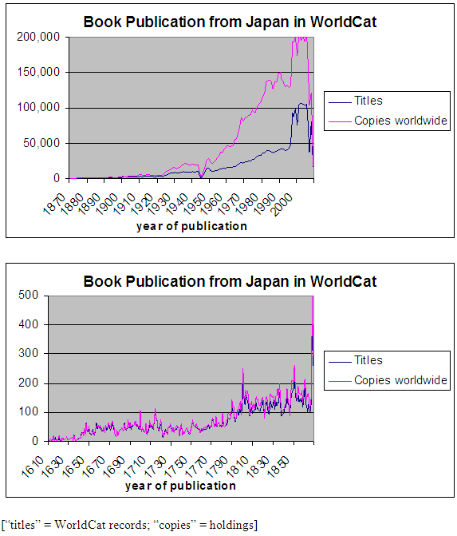
Japanese Book Publication

Slide 8


Japan in WorldCat
Materials published in Japan:
As of July 2008: 2,660,638
As of July 2010: 3,185,301 (+20 percent)
Japanese “Collective Collection” in WorldCat
Japanese-language materials:
As of July 2008: 2,539,948
As of July 2010: 2,985,134 (+18 percent)
4.1 million
4.3 million
1.3 million
1.4 million
Total Japanese holdings:
6,322,711
Original WorldCat records contributed by Japanese institutions:
1,099,346
Total holdings in WorldCat attached to Japanese-contributed records:
2,160,027
Statistics current as of July 2010
Notes:
8

Slide 9
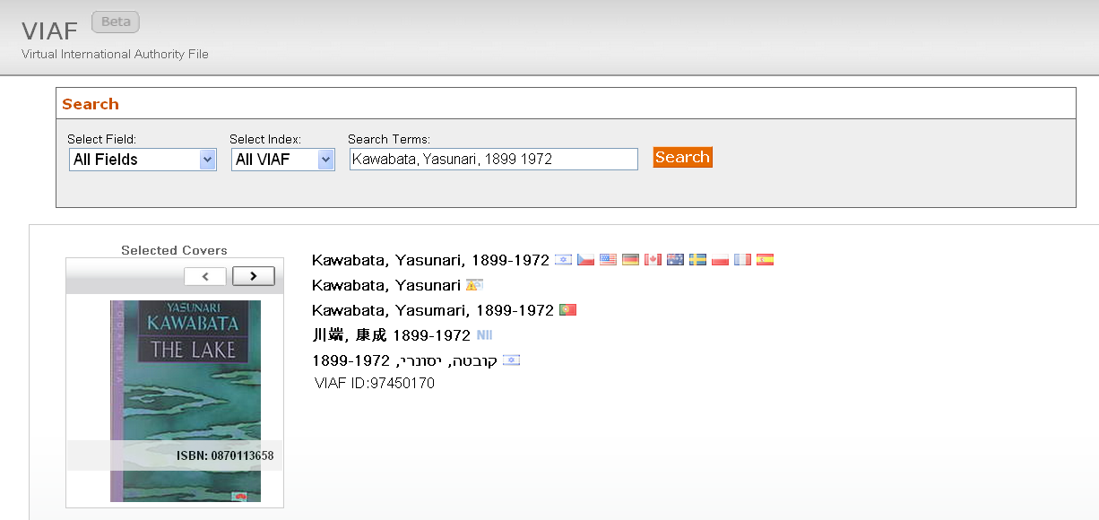
Notes:
9

Slide 10
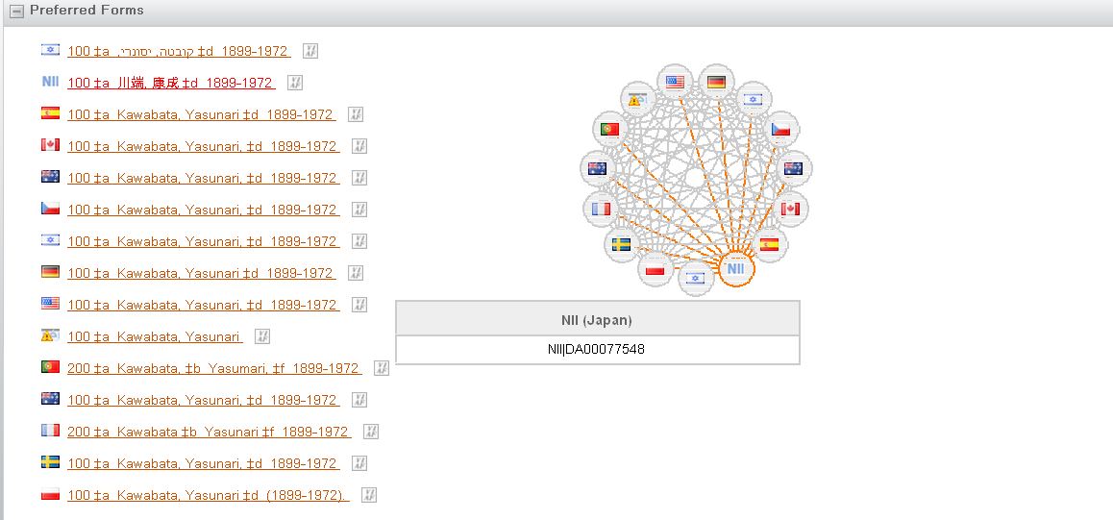
Notes:
10

Slide 11
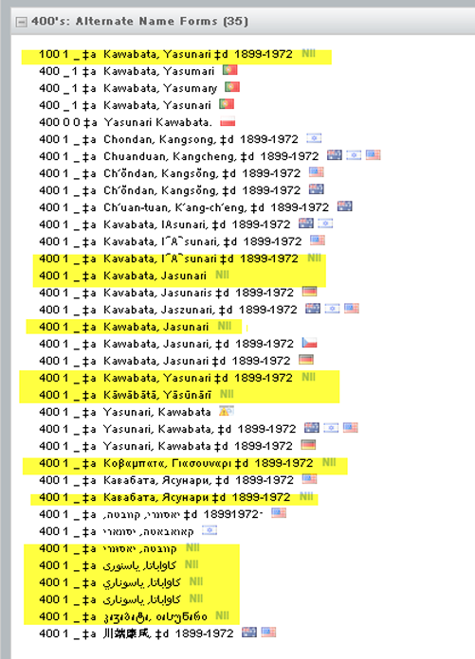


Notes:
11

Slide 12
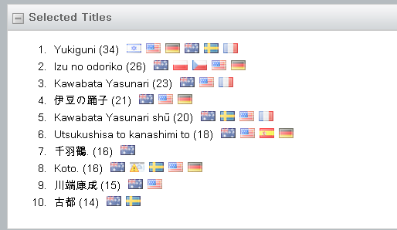
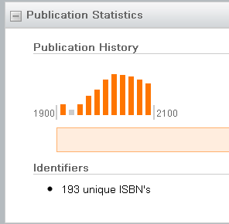
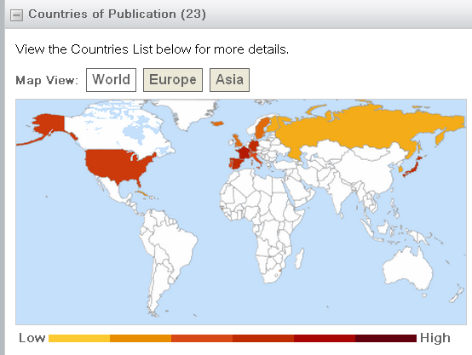
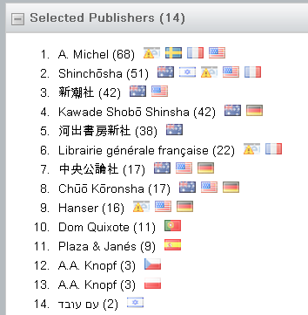
Notes:
12

Slide 13
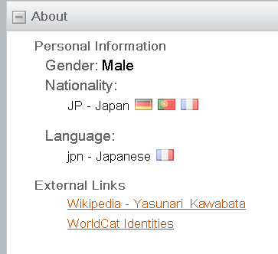
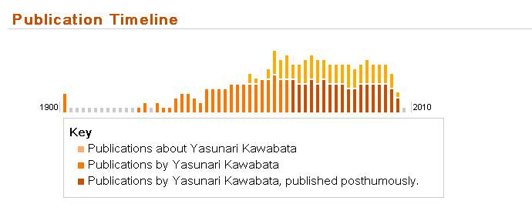

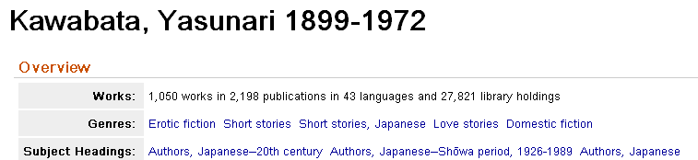
Notes:
13

Slide 14

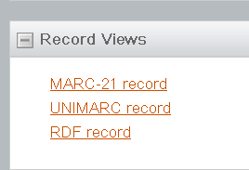

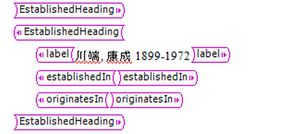
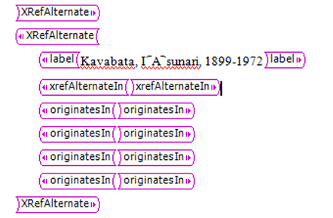
Notes:
14

Slide 15
Overview
Disclaimer
  my perspective is research and academic libraries
  Based on USA – the forecast in Japan may be very different

Slide 16
Overview
The changing place of the Library within University
Collection trends (within US research libraries)
Mass Digitization and the switch to e-books
Implications for academic libraries, national libraries and OCLC

Slide 17
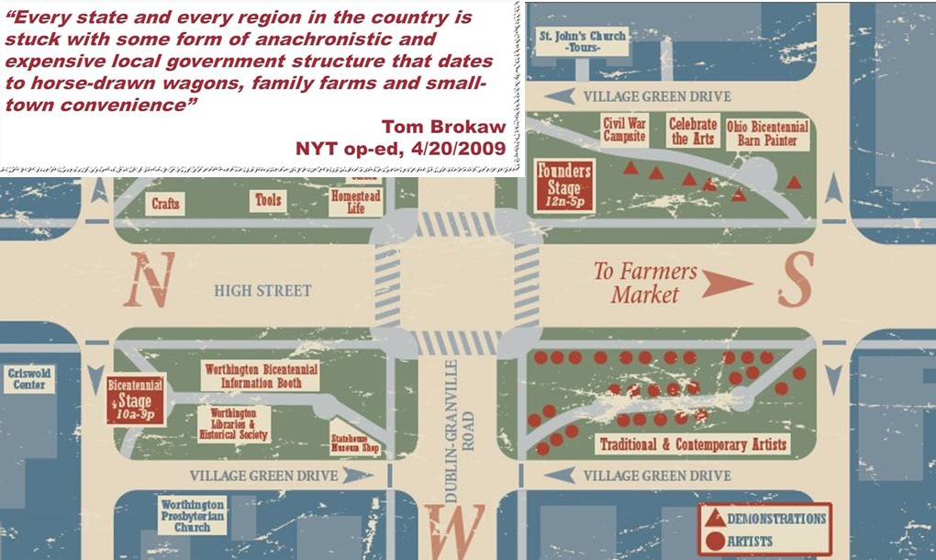
Place of the Library in University
Why do Universities have libraries?
It was more economical to have a physical collection than to send researchers or students to the information.
It was useful to locate all the needed information resources for research and learning physically close to the work.
Local collections were assets and contributed competitively to scholarly output
Consider the town square
in the United States…

Slide 18
The network changes everything
The network has reconfigured whole industries
  Travel, News, Book Retailing
The network is now the first option for researchers and learners
Impact on the university library
  changed the value of physical book collections and library space
  changed the relevance of the library assets and services to the University’s outputs
We do not yet know what it will mean to reconfigure the library within the University

Slide 19
collection trends

Slide 20
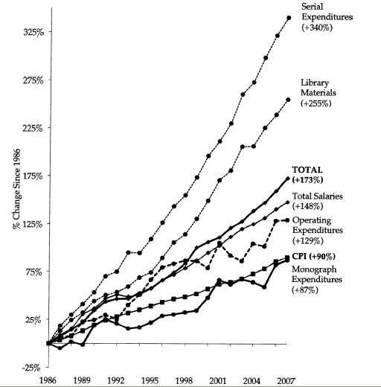
ARL Expenditures, 1986-2007
An unsustainable
pattern of growth
Source: “Expenditure Trends in ARL Libraries, 1986–2007”ARL Statistics 2006–2007, Association of Research Libraries, Washington, DC

Slide 21
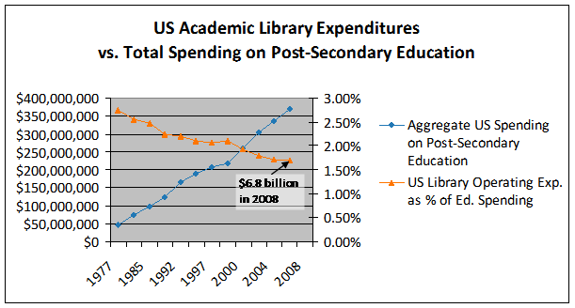
Less investment in libraries
Analysis based on NCES data: Constance Malpas
If this trend continues library allocations would fall below 0.5% by 2015. Growth
in for-profit sector, concerns about infrastructure costs in the ‘middle’ and budget
issues in the research sector all support this trend.

Slide 22
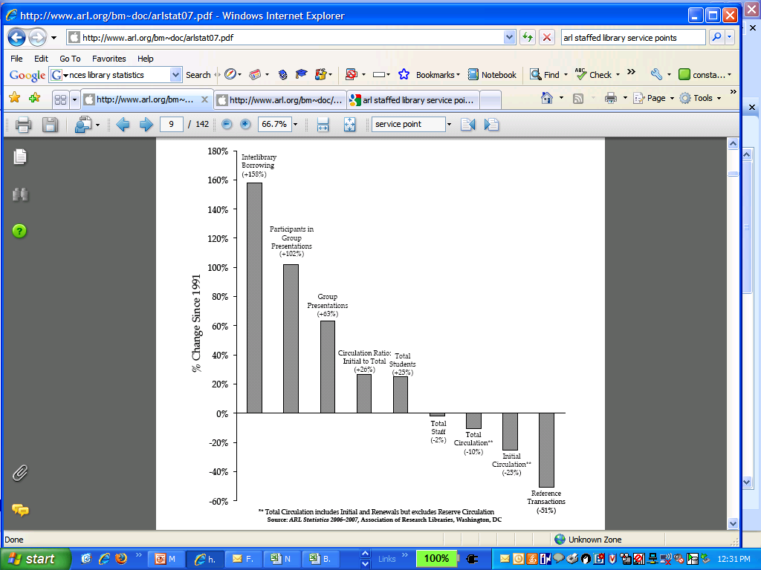
In the last 15 years . . .
While student enrollment has increased (+25%) . . .
use of onsite library collections/services has decreased (-10 to -50%). . .
and reliance on external collections has more than doubled (+150%)
Students and researchers reliance
on library has changed
Source: “Service Trends in ARL Libraries, 1991–2007 ”ARL Statistics 2006–2007, Association of Research Libraries, Washington, DC

Slide 23
What Do We Know About Print Book Use
The 80/20 rule applies
Past use predicts future use (better than anything else)
Use declines with age
In academic print collections users fail to find owned known items 50% of the time
Cost to the user is largely in the uncertainty of finding what they want
The are no longer using what we have. The value of our print collections to the University has declined rapidly.
© 2010 David W. Lewis.

Slide 24
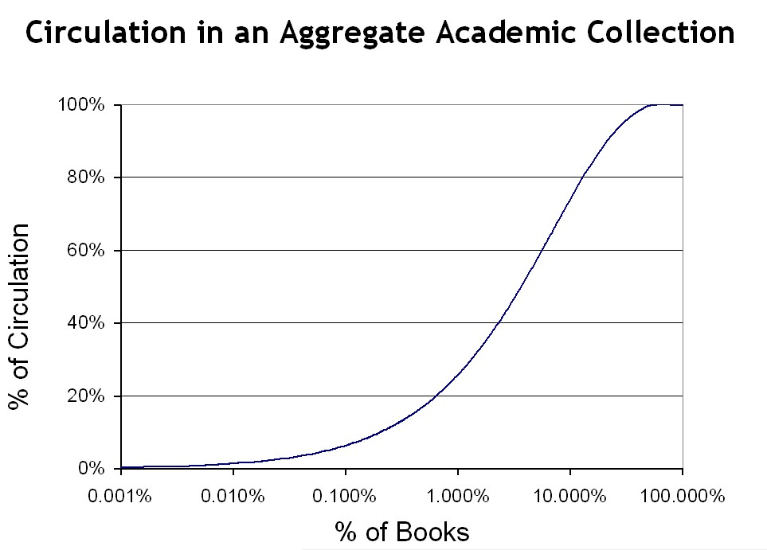
12.9%

Slide 25
switch to e-books

Slide 26
Move from Print to Electronic Collections
© 2010 David W. Lewis.

Slide 27
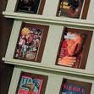
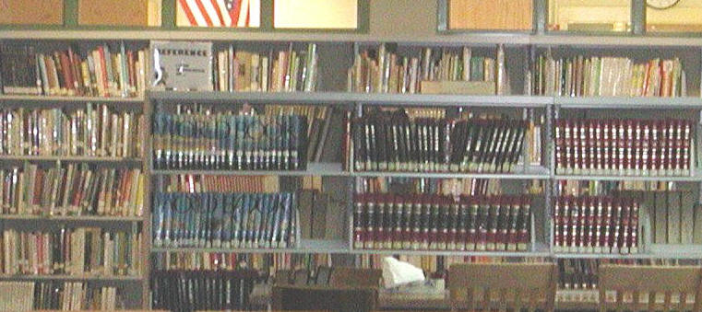
Move from Print to Electronic Collections
© 2010 David W. Lewis
Complete for journals
  But we’re still shelving unused paper
Nearly complete for reference works
  But we’re still buying paper reference works

Slide 28
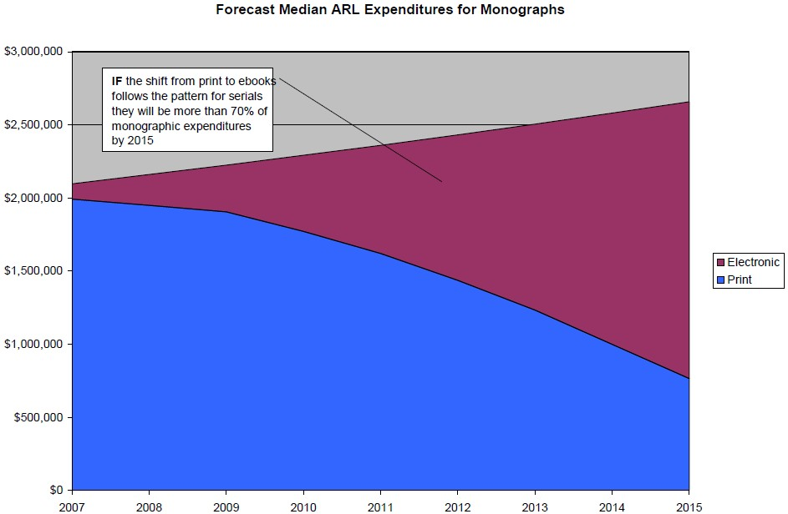
and the switch to primarily e-book purchasing will happen soon

Slide 29
Forecasts – Digital Availability of e-books
- the publishers expect this switch
Current*
Segment
Five Years*
Ten Years#
Front
Back
25%
Trade:
85%
50%
100%
10%
Acad/Prof:
75%
30%
100%
Text books:
20%
College:
90%
10%
100%
1%
H/S:
20%
5%
50%
Memo:
*Assumes top tier publishers – 1,000 active publishers
# Assumes any active publisher selling on Amazon.com
OCLC work commissioned from Michael Cairns.
Based on interviews with selection of industry experts.
Notes:
29

Slide 30

Status of the switch to e-publications
www.hathitrust.org
Complete for e-journals
Will be primarily electronic for books soon
Combine with
Mass digitization of legacy print collections
  Google in USA – digitizing everything regardless of copyright status
  Google participating libraries creating a joint platform to store, preserve and ultimately access their copies of the Google digital versions. The platform is run by the University of Michigan and called the Hathi Trust

Slide 31
Hathi Trust - current members
California Digital Library
Indiana University
Michigan State University
Northwestern University
The Ohio State University
Penn State University
Purdue University
UC Berkeley
UC Davis
UC Irvine
UCLA
UC Merced
UC Riverside
UC San Diego
UC San Francisco
UC Santa Barbara
UC Santa Cruz
The University of Chicago
University of Illinois
University of Illinois at Chicago
The University of Iowa
University of Michigan
University of Minnesota
University of Wisconsin-Madison
University of Virginia
MOST OF THE US GOOGLE BOOK PARTNERS
Notes:
31

Slide 32
Moving from Print to Electronic Books
IF
E-book publishing will be the norm and
Legacy print will be digitized (Google, Hathi, the Digitizing Academic Books in Japanese project)
THEN
We can change the management of our existing print collections
We can retire our legacy print collections

Slide 33
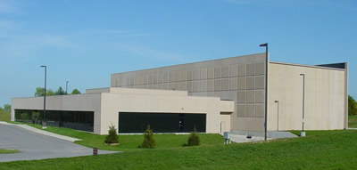

Retire Legacy Print Collections
Under way at many institutions
Discussions in process on collaborations and national programs
© 2010 David W. Lewis.

Slide 34


Retiring Legacy Print Collections
- digital is much cheaper than the library or a storage facility
$5.00 to $13.10
$28.77
$50.98 to $68.43
Life cycle cost based on 3% discount rate. From Paul N. Courant and Matthew “Buzzy” Nielsen, “On the Cost of Keeping a Book,” in The Idea of Order: Transforming Research Collections for 21st Century Scholarship, CLIR, June 2010, available at: http://www.clir.org/pubs/abstract/pub147abst.html

Slide 35
implications

Slide 36
US Investment in Academic Print Collections
You are here
Source: US Dept of Education, NCES, Academic Libraries Survey, 1998-2008
Notes:
36

Slide 37
A global change in the library environment
Academic print book collection already substantially duplicated in mass digitized book corpus
June 2010
Median duplication: 31%
June 2009
Median duplication: 19%
Data current as of June 2010
Notes:
37

Slide 38
Result of E-books plus stored print
With the exception of a small number of large research libraries,
retrospective print collections will be managed as a shared resource and
physically consolidated in large regional stores
Library materials spending in the academic sector will be
80+% directed toward licensed electronic content
distributed by a small number of large aggregators
Strong downward pressure on costs will
push towards library consolidation,
more resource sharing,
move to outsourced services.

Slide 39
IF
most academic libraries become
  license agencies and
  provide local teaching and research support
What happens to the record of scholarship? to cultural heritage?
  Who collects it comprehensively?
  Who takes responsibility for preservation?
The burden falls on research and national libraries…

Slide 40
The Scholarly Record includes
  Legacy print
  Digitized print
  Licensed (e-books + e-journals)
  New scholarly outputs
  Primary sources
    Data
    Archives and Special Collections
    Communications

Slide 41
Models of Provision for Scholarly Communication/Journals
From Lorcan Dempsey March 2010
Small but growing segment, aided by public policy support
Free Access
Mostly experimental at this point
Open Access (e.g., PLoS)
ArXiv.org
RePEc.org
PubMed Central
NARCIS
Author Pages
Social Networks
(e.g., Nature Network)
Open Access
(e.g., BioMed Central)
Non-Profit
For-Profit
ICPSR
American Economic Review
JSTOR
“trad” Publishing
Often enhanced with new forms of value added:
e.g., bundling articles with data; semantic enrichment
Long tradition of coexistence with commercial publishing
Paid Access

Slide 42
Models of Provision for Scholarly Communication/Journals
From Lorcan Dempsey March 2010
Small but growing segment, aided by public policy support
Free Access
Mostly experimental at this point
Research institutions:
significant funder?
Open Access (e.g., PLoS)
ArXiv.org
RePEc.org
PubMed Central
NARCIS
Author Pages
Social Networks
(e.g., Nature Network)
Open Access
(e.g., BioMed Central)
Non-Profit
For-Profit
Research institutions:
75% of academic revenue?
ICPSR
American Economic Review
JSTOR
“trad” Publishing
Often enhanced with new forms of value added:
e.g., bundling articles with data; semantic enrichment
Research institutions:
major constituency?
Long tradition of coexistence with commercial publishing
Paid Access

Slide 43
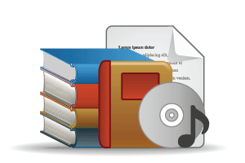



COLLECTIONS GRID (from OCLC Research)
Another view of what
needs to be collected …
Stewardship/
scarcity
a
high
low
Low-High
Books & Journals
Newspapers
Gov Documents
CD & DVD
Maps
Scores
Low-Low
Freely-accessible web resources
Open source software
Newsgroup archives
low
Uniqueness
High-Low
Research & Learning Materials
Institutional records
ePrints/tech reports
Learning objects
Courseware
E-portfolios
Research data
Prospectus
Insitutional website
High-High
Special Collections
Rare books
Local/Historical Newspapers
Local History Materials
Archives & Manuscripts
Theses & dissertations
high

Slide 44
COLLECTIONS GRID
Stewardship
From Lorcan Dempsey March 2010
high
low
All institutions: shift to licensed
All institutions: manage transition from print?
Licensed channel providers: consumer, education, scholarly, ..
low
Uniqueness
Research institutions:
managing institutional assets
Research institutions:
new scholarly outputs
All institutions: learning materials
high
All institutions:
How much investment?

Slide 45
Conclusion #1
The switch to e-publications and digital delivery will reconfigure the academic library
The academic library will use its resources to
become the most efficient unit that adds local value
By moving beyond its past and its tradition as a physical storehouse of texts the library will
become a bundle of services that adds value to the University’s output – scholarship and research

Slide 46
Conclusion #2
This reconfiguation will require national libraries and agencies to
Collaborate explicitly with academic libraries
Redefine their mission
Adjust their focus and investments
Become part of a new reconfigured national system
Take a key role in a this new system
Result – managed collection and preservation of the nation’s scholarly record and its cultural heritage

Slide 47
THANK YOU
MICHALKJ@OCLC.ORG
comments, questions and observations are very welcome via email…
with thanks to Lorcan Dempsey, Brian Lavoie, David Lewis, Constance Malpas and Karen Smith-Yoshimura for their contributions…

