Slide 1
OCLC Research Library Partnership Meeting: Rep, Rank & Role
Tweet #orlp
WRAP - UP
SORT OF…

Slide 2
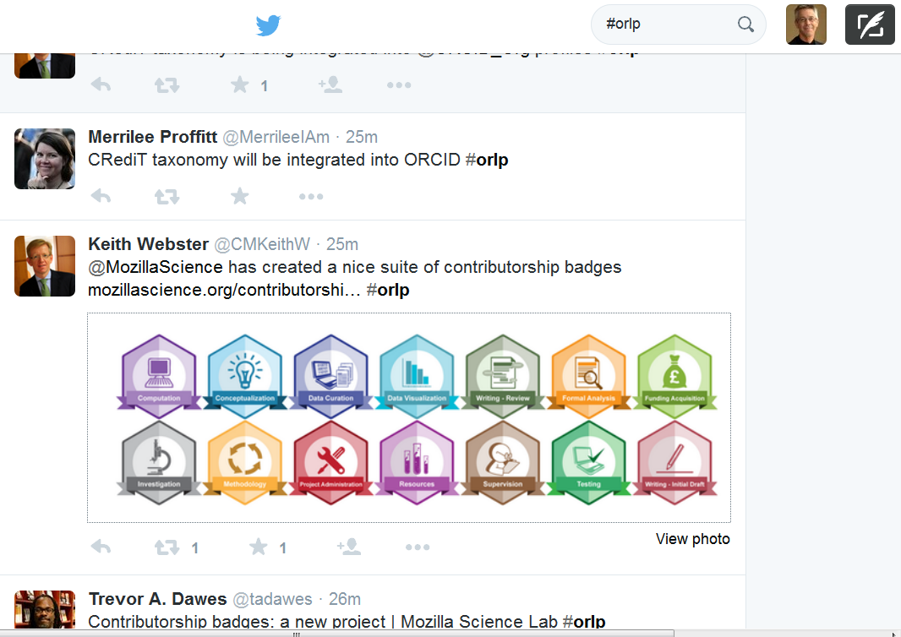

Slide 3
Observations = things that stuck
Research Assessment regimes
Ranking – complexity/proliferation
Intra-university collaboration
Manage expectations
Communicate
Library and librarians have a role
Library’s power to convene
Library as neutral party
Motivating faculty participation
Influencing rank/rep is a long-term play
Humanities is fraught
Range of library contributions
- system, data, ID, viz, access
Connect high level goals with reputation
- tell a story
Ban “infrastructure” and “assessment”
Build an institutional bibliography, dark archive, services
Good want to get better

Slide 4
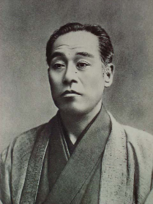
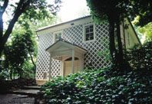
Yukichi Fukuzawa
Founded Keio in 1858.
Introduced Western science and institutions.
Provided the basic principles of modernization.
Believed in the independence of individuals.
Believed in the importance of business. Created industrialists and introduced modern institutional systems such as patents, joint stock company, and book keeping.

Slide 5
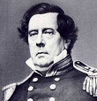
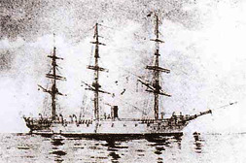
A Little History
Arrival of Commodore Perry in 1853 saw both the arrival of the threat of colonization and the industrial revolution.
Japan was quick to respond…
Kanrin Maru

Slide 6
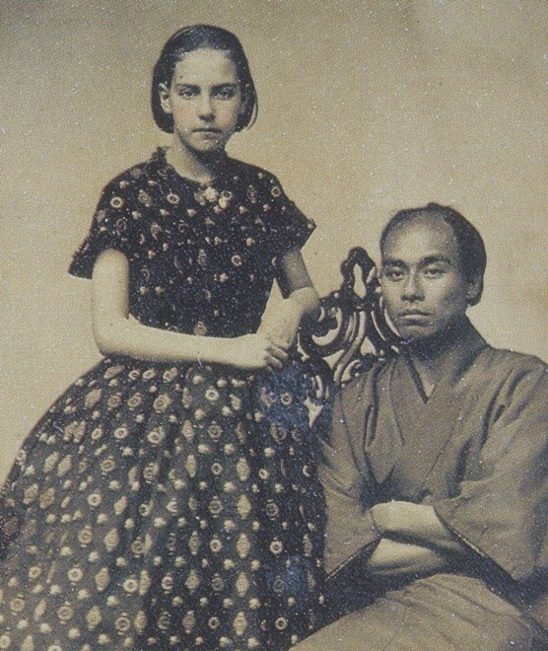
San Francisco
1860

Slide 7
NEXT

Slide 8
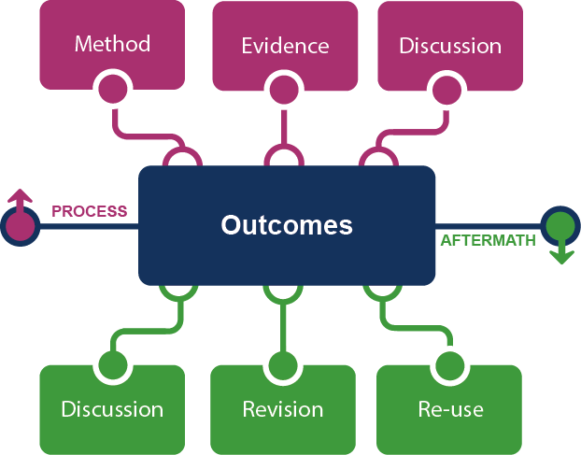
Framing the Scholarly Record …

