Slide 1
Rethinking the Boundaries of the Library
Evolving Scholarly Record and Evolving Stewardship Ecosystem—San Francisco Workshop
Jim Michalko
Vice President, Research Libraries
June 2, 2015
produced with contributions by
Lorcan Dempsey, Brian Lavoie,
Constance Malpas
Sir Francis Drake Hotel
#esrworkshop

Slide 2
Overview
Library as it was
economics, education, research
How this shaped library structure and services
Change – network, mandates, ESR
Re-organizing and re-structuring
How this shapes where future activities occur
implications of ESR choices
on library boundaries and
operations
Notes:
current library organization reflects the scholarly record as it was as well as the economics of information, education and research as they once were
· what were those economics that shaped structure - Boundaries lite
· what’s changed those economics – network, external mandates, and the ESR
· how do economics and mandates make us think differently about where certain future activities should be done – multi-scalar plus some references to Herbert’s ‘registration agency’ diagram and process overview
· some institutions are in the early stages of re-organizing and re-structuring to reflect these changes in economics, mandates and externalization

Slide 3
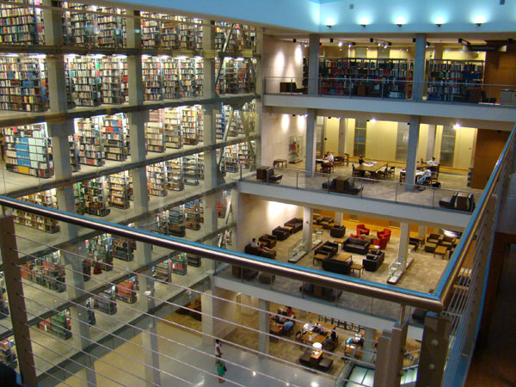
Rethinking the boundaries of the academic library
“Pull” of the Network
“Push” of Economics
Academic Libraries
?

Slide 4
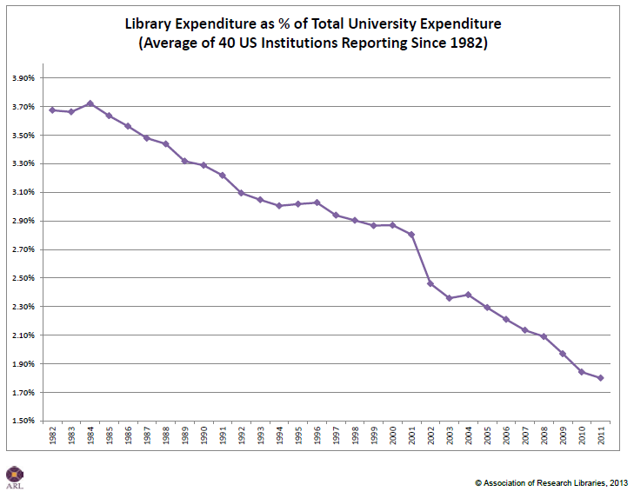

Slide 6
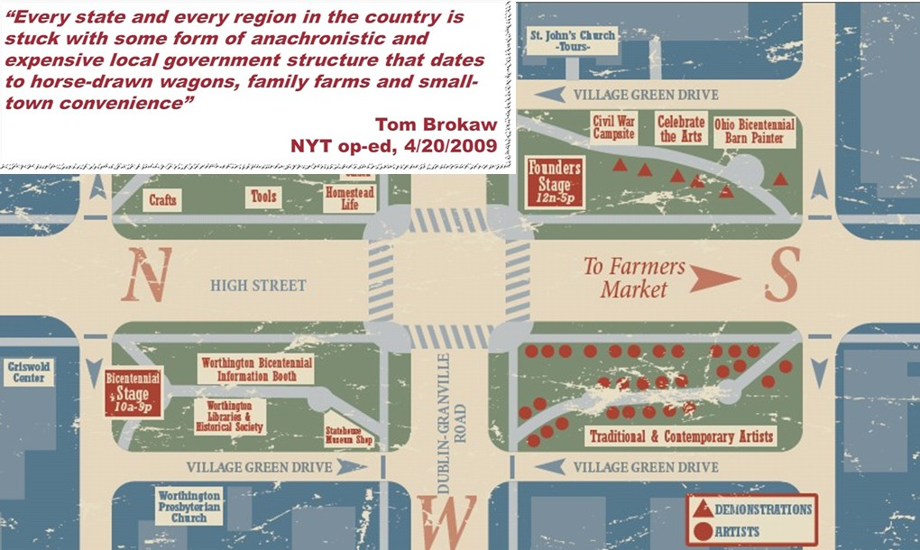
Library as it was
Why?
It was more economical to have a physical collection than to send researchers or students to the information.
It was useful to locate all the needed information resources for research and learning physically close to the work.
Local collections were assets and contributed competitively to scholarly output
Consider the town square
in the United States…
Notes:
I start with the position of the library within the university.
Its place was determined in the same way that physical proximity of scarce assets dictated much of our built culture and our political culture with the church, the post office, the town hall and the library all placed around the town square. These are now out-of-place.

Slide 7
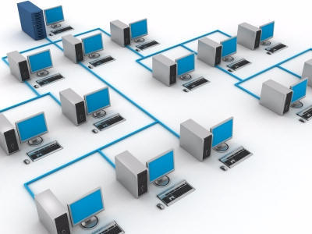
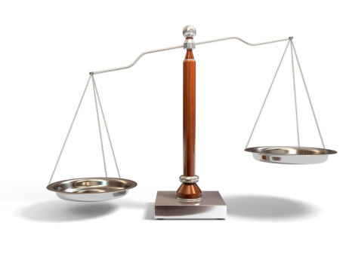
Network is reducing transaction costs …
Computing and network technologies …
… reduce the cost of establishing & managing
interactions with external parties …
… which creates incentive to re-assess mix of
internalized & externalized activities …
… which reconfigures organizational boundaries
(i.e., boundaries of the library)

Slide 8
Examples
Company
Research
Library

Slide 9
Harvard Business Review (1999)

Slide 10
CORE COMPONENTS OF A FIRM
Attracting and building relationships with customers
“Service-oriented”, customization
Economies of scope important
Develop new products and
services and bring them to
market
Speed/flexibility important
Customer
Relationship
Management
Product Innovation
Infrastructure
Back office capacities that
support day-to-day operations
“Routinized” workflows
Economies of scale important

Slide 12
Internalize
more of this
Externalize
more of this

Slide 14
The new rules
http://www.arl.org/resources/pubs/mmproceedings/160mm-proceedings.shtml#colls
Wendy Lougee at the 4 May 2012 ARL Membership Meeting Chicago, IL
Notes:
Wendy Lougee called this the new rubric which means a kind of general prescription. In this case she is prescribing the shape of the future library. She believes that the 21st century library will align itself closely to the local priorities of its institution. It will manage some local infrastructure and will provide services that respond to unique institutional assets which includes areas of research or teaching distinction.
However that local alignment will be supported by collective goals and priorities understood by the community of research libraries. These local operations will depend on shared infrastructure (like data management and preservation facilities) and on shared assets (like print collections jointly owned by many institutions).
This kind of alignment of the local with collective shared structures will define the 21st century library.
Note to myself: An established custom; a set of rules, an injunction; a general prescription.

Slide 15
Multi-scalar strategies
HathiTrust
HathiTrust
MARLI
ReCAP
HathiTrust
HathiTrust
2CUL
Columbia
Ohio
LINK
CIC
simultaneous participation in cooperative efforts operating at multiple scales
?
WEST
HathiTrust
HathiTrust
HathiTrust
HathiTrust
HathiTrust
UC
Harvard
RLF
UCLA
HD
Widener
Figure: Multi-scalar library partnerships. OCLC Research, 2014.

Slide 16
(Re)-organizing -structuring
Structure to support strategy
Event(s)
Opportunity
User-centered
University alignment
Extra-library
skill sets
Specific gravity
of services
Shared Services
Community of
Practice
Success essentials
Principles
Advance management
Communication
Master space plan

Slide 17
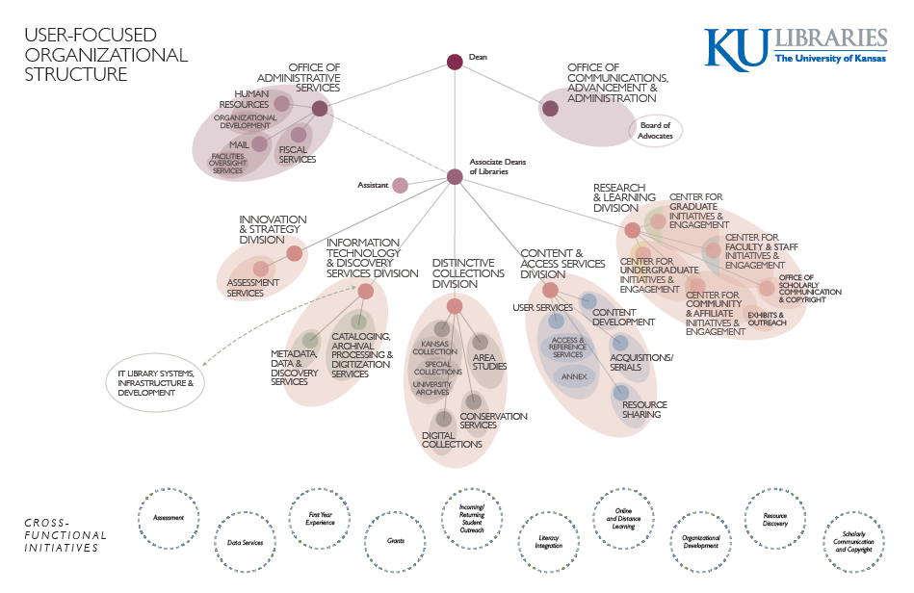

Slide 18
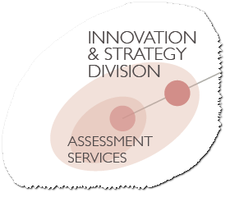
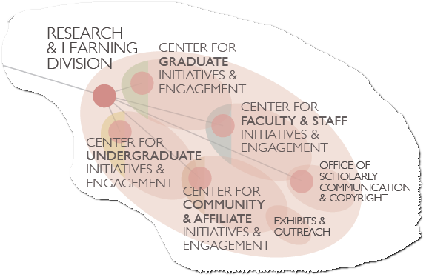
Shared Services

Slide 19
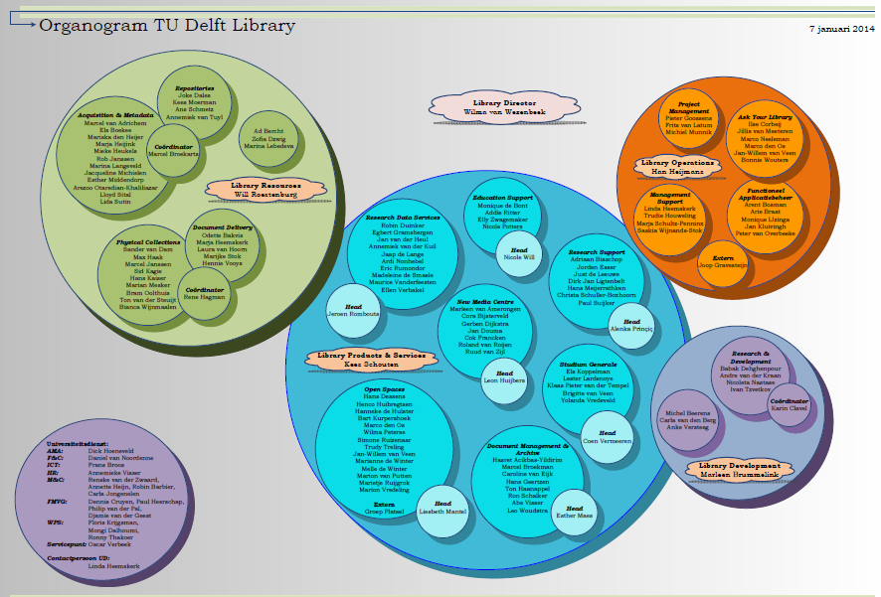

Slide 20
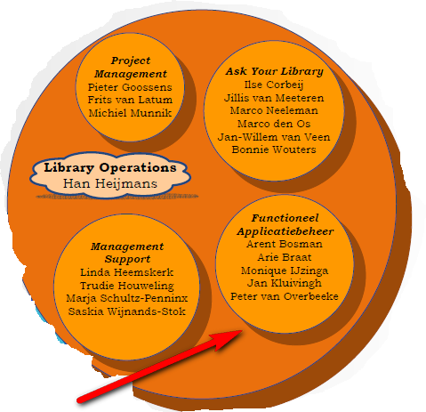
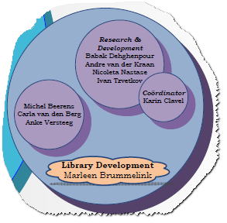
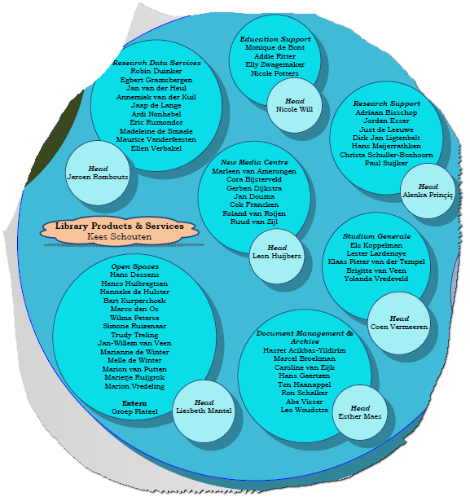
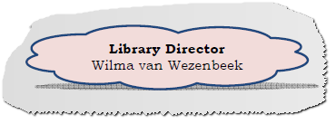
Shared Services

Slide 21
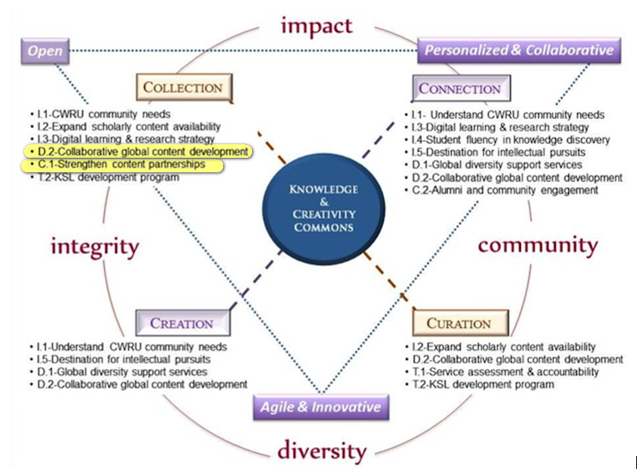
Shared Services
Case Western Reserve University

Slide 22
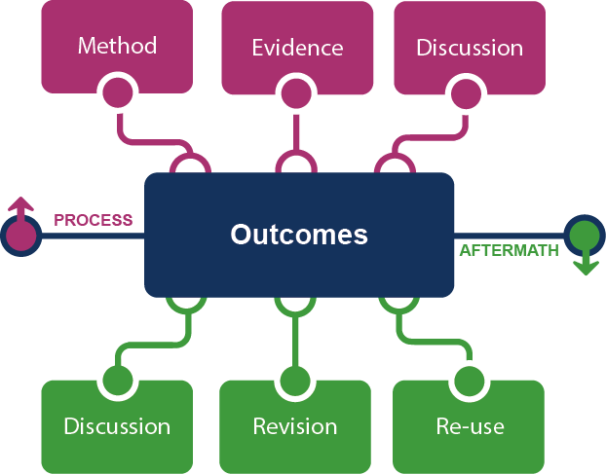
?
&
Transformation of the academic library
Kurt de Belder
http://www.oclc.org/content/dam/research/events/dss/ppt/dss_debelder.pptx

Slide 23
Framing the Scholarly Record …

Slide 24
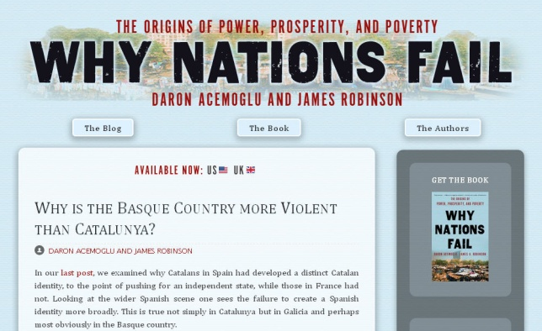
In practice …
Notes:
http://global.oup.com/uk/orc/busecon/economics/carlin/

Slide 25
Tools of the new scholarly record
arXiv, SSRN, RePEc, PubMed Central (disciplinary repositories that have become important discovery hubs);
Google Scholar, Google Books, Amazon (ubiquitous discovery and fulfillment hubs);
Mendeley, ResearchGate (services for social discovery and scholarly reputation management);
Goodreads, LibraryThing (social description/reading sites);
Wikipedia, Yahoo Answers, Khan Academy (hubs for open research, reference, and teaching materials).
GalaxyZoo, FigShare, OpenRefine (data storage and manipulation tools)
Github (software management)
Recording Infrastructure
External to the Library

Slide 27
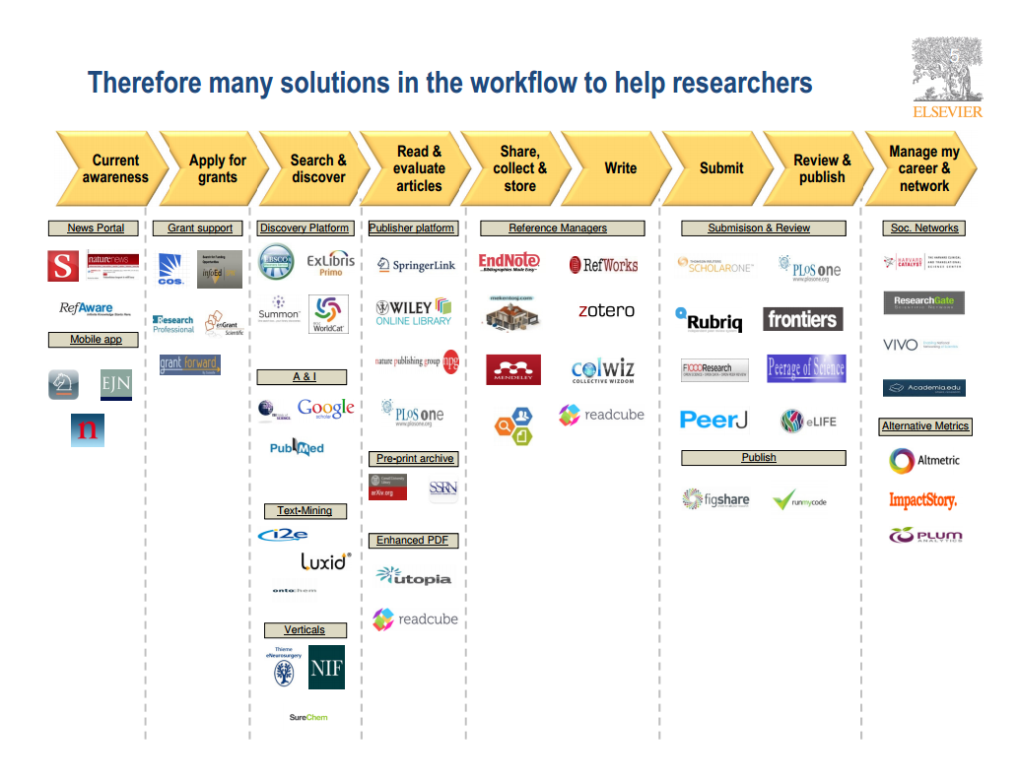
Recording Infrastructure
Wouter Haak
Elsevier, VP Product Strategy
LIBER, Riga, 2014

Slide 28
Recording versus Archiving
Recording | Archiving
Short-term | Longer-term
No guarantees provided | Attempt to provide guarantees
Write many/read many | Write once/Read many
Scholarly process | Scholarly record

Slide 29
Library
Service
Opportunity?
Library Relationships?
Library Involvement?L
Provided by ?

Slide 30
? now
Look forward to discussion this afternoon –
Collaboration with external entities

