Slide 1
VRA/ARLIS 3rd Joint Conference • 11 March 2016
Roundtable
OCLC Research Library Partnership
Dennis Massie
Program Officer, OCLC Research

Slide 2
welcome

Slide 3
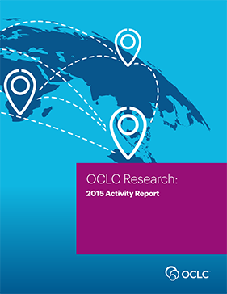
OCLC Membership and Research
Research Collections & Support
Understanding the System-Wide Library
Data Science
User Studies
Scaling Learning
Just published!
oc.lc/research
Notes:
New publication reviews work done during 2015 across the Division’s 5 thematic areas:
Understanding the System-wide Library
Research Collections and Support
User Studies
Data Science
Scaling Learning

Slide 4
Today’s agenda
Mangia, mangia!
Welcome
Web Archiving Metadata Working Group
Art Museum ILL Data Study: divin’ deep
Art Discovery Group Catalogue update
What we talk about when we talk about
Linked Data
Round Robin Round-up – Pacific Northwest style
Notes:
I prepared individual snapshots of the data for each institution, showing their activity versus the group averages. Mostly this helped us find several mistakes – some of them mine, some of them theirs – that explained most of the differences in the data reported to ARL and to me. Then we spent the rest of each hour talking about these topics right here.

Slide 5
Today’s agenda
Mangia, mangia!
Welcome
Web Archiving Metadata Working Group
Art Museum ILL Data Study: divin’ deep
Art Discovery Group Catalogue update
What we talk about when we talk about
Linked Data
Round Robin Round-up – Pacific Northwest style
Notes:
I prepared individual snapshots of the data for each institution, showing their activity versus the group averages. Mostly this helped us find several mistakes – some of them mine, some of them theirs – that explained most of the differences in the data reported to ARL and to me. Then we spent the rest of each hour talking about these topics right here.

Slide 6
Today’s agenda
Mangia, mangia!
Welcome
Web Archiving Metadata Working Group
Art Museum ILL Data Study: divin’ deep
Art Discovery Group Catalogue update
What we talk about when we talk about
Linked Data
Round Robin Round-up – Pacific Northwest style
Notes:
I prepared individual snapshots of the data for each institution, showing their activity versus the group averages. Mostly this helped us find several mistakes – some of them mine, some of them theirs – that explained most of the differences in the data reported to ARL and to me. Then we spent the rest of each hour talking about these topics right here.

Slide 7
Partnership anniversaries in 2016
35 years
Metropolitan Museum of Art (Jan 21)
Museum of Fine Arts, Boston (Jan 8)
Museum of Modern Art (Feb 2)
30 years
Hagley Museum and Library (Dec 12)
25 years
Frick Art Reference Library (Nov 18)
Kimbell Art Museum (Nov 19)
20 years
Victoria and Albert Museum (Dec 30)
Notes:
Here’s what they said.
Their goal has long been to automate as much routine ILL traffic as possible. Arrangements such as consortial borrowing schemes and a journal-article-delivery system from the States called RapidILL allow them to do just that. In both Borrow Direct and RapidILL, institutions commit to delivering with super fast turnaround certain portions of their collections. The routine stuff. Borrow Direct’s Relais software shows real-time availability of the items, so requests are sent only to libraries where the material is available. RapidILL takes the holdings data for each library that joins and normalizes it so that a machine can route article requests to places where the volume and issue are actually owned. Both have fill rates of around 95%. Both take staff largely out of the equation, and what tasks there are that must be performed by staff can be done by student workers. Both in consortial borrowing and in RapidILL, libraries arrange things so they trade with their best friends first, and then in ever-widening circles until they get to the occasional distant acquaintance.

Slide 8
What ever happened to…?
Günter Waibel Named New Executive Director of the California Digital Library, to start in May 2016

Slide 9
Web archiving metadata
Working group
WAM!

Slide 10
WAM!
Web Archiving Metadata working group
Started work in January 2016
Seeds planted at ARLIS in 2014
OCLC Research surveyed RLP staff in October 2015
Two main areas of action identified:
Develop metadata guidelines
Explore user needs
Coordinating with IIPC, SAA, and Internet Archive
Building on work done by and for NYARC
26 volunteers on the working group
Notes:
What are some of the forces at work that drive the decisions that administrators at these libraries are making about collection-sharing?
Their users are finding things. Lots of things. They have high expectations. Digital surrogates do not always suffice.
No library can buy as much as they once did, even if they are spending more. They need partners if they are to fulfill the needs of their users.
ILL has earned a reputation for taking too long, costing too much, and yielding mixed results, all while being bounded by restrictive policies for the user.
Monographs -- which are requested via ILL by users by a 2 to 1 margin over articles – are still king, and they are available mostly in print. And so consortial borrowing is now the king of collection sharing models.

Slide 11
WAM, cont.!
1st order of business: our charge
Monthly WebEx sessions with full group
User needs subgroup has begun work
Other subgroups will be formed as needed
Identifying gaps in available tools/technology
Summarizing existing guidelines
Building an annotated bibliography
Join the OCLC RLP’s Web archiving discussion list
Web presence coming soon
Notes:
What are some of the forces at work that drive the decisions that administrators at these libraries are making about collection-sharing?
Their users are finding things. Lots of things. They have high expectations. Digital surrogates do not always suffice.
No library can buy as much as they once did, even if they are spending more. They need partners if they are to fulfill the needs of their users.
ILL has earned a reputation for taking too long, costing too much, and yielding mixed results, all while being bounded by restrictive policies for the user.
Monographs -- which are requested via ILL by users by a 2 to 1 margin over articles – are still king, and they are available mostly in print. And so consortial borrowing is now the king of collection sharing models.

Slide 12
WAM working group members!
Trevor Alvord, Brigham Young University
Alexis Antracoli, Princeton University
Penny Baker, Clark Art Institute
Kate Bowers, Harvard University
Evan Echols, University of Delaware
Karen Stoll Farrell, Indiana University
Rick Fitzgerald, Library of Congress
Ben Goldman, Pennsylvania State University
Rebecca Guenther, consultant
Claudia Horning, University of California, Los Angeles
Chad Hutchens, University of Wyoming
Deborah Kempe, Frick Art Reference Library
Tammi Kim, University of Nevada, Las Vegas
Jason Kovari, Cornell University
Rosalie Lack, California Digital Library
Eilidh MacGlone, National Library of Scotland
Matthew McKinley, University of California, Irvine
Allison O’Dell, University of Florida
Joy Panigabutra-Roberts, American University in Cairo
Dallas Pillen, University of Michigan
Lily Pregill, New York Art Resources Consortium (NYARC)
Mary Samouelian, Harvard Business School
Aislinn Sotelo, University of California, San Diego
Alex Thurman, Columbia University
Jessica Venlet, Massachusetts Institute of Technology
Olga Virakhovskaya, University of Michigan
Jackie Dooley, OCLC Research
Dennis Massie, OCLC Research

Slide 13
Deborah Kempe
Chief, Collection Management & Access
Frick Art Reference Collection

Slide 14
TOE DIP
A deep dive into the museum library ill data pool
WADING

Slide 15
Museum ILL Data: the who & what
All filled ILL transactions that passed through the OCLC ILL infrastructure
With one of 22 OCLC Research Library Partnership museum libraries as either borrower or lender
From 2007 through 2013
Returnables and non-returnables
197,147 filled transactions
Enhanced with holdings, geo-location, conspectus, Hathi, and copyright status data

Slide 16
How much did museum libraries borrow? 132,085 items

Slide 17
How much did museum libraries lend? 123,967 items

Slide 18
Museums loaned 8,277 items where they were the only holder in WC
Uniquely-held items loaned by all 22 museums that are also represented in HathiTrust (as of 2014): 5
As of 2016: 73
In HathiTrust and also public domain (as of 2014): 1
As of 2016: 58
55 items were loaned by museum libraries where there were zero holdings in WorldCat.

Slide 19
Customized museum library ILL snapshots
How much did each museum library borrow?
How much did each museum library lend?
For both of these categories:
Proportion of loans to copies?
Proportions within and outside the group?
How did all this change over time?
Which libraries in the group behaved like each other?
Regarding the materials loaned and borrowed:
What subject classifications?
What languages?
Where published?
How old?
How widely held within WorldCat?
What was requested more than once?
What raw data would be useful?
Uniquely held loaned?
Borrowed and loaned?
5 holdings? 10?
Everything?

Slide 20
RLP Museum Libraries: Types Loaned & Borrowed via ILL

Slide 21
ILL, Museum Libraries, Overall Lending, Loans vs Copies

Slide 22
ILL, Museum Libraries, Overall Borrowing, Loans vs Copies

Slide 23
RLP Museum Libraries: ILL among museums, SHARES

Slide 24
ILL Lenders by Format

Slide 25
Peer Groups by Activity
Lenders Borrowers

Slide 26
Is There Any Correlation?

Slide 27
Promises, Promises…
Individual Institutional Profiles
Give you your raw data
Compare yours vs. group averages
Explore peer groups
Compare with old SHARES data
Analyze the natures of the materials being shared
Interview staff

Slide 28
Art Discovery group catalogue -- update

Slide 29
Kathleen Salomon
Assistant Director
Getty Research Institute

Slide 30
http://artdiscovery.net
Art Discovery Group Catalogue Update ARLIS/NA 2016
New website up and running
63 art libraries, more in progress
Improved interface
Now includes SCIPIO database and indexes

Slide 31
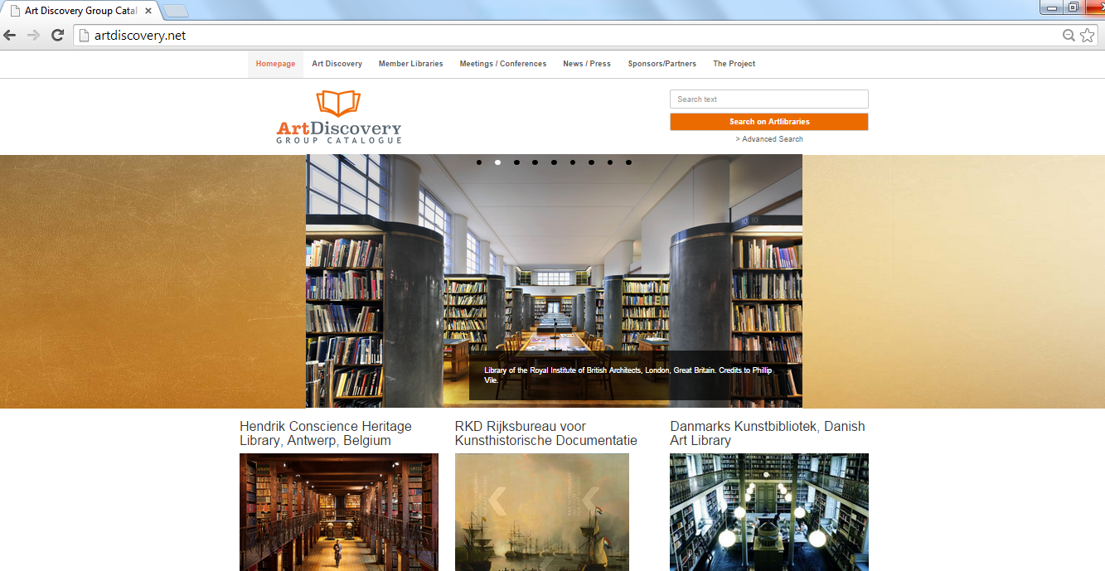

Slide 32
63 Libraries

Slide 35
Questions?
ADGC committee members in Seattle this week:
Sandra Brooke (sbrooke@Princeton.edu)
Wendy Fish (wendy.fish@riba.org)
Deborah Kempe (kempe@frick.org)
Kathleen Salomon (ksalomon@getty.edu)
Biannual Art Libraries (formerly artlibraries.net) International Conference
Florence, Italy, October 28-29, 2016

Slide 36
What we talk about when we talk about linked data

Slide 37
Jeff Mixter
Software Engineer
OCLC Research

Slide 38
ARLIS/VRA 2016 Seattle
OCLC Research Update
Jeff Mixter
Software Engineer, OCLC Research

Slide 39
Agenda
Linked Data 101
Current and Future Uses

Slide 40
Linked Data 101
Linked data != RDF
Linked data is a method for publishing data such that is can be interlinked with other data and use for semantic queries
It is built on existing Web technologies: HTTP, RDF, and URIs
Ontologies
Notes:
Linked data is not the same as RDF. Linked data is a set of best practices for publishing things on the Web. Linked data is built on three Web technologies: HTTP, RDF and URIs

Slide 41
HTTP
Stands for Hypertext Transfer Protocol
If you have ever been to a Website or shared information over the Internet, you have used HTTP
Notes:
If you have used the Internet you have used HTTP.

Slide 42
RDF
RDF stands for Resource Description Framework
It is a World Wide Web Consortium (W3C) Recommendation
RDF is used to model entities and relationships
RDF data is composed of individual statements called Triples
RDF can be serialized in a variety of ways BUT it is all RDF and changing serializations results in NO semantic loss
Notes:
RDF is a W3C recommendation. It is used to describe things and their relationships. There are many serializations of RDF but they are all compatible – there is no semantic loss

Slide 43
Understanding “RDF Triples”
A triple is a statement that relates one thing to another, specifying a Subject, Predicate, and Object. RDF triples use URIs for those three elements.
Subject | Predicate | Object
https://viaf.org/viaf/52010985 | https://schema.org/birthPlace | https://id.worldcat.org/fast/1204916
Barack Obama | Was born in | Honolulu, Hawaii
Notes:
Before getting too far ahead of ourselves, let’s contend with some necessary jargon and define an important concept … RDF Triples. We’ll be referring to “triples” a lot in this presentation.
A “Triple” is simply a statement that relates one thing to another. It has 3 parts, a subject, predicate, and object.
When working with large and varied data sources we need a common mechanism for comparing and sifting the aggregated data, and a way to relate one thing to another.
The RDF Triple gives us a common way to do that. RDF stands for Resource Description Framework, a way of modeling data, and an “RDF Triple” is a triple that has identifiers for the subject, predicate, and object.
In this example we see a VIAF identifier for Barack Obama, a schema.org identifier for place of birth, and an OCLC FAST identifier for Honolulu Hawaii, expressing a factual claim about the President’s place of birth. The triple can be read like a very simple English sentence: “Barack Obama was born in Honolulu, Hawaii.”.
These identifiers have an important quality of being “dereferenceable” … that is, they can be used with an internet protocol, like HTTP on the web, to look up more information about the thing they represent, and they are language-independent.

Slide 44
URIs
Stands for Uniform Resource Identifier
A URL (web address) is a type of URI
https://www.wikidata.org/entity/Q5582
There is some odd HTTP stuff that goes on with URIs but it is not necessary for discussion now
https://www.w3.org/TR/cooluris/
Notes:
URIs are identifiers for things that can be dereferenced on the Web and deliver back a description of the thing. A URL is an example of a URI. This is an example WikiData URI for Vincent van Gogh. There is some odd HTTP stuff that goes on with URIs but that is not important now. If you are interested in the gory details feel free to read this W3C article or ask me after the workshop.

Slide 45
Ontologies
Data models used in the creation of RDF
Classes Properties and Relationships
Set theory
Levels of intensity for ontologies
Reasoning
Schema.org and BIBFRAME are two ontologies
Both are perfectly suitable for describing your things
Difference is in the level of detail and expected use

Slide 46
Linked Data 101
Tim Berners-Lee coined the term in 2006 and defined 4 linked data principles
Use URIs as names for things
Use HTTP URIs so that People can look up these names
When someone looks up the URI, provide useful information, using the standards
Include links to other URIs, so that they can discover more things
Notes:
So back to linked data. The term was first coined by Tim Berners-Lee back in 2006. At the time he outlined 4 Linked data principles.

Slide 47
5 Star Linked Data
On the Web
Machine-readable data
Non-proprietary format
RDF standards
Linked RDF
Notes:
He later amended the linked data article to add a 5 star linked data rating system whereby people could score their linked data. I also provided the opportunity for the W3C to market new merchandise.

Slide 48
Use Cases for Linked Data

Slide 49
Why Linked Data?
Notes:
This is the Semantic Web cloud. It shows all of the various linked open datasets that are available, as of 2014. In the center you can see Dbpedia and Geo Names.

Slide 50
So.. why again?
AAT
It is NOT good enough to just be on the Web. You need to also be part of the Web
That means linking!!
Linked Data does just that – links your data to other data on the Web
VRA RDF
Data
LCSH
Other Guy’s
VRA RDF Data
TGN
Notes:
So at this point you are probably thinking “I have never heard of any of those datasets and I could barely even read the names of the ones on the periphery. So again, why?”. Let’s take a micro look at this Cloud. If you data is linked to other data which is linked back to your data you can create a “web” (pun intended). Linking allows your data to not just be on the Web but more importantly be OF the Web.

Slide 51
Leveraging the Web
Publishing linked data is a two way street
People can use your data but you can also use other peoples data
Notes:
Being OF the Web allows you to leverage the Web. This allows you to take advantage of you data in ways not previously possible. The Web is a two way street – people can use your data and visa versa.

Slide 52
Example
<http://exampleMuseum.org/entity/1>
<http://schema.org/creator>
<https://www.wikidata.org/entity/Q5582> .
Notes:
Let’s look at an example. If you have this triple in your data. This Museum thing (lets call it a painting) was created by this Thing (if we recall back to the previous N-Triple slide you will recall that this is a WikiData URI for Vincent van Gogh). So this this means is that you have a painting by Vincent van Gogh.

Slide 53
The Power of the Web
You can use that WikiData URI to get more information about the thing without having to store it in your local databases
Notes:
With that WikiData URI you can pull in outside data to help enhance your own data and improve the experience for end-users. This is very helpful since most internal data (records) does not store that much info about secondary things. In VRA you would only have a name, birth date, death date, culture and role (if you were strictly following the VRA Core 4 suggestions). But using the Web you are able to go out to the WikiData URI and pull back very useful info such as.

Slide 54
Descriptions
Vincent Willem van Gogh (Dutch: [ˈvɪnsɛnt ˈʋɪləm vɑn ˈɣɔx] (30 March 1853 – 29 July 1890) was a Dutch post-Impressionist painter whose work had far-reaching influence on 20th-century art. His output includesportraits, self portraits, landscapes, still lifes, olive trees and cypresses, wheat fields and sunflowers. Critics largely ignored his work until after his presumed suicide in 1890. His shortened life, highly expressive and spontaneous use of vivid colours, broad oil brushstrokes and emotive subject matter, mean he is recognisable both in the modern public imagination by his first name as the quintessential misunderstood genius and by art historians as a supreme and pivotal aestheticist.
Notes:
A description

Slide 55
Images of the Thing
Notes:
Images of the thing (that is Vincent at age 13 from 1866)

Slide 56
Other Images (created by the Thing)
Notes:
Other images associated with the thing (Other works of art by Vincent)

Slide 57
It’s All about the Graph!
VRA
WikiData
Creator
Birth Place
WikiData
Notes:
Because this is all a connected graph you can also take advantage of data that is not even directly linked to your data. In this example we have have your VRA thing (say a work of art) that is linked to a WikiData thing (say Vincent van Gogh) with a creator property. You can actually use the WikiData data to continue out on the network to pull back information about where that person was born (in this case Zundert, Netherlands). This would allow you to get a name, geo locations etc.

Slide 58
SEO
Can using RDF on your pages help improve your Google ranking tomorrow?
NO
Notes:
The other why people sometimes talk about is SEO. What about SEO. Can linked data help improve my Google ranking. Short answer, NO.

Slide 59
Why?
RDF != Linked Data
Just because Google can understand you does not mean that they care
Notes:
First off remember RDF is not linked data. Second, just because Google can understand you does not mean that they care.

Slide 60
But…
Google does care about the relevance and popularity of your website!
Being able to better understand the data on it makes their job easier
PageRank
Notes:
But, Google does care about the relevancy and popularity of your website. And being able to better understand your data makes their job of crawling easier. There is also this thing called PageRank that Google uses.

Slide 61
Notes:
Here is a simple diagram of what PageRank is.

Slide 62
So what?
Fostering an environment of linking could help influence others to link to you
Notes:
So fostering an environment of linking could help influence other to link to you.

Slide 63
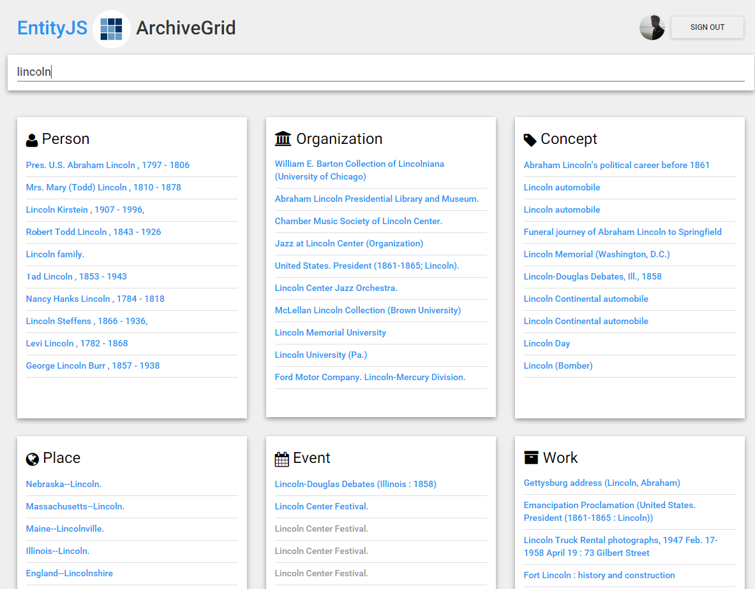
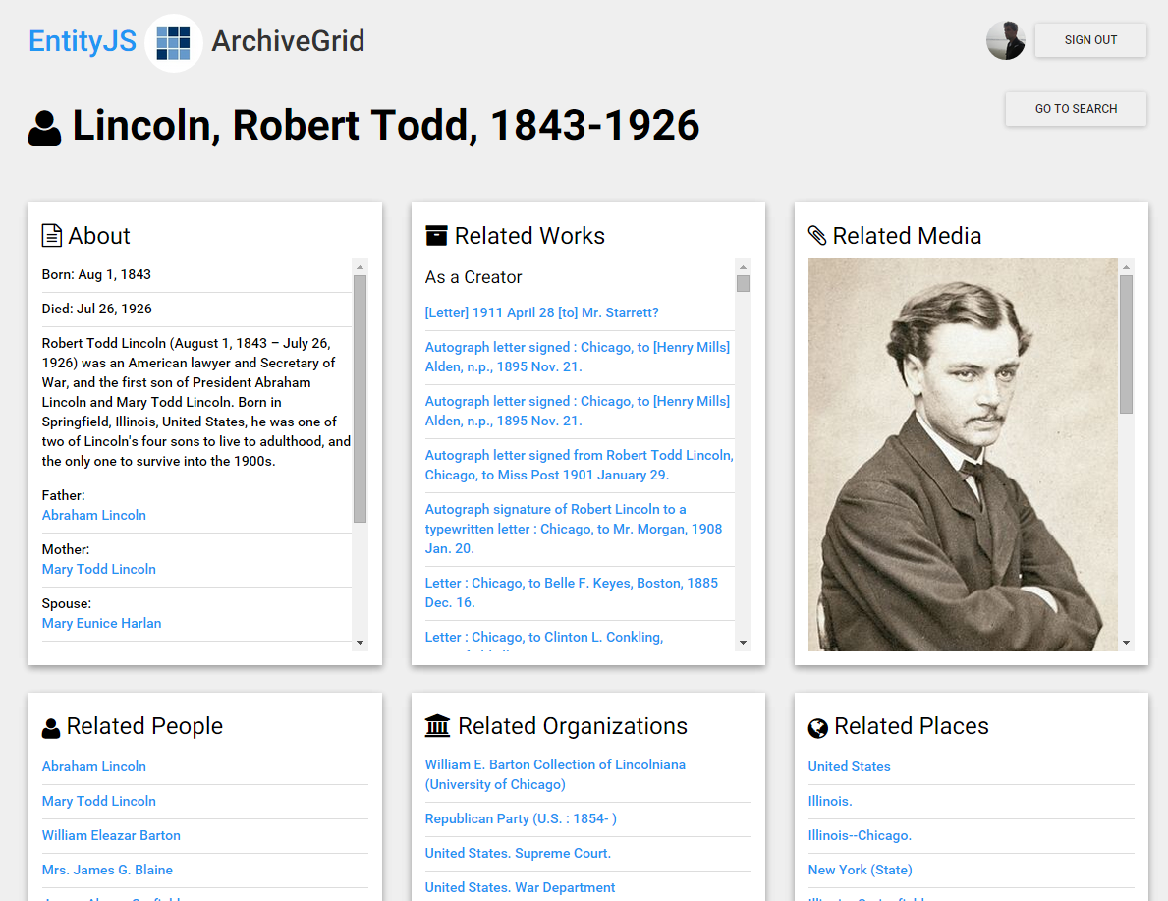
Entity JS
OCLC Research is experimenting with how to use linked data in an experimental discovery system we call “EntityJS”

Slide 64
Search across entities
Notes:
Based on triples in our knowledge vault we built an ElasticSearch engine that helps us quickly search across entities.

Slide 65
Show related entities
Notes:
When an entity is selected, we base the initial view of it on its RDF data source (in this case, a person entity represented by a VIAF record).
We supplement that with information represented by knowledge vault triples, displaying related works and the role this person has associated with that work (creator, contributor, or subject). We also find other related entities and show those that are identified most frequently in the set of ArchiveGrid source records … a kind of “PageRank” to show the most closely related entities first.

Slide 66
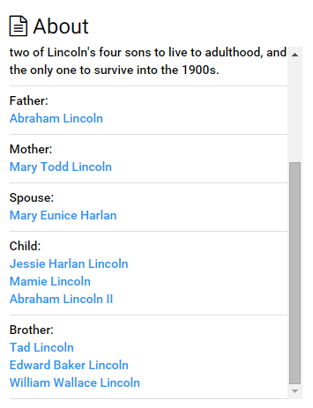
Show related entities
Notes:
And can identify family relationships to other people, not all of whom would have been otherwise represented in the initial set of ArchiveGrid MARC records. The family relationships from WikiData provide another network layer on top of the relationships in the MARC data.

Slide 67
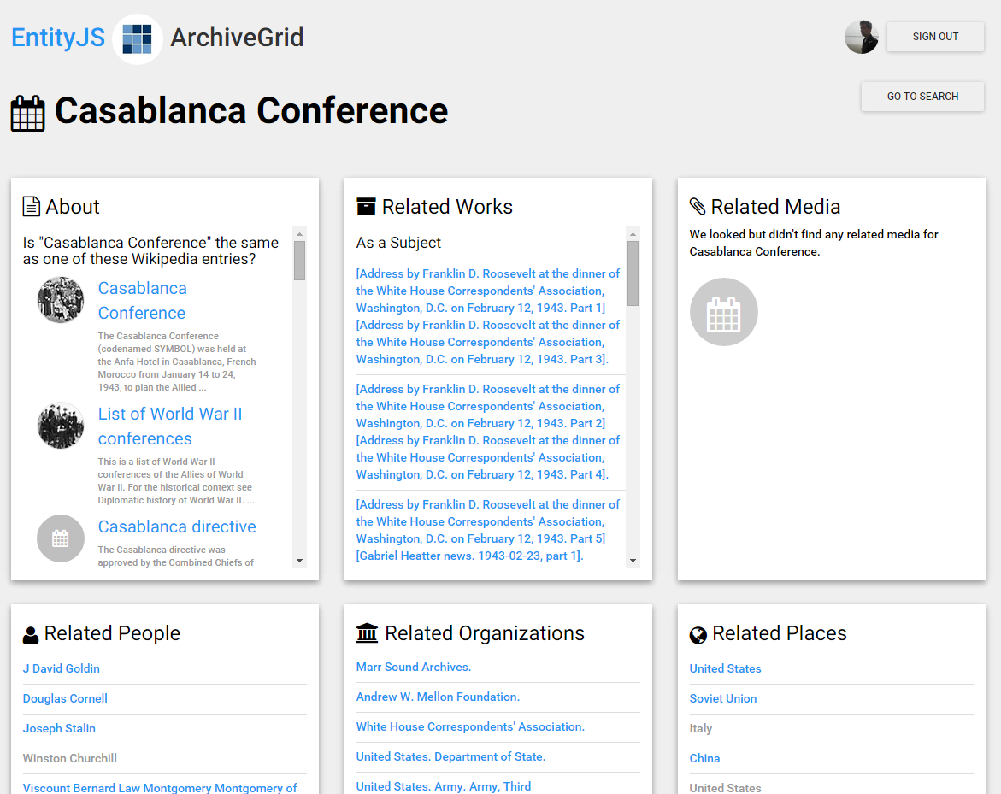
User-contributed “same as” relationships
Notes:
Not all of our bibliographic or authority records contain connections to related forms. Here is an example of a FAST subject that could benefit from a connection to the corresponding WikiData page.
EntityJS offers a way for users to select from a set of potentially related WikiData/Wikipedia articles for the subject.

Slide 68
User-contributed “same as” relationships
INSERT DATA { GRAPH <http://id.worldcat.org/fast/1405559> <http://schema.org/sameAs> <http://www.wikidata.org/data/Q502093>; <http://schema.org/sameAs> <http://dbpedia.org/resource/Casablanca_conference>.}
Notes:
Selecting a matching subject from the list sends an instruction to the EntityJS knowledge vault services to remember that as a “same as” relationship …

Slide 69
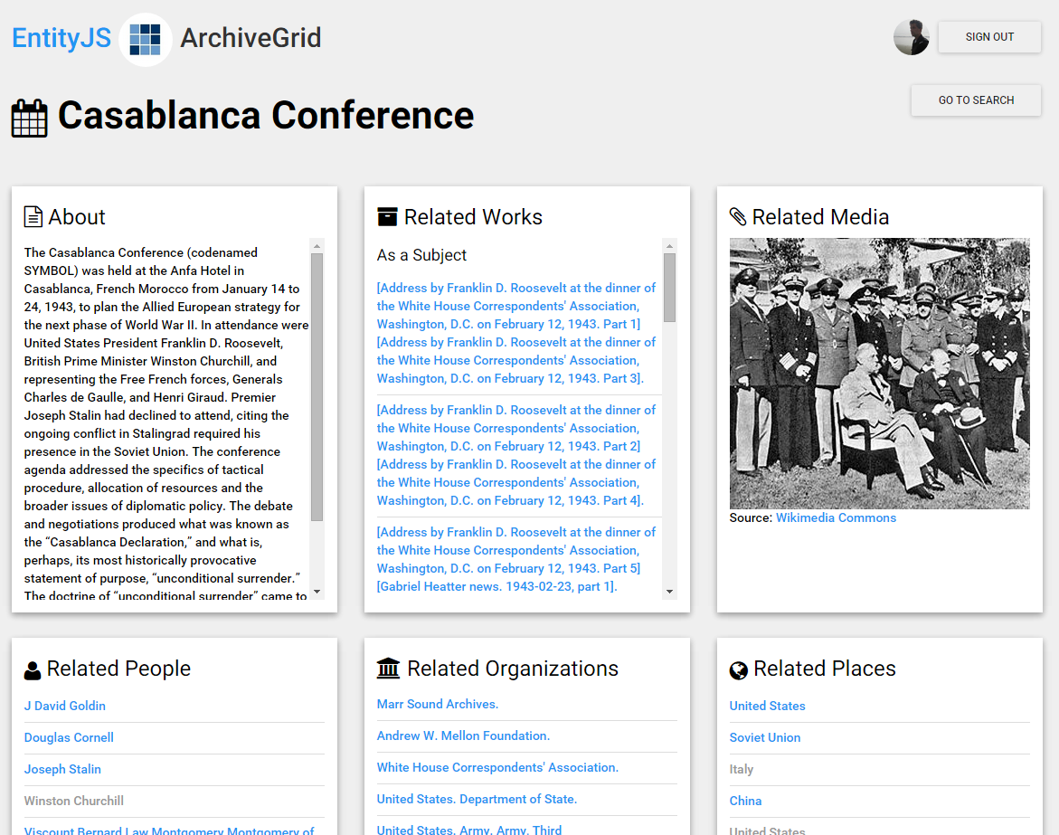
User-contributed “same as” relationships
Notes:
… and the data and related images from Wikidata and Wikipedia can immediately enrich the view in the EntityJS application, while going back into the mix to compete with other factual claims in the process that creates the knowledge vault.

Slide 70
Using Linked Data
Questions?
Jeff Mixter
Software Engineer, OCLC Research
mixterj@oclc.org

Slide 71
Round robin round-up 2016

Slide 72
Twin Peaks Style!
(image removed)

Slide 73
Who are we this year?
(image removed)
Total responses: 11
Museums = 10 Academic = 1

Slide 74
Administrative & Staff Changes
Status quo : 3
7 staff
resignations
(image removed)
6 promotions
39 new hires
3 staff retirements
2 staff openings
1 new museum director
1 new library director

Slide 75
Programs
A First: SHARE visiting program officer.
Lots going on:
Exhibitions;
Fellowships;
Internships; Lectures; Symposia;
Publications;
Wikipedia edit-a-thons.
Trending: Participating in city-wide “open house”-type activities.
(image removed)
Favorite pun in a program title:
“Octavofest”
Most Appetizing program title:
“The Edible Monument: The Art of Food for Festivals.”

Slide 76
Facilities
Most novel re-purposing of space: offsite materials moved back onsite; annex building demolished; lot used for free museum parking.
Lots of additional shelving, better lighting, new display cases, even some new circuit boards for compact shelving.
1 major library trans-for-ma-tion project
(image removed)
1 new roof, 1 new conservation/digitization lab, 1 nearly-completed expansion, 1 new state-of-the-art offsite storage facility.

Slide 77
Technology (a sampling)
Created “capture station” to digitize negatives & transparencies
Digitization projects
abound -- again
3D scanning
(image removed)
Social media use includes Tumblr, Facebook, Twitter, Pinterest, and – mentioned for the first time this year -- Instagram
Developed “Ask Expert” app prototype for iPad
Improved mobile device for local catalog
Primo discovery layer

Slide 78
Financial
Innovation: consulted circ records, sent solicitation letters to selected reseachers.
(image removed)
“Received first increase to overall book acquisitions fund since 2004.”
Grant-a-palooza: Carnegie, Delmas, IMLS, Ingalls, Kress, Mellon, NEH…
“Steady.” “Stable.” “Maintained last year’s funding level.” NO BUDGET CUTS.

Slide 79
Acquisitions
Favorite title: Catalogue of the late Lord Northwick’s extensive and magnificent collection of ancient and modern pictures, cabinet of miniatures and enamels and other choice works of art and the furniture, plate, wines and effects, at Thirlestane House, Cheltenham.
(image removed)
Item I’d most like to sit down with:
Favorite item: Broadside of the Declaration of Independence, printed in Newport, RI, dated July 13, 1776.
NEON Paris: [s.n.], 1948-[1949] 5 vols. Complete run of late Surrealist periodical. Including work from Breton, Matta, Ernst,and more.

Slide 80
5 Years From Now…
“I think we’ll be seen increasingly as a source for unique and hard-to-find materials documenting the art of our times.”
“Aspirationally, we will be hosting Fellowships in our Reading Room to complement the Drawings Institute.”
“As part of the institution’s campus redevelopment plan, The Hirsch Library will move to a new space in the Audrey Jones Beck Building.”
(image removed)
“Entering our second century of existence, the Library will have completed an in-depth analysis of what our researchers need in order to inform a new strategic review.”
“The library will have developed a new space plan to facilitate 21st century research requirements.”

Slide 81
See you next year… in the Big Easy!
(image removed)
All images stolen.

Slide 82
Thanks for attending!
Dennis Massie
Program Officer
massied@oclc.org

