Slide 1
47th Colorado ILL Conference • 29 April 2016
The OCLC ILL Cost Calculator
Dennis Massie
Program Officer, OCLC Research

Slide 2
WHY

Slide 3
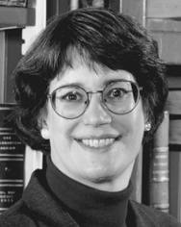
Where is the fresh ILL cost data?
$16.93/$10.56
$17.82/$9.56
$16.46/$8.73
$17.50/$9.27

Slide 4
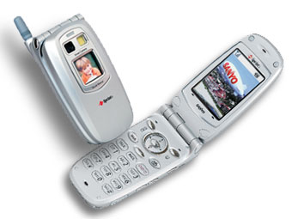
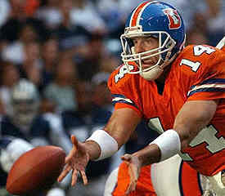
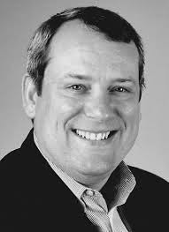

Slide 5
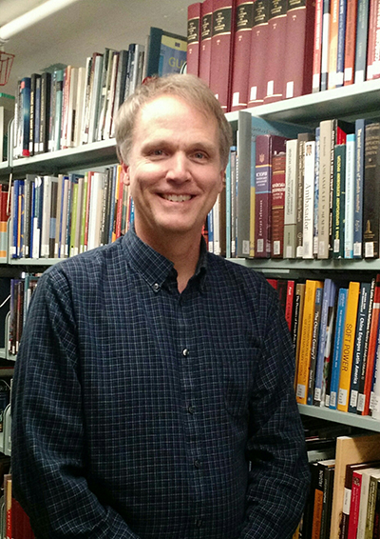
Lars and Nancy to the rescue
$9.62/$3.93
(23 responses)
$17.50/$9.27
(72 responses)
Notes:
THE EARLIER STUDIES DREW MORE THAN THREE TIMES THAT MANY.

Slide 6
Old Apples vs New Oranges
2002
Filled requests only
Selective tracking of unmediated methods
2011
Filled and unfilled
No tracking of mediated vs unmediated
Meanwhile:
Libraries are now lending from electronic holdings
Print items are being loaned directly from offsite storage
Many new methods, models, and technologies have emerged
Notes:
THE AGE OF THE DATA IS DEFINITELY A PROBLEM. BUT SO IS THE FACT THAT THE TWO MOST RECENT STUDIES DIFFER IN SEVERAL IMPORTANT RESPECTS, LIKE WHETHER OR NOT THEY TAKE INTO ACCOUNT UNFILLED REQUESTS, OR WHETHER THE BORROWING REQUESTS INVOLVED EXPENSIVE STAFF MEDIATION.
MEANWHILE THE RESOURCE SHARING LANDSCAPE HAS CHANGED RADICALLY IN THE PAST 14 YEARS. NOW WE MIGHT LIKE TO KNOW NOT ONLY HOW MUCH IT COSTS TO SUPPLY A COPY REQUEST FOR ANOTHER LIBRARY, BUT HOW MUCH IT COSTS TO DELIVER IT FROM A PRINT SOURCE OR AN ELECTRONIC ONE. HOW ABOUT THE COSTS OF SUPPLYING FROM OFFSITE STORAGE? NOT TOO MANY PEOPLE WERE WORRYING ABOUT THAT IN 2002.
NEW MODELS OF RESOURCE SHARING HAVE EMERGED, LIKE PURCHASE ON DEMAND AND DIRECT CONSORTIAL BORROWING. AND THE TECHNOLOGY HAS EVOLVED, AS TECHNOLOGY USUALLY DOES.

Slide 7
WHO

Slide 8
Current Working Group
Megan Gaffney, University of Delaware
Justin Hill, Temple University
Ralph LeVan, OCLC Research
Margarita Moreno, National Library of Australia
Moi!

Slide 9
Original SHARES Working Group – 2010
Megan Gaffney, University of Delaware
Penelope Myers, Temple University
Margarita Moreno, National Library of Australia
Moi!

Slide 10
Beta Testers – October 2015-present
Megan Gaffney, University of Delaware
Justin Hill, Temple University
Margarita Moreno, National Library of Australia
Lars Leon, University of Kansas
Brian Miller, The Ohio State University
David Larsen, University of Chicago
Jenny Lee, University of California, Los Angeles
Ronald Figueroa, Syracuse University
Matthew Sheehy, Brandeis University
Don Pawl, University of Colorado at Colorado Springs

Slide 11
What (songs of innocence)

Slide 12
Our aspirations for the calculator
Provide fresh data about current models
Help establish best practices
Facilitate comparison to anonymized peers
Support evidence-based decision-making

Slide 13
Use Cases
Users want to know:
Their resource sharing unit costs
How those costs evolve over time
How their costs compare with peers
Users would like to project:
The financial impact of joining a consortium
Of buying a certain piece of equipment
Of implementing a new service

Slide 15
Peers
My region
Equipment
Networks
Request method

Slide 16
Some guiding principles
Make data entry simple and easy
Minimize collection of confidential or sensitive data
Aggregate and anonymize data in reports
Use existing functionality where possible
Aim to produce actionable intelligence, not satisfy curiosity

Slide 17
how

Slide 18
Best laid plans…
We thought that:
all functionality would reside in the Web application (including Help)
vocabulary would be obvious
it would be easy to measure mediated vs. unmediated
pull-down menu’s seeded with popular equipment choices would save time
we would be able to pre-populate a lot of fields based on OCLC symbol

Slide 19
Why create one piece when four will suffice?
2
3
1
4

Slide 20
You say tomato, I say…
Transaction types
Loans borrowed? Non-returnables loaned?
Systems
Network? Manager? Router?
Library types
Academic? Research? National? Government?
Staff categories

Slide 21
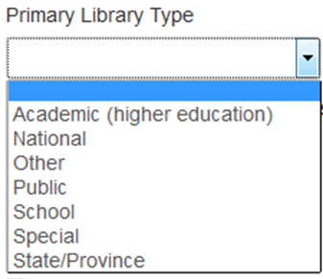
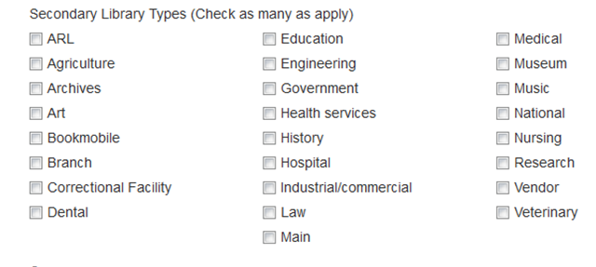
So…we rolled our own.
Primary & Secondary Library Types
Transaction types
System Types

Slide 22
So…we rolled our own.
Primary & Secondary Library Types
Transaction types
System Types

Slide 23
Returnables
Non-returnables
Loans
Copies

Slide 24
Loans
Copies

Slide 25
We kept staff types simple.

Slide 26
Mediated vs. Unmediated
Can we separate and count them?
Can you measure the impact of unmediated?
Without doing a time/motion study?

Slide 27
We went with “Degree of Automation” instead.

Slide 28
Let’s pre-populate fields to save time!
Because: We have the WorldCat Registry, which is machine-readable and contains information about every institution that has an OCLC symbol
Except that the information there is, um, non-standard
Because: How much variety can there be in the equipment being used across the community?
Um, according to a survey we conducted:
Flat bed scanners: 36
Overhead scanners: 16
Multifunctional devices: 47

Slide 29
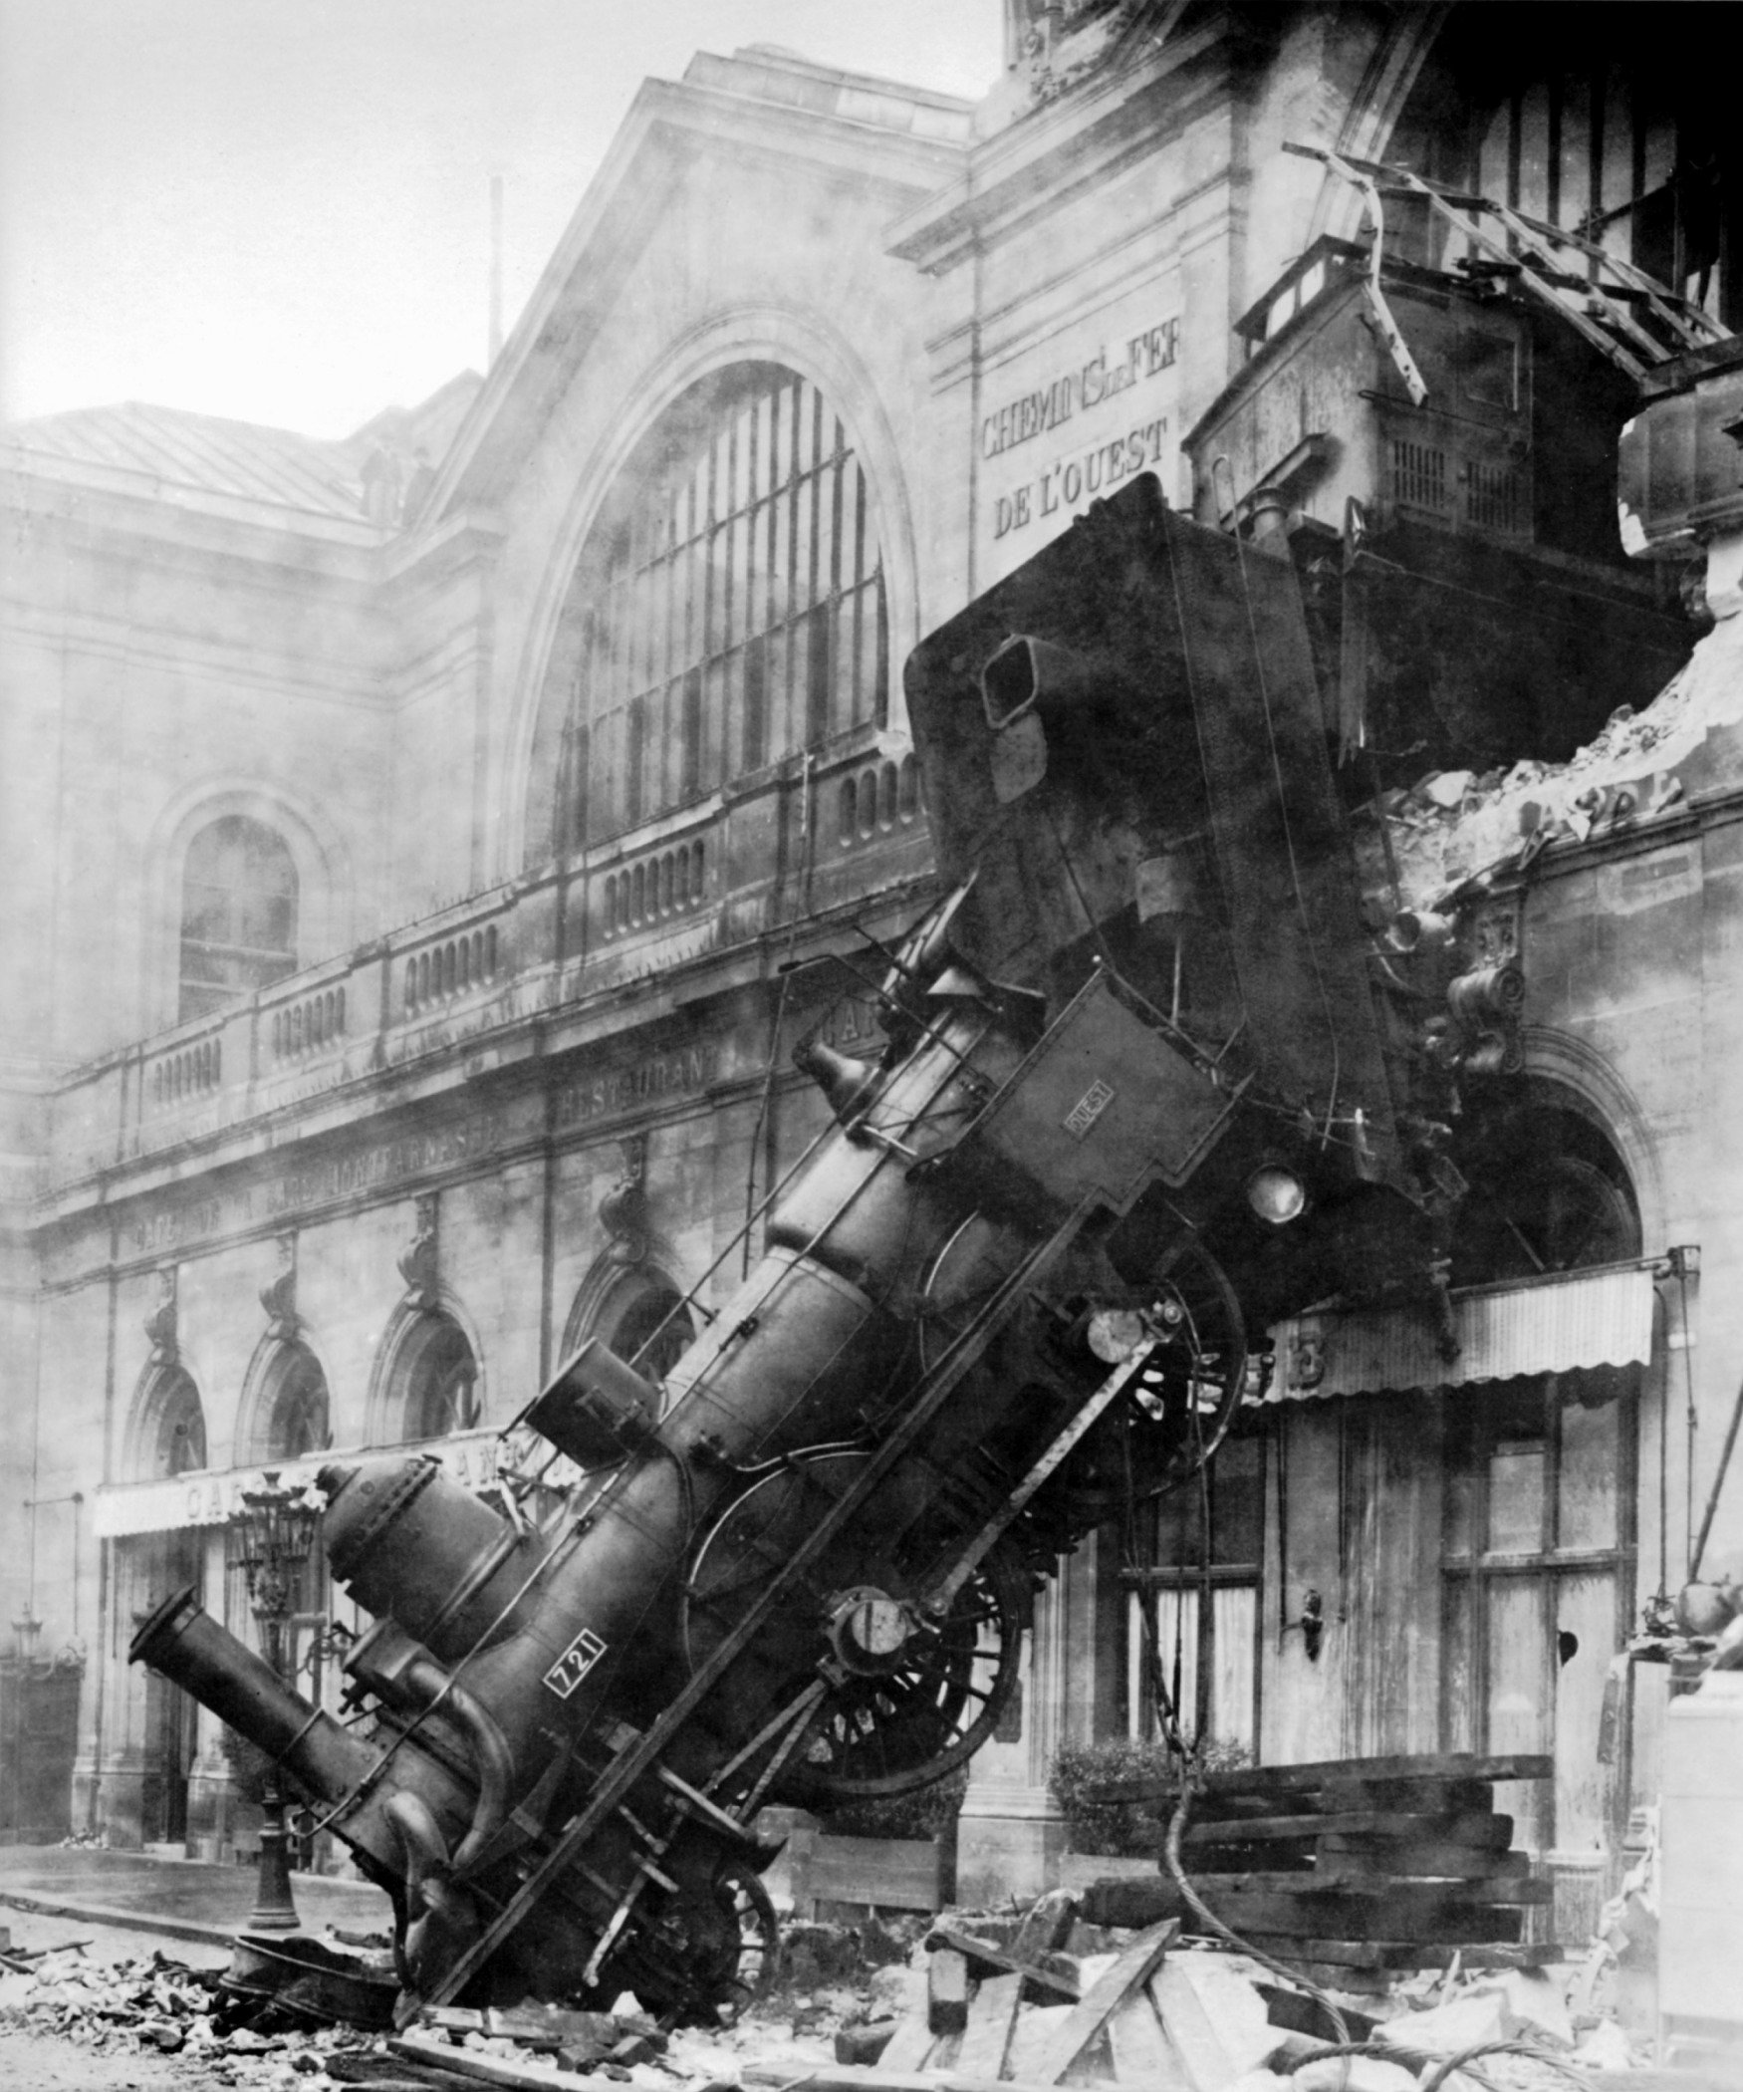
We (mostly) gave up on pre-populating.

Slide 30
We like to think we’ll meet our other design challenges more successfully.

Slide 31
What (songs of experience)

Slide 32
Basic functions
Show your unit cost
Show your anonymized peers' unit cost
Show how costs evolve over time

Slide 33
Advanced functions
Project the financial impact of joining a consortium/buying equipment
Provide a calculation option that takes unfilled requests into account
Separate out the costs of consortial borrowing
Identify a set of characteristics shared by high performers

Slide 34
Reports
High-level average costs – public reports
Detailed costs
What-if scenarios
privileged reports
*Only those who contribute data can access advanced reports and custom query functions.

Slide 35
You’ll keep sensitive information to yourself.
Enter salary for each staff person and estimate what percentage should be applied to each type of request.

Slide 36
The system calculates Staff costs and reports only totals for each category.
You’ll enter the salary data and review the system-calculated totals on private worksheet tabs that only you will see.

Slide 37
You’ll send in only totals by Staff category.
On a “staff totals” tab, re-type the numbers calculated by the system and then delete the tabs containing salary information for individual staff members.

Slide 38
We understand that salary information is extremely sensitive.

Slide 39
The very latest developments

Slide 40
Recent issues tackled by the Betas
Which staff should we include?
Circ? Offsite storage? Mail room? Work study?

Slide 43
Recent issues tackled by the Betas
Which staff should we include?
Circ? Offsite storage? Mail room? Work study?
What equipment should be counted? Amortized?
High-end scanners? PC’s? Printers? MFD’s?
How should we define an unfilled request?
From the patron’s POV? The ILL system’s?
Should we count delivering own stuff to own patrons?
What about costs covered by confidentiality agreements?
What about costs that we simply can’t come up with?

Slide 44
when

Slide 45
Now in Beta Testing

Slide 46
Birthing an ILL Cost Calculator
Next 4 months:
Beta testers will gather and submit their data
OCLC software engineer will build database and reporting functions
Beta testers will test reports
Next 6 months:
“Early interest” folks will be invited to submit data
Eventually
We’ll open it up to everyone
We’ll work with various groups and organizations to encourage use
Google OCLC ILL Calculator for more information.

Slide 47
47th Colorado ILL Conference
Questions? Comments?
Dennis Massie
Program Officer, OCLC Research
massied@oclc.org
©2016 OCLC. This work is licensed under a Creative Commons Attribution 4.0 International License. Suggested attribution: “This work uses content from The OCLC ILL Cost Calculator © OCLC, used under a Creative Commons Attribution 4.0 International License: http://creativecommons.org/licenses/by/4.0/.”
Notes:
.

