Slide 1
Transforming Resource Sharing in a Networked Global Environment • 10 August 2016
A Pinhole Approach to Understanding ILL Costs and Trends, or,
What a Dutch Master Can Teach Us About Analyzing Resource Sharing Data
Dennis Massie
Program Officer, OCLC Research
Notes:
Thank you. And good morning.
I’d like to thank the conference organizers for this wonderful opportunity to be with you here today. It’s an honor and a privilege to be addressing you.
Are you ready to hear more than you ever wanted to know about pinholes?

Slide 2
Introduction: Asking big questions is the easy part
Notes:
On that note -- let’s get started!

Slide 3

Notes:
It’s a big universe out there. Vast. Incomprehensible. And we as human beings sometimes like to contemplate that vastness, and to seek some understanding of our place in it.
Often such pondering gives rise to profound questions. Such as:
How big IS the universe? Or: Will it just keep expanding, for all eternity? And does it support alien life forms?
Sometimes the questions are focused a bit closer to home.
Is library collection-sharing activity going up or down across the ecosystem?
And, in today’s environment, which costs more for a lender to process – a request for an article from a printed volume, or a request for that same article from an e-journal?
Unfortunately we don’t know the answer to any of these questions.

Slide 4
Chapter 1: A “water, water everywhere” sort of problem…and some of the water is not fresh
Notes:
I get paid to spend time thinking about that second set of questions.
I work for OCLC, where we have a long-standing interest in supporting collection-sharing activity.
Naturally, it behooves us to try to understand some basic things about the universe in which we operate.

Slide 5
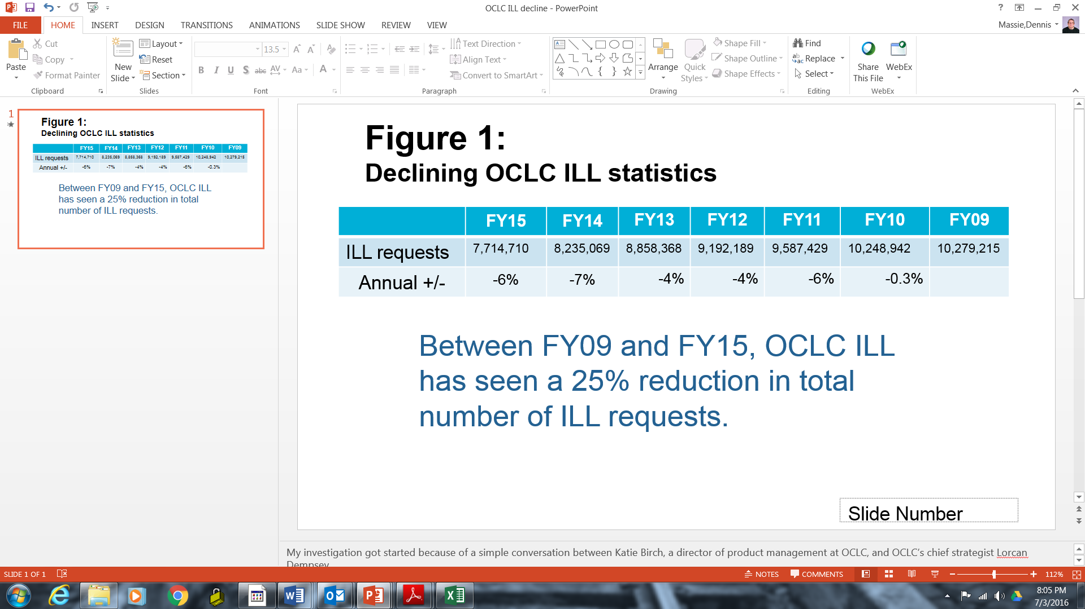
Declining OCLC ILL statistics
Notes:
But we have ready access to only a tiny portion of the data that describes that universe. Our own data, drawn from our own resource sharing infrastructure, indicates that interlibrary lending traffic is trending steadily downward—from about 10.3 million items requested in 2009 to less than 8 million by 2015, a drop of twenty-five percent over six years
Is this happening everywhere, across all ILL systems worldwide? We have no way of knowing. While experience tells us that sharing collections generates a vast amount of statistical information, no one collects such data from all parts of the globe and puts it in one place where we can all get at it. Even within the confines of a single continent – say, North America -- there is no central source of ILL data. The Association of Research Libraries, which includes 125 academic, state, national and public libraries in the United States and Canada, collects data from its members each year, including the numbers of items borrowed and loaned via ILL. But the numbers are expressed as a total for each institution, with one big number representing items loaned, and another number for items borrowed. There is no indication of how the requests were sent, whether the items loaned were print or electronic, or what proportion of the materials were provided in returnable formats. And there is certainly no indication of the “why” behind any changes that occur from year to year. Another source of uncertainty is the fact that the numbers are self-reported, not gathered directly from an automated resource sharing system. If one spends some time exploring the footnotes of ARL’s annual statistical reports, one finds things from the reporting institutions such as “Sorry, we’ve been double-counting this one category of ILL requests for the past few years, but we promise not to do that any longer.”
.

Slide 6
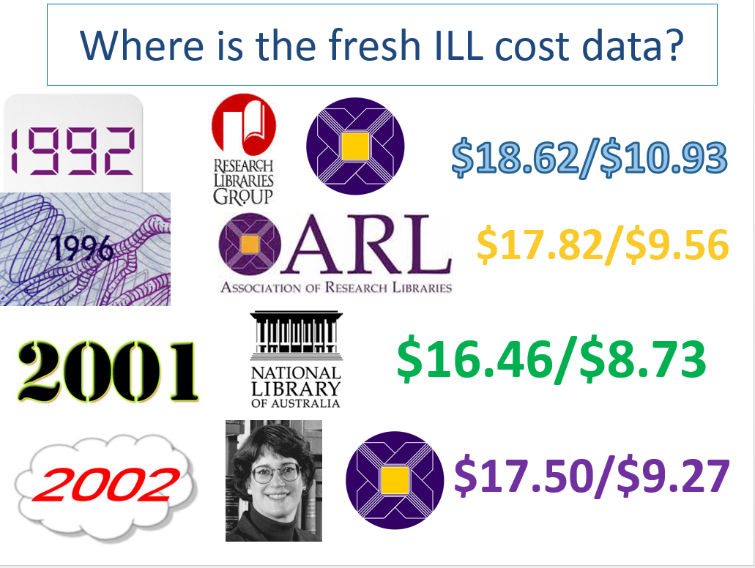
Notes:
We also have no idea how much it costs to share collections. The figures quoted today when folks talk about the costs of resource sharing are culled from studies conducted here in North American and Australia more than a decade ago.
The findings referenced most often are from a 1992 study conducted jointly by the previously-mentioned ARL, in association with the Research Libraries Group, which no longer exists; this study of 76 large North American academic libraries found that processing an average borrowing request cost $18.62 USD, while processing the average lending request cost $10.93 USD.
Lending fees were not included as part of the costs – these numbers are strictly overhead. The report itself does go into some detail about the difference costs between copies and loans, but these gross numbers are typically what still get quoted.
In a world where comprehensive library data is difficult if not impossible to get, what’s a library administrator (or OCLC Research program officer) to do?

Slide 7
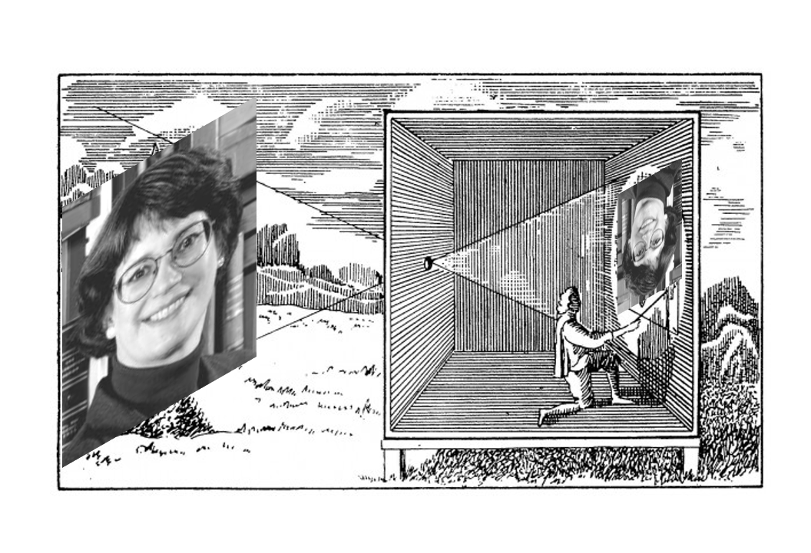
Notes:
Time for the old pinhole approach. Right? The old camera obscura.
You didn’t see that one coming, did you? Nothing about the title of my presentation gave you a hint.
What an ingenious method for bringing a bit of the wild and unfathomable outside world indoors, taming it, civilizing it, making it more manageable by projecting it upside down onto a blank wall or canvas.
According to at least one art historian, many great Renaissance paintings were accomplished using this technique. Why, then, shouldn’t this same idea be applied to processing and understanding wild and unfathomable collection sharing data?
If it’s good enough for Vermeer, , by gum, it’s good enough for OCLC Research.
I know what you’re thinking.

Slide 8
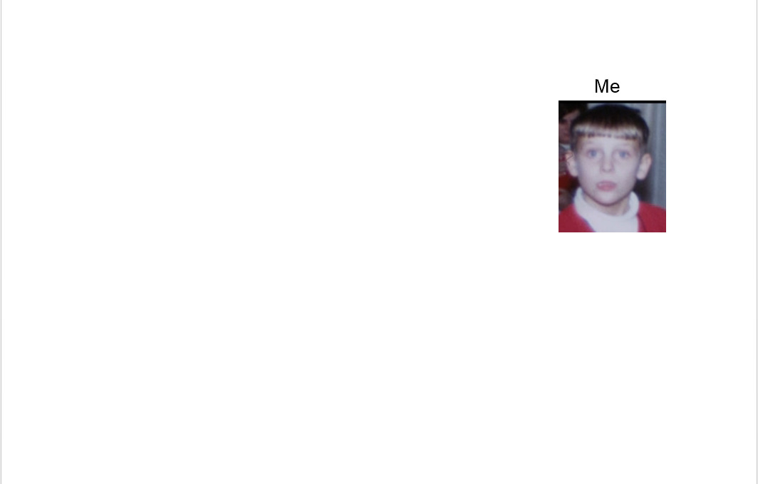
Notes:
You remembering when you were a kid, and there was a solar eclipse coming. And some responsible adult in your life told you that you’d fry your eyes right in their sockets if you so much as thought about looking at the eclipse.

Slide 9
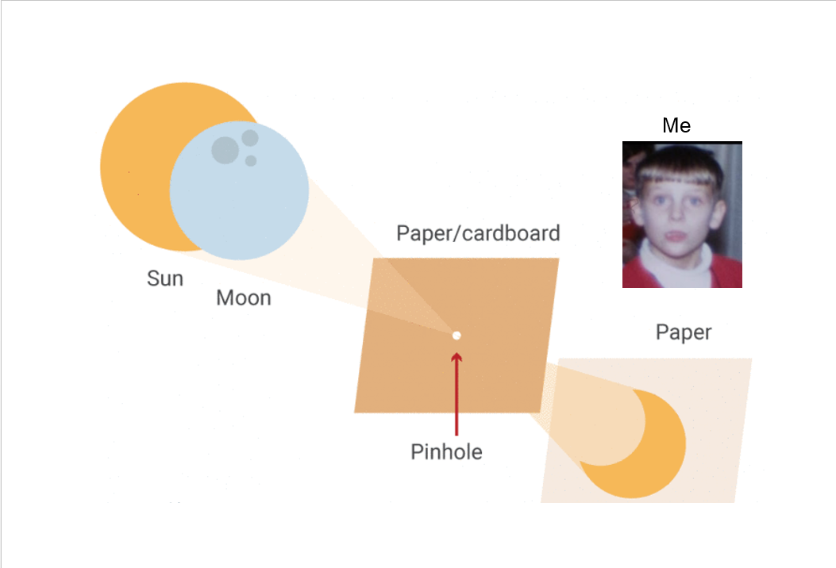
Notes:
And instead you were instructed to punch a hole in a piece of cardboard and turn your back on the action and watch a shadow play of the eclipse on a sheet of paper.
And that always felt like a – well, like a let-down. Didn’t it? Standing there with a piece of cardboard with a pinhole in it made you feel like a dork.

Slide 10
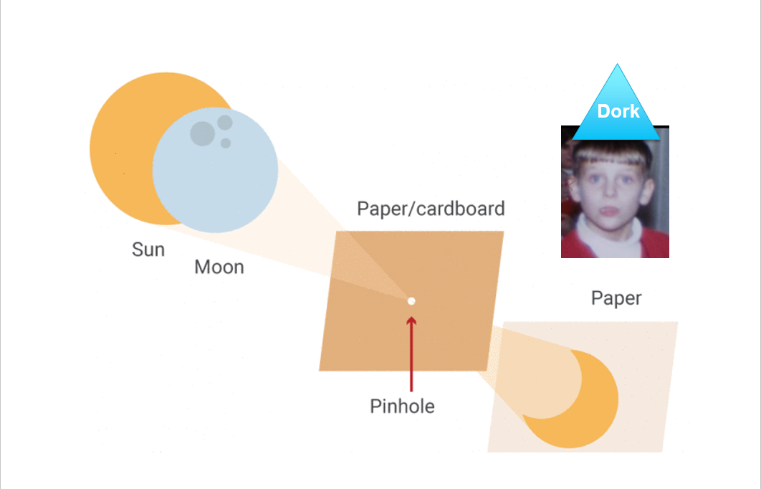
Notes:
Am I right? This way of viewing an eclipse gave the pinhole approach a bad name. It became the kind of approach only a dork would use. In short, a dork approach. In case there is no direct translation for “dork,” let me add that I also felt foolish and ridiculous. You get the idea.

Slide 11

Notes:
After all, this is the SUN we’re talking about here.
This is the most awesome force in our solar system, a ball of burning gas with a diameter 109 times that of earth, with a mass 330,000 times that of earth, and the almost unimaginable surface temperature of 5500 degrees Celsius, 10,000 degrees Fahrenheit.
And you’re supposed to get some idea of its magnificence by observing its shadow through a little pinhole? Are you kidding me?

Slide 12


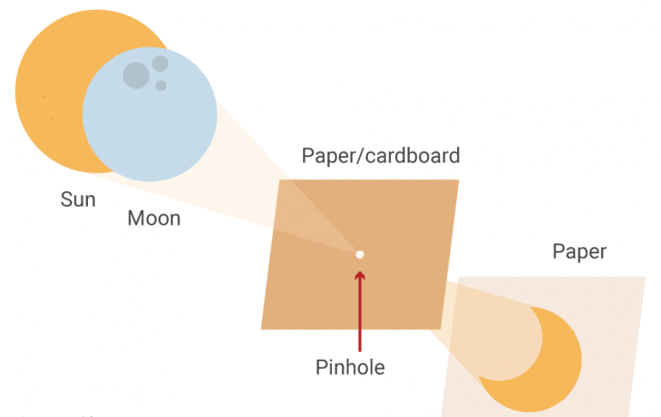

Notes:
If you were anything like me as a kid, you wouldn’t have been satisfied with the pinhole approach unless it made your sunglasses burst into flames and deposited a crackling campfire through that tiny hole and onto your dorky safe bland piece of paper.
That’s the kind of eclipse action I was looking for. Heck, yeah.
And then, at times like these, my mother always used to tell me, “Son, be careful what you wish for.”

Slide 13
Chapter 2: the borrow direct consortium to the rescue
Notes:
I always listen to my mother. So I put on my dork hat and off I went in search of a collection-sharing pinhole. I knew that a long-time colleague, about to retire, was closely connected with the Ivies Plus consortium. The eight Ivy League institutions – Brown, Columbia, Cornell, Dartmouth, Harvard, Pennsylvania, Princeton, and Yale -- had joined together with a few like-minded institutions – the Plus part of Ivies Plus – such as MIT, University of Chicago, and Johns Hopkins University, -- and most recently Duke and Stanford -- to create a resource sharing consortium called Borrow Direct .

Slide 14

As of December 2014:
Made up of 11 institutions with sophisticated, innovative resource sharing operations
Some long-established members, some newer Involved in all manner of consortial arrangements within and outside the group
Would serve as an excellent illustration of current trends in the research library community
Notes:
Borrow Direct is based on a model of resource sharing known, for lack of a better phrase, as consortial borrowing, or, perhaps more usefully, expanded circulation, or circ-to-circ. The way this model works is that the institutions involved create a big virtual group catalog that shows all the monographs available for borrowing via the scheme at all of the participating libraries, as well as real-time availability status. Library users at any of the institutions can order a book directly from any of the others, and it shows up at the user’s home institution in three-to-five days. So it’s fast. And because the availability of each item is known, the fill rate is about 95%. And because many institutions allow their users to order books that are owned but checked out at the home library, rather than instituting a recall, this model of sharing is enormously popular. I chose the Borrow Direct group to study because they are active, well-funded, well-run, and innovative. But mostly I chose them because my retiring colleague could make the introductions and smooth the way for me to get all the collection sharing data from the eleven (at the time) Ivies Plus institutions. Not just the Borrow Direct transactions, but all resource sharing data across all the libraries across all the ILL systems, both within the group and also with partners outside the group. Staff at each institution graciously agreed to collect and hand over to me five years’ worth of their collection sharing data, which they did, quickly, and cheerfully, on very short notice, during an exceedingly busy part of the year. Voila! I had my pinhole.

Slide 15
OCLC/Borrow Direct ILL Study
What numbers of borrows and loans has each institution executed in each of the various resource sharing venues in the past 5 years?
What factors determine the requesting method or model used for each request?
How/why is all this changing over time?
How will it most likely change in the future?
Notes:
So immediately I set to work. Here are the main questions I wanted to explore going in.
They had to do with overall volume, the volume of requests on particular systems, and any possible explanations for the changes taking place from year to year.
I was also interested in what the library staff thought would be happening 5 years from now, and why they thought that.
The ILL folks and the members of the Borrow Direct Policies Committee agreed that they were interested in these things, too.
I want to emphasize that these conversations and much of the analysis work took place over the course of the last year and represent Ivies Plus activity at a particular point in time. The work and planning within that group continue to evolve, and no doubt much has changed. But here is a detailed snapshot from about a year ago.

Slide 16
ARL vs Our Study Why might the numbers differ?
Institutions with multiple libraries and with complex ILL set-up’s might not have reported all activity to us.
Both sets of data are self-reported, and possibly compiled by different people.
Potential fiscal/calendar confusion
Overall, study participants reported 97.9% of what was reported to ARL.
Notes:
The first thing I did when I got the data from the eleven Borrow Direct institutions was add it all up and compare the totals with what they had reported to the Association for Research Libraries for those same years.
And guess what? Not only did it match pretty closely, it also told a fairly simple and straightforward story.
Overall they reported to me nearly 98% of what they reported to ARL, which I felt was reassuring. And the trend in activity clearly seemed to be going up.
The dark columns are the numbers reported to ARL, and the lighter columns represent what was reported to me. This was everything, by everybody in Borrow Direct, on any system, with any partner, borrowing and lending.
The news gets even better. See the one place where the two sets of numbers don’t add up? In 2012. The ARL numbers take a dip but the numbers reported to me continue their steady rise. Right away I noticed that one institution accounted for that drop. It turns out, when they reconsidered, that what they reported to ARL that year was probably wrong. So the story becomes even simpler and cleaner. Steady rise in collection-sharing activity, mirrored in both sets of data.

Slide 17
% ARL Numbers Reported to Us
Notes:
Unfortunately my sunglasses burst into flames the second I dug deeper. That clean, simple story turned out to be a mirage. This scatter chart shows a comparison between what the 11 individual Borrow Direct institutions reported to ARL and what they reported to me. One, where you see the yellow star, reported pretty much exactly the same numbers to both. The four dots within the red circle are within 10% of reporting the same. The lonely dot way out there in the middle of the chart – I didn’t worry about them, because they told me ahead of time that they would only be reporting data from the main library, and they did that consistently across the five years. No problem, I can still detect trends. It’s the two in the green circle, and especially the three in the blue triangle, that worried me. When I saw this, I knew this couldn’t be billed as any sort of scientific study. With this self-reported data from so many sources, we were obviously going to be painting our version of The Girl with the Pearl Earring with a broad brush. The only kinds of trends we might identify would be rather obvious ones.

Slide 18
Circ-to-Circ is where the growth is.
Notes:
Even with the wooly data I was able to identify two important trends. Here is the first one. The growth in the activity across the eleven institutions was to be found solely in the consortial borrowing numbers – not just the Borrow Direct traffic, but also other expanded circulation arrangements that four of the Ivies Plus libraries are involved in outside the group.
The light blue columns here show the circ-to-circ traffic, going steadily up.
The darker columns represent the more traditional union-list-based ILL activity, including OCLC’s WorldShare ILL, RapidILL, and Docline, with the numbers peaking in 2012 and then showing a slight decline.

Slide 19
Growth is due to new players.
Notes:
The second major trend I found in the data is that all the growth in collection-sharing activity across the group was isolated within the new members.
The chart shows all collection-sharing activity of the Ivies-Plus libraries, broken into three slices. The top line, the light blue, represents all the sharing activity of the three founding members of Borrow Direct. The second line represents all the sharing activity of the four institutions that joined Borrow Direct in 2002. Notice that they mirror each other, with almost exactly the same shape, with the original group doing just a tick more sharing than the 2002 group.
The line on the bottom shows the activity of those four institutions that joined Borrow Direct after 2011. Again, this is all sharing activity, with all partners, across all systems, borrowing and lending. And look how the volume takes off starting in 2011.
This surprised me. It’s probably the one thing that surprised most of the Ivies Plus ILL staff

Slide 20
Chapter 3: If the numbers won’t tell you why, ask the people behind the numbers
Notes:
I know that because at this point I went back and conducted interviews with the ILL folks at each of the 11 institutions.

Slide 21
6 Basic Questions for BD ILLer’s
What is the strategic thinking behind the groups you join? Technologies you adopt? Workflows you establish?
What forces are at work driving your choices?
Who are your users, and what needs do they hope will be met by your collection sharing services?
What user experience do you offer? What do you aspire to offer?
What would you like to learn from this data, or any data?
How will collection sharing evolve over the next 5 years?
Notes:
From the beginning I suspected that staff interviews would be the most important and interesting aspect of this study. In the end, I was not disappointed.
I prepared individual snapshots of the data for each institution, showing their activity versus the group averages. Mostly this helped us find several mistakes – some of them mine, some of them theirs – that explained many of the differences in the data reported to ARL and to me. Then we spent the rest of each hour talking about these topics right here.
[Read slide]

Slide 22
Strategic thinking
Automate the routine.
Build in predictability.
Push staff tasks lower in the hierarchy.
Introduce efficiencies, relax restrictive policies.
Partner in concentric circles.
Notes:
For the most part, their answers were exactly what you might expect them to be.
Why do they join certain groups, adopt certain workflows, embrace certain technologies? Their goal has long been to automate as much routine ILL traffic as possible. Arrangements such as consortial borrowing schemes and a journal-article-delivery system from the US called RapidILL allow them to do just that. In both Borrow Direct and RapidILL, institutions commit to delivering (with expectations of a super-fast turnaround) certain portions of their collections. The routine stuff. Borrow Direct’s Relais software shows real-time availability of the items, so requests are sent only to libraries where the material is available. RapidILL takes the holdings data for each library that joins and normalizes it so that a machine can route article requests to places where the volume and issue are actually owned. Both have fill rates approaching 95%. Both systems take staff largely out of the equation, and what tasks remain can be done by student workers. Both in consortial borrowing and in RapidILL, libraries arrange their routing tables so they trade with their best friends first, and then in ever-widening circles until they get to the occasional distant acquaintance.

Slide 23
Forces at work
Discovery is easier than delivery.
Library users have Amazoogle-type expectations.
Library users want print when they read to learn.
Even the richest libraries are buying less.
ILL has a bad reputation.
The e-book revolution hasn’t come close to catching up with the e-journal revolution.
Notes:
What are some of the forces at work that drive the decisions that administrators at these libraries are making about collection-sharing?
Their users are finding things. Lots of things. They have high expectations. Digital surrogates do not always suffice.
No library can buy as much as they once did, even if they are spending more. Libraries need partners if they are to fulfill the needs of their users.
ILL has earned a reputation for taking too long, costing too much, and yielding mixed results, all while being bounded by restrictive policies for the user.
Monographs -- which in the US are requested via ILL by users by a 2 to 1 margin over articles – are still king, and they are available mostly in print. And so consortial borrowing is now the king of collection sharing models.

Slide 24
Users (the who and the what)
Graduate students, mostly. And some faculty.
They want to borrow what’s in use at the home institution.
They expect extended loan periods.
They don’t care where it comes from or how you get it.
They want it yesterday.
They think everything is fair use.
Notes:
Who are the users, and what needs do they expect to be met by your collection sharing services?
Nearly half the users are graduate students, with faculty making up the next largest group.
They want what they want when they want it. Preferably free of charge.
They have high expectations.
They think everything is fair use.

Slide 25
User experience
Currently being offered:
A few fancy hidden algorithms
Some linking of systems with standards or Web services
Buttons on a Web page, describe each service, ask patron to choose
Unanimous aspiration:
Single entry point for all interactions with library services
Notes:
What user experience do you offer? What do you aspire to offer?
Some of the Borrow Direct libraries have programmers on hand who have developed hidden algorithms that route user requests into the fulfillment method that makes the most sense, and which give users one place to check for all their use history.
Others have started experimenting with off-the-shelf products that allow them to link up different systems they use, so that updating one updates the other.
Some are still at a place where they stick a couple of buttons up on a Web site, explain what each of the buttons means – this is ILL, it can take weeks; this is Borrow Direct, it can take 2-3 days – and let the patrons pick which one they want to try.
They all share the aspiration of having one place where a user puts in a request, and the system routes it where it needs to go. They say they want this even as they lament that it will eliminate the branding of their service – the very effective and popular brand of Borrow Direct, which many patrons know by name and in fact happily use whenever talking about any resource sharing service the library offers, whether it is really a Borrow Direct partner that is providing the material they requested or not.

Slide 26
They wish they knew…
What’s borrowed within vs outside the group.
What % of borrowed items are already owned.
Effects of consortial borrowing on OCLC ILL traffic with those same partners.
Per capita consumption of library services.
Others’ budgets and workflows for purchase-on-demand.
Correlation between expenditures and collection-sharing activity.
Why some constituents don’t use library services for their research needs.
Notes:
There were a number of things that the ILL folks wish they could learn, either from my data, or from what they’ve collected in the Borrow Direct data farm, or from any data anywhere.
What percent of what’s borrowed they already own. They’ve answered that one by now, I believe.
If there is any correlation between materials expenditures or number of students and faculty and the collection sharing data.
Who among their prospective users they’re not serving.

Slide 27
In 5 years…
Patrons will enjoy a more unified user experience.
Libraries will do more within consortia.
Circulation will stop declining and possibly even show an uptick.
The library will figure in a smaller proportion of a typical researcher’s material-gathering transactions.
Print will maintain its popularity.
Special trusted partnerships will be needed for sharing scarce and valuable materials.
Notes:
Staff at the eleven Borrow Direct institutions had a few predictions about what will come to pass in the next five years:
Libraries will increasingly share more than just ILL requests. There will be shared collections. Shared facilities. Shared staff expertise.
Some predicted the decline in circulation would stop and possibly even reverse itself. But others felt that, going forward, the library would participate in a smaller proportion of the information-gathering transactions initiated by scholars.
Print will stay popular.
Special trusted partnerships will be needed if you’re going to get hold of the hard stuff, those items that are most difficult to obtain.

Slide 28
Circ-to-Circ is where the growth is.
Notes:
Finally, the ILL folks at the 11 Borrow Direct institutions explained the causes behind the two big trends I had noticed in their data.
The consortial borrowing is going up because the institutions are thinking of it as a way to provide access to supplemental copies of recent publications that are likely to be needed by their users. Many of these things they already own. But the consortial borrowing workflows are so efficient that it is faster, easier, and cheaper to let a user borrow a copy of a book that is owned but checked out than it is to recall that same book from the current user. So many of these consortial borrowing requests were NOT things we would have seen ordered through the more labor-intensive, more restrictive ILL..

Slide 29
Growth is due to new players.
Notes:
And all the collection sharing growth is happening among the new members because Borrow Direct is a mature service at the institutions that have been long-time members. The Borrow Direct market is saturated there. But the new members come on board and they promote the new service aggressively and so of course they are the ones seeing all the growth.
Mystery solved. Pinhole data explained.

Slide 30
Next steps/further study
Chart OCLC ILL interactions in detail as new members joined Borrow Direct
Isolate returnables and non-returnables
Overlay expenditures and demographics onto collection sharing data
Notes:
There are still a few things left for me to work on with Borrow Direct, and most of it involves enhancing the picture of the group’s collection-sharing activity with data from other sources.
For instance, I’m now tracking interactions among the members where the requests go through OCLC ILL, because that’s data to which I have ready access. It will be interesting to see how that traffic evolved as new members joined the Borrow Direct cohort.
The Borrow Direct folks also want me to isolate returnable requests across all the systems, and nonreturnable requests across all the systems, rather than comparing OCLC ILL with RapidILL, and consortial borrowing with OCLC.
Finally, they’d like for me to overlay data about materials budgets and relative size of the user bases to see if that correlates at all with the sharing activity.

Slide 31
Newbie OCLC ILL Interactions with Borrow Direct Partners
Notes:
I’ve started on some of this “next step” work.
For instance, here is data for one of the newer Borrow Direct members showing how they interacted with the other partners via OCLC ILL over the years. You can see a steep and sudden drop in the borrowing of originals, which is no surprise.
But look how healthy the borrowing of copies has remained, possibly because now the new member is tied more closely than ever with the Borrow Direct libraries, and interacts with them more frequently than before in all their resource sharing venues, not just Borrow Direct.
Having the Borrow Direct data has allowed me to take a long look at a pinhole reflection of one busy consortium’s collection-sharing activity over a five-year period. Even though the numbers were self-reported and, in some instances, inconsistent, I believe that they revealed the outlines of some significant trends that may shed light on what is happening across the entire spectrum of libraries – at least across the spectrum of large, well-funded North American research libraries. I believe that the data, rough as it is, gives us some license to start painting a portrait of what we think may be going on with Collection Sharing writ large. True, I’m working from a small and rather unscientific sample. There is really only one thing I can ever do about that: conduct more research.

Slide 32
Chapter 4: If having one pinhole view is good, isn’t having two, by definition, twice as good?
Notes:
I’m in the midst of a second 5-year collection-sharing study with another US-based consortium which until recently was called the Committee on Institutional Cooperation, or the CIC.
Quite recently the CIC changed its name to the Big Ten Academic Alliance. For the purposes of this presentation, I’m going to refer to the organization as the CIC.

Slide 33


As of December 2015:
Made up of 14 institutions with sophisticated, innovative resource sharing operations
Some long-established members, some newer Involved in all manner of consortial arrangements within and outside the group
Would serve as an excellent illustration of current trends in the research library community
Notes:
In September of last year I got five years’ worth of data from 14 CIC institutions, who have a consortial borrowing set-up that they call Uborrow.
Again, this is a group of large US academic institutions, so one could suppose that the results I would see from examining their data wouldn’t differ that much from the Borrow Direct data. Right?

Slide 34
CIC ILL Study
They:
Volunteered
Owned the process
Profited from my Borrow Direct experience
Opted to track purchase-on-demand
Share a member with Borrow Direct
Set up their consortial borrowing process to run through ILL rather than Circulation
Notes:
One difference was that doing the study was the CIC’s idea, so they were more deeply involved in the planning and wrangling.
Interestingly, they share a member with the Borrow Direct group.
And they opted to run their consortial borrowing requests through the ILL infrastructure rather than mimicking circulation.
So that’s an interesting difference.

Slide 35
Per-Student Expenditures, 2012 NECS Survey
IviesPlus
CIC
Notes:
I mentioned earlier that I was going to overlay data on expenditures and demographics on top of the collection-sharing data, to see if there is any correlation.
This slide shows that there could possibly be some interesting differences between the two groups, in terms of how they are funded. The Ivies-Plus institutions are mostly private institutions with large endowments, while the CIC is mostly state schools that are publicly funded. You can see here the differences in expenditures per student for the two groups as of 2012.
So I’m at the beginning stages of investigating this sort of thing.

Slide 36
Total sharing activity is going down.
Notes:
And now I’ve had my first pass through the CIC ILL data. I totaled it all up and threw it onto a chart.
And guess what?
It’s nothing like the Borrow Direct data. Total activity for the CIC is trending down.

Slide 37
traffic is way, way up.
Notes:
True, the consortial borrowing among the group is skyrocketing. So, again, this resembles the experience of the Borrow Direct group.
But remember, this is a fresh service to the CIC, being heavily promoted by most of the partners.

Slide 38
Other Consortial Borrowing: Down-ish.
Notes:
If you look at the consortial borrowing activity of the CIC libraries in schemes other than Uborrow, we see, at least in the lending, a distinct downward trend.
Huh? I thought consortial borrowing was the king of collection sharing models? What’s going on here?
I haven’t spoken to the CIC ILL folks yet – my first call with a CIC ILL unit is scheduled for next week. But it seems that many of them are involved in state networks where the level of activity is dropping.
This line of inquiry is worthy of some further attention.
Two pinholes really are better than one.

Slide 39
Free online, POD of non-returnables up.
Notes:
Another big difference between the two studies is that the CIC folks decided we would track the purchasing-on-demand traffic of their members, and the finding of requested items free online.
This chart looks very much like someone reclining on a hammock but it actually shows quite a lot of purchase-on -demand activity, especially of articles. It also shows a great increase in finding things free online starting in 2013. And I love that for each year there are a few instances where lenders found things free online for borrowers and counted that as a “fill.”

Slide 40
Notes:
In the meantime, I’ve been hearing a different sort of question about the various models of resource sharing, particularly regarding consortial borrowing. You remember this slide. Sure, folks are still wondering if collection-sharing traffic is going up or going down, or if it is switching from one model to the next. But increasingly people have been asking me what the various models and methods cost.
At this moment, I don’t know the answer to that question. But I know how we can find out.

Slide 41
Chapter 5: the oclc ill cost calculator – a different type of pinhole
Notes:
This project has been about five years in the making. It started with the SHARES resource sharing consortium’s pricing committee debating whether or not it is crazy to value the provision of a book the same as the provision of an article. It was Margarita Moreno of the National Library of Australia’s idea to take that question a step farther. Why not design a tool that would answer many such questions, for many years to come?

Slide 42
Working Group
Megan Gaffney, University of Delaware
Justin Hill, Temple University
Ralph LeVan and JD Shipengrover, OCLC Research
Margarita Moreno, National Library of Australia
Moi!
Notes:
A working group was formed, and after several years of thrashing around we are finally closing in on having a functioning tool.

Slide 43
Our aspirations for the calculator
Provide fresh data about current models
Help establish best practices
Facilitate comparison to anonymized peers
Support evidence-based decision-making
Notes:
We felt the need for a tool what would address the most current models of sharing collections, which have evolved quite a bit in the past few years.
We felt that such a tool should be able to identify efficient practices that could then be shared with others.
We thought users would want to know not only their own unit costs but also how they’re doing when compared with others in their peer group.
And we wanted a tool that would give library administrators data that would help guide them in their decisions about how they will support collection sharing at their institutions.

Slide 44
Use Cases
Users want to know:
Their resource sharing unit costs
How those costs evolve over time
How their costs compare with peers
Users would like to project:
The financial impact of joining a consortium
Of buying a certain piece of equipment
Of implementing a new service
Notes:
From surveys, from looking at past studies, and from our own experiences we know that ILL practitioners and their administrators also want a tool that can help them answer “the hypotheticals.”
What will the financial impact be of joining a certain type of consortium, or buying a high-end scanner, or implementing a new service?
We are working to make the calculator capable of answering such questions.

Slide 45
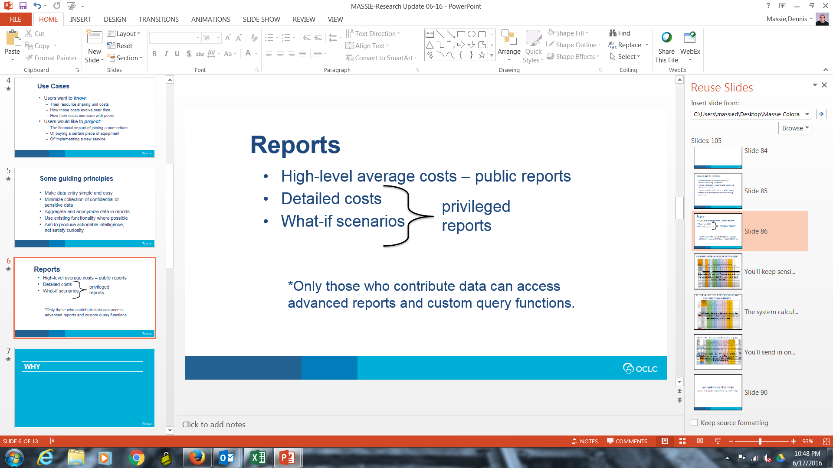
Notes:
The tool will be freely available to anyone on the Web.
Absolutely anyone will be able to come and click on some buttons and find out how many libraries have contributed data and what the overall average costs are for borrowing and lending.
But if you want detailed reports, breaking down costs by category such as staff, systems, and equipment, and if you want to know your own costs and be able to compare them with your peer group, you’ll need to contribute your data to the calculator.

Slide 46
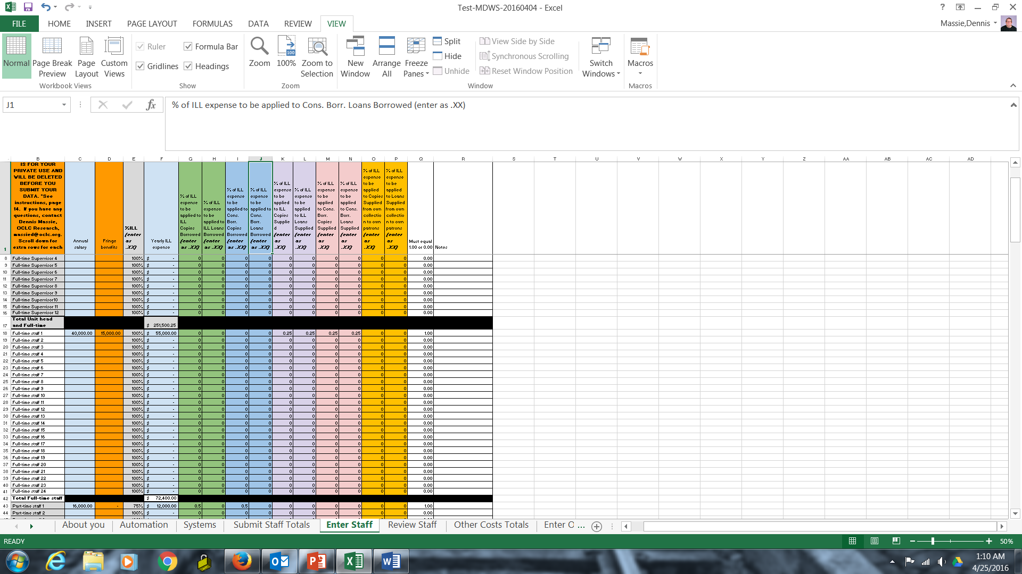
You’ll keep sensitive information to yourself.
Enter salary for each staff person and estimate what percentage should be applied to each type of request.
Notes:
The success of the tool will depend largely upon the willingness of library administrators to allow their data to be included. We realize that all of the cost data, but especially the salary information, is quite sensitive. Only you will be able to see the sensitive stuff. Detailed salary information will not be sent to the calculator. No report except your private reports will identify any data as yours. The privacy of individuals and institutions has been uppermost in our minds all the time we’ve been working on this.
So on this tab of the data worksheet you could gather and enter detailed salary information for each staff member.

Slide 47
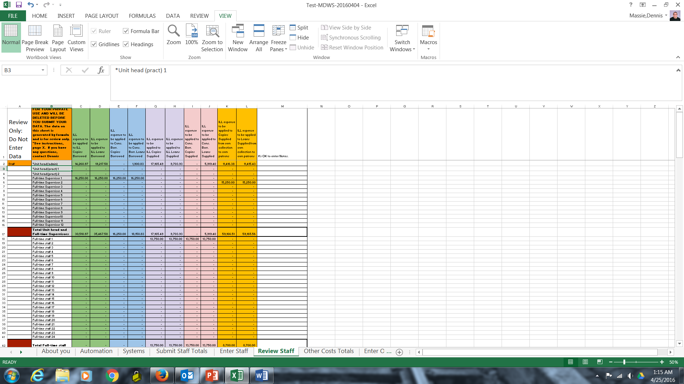
The system calculates Staff costs and reports only totals for each category.
You’ll enter the salary data and review the system-calculated totals on private worksheet tabs that only you will see.
Notes:
The spreadsheet does some calculations and comes up with total expenditures for each ILL task for each staff category.

Slide 48
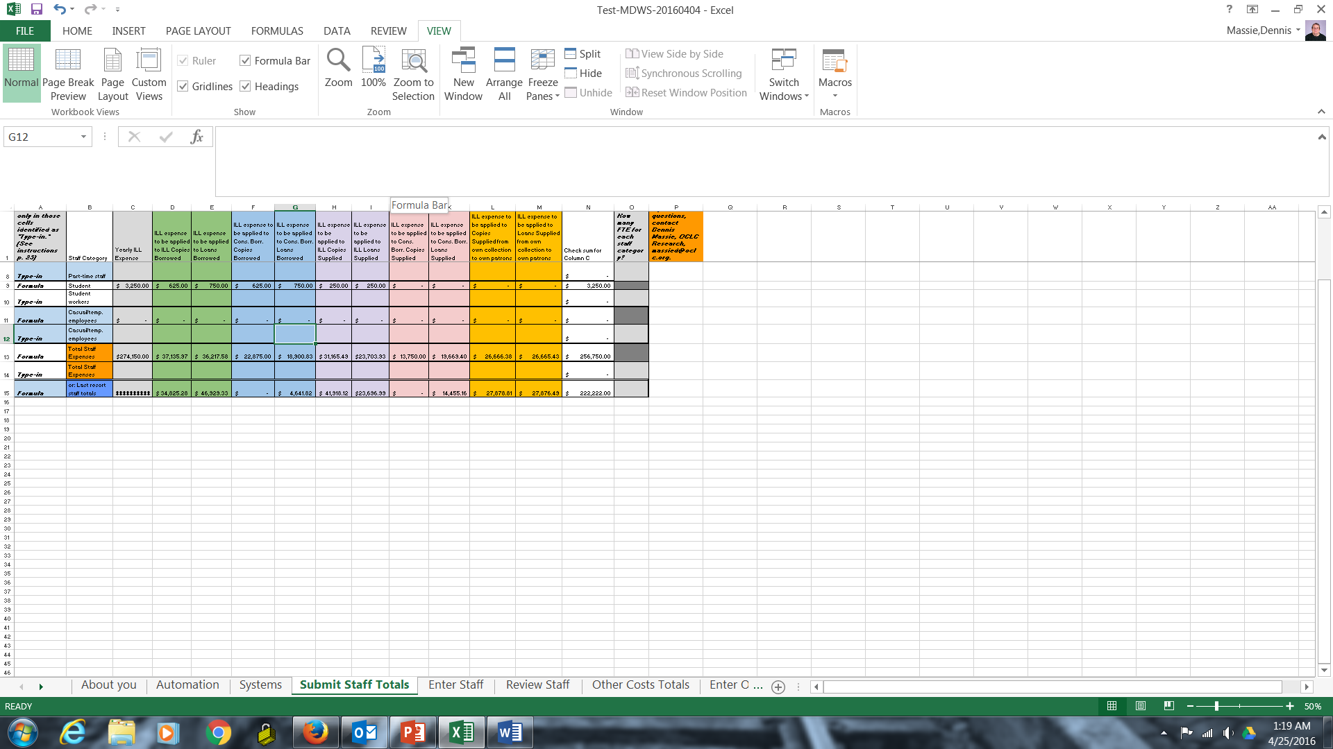
You’ll send in only totals by Staff category.
On a “staff totals” tab, re-type the numbers calculated by the system and then delete the tabs containing salary information for individual staff members.
Notes:
It then places those totals on a different tab, where you will be asked to re-enter the numbers below the system-generated numbers.
Before submitting your data intake tool, you will delete the tabs with the detailed staff information, after first saving a copy for yourself.
Privacy protected.

Slide 49
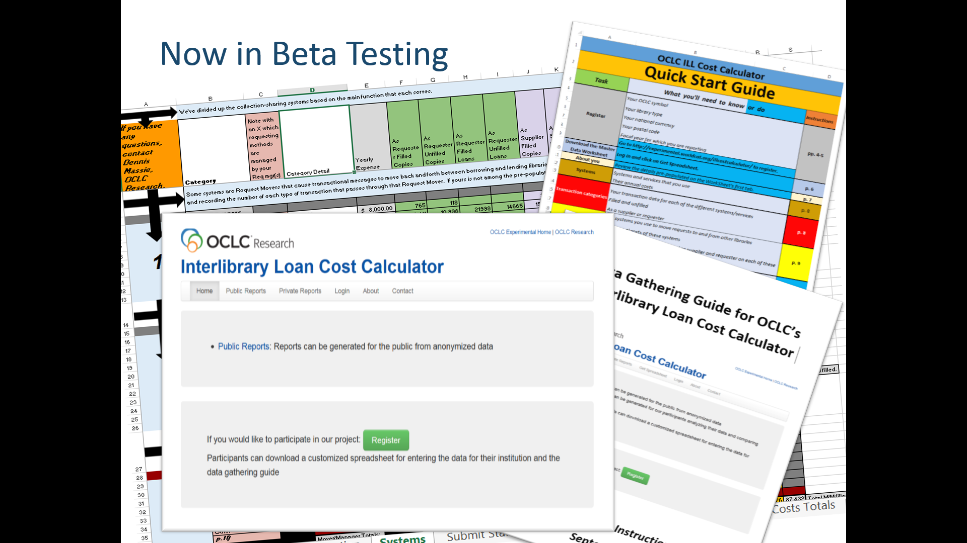
Notes:
The registration and data gathering and submission functions are currently in beta test at 11 institutions.

Slide 50
Beta Testers – October 2015-present
Megan Gaffney, University of Delaware
Justin Hill, Temple University
Margarita Moreno, National Library of Australia
Lars Leon, University of Kansas
Brian Miller, The Ohio State University
David Larsen, University of Chicago
Jenny Lee, University of California, Los Angeles
Ronald Figueroa, Syracuse University
Matthew Sheehy, Brandeis University
Josh Steans, University of Wisconsin-Stout
Don Pawl, University of Colorado at Colorado Springs
Notes:
These folks have been hard at work putting the Web interface and the master data worksheet through their respective paces.

Slide 51
Recent issues tackled by the Betas
Which staff should we include?
Circ? Offsite storage? Mail room? Work study?
How should we define an unfilled request?
From the patron’s POV? The ILL system’s?
Should we count delivering own stuff to own patrons?
What about costs covered by confidentiality agreements?
What about costs that we simply can’t come up with?
Notes:
The beta testers have brought up literally hundreds of issues with the tool since October. Some recent ones are:
Which staff costs to include. Leaning toward anyone who touches the requests, comes out of library funds, and who spends a substantial amount of their time on collection-sharing tasks. Defining substantial has proven to be tricky. What we won’t be collecting is whether or not staff are degreed librarians. Does not affect costs. Full time managers, full-time staff, part-time, etc. We saw no need to set apart librarians from paraprofessionals.
We want to include unfilled costs, because staff spend time on them. But different places define unfilled differently. Different automated systems also define it differently. One approach is “The patron asked for it, did the patron get it. Yes? Or no?” We’ll see how that works out. That’s not quite resolved yet.
Should we count delivering our own stuff to our own patrons? Not sure. Does the answer depend upon whether ILL staff or circ staff do the work? Or is it out of scope? I think we’re probably going to count it, or at least make it an option.
Finally, and maybe the last major hurdle we face with the data intake, is what about costs deemed confidential, or costs you simply can’t get?
As I said, because of the sensitivity of the data, we’ve decided that we’re only asking for total costs in each staffing category, applied by percentages across all the various collection-sharing tasks. For other sensitive data points, like some service provider fees or contracts with certain shipping companies, we may have to do like with staff and only report the total in each of the various categories. For unavailable costs, we hope to develop some formulas that give approximate costs based on several aspects.

Slide 52
Birthing an ILL Cost Calculator
Next 4 months:
Beta testers will gather and submit their data
OCLC software engineer will build database and reporting functions
Beta testers will test reports
Next 6 months:
“Early interest” folks will be invited to submit data
Eventually
We’ll open it up to everyone
We’ll work with various groups and organizations to encourage use
Google OCLC ILL Calculator for more information.
Notes:
Building and testing the reporting functions will be the next phase. Then we’ll open it up to some early adopters when we’ve implemented the improvements put forth by the betas. And before the new year is very old we hope to be open for business for everyone.
Google OCLC ILL Calculator for more information and future updates.

Slide 53
Conclusion: Wouldn’t the “drinking from a firehose” metaphor be faster?
Notes:
It is frustrating to live in a world where so much library data exists and to be able to get my hands on only a tiny portion of it. But this type of research is a little bit like that popular definition of politics that is often heard: it is the art of the possible.
The pinhole approach to studying the collection-sharing universe has not been perfect or comprehensive, but it has generated some interesting food for thought. I am very grateful to the administrators and staff at the CIC and Borrow Direct institutions for so generously providing me with their data and taking the time to answer my questions and to think big thoughts with me.
My hope is to continue to gain access to transactional resource sharing data from more groups of libraries. Moving forward it would be interesting to concentrate on different types of libraries than those in the CIC and Borrow Direct – libraries in other countries, public libraries, libraries that must get by on flat or declining budgets. Attracting many types of libraries from all over the world to enter their data into the ILL Cost Calculator will also be an important focus for me in the coming months.

Slide 54
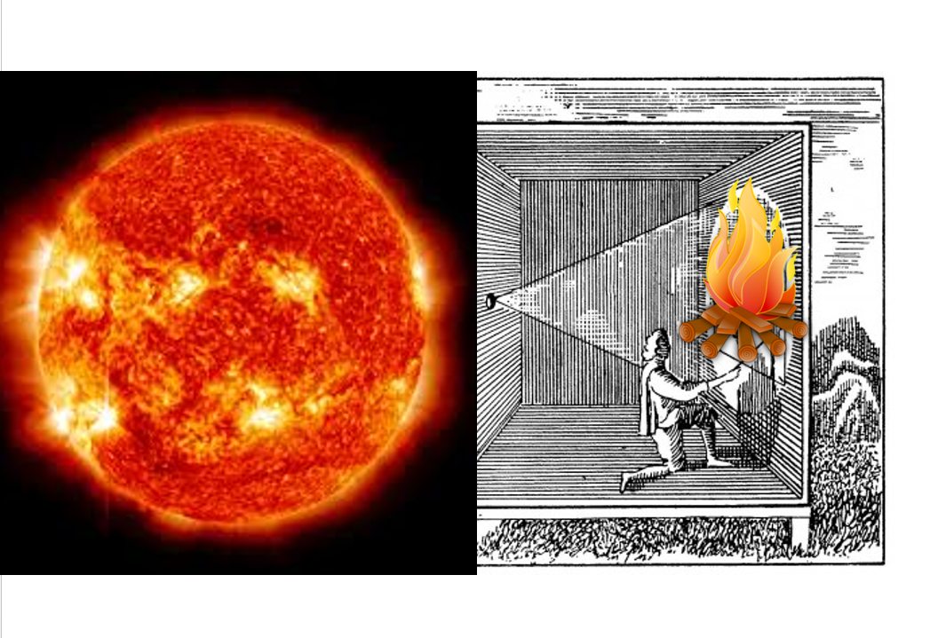
Notes:
With each added piece of data that comes in through the pinhole, hopefully the image of the collection-sharing universe that is being projected will come into an ever sharper focus. And if we’re lucky we can trace what is there quickly enough to capture a good likeness before that universe evolves into something not yet imagined.

Slide 55
Interesting is nice, Actionable is essential
Notes:
My written paper ends there. The conference organizers asked that we submit our finished papers a couple of months ago.
Since then I’ve been doing a lot of thinking about this difficulty in gaining access to data that could help us plot our way more confidently and efficiently toward our collection sharing future.
And I’ve been thinking about the kinds of questions that seem most urgent for us to answer.
I wanted to share a few thoughts with you.

Slide 56
Interesting is nice, Actionable is essential
Compile worldwide collection sharing data
Notes:
We should make a serious effort to gather and share as much collection sharing data from around the world as we can. Perhaps IFLA can play a part in this effort. I would certainly be willing to spend time on it.
If work in this area has already gone on, I wasn’t able to find it.
Of course, there are challenges. One is finding the most likely sources of data in the various corners of the globe. Another is that data can be thought of as an asset and a commodity, so the types of data that can be freely shared may be limited. But I think we should make the effort.

Slide 57
Interesting is nice, Actionable is essential
Compile worldwide collection sharing data
Get to know our users – and potential users
Notes:
We could stand to learn a lot more about the users of our services – and the potential users who are currently going elsewhere for their information needs. There has already been some interesting work in this area. OCLC has published some studies about how people seek information, and Ithaka S&R has published a fascinating study focusing on historians.
Many of you are aware of Gabriel Gardner of Cal State Long Beach and his work studying the use of the pirate article site Sci-Hub.
But a comprehensive study of ILL users and non-users would seem to be something for which our world is ready. There are lots of people in this room who could help that happen.

Slide 58
Interesting is nice, Actionable is essential
Compile worldwide collection sharing data
Get to know our users – and potential users
Learn more about what’s being shared
Notes:
Rather than just focusing on numbers and the flow of requests through various systems and among various partners, I think it will become increasingly important for us to know more about what is being shared.

Slide 59
Interesting is nice, Actionable is essential
Compile worldwide collection sharing data
Get to know our users – and potential users
Learn more about what’s being shared
How old?
How widely owned?
What subjects? Languages?
Notes:
When was it published? Is it scarce or widely held? What subjects and languages are most popular or the hardest to get?
Knowing such things will enable you to make better collection management decisions and let you know what institutions out there would make the best resource sharing partners for your library.
Also, knowing what percentage of your borrows are long-tail items and what proportion of your staff time goes to tracking down such hard-to-find items can have staffing and workflow implications.

Slide 60
Interesting is nice, Actionable is essential
Compile worldwide collection sharing data
Get to know our users – and potential users
Learn more about what’s being shared
How old?
How widely owned?
What subjects? Languages?
Explore what “managed scarcity” will mean when more institutions are depending upon fewer copies
Notes:
Many of you are entering into shared print agreements where you take responsibility for holding onto certain items for the benefit of the collective while at the same time you can consider managing down your duplicate copy of items being preserved and shared by others.
Have we fully thought out the implications of this? Will it become more difficult for those institutions not privy to shared print agreements to borrow from this reduced stock? Will forming partnerships become even more important?
Following the flow over time of requests and fill rates for requests outside existing partnerships would be a good way to monitor this potential outcome of managing down duplicate print collections.

Slide 61
Interesting is nice, Actionable is essential
Compile worldwide collection sharing data
Get to know our users – and potential users
Learn more about what’s being shared
How old?
How widely owned?
What subjects? Languages?
Explore what “managed scarcity” will mean when more institutions are depending upon fewer copies
Discover predictive relationships between data elements
Notes:
It’s one thing to identify and track important variables. It’s another when you can come to understand the interrelationships among the variables so well that if you change one element you can predict what will happen to the others.
This is what I aspire to with some of the follow-up work on the Borrow Direct and CIC data – seeing if various financial, demographic, or technical variables correlate to resource sharing activity, and if so whether any of those lend themselves to forecasting.

Slide 62
Interesting is nice, Actionable is essential
Compile worldwide collection sharing data
Get to know our users – and potential users
Learn more about what’s being shared
How old?
How widely owned?
What subjects? Languages?
Explore what “managed scarcity” will mean when more institutions are depending upon fewer copies
Discover predictive relationships between data elements
Measure the impact that collection-sharing activity has on the ability of parent organizations to fulfill their mission
Notes:
And finally – perhaps the most important question of all for our directors and provosts – can the impact of what we do to benefit our parent organizations be measured? Can this key metric be teased out of the data generated not only by the libraries but also by the scholars served by those libraries?
I’ve been talking today about answering some fairly simple questions using library data. Is sharing volume going up or going down? What’s the cost of borrowing an item from another library? Understanding our current environment is merely a first modest step toward addressing issues like these.

Slide 63
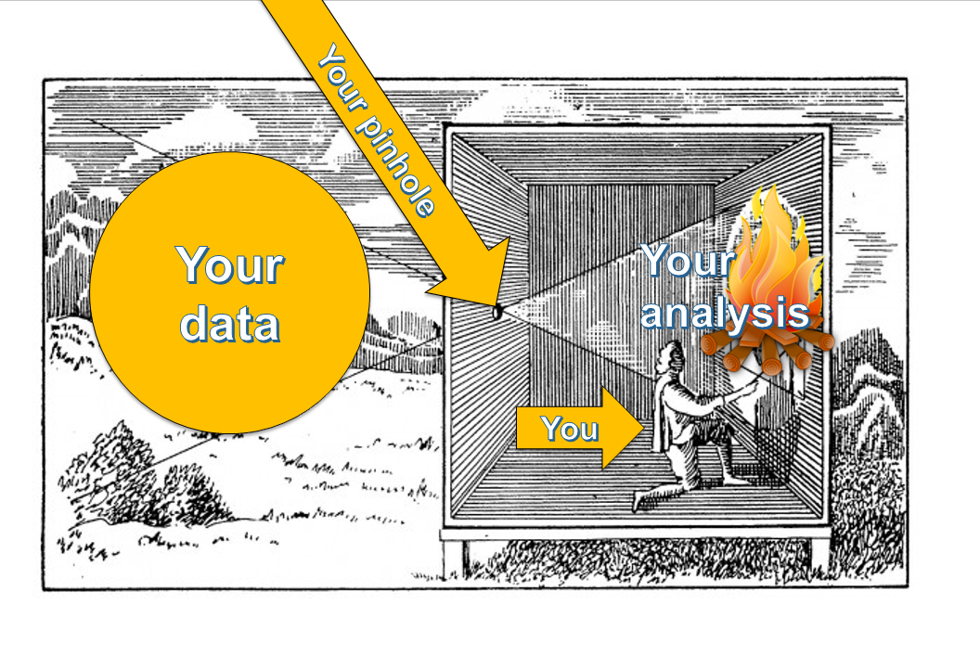
Notes:
Most of you have access to much of the data you need to answer these questions about your own institutions. I encourage you to gather it, query it, look for patterns.
And then don’t keep what you’ve learned to yourself. Share what ends up being projected through your pinhole, and share it widely.
All of my findings will be written up and shared freely on the OCLC Research Web site. Let’s make this a conversation. A global conversation. Let’s share not only data but the questions we’re asking of our data, and what our data is telling us in return. Do it yourself. Work with your consortia or service providers. And ask some big questions of your own.

Slide 64
IFLA Resource Sharing & Document Supply Satellite Meeting
Thanks for listening.
Dennis Massie
Program Officer, OCLC Research
massied@oclc.org
Notes:
Thank you very much -- for your attention, your forbearance and your endurance.

