Slide 1
Dennis Massie, OCLC
Kathleen Salomon, Getty Research Institute

Slide 2
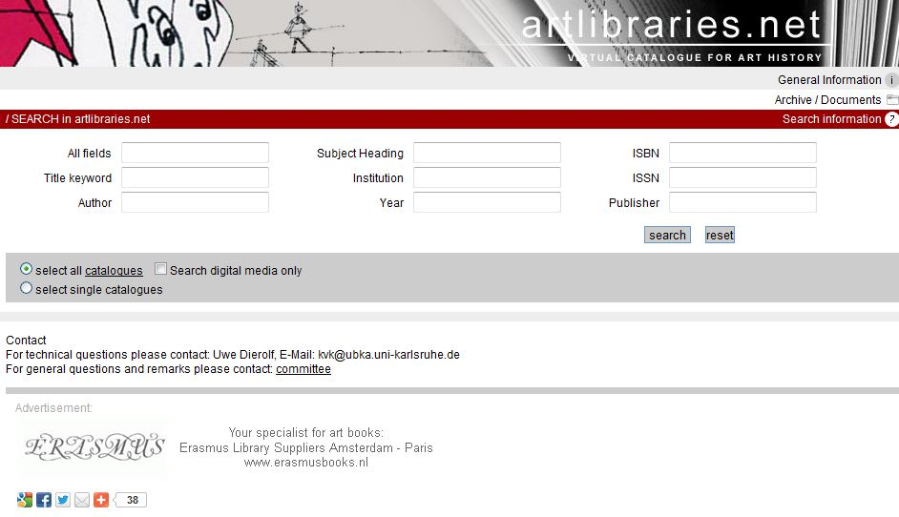

Slide 3
Launched in 1999 as VKK; relaunched in 2007
Virtual catalog of art history materials
Started out as a meta search interface based on technology developed for the KVK
(Karlsruher Virtueller Katalog)
Searches multiple Web catalogs and returns standardized short-title hit lists
Users click through to target catalogs for detailed information on each title
As of September 2012: provides access to 13m records in over 40 target catalogs throughout Europe, the UK and North America. Japan is forthcoming.

Slide 4
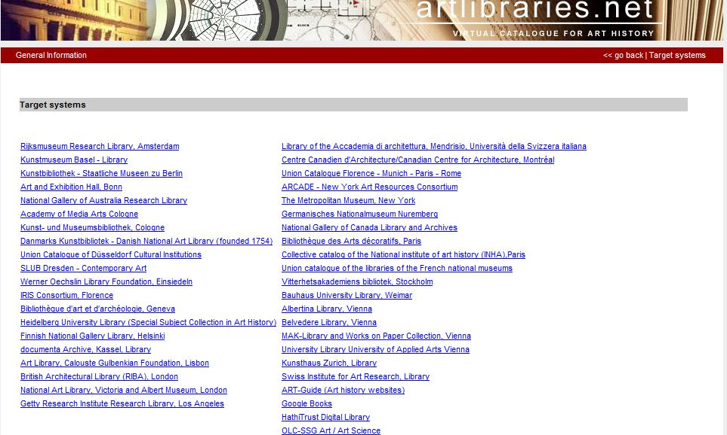

Slide 5
Discussions with OCLC began within the Future of Art Bibliography initiative
Desire for a new platform with potential added value led to OCLC
OCLC built a prototype of art libraries group catalog: “Art libraries in WorldCat” based on the WorldCat search API
This has been integrated into artlibraries.net, as one collective target, representing 30+ libraries
There is some intentional overlap with artlibraries.net
4

Slide 6
OCLC built a second prototype of art libraries group catalog: “Art libraries in WorldCat” based on a group catalog view of WorldCat.org
This is available at www.artlibraries.worldcat.org and currently includes 28 libraries
This prototype is separate from artlibraries.net
Prototype will be available at least through July along with “classic” artlibraries.net

Slide 7
“Art libraries Group Catalog” prototype (28 targets)
Amon Carter Museum
Art Institute of Chicago
Bard Graduate Center
Bauhaus University, Weimer
Berenson Library, Florence
Bibliothèque d’art, Geneva
Brooklyn Museum
Centre Canadien d’Architecture
Cleveland Museum of Art
Frick Art Reference Library
Getty Research Institute
Harvard University Fine Arts Library
Institut national d'histoire de l'art
Kunstbibliothek - Staatliche Museen, Berlin
Kunstmuseum Basel
Metropolitan Museum of Art
Museum of Fine Arts, Houston
Museum of Modern Art
National Gallery of Art
National Gallery of Australia
National Gallery of Canada
Nelson-Atkins Museum of Art
Philadelphia Museum of Art
Rijksmuseum Research Library
Saint Louis Art Museum
SLUB, Dresden
Sterling & Francine Clark Art Institute
Swiss Institute for Art Research

Slide 8
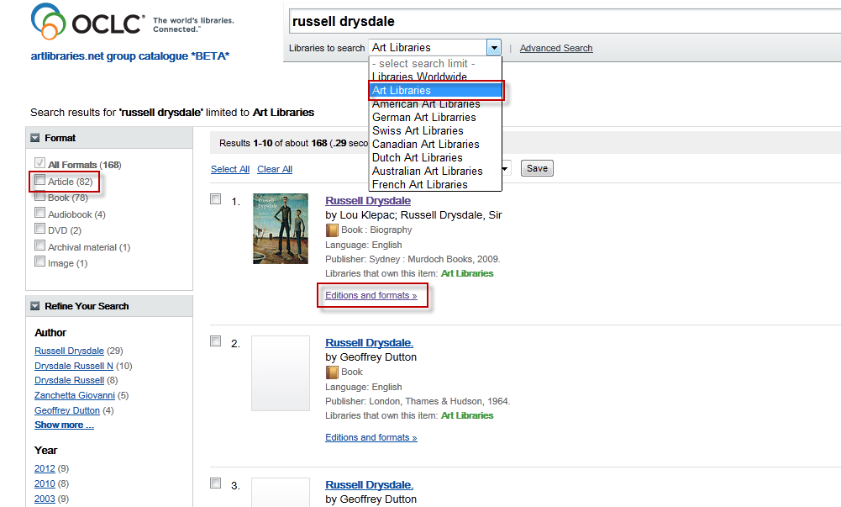
Can change scope
Facets to narrow results
Results at FRBR work level

Slide 9
New features of Group Catalog
Single result set
thumbnails where available
Results consolidated at work level (FRBR)
Unlimited # of libraries can be included
e.g. Tate Library
Can change scope of results & of holdings
Art libraries
all WorldCat
Sub groups, e.g. by country
Includes articles
(all articles covered by WorldCat.org > 200 million)
Facets – narrow result sets by
Format, e.g. articles only
Co-authors
Year of publication
Language of work
Content, e.g. biography
Topic (subject heading)

Slide 10
Evolution of WorldCat.org
FRBR – clusters of records at work level
Currently one record represents the work in the result list display
OCLC is building a work level record
to be used in the result list
to create a work landing page
GLIMIR
Works at the sub work level to provide 2 clusters
Equal content , grouping text, electronic, microform, reprints
Exact manifestation, grouping metadata descriptions of the same resource in different languages
Holdings are consolidated, maximising retrieval
Reduces apparent duplication

Slide 11
Worldcat.org with GLIMIR – Mock-up landing page
The long walk / Stephen King writing as Richard Bachman
20 editions in 8 languages, held by 1,818 libraries
81 records
In the near future, where Amerika has become a police state, one hundred boys are selected to enter an annual contest where the winner will be awarded whatever he wants for the rest of his life. The game is simple - maintain a steady walking pace of four miles per hour without stopping. Three warnings, and you're out - permanently.
12 content clusters plus singletons
 | Title | Publisher/s | Dates of public’n |  | Formats | Holdings | Language
+ | Long walk | Signet, Penguin, New American …. | 1979-1999 |  | Text | 963 | Eng
+ | Long walk | Penguin, Blackstone | 2009-2010 | Kirby Heyborne (read by) | Cassette, sound disc | 20 | eng
+ | La larga marcha | Plaza, Debolsillo | 1998-2004 | Hernan Sabate (trans) | Text | 10 | Spa
+ | Wielki marsz | Proszynskii | 2008 | Pawel Korombel (trans) | Text | 478 | Pol
+ | Den lange vandring | Medhor | 2006 | Dan Schlosser (read by) | dvd | 347 | dan
Description language
eng, fre, slv
eng
eng, spa
eng, pol
dan
Notes:
For the first line, the original English edition, there are cataloguing descriptions in English, Danish, Dutch and German. Behind the scenes, worldcat.org will be able to use the most appropriate record, depending on the IP address of the user. GLIMIR has made 7 content clusters (of which 5 are displaying) within this work and has also condensed 7 work sets into one. This will enable worldcat.org to present the work in 7 lines instead of 96 as that is the number of records in the work set.
On click – purple boxes show what the user doesn’t see

Slide 12
What’s next?

