Slide 1
Many paths, one moon
わけのぼる
ふもとのみちはおおけれど
おなじくもいの
つきをこそみれ
The future of academic print management in Japan
Constance Malpas
Program Officer, OCLC Research
28 February 2014
Keio University Shared Print Forum
Notes:
It is a great honor and privilege to participate in this shared print forum organized by Keio University. I am grateful to Tamura-sensei, Seki-san, Shimada-san and other Keio colleagues for inviting me to speak, and for the warm welcome they have shown us.
It is very impressive to see the range of individuals and institutions that are participating in this meeting, including library directors from the top research universities in Japan. I understand that most university library directors in Japan are scholars and faculty members, rather than professional librarians, and so I have tried to structure my remarks this morning accordingly.
As you can see, the title of my presentation was inspired by a famous Japanese proverb: “there are many paths up the mountain, but just one moon at the top.” This is a very poetic reminder of the fact that while our paths and perspectives may vary, we are headed in the same direction – whether this is understood in terms of spiritual enlightenment or more simply as an acknowledgment that common goals can be achieved by different means.
わけのぼる ふもとのみちはおおけれど おなじくもいの つきをこそみれ
The paths from the foot of the mountain are many, but we still see the same moon in the sky above (Ikkyū, 15C Zen Buddhist monk and poet)
http://www.epubbud.com/read.php?g=FN2RRLTU&p=1

Slide 2
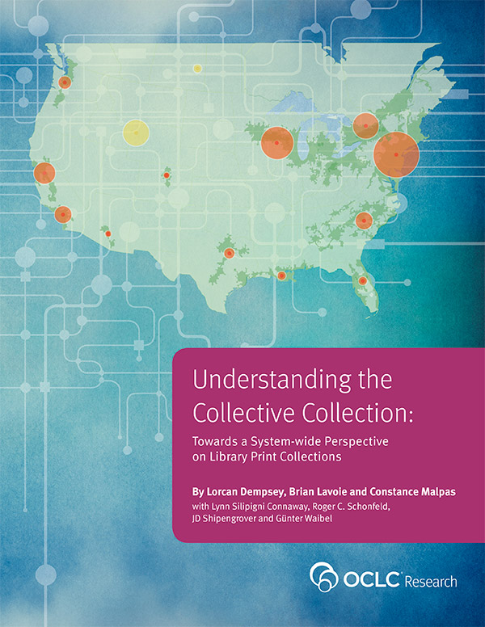
Roadmap
Shared Print: Concepts & Themes
A view of Japan in the cultural record
Future directions
Notes:
I was asked to present some key concepts and themes related to shared print management as it has developed in North America. I want to be clear that my remarks are shaped by my understanding of the North American library and higher education environment. Not everything I have to say may be equally relevant to the Japanese context.
To frame these remarks, I will start with a few observations about the Japanese national presence in the global library system.
And I will close with some speculations about how what we have learned about shared print in North America might (or might not) be applied to shared print planning efforts among Japanese university libraries.

Slide 3
Japan in the cultural (library) record
LITERARY FORMS
History 153,229 titles, avg. 12 holdings
Biography 49,459 titles, avg. 9 holdings
Fiction 16,147 titles, avg. 46 holdings
TOPICS
International relations 31,626 titles, avg. 16 holdings
World War (1939-1945) 18,984 titles, avg. 22 holdings
Graphic novels 16,565 titles, avg. 20 holdings
PEOPLE
高橋, 留美子 1,449 titles, 29 avg. holdings
Takahashi, Rumiko (b.1957)
岸本, 斉史 753 titles, avg. 63 holdings
Kishimoto, Masashi (b.1974)
Morimoto, Mari 355 titles, avg. 86 holdings
An anime stylized eye. Oni Lukos (2006)
Notes:
One way to look at the presence of Japan in the global cultural record is to explore the terms and concepts that are most frequently associated with it.
Using the WorldCat bibliographic database, we can compute the frequency with which different subject headings co-occur with the geographic heading for Japan. I have highlighted a few of these related headings here.
As you can see, there are many thousands of works of history related to Japan. There are fewer works of fiction – but they are more “popular” in the library system. That is, many more libraries have purchased copies of Japanese literature than titles about Japanese history.
Looking at topics that co-occur most frequently with Japan, we see that while there is an abundant literature related to international relations, libraries have purchased much more material related to the Second World War.
Finally, if we consider the names that co-occur most frequently with Japan, we see that TAKAHASHI Rumiko, a famous manga artist, is very well represented with almost 1500 titles. KISHIMOTO Masashi, another manga artist has published fewer titles but they are generally held by more libraries. The most “influential” name on this list – as measured by the number of libraries that hold her works – is Mari MORIMOTO, who has translated several hundred very popular manga titles.
Now, these examples obviously provide a very limited view of cultural associations with Japan – but it is (I think) an instructive one. In the West, the image of Japan is shaped by these influences, which are institutionalized in library collections.
This – the relationship between cultural heritage and library collections – is a theme that I will explore today, as it relates to the future of academic print management.
Image credit: “An anime stylized eye” (2006) by Oni Lukos
http://en.wikipedia.org/wiki/File:Anime_eye.svg
CC –BY-SA

Slide 4
Shared
Print
a strategic reconfiguration of stewardship arrangements to:
Maximize collective capacity to preserve, provide access to the past and future cultural/scholarly record
Rationalize and redistribute stewardship roles across library system
Reduce costs of managing low-use print inventory
Improve alignment between library service profile and institutional mission
part of broader shift from institution-scale to group-scale solutions
Notes:
Shimada-san suggested that it would useful if I introduced some core concepts and basic terminology in my presentation.
I want to start with a definition of what we mean by “shared print” to clarify what it is, and what it is not. I want especially to emphasize that while library space recovery and cost avoidance may be positive outcomes of cooperative print management, they are not its primary goal.
The shift from local to shared print management is motivated primarily by the need to develop new and more cost-effective approaches to library stewardship of the scholarly record. What this means is that library operations that used to organized at “institution scale” are now being re-organized at “group scale” not because individual libraries care any less about preservation of print collections, but precisely because they recognize that responsibility for the long-term survival of scholarly resources must be shared, and must be deliberately coordinated.

Slide 5
A few core concepts
Retention statement: an explicit commitment to retain and preserve (if not conserve) selected titles or items for a designated period of time
Registration: deliberate action to make shared print collections known and visible, e.g. in union catalogs
Validation: explicit intent to audit the condition or completeness of retained titles or items
Rightscaling: optimizing scale of cooperation to maximize benefit for all participants

Slide 6
Thesis:
The value of national and international shared print efforts will be measured by our success in preserving coherence and expanding coverage of the cultural record, as it is represented in the collective collection.

Slide 7
Implications
Understanding the scope and distribution of system-wide library resources is important to ‘right-scaling’ shared print strategies.
Cooperative management requires deliberate coordination and a long-range view.

Slide 8
Shared evidence base supports informed
decision-making
Examine preservation risks
assess redundancy
Assess infrastructure capacity
leverage collective investment
Apply system-wide perspective
sourcing and scaling
Build conceptual frameworks, a common vocabulary
support community discussion
Notes:
Over the past decade, OCLC Research has developed a program of work that explores the changing context for library print management. Some of the outcomes from this work have been compiled in a recently published volume that is being shared today with attendees at this forum. I will not attempt to summarize all of the work that is represented there, but will simply highlight a few distinctive themes and preoccupations that organize our research in this area.
You will note that the cover image for this report features a map of North America and this is significant. Much, though not all, of our research on the collective collection and more particularly on shared print has focused on libraries in North America. This is partly because it is the geographic and cultural context with which we are most familiar, but it also reflects the fact that WorldCat, the bibliographic and holdings data that we use in many of our analyses, is more representative of North America and some English-speaking geographies than it is for other global regions.

Slide 9
North American Context
Continued growth of academic print collections
1.1 billion volumes in 3,700 libraries
Declining use of print formats, compared to e-formats
Inter-lending decreased 6% between 2010 and 2012
Economic stagnation = limited investment in institution-scale storage infrastructure
Growing corpus of retrospectively digitized and licensed electronic resources
US academic libraries added >52M e-books in 2012
Shared digital preservation infrastructure (HathiTrust, Digital Preservation Network, SHared Access to Research Ecosystem)
Notes:
To understand why shared print management strategies have gained traction in North America, it is helpful to consider the context in which academic libraries in the US and Canada are operating.
Statistics on North American Academic Libraries: http://nces.ed.gov/pubs2014/2014038.pdf

Slide 10
Context for shared print (US)
Robust resource-sharing (ILL) arrangements
Builds confidence, service-level expectations
Shared bibliographic infrastructure
Supports cooperative intelligence, analytics
Format migration from print to digital
Limits disruption of changing print operations
Institutional incentives to ‘reconfigure’ library
License to innovate
Duty to preserve scholarly record
Desire to transform library operating models
Notes:
Additionally, there are some general changes in the library operating environment that are accelerating the shift from institution-scale print management to group-scale solutions.

Slide 11
Global Resources & Shared Print
Since 1958, federal funding (“Title VI”) allocated to support development of non-English language programs and university research collections
National network of Resource Centers (NRC) provides shared infrastructure for research, teaching and library acquisitions
24 NRC support East Asian studies (2013)
Government austerity measures mean future funding is uncertain
New strategies needed to ensure preservation and continued growth of library resources
Notes:
It is often assumed that shared print is mostly a priority in ‘general’ collections and not in more specialized research collections. This is an important misperception. For example, in the area of global resources – that is, library collections that are intended to document the language and culture of non-native populations – there is growing concern that traditional, institution-scale print management is no longer sustainable.
To understand why, it is helpful to know something about the history of area studies collections in US university libraries.

Slide 12
The Global Dimensions of Scholarship & Research Libraries: A Forum on the Future (2012)
To ensure continued relevance, university
libraries supporting global education must:
energetically shift toward digital sources as they continue their support for international scholarship.
internationalize all of their programs and services
must build active collaborations, on an international as well as national level
http://www.crl.edu/sites/default/files/attachments/events/Global_Forum_Recommendations.pdf
Notes:
In 2012, a group of prominent library leaders and scholars convened a meeting to discuss the future of global resources in US university libraries. They put forth a set of recommendations that include a deliberate recalibration of investment in digital resources, a systematic effort to internationalize library programs and services, and a commitment to developing new partnerships.
I mention these recommendations because I think they are relevant to shared print planning efforts in Japan, as well the United States.
Source: http://www.crl.edu/sites/default/files/attachments/events/Global_Forum_Recommendations.pdf

Slide 13
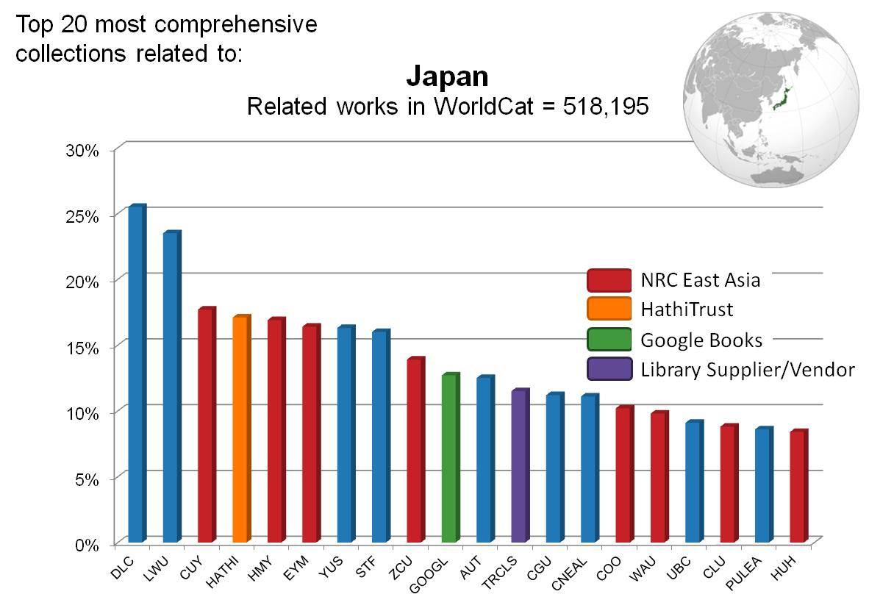
Coverage in WorldCat
Holding Library (OCLC Symbol)
Notes:
This chart represents the twenty libraries represented in WorldCat that provide the most comprehensive coverage of literature related to Japan. This would include works of literature, historical treatises and scholarly monographs as well as maps, guidebooks, and other materials.
Not surprisingly, we see that US National Resource Centers for East Asian studies account for almost half of the most comprehensive collections. These are institutions that are known to have very rich holdings related to Japan.
But there are some other surprises. For instance, two of the major digital text aggregations in the US (HathiTrust and Google Books) have coverage that rivals or exceeds coverage in National Resource Centers.
And Toshokan Ryutsu Center, a major library supplier of books related to Japan, is also among the top 20.
Most surprising of all is the fact that the only library in Japan that appears on this list is Waseda University. It ranks near the very top, which seems reasonable – but where is the National Diet Library? Where is Todai? Where is Keio?

Slide 14
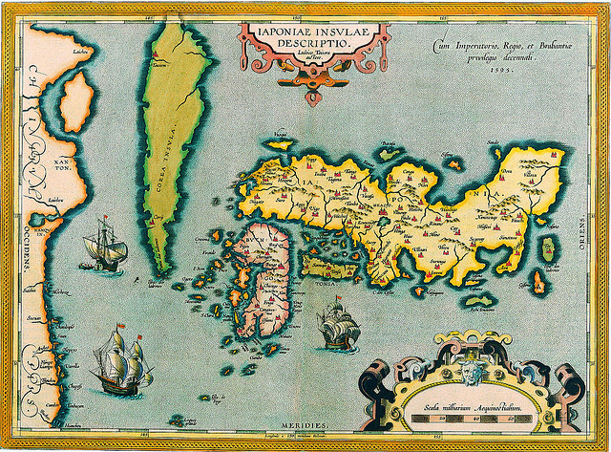
Orientation
What you see depends on where you stand
Ortelius. Japoniae Insulae Descriptio (1598)
Attribution-NonCommercial-ShareAlike 2.0
Notes:
The global WorldCat bibliographic database provides us with a view of the library system – but it is not a complete view. Like early western maps of Japan, its perspective is somewhat distorted.
It is worth taking a few moments to look at what we know of Japanese collections in WorldCat.
Image Credit: Ortelius’ Map of Japan ca. 1590 (Changhua Coast Conservation Action )
http://www.flickr.com/photos/waders/3177254404
Attribution-NonCommercial-ShareAlike

Slide 15
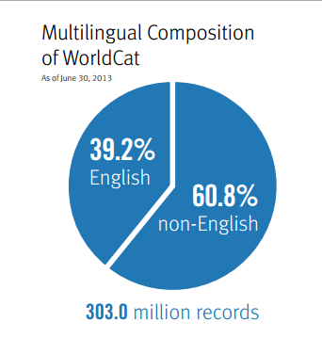
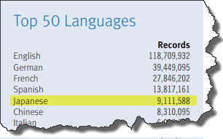
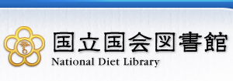
Japanese-language content
in WorldCat
=3%
>5 million records (titles) contributed by
Notes:
Coverage of Japanese literature in WorldCat is not insignificant – more than 9 million titles.
And this is partly due to a partnership with the National Diet Library, which has contributed more than 5 million records.
Yet, our understanding of the Japanese library system, as it is reflected in WorldCat, is incomplete.
For example, we have very incomplete coverage of the “RU11” university libraries, with the notable exception of Waseda and Keio.
Source: http://www.oclc.org/content/dam/oclc/publications/AnnualReports/2013/2013.pdf

Slide 16
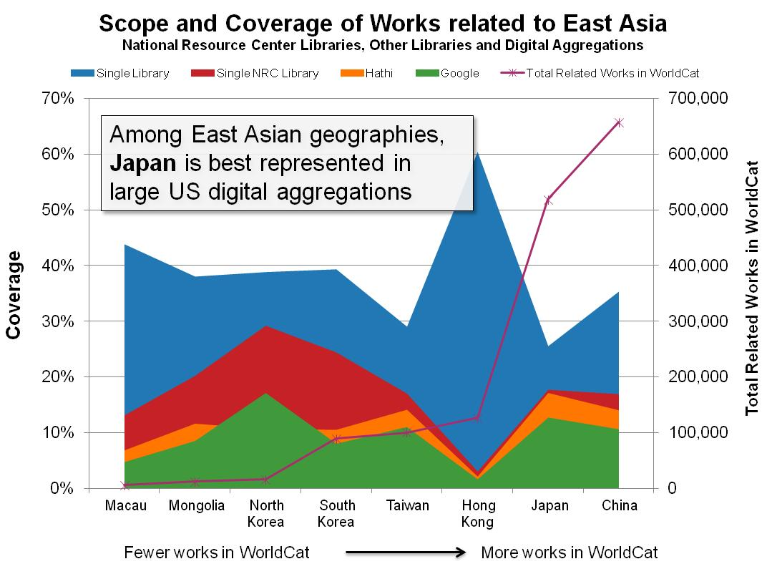
Notes:
Here is another way to measure Japan’s presence in the global library system – by looking at coverage related to Japan as a place in the context of WorldCat and in the context of large US digital text aggregations.
This chart compresses a great deal of information into a single picture, but put simply it tells us that there are more than .5 million creative works related to Japan (the geographic place); that individual library coverage of this literature is relatively limited (no more than 25% coverage); and that among East Asian geographies, Japan is best represented in large US digital aggregations.
Of course, this give only a very general picture of how “present” Japan is in the global library system.

Slide 17
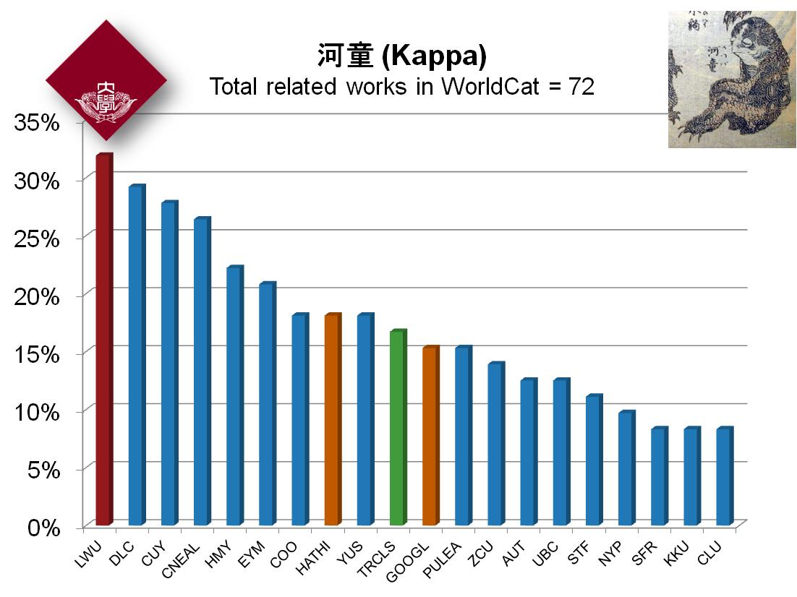
Present in vendor supply-chain
Visible in digital aggregations
Coverage in WorldCat
Holding Libraries in WorldCat
Notes:
We can also look at how well individual Japanese identities and concepts are represented in WorldCat.
Here is a highly specialized example – the mythological Kappa or “river child” pictured in this marvelous Hokusai print. There are fewer than 100 works related to Kappa in WorldCat. Waseda University Library offers the best coverage of this literature.
Yet even for this relatively esoteric topic, we find not insignificant coverage outside of Japan – there is a global constituency that continues to care about the Kappa. In North America, the Library of Congress, the University of California, Berkeley and the University of Toronto all have rich collections.
And we also see that our Kappa friends are present in the vendor supply chain and in large digital aggregations.
Image credit: http://commons.wikimedia.org/wiki/File:Hokusai_kappa.jpg
Public Domain

Slide 18
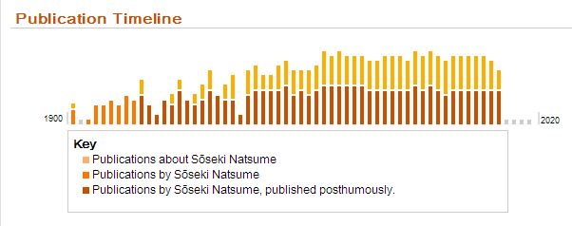
Coverage in WorldCat
Holding Libraries in WorldCat
Notes:
Natsume Soseki, pre-eminent Japanese author of Meiji period – works are widely translated and many still in print. The timeline in the upper left corner of this slide shows us that even now, almost a century after his death, there are as many titles being published about Natsume as titles he wrote himself. Clearly, he continues to shape cultural understanding of Japan – WorldCat data show that his works have been translated into 20 languages -- but even the finest NA East Asian libraries have relatively poor coverage of this author’s works. NDL and Waseda’s collections are much stronger.
Inset publication timeline from WorldCat Identities: http://www.worldcat.org/identities/lccn-n79084664/
Image credit: http://en.wikipedia.org/wiki/File:Soseki.jpg
Public Domain

Slide 19
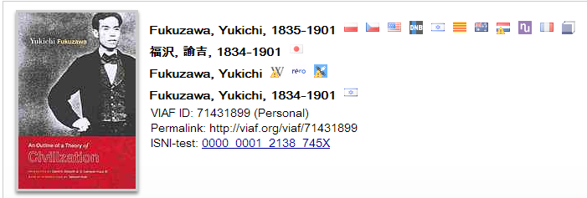
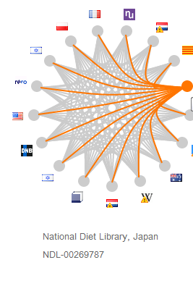
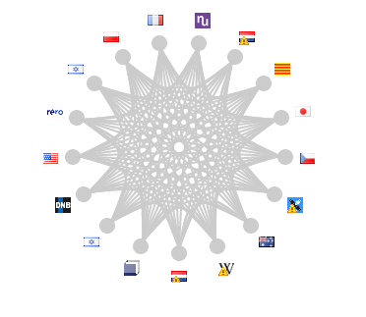
Global presence of Japanese scholarship reflected in international name authority files
Notes:
http://viaf.org/viaf/71431899
Fukuzawa, the founder of Keio University, is present in 17 national authority files, from Japan to the Netherlands – this signifies that Fukuzawa’s importance in the cultural record is acknowledged around the world. Libraries are collecting his materials, and national bibliographic authorities are investing time and effort in disambiguating his name and establishing its preferred form.
This has important implications for understanding distributed nature of print preservation .

Slide 20
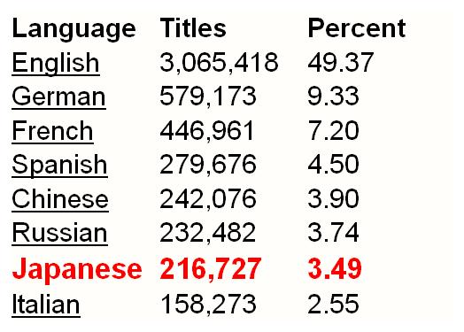
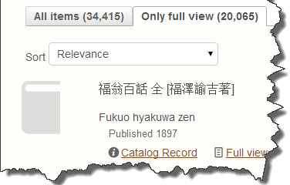
Notes:
I have pointed to several illustrations that demonstrate that Japanese authors, concepts and places are increasing present in digital text aggregations. This is partly explained by the fact that some of the very large East Asian studies library collections in North America have been digitized. But there is also a “local” explanation for this phenomenon, and that is the fact that content digitized by Keio University has been included in Google Books for several years and is now, as of January 2014, also present in the HathiTrust Digital Library. This is a major accomplishment and it complements efforts that the NDL has made over many years to digitize historical titles from the national bibliography.
I can tell you that East Asian library listservs in the US are buzzing with excitement about the new Keio content in HathiTrust. And no wonder – it has had a measurable impact on coverage of Japanese language literature, which now represents almost 3.5% of titles in the HathiTrust collection. That’s truly impressive when you consider that in WorldCat, Japanese language content represents just 3% of all titles. Even more exciting is the fact that the Keio contribution has resulted in more than 20 thousand new public domain titles that are available for anyone to read online.
Omedetō!
Sources: http://www.hathitrust.org/updates_january2014
http://www.hathitrust.org/visualizations_languages

Slide 21
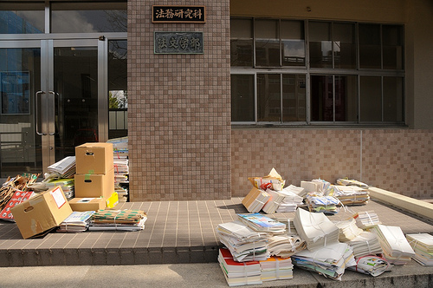
Managing Redundancy
Recycling day at Shimane University School of Law. (Deborah Bryan Macartney)
Notes:
In my last 10 minutes, I would like to turn to some “real life” examples of print management in Japanese libraries. I will confess this is the weakest part of my presentation, since my knowledge of Japanese university libraries is very limited and (as we have seen) WorldCat does not have sufficient holdings of Japanese libraries to make any meaningful analysis possible. So, I will limit myself to a single example from which we might extrapolate to a few scenarios.
This picture, by the way, is apparently a photo of the front of the Shimane University School of Law on recycling day. I was glad to find this image on Flickr because it is unfortunately often the case that the rational disposal of library materials is regarded as a scandalous act. In fact, it is an essential part of library management.
Image credit: Recycling day at Shimane University School of Law (Deborah Bryant Macartney)
http://www.flickr.com/photos/opengov/3355600813
CC with attribution

Slide 22
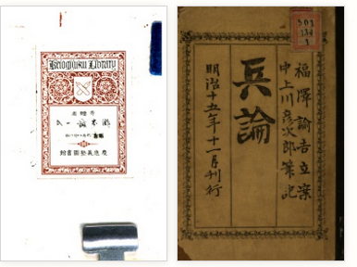
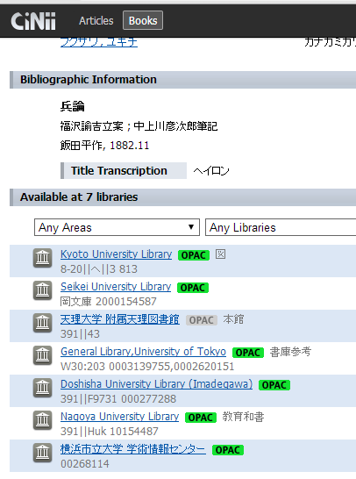
1 library…
1 library…
7 libraries…
Notes:
As my example, I thought I would use one of the titles from Keio University Library that was recently contributed to HathiTrust.
This is Fukuzawa’s 1882 study of “soldier theory” or military defenses.
In WorldCat, I can find only two copies of this title, one held by the CV Starr East Asian Library at the University of California, Berkeley, and the other held by the National Diet Library. (For reasons I will not go into here, these holdings do not cluster together as one might hope, so it is actually quite difficult to determine how many libraries hold this book.)
Separately, by searching in the catalogue of the National Diet Library, I was able to confirm that this title is part of the national collection.
And finally, by searching in the NACSIS WebCat-Plus database, I was able to determine that Fukuzawa’s Soldier Theory (1882) is also held by 7 additional libraries in Japan, including the University of Tokyo.
From this we learn two important lessons. First, the bibliographic landscape for Japanese language materials is quite fragmented. It was only by searching in two union catalogs and two local bibliographic databases that I was able to determine that this book is held by 10 libraries. Secondly, it is very easy to misjudge preservation risks based on library holdings alone.
http://www.worldcat.org/title/heiron/oclc/769137136 [NHN holding is on OCN 673441782]
http://iss.ndl.go.jp/books/R100000002-I000000481965-00
http://ci.nii.ac.jp/ncid/BN13573581

Slide 23
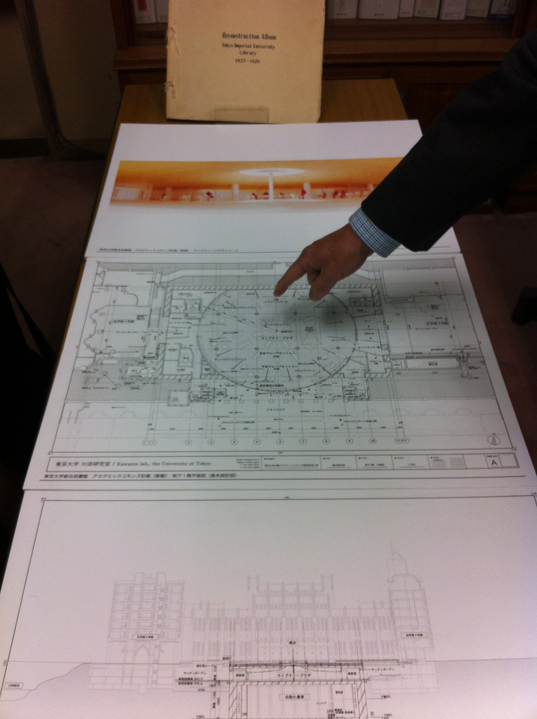
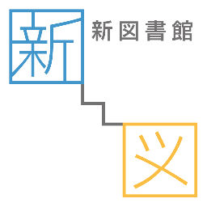
A “what if” scenario
At least 9 copies of Fukuzawa’s Hei-ron (1882)
in Japanese research libraries
4 copies in Tokyo alone
1 is here (or will be)
+ National Diet Library
+ Keio University
+ Seikei University
University of Tokyo Library Underground Storage construction (OCLC Research)
Notes:
I mention the holdings at Todai in particular because I am aware that the University is in the midst of a major Academic Commons library renovation project, which includes construction of a new Automated Storage and Retrieval System (ASRS) with a built capacity of 3 million volumes.
By consolidating its print holdings in a high-density storage facility, the university library will be able to use its existing space in new ways while also making room for additional growth in the collections.
Of course, to the extent that Todai’s collection duplicates that of other Japanese university libraries, investments made to improve “institution-scale” collection management can also have secondary, group-scale benefits.
We have an analogous situation in the United States. The University of Chicago has constructed a large high-density library storage facility on campus. Chicago, like Todai, has an enormous library collection that duplicates the holdings of many universities. Chicago is also a major supplier in inter-library loan networks. So there is an open question of whether Chicago might serve as a shared print service hub.
Source: http://new.lib.u-tokyo.ac.jp/en/about
Image credit: University of Tokyo Library Underground Storage construction (OCLC Research)
http://www.flickr.com/photos/oclcpar/11074931343/
CC Attribution

Slide 24
What if…
University of Tokyo’s copy was retained and registered as shared print?
… would other university libraries in Tokyo de-duplicate holdings?
… would other Japanese university libraries de-duplicate holdings?
Keio University’s copy was retained and registered as shared print?
… would Todai still transfer its copy to new Automated Storage& Retrieval System (ASRS)?
Notes:
As a thought experiment, we might consider what might happen if Todai were to designate some part of its physical library holdings as a “shared print” collection.
Of course, every university library holds material that has special institutional importance. We would not expect to see Keio withdraw any of its Fukuzawa holdings, for example.
These scenarios are purely speculative and I include them here simply as examples of the different ways in which university libraries might “rightscale” traditional print management operations.

Slide 25
What if … (continued)
Thousands of print titles in RU11 libraries were managed as a national shared print collection?
…could Japanese university libraries manage a broader range of scholarly resources?
…would international East Asian libraries (NRC, for example) collect differently?
…might longevity and impact of Japanese scholarship in global network increase?
Right-scaling stewardship of print collections will rely on new forms of library collaboration

Slide 26
Coverage in WorldCat
Holding Libraries in WorldCat
Notes:
I would like to close with this somewhat incongruous illustration of global library coverage of works by the eminent Scottish Enlightenment economist Adam Smith.
Smith is best known as the author of the Wealth of Nations, a study of the causes and also the distribution of wealth (or opulence, as he liked to call it) across the globe. In the 18th century, when Smith was writing, there was of course no official foreign trade between England and Japan.
Yet, looking at the global distribution of Adam Smith’s writings today, it is clear that there is a very broad market for his ideas. In fact, Waseda University Library holds a greater share of his published works than the National Library of Scotland.
I include this example because I want to reiterate my thesis that the value of shared print management will be measured by our success in preserving a globally distributed cultural record. This means that libraries in Japan will be as concerned about the preservation of Adam Smith’s legacy, as libraries in North America are concerned with preserving the legacy of Natsume or Fukuzawa.

Slide 27
Local knowledge
is the best guide
City Map. A 3D Map of Kanazawa (Laura Longenecker)
Notes:
Having spent the last hour making some broad generalizations about library print collections and the current and future state of shared print, I wanted to close on a note of humility and acknowledge that my perspective is limited, my ability to “read” or understand the Japanese library system based on WorldCat data is very incomplete, and the issues I have raised today are complex and not easily resolved. Rather than leaving you with answers, I have left you with questions. I hope that we will have an opportunity to answer them, together.
Image credit:
3D Map of Kanazawa. Laura Longenecker
http://www.flickr.com/photos/longeneckerlaura/5187317412
Attribution-NonCommercial-ShareAlike 2.0

Slide 28
Email: malpasc@oclc.org
Twitter: @ConstanceM
Understanding the System-wide Library http://oclc.org/research/activities/usl.htm

Slide 29
Image Credits
Acknowledgements
I am glad to credit Lorcan DEMPSEY for developing “collective collection” and “right-scaling stewardship” concepts, and Thom HICKEY for developing the library centers and coverage analysis.
Thanks to Karen SMITH-YOSHIMURA, OCLC Research , for sharing expertise on Japanese collections in WorldCat.
Thanks to Toshie MARRA , C.V Starr East Asian Library, University of California, Berkeley for insights on the state of library collaboration among Japanese libraries in North America.
All images used in this presentation are licensed under Creative Commons Attribution-NonCommercial-ShareAlike terms, or are in the public domain, and are sourced from Flickr Commons or Wikimedia.
Specific image credits are included in speaker notes for relevant slides.

