Slide 1
University Futures, Library Futures
Emerging directions in shared library services: a discussion with shared library and consortium directors
11 February 2018 | ALA Midwinter Conference
Constance Malpas – malpasc@oclc.org
Rona Stein – steinr@oclc.org

Slide 2
University Futures, Library Futures
OCLC Research and Ithaka S+R collaboration with support from Andrew W. Mellon Foundation
Examining impact of increasing differentiation of US higher education on the organization of academic libraries
Shift from collection-centric model of excellence to engagement-oriented model supporting distinctive needs of parent institution
More information: oc.lc/libfutures

Slide 3
Institution Typology: working model
Population: 1506 US higher education institutions (HEI) comprising four-year public and private non-profit degree-granting colleges and universities
Unit of analysis: institution as defined by IPEDS unit ID
Institutional profiles derived from 2015 IPEDS survey data:
What colleges and universities do (research, liberal education, career preparation)
How/for whom they do it (traditional vs. ‘new traditional’)

Slide 4
Most four-year institutions exhibit multiple tendencies; they have several ‘lines of business’
distinctive focus on doctoral research and scholarship
Research
distinctive focus on preparation for career professions
distinctive focus on interdisciplinary baccalaureate education
Career
Liberal Education
Notes:
Teaching and learning is at the center of the university

Slide 6
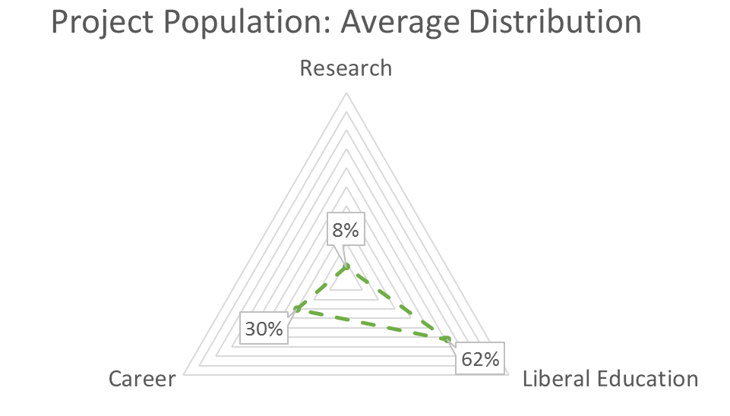

Slide 7
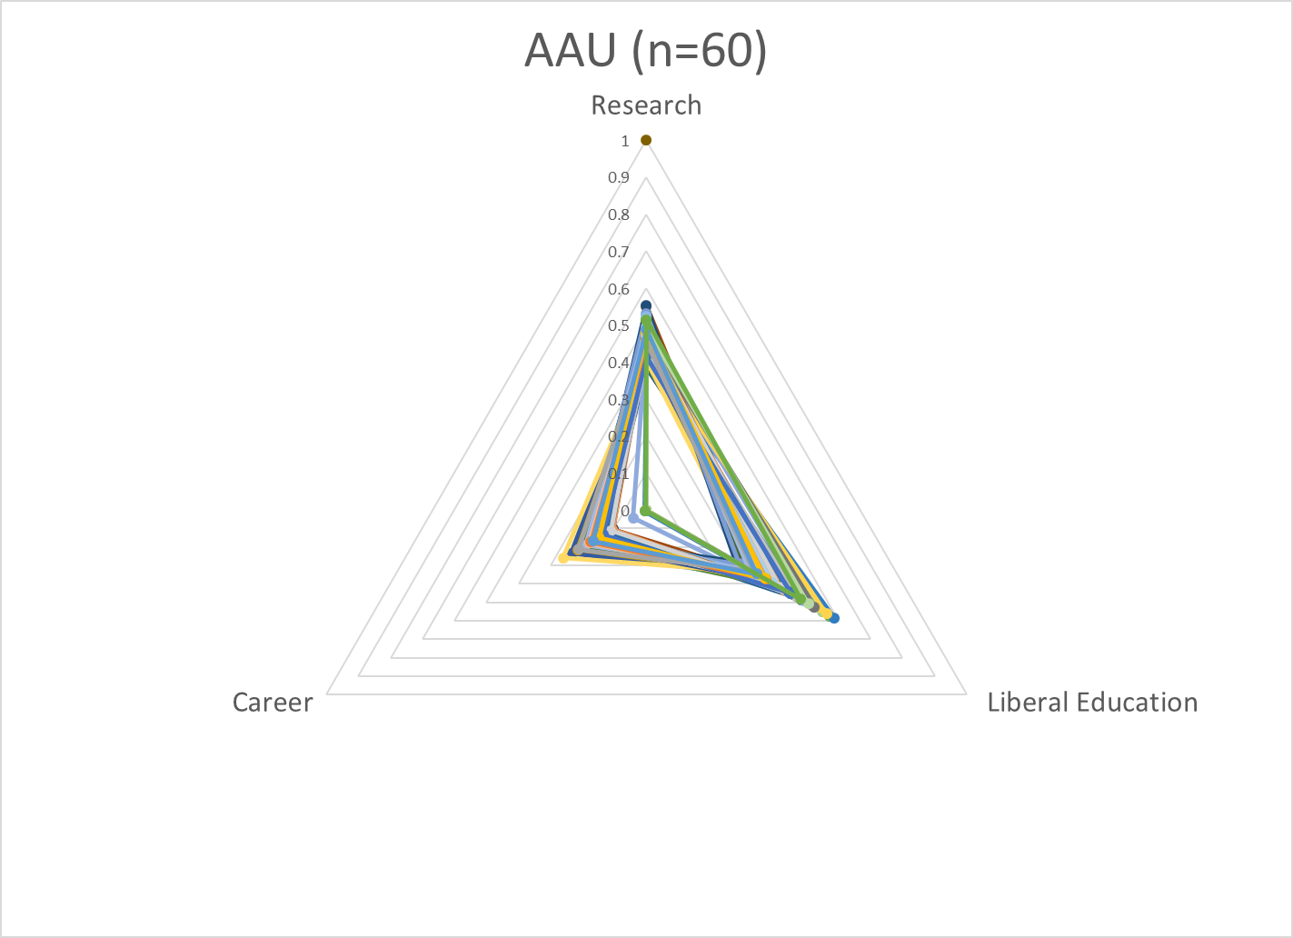
Model can be used to examine groups of institutions for conformance to type

Slide 8
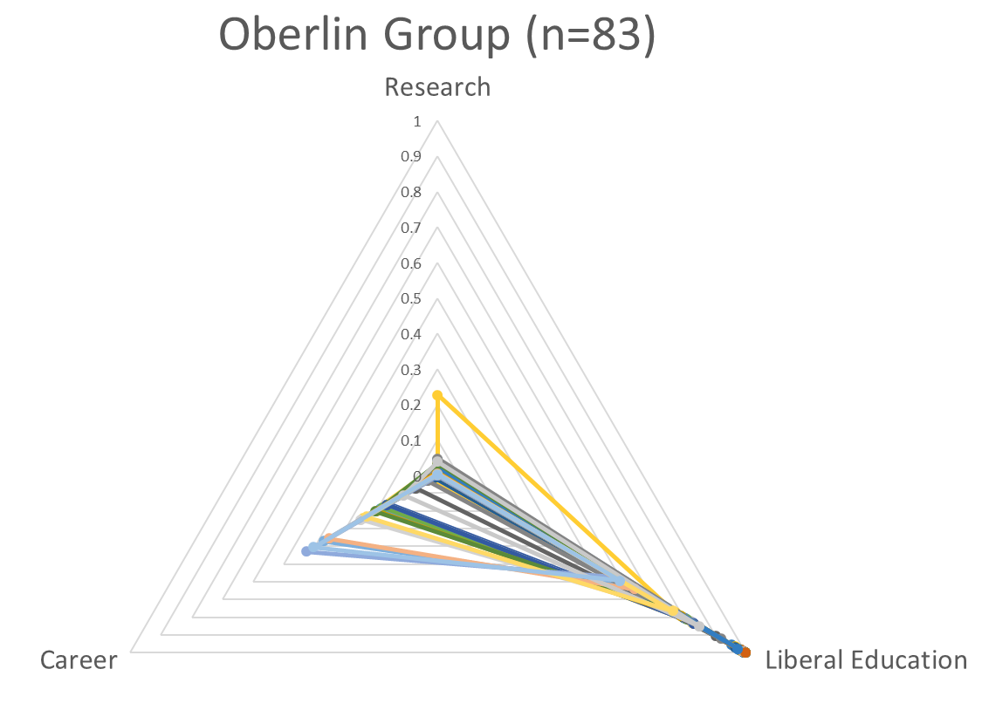

Slide 9
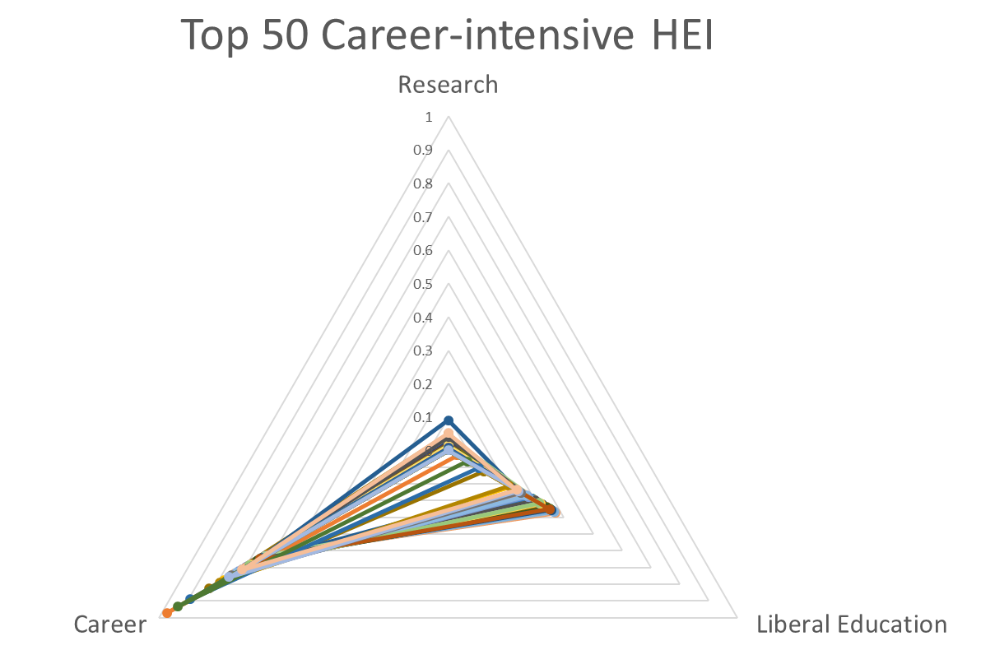

Slide 10
Consortium profiles

Slide 11
Model can be used to compare institutional directions in different groups
Opportunities for shared service provision, value of cross-consortium partnerships?
Notes:
Diverging vs. converging needs

Slide 12
Are service needs in different ‘consortium types’ diverging?

Slide 13
Exercise 1: University directions

Slide 14
Objectives
Identify current, emerging opportunities for shared library services supporting liberal education, career preparation, research in your group or shared library
Explore incentives for group-scale provision – who are the key stakeholders? Who decides which services should be sourced/deployed at consortium level?
5-10 minutes to jot down reflections (we will collect these at the break)
Consolidate and discuss – 20 minutes

Slide 15
Research
Library services, infrastructure?
Library staff positions?
Other library investments or activities?
Career
Liberal Education

Slide 16
RDM activities
RIM/CRIS implementation
Text and data analysis services
Research impact librarian
Research data librarian
Office of sponsored research
VP for Research
Institution-scale library services, staff, stakeholders
Research
E-portfolios
Instructional design services
Fablab
Student Success Librarian
Dean of Undergrad Education
Department chairs
Training and internship resources
First Year Experience Librarian
Guided pathways support staff
Career Services
VP Enrollment
Career
Liberal Education

Slide 17
Shared print collections
Shared research data repository
Shared staffing:
Research impact librarian
Scholarly communications librarian
Office of sponsored research
VP for Research
Group-scale library services, staff, stakeholders
Research
Shared OER repository
Shared instructional design services
Shared staffing:
Student Success Librarian
Dean of Undergrad Education
Department chairs
Group licensing of test prep services
Shared staffing:
First Year Experience Librarian
Career Services
VP Enrollment
Career
Liberal Education

Slide 18
Exercise 2: New Traditional Students

Slide 19
Nontraditional is the New Traditional
“Nontraditional learners” have at least one of these characteristics: they have no high school diploma, enrolled more than one year after high school, are financially independent from parents, work full time, or are responsible for children or other dependents” (Kamenetz, 2015, p. 40)
Kamenetz, Anya. 2015. “DIY U: Higher Education Goes Hybrid.” In Remaking College: The Changing Ecology of Higher Education, edited by Michael W. Kirst and Mitchell L. Stevens, 39–60. Stanford, CA: Stanford University Press.

Slide 20
Objectives
Identify shared library services that support the distinctive needs of
Distance learners
Part-time enrollees
Adult students
What constitutes success?
E.g. library/consortium role in assisting members achieve institutional enrollment/retention targets; progress toward state/funder mandate for increasing educational provision etc.

Slide 21
Resources: New Traditional Students and Library Services
https://www.chronicle.com/article/The-New-Traditional-on/135012
https://www.insidehighered.com/views/2016/08/05/defining-students-nontraditional-inaccurate-and-damaging-essay
http://lj.libraryjournal.com/2012/03/opinion/nontraditional-students-are-the-new-majority-from-the-bell-tower/#_
http://www.sr.ithaka.org/blog/on-non-traditional-college-students-libraries-and-family-space/
Andria L. Tieman and Megan E. Black (2017) “Exploration of Library Outreach to Nontraditional Students” Reference & User Services Quarterly, vol. 56, no. 3, pp. 198–205
Notes:
Family rooms
Peer cohorts

Slide 22
Participant profiles

Slide 23
Caltech
R: 0.55, LE:0.34 , C:0.11
Golden Gate University
R:0.00 , LE:0.11 , C:0.89
Austin College
R: 0.01, LE: 0.99, C:0.00

Slide 24
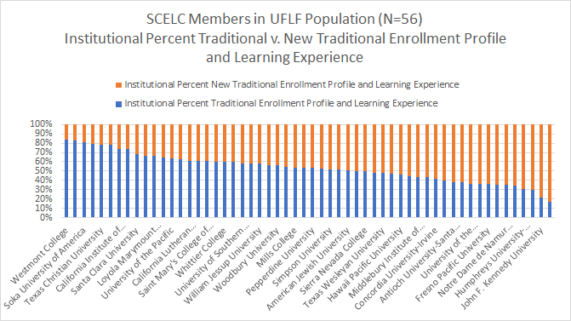

Slide 25
University of Chicago
R: 0.49, LE:0.51 , C:0.00
Penn State University
R:0.41 , LE:0.37 , C:0.21
University of Chicago
R: 0.49, LE:0.51 , C:0.00

Slide 26
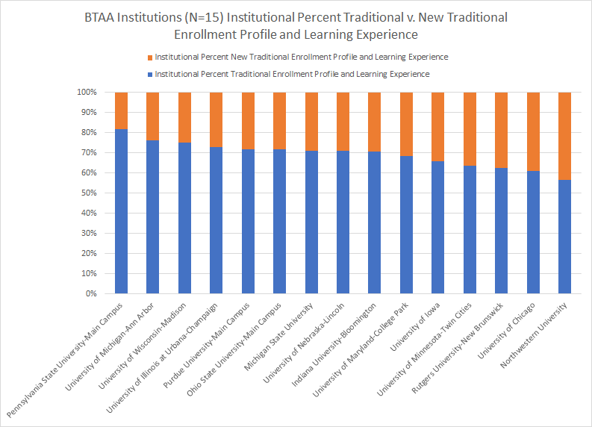

Slide 27
Georgetown University
R: 0.47, LE:0.39 , C:0.14
Marymount University
R:0.00 , LE:0.57 , C:0.43
Gallaudet University
R: 0.05, LE: 0.73, C:0.22

Slide 28
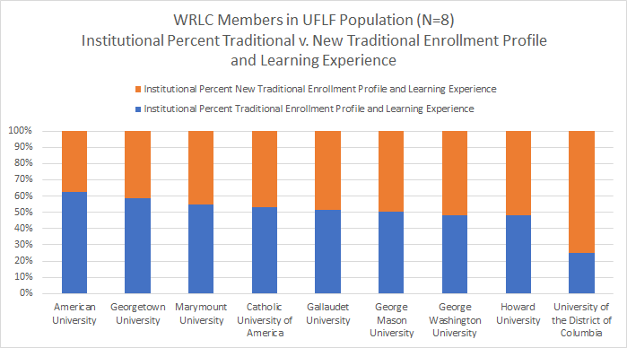

Slide 29
Oakland City University
R: 0.02, LE:0.58 , C:0.40
University of Saint Francis
R:0.00 , LE:0.55 , C:0.45
DePauw University
R: 0.00, LE: 1.00, C:0.00

Slide 30
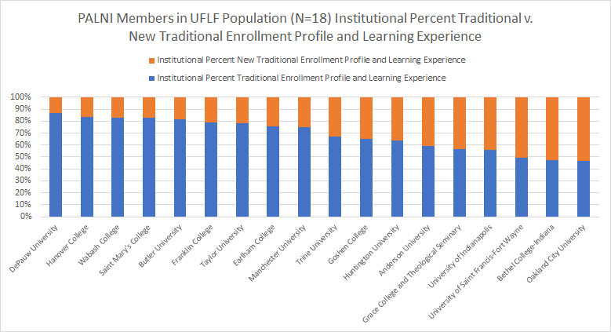

Slide 31
University of Minnesota, Twin Cities
R: 0.46, LE:0.37 , C:0.18
Concordia University – Saint Paul
R:0.00 , LE:0.27 , C:0.73
St. Olaf College
R: 0.01, LE: 0.99, C:0.00

Slide 32
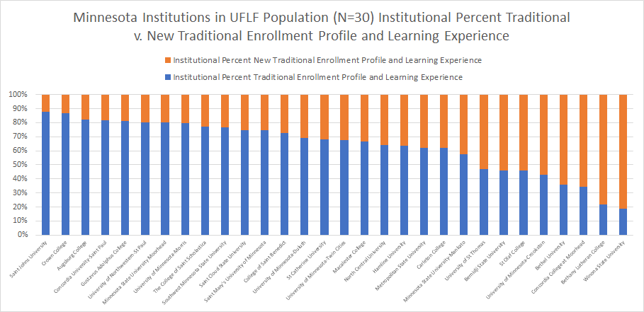

Slide 33
North Dakota State University
R: 0.36, LE:0.40 , C:0.24
Minot State University
R:0.01 , LE:0.45 , C:0.55
University of Jamestown
R: 0.00, LE: 0.67, C:0.33

Slide 34
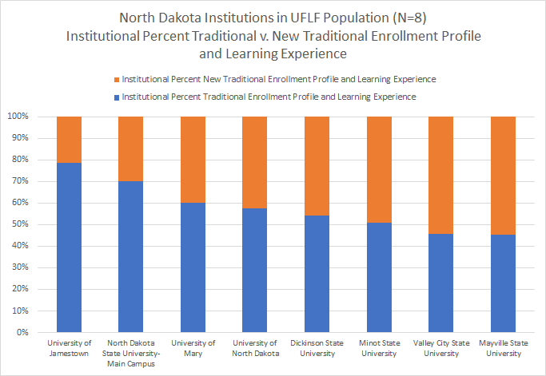

Slide 35
South Dakota State University
R: 0.34, LE:0.41 , C:0.35
Mount Marty College
R:0.00 , LE:0.37 , C:0.63
Augustana College
R: 0.02, LE: 0.72, C:0.26

Slide 36
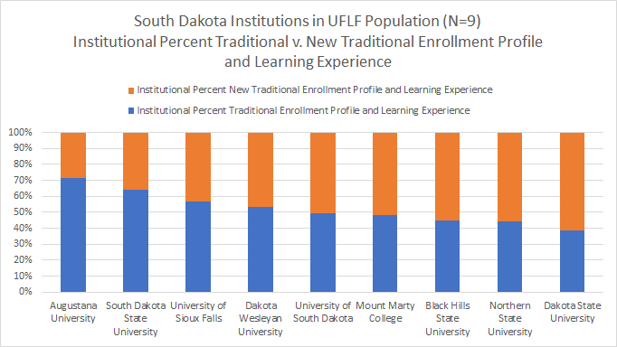

Slide 37
Carnegie Mellon University
R: 0.50, LE:0.31 , C:0.19
Gwynedd Mercy University
R:0.00 , LE:0.35 , C:0.65
Lycoming College
R: 0.00, LE: 1.00, C:0.00

Slide 38
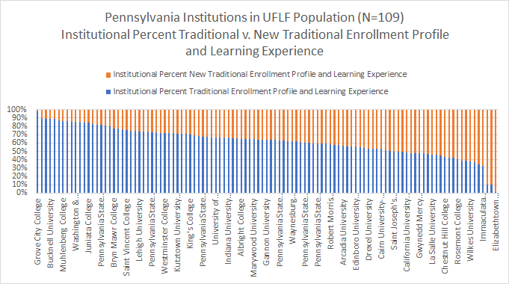

Slide 39
Carnegie Mellon University
R: 0.50, LE:0.31 , C:0.19
Philadelphia University
R:0.00 , LE:0.38 , C:0.62
Lycoming College
R: 0.00, LE: 1.00, C:0.00
Notes:
0 0.3839 0.6161

Slide 42
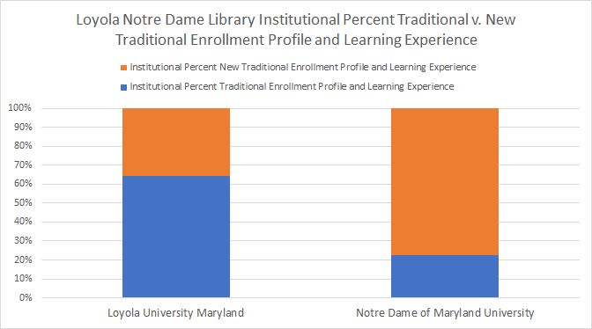

Slide 44
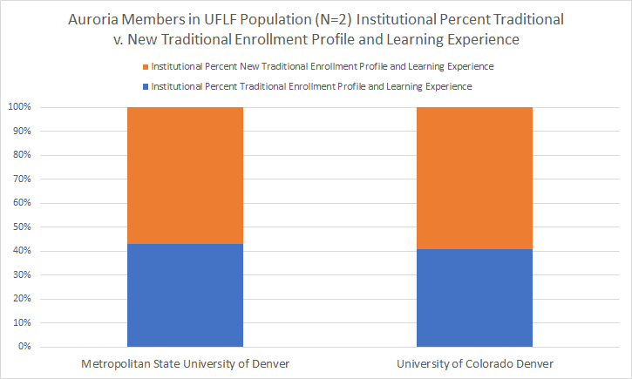

Slide 45
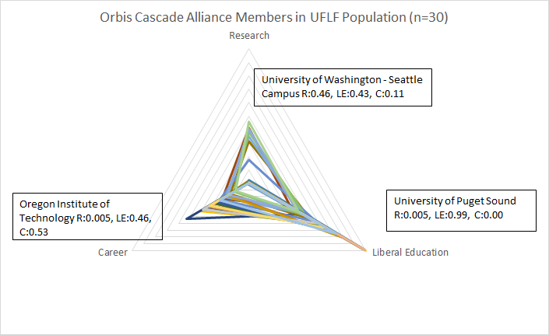

Slide 46
