Slide 1
OCLC Research Library Partner Meeting, San Francisco
3-4 June 2015
The Evolving Scholarly Record: ranking and reputation
Constance Malpas
Notes:
Several people have asked if I will be summarizing discussions of the last several days. I will not – they defy easy synthesis and I’m not sure it was even Ricky’s intent to arrive at an action agenda.
What I will do is provide some impressionistic observations about what I have heard, and suggest some points of connection between our discussions about library-based stewardship on Tuesday and our conversations about rank and reputation. And without claiming to know what an appropriate action agenda for this group might be, I will close with some concrete next steps that make sense to me – though they may not make sense to you.

Slide 2
How will changes in scholarly practice affect library service portfolio?
Collections -> engagement
Research Collections and Support
Changing roles, responsibilities of research libraries
Evolving Scholarly Record
How will libraries organize around changing business operations?
Which operations should be sourced internally, which might be externalized?
Understanding the Systemwide Library
Organization of library enterprise in higher education; locus and scale of operations

Slide 3
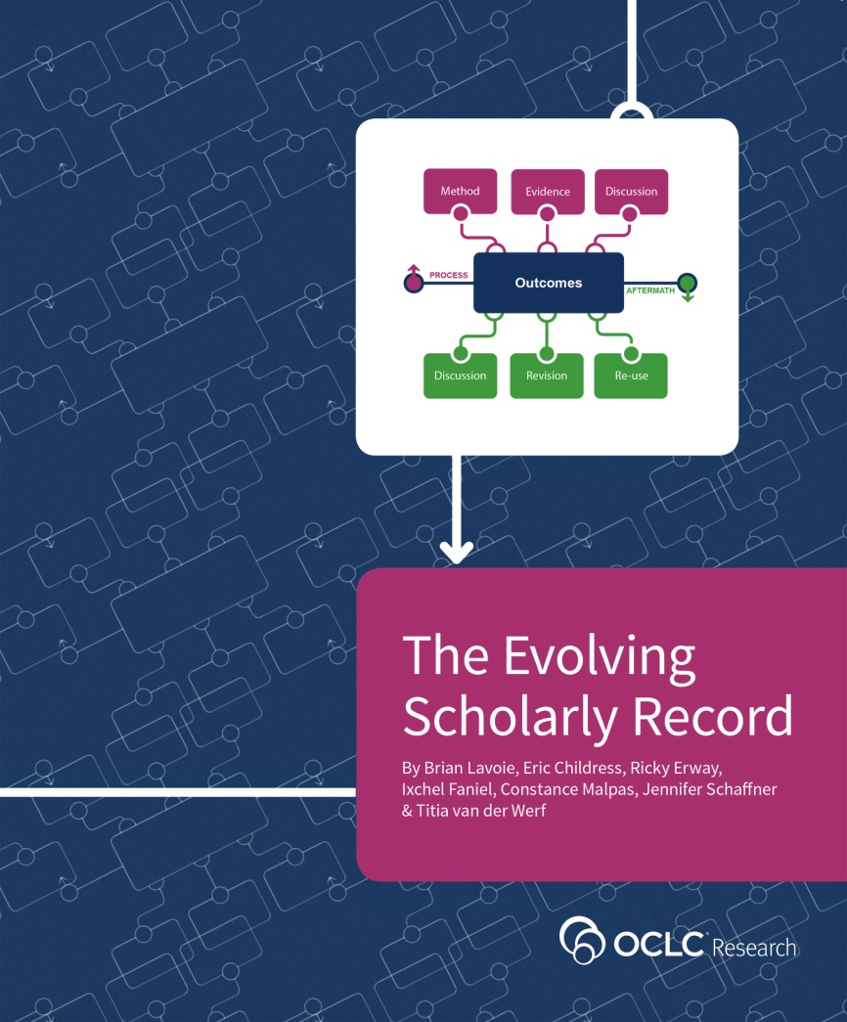
Framing the scholarly record
Shared vocabulary supports conversations across diverse stakeholder ecosystem
Roles, relationships of libraries, publishers, research administrators
Implications for discovery, stewardship, reputation management

Slide 4
ESR Workshop Series
Chicago
May 2015
Amsterdam
June 2014
Washington, DC
December 2014
San Francisco
June 2015
Boundaries of evolving scholarly record
Curatorial roles of various stakeholders
#ESRworkshop

Slide 5
Discussion themes
Selection – trend to campus bibliography; automation
Catherine Hamer, University of Texas, Austin
Anna Grigson, London School of Economics
Support for Researchers – (re-)establishing trust
Mary-Jo Romaniuk, University of Manitoba
Susan Lafferty, University of New South Wales
Collaboration within the university – find a champion
Holly Mercer, University of Tennessee, Knoxville
Kristin Antelman, Cal Tech
Collaboration with external partners – calculated, necessary risk
John MacColl, University of St. Andrews
Teresa Chitty, University of Melbourne

Slide 6
Reputation and ranking
‘Notability’
Norms (reproducibility)
Promotion / Tenure
Individual
motivated by
incentives
[scholarly work]
Funding
Following (enrollment, recruitment/retention)
Institutional
measured by
citation
License (CC-BY…)
Identifiers (ORCID, DOI…)
Persistence (SLA?)
supported by metadata

Slide 7
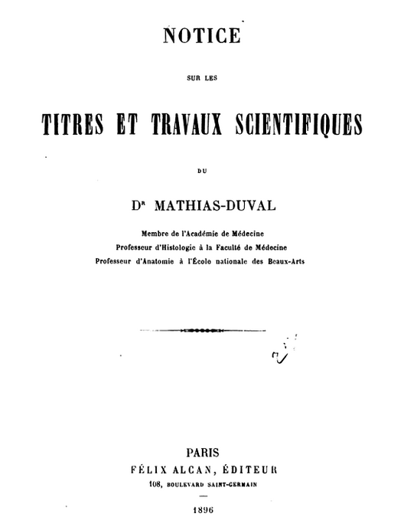
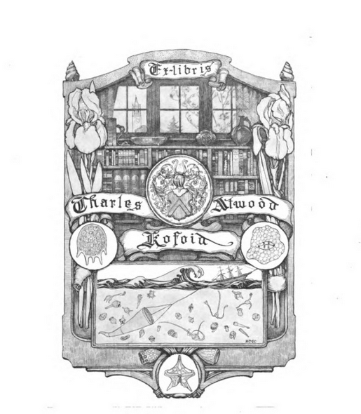
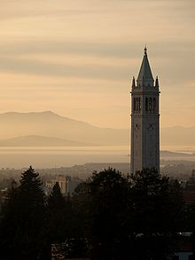
Reputation management and metadata
collect
publish
(220 pp.)
publish
preserve
http://hdl.handle.net/2027/uc1.$c29885

Slide 8
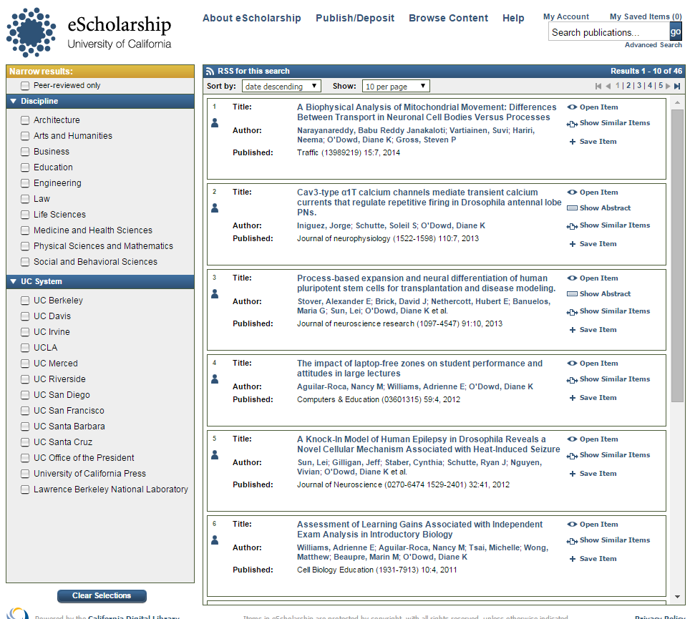
Personal bibliography
Campus bibliography
group-scale and ‘network-scale’ infrastructure supports individual-scale, institution-scale
reputation management

Slide 9
More (or less?) of a good thing
Maximizing productivity, yield of scholarly work
Not ‘more publications’ but ‘more impact’
Reputation = credit for impactful work (relationships)
Research funding cycle
NIH bio-sketch…5 publications
UK REF…4 publications
Researcher lifecycle
Hundreds of articles? Several books?

Slide 10
Evolving manuscripts and metadata
. . .
H. Else, “Evolving Manuscripts” THE (14 May 2015)
https://www.timeshighereducation.co.uk/news/evolving-manuscripts-the-future-of-scientific-communication/2020200.article

Slide 11
Differential service model?
Services related to ‘recording infrastructure’
Guidance on personal workflow support tools, referral services
Selective integration of best-of-breed, interoperable modules (social discovery, data management, researcher profiling etc.)
Services layered on institutional bibliography
Disciplinary discovery layers (relevance ranking based on scholarly citation practices) etc.
Institutional stewardship ‘archiving infrastructure’
Highly focused, aligned with local/community capacity

Slide 12
Needs…
Services…
Scholarly output
Scholarly record
workflow support
business
intelligence
reputation
management
metadata
management
Institutional
archive
stewardship
selection protocols
repository infrastructure(s)

Slide 13
Business functions
Scholarly output
Scholarly record
Customer relationship management
workflow support
business
intelligence
reputation
management
Innovation
metadata
management
Institutional
archive
Intrastructure
stewardship
selection protocols
repository infrastructure(s)

Slide 14
Scope, locus of action – local? group?
Business intelligence on researcher uptake for network-level services
Articulate interoperability requirements for selected workflow support tools
Machine-readable selection profiles
Renovate metadata practices to focus on identifiers, relationships between entities
Quantify VFM for renovated library service portfolio (‘renegotiate ICR’)
Recording infrastructure
Archiving infrastructure

Slide 15
‘Libraries should’ (make choices)
Aggregate information about researcher workflow preferences
ORLP facilitated response to UU survey? Local response?
Develop best practices for library-based ORCID, ISNI, DOI assignment
ORLP Metadata Managers task group?
Prioritize (vendor) metadata interoperability requirements for selected tools
Cross consortium effort? RLUK, ARL, CAUL?
Case studies in successful faculty engagement around implementing researcher profiling services, data management services?
ORLP Research Information Management group?

Slide 16
Your turn: triage…
Issue:
Document researcher workflow practices
Renovate metadata management (identifiers; entities: relationships)
Machine-readable acquisition profiles; interoperability
Faculty engagement – ground rules
…
Priority:
Urgent care – next 12 months?
Rehabilitation – next 2 years?
Chronic care – within 5 years?
Locus:
Institution-scale response
Group-scale
Network?

Slide 17
Mutually reinforcing goals
Ours: maximize cumulative impact
Useful evidence for local and collective action
Yours: reduce uncertainty, raise confidence
Ensure institutional decisions reflect best practice
Where can we work together?

Slide 18
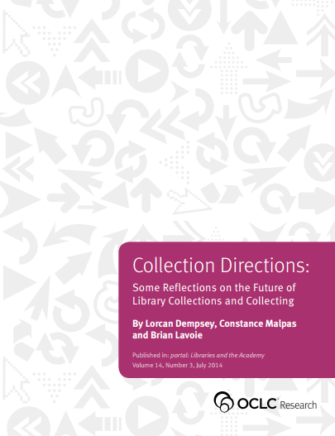
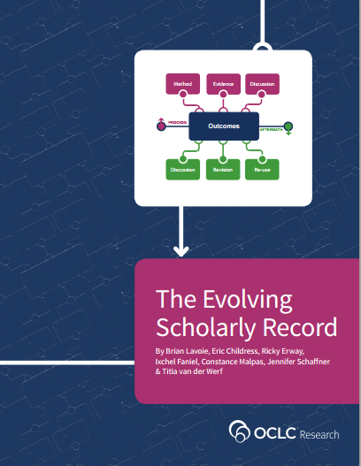
[in press]
Stewardship of the Evolving Scholarly Record: From the Invisible Hand to Conscious Coordination
By Brian Lavoie & Constance Malpas
http://www.oclc.org/research
Notes:
ESR work is at intersection of two OCLC Research portfolios: Research Collections and Support (focused on changes in the roles and responsibilities of research libraries, shift from collections to engagement) and Understanding the Systemwide Library (examining the organization of libraries in the larger higher education environment, particularly the scale at which business operations are organized. Much of this has focused on analyses of ‘above campus’ approaches to managing collections.)

