Slide 1
University Futures, Library Futures: re-examining academic library relevance
Constance Malpas, Rona Stein
OCLC Research

Slide 2
Library Excellence … to What End?
Academic library excellence: collection size, spend, use
Measuring the means vs. effecting the ends
Universities compete: students, resources, prestige
University differentiation ➔ differentiated library services
Managing collections ➔ supporting new user workflows

Slide 3
University Futures, Library Futures
Collaborative project with Ithaka S+R, with support from the Andrew W. Mellon Foundation
Population: 1506 US higher education institutions (HEI) comprising four-year public and private non-profit degree-granting colleges and universities
Institutional profiles derived from 2015 IPEDS survey data:
What colleges and universities do (research, liberal education, career-focused education)
How they do it (residential vs. convenience modes of provision)
Mapping library service models to institution types

Slide 4
Most four-year institutions exhibit multiple tendencies; they have several ‘lines of business’
primary focus on doctoral research and scholarship
Research
primary focus on preparation for career professions
primary focus on interdisciplinary baccalaureate education
Career
Liberal Education

Slide 5
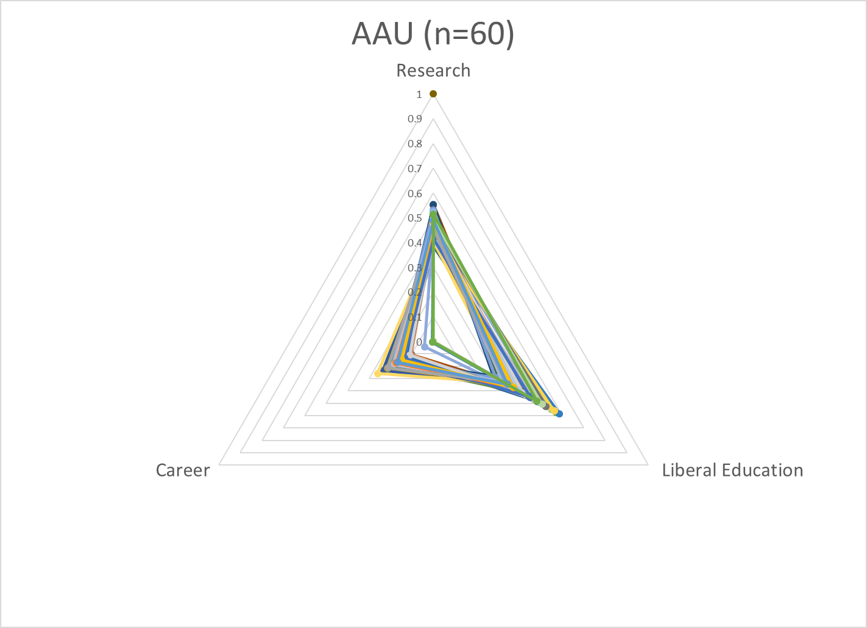
Model can be used to examine groups of institutions for conformance to type (isomorphism)
Pronounced skew toward supporting research + broad baccalaureate education

Slide 6
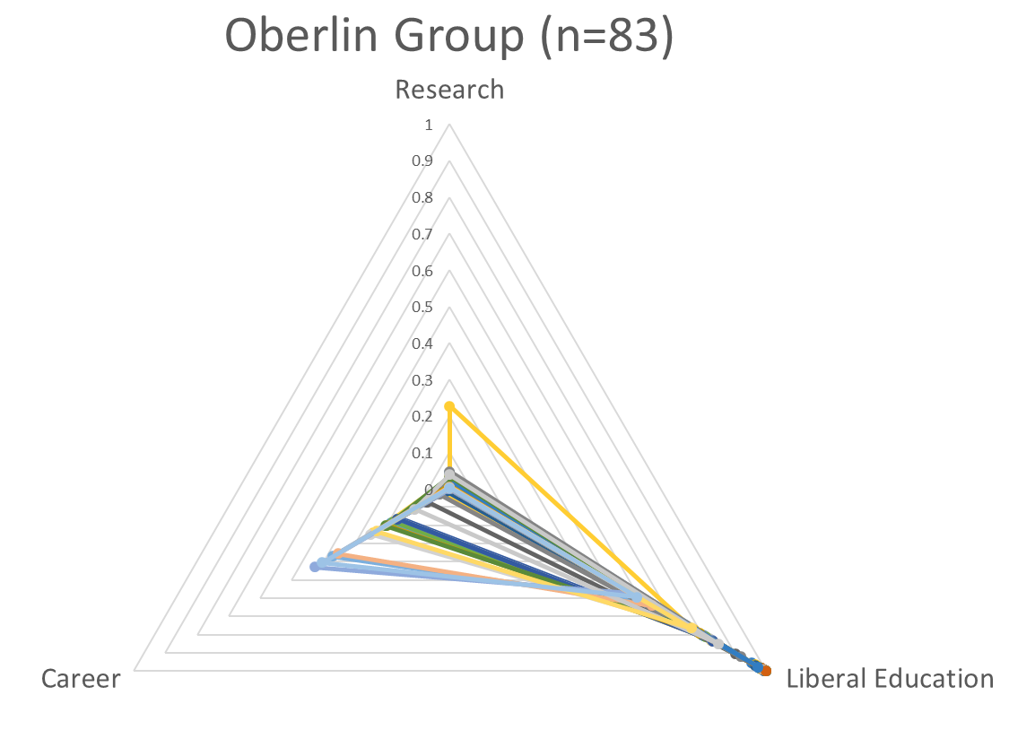
Broad baccalaureate education with some career orientation

Slide 7
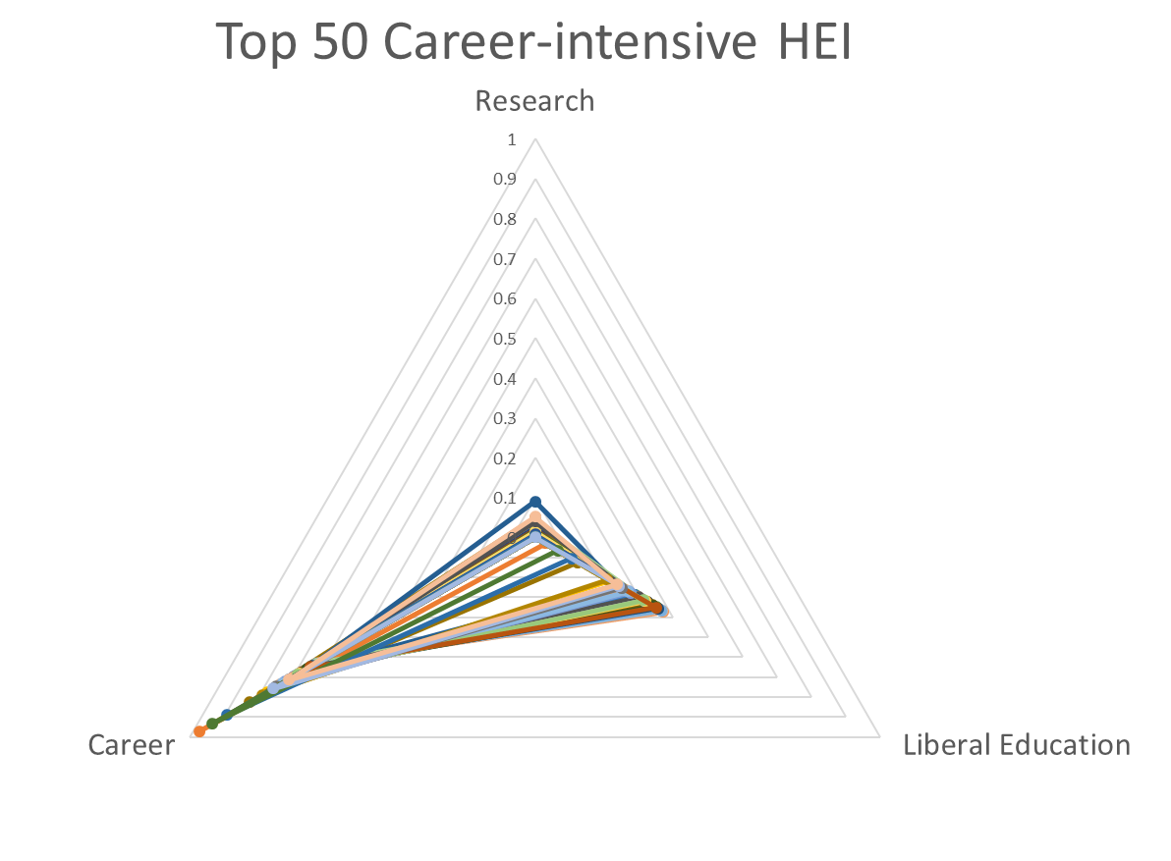
Career-ready focus with baccalaureate foundation

Slide 8
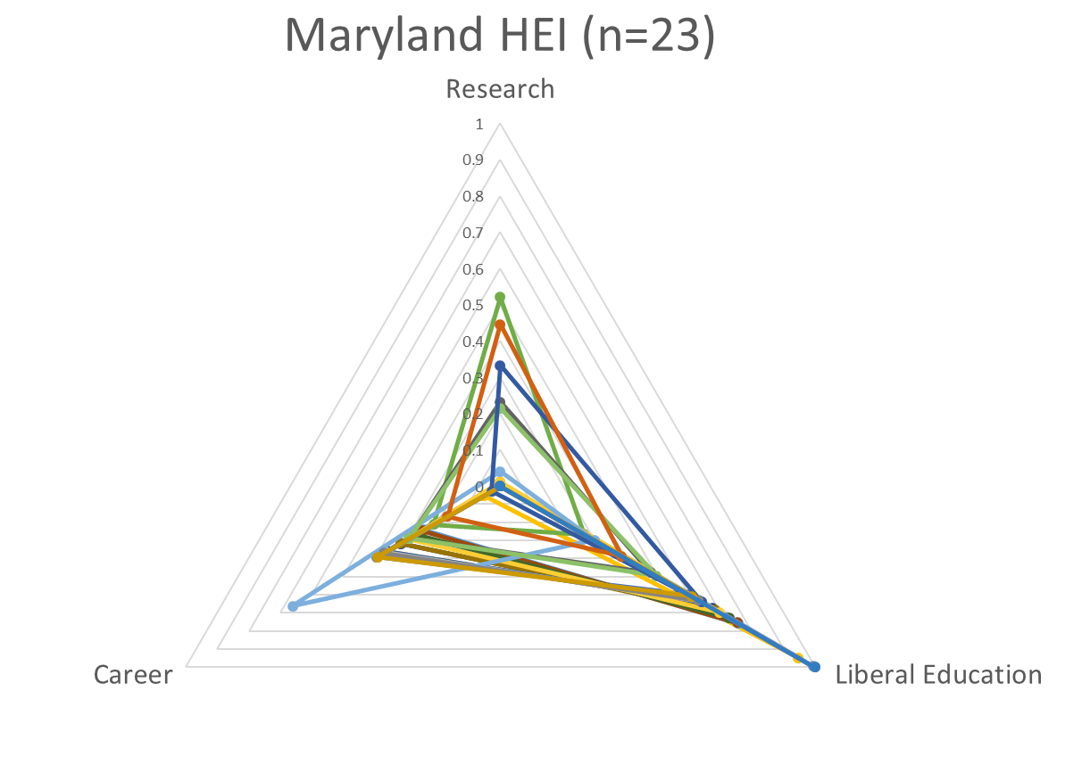
Model can be used to examine range of institutional activity within different geographies
Research focus:
Johns Hopkins
Liberal education focus:
Goucher College
Career focus:
University of Baltimore

Slide 9
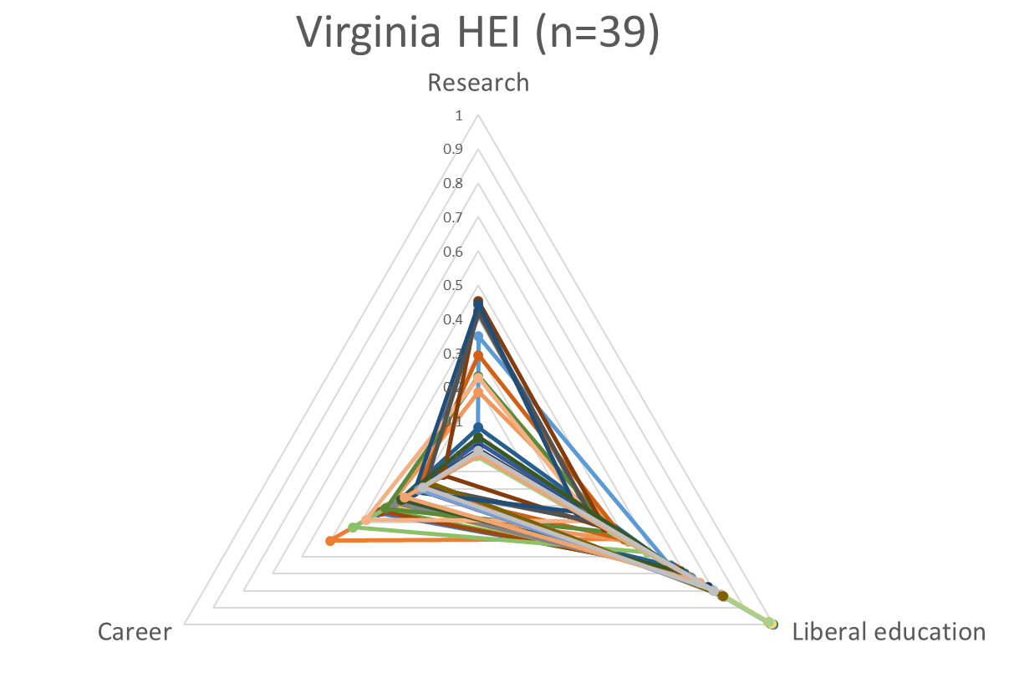
Research focus:
University of Virginia
Liberal education focus:
Sweet Briar College
Career focus:
Bluefield College
Notes:
A pronounced emphasis on liberal education – a difficult place for Sweet Briar to succeed

Slide 10
Our premise
Academic library service bundle should support primary institutional business objective(s) of college / university
I.e., institutions with a greater focus on research will require different library services than institutions focused on baccalaureate education or career preparation
In an increasingly competitive market, colleges and universities will seek to differentiate their educational offer and value proposition; library service models will look increasingly different (less ‘Harvardization’ or ‘Berkeley-itis’)

Slide 11
University directions shape library directions

Slide 12
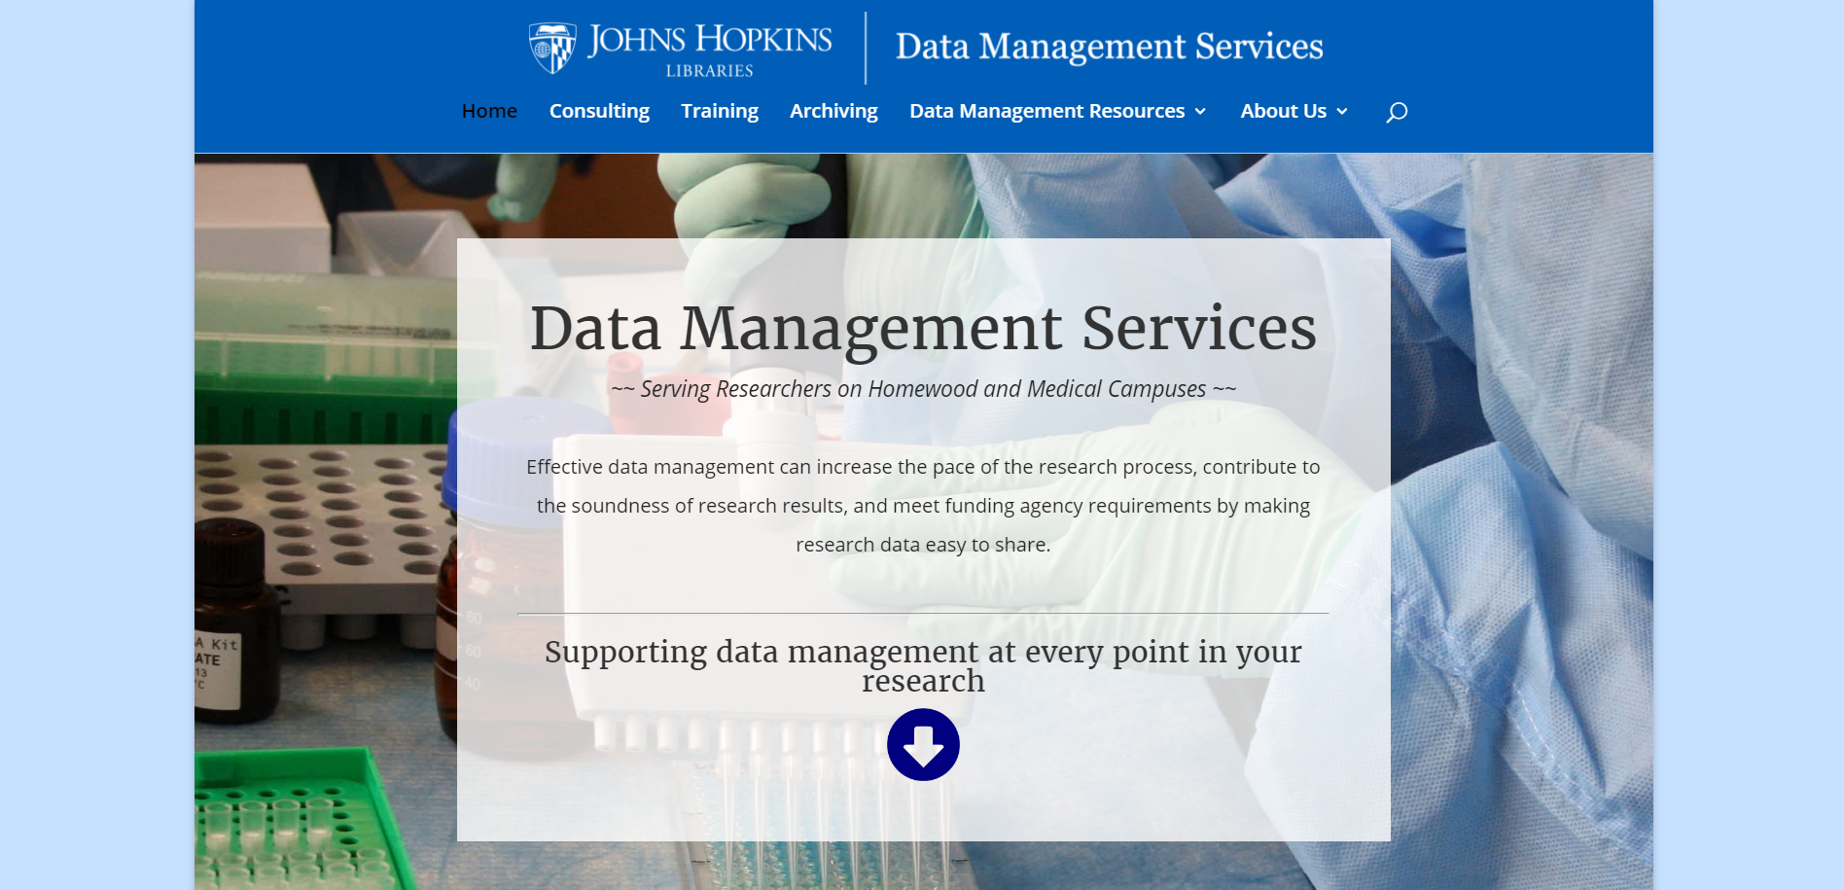
RESEARCH
From collections to engagement, workflow support

Slide 13
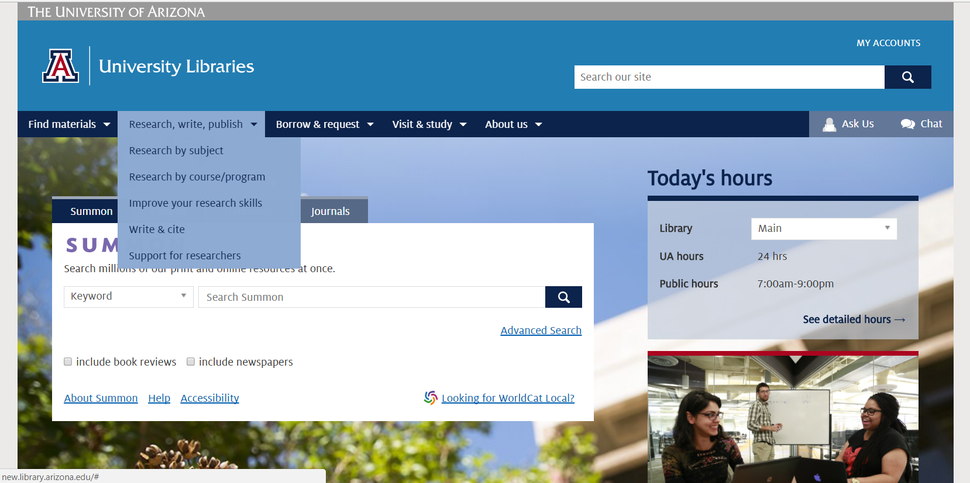
RESEARCH
From ‘search’ to research, support for content curation and content creation

Slide 14
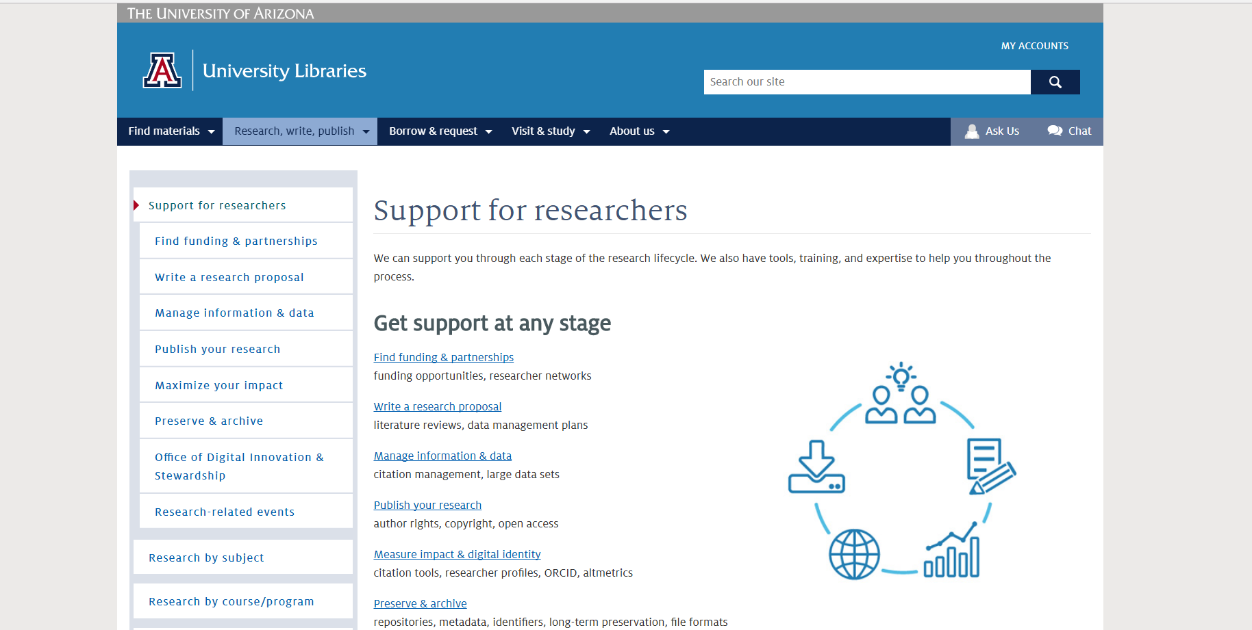
Supporting workflows throughout the research lifecycle
RESEARCH

Slide 15
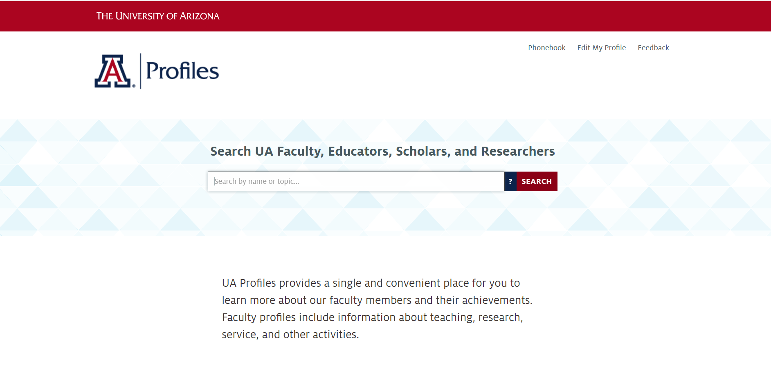
RESEARCH
Showcasing faculty expertise, assisting with reputation management

Slide 16
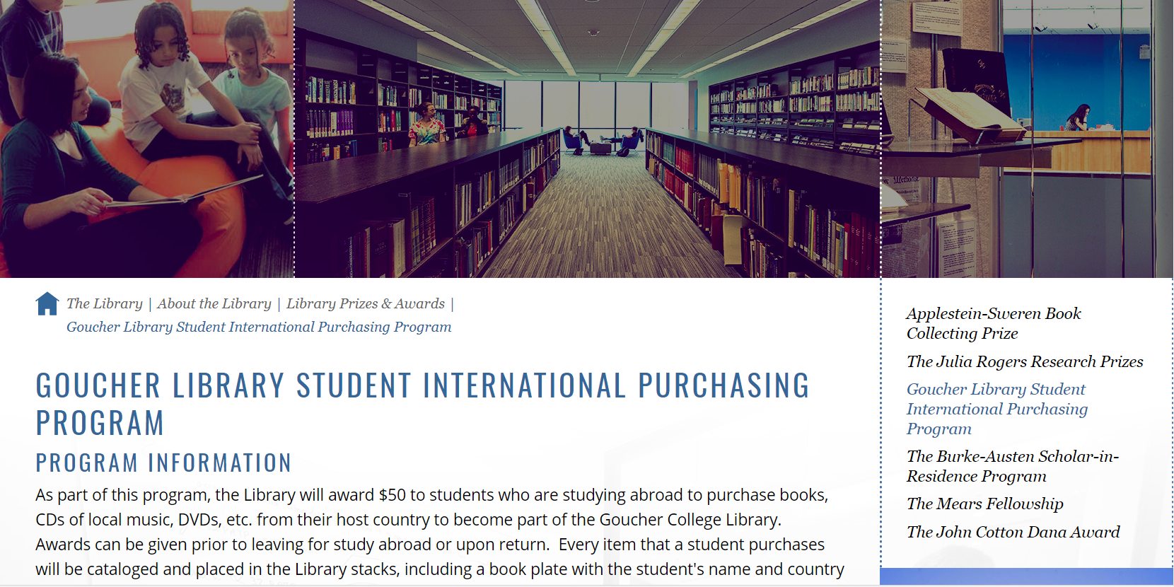
PDA program supports equity, diversity, inclusion and student success
LIBERAL EDUCATION

Slide 17
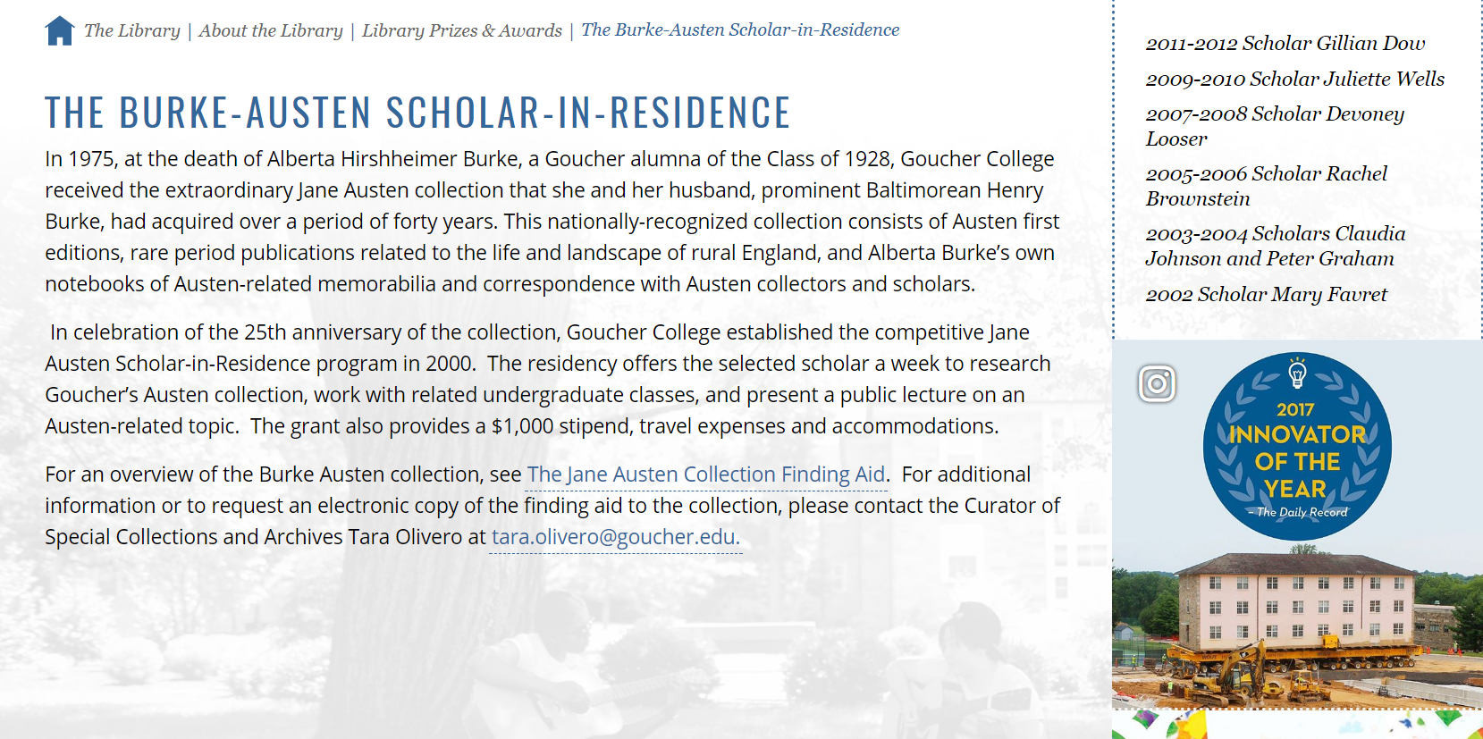
Special collections support teaching & learning mission
LIBERAL EDUCATION

Slide 18
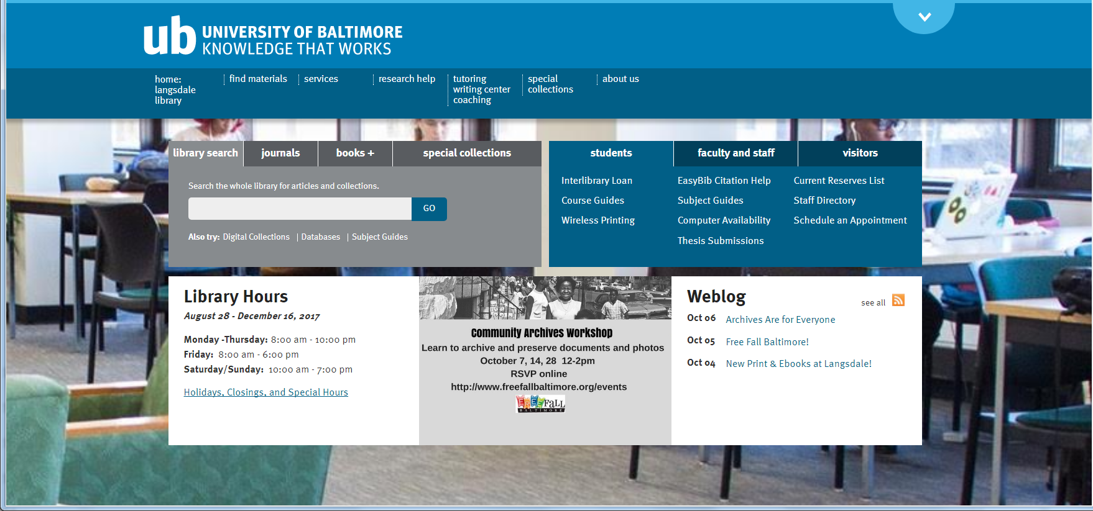
CAREER
Library-based tutoring, writing center, academic coaching
Library-centered community engagement

Slide 19
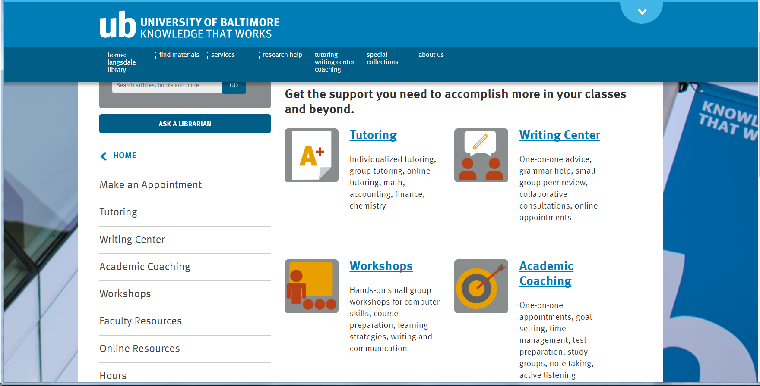
Embracing student success as a central focus of library activity and attention
CAREER

Slide 20
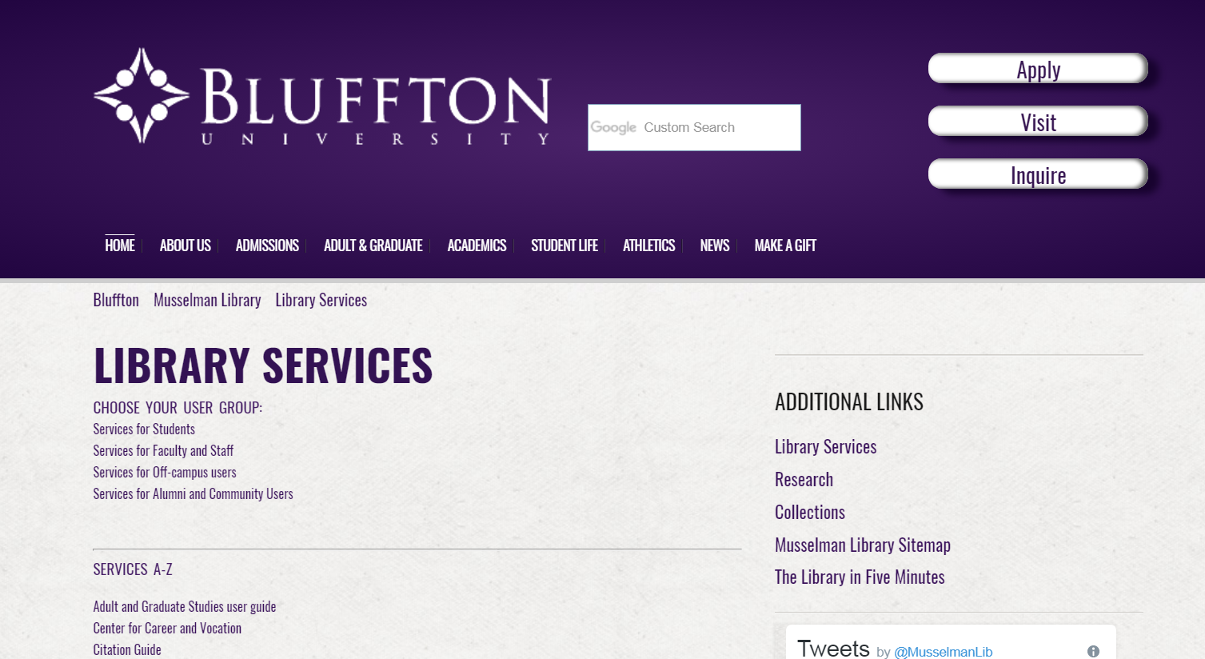
Customized support for “new traditional” students, clear alignment with career-ready educational model
CAREER

Slide 21
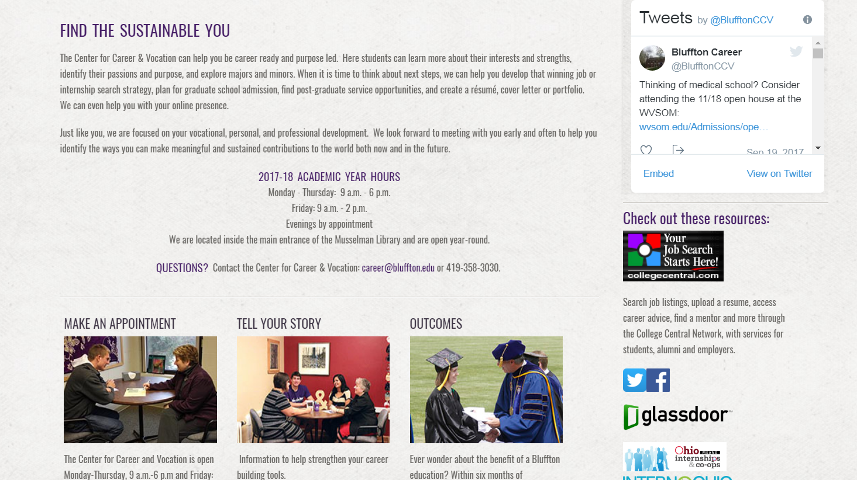
Expert search strategies for vocational and professional success, find and locate jobs and internships
CAREER

Slide 22
Institutional Category vs. Institutional Context

Slide 23
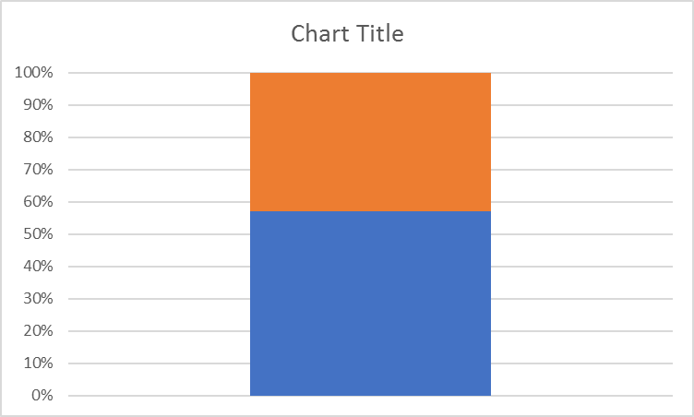
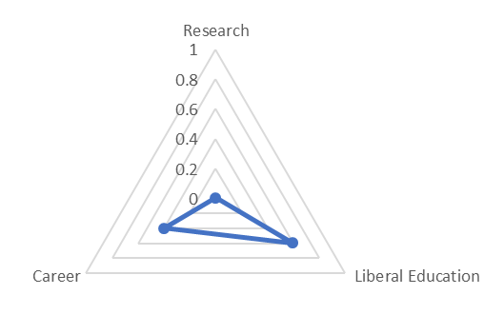
Master's Colleges & Universities: Larger Programs
Convenience
Residential
60% Liberal Education; 40% Career-ready
60% Residential; 40% Convenience
Notes:
“Opportunity afforded”

Slide 24
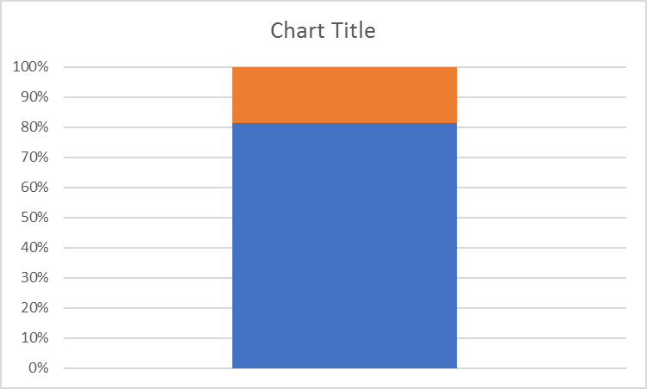
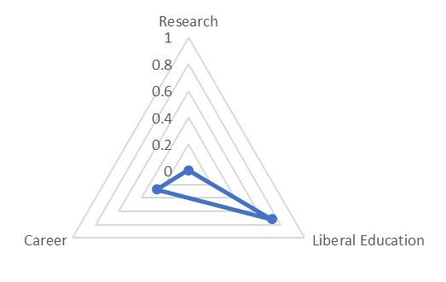
Master's Colleges & Universities: Larger Programs
Convenience
Residential
80% Liberal Education; 20% Career-ready
80% Residential; 20% Convenience
Notes:
“Knowledge is liberty”

Slide 25
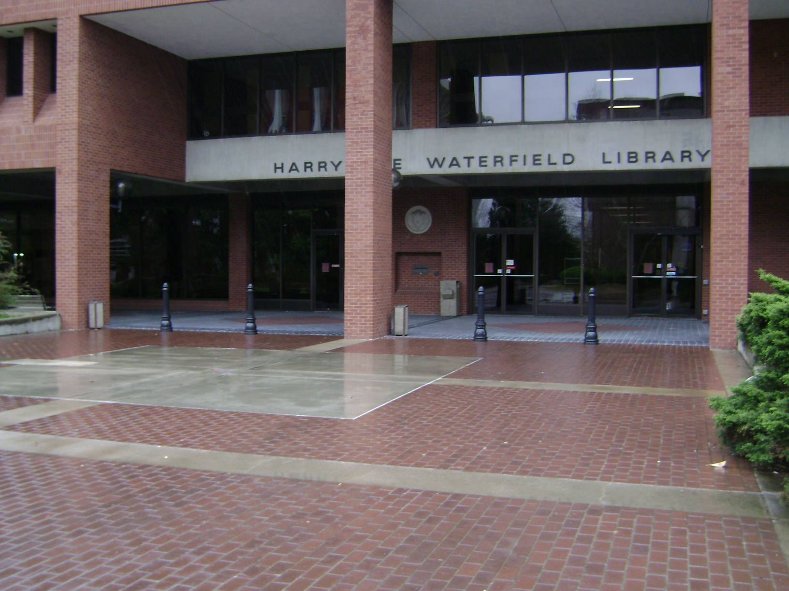
“Intellectual commons for both on and off-campus students” offers support for distance learners
Library support for faculty instructional design, integrating library services in Canvas LMS
Writing and Oral Communications Centers
Credit-bearing courses for Information Studies minor
Support for teaching, learning and student success
Image source: https://slinn475.files.wordpress.com/2010/04/0031.jpg

Slide 26
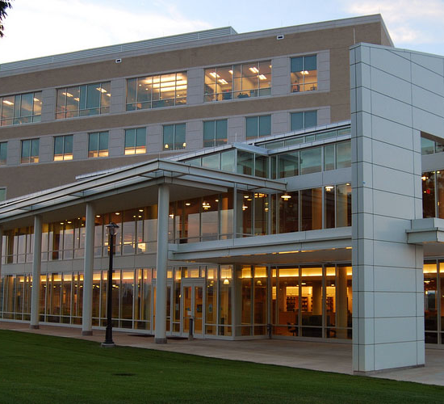
Library ‘space as a service’, group study spaces
Madison Research Essentials Toolkit – information literacy essentials
MADlab supports distinctive educational programs in the visual arts
Student Gov’t. Association / Libraries Collaborative maximizes student engagement with library planning
Library contributes to distinctive residential student experience
http://sites.jmu.edu/specialcollections/how-weve-grown-through-the-years-east-campus/

Slide 27
Key message
Library relevance to the academic mission is not measured by collection size or expenditures, but by alignment and fit of services to distinctive institutional purpose(s)
As colleges and universities seek to differentiate their offer, models of library excellence look increasingly different
Be the smarter library: think beyond basic institutional categories (Carnegie type, size, control) when considering the business you are in: enrollment profile, competitive horizon (regional, national, international), revenue model are important indicators of institutional direction and the library’s future

Slide 28
Constance Malpas
Watch for our upcoming survey with Ithaka S+R
in late October
OCLC Research
malpasc@oclc.org
@ConstanceM
https://orcid.org/0000-0002-9312-8294

Slide 29
Group Exercise (1)
Quickly sketch your institution’s Research, Liberal Education and Career dimensions – where does the university aim to differentiate itself from peers/competitors?

Slide 30
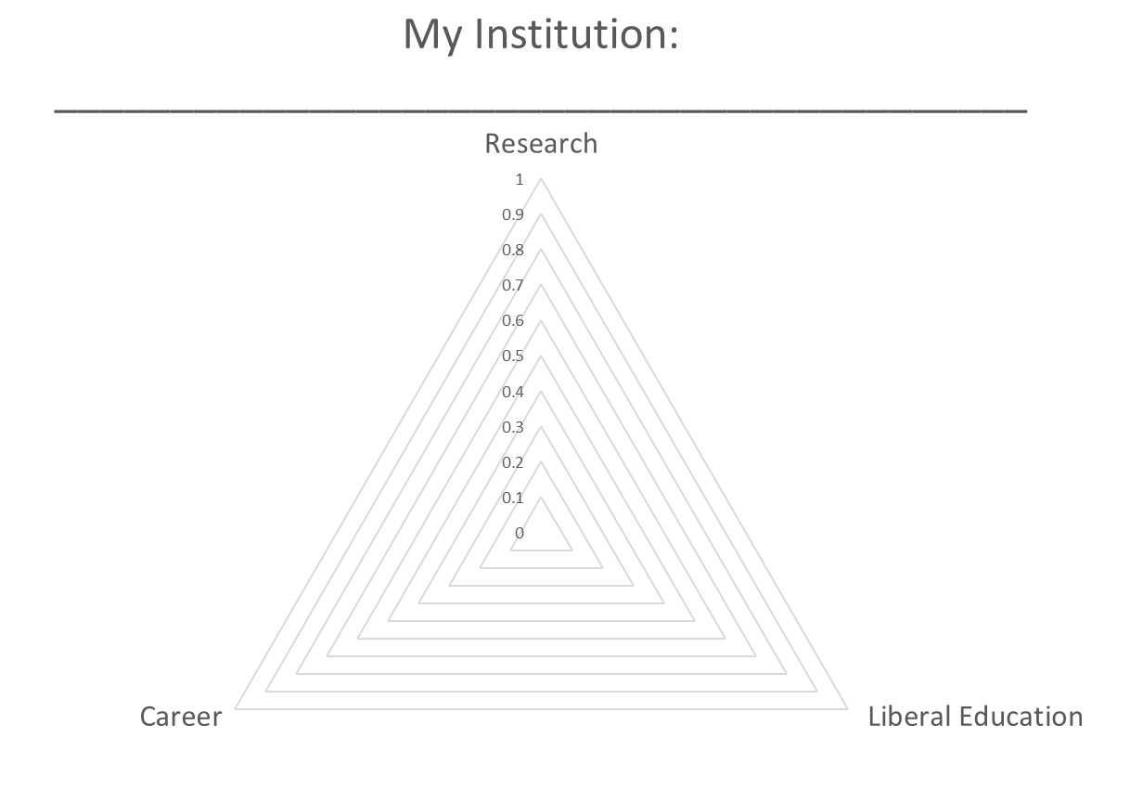
St. Martin’s College

Slide 31
Group Exercise (2)
In 2 minutes (or less), jot down what your library is or should be doing to assist or accelerate institutional differentiation
innovative new services and/or
increasing efficiency in legacy operations

