Slide 1
Evolving Scholarly Record and Evolving Stewardship Ecosystem—San Francisco Workshop, 2 June 2015
Stewardship of the Evolving Scholarly Record
Constance Malpas and Brian Lavoie

Slide 2
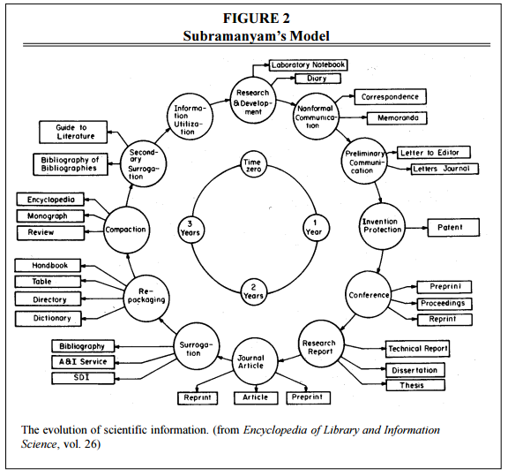
A model of scholarly communications, 1981
Library-based stewardship covered
~ 80%?
S. Curl “Subramanyam Revisited: Creating a New Model for Information Literacy Instruction”
http://crl.acrl.org/content/62/5/455.full.pdf
Notes:
Premise of bib instruction was that library collected/could lay hands on most documentation of scholarly process

Slide 3
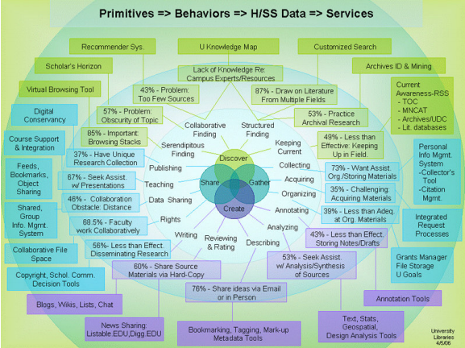
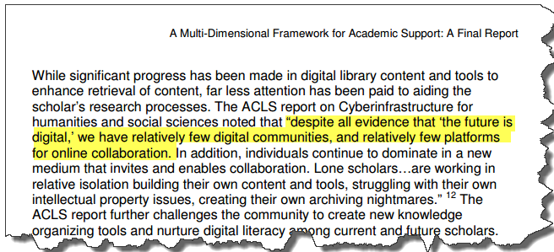
Scholarly behaviors and workflow support, 2006
University of Minnesota Libraries
http://www.research.umn.edu/documents/UMN_Multi-dimensional_Framework_Final_Report.pdf

Slide 4
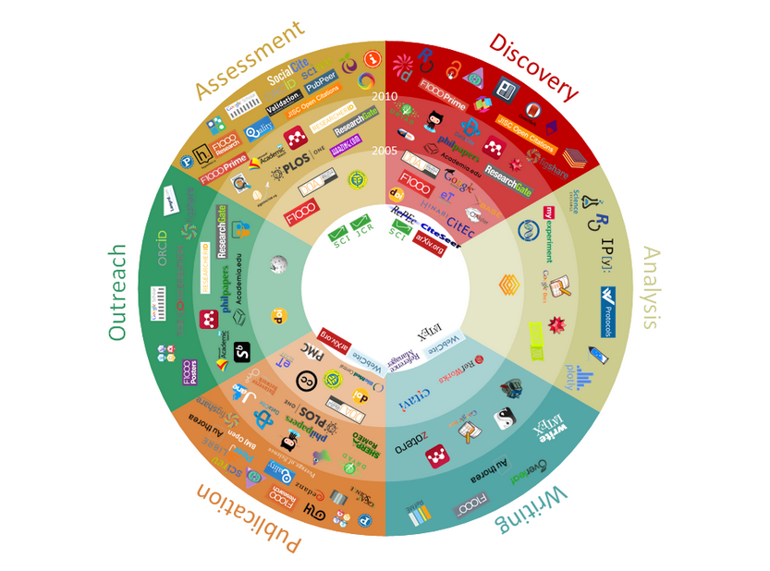
Workflows and scholarly communication tools, 2015
Library-based stewardship covers
???
J. Bosman, B. Kramer “101 Innovations in Scholarly Communication”
University of Utrecht Library
http://innoscholcomm.silk.co/

Slide 5



A “weightless” scholarly record?
As scholarly practice becomes anchored in digital,
networked spaces …
… scholarly outputs move from bookshelf to network
Notes:
Scholarly practice moves to the network: tools for creating, consuming, curating
As a result, the outputs of scholarly work also are moving to the network
Broadly speaking, this can be seen as a move from print to digital:
Traditionally: Users congregated around the library stacks where the (print) scholarly record resided
Today: users congregate on the network where a greater and greater portion of the scholarly record now resides
But much more nuanced than that: the digital scholarly record is far from being just a digital copy of print books and journals; in fact the scholarly record is evolving to encompass a wide range of scholarly outputs

Slide 6
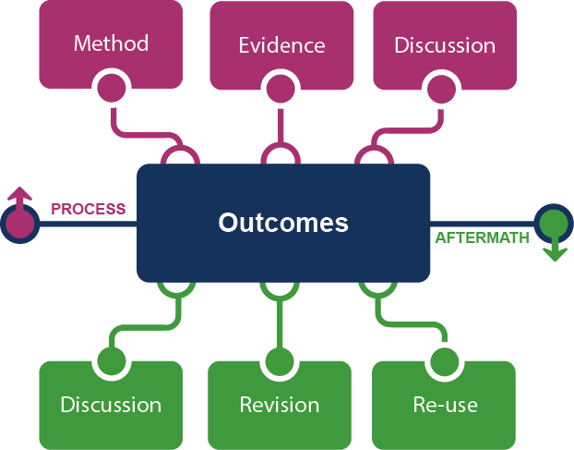
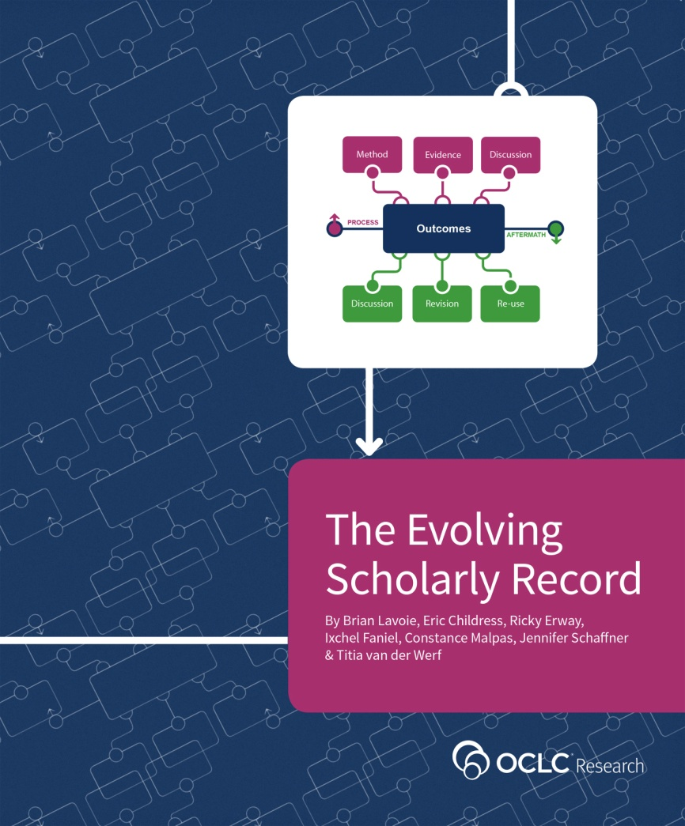
The evolving scholarly record
http://oc.lc/esr
Notes:
We capture the evolution of the scholarly record in this framework, where we see a much deeper, more complete record of scholarly inquiry than what was captured in the past.

Slide 7
Key characteristics of the ESR
Increasing volume of content
  Ease of creation & distribution of digital materials
  Vertical and horizontal growth
Increasing diversity and complexity of content
  Forms/formats of outputs are diversifying
  Technical complexity is growing
  Structural complexity is increasing
Increasing distribution of custodial responsibility
  Expansion of publication channels (formal & informal)
  Technological specialization across formats/types
  Library selection decisions
Notes:
Important characteristics of the scholarly record to think about when designing stewardship models for the ESR

Slide 8
What is the scholarly record?
Scholarly Outputs
Scholarly Record
systematically identified, gathered, organized, curated, and made persistently accessible
Notes:
What is the scholarly record? It is the portion of scholarly output that is placed under some form of stewardship (where stewardship is defined as above).

Slide 9
Stewardship … historically
Stewardship of scholarly record was byproduct of uncoordinated, highly distributed, and duplicative process of managing local print collections.
Sum of local stewardship efforts resulted in aggregate library resource that was relatively complete record of published (print) scholarly outputs
“Invisible hand” metaphor: uncoordinated local efforts lead to socially desirable outcome
Notes:
How has stewardship been undertaken historically? The invisible hand metaphor …
Collections managed as autonomous units, with little attention to broader system-wide conditions.

Slide 10
Stewardship … now
Scholarly record imperfectly approximated in aggregate library resource
  Libraries not collecting full range of ESR
  Portion of scholarly record that libraries can collectively capture and make available is diminishing
New stewardship models require conscious coordination.
The ‘owned’ collection
The ‘facilitated’ collection
‘borrowed’
‘demand-driven’
‘licensed’
‘shared print’
Notes:
But today, the evolution of scholarly record requires evolution of stewardship models – in particular, stewardship models designed around the principle of conscious coordination
Providing local access to scholarly record less about accumulating large, representative local collections, and more about facilitating access to scholarly resources distributed across the network

Slide 11

Conscious coordination
System-wide awareness
Explicit commitments
Division of labor
Reciprocal access
Notes:
Key components of conscious coordination

Slide 12

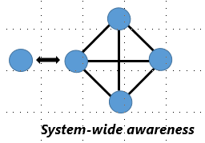
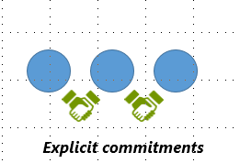





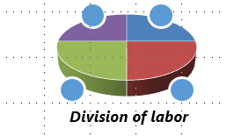

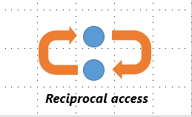





Examples
marc 583
Notes:
Examples of each component

Slide 13
Right-scaling stewardship
Increasing, accelerating:
specialization, division of labor
reliance on external partners
attention to ROI in group-scale operations
Diminishing:
acceptance of ‘intrinsic value’ arguments for local collection, curation operations

Slide 14
Managing transaction costs
Increasing, accelerating:
reliance on data-driven decision support
attention to coordination capacity
collection-level metadata management
Diminishing:
acceptance of ‘gentlemen’s agreements’ around collaboration

Slide 15
Preserving institutional identity
Increasing, accelerating:
alignment of local stewardship, institutional brand
focus on distinctive information assets
attention to ‘networks of excellence’
Diminishing
incentives to maximize private benefits of stewardship – value of local record depends on network connections

Slide 16
Outstanding issues
Impact of distributed stewardship on discovery services
Measuring scholarly impact – ‘rolling up’ impact of diffuse outputs
Operational integration of metadata flows from diverse platforms – funders, publishers, libraries, university HR etc.

Slide 17
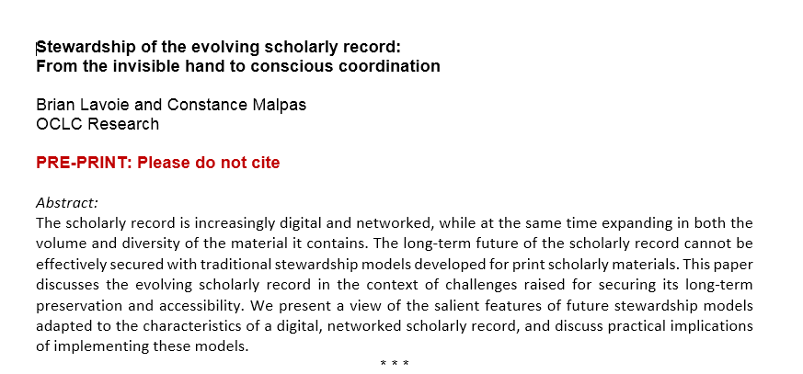
Comments and questions welcome:
malpasc@oclc.org
lavoie@oclc.org

