Slide 1
Cloud-sourcing Research Collections: a model for strategic change
ARL Fall Forum
Achieving
Strategic Change
in Libraries
15 October 2010
Constance Malpas
Program Officer
OCLC Research

Slide 2
Cloud Library Project (2009/2010)
Objective: Assess feasibility of ‘externalizing’ library repository functions to network service providers
Scope: Legacy monographic collections in mass-digitized corpus
Case study:
  Motivated client: NYU
  Shared print repository: ReCAP
  Shared digital repository: HathiTrust
Method: Analyze holdings overlap for generic ARL service population; assess opportunity for surrogate service provision and relegation of local holdings; quantify potential space savings and cost avoidance

Slide 3
Our Starting Point: June 2009
Library off-site storage
0101010101010
1010101010101
0101010101010
1010101010101
0101010101010
1010101010101
0101010101010
25 years
+70M vols.
9 months
+3M vols.
HathiTrust
Will this intersection create new operational efficiencies?
For which libraries?
Under what conditions?
How soon and with what impact?

Slide 4

Context: a switching point in library operations
Network service provision entails a
“trade-off between cost and control”
Nicholas Carr, The Big Switch (2008)
In libraries …
shift to licensed provisioning, shared management infrastructure; gain in operational efficiencies
print still managed as local asset; increasing attention to long-term costs of redundant inventory, burdensome operations
“turnouts, Knoxville, Tennessee” by Steve Minor

Slide 5
Attention Switch: from Print to Electronic
You are here
Derived from US Dept of Education, NCES, Academic Libraries Survey, 1998-2008

Slide 6
Format Transition is a Driver
Growing number of institutions with
e-centric acquisitions, service model
50% of ARL materials budget
Shrinking pool of libraries with mission and resources
to sustain print preservation as ‘core’ operation
Derived from ARL Annual Statistics, 2007-2008

Slide 7
Medium | Discounted Life Cycle Cost (per unit) | Total Life Cycle Cost (per unit) | Purchase Cost (per unit) | Total Cost / Purchase Cost (per unit)
Monographs | $ 119.56 | $ 343.03 | $ 47.78 | 718%
Current serials | $ 634.91 | 801.87 | 590.97 | 134
Microforms | $ 0.27 | 0.45 | 0.11 | 256
Govt. Docs | $ 14.13 | 55.40 | 0.00 | 311
MSS & Archives | $ 20.26 | 126.79 | 4.46 | 1130
Maps | $ 26.78 | 73.82 | 11.05 | 247
Graphic materials | $ 1.65 | 2.91 | 0.06 | 216216
Sound recordings | $ 22.64 | 24.77 | 6.80 | 219
Video & Film | $ 128.95 | 107.50 | 15.70 | 307
Computer files | $ 0.17 | 0.07 | 0.01 | 331
“monographs are overwhelmingly the largest
source or driver of library costs . . . If research libraries
want to control their costs, they must work to control
and reduce the life cycle costs of maintaining their
monograph collections”
Lawrence , Connaway & Brigham (2001)
Potential life-cycle
cost savings of
(119.56-47.78)*500,000 titles
=$35,890,000
S. Lawrence et al. (2001) Based on 1999 ARL Data

Slide 8
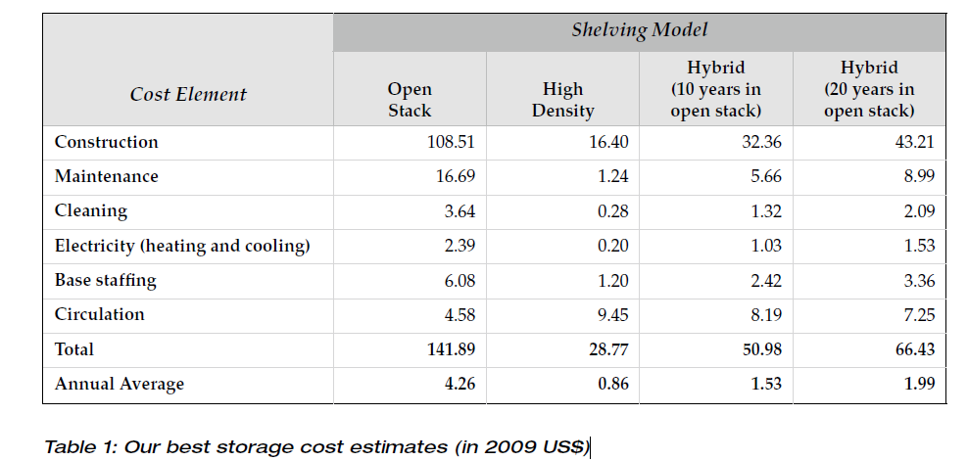
Inertia: a hidden cost driver?
Cost of management decreases as collections move off-site; the sooner they leave, the greater the savings
If 13% of on-campus collection circulates, more than 80% of the expenditure on locally managed collections delivers ‘symbolic’ value
Source: P. Courant and M. Nielson (CLIR, 2010)

Slide 9
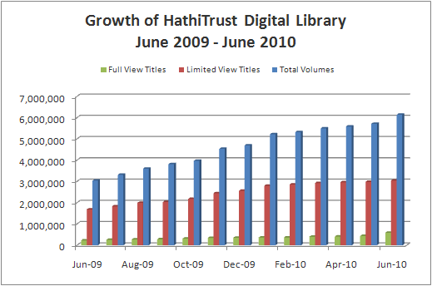

Enter the Elephant . . .
Equal in size to median ARL library
Equal in scope to e.g. University of Minnesota

Slide 10
A global change in the library environment
Academic print book collection already substantially duplicated in mass digitized book corpus
June 2010
Median duplication: 31%
June 2009
Median duplication: 19%

Slide 11
Mass Digitized Books in Shared Repositories
~3.6M titles
~75% of mass digitized corpus is ‘backed up’ in one or more shared print repositories
~2.5M

Slide 12
Shared Print Service Provision: Capacity Varies
Union of 5 major shared print collections
Library of Congress
UC NRLF/SRLF
ReCAP
CRL

Slide 13
Prediction
Within the next 5-10 years, focus of shared print archiving and service provision will shift to monographic collections
large scale service hubs will provide low-cost print management on a subscription basis;
reducing local expenditure on print operations, releasing space for new uses and facilitating a redirection of library resources;
enabling rationalization of aggregate print collection and renovation of library service portfolio
Mass digitization of retrospective print collections will drive this transition

Slide 14
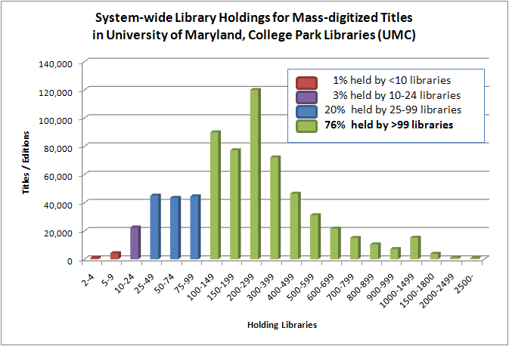

A ‘Green’ Strategy: Cooperative Management
Shared print provision could enable at least 32K linear feet of space recovery …
Data current as of June 2010

Slide 15
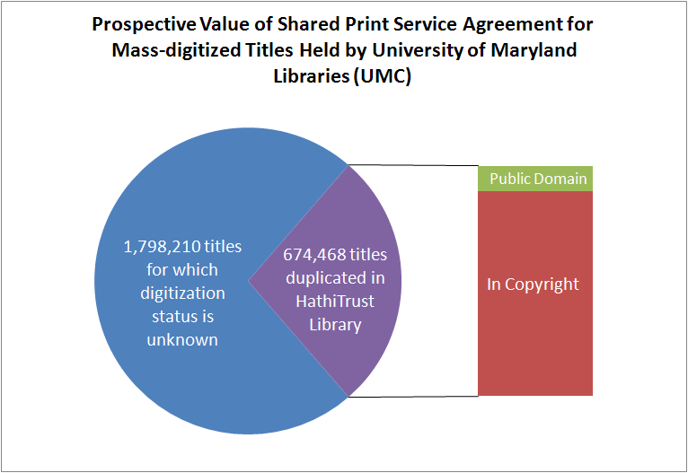
A Strategy to Transform Library Operations
Represents +30K linear feet of shelving and at least $440K in annual cost avoidance*
* Assuming relegation for titles held by >99 libraries; one volume per title * $.86
Data current as of June 2010

Slide 16
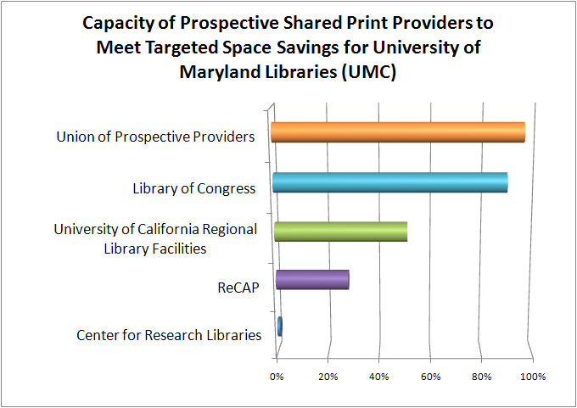
An Achievable Strategy -- if latent shared print capacity is activated
95% of target
30K linear ft
$420K
Data current as of June 2010

Slide 17
Implications: Shared Print
A small number of repositories may suffice for ‘global’ shared print provision of low-use monographs
Generic service offer is needed to achieve economies of scale, build network; uniform T&C
Fuller disclosure of storage collections is needed to judge capacity of current infrastructure, identify potential hubs
Service hubs will need to shape inventory to market needs; more widely duplicated, moderately used titles
If extant providers aren’t motivated to change service model, a new organization may be needed

Slide 18
Recommendations: Where to Start
If your institution has significant holdings in storage swap your symbol so that aggregate preservation resource is addressable and carrying capacity can be assessed
Use the mass digitized book corpus as driver for de-duplication and storage transfers; strengthen preservation infrastructure where it is most needed
Retain on-site only those titles for which demand and local value exceeds the (significant) economic and opportunity costs of local management; est. 13% circ rate does not justify current expenditure pattern

Slide 19
Recommendations: What to Stop
Storage transfers that don’t meet a known preservation need; local space pressures (alone) shouldn’t dictate what moves first or farthest
Preservation strategies that presume local autonomy; the scholarly record is a shared asset and its preservation is a collective responsibility
Enhancing bibliographic records for digitized content, beyond the addition of standard identifiers; let network visibility and full-text search hasten the migration of inventory from stacks to storage

Slide 20
Proposal: Pilot a Strategic Print Reserve
Largest shared storage collections use mass-digitized titles held in common to characterize generic service offer and common price point for a ‘national print reserve’
Compare:
Availability in print (restricted collections, NOS, loss rate)
Delivery timetable (including home-delivery option)
Repository characteristics (environmental conditions, etc.)
Transaction costs (establish baseline, look for efficiencies)
subscription cost based on N titles * ($.86 * x) / no. participants in region holding print version; service level sufficient to enable reduction in inventory

Slide 21
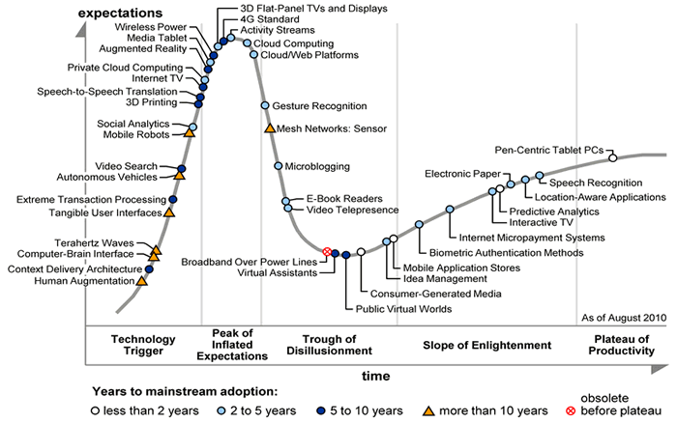
An Ideal Time for Experimentation …
2-5 years to refine the model
Source: Gartner's Hype Cycle Special Report for 2010

Slide 22
Acknowledgments
Cloud Library Project staff:
Michael Stoller, Bob Wolven, Matthew Sheehy (NYU & ReCAP)
Kat Hagedorn, Jeremy York (HathiTrust)
Roy Tennant, Bruce Washburn, Jenny Toves (OCLC Research)
Sponsors:
Carol Mandel, Jim Michalko, Jim Neal, John Wilkin
Funder:
Andrew W. Mellon Foundation

