Slide 1
Digital Library Services and the Changing Environment
John MacColl, European Director
OCLC Programs and Research
Oxford University Library
29 August 2008

Slide 2
Themes
Concentration - network-level
Diffusion - high-use web environments
Local - Group - Global
Local infrastructure: 4 pillars and three environments
Web-scale digitisation
Digitisation of unique assets
Global - Local switching

Slide 3
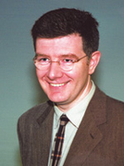
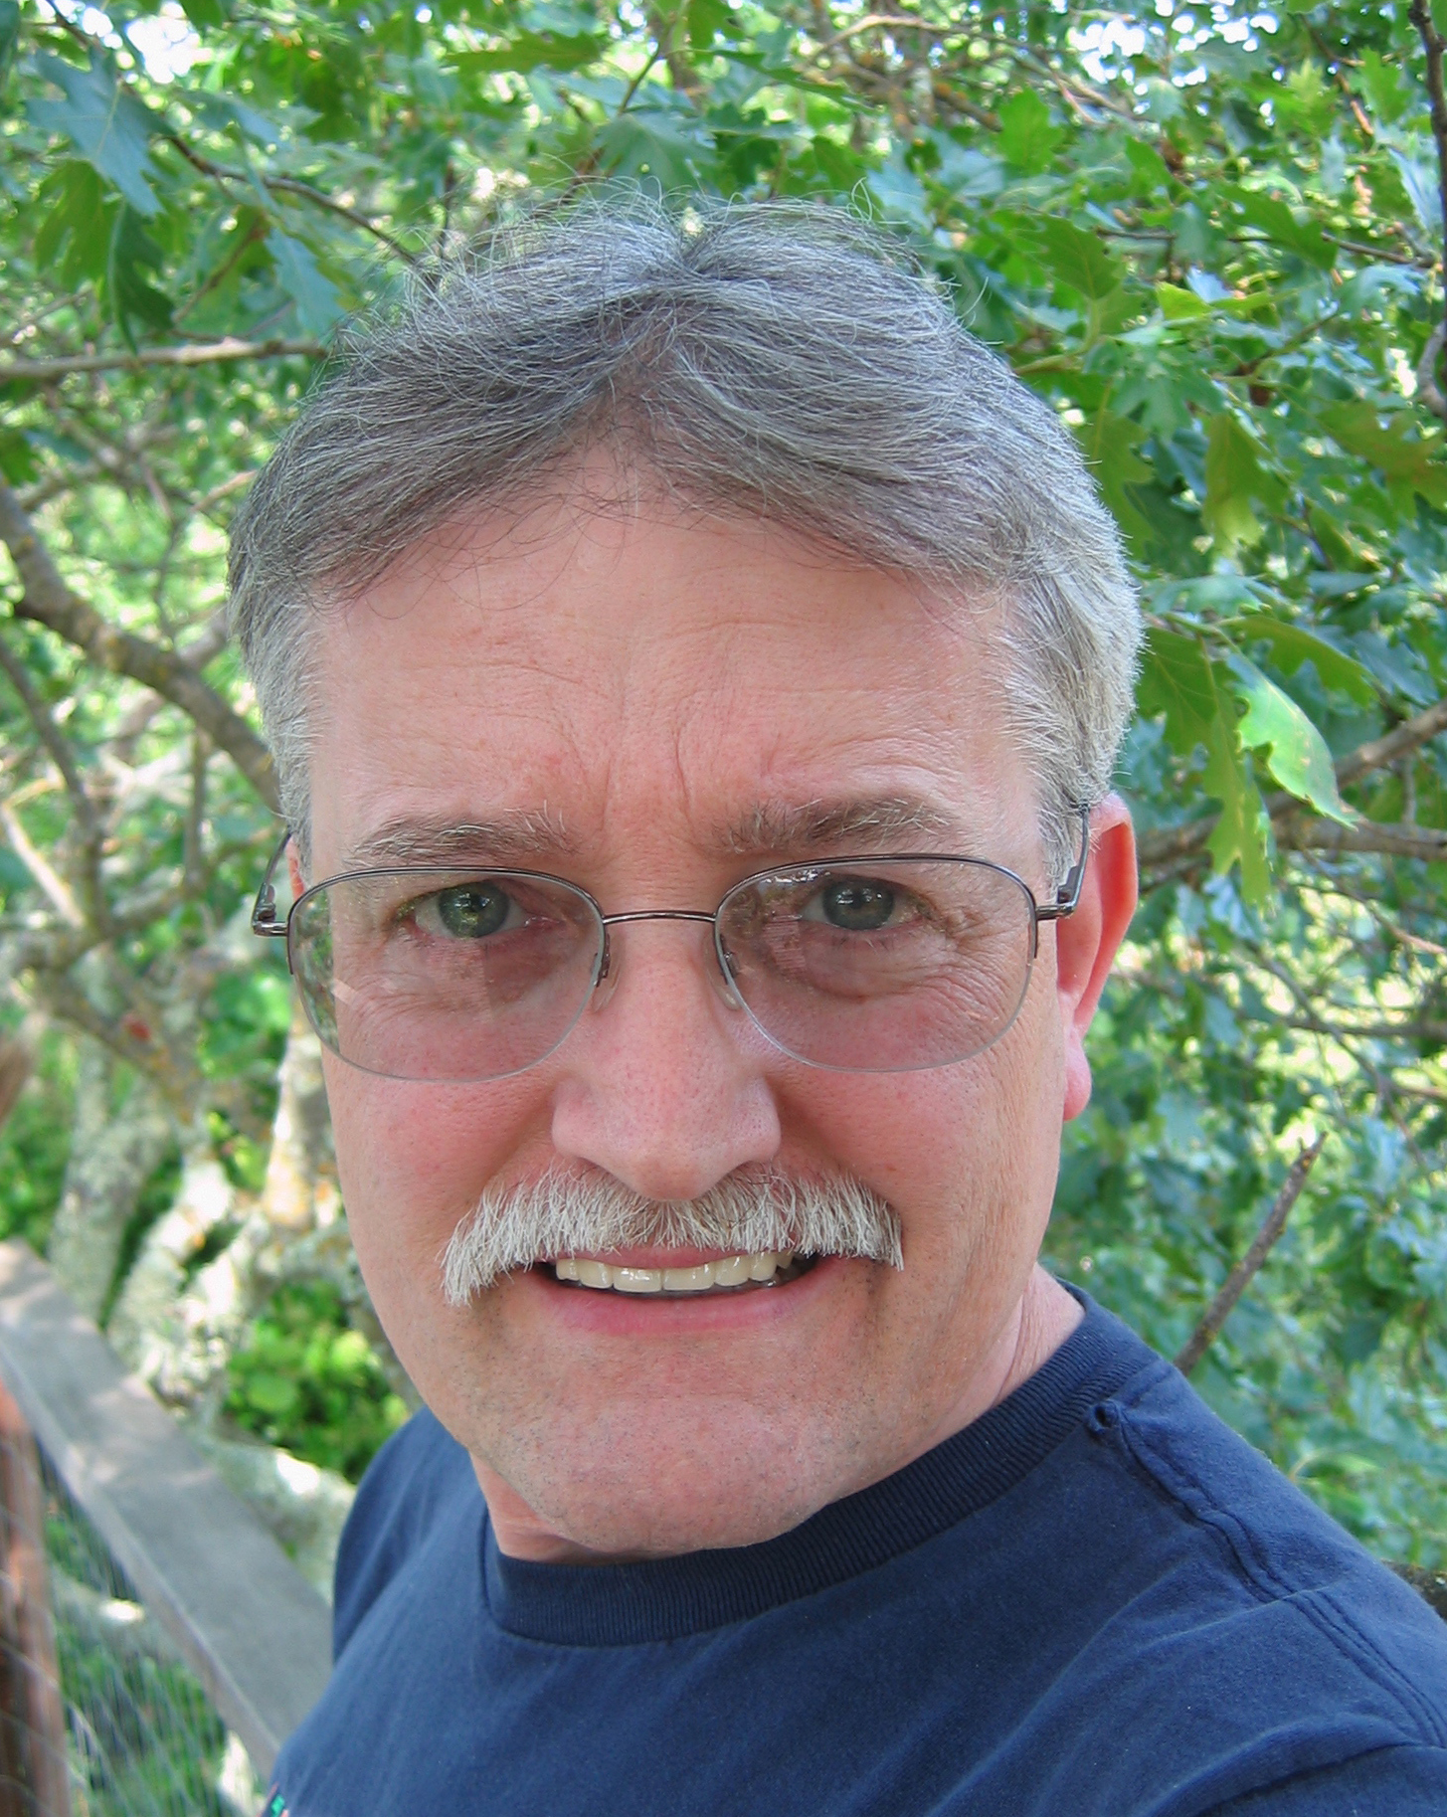
Credits
Lorcan Dempsey
Roy Tennant

Slide 4
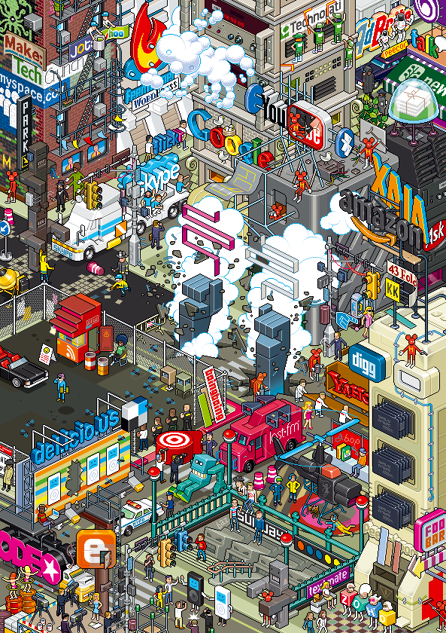

Concentrate, and diffuse
Concentration
Scale matters
Data
Diffusion
Spread matters
Syndication

Slide 5
Network level
Concentration
A web-scale presence
Mobilise data
Web-scale
Diffusion
Disclosure of links,
data and services

Slide 6











Concentration: network level

Slide 7


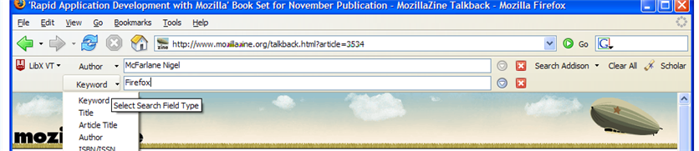

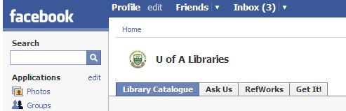

Diffusion: workflow

Slide 8
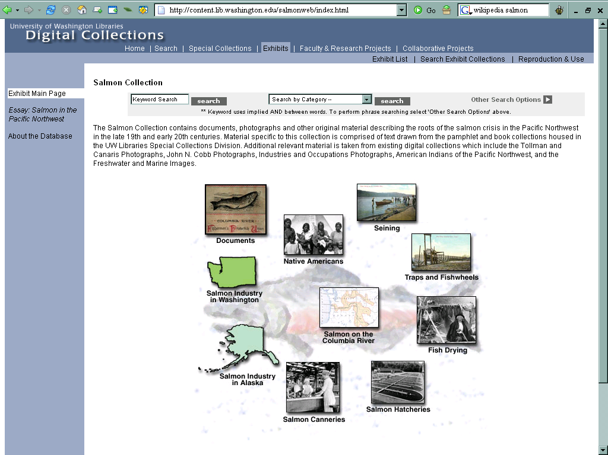
Local

Slide 9
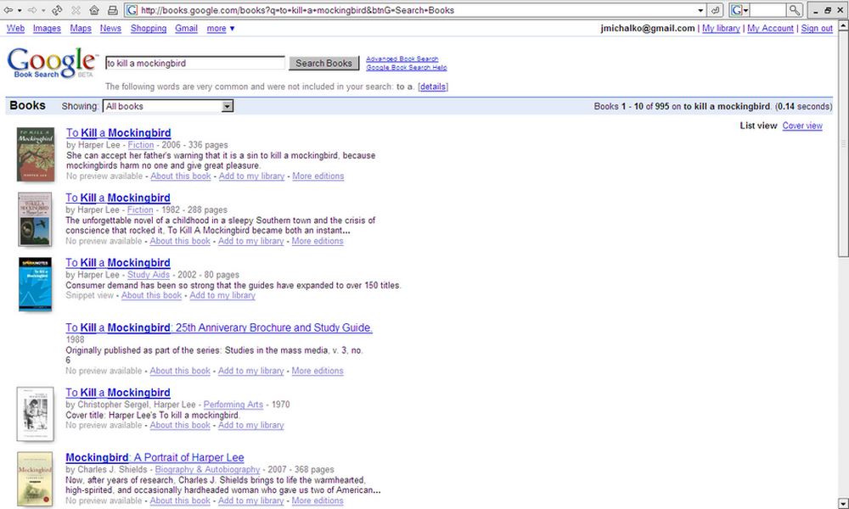
Global: catalogue records at the
network level

Slide 10
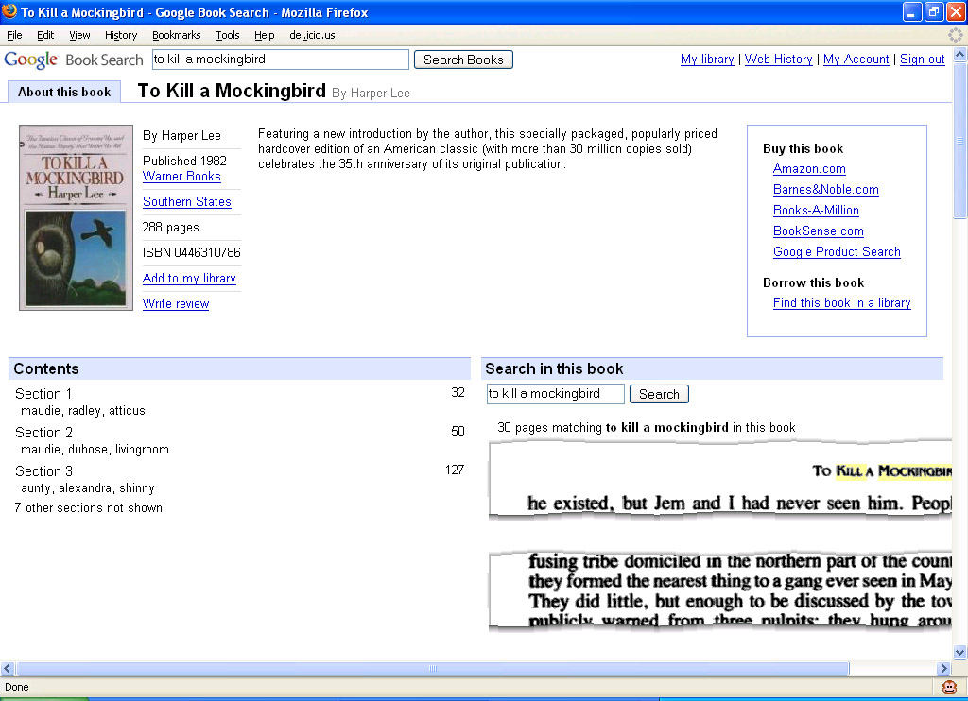
Global → Local: libraries in the flow

Slide 11
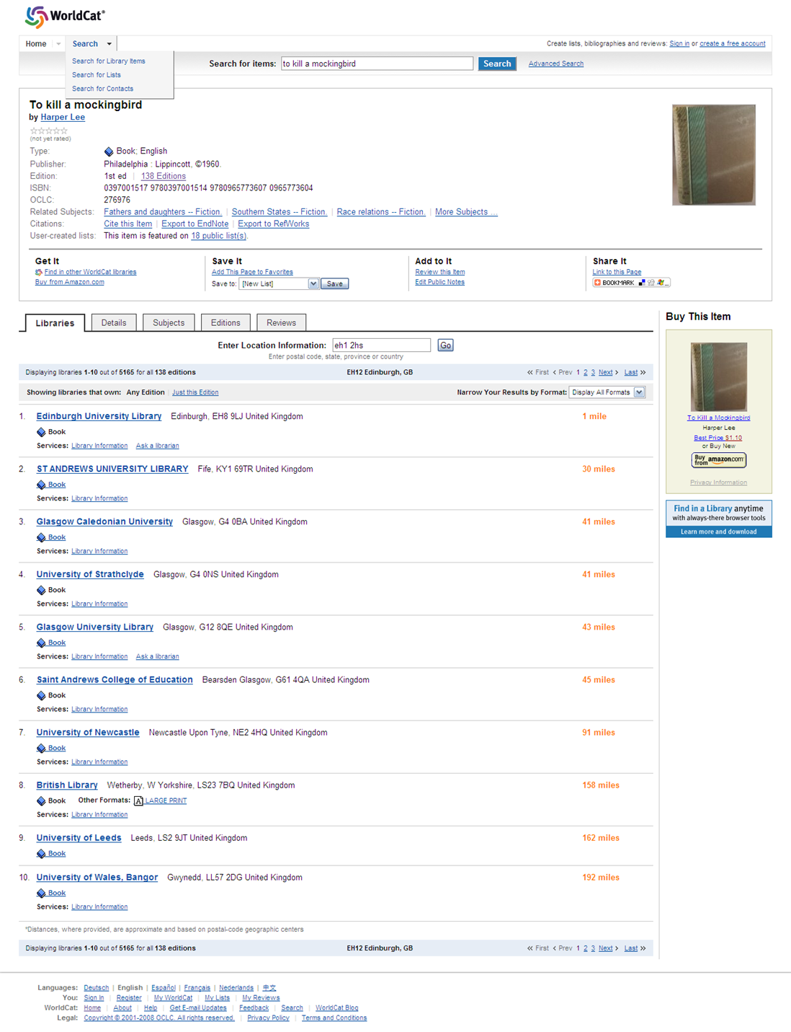
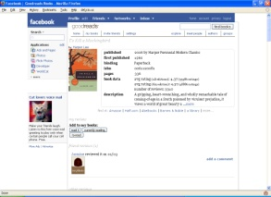
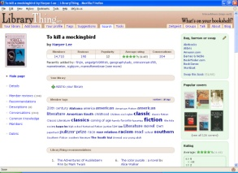
Not just Google
Facebook
LibraryThing

Slide 12
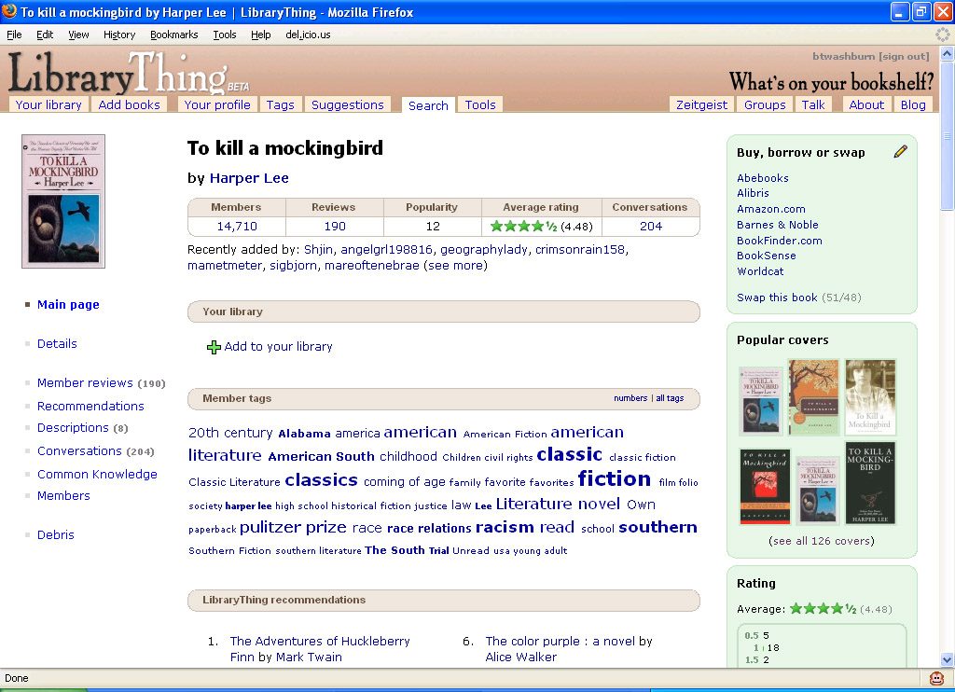
WorldCat as a ‘switch’

Slide 13
4 pillars and 3 environments
User
environment
End User Access
Bought/
Physical
Electronic/
Licensed
Digitised/
Digital
Special
colls/
Archives
Library &
Network
Resource
Management
environment
Management
Management

Slide 14
With verbs
User
environment
Find It
Get It
Bought/
Physical
Electronic/
Licensed
Digitised/
Digital
Special
colls/
Archives
Library &
Network
Resource
Metadata
Content
Management
environment
Management
Manage It

Slide 15
With tools
Find It
User
environment
End User Access
OPAC
MetaSearch
A-Z
NextGen
Website
Get It
Bought/
Physical
Electronic/
Licensed
Digitised/
Digital
Special
colls/
Archives
ILL/CIRC
LINK RESOLVER
SPECIAL
Library &
Network
Resource
Metadata
MARC
A&I
XXX
DC
EAD
Content
Management
environment
ILS
ERM
REPOSITORY
SPECIAL
Management
Manage It

Slide 16
Stuck in the middle …
Diffusion
network level – library website - workflow
Concentration
A thin layer around
complex legacy systems
Low gravitational pull?
Little social dynamic
Limited usage data
Difficult to ‘mobilize’
library resource into
workflows

Slide 17
‘Monolithic fragmentation’
Move to ‘concentrate’ at local level
  Single search environments
Move to ‘diffuse’ at local level
  RSS, APIs, ….
But …
  Have to manage presence at the local, group and global level

Slide 18
Group
Data?
Applications?
Knowledge base
Aggregate usage data
  Resolver data
  Download data
  Database usage data
  Circulation
  …
Shared catalogue (eg OhioLink)
Syndicate to global (eg Google Scholar and union catalogues)
Switch to local for fulfilment
Repository? (eg HAL)
Search
  Institutional search (Primo, WC Local, etc)
  Metasearch
  Catalogue
LMS?
  Network effects: e.g. circulation and recommendation
  Shared selection
  CIRC <> resource sharing

Slide 19
Group
The collective collection?
The collective collection?
Competition for space and ongoing cost a concern
Legacy print collections
(cf UKRR)
  Storage
  Preservation
  Access
Physical delivery architecture
Managing a licensed collection
  Ebooks
  Journals
  Preservation
  Access models

Slide 20
Where data aggregation is beneficial
More effective exposure in a web-scale site (metadata)
To attract users and social engagement
Avoid redundant data management (supplier details, supplier suggestions)
Collective knowledge - tasks less complicated or more accurate (serial prediction)
New knowledge via deduction or mining (eg holdings count indicating rareness and popularity, supplier performance, enriched name metadata)
Most effective management of links and imported enriched data
Comparison of collections; facilitating the management of the collective collection
Notes:
20

Slide 21
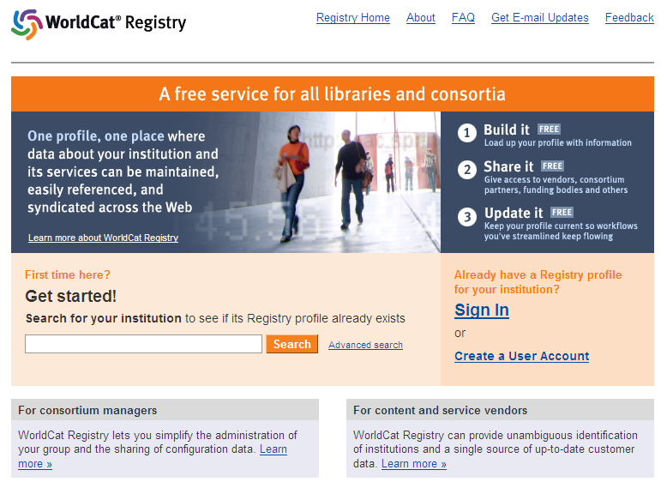
Global
Discovery
Registry (of institutions, services, collections)
Electronic delivery architecture

Slide 22
Local
Interpretation of specific research and learning needs of institution
Intersection of research/learning and information management
Reputation management
Disclosure to group and global levels
Funding

Slide 23
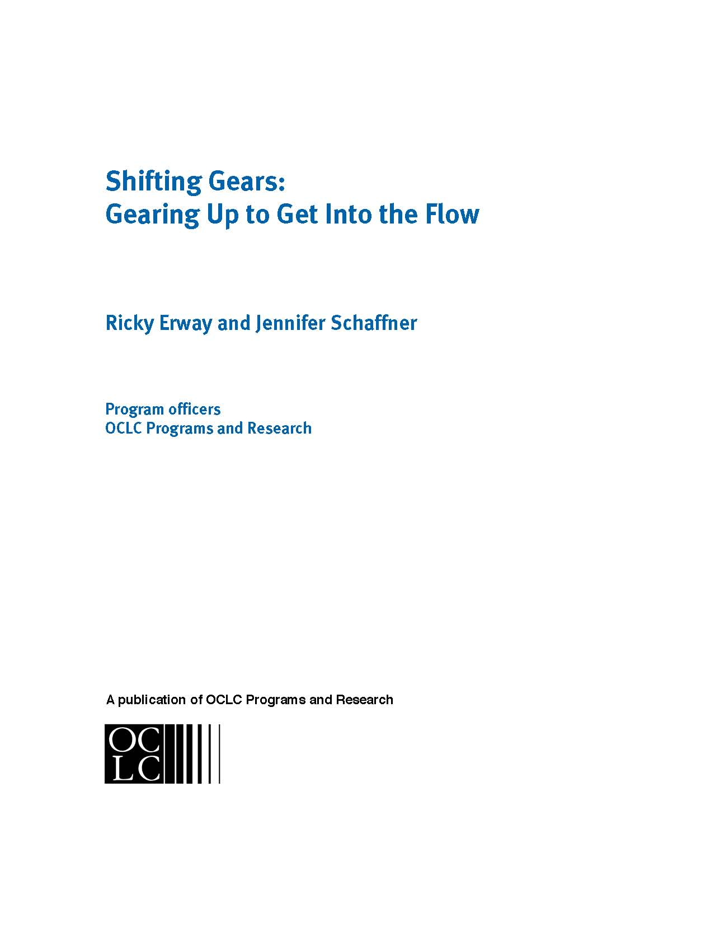
Mass digitisation of special collections

Slide 24
Urgency
“There’s an illusion being created that all the world’s knowledge is on the web, but we haven’t begun to glimpse what is out there in local archives and libraries. Material that is not digitized risks being neglected as it would not have been in the past, virtually lost to the great majority of potential users.” - Ed Ayers
Notes:
24

Slide 25
Fulfilment
Which do you prefer?

Slide 26
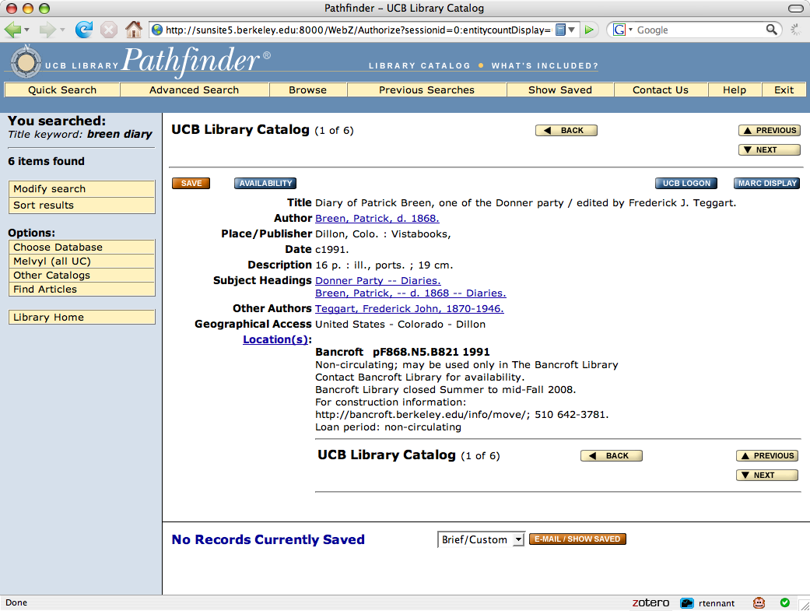

Slide 27
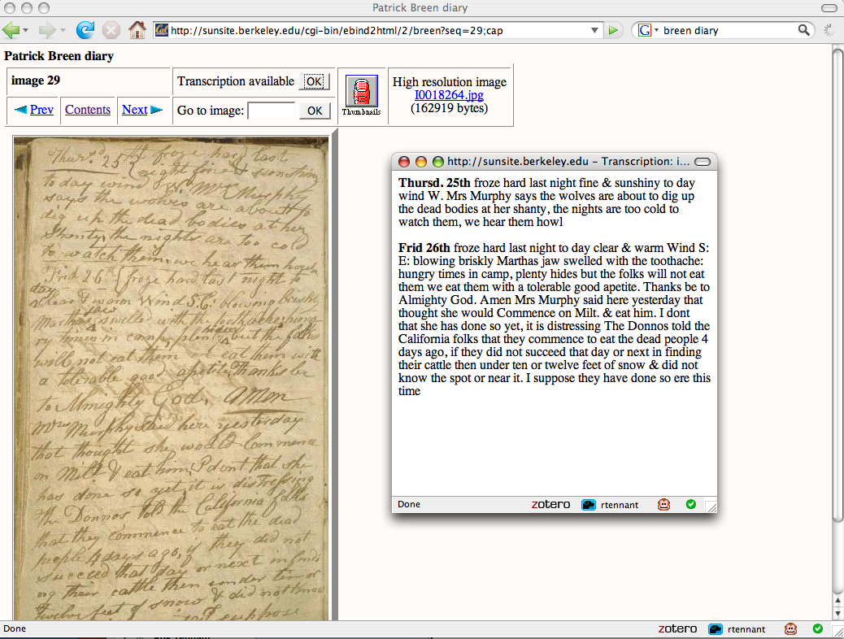

Slide 28
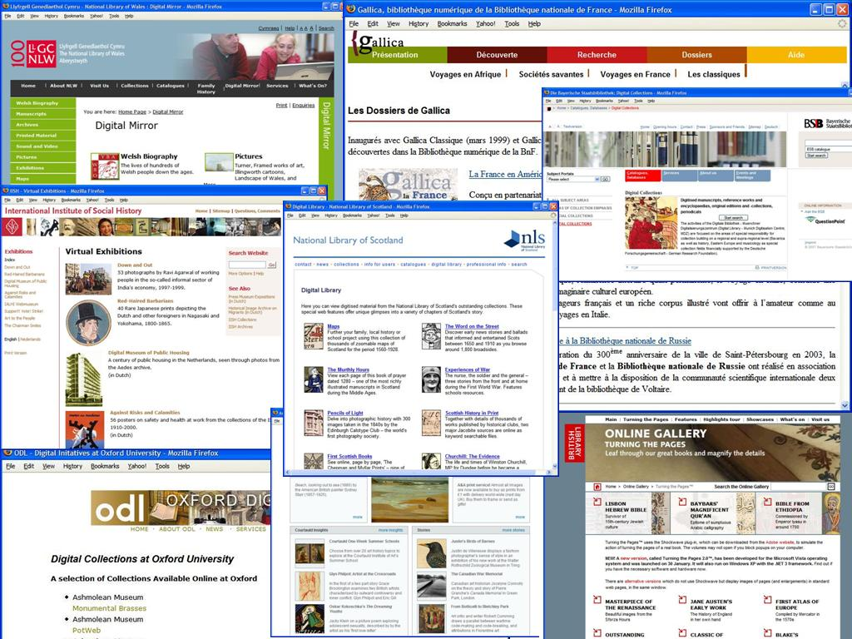
Stop cherry-picking

Slide 29
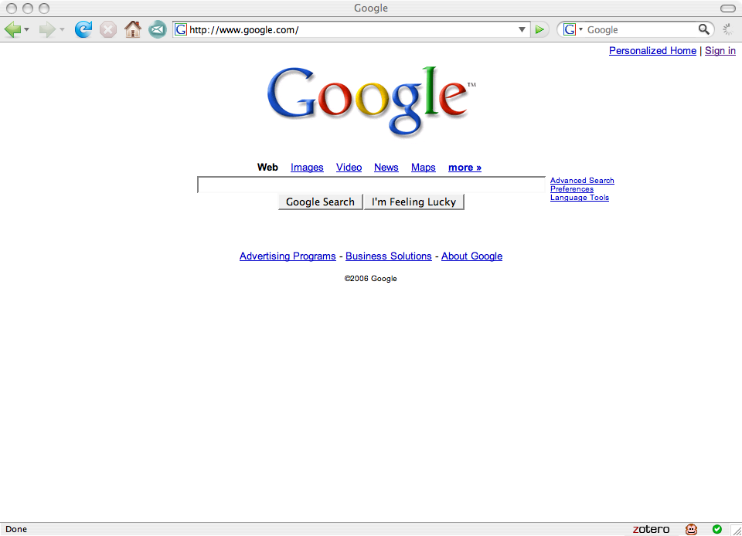

Slide 30
Breaking it down
Do whatever it takes to get your material online
Expose it where people congregate

Slide 31
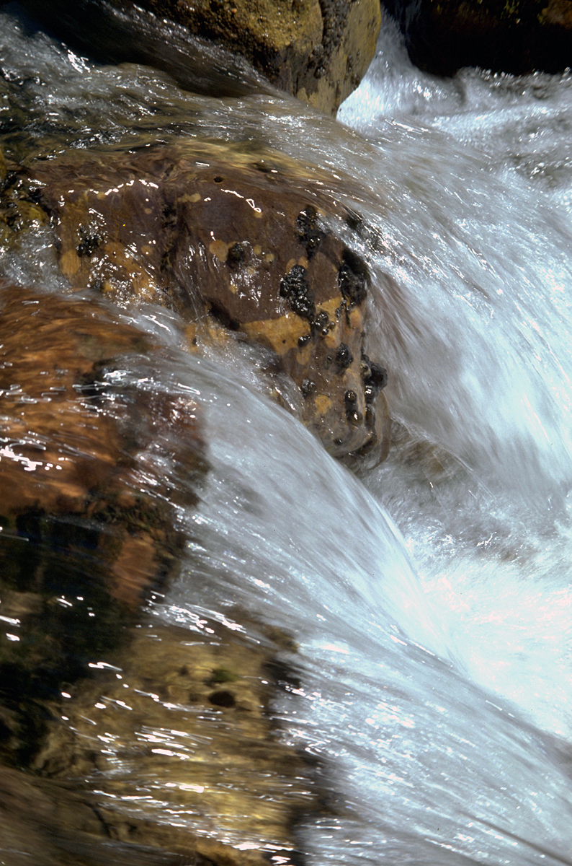
How do we achieve web-scale?
Notes:
31

Slide 32
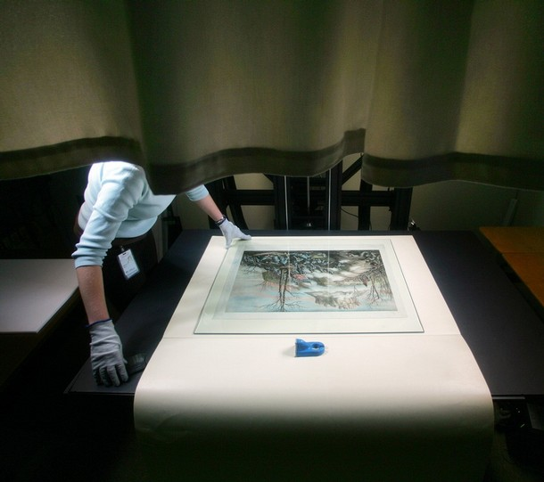
Not the way we’ve been doing it!

Slide 33
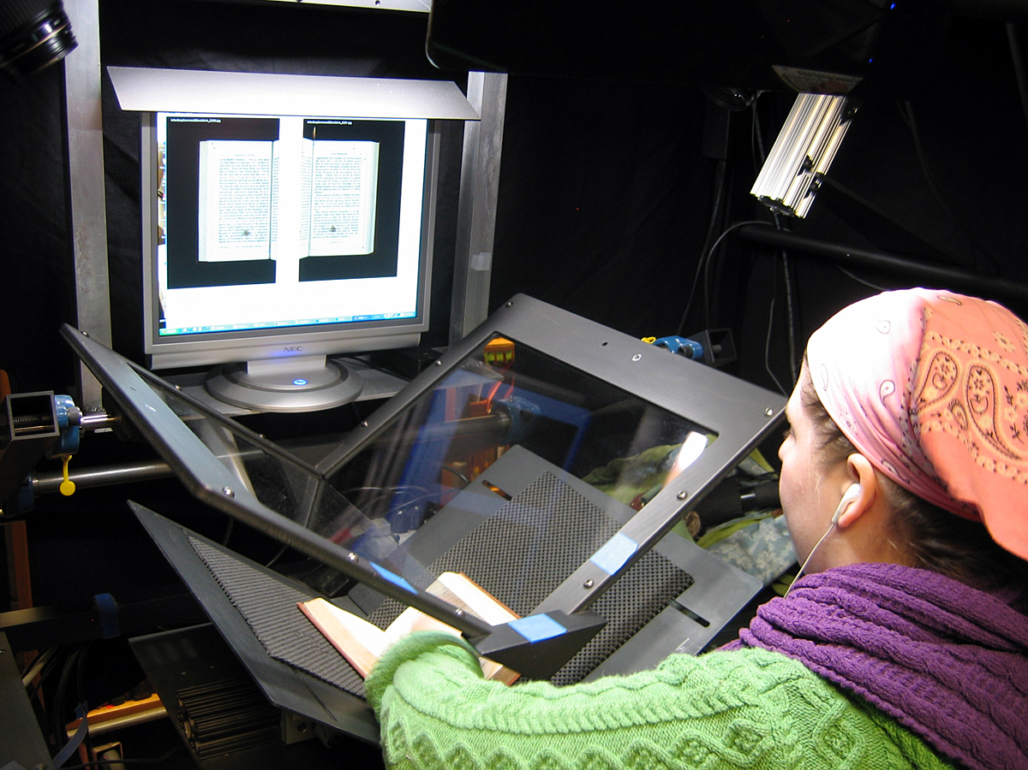
Web Scale

Slide 34
Access vs preservation — access wins!

Slide 35
Access wins!
No one has been throwing away originals…so preservation needs are best served by them
Only by surfacing presently ignored collections can we justify their preservation
Our brave new world shows we can go back and do it again

Slide 36
Selection has already been done
Don’t spend time selecting items to digitized
Capture materials as accessioned
  For important collections, capture it all
  For others, sample and allow user interest to guide your choices
Capture on demand
Capture ‘signposts’ and devote more attention when/where warranted

Slide 37
Handle once (then iterate)
Handle incoming items once for both description and digitisation
Compromise on image resolution and metadata as needed to achieve throughput requirements
Create a single unified process
Let usage guide further efforts

Slide 38
Programmes not projects
Forget ‘special projects’ — it’s long past time to make this a basic part of our everyday work!
Digital capture must be embedded in our basic procedures, budgeting, etc.
Figure out a way to fund it yourself and you’ll figure out a way to do it cheaper

Slide 39
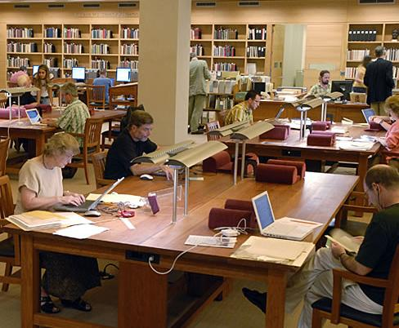
Scan on demand
Change in Photoduplication Policy
As of March 17, 2008, the Ransom Center's policy regarding research copies of items from its collections will change. We will no longer furnish photocopies. For all requests received on or after March 17, our default procedure will be to make digital scans of the originals and furnish PDF files (72 dpi) either by email or on CD-ROM. For patrons who are unable to make use of PDFs, printouts will be available in lieu of digital files.
For publication purposes, high-resolution images will still be furnished on the same terms as before.
Harry Ransom Center, UT Austin
Notes:
39
-another tactic: scan on demand…
Scan when requested for research – HRC
Announcement:
Scan the whole thing
No matter what has been selected
Hand the scan to their digital library
(72 dpi and a pdf?)
With whatever metadata they happen to have
No new metadata
Also, preserves the originals, save them from repeated copying.

Slide 40
Engage your community in description
Do not describe everything in painstaking detail
Start with basic description, then…
…allow serious researchers to contact you for more detail, and…
…engage your user community with adding to the descriptions

Slide 41
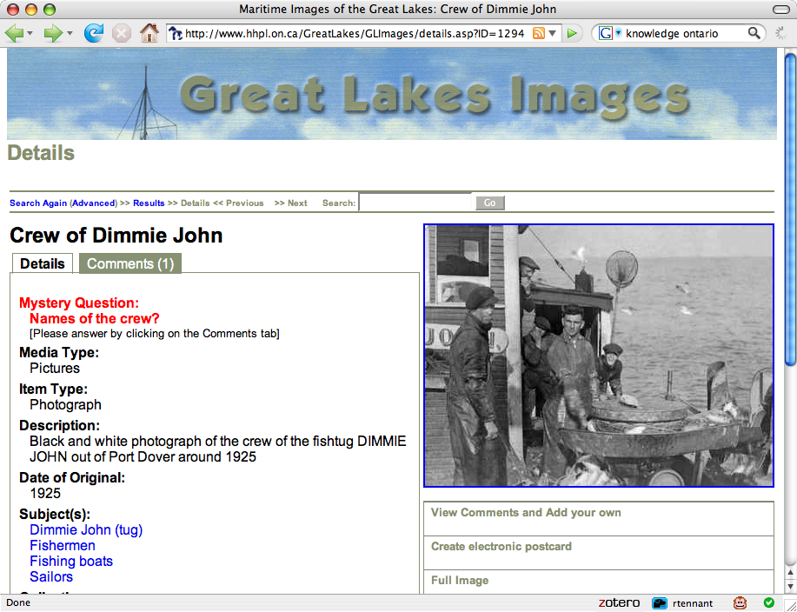

Slide 42
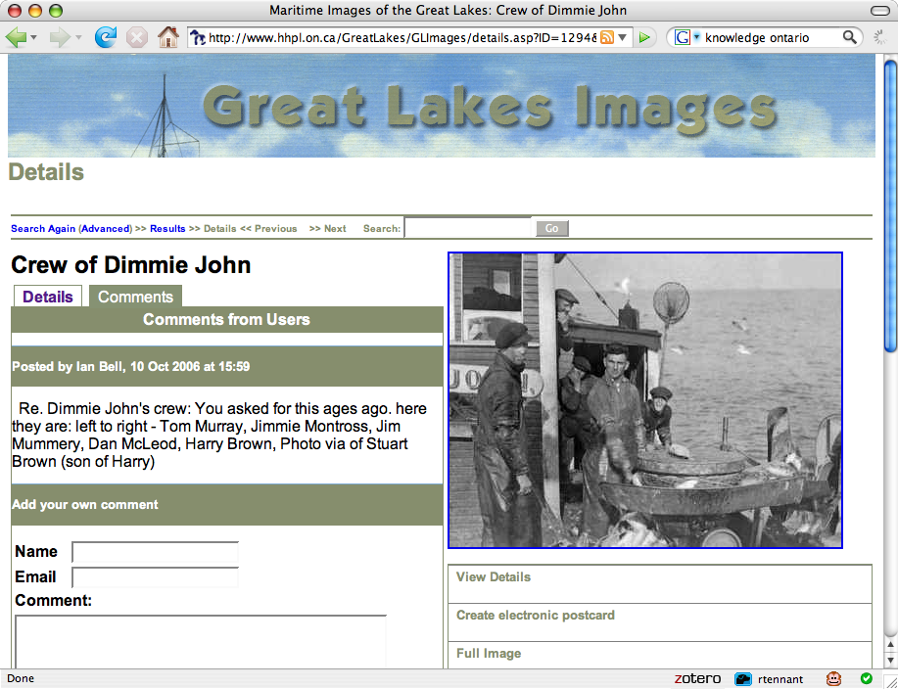

Slide 43
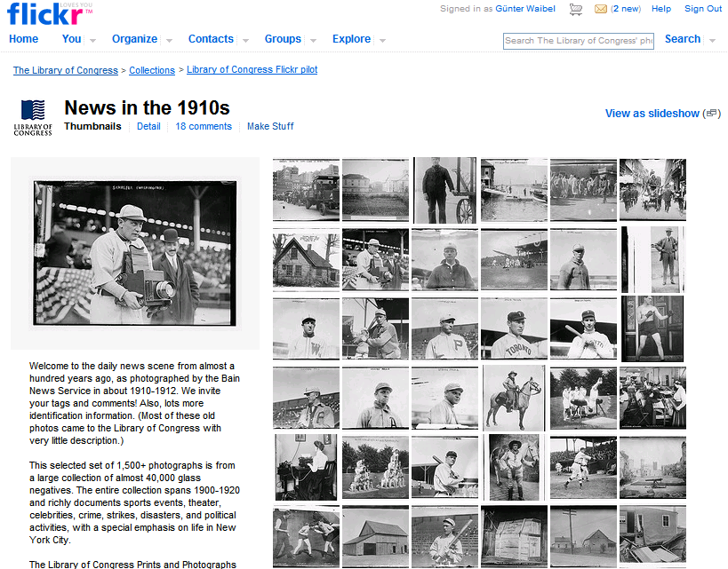
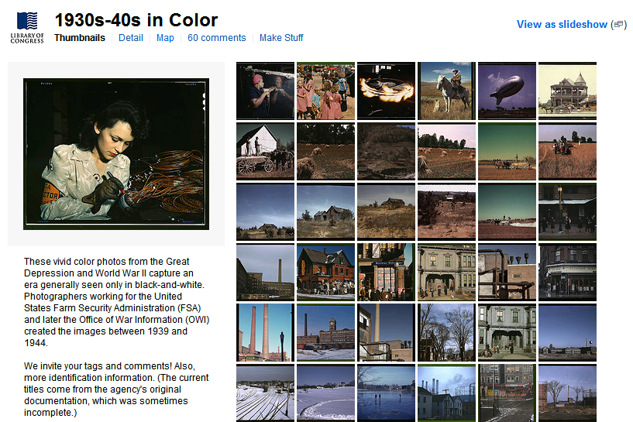
January 16th 2008: LC photographs on Flickr
Notes:
43

Slide 44
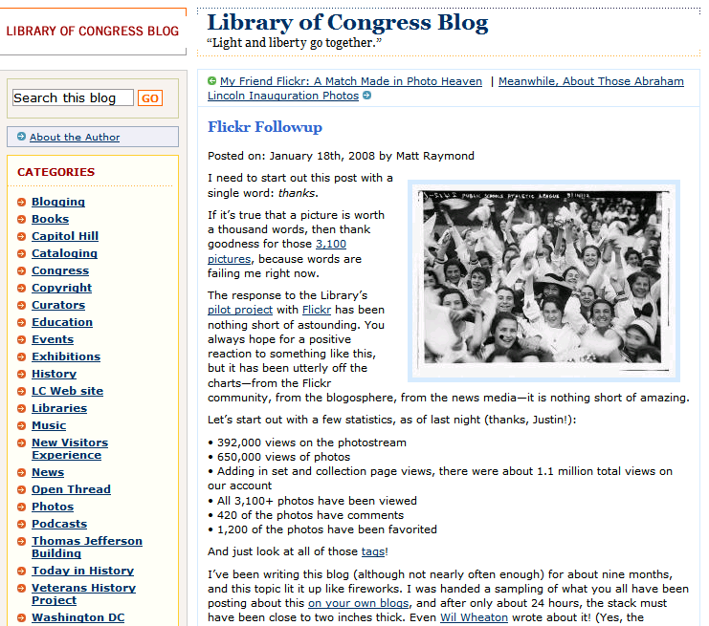
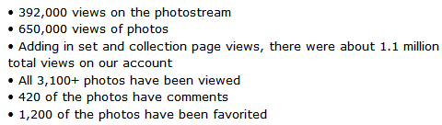
24 hours later
Exposure
Notes:
44

Slide 45
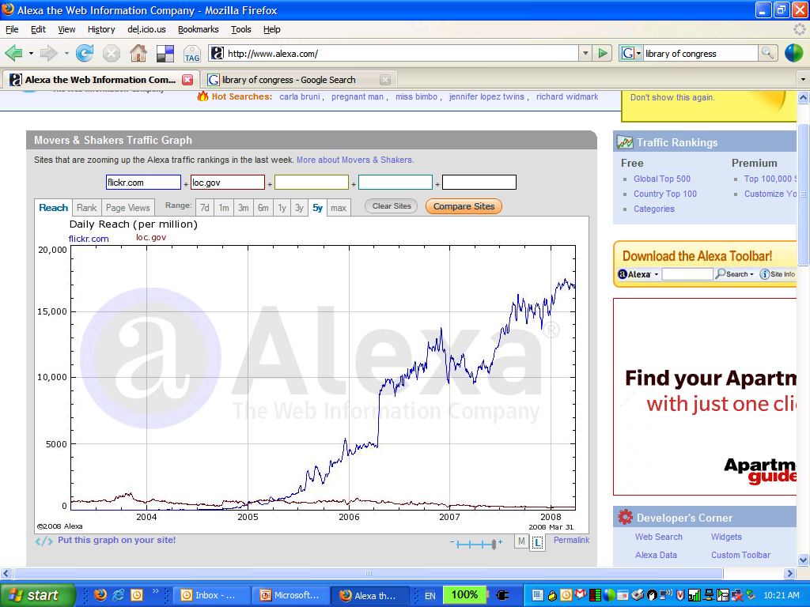
Impact: exposure
Flickr: Top 50
LC: Top 6000
Notes:
45

Slide 46
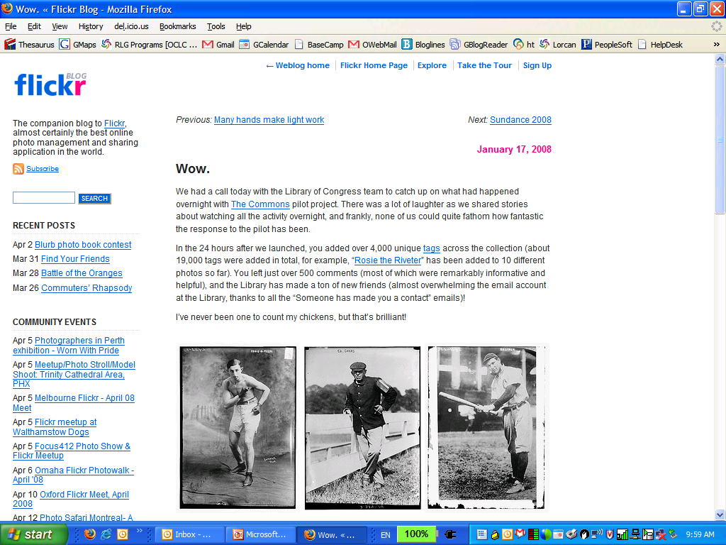
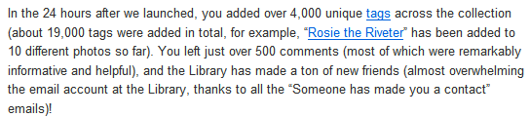
How to lose control
Contributions
Notes:
46

Slide 47
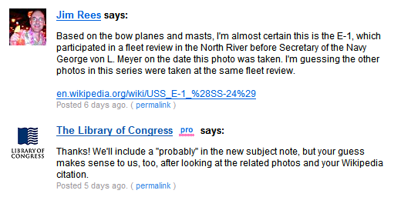
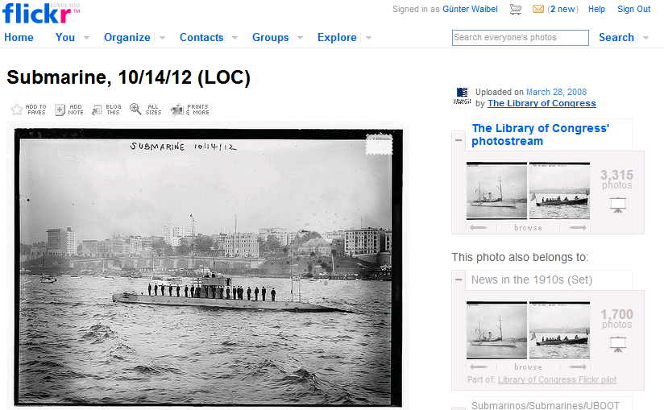
Go with it
Notes:
47

Slide 48
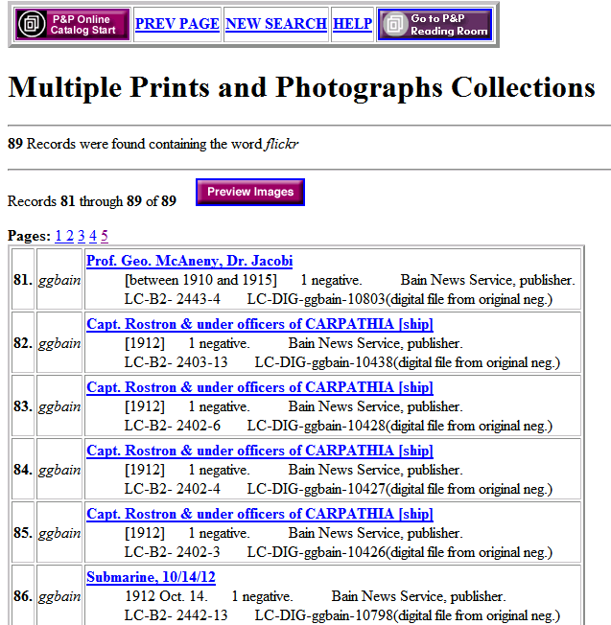
Feeding back into our work
89 records updated
Notes:
48

Slide 49
Quality vs quantity: quantity wins!
The perfect has been the enemy of the possible
Achieving excellence can have a substantial cost
Any access is better than none at all
Instead of measuring cataloguer/archivist output we should be measuring impact on users

Slide 50
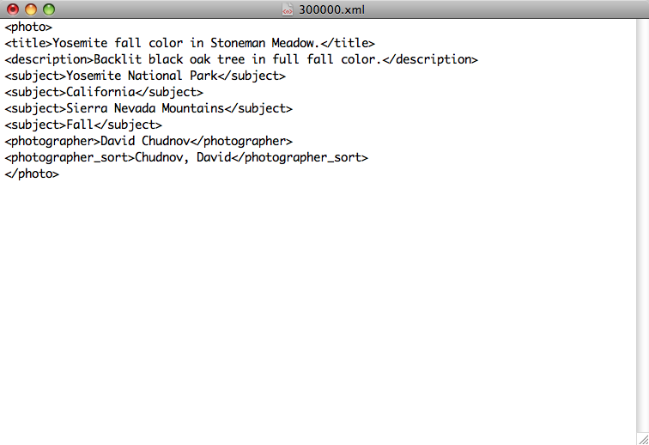
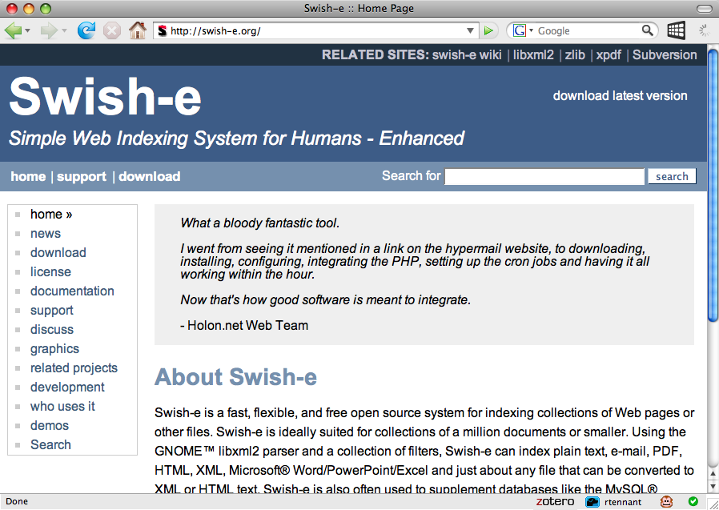

Slide 51
Discovery happens elsewhere
People don’t discover our content by coming to our lovingly crafted web sites (can you say ‘Google’?)
We must expose our content to web search engines and hubs like Flickr

Slide 52
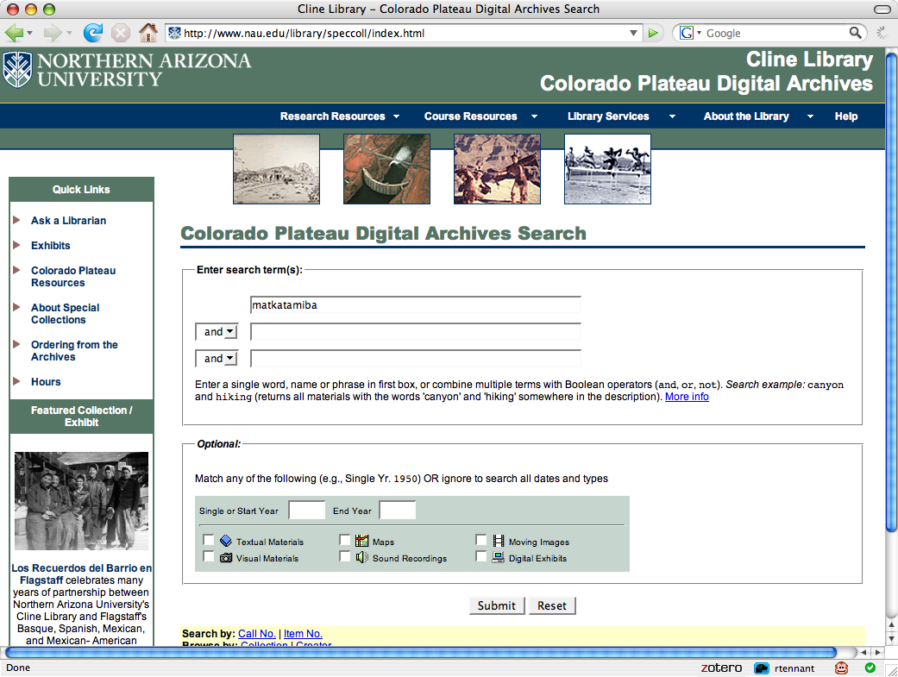

Slide 53
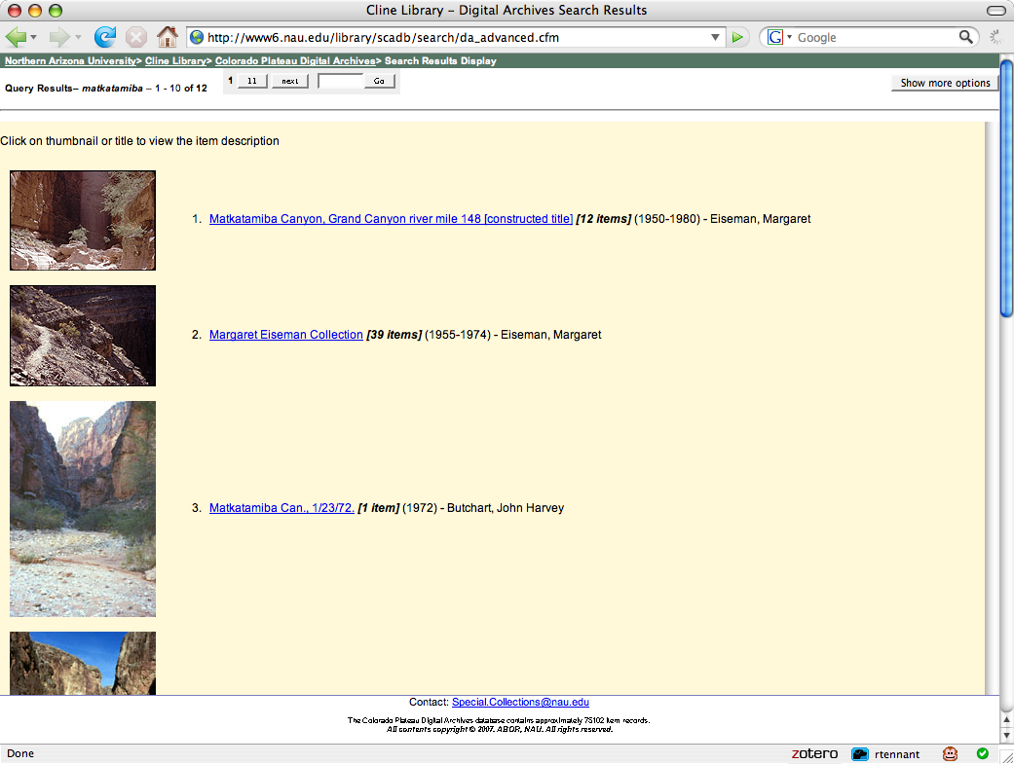

Slide 54
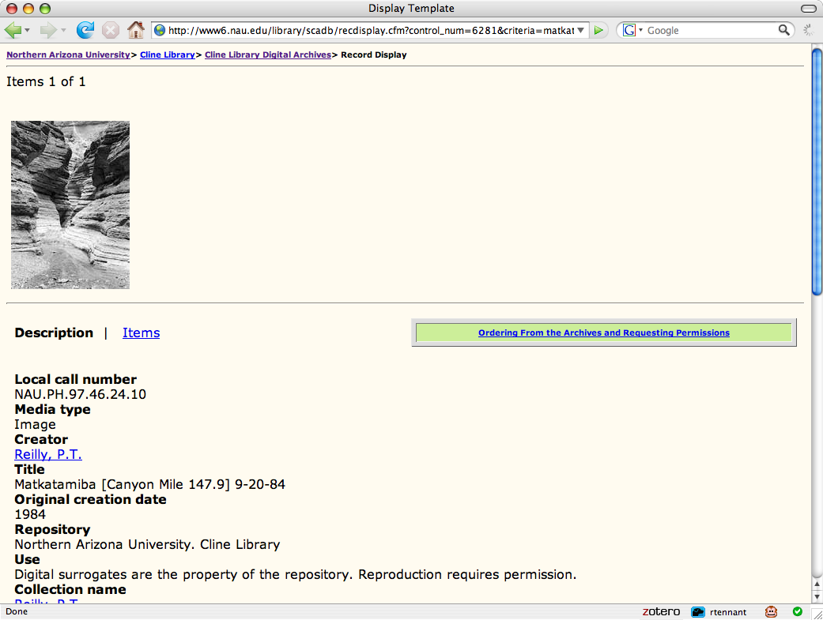

Slide 55
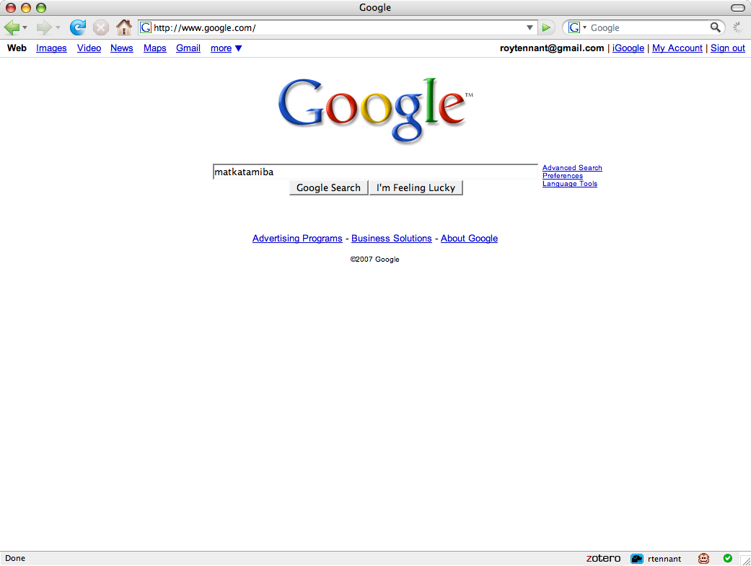

Slide 56
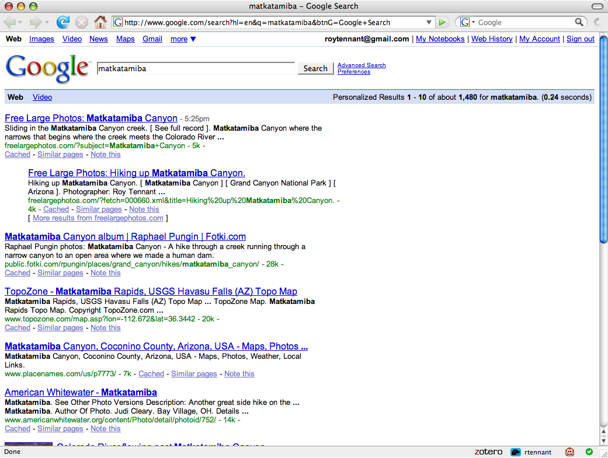

Slide 57
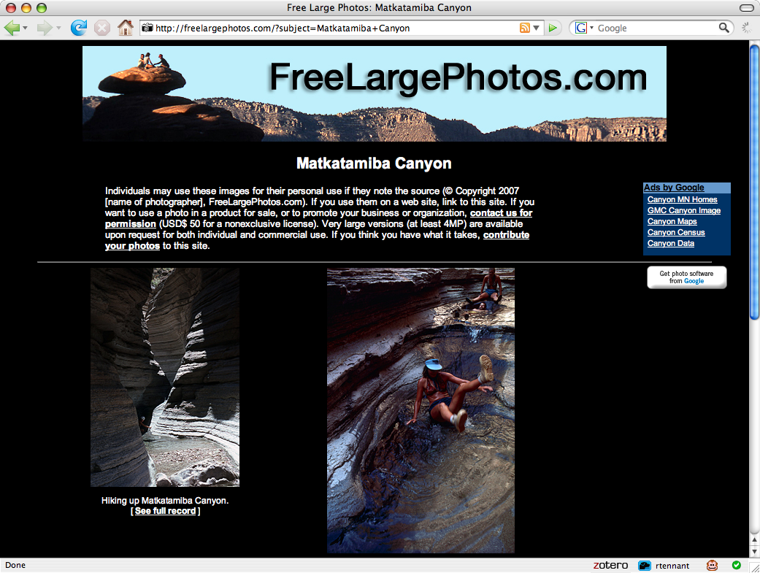

Slide 58
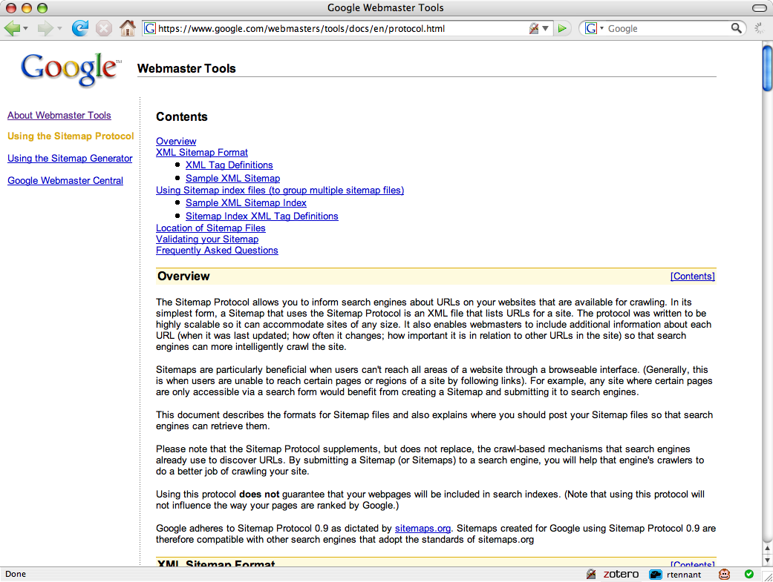

Slide 59
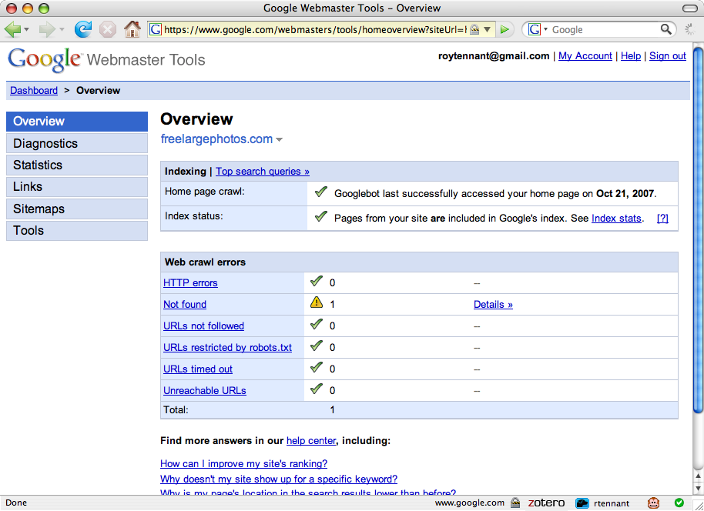

Slide 60
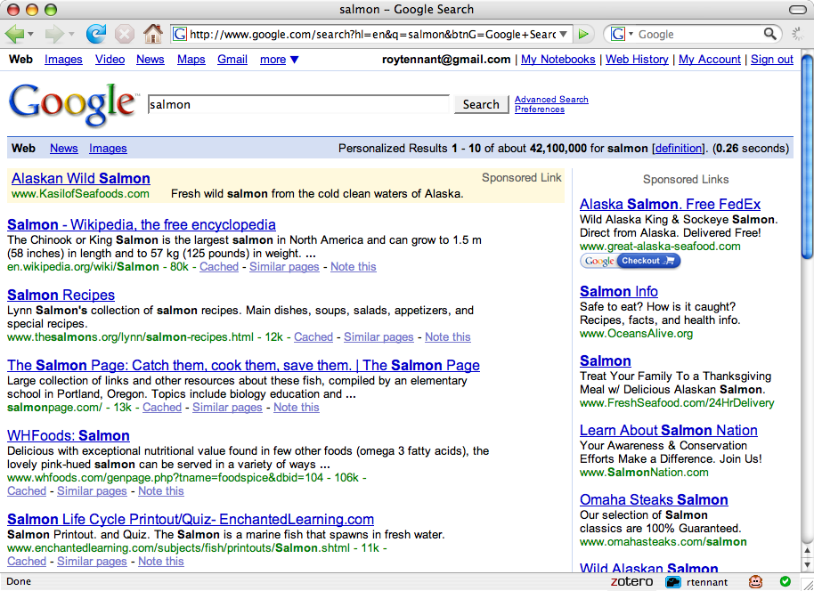
Global → Local switching

Slide 61
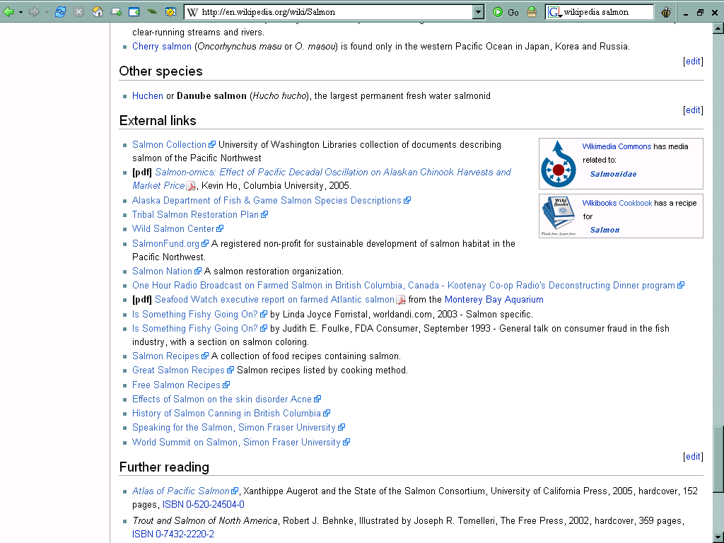

Slide 63
Then: Users built workflow around
libraries
Now: Library must build services around user workflow
Discovery happens elsewhere
Disclosure

Slide 64
Benefits of concentration
Search results ranking
  Holdings data
  Usage data (eg display, circulation)
Recommendations of related books
User contributed content can be shared
User contributed content can be made better
Attention can be attracted and redirected

Slide 65
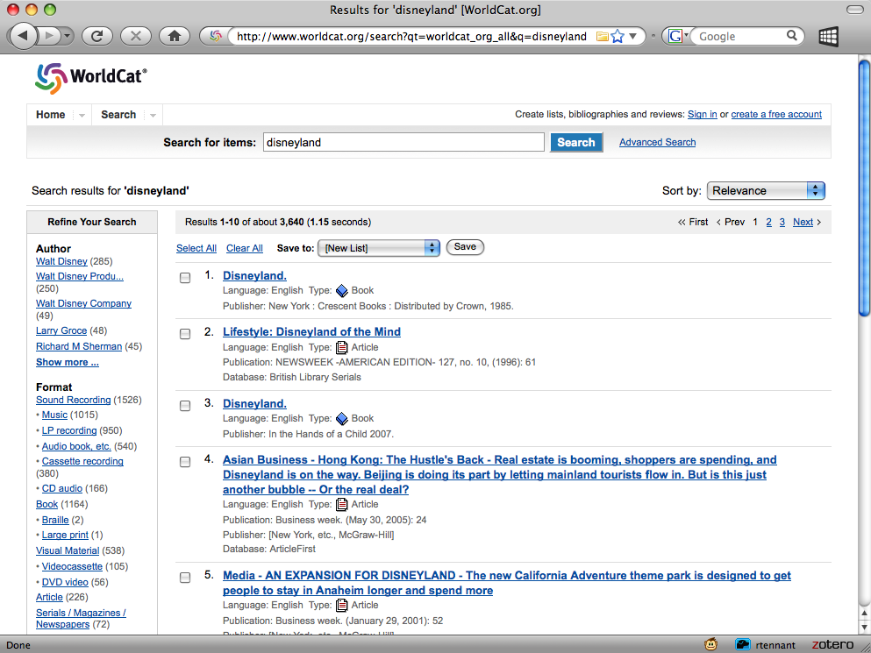
Benefit of concentration:
ranking based on number
of holding libraries

Slide 66
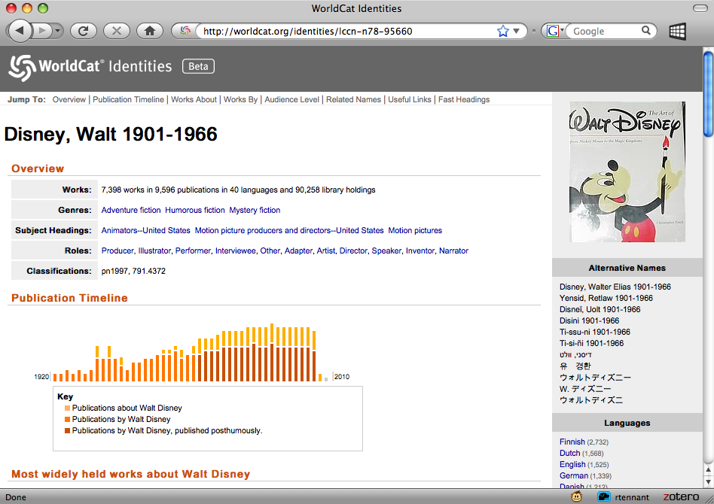
Benefit of concentration:
More data to mine
Notes:
66

Slide 67
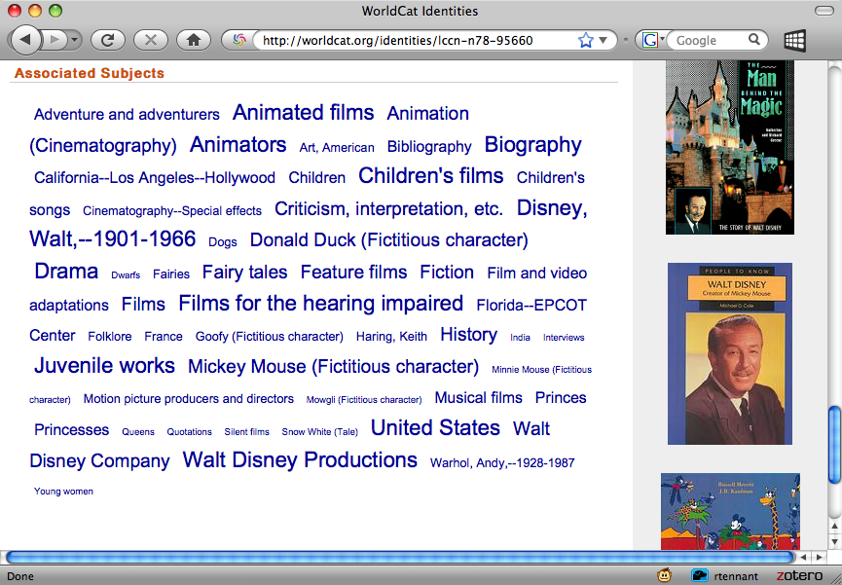

Slide 68
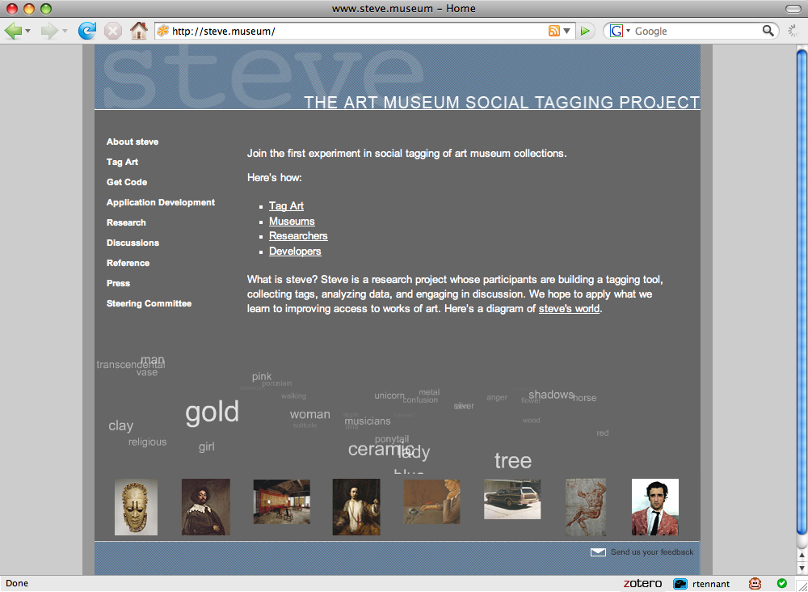
Benefit of concentration:
ability to make user-
contributed data better

Slide 69
Benefits of diffusion
Library holdings syndicated into places where people are found (eg Google)
Small libraries can play in big spaces (the ‘long tail’)
The more paths there are, the easier it is for people to reach you

Slide 70

Put things under people’s noses
Benefit of diffusion:
exposed in spaces where
potential users are found

Slide 71
Put another way...
“It is not necessary to change. Survival is not mandatory.”
—W. Edwards Deming
Notes:
71
As management consultant W. Edwards Deming once said, “It is not necessary to change. Survival is not mandatory.”
CLICK TO THANK YOU !
71

Slide 72
The End
John MacColl
maccollj@oclc.org
RLG Programs
OCLC Programs & Research

