Slide 1
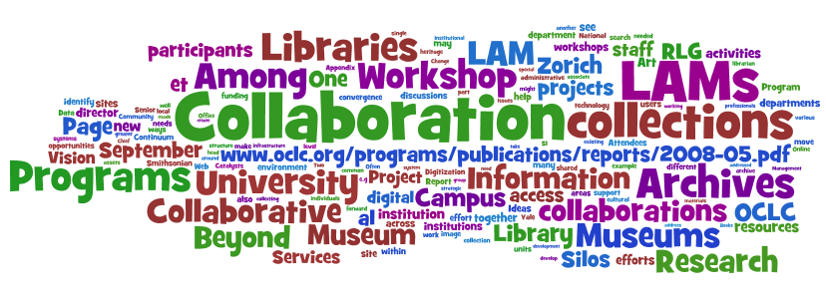
Risks and strategies: the view from OCLC Research
0John MacColl
European Director, RLG Partnership, OCLC Research
12 June 2009

Slide 2
Themes
Risks
Urgency
The primary purpose of digitisation
Users as co-creators
Digitisation as default
Shared digital and shared print
Where the wild users are
Specialists step forward
Aggregate to innovate
Accentuate the positive

Slide 3
Risks

Slide 4
Recent risk analysis
In a rapidly evolving information environment, what are the greatest risks to research libraries?
Individually – as local service providers
Collectively – as a distributed enterprise
Which of these risks is susceptible to mitigation?
Feasibility – controllable risk?
Impact – worth the investment?
Where should local effort be directed?
Where can collective action make a difference?
Notes:
Work done by RLG recently. Continuous with “What’s keeping you up at night” RLG podcast interview series – but directed at library management.

Slide 5
Risk Clusters
Value Proposition
… a reduced sense of library relevance from below, above, and within
Human Resources
… uncertainties about adequate preparation, adaptability, capacity for leadership in face of change
Durable Goods
… changing value of library collections and space; prices go up, value goes down – accounting doesn’t acknowledge the change
Legacy Technology
… managing and maintaining legacy systems is a challenge; replacement parts are hard to find
Intellectual Property
… losing some traditional assets to commercial providers (e.g. Google Books) and failing to assume clear ownership stake in others (e.g. local scholarly outputs)
Notes:
We identified five thematic risk clusters that seemed to us to reflect the most important classes of risk.

Slide 6
Urgency

Slide 7
Scale matters
Network level
Concentration
A web-scale presence
Mobilise data
Web-scale
Diffusion
Disclosure of links,
data and services
Notes:
These are themes which will be familiar to those of you who read Lorcan Dempsey’s weblog. This is a simple and effective way to concentrate the attention of library directors on the realities of the environment in which our services now play. We need to be thinking about how to push our content, our data, to the network level; and we need to think about the implications of web-scale. Data needs to be pushed up to the surface of the web, and diffused from there. That goes for archival data as well as library metadata and digital materials.

Slide 8
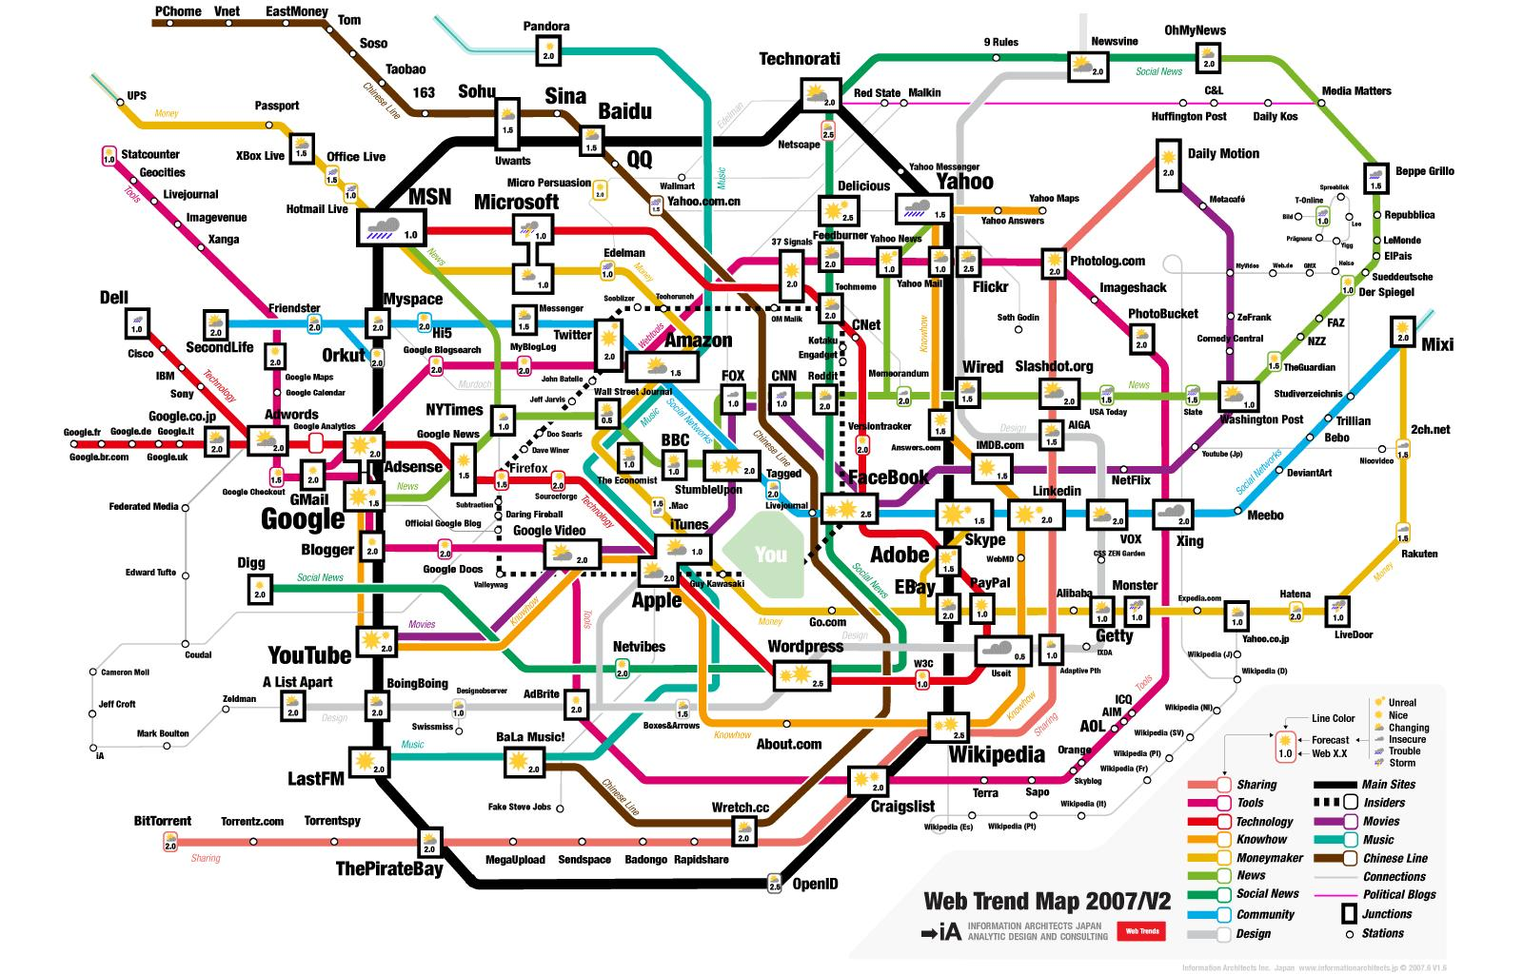
Be where the users are
Image: informationarchitects.jp/web-trend-map-2008-beta/
Notes:
This is the map our users use to navigate today’s information landscape. It’s the 300 most visited sites on the web, mapped onto the Tokyo train map. It shows where our users are going.
Amazon, Yahoo, Google, Wikipedia, and YouTube are dominant, but they’re not overwhelmingly dominant.
Is your library or archive in this picture? There are no libraries in this picture. No OCLC, no JISC, no TEL…
What does their absence tell us?
Libraries deliver services in an environment increasingly dominated by large-scale information hubs. Users bypass the authoritative offerings of libraries in favour of just-in-time information from sources more conveniently embedded in their daily networked lives.
DISCOVERY HAPPENS ELSEWHERE – we need to position supply where the demand is.
So, ‘winning researchers back to the library’ really means ‘putting the library in front of researchers’ - wherever they might be on this train map!

Slide 9
Discovery happens elsewhere
People don’t discover our content by coming to our lovingly crafted web sites
We must expose our content to web search engines and hubs like Flickr
Notes:
We can’t successfully emulate Flickr or Google. We must be present to them. By ‘learning from’ Google, Flickr and Yahoo!, we really mean ‘learning to’ use them.

Slide 10
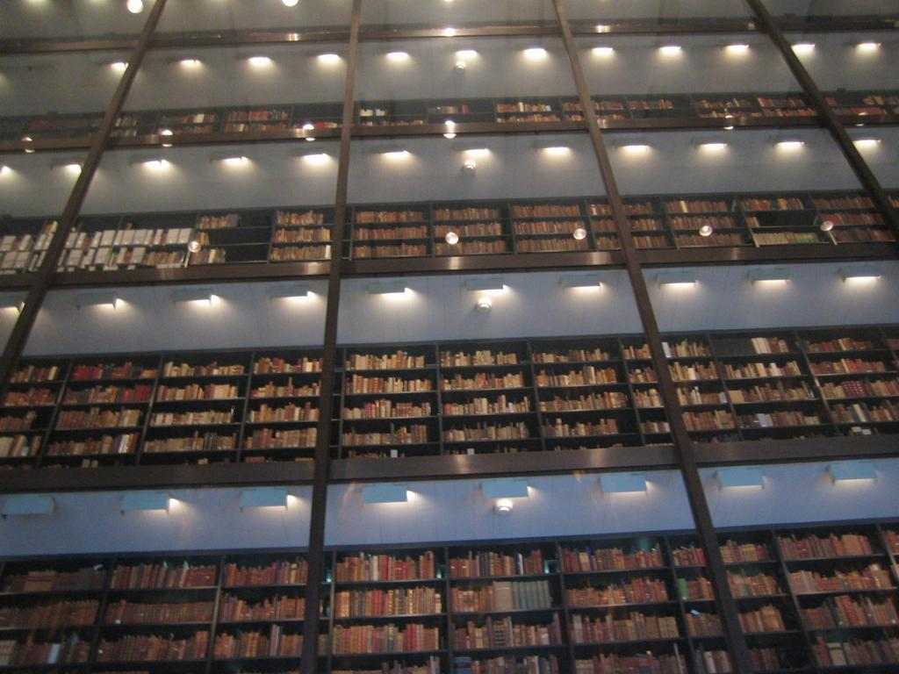
Yale University
Notes:
Google is of course one of these transforming forces. Google has completely changed the way libraries have thought about the digitisation of books. We used to think books were the hardest part of library digitisation (with their sequence and hierarchy, hundreds of images, text conversion …) – we didn’t imagine we’d ever digitise all the books. By focusing on quantity over quality, Google has made the seemingly impossible begin to happen. A UK colleague sometimes comments that history will criticise libraries for having let this initiative be taken by a private company. But how could libraries ever have afforded it? Or did we just lack the imagination?
Google supplied and changed demand.
Now, with millions of books flying off the shelves and ‘into the flow’, research libraries also need to change the way they think about digitisation of special collections. Soon students will only look online -- what’s not there, will not be considered.
As we increasingly share a collective collection of books, it is the special collections that will distinguish our institutions. Yet ironically they run the risk of being marginalised. If they aren’t accessible, they aren’t used; if they aren’t used, they go away. Neglect leads to obsolescence.
It is our job to offer up these materials to the demand Google has created.

Slide 11
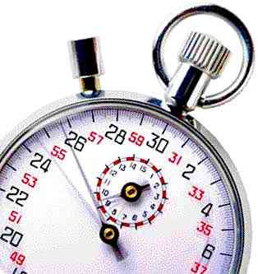
We are now in a race to remain relevant to researchers
‘Cataloguing is a function which is not working’
Forget item level description
“Insanity is when you do things the way you’ve always done them, but expect a different result” (Einstein and/or Emerson)
‘Good enough’ beats perfection
Accept ‘the demise of the completeness syndrome’ (Ross Atkinson)
Notes:
The Greene-Meissner paper, More product, less process: pragmatically revamping traditional processing approaches to deal with late 20th-century collections, has deeply influenced our thinking in OCLC Research. The priority has become disclosure, creation of proxies via digitisation, and process acceleration. But it is very difficult for libraries - and archives - to change the way they operate, even if they agree with these priorities.

Slide 12
The primary purpose of digitisation …

Slide 13
Access vs preservation …
Notes:
A challenging paper which poposed ways to apply mass digitisation to special collections.

Slide 14
Access wins!
No one has been throwing away originals … so preservation needs are best served by them
Only by surfacing presently ignored collections can we justify their preservation
Our brave new world shows we can (usually) go back and do it again
Notes:
We took some particular stances, including this one: digitisation should be In service to access rather than preservation. Heresy?

Slide 15
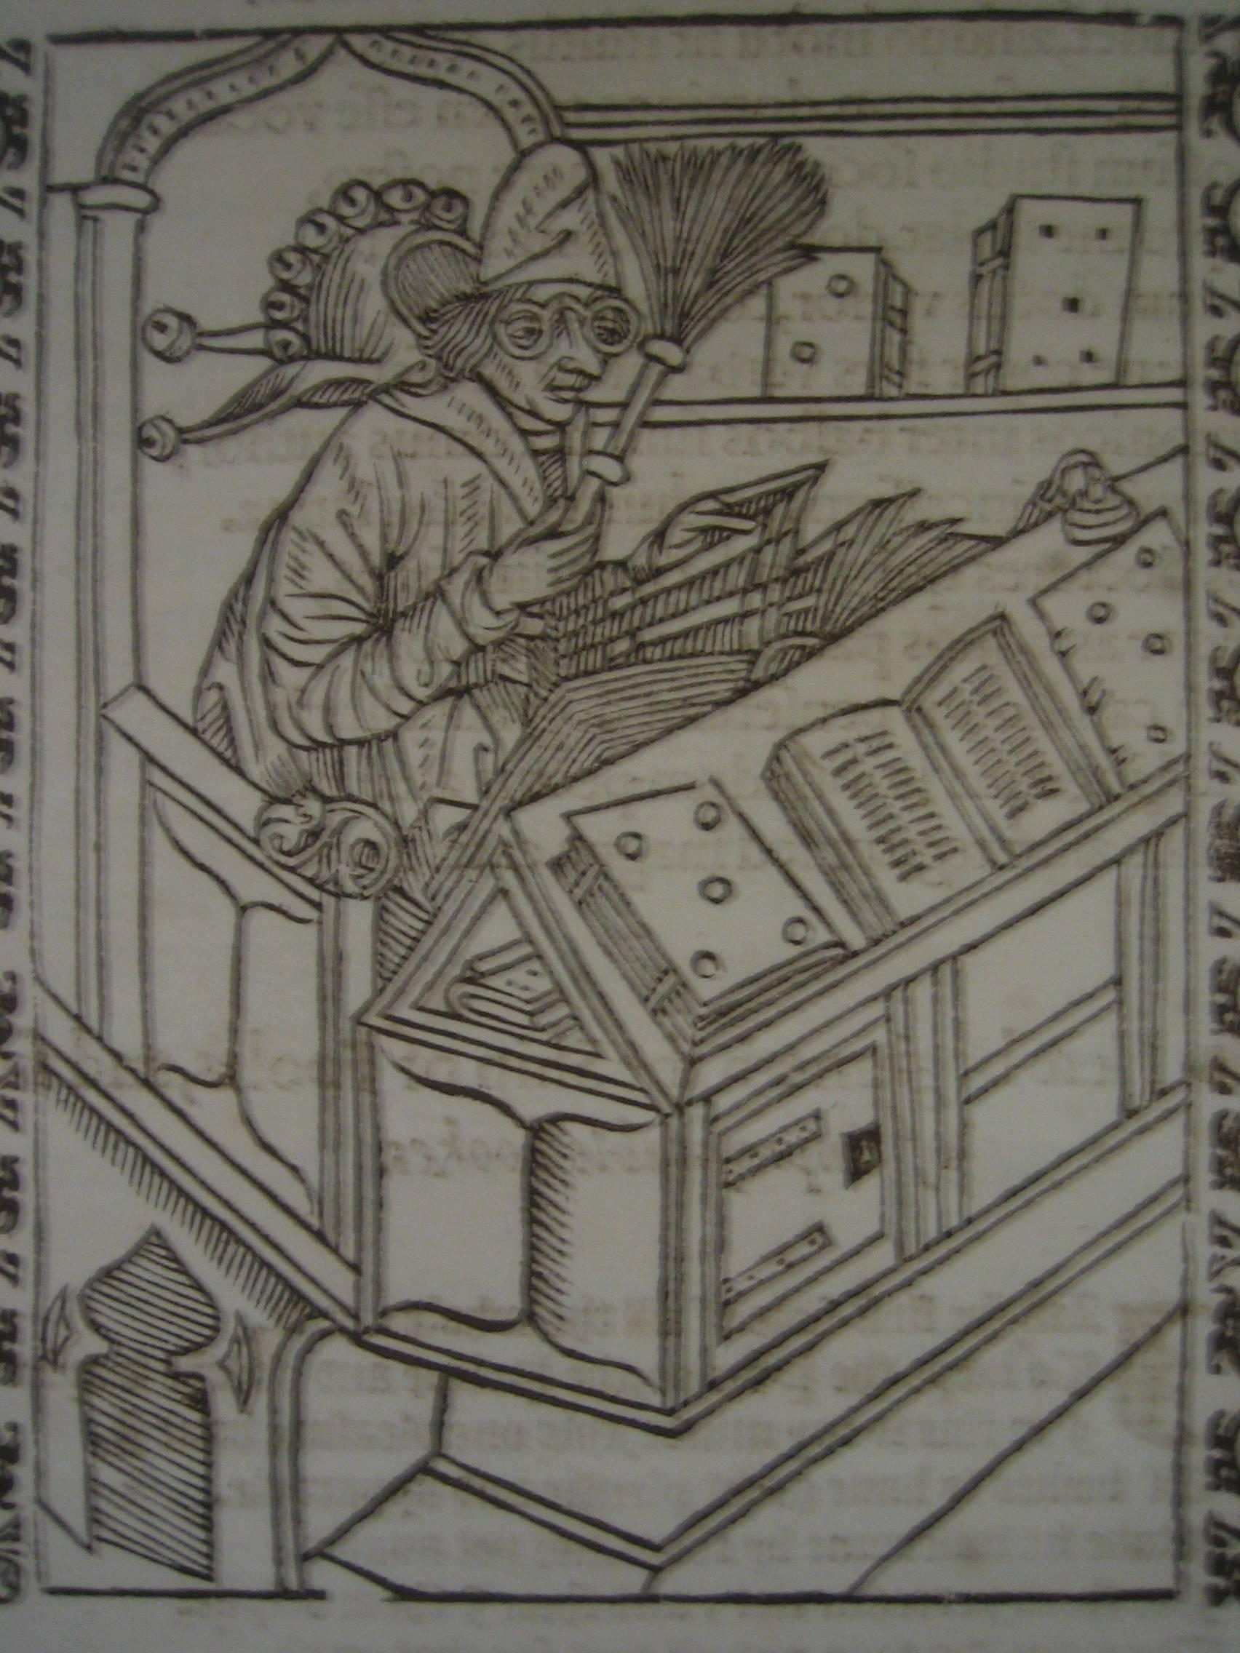
Selection has already been done
Don’t spend time selecting items to digitise
Capture materials as accessioned
For important collections, capture it all
For others, sample and allow user interest to guide your choices
Capture on demand
Capture ‘signposts’ and devote more attention when/where warranted
Woodcut from Sebastian Brant,
“Stultifera…” The ship of fooles… 1570
University of Edinburgh Library

Slide 16
Handle once (then iterate)
Handle incoming items once for both description and digitisation
Compromise on image resolution and metadata as needed to achieve throughput requirements
Create a single unified process
Let usage guide further efforts
Notes:
Aim to collapse decisions.

Slide 17
Have programmes not projects
Forget ‘special projects’ — it’s long past time to make this a basic part of our everyday work!
Digital capture must be embedded in our basic procedures, budgeting, etc.
Figure out a way to fund it yourself and you’ll figure out a way to do it cheaper

Slide 18
Quality vs quantity: quantity wins!
The perfect has been the enemy of the possible
Achieving excellence can have a substantial cost
Any access is better than none at all
Instead of measuring cataloguer/archivist output we should be measuring impact on users
Notes:
We tend to measure the wrong things. Measurement now should be all about usage. Our productivity measures should be shown in relation to usage. We have a lot to do in this area.

Slide 19
Users as co-creators

Slide 20
Engage your community
Do not describe everything in painstaking detail
Start with basic description, then…
…allow serious researchers to contact you for more detail, and…
…engage your user community with adding to the descriptions
Encourage them to submit their content too

Slide 21
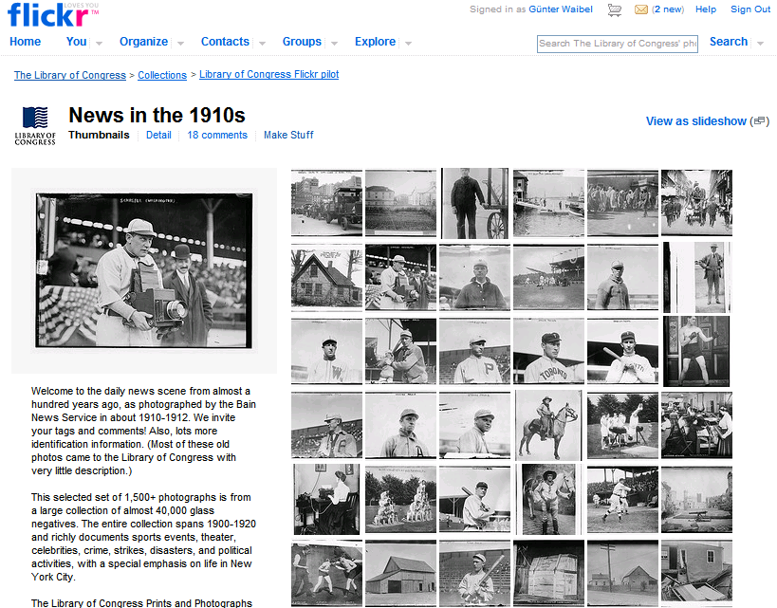
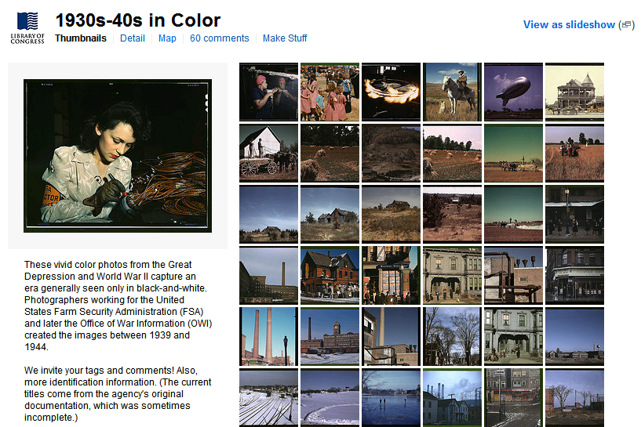
January 16th 2008: LC photographs on Flickr
Notes:
21

Slide 22
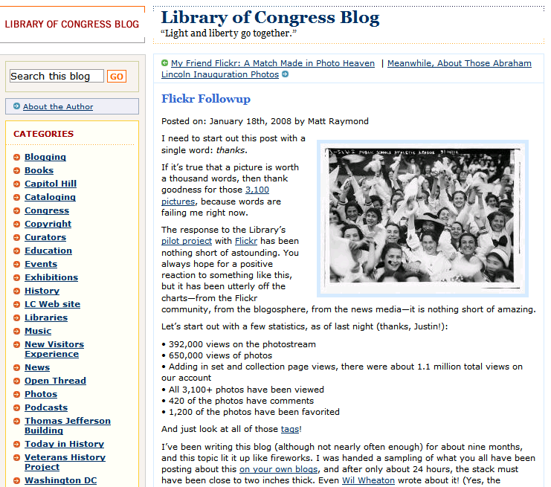
24 hours later
Exposure
Notes:
22

Slide 23
Impact: exposure
Flickr: Top 50 LC: Top 6000
Notes:
23

Slide 24
How to lose control
Contributions
Notes:
24

Slide 25
Go with it
Notes:
25

Slide 26
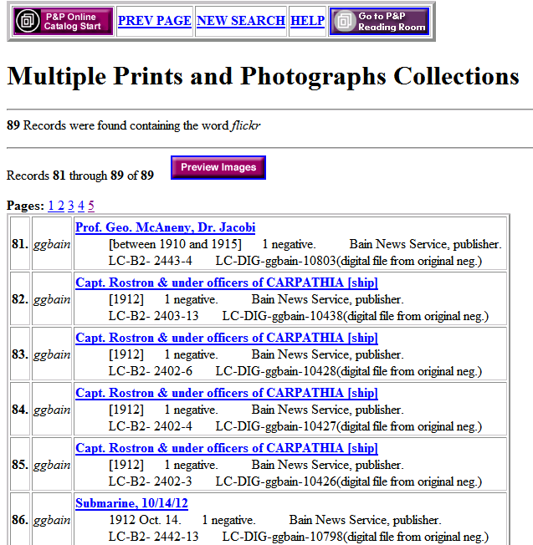
Feeding back into our work
89 records updated
Notes:
26

Slide 27
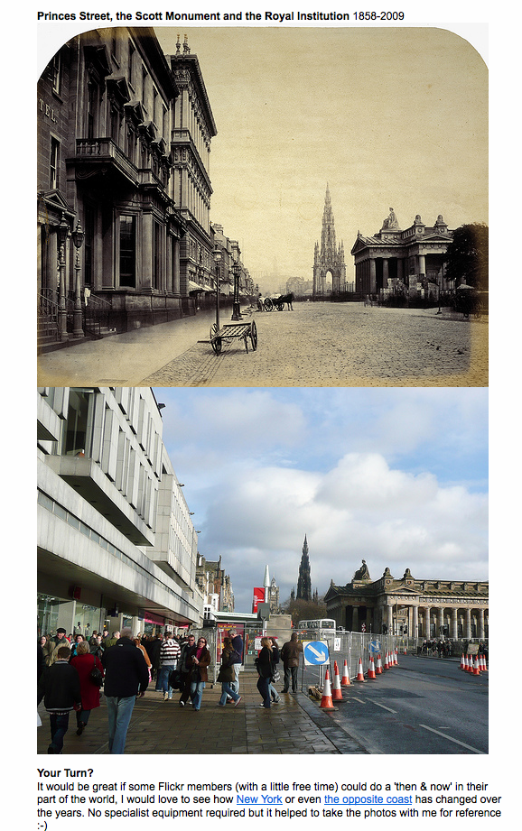
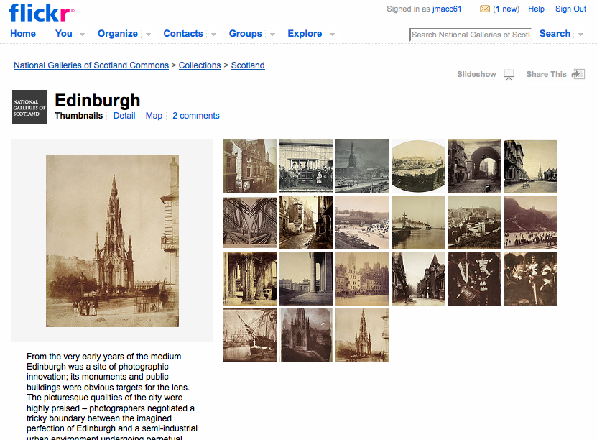
Notes:
Kudos to the National Galleries!

Slide 28
Digitisation as default

Slide 29
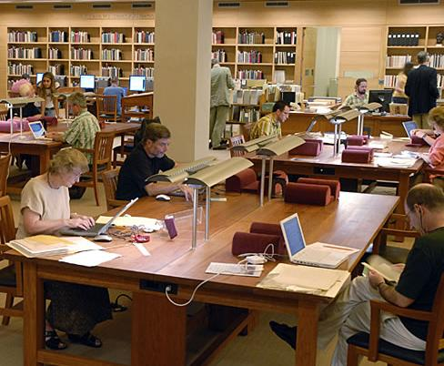
Example: Scan on demand
Change in Photoduplication Policy
As of March 17, 2008, the Ransom Center's policy regarding research copies of items from its collections will change. We will no longer furnish photocopies. For all requests received on or after March 17, our default procedure will be to make digital scans of the originals and furnish PDF files (72 dpi) either by email or on CD-ROM. For patrons who are unable to make use of PDFs, printouts will be available in lieu of digital files.
For publication purposes, high-resolution images will still be furnished on the same terms as before.
Harry Ransom Center, UT Austin
Notes:
29
A good tactic: scan on demand. But the Ranson Center has gone further, by collapsing routines - reducing ‘decision friction’ - and compromising on quality. Theirs is a lead for others to follow.
Scan when requested for research – HRC
Announcement:
Scan the whole thing
No matter what has been selected
Hand the scan to their digital library
(72 dpi and a pdf?)
With whatever metadata they happen to have
No new metadata
Also, preserves the originals, save them from repeated copying.

Slide 30
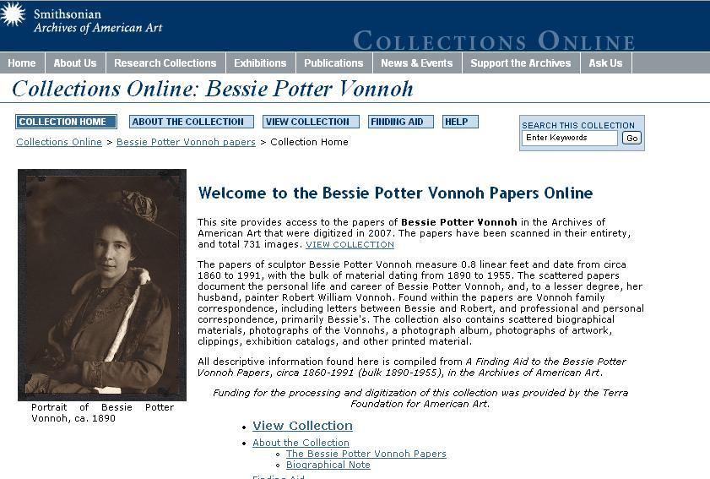
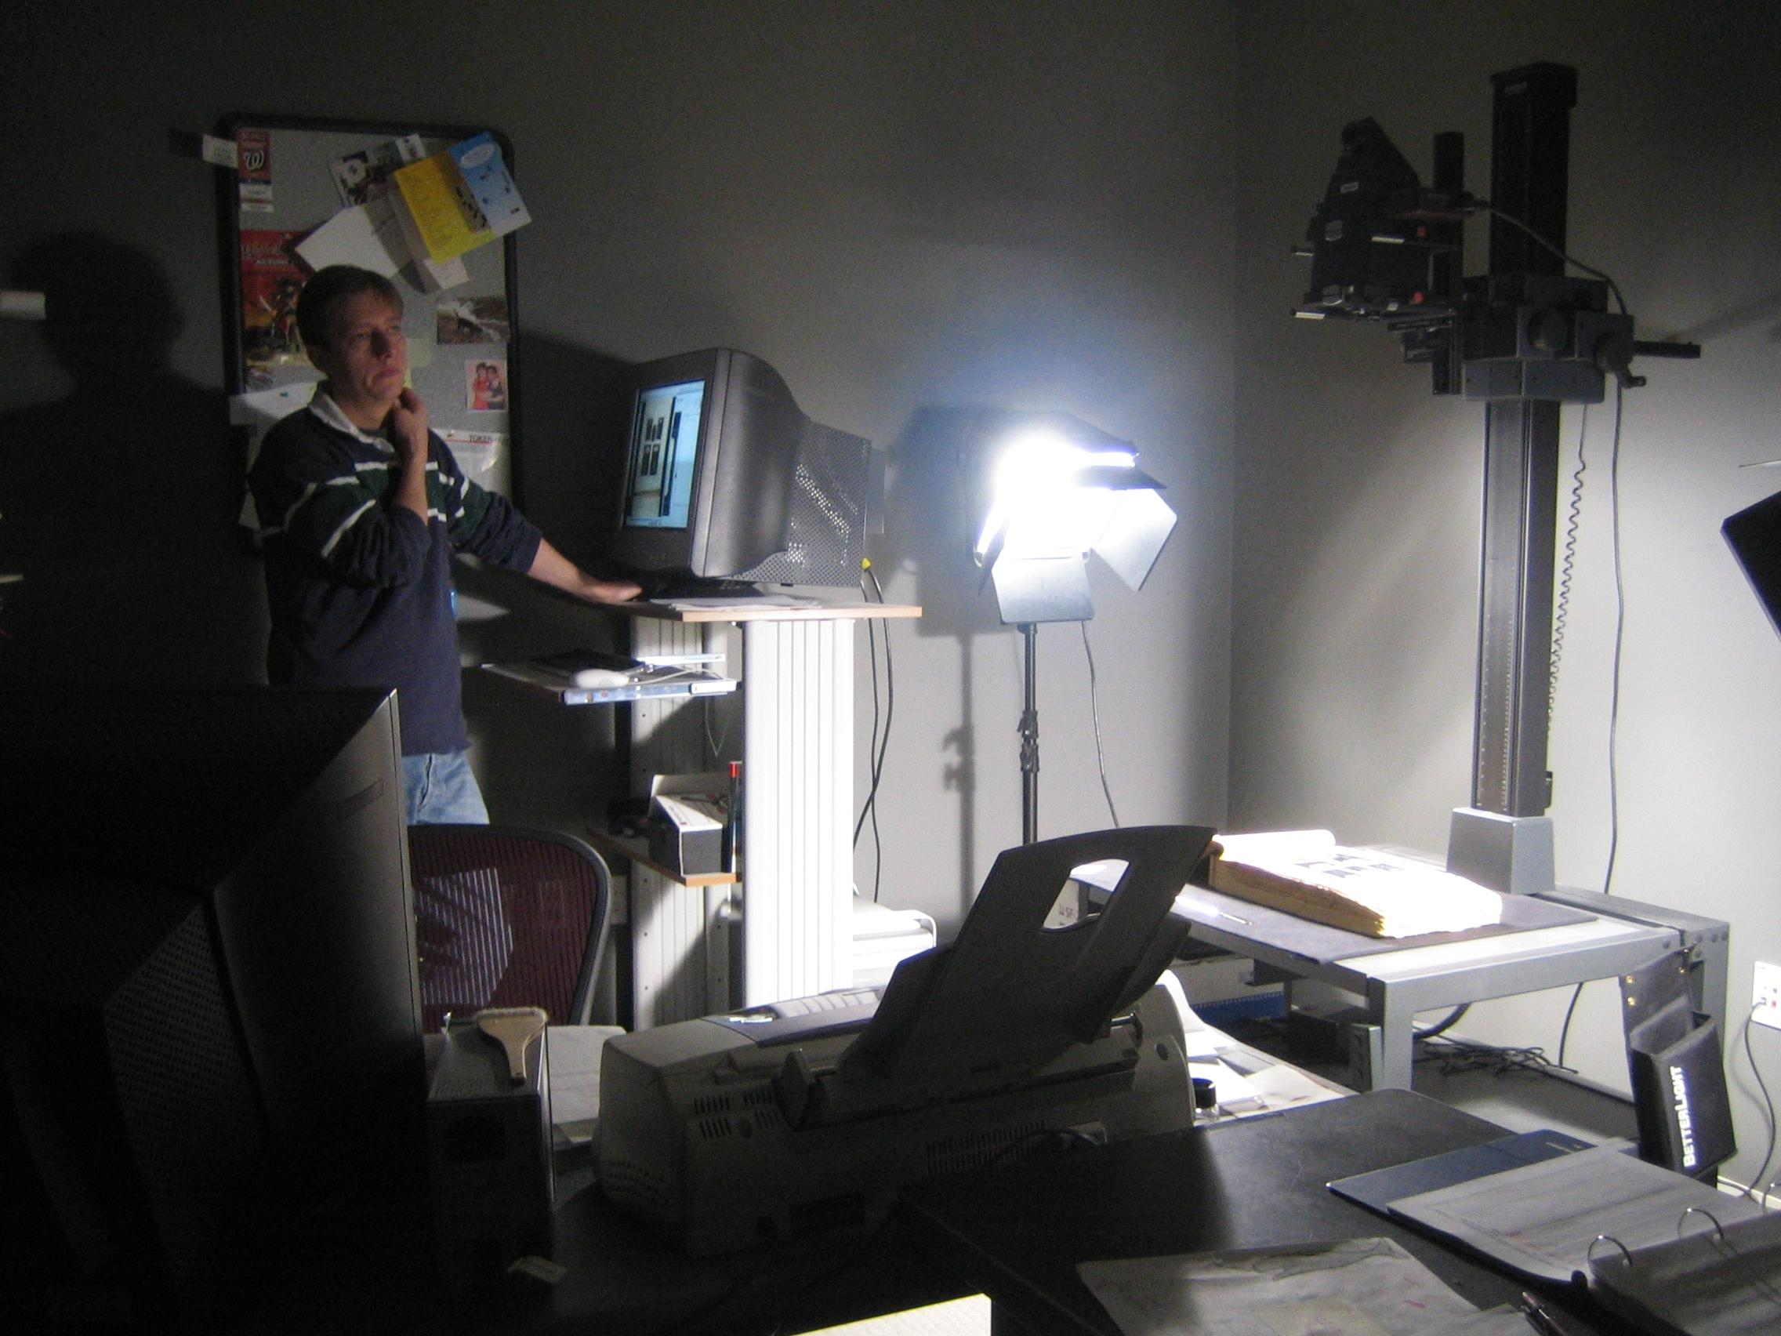
Combine approaches
Notes:
The Archives of American Art at the Smithsonian is using two tactics at one time
They’re scanning on demand for reading room requests – if they touch it, they scan it (as at the Ransom Center). Even if the request is only for a page, they scan the whole thing (an entire book or an entire folder of correspondence). They are building quite a resource of materials that, having been requested, are likely to be of interest again.
And they’re methodically scanning entire collections according to their archival arrangement – no cherry-picking, no decisions. The result is unprecedented access to the content and context of thousands of documents, photographs, diaries, sketches, writings, and rare published materials.

Slide 31
Shared digital & shared print

Slide 32
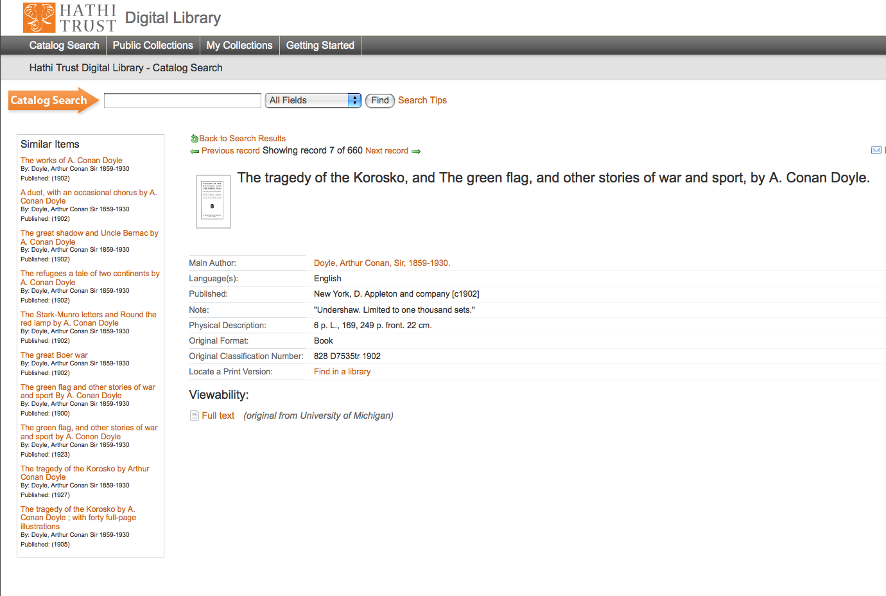

Slide 33
Library storage facilities
Recommendations for current storage institutions
Aggressively archive print journals
Implement last copies policies
Disclose holdings
Explore subscription models
Recommendations for the academic library community
Define mechanisms for disclosure and associated services
Consider a formal print repository network
Develop sustainable business models
Notes:
Shared Print Program – Current Projects – these are working groups
Deaccession materials held in print and electronic form
Define policy and infrastructure requirements for building and managing shared print collections
Journal Preservation Project
Monograph Preservation Project

Slide 34
The mechanics of shared print

Slide 35
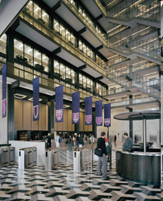
Loans
Borrowing
System
The ‘Cloud Library’
Off-Site Collections
Digitized
Library Collections
Shared
Collections
ReCAP
Transfers
Commitments
Retrievals
Registry
Aggregate holdings and joint commitments constitute a shared asset
enabling collaborative management strategies
Disclose
Local
Collections
Holdings
Assets
Infrastructure
Withdrawals
Policies
Procedures
Notes:
A system diagram. As Andrew suggested yesterday, we already have reasonably good infrastructure to support ‘virtual’ shared collections via inter-lending and document delivery. What we lack is view of the assets that are locked up in digital repositories and off-site storage. To make the cloud library work, we need to make the preservation status and availability of this content more available for collection management decision making.
Case study:
NYU – motivated customer
Acute space pressures; major library renovation
Limited mandate to build local collection of record
ReCAP – supplier
Large-scale shared academic storage collection
HathiTrust – supplier
Large-scale shared digital repository
OCLC Research and CLIR – consultants & convener
Goals
Implementation framework to maximize value of Hathi & ReCAP
Model costs and benefits of deeper reliance on extramural coll’ns
Requirements for sustainable business partnerships
This is what we mean by the ‘cloud library’ – increased reliance on a network of collections and services with a robust underpinning of shared policy and service infrastructures that are jointly owned by participating libraries.
The intersection between NYU and Hathi Trust holdings creates opportunities for changed management of physical inventory at NYU (and other institutions);
… as does the intersection between NYU and ReCAP holdings. The nature of the opportunity varies according to the relatively ‘availability’ of content in digital or print form as well as local demand patterns.
The intersection of NYU/Hathi/ReCAP collections represents a particularly significant opportunity: titles in the public domain can be sourced from Hathi; titles in copyright can be discovered and searched in Hathi and delivered from ReCAP.
Note that ReCAP and Hathi collections are growing at a faster pace than NYU’s own holdings, accelerating the rate at which NYU can increase its reliance on the shared repositories.

Slide 36
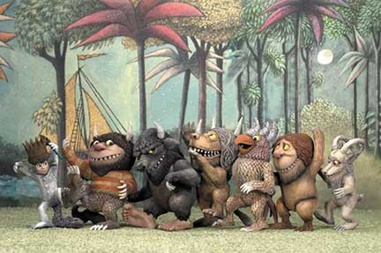
Where the wild users are

Slide 37
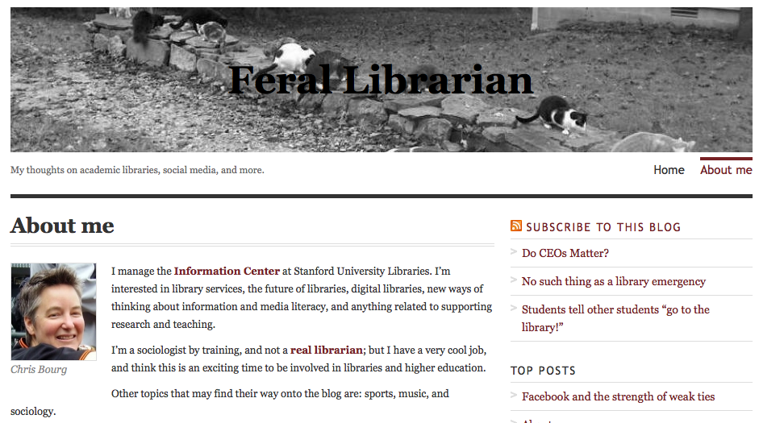
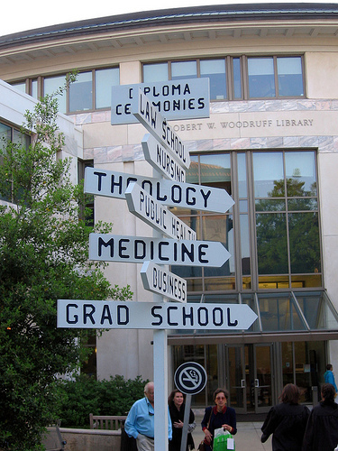
Rick Luce: ARL/CNI presentation on the future support of eResearch, October 2008

Slide 38
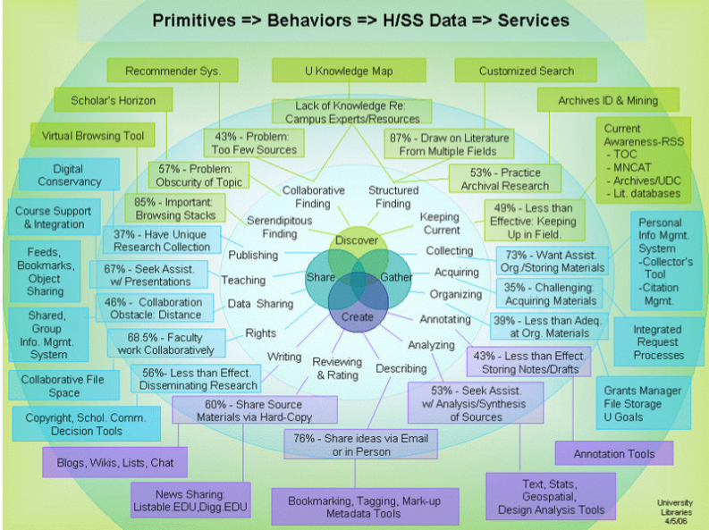
User complexity (the circle game …)
Users
Interdisciplinary
probing
translating
Data Environment
Users
Users
Institution
Domain
accessing
assessing
chaining
disseminating
networking
User
Humanities
Sciences
browsing
collecting
re-reading
assembling
consulting
note-taking
direct searching
scanning
co-authoring
coordinating
monitoring
data-sharing
Assessment Regime
Users
Users
Users
Adapted from C. Palmer, L. Teffau, C. Pirmann (2009)

Slide 39
Specialists step forward

Slide 40
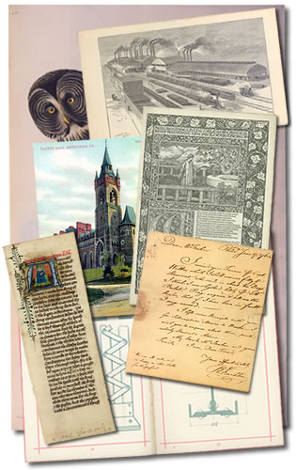
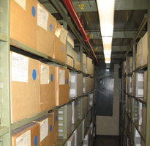
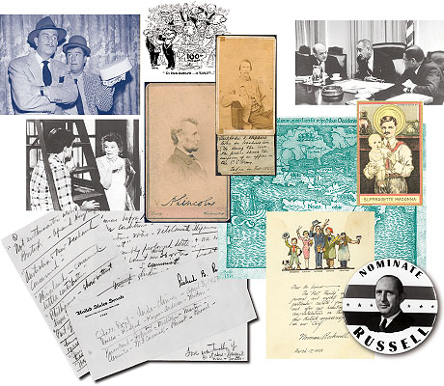
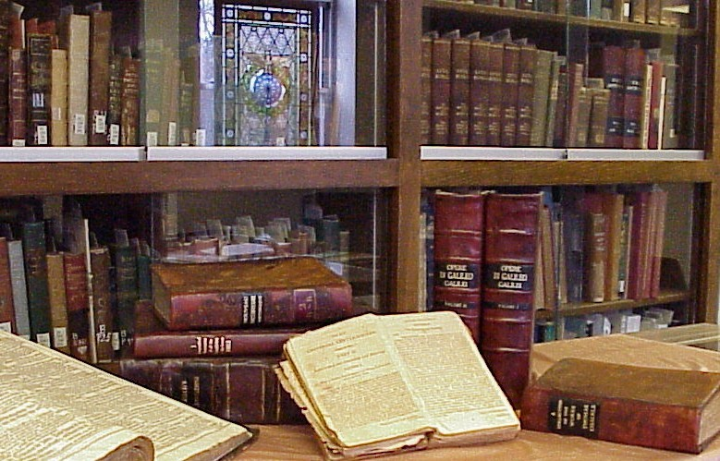
Mobilising Unique Materials
Treasures on trucks
Rescuing orphans
What a picture!
Uncloaking archives
Notes:
Lending/sharing special collections
Copyright and risk taking in digitisation
Best practices around library and user scanning and digital photography
Archival collections standardisation of management and desciption

Slide 41
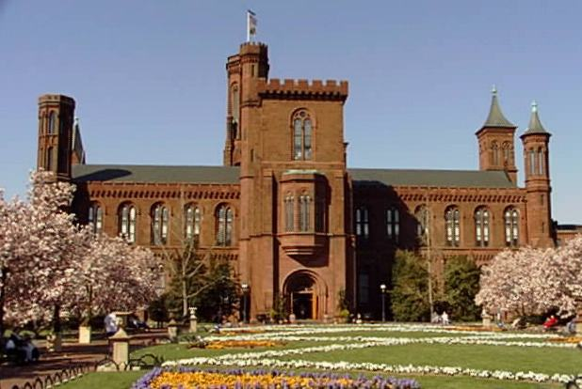
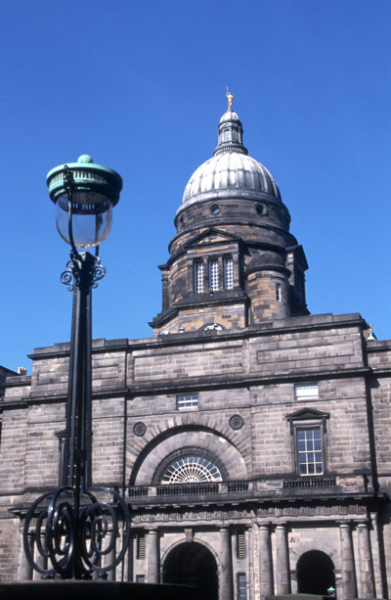
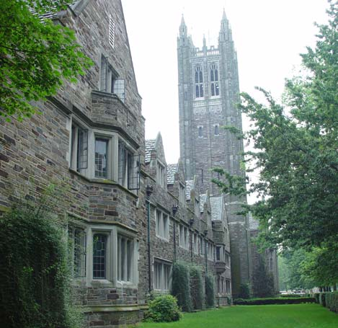
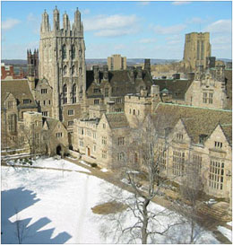
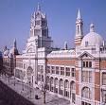
Unifying fragmented memories
Organisational and service relationships in multi-type institutions
Intention: bring about greater collaboration among libraries, archives and museums by surfacing models for sharing data, services and expertise
Smithsonian Institution
Princeton University
Edinburgh University
Yale University
V&A Museum

Slide 42
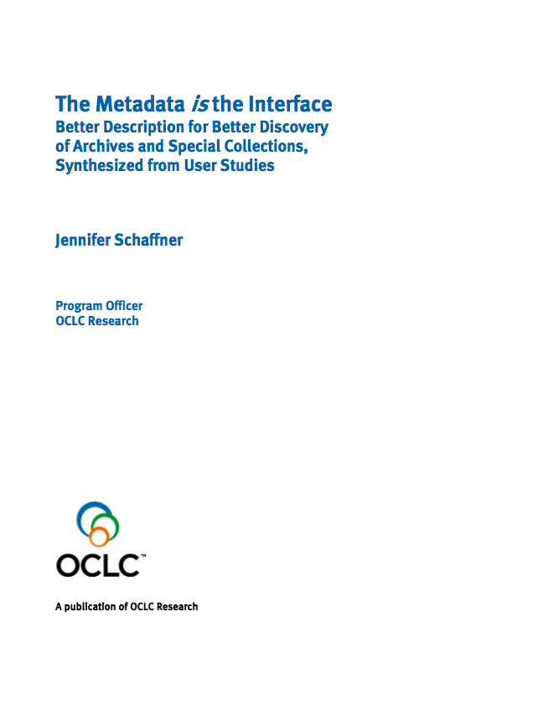
Where to invest time and money
‘Ofness’ vs ‘Aboutness’

Slide 43
Aggregate to innovate …

Slide 44
The power of datamining
(2005)
Rareness is common …
Notes:
Last copies – characterizing content and distribution of unique book holdings
Examining system-wide holdings for shared collection and community profiles
This is a good example of datamining for evidence
This research was done in 2005, and there are many more holdings in the database now.
This kind of work is a good example of the RLG partnership getting the advantage of the full force of OCLC Research.
Economics 101: Asset valuation (Courant)
Balance sheet: print collections = an institutional asset digital collections = liability
In reality, digital collections deliver greater value to users; print collections represent a continuing cost with little direct return
Must recalibrate the university administration’s understanding of how collections deliver value to research institutions and users
Value of collections will be maximized when they are effectively concentrated (jointly owned and managed) and diffused (into the network)
Assessing overlap and characterizing uniqueness in system-wide holdings, enabling institutions to make better informed
decisions about the disposition of local holdings
Source: Books without Boundaries: A Brief Tour of the System-wide Print Book Collection
Roger C. Schonfeld, Brian F. Lavoie
Ann Arbor, MI: Scholarly Publishing Office, University of Michigan, University Library
vol. 9, no. 2, Summer 2006
URL: http://hdl.handle.net/2027/spo.3336451.0009.208

Slide 45
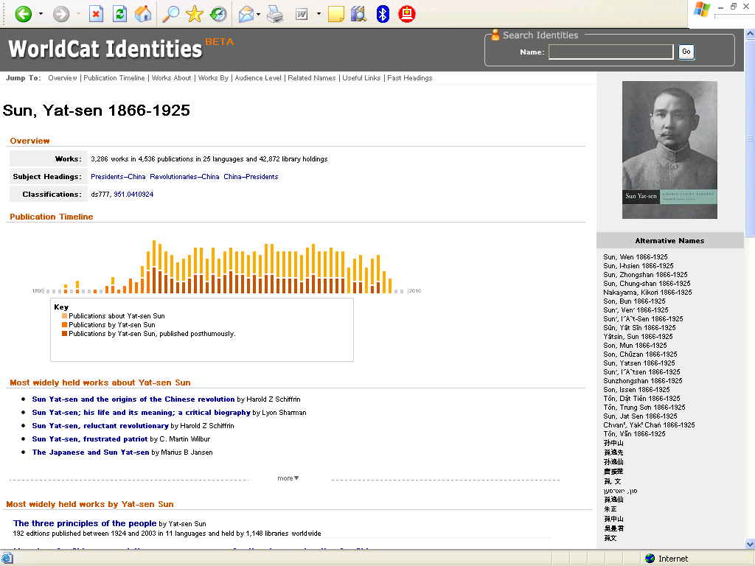
Knowledge Structure: structure for controlled data: metadata workflows
Notes:
WorldCat Identities leverages both the vocabularies that catalogers have been including in bibliographic records and OCLC Research’s datamining techniques to provide much richer information about persons and organizations than you can find in the LC/NACO Authority File – or the national authority files from other countries.
WorldCat Identities is mined from all the names in catalog records, not just the controlled names, linked to and from the publications.
The number of different works and titles in different languages and worldwide holdings at the top comes from WorldCat. The publication timeline differentiates works by the person (including those published posthumously) and works about the person. Note that in the “Alternate Names” section in the right frame we have a number of names represented in non-Latin scripts – Sun Yat-sen’s name as it appears in Chinese, Japanese, and Hebrew-language publications. These are alternate forms not yet in the LC/NACO Authority file – we will be using these forms datamined from WorldCat to pre-populate the LC/NACO Authority files when all NACO nodes start supporting non-Latin scripts in April 2008.
This is also an example of RLG Programs working with OCLC Research colleagues – 95 staff from 21 RLG Programs partners beta-tested an earlier version of WorldCat identities in February – April 2007, and made good suggestions that were incorporated.
A version of WorldCat Identities is being incorporated into WorldCat.org. Programs and Research is looking at what else is needed to make the Identities resource available as a Web service that other applications can use.

Slide 46
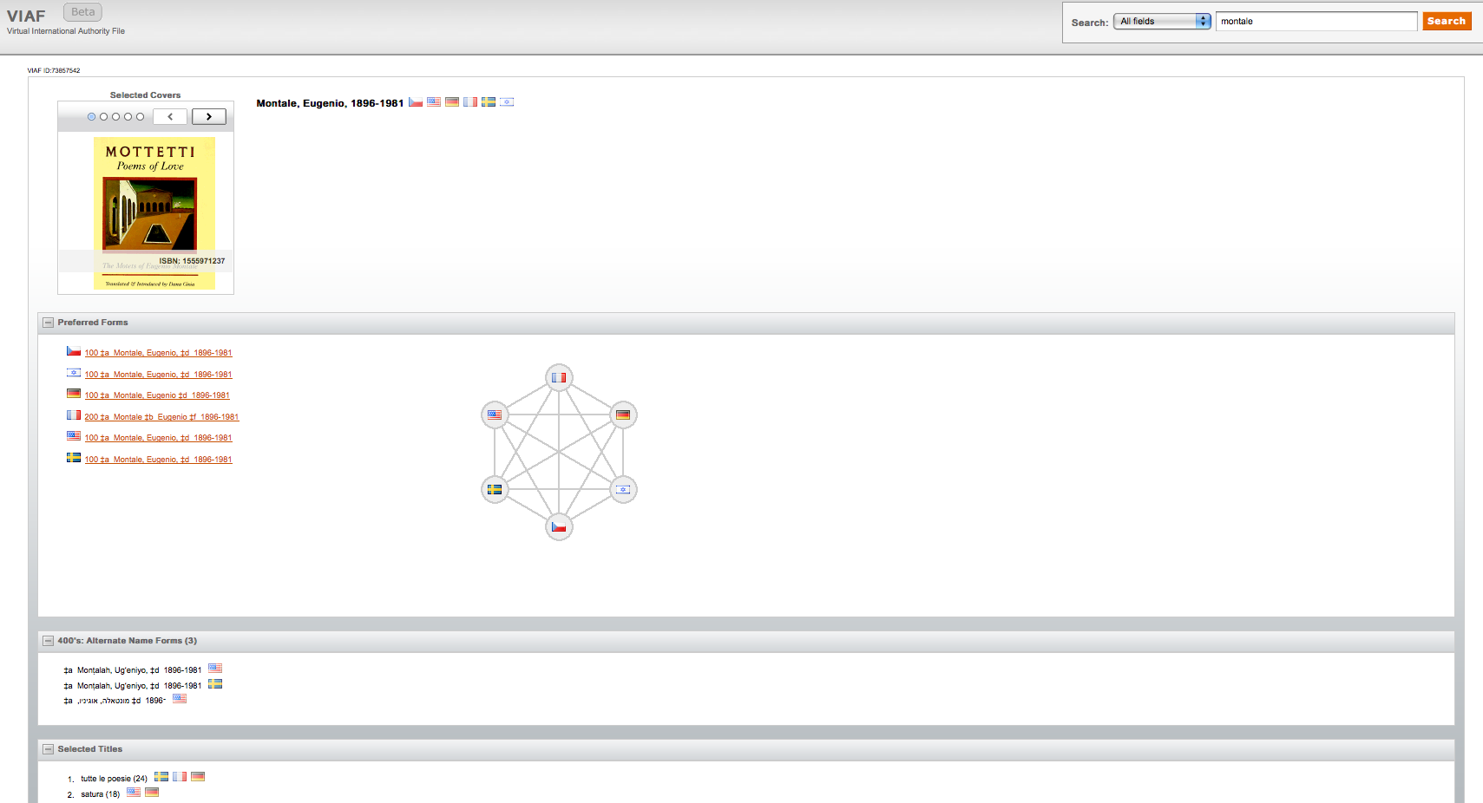
Increase the gravitational power of names
Notes:
VIAF: Virtual International Authority File
The Deutsche Nationalbibliothek, the Library of Congress, the Bibliothèque nationale de France, and OCLC are jointly conducting a project to match and link the authority records for personal names in their retrospective personal name authority files . This relates to (and builds on?) earlier TEL LEAF work. Recently, a number of additional national libraries have decided to join: the Czech Republic, Portugal, Sweden, Spain, Italy, Denmark, Norway, Slovenia, China, Japan and Israel.

Slide 47
Accentuate the positive

Slide 48
“It is not the strongest of the species that survives, nor the most intelligent that survives. It is the one that is the most adaptable to change.”
—Charles Darwin
Image: Auckland Museum

Slide 49
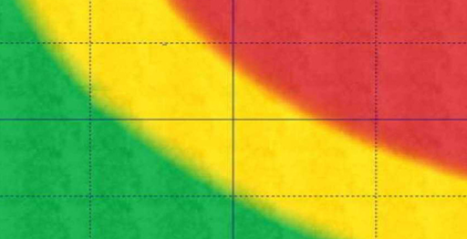
LAM risks and strategies
Impact
Effective network disclosure
Move new services ‘into the flow’
Articulate compelling new vision to
attract a new generation of LAM
professionals
These risks will remain high but can be managed.
Notes:
The high risks that remain after mitigation.
Can some coordinated action change these residual risks, or make them less threatening to individual libraries?
1 – [click] Our best strategy is to focus on more effective disclosure of library assets
6 – [click] Must develop new services that are “in the flow” of research practices; this will require reallocation of resources that is only possible after changes in library operations are tackled
12 – our culture won’t change until our organizations do
14 – this is a problem for library schools, not libraries – but the solution requires a new library value proposition capable of attracting a new generation of professional.

Slide 50
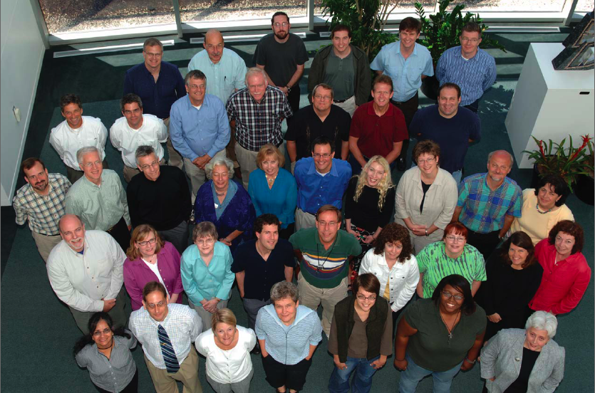
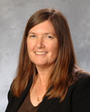
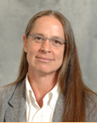
Thank You
John MacColl
maccollj@oclc.org
OCLC Research

