Slide 1
Who Are the Masses? A View of the Audience
OCLC – Philadelphia
March 19, 2013
Howard Lurie / VP Content & University Relations

Slide 2
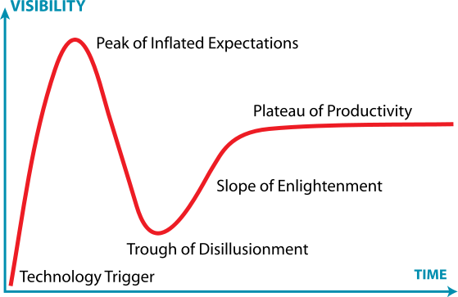

Notes:
Industry

Slide 3
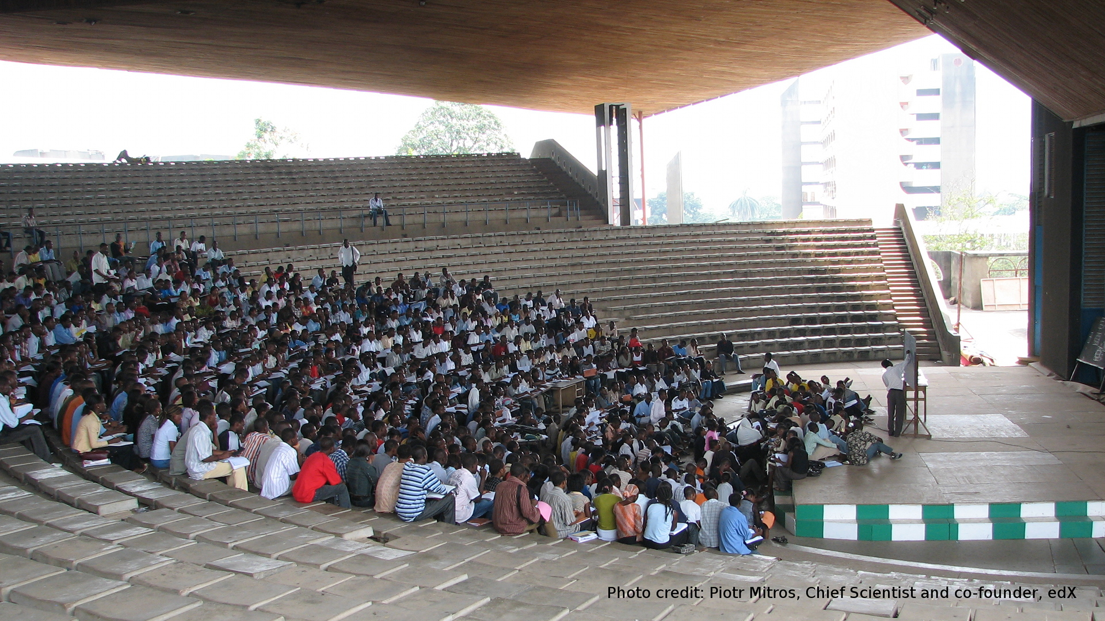
Obafemi Awolowo University, Nigeria

Slide 4
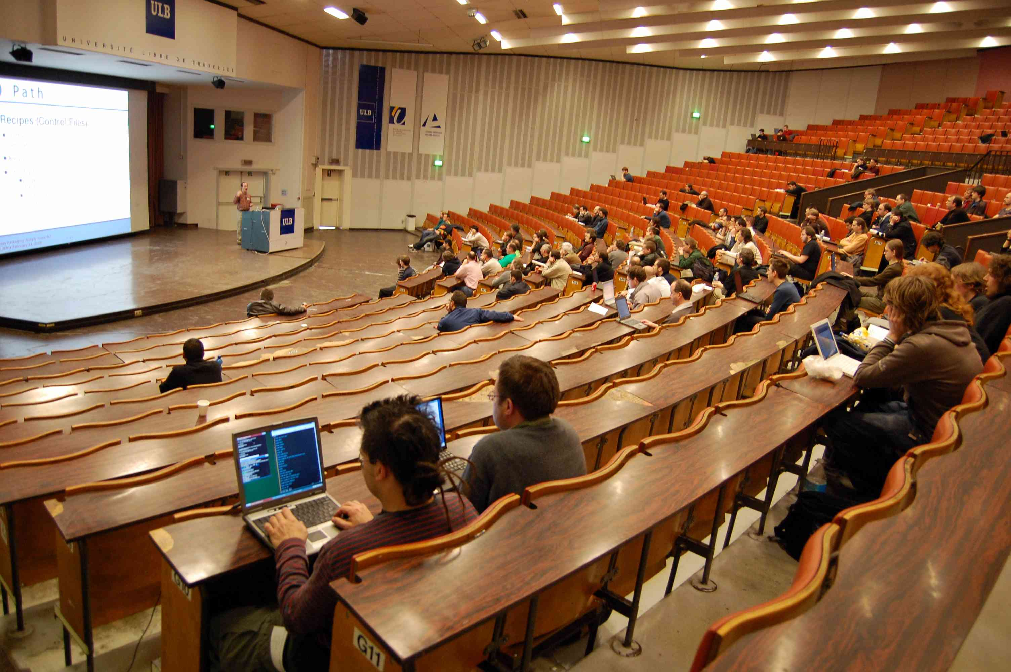
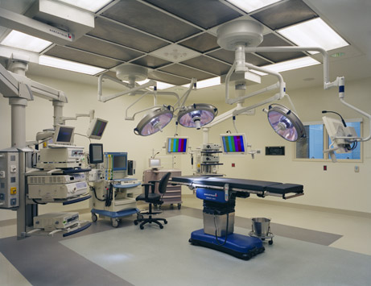
Notes:
Industry

Slide 5
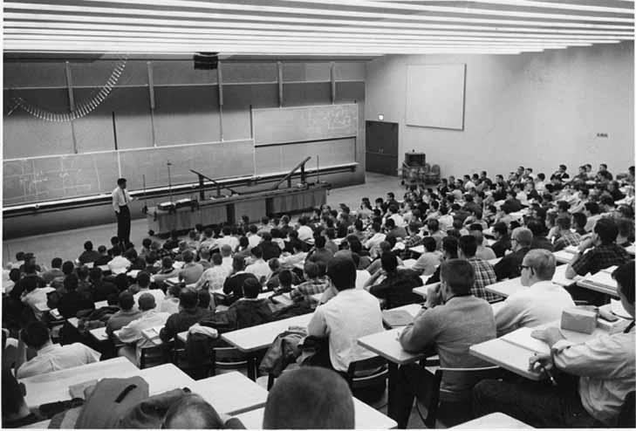
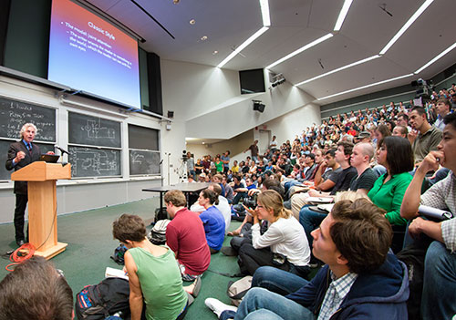

Slide 6
A Not-for-Profit Venture of Harvard & MIT
Open source Platform
Portal for learning edx.org
Harvard → HarvardX
MIT → MITx
Berkeley → BerkeleyX
U → Ux
X university consortium
Pedagogy research on learning using “big data”
Production support to ensure high quality
*Harvard and MIT have committed $60M to the venture

Slide 7
Mission: Expand access to education for students worldwide through online learning, while reinventing campus education through blended models
Not-for-profit, research driven online learning initiative
Founded by MIT and Harvard – April, 2012
Innovative and open learning platform designed to reinvent online and on-campus education
The best courses, best teachers, best schools @ edX.org
Notes:
Industry

Slide 8



Admitted
~1500
Applied to MIT 2017
~19,000

Slide 9
After: We’ve Flipped the Funnel
7,157
Certified
8,240
Took the Final
9,318
Passed the Mid-Term
10,547
Made it the Mid-Term
26, 349
Tried the First Problem Set
154,763
Registered for 6.002x: Circuits and Electronics
Same staff resources as 150 person on-campus class

Slide 10
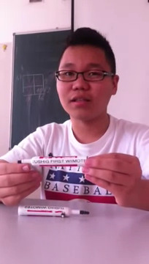
Global edX learners share their stories
Battushig, a 15-year-old high school student from Mongolia took MITx 6.002x as part of a blended course and received a perfect score on the final exam. He is now applying to attend MIT and UC Berkeley.
Radhika, a 15-year-old from New Delhi has taken two edX courses online: “The professors are awesome and many of us around the world have never been taught by someone who loves their area of teaching so much.”
Francesca, a 25-year-old Master’s degree student in biostatistics at University of Milan: “I have studied these topics for my Master’s but in the edX course there are a lot of details. A lot of videos, exercises and homework.”
Ashwith, a 24-year-old from Bangalore preparing for the entrance exam to a Master’s program: “It's amazing to see the amount of talent out there - like high school students studying engineering subjects and people above 70 years of age still having the energy to never stop learning.”
Arthur, an 18-year-old high school graduate from Brazil: “One of the best things about 6.002x was the community built by the students themselves. The atmosphere was great: people shared their enthusiasm and knowledge, and lended a hand to those like me who didn’t have the basics for the course. All of this was done in a very friendly environment. This was something that really helped me keep moving forward in 6.002x.”

Slide 11

“This course was the most rewarding experience of my life.”
-Student, Pakistan
Notes:
Industry

Slide 12
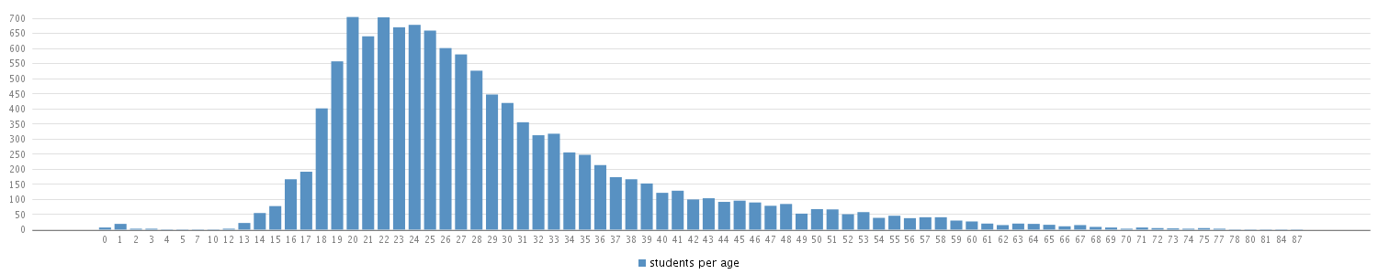
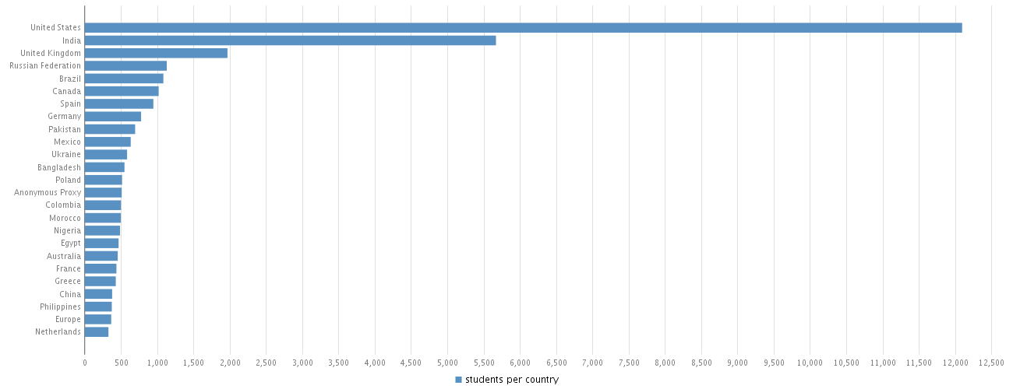
Sample: Spring 2013 course

Slide 13
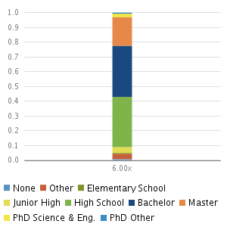
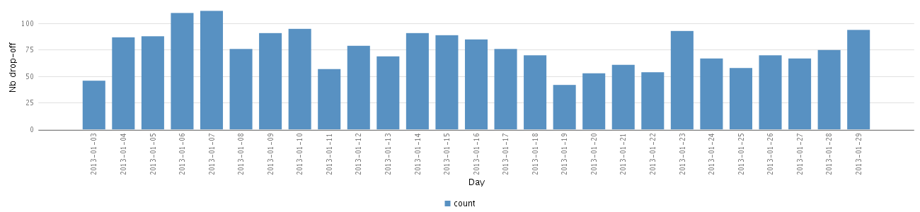
Possible “universals”:
Weekends rule
Global Procrastination

Slide 14
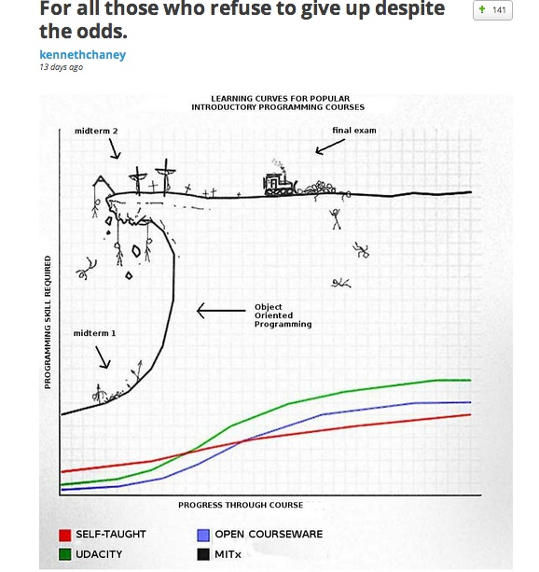

Slide 15
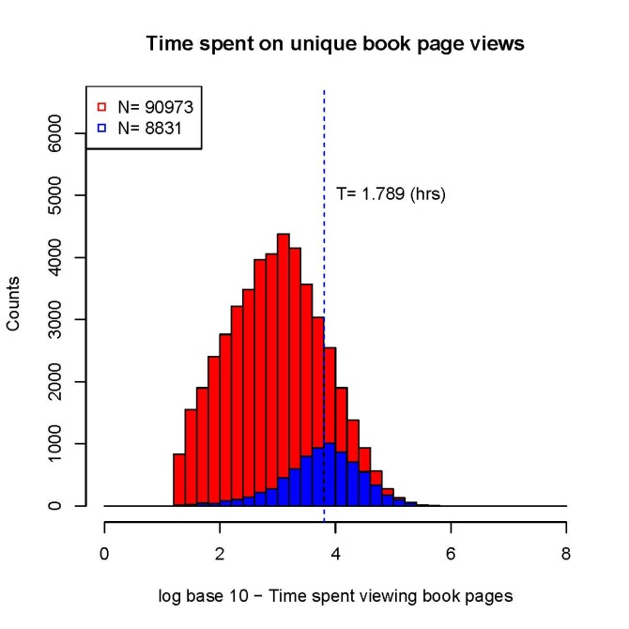
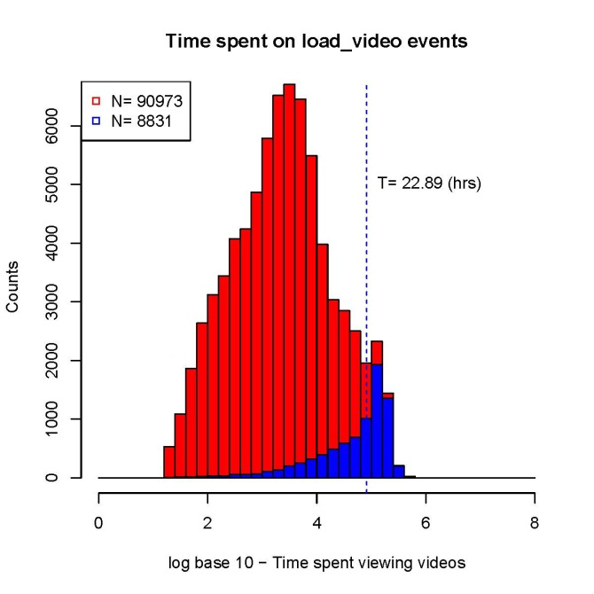
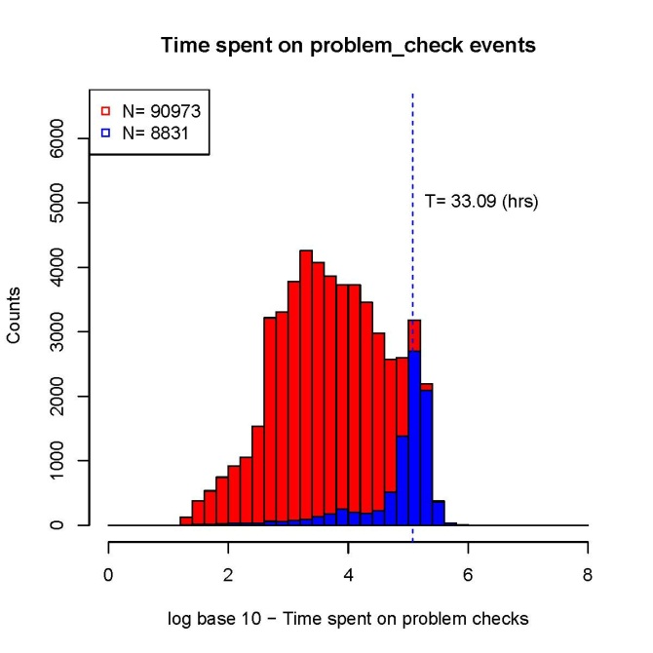
Access to Research in Learning on an Unprecedented Scale
Online
textbook
Videos
Assessments
How does learner activity correlate to performance?
Courtesy Seaton, Pritchard Aug 2012

Slide 18
Instant Feedback Improves Learning
Rapid feedback has a significant and positive effect on student performance when compared to no rapid feedback.
– Chen, Whittinghill, Kadlowec 2010

Slide 19
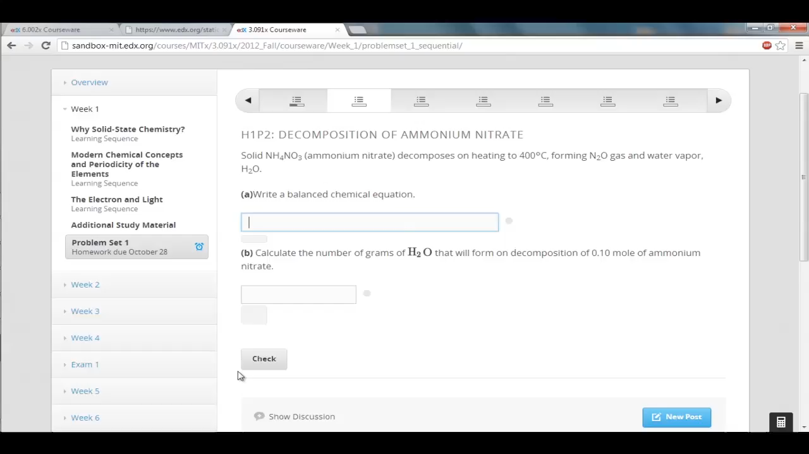
Rich Set of Autograded Exercises Provide Instant Feedback
Chemical Equations

Slide 20
An edX cult symbol?

Slide 21
Oh god; have I missed you... :~}

Slide 22

Notes:
Industry

Slide 23
Student Controlled Pacing Improves Learning
Students who were able to press a
continue button to go on to the next segment performed better…
– Mayer 2003
J. Educational Computing Research

Slide 24
Notes:
Industry

Slide 25
Great lectures were theater, but the future is in games…

Slide 26
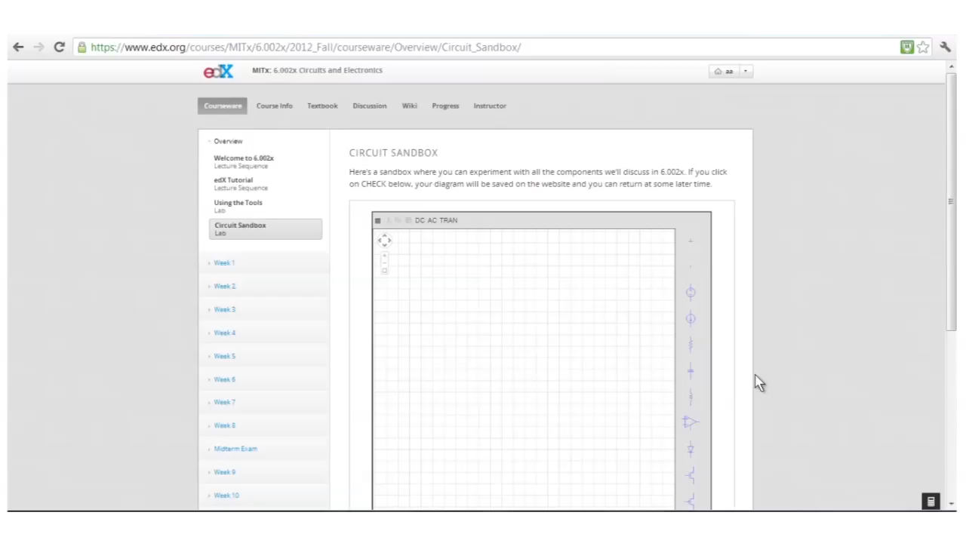
Virtual Game-Like Laboratory

Slide 27
A “Blended” edX course in a Silicon Valley, California Campus
San Jose State University EE99
Flipped classroom with 86 students, Fall 2012 using edX MITx circuits and electronics MOOC class hosted by edX
Outside class:
      Watch edX MITx circuits and electronics video lectures
      Do online interactive exercises (homeworks and exams)
      Do online virtual simulation based laboratories
In class:
      The instructor answers questions in the first 15 minutes of class
      Students solve problems in groups of 3 with help from the instructor and two TAs. (15% of the course grade).

Slide 28
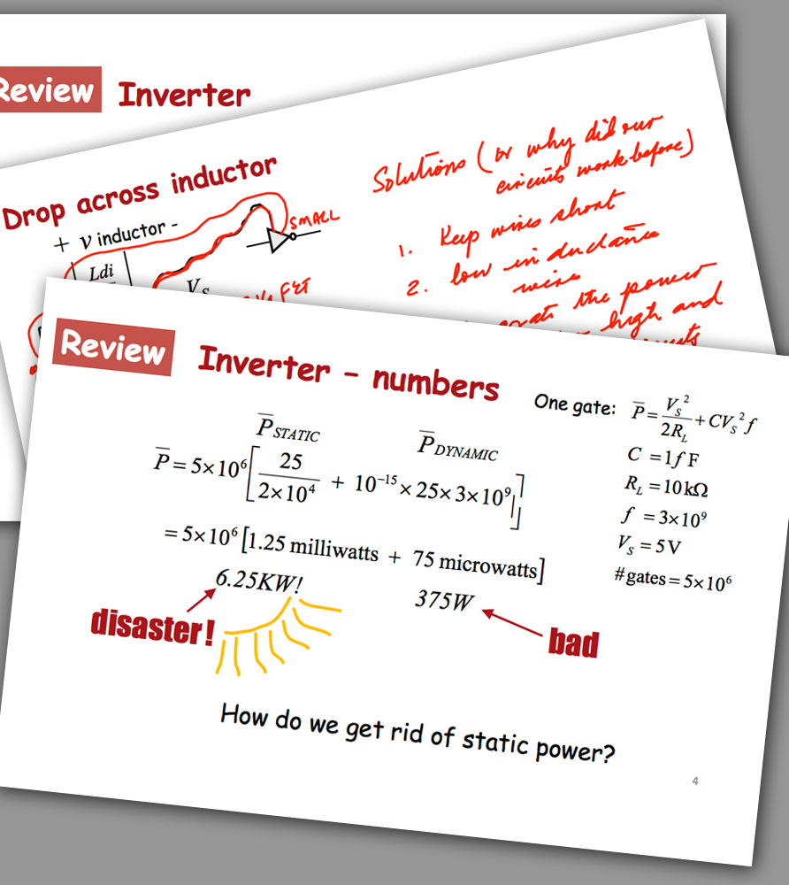
Preliminary Findings
Compared to the students enrolled in the Spring 2012 EE99 course, the Fall 2012 students:
Scored an average of 5.7% higher on the Midterm 1 exam and average of 9.6% higher on the Midterm 2 exam
Overall Result:
Course retake rate drops from 41% to 9%
Source: San Jose State University College of Engineering
Notes:
SJSU-
Total of 87 students in the course
Students viewed lectures and completed problems outside of class.
During class, faculty and course staff facilitated 15 minutes of question and answer. Remaining time on peer and team instruction and problem solving.
Instructors and TAs hired as graders are spending less time on grading work due to edX courseware. This frees their time up for instruction and work with students in class.
Next Step: Offer edX section again in Spring 2013- study more deeply.

Slide 29
Open Source Platform
A Focus on Continuous Improvement
What
edX is building an open, evolving and localizable platform
Cloud-based provisioning for global connectivity and uptime
Built from the ground up to be an international platform
Why
Platform and “Big Data” learning it feeds will evolve through global networks developers and researchers
edX will share the platform with other global educators and innovators to host their own courses and push education forward

Slide 30
“This course was the most rewarding experience of my life.”
-Student, Pakistan
Notes:
Industry

