Slide 1
The Evolving Scholarly Record
Scope, Stakeholders, and Stewardship
Brian Lavoie
Research Scientist
OCLC Research
April 1, 2014
CNI Spring Meeting
St. Louis, Missouri

Slide 2
Roadmap
What is the scholarly record?
Current trends
OCLC Research: Evolving Scholarly Record
Scholarly record framework:
Content
Stakeholder roles & configurations
Stewardship
Closing thoughts & discussion

Slide 3
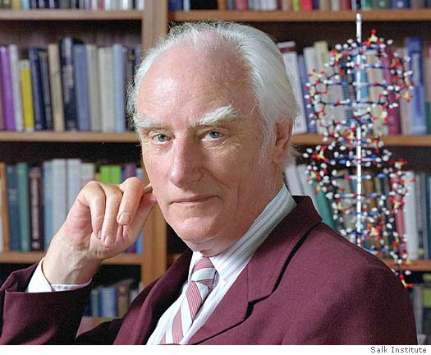
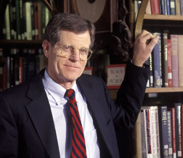
What is the scholarly record?
Francis Crick:
What is molecular biology? Whatever interests molecular biologists.
Ross Atkinson:
“… that stable body of graphic information, upon which each discipline bases its discussions, and against which each discipline measures its progress …”

Slide 4
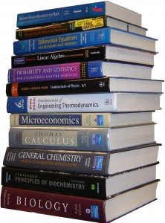
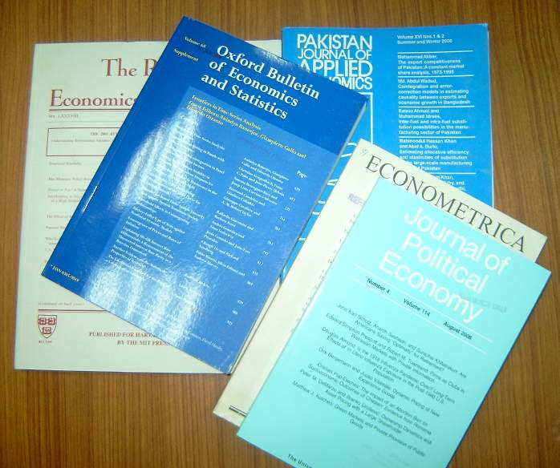
Scholarly record: Content & perspective
Faculty: what establishes credentials
Date $ bn
2012-01-01 16289.6
2012-04-01 16419.2
2012-07-01 16603.7
2012-10-01 16677.3
2013-01-01 16772.7
2013-04-01 16907.9
2013-07-01 17175.9
Researchers: what is necessary to validate & build on current literature
Publishers: what is “published”
Scholarly?
e-
float gasdev(long *idum) {
static int iset = 0;
static float gset;
float fac, rsq, v1, v2;
if (iset == 0) {
do {
v1 = 2.0*ran1(idum) - 1.0;
v2 = 2.0*ran1(idum) - 1.0;
rsq = v1*v1 + v2*v2;
Library: what is selected
and preserved

Slide 5
Evolutionary trends …
Formats shifting:
Print-centric to digital, networked
Boundaries blurring:
Articles/monographs, but also data, computer models, lab notebooks, blogs, e-mail discussion, e-prints, interactives/executables, visualizations, etc
Characteristics changing:
Traditionally: static, formal, outcome-focused
Today: dynamic, blend of formal & informal, more focus on process, replicability, “leveragability”
Stakeholder roles reconfiguring:
New paths for the scholarly communication “supply chain”

Slide 6
Evolutionary, not revolutionary
Scholarly record is always evolving
So boundaries & stewardship always evolving
Dewald, W., Thursby, J., Anderson, R. (1986) “Replication in Empirical Economics: The Journal of Money, Credit, and Banking Project” American Economic Review (September 1986)
Confluence of trends accelerating evolutionary process

Slide 7
OCLC Research: The Evolving Scholarly Record
Develop framework to:
Organize/support/drive discussions about ESR
“Big picture” view of the scholarly record
Define key categories of material and stakeholder roles
High-level; cross-disciplinary application; practical use
Benefits:
Common reference point: concepts, terms (e.g., OAIS)
Organize/support conversations within/across domains
Reduce fragmentation
Equip libraries, scholars, funders, publishers, scholarly societies, etc. with resource for strategic planning

Slide 8
OCLC Research team
Brian Lavoie
Ricky Erway
Constance Malpas
Jennifer Schaffner
Titia van der Werf
Ixchel Faniel
Eric Childress
Supporting work across OCLC Research portfolios:
Research information management
Understanding the system-wide library
Digital humanities

Slide 9
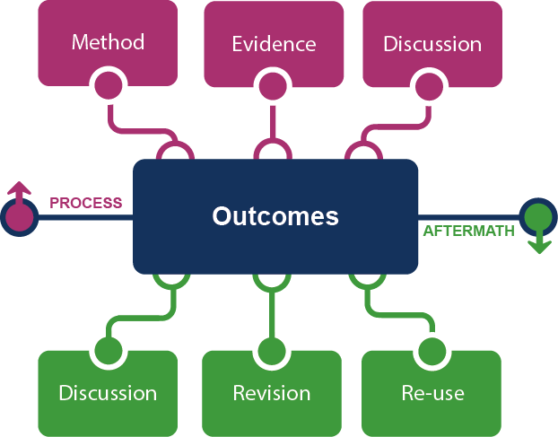
Framing the Scholarly Record …

Slide 10
Some remarks …
Framework components not new or “suddenly important”
But not formalized into scholarly record through systematic collection, referencability, accessibility
Prior work is foundation of future inquiry
Scholarly record itself available as input to new research
Framework conceptualizes scholarly record evolving into:
Greater emphasis on context (process & aftermath), not just outcomes
Deeper and more complete record of scholarly inquiry

Slide 11
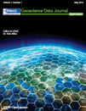
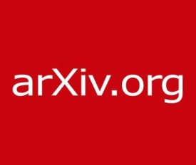
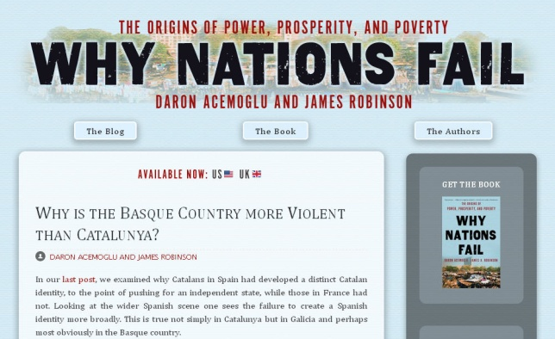
In practice …

Slide 12
Framing the stakeholder eco-system …
Fix
Collect
Create
Use

Slide 13
Evolving configurations in the eco-system …
Fix
Create
Social media (blogs, Twitter)
Social storage (SlideShare, YouTube, Flickr)
e-literature
Collect
Use

Slide 14
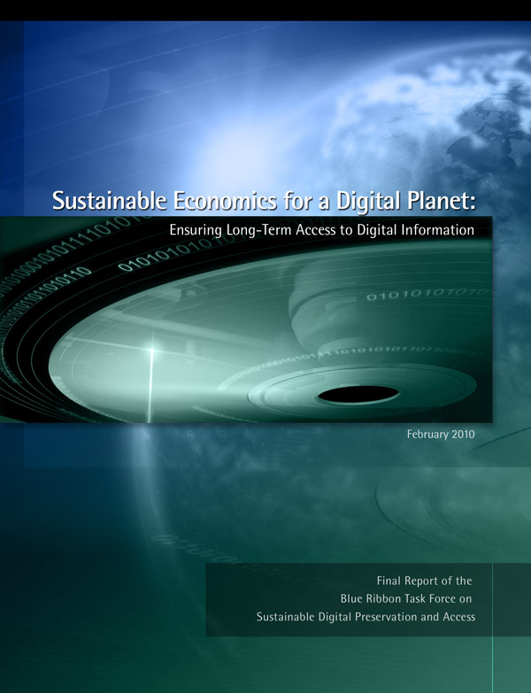
Use of the Framework: Example
Sustainable Economics for a Digital Planet:
Ensuring Long-Term Access to Digital Information (2010)
Recommendation:
“ … Libraries, scholars, and professional societies
should develop selection criteria for emerging
genres in scholarly discourse, and prototype
preservation and access strategies to support them.”
p. 55

Slide 15
Stewardship of the scholarly record
Fix
Collect
Create
Use
Key characteristics impacting stewardship …
Increasing volume of content
Increasing diversity/complexity of content
Increasing distribution of custodial responsibility
“local copies” of scholarly record becoming increasingly partial

Slide 16
Evolving stewardship model …
System-wide stewardship of ESR:
More distributed (beyond traditional collecting institutions)
More specialized (not everyone can collect everything)
“Conscious coordination”:
More explicit collecting responsibilities
More attention to coordination & cooperation
More reliance on external sources for access; “trust networks”
Collecting for the “public interest”:
Benefits for scholarly community; local benefits incidental
Institutional resources and priorities

Slide 17
Other issues …
Drawing a distinction between the scholarly record and the cultural record
Criteria for inclusion?
Dynamics of the scholarly record
Versioning
Defining a “scholarly work”
Relationships, data layer
“Selecting” the permanent scholarly record
Choices, priorities

Slide 18
Next steps
White paper forthcoming
Draft reviewed by external experts (multiple domains)
http://oclc.org/research/activities/scholarcomm.html
Scholarly record & system-wide stewardship
Division of labor; incentives & benefits
Coordination models; cooperative infrastructure
Higher education trends
Springboard to discussion …
Thoughts on framework (content & roles)?
Thoughts on stewardship issues?
Thoughts on additional issues related to ESR?

Slide 19
Brian Lavoie
OCLC Research
lavoie@oclc.org

