Slide 1
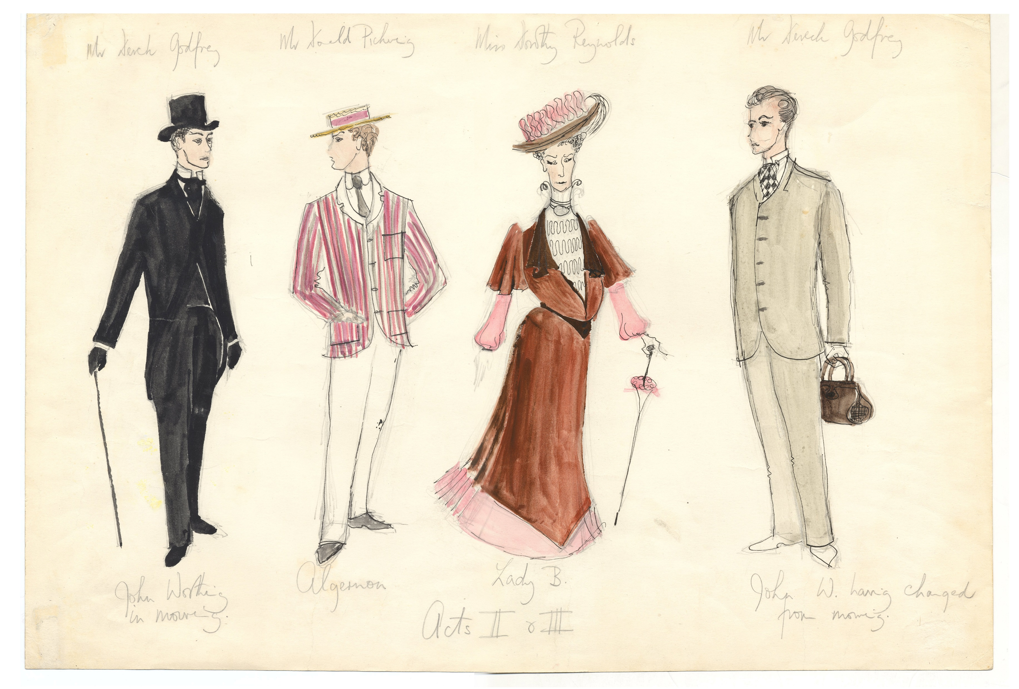
The Irish Presence in the Published Record
Brian Lavoie and Lorcan Dempsey, OCLC
@lorcanD
CONUL Annual Conference. Athlone, Ireland. 30-31 May, 2017
Image from “Costume Design and Photographs for The Importance of Being Earnest, ‘John Worthing’, ‘Algernon Moncrief’, ‘Lady Bracknell’ (Acts II-III)”
Daphne Dare Collection, The Ohio State University Libraries
http://drc.ohiolink.edu/bitstream/handle/2374.OX/58079/SPEC.DD.DES.62.jpg?sequence=12

Slide 2
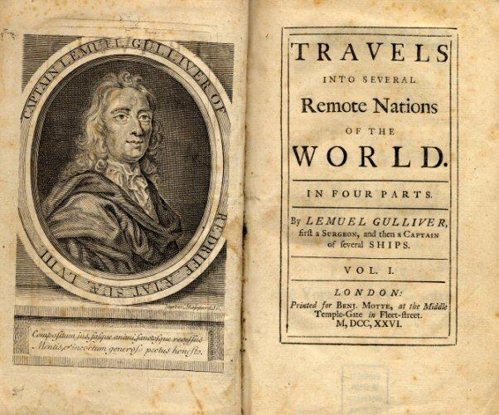
Icebreaker:
Name the most popular* literary work
by an Irish author …
*measured by global library holdings
Gulliver’s Travels,
by Jonathan Swift
2. Dracula (Stoker)
3. The Vicar of Wakefield (Goldsmith)
4. The Picture of Dorian Gray (Wilde)
5. Artemis Fowl (Colfer)

Slide 3
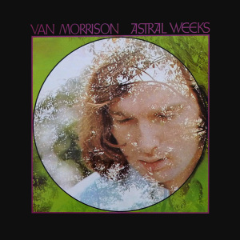
One more:
Name the most popular* musical work
by an Irish artist …
*measured by global library holdings
Astral Weeks,
Van Morrison
2. Watermark (Enya)
3. A Day Without Rain (Enya)
4. Moondance (Van Morrison)
5. How to Dismantle an
Atomic Bomb (U2)

Slide 4
Three premises:
1. Cultural patterns & trends can be discerned by exploring the published record
2. The published record is approximated by the global library collective collection
3. The global collective collection is approximated by WorldCat
March 2017: ~400 million bibliographic records, 2.5 billion holdings

Slide 5
1. We can define a national presence in the
published record:
Materials published in the country
Materials published by people from the country
Materials published about the country
2. With WorldCat, we can operationalize and analyze a national presence
Scotland, New Zealand … and now Ireland

Slide 6
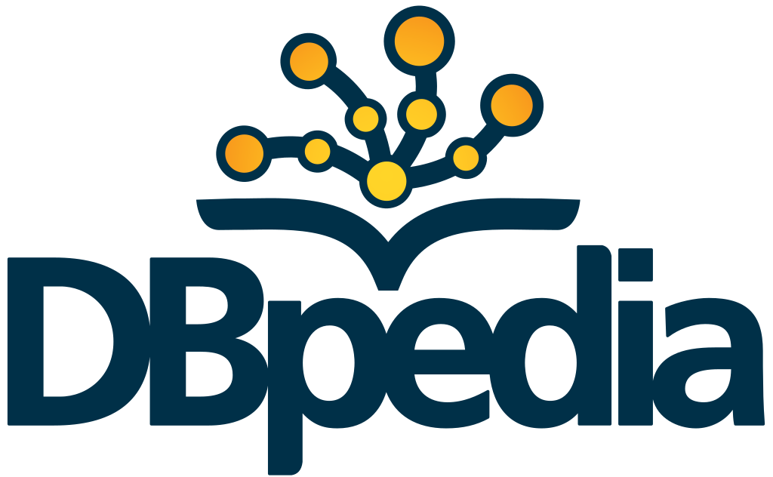
Data sources/caveats/definitions
Findings based on …
July 2016 snapshot
Institutional collections as they are registered in WorldCat
Some limitations in coverage/interpretation of holdings
October 2015 snapshot (English-language Wikipedia)
Used to compile list of Irish authors/creators
Some limitations in coverage/”notability” threshold
Ireland = Island of Ireland
Irish = born in Ireland
(Irish, Northern Irish, Anglo-Irish)

Slide 7
The Irish national presence in the published record
BY:
725,000 publications
(292,000 works)
ABOUT:
659,000 publications
(419,000 works)
1.6 million
distinct publications
900,000
distinct works
IN:
615,000 publications
(416,000 works)

Slide 8
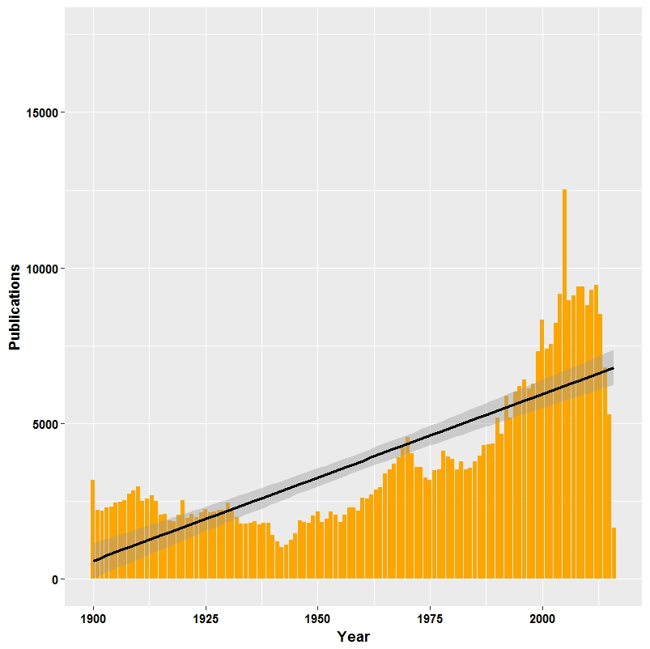
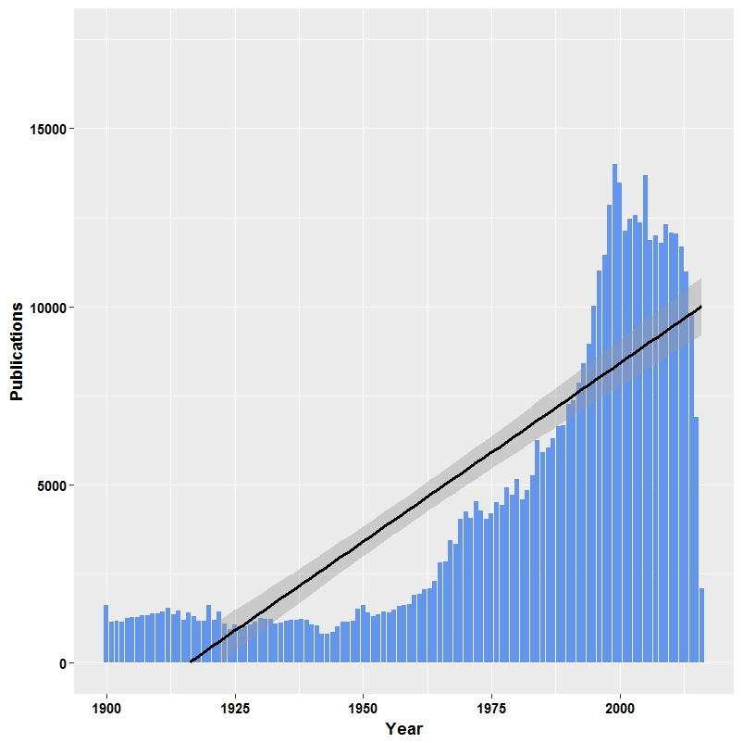
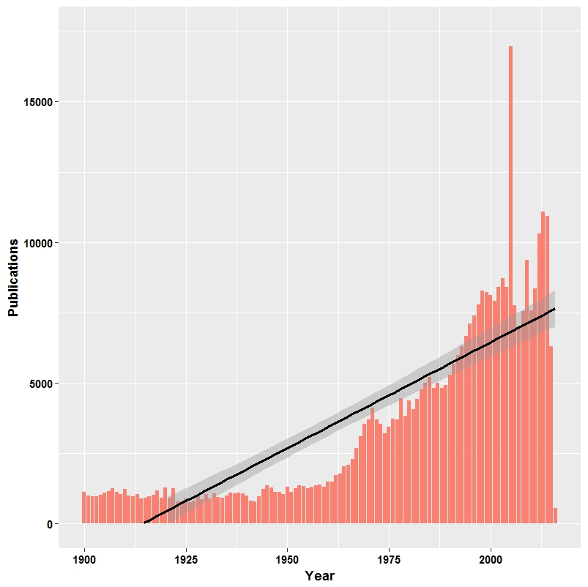
Over time ...
Earliest “take-off”
Fastest growth
BY
ABOUT
IN

Slide 9
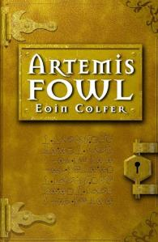
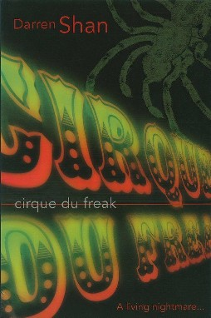
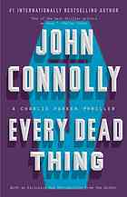
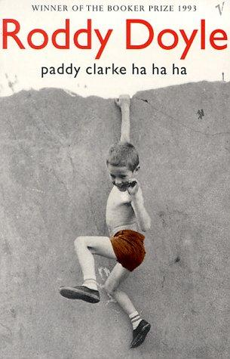
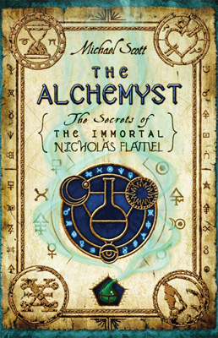
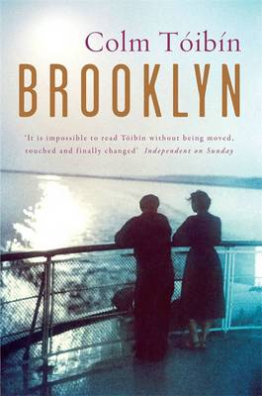
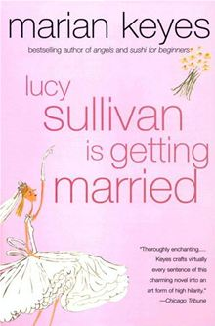
Most popular* contemporary** Irish authors
*measured by global library holdings **born after 1945
1) Eoin Colfer
2) Darren Shan
3) Alister McGrath
4) John Connolly
5) Roddy Doyle
6) Michael Scott
7) Cecelia Ahern
8) Colm Tóibín
9) Marian Keyes
10) Emma Donoghue
Young adult fantasy fiction

Slide 10
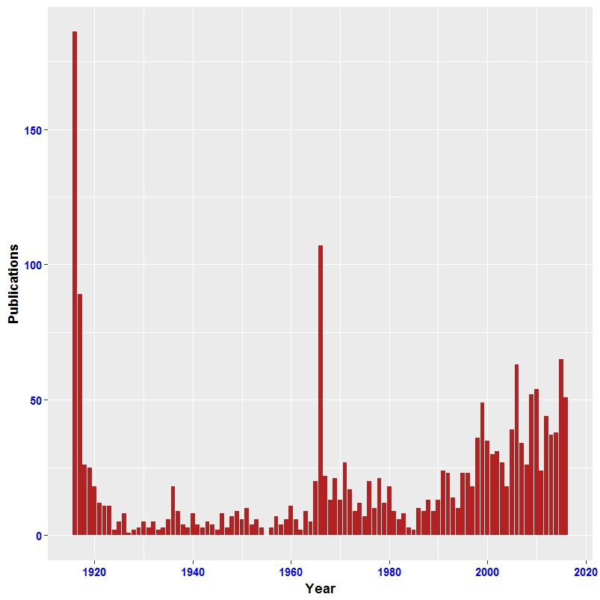
publications about:
“Easter Rising”
1916
1966
50th anniversary
2016 (extrapolated)
100th anniversary
2006
90th anniversary
1936
20th anniversary

Slide 11
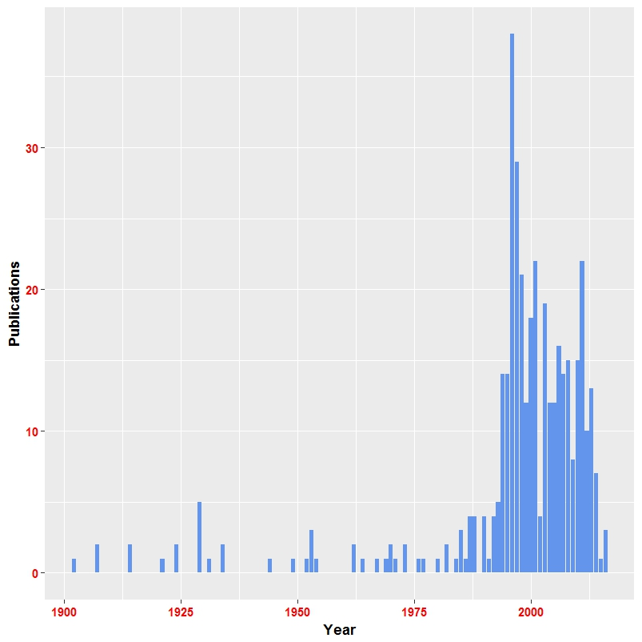
publications about:
“Folk dancing,
Irish”
Lord of the Dance
1996: Stage show opens
Riverdance
1994: Eurovision contest
1995: Stage show opens

Slide 12
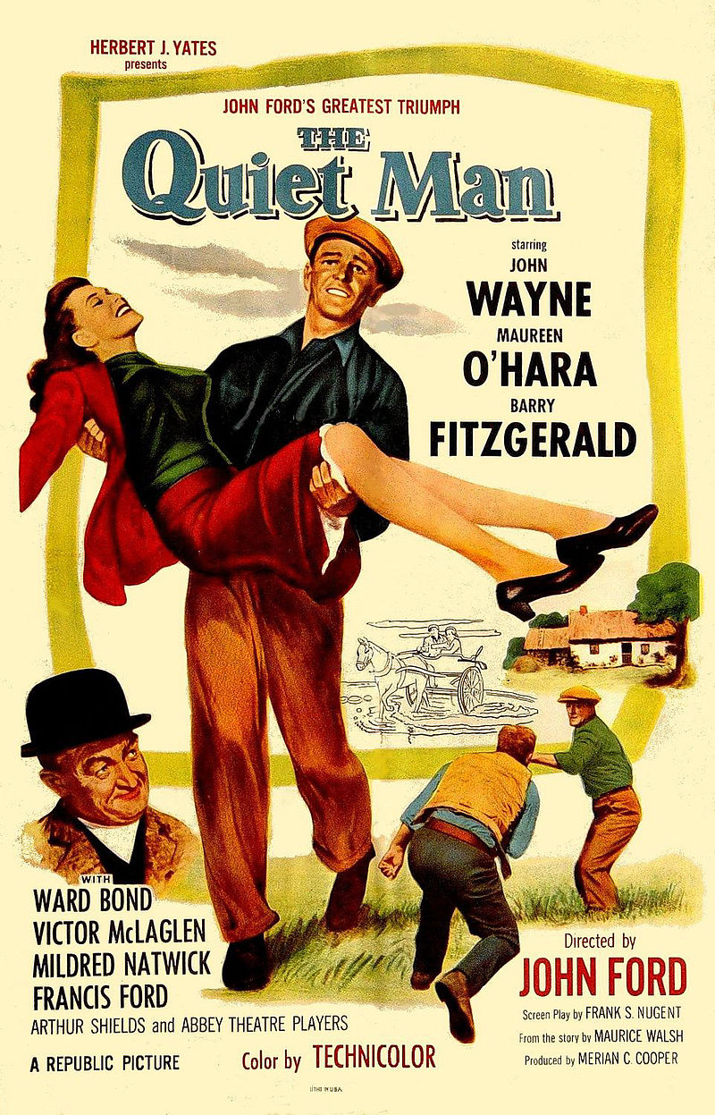
Interlude:
Name the most popular* movie set in
Ireland …
*measured by global library holdings
The Quiet Man
John Wayne, Maureen O’Hara
1952
2. Philomena
3. My Left Foot
4. The Crying Game
5. Once

Slide 13
Top 10 most published Irish authors/creators
(over 5 year period)
George Bernard Shaw
Oliver Goldsmith
Oscar Wilde
James Bryce, 1st Viscount Bryce
W.B. Yeats
L.T. Meade
Jonathan Swift
Charles Lever
Justin McCarthy
Charles Villiers Stanford
[ ]
[ ]
[ ]
[ ]
[ ]
1900-04
1925-29
1950-54
1975-79
2000-04

Slide 14
Top 10 most published Irish authors/creators
(over 5 year period)
George Bernard Shaw
Oscar Wilde
W.B. Yeats
Jonathan Swift
Oliver Goldsmith
George Moore
J.B. Bury
James Joyce
James Stephens
Edward Plunkett, 18th Baron of Dunsany
[ ]
[ ]
[ ]
[ ]
[ ]
1900-04
1925-29
1950-54
1975-79
2000-04

Slide 15
Top 10 most published Irish authors/creators
(over 5 year period)
George Bernard Shaw
Oscar Wilde
Jonathan Swift
Joyce Cary
Jimmy Kennedy
James Joyce
W.B. Yeats
Cecil Day-Lewis
Elizabeth Bowen
Oliver Goldsmith
[ ]
[ ]
[ ]
[ ]
[ ]
1900-04
1925-29
1950-54
1975-79
2000-04

Slide 16
Top 10 most published Irish authors/creators
(over 5 year period)
James Joyce
Samuel Beckett
George Bernard Shaw
Oscar Wilde
Jonathan Swift
Iris Murdoch
W.B. Yeats
James Galway
Sheridan Le Fanu
Norma Burrowes
[ ]
[ ]
[ ]
[ ]
[ ]
1900-04
1925-29
1950-54
1975-79
2000-04

Slide 17
Top 10 most published Irish authors/creators
(over 5 year period)
Oscar Wilde
Maeve Binchy
George Bernard Shaw
Jonathan Swift
Samuel Beckett
Eoin Colfer
James Joyce
W.B. Yeats
Bram Stoker
Marian Keyes
[ ]
[ ]
[ ]
[ ]
[ ]
1900-04
1925-29
1950-54
1975-79
2000-04

Slide 18
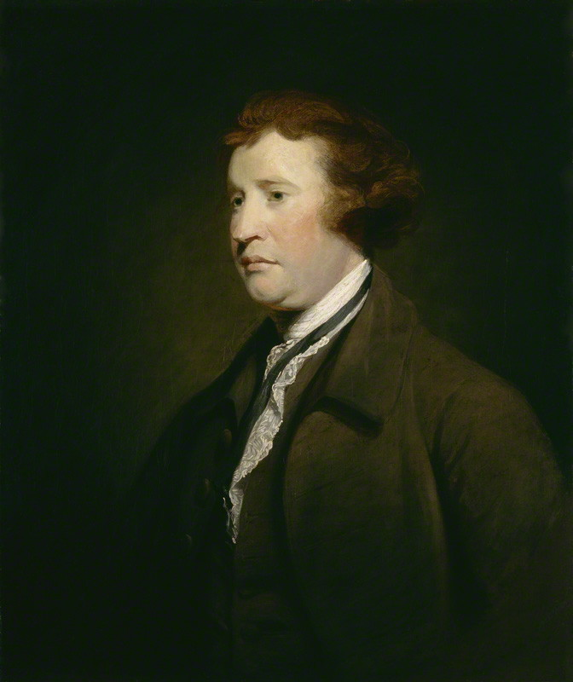
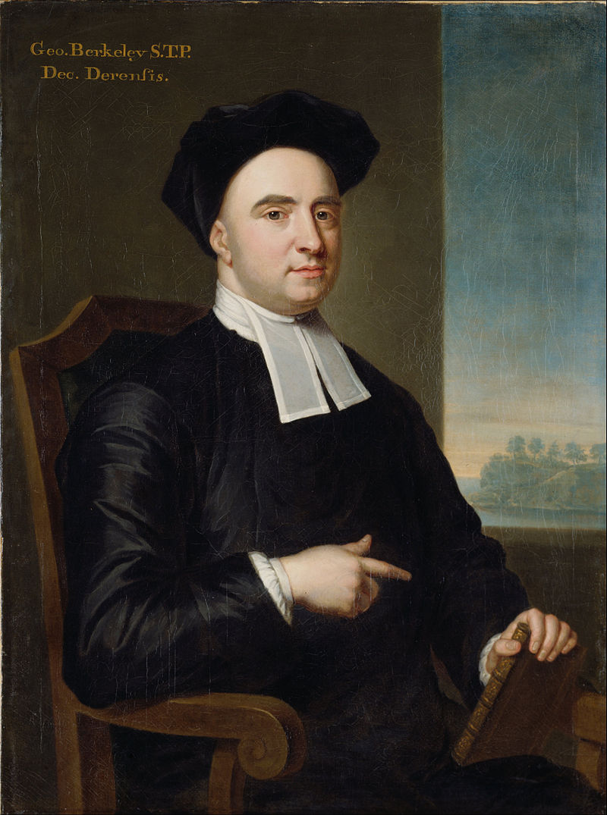
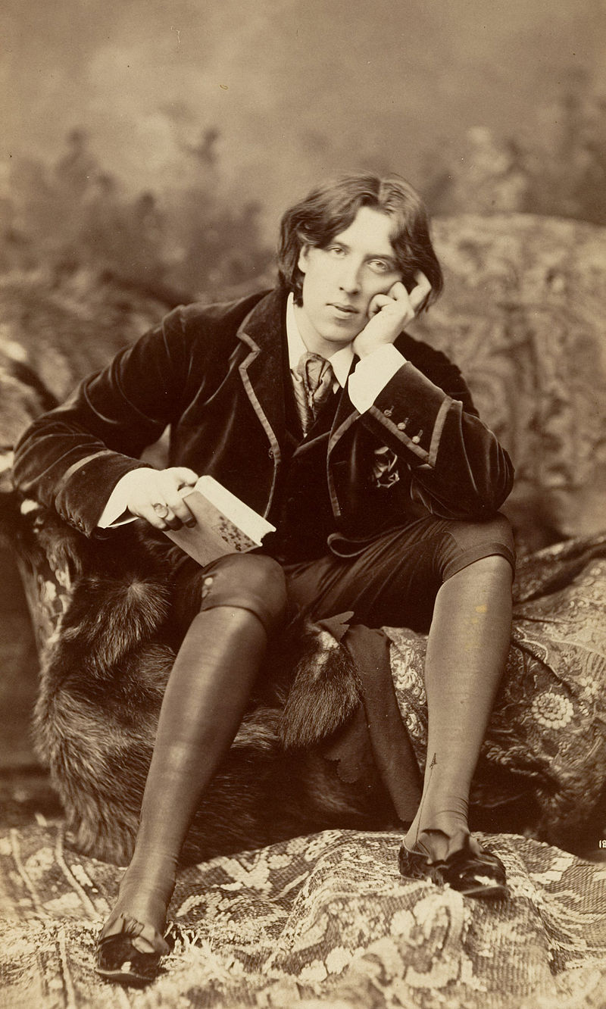
Most popular* non-fiction works by Irish authors
*measured by global library holdings
Reflections on the Revolution
in France
(Edmund Burke)
A Philosophical Enquiry into the
Origin of Our Ideas of the Sublime
and Beautiful
(Edmund Burke)
Three Dialogues between Hylas and Philonous
(George Berkeley)
A Treatise Concerning the Principles of Human
Knowledge
(George Berkeley)
De Profundis
(Oscar Wilde)

Slide 19
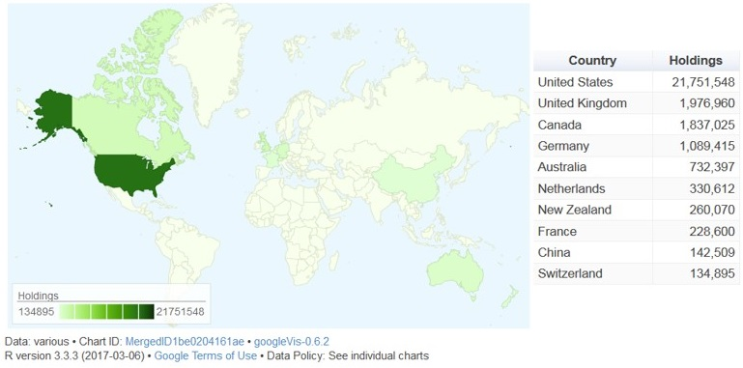
Beyond Ireland … Global diffusion* of the
Irish presence in the published record
*total holdings of Irish materials, by country (top 10);
total publications, non-English language

Slide 20
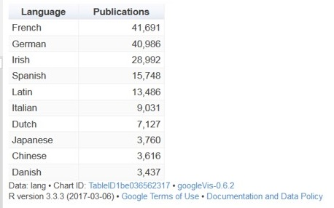
Beyond Ireland … Global diffusion* of the
Irish presence in the published record
*total holdings of Irish materials, by country (top 10);
total publications, non-English language

Slide 21
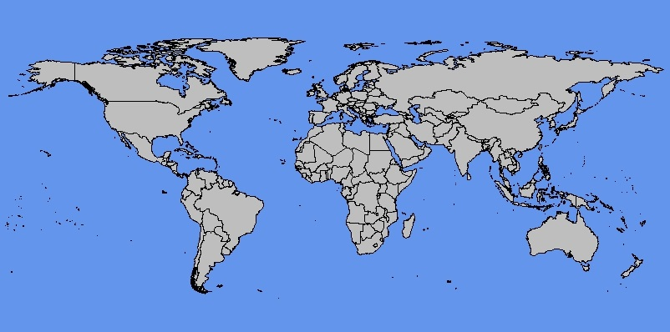
Top 10 largest institutional concentrations*
of Irish materials
*by OCLC symbol, national libraries excluded
Trinity
Univ. Coll. Dublin
McGill U.
Univ. Coll. Cork
Oxford
NY Public
Cambridge
Cornell
Michigan
Yale

Slide 22
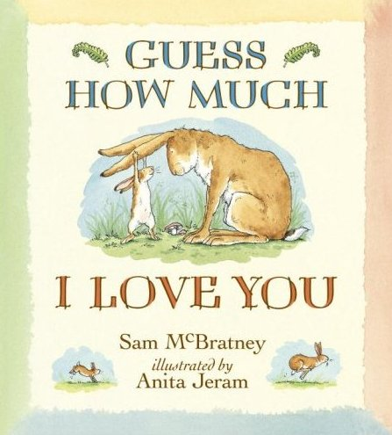
Last question:
Name the classic picture book, written
by a Northern Irish author, that was a
1996 ALA Notable Children’s Book …
Guess How Much I Love You?
Sam McBratney

Slide 23
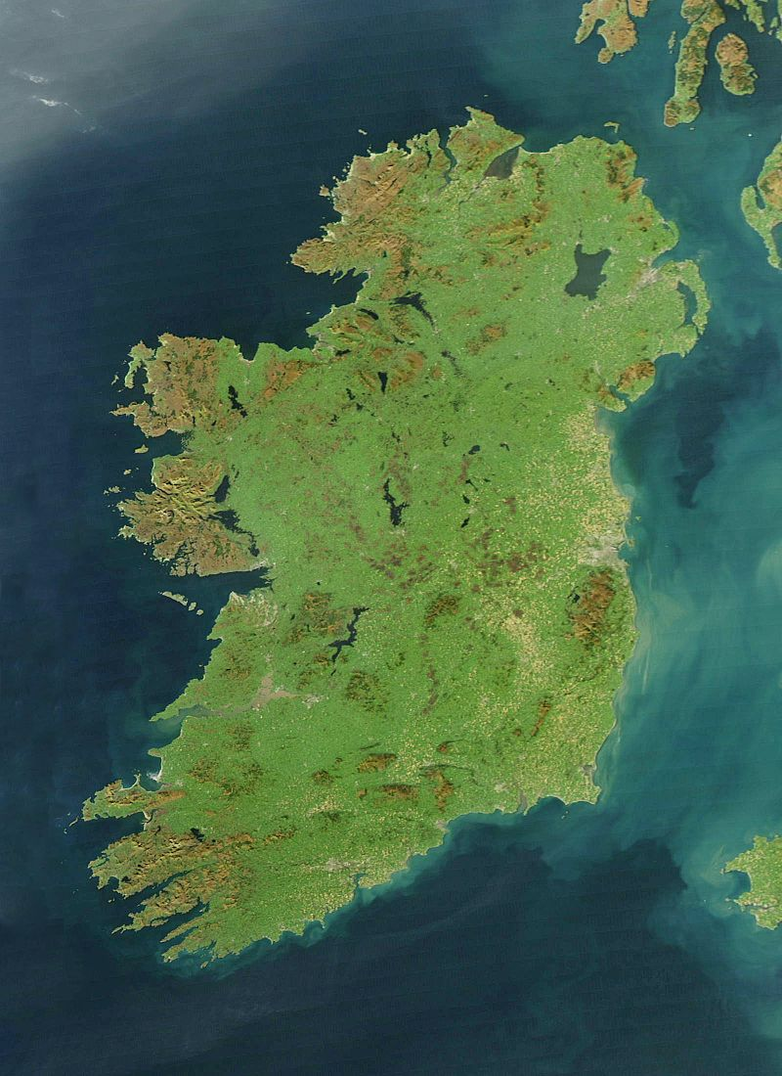
A distant reading of the Irish presence
in the published record …
Fantasy fiction & Irish family life are key topics for today’s Irish authors
Quantifiable:
1.6m distinct publications
900k distinct works
Strong interest in Ireland reflected in rapid growth in materials about Ireland
Top destinations for the diffusion of Irish materials include countries in North America, Europe, Asia/Pacific
Publication patterns reveal emerging interest in Irish-related events & aspects of Irish culture
7 of 10 top concentrations of Irish materials are outside Ireland
Classic Irish authors endure (e.g. Shaw, Wilde) alongside dynamic patterns of interest in contemporary authors
Encapsulated in & distributed across library collections worldwide

Slide 24
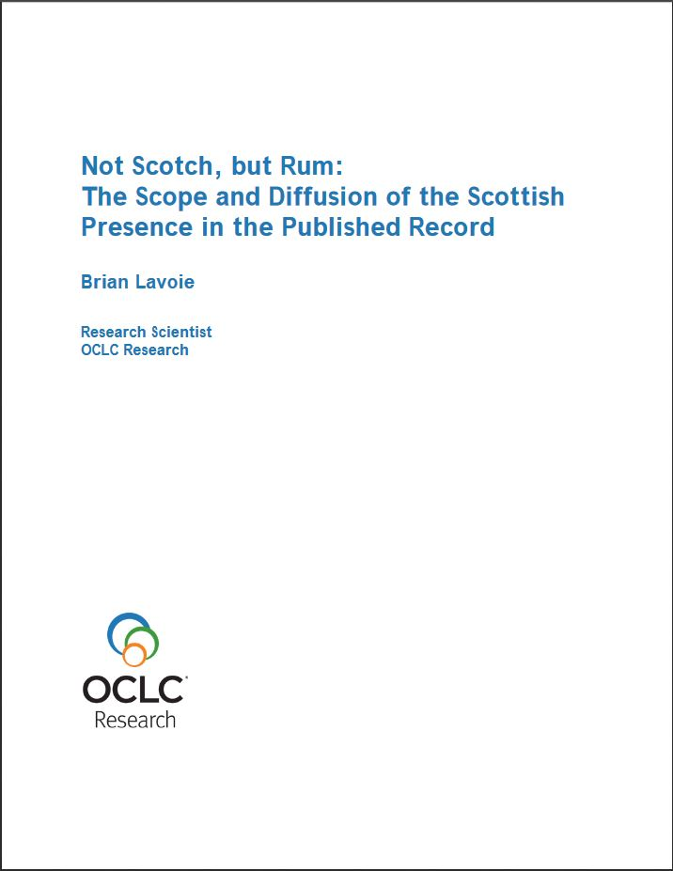
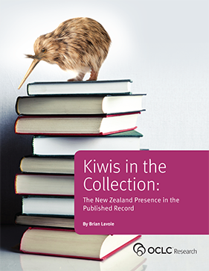
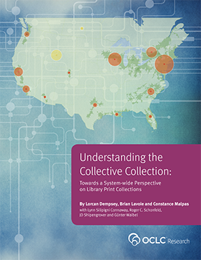
With thanks for advice & consultation …
Aedin Clements (University of Notre Dame); Joanna Finegan (National Library of Ireland); Anne Ray (JSTOR); Mark Tynan (University College Dublin); Deirdre Wildy (Queen's University Belfast); Kathleen Williams (Boston College); Ger Wilson (National Library of Ireland); Nicholas Wolf (New York University)
Ireland
… forthcoming
…
More information on OCLC Research collective collections work:
Understanding the Collective Collection
http://www.oclc.org/research/publications/library/2013/2013-09r.html

Slide 25
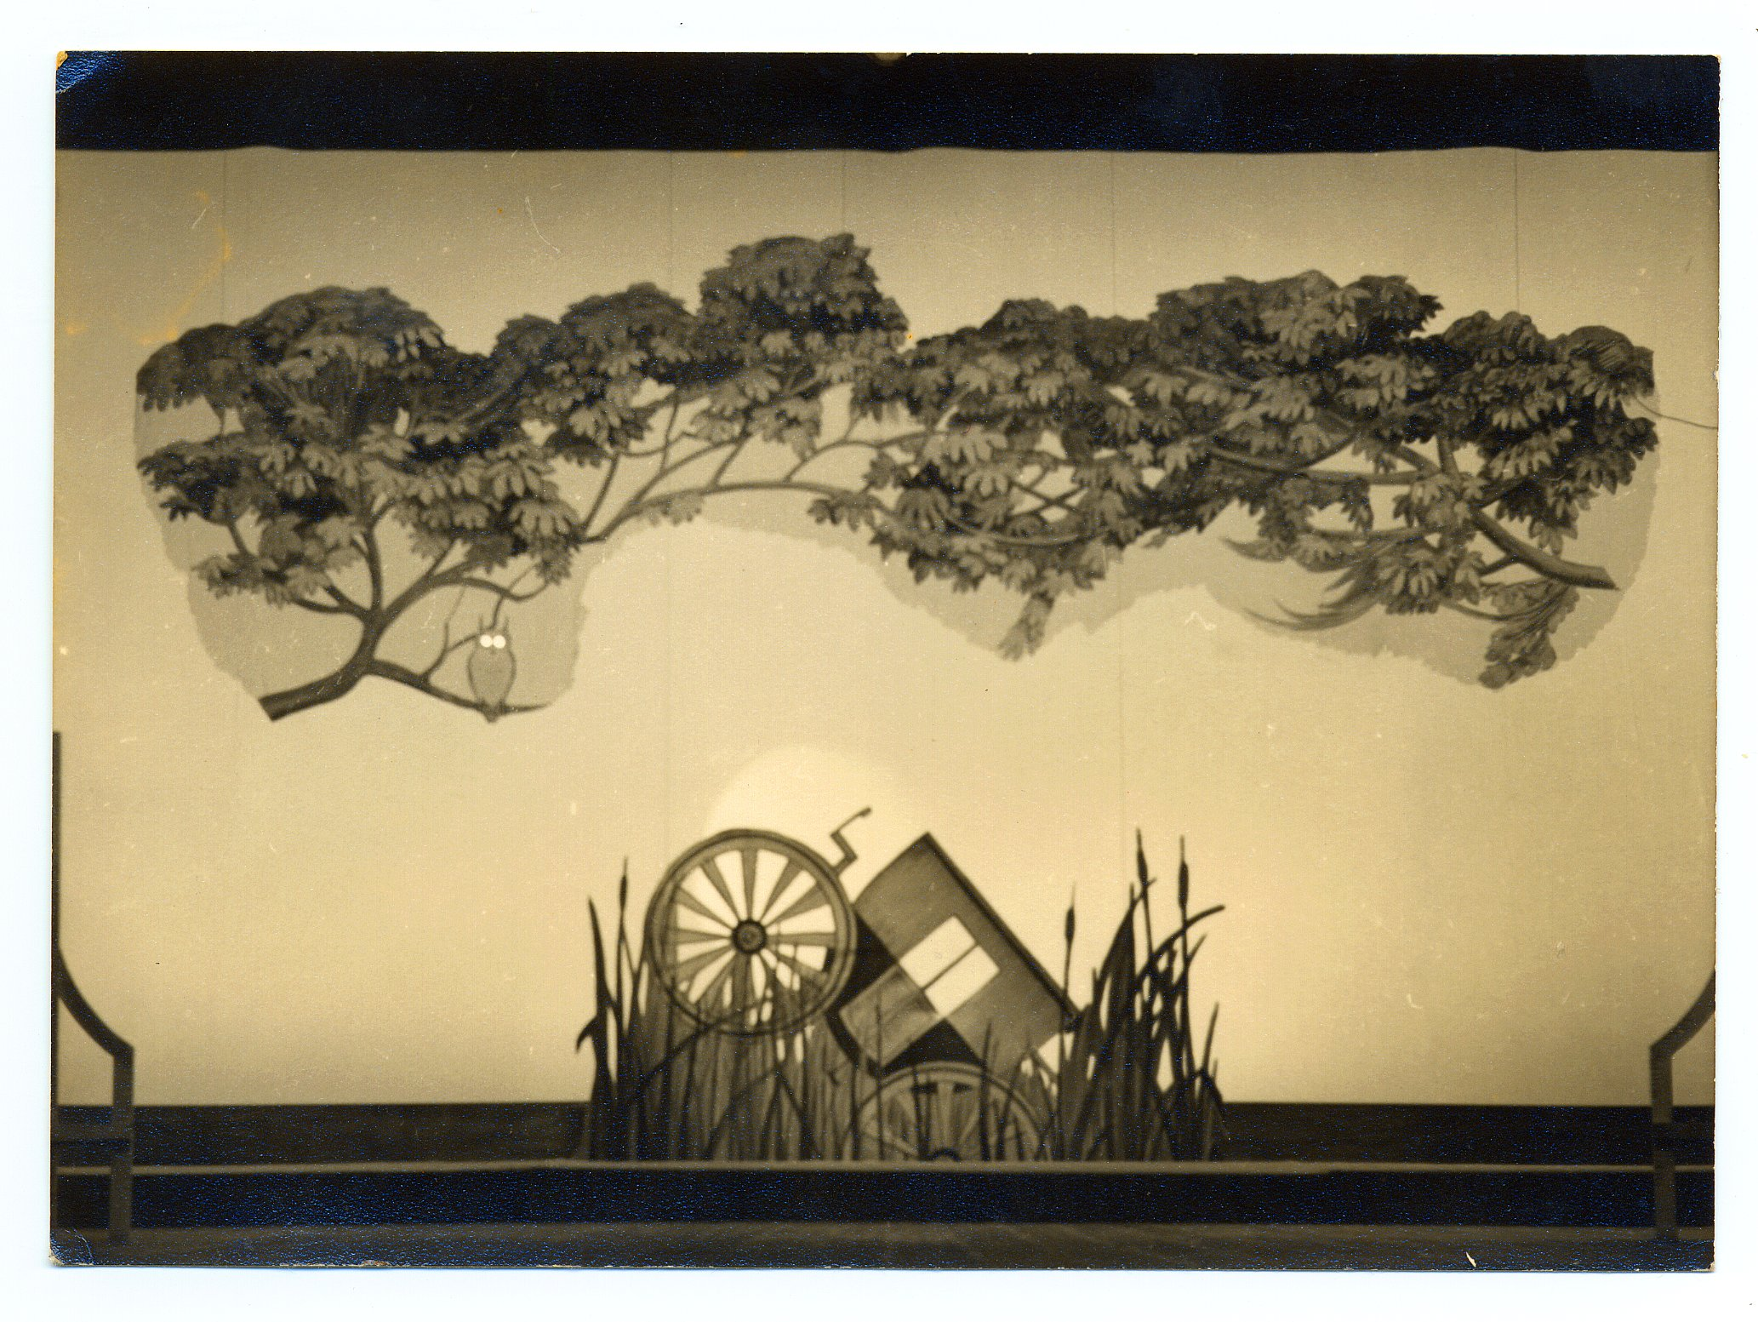
@lorcanD
Thank you …
Brian Lavoie & Lorcan Dempsey, OCLC
Image from: “Photographs for She Stoops to Conquer”
Daphne Dare Collection, The Ohio State University Libraries
https://drc.ohiolink.edu/bitstream/handle/2374.OX/58392/SPEC.DD.DES.931-g.jpg?sequence=8

