Slide 1
VIAF Data in Wikipedia & Wikidata
Maximilian Klein
Wikipedian in Residence at OCLC
25th February 2013

Slide 2
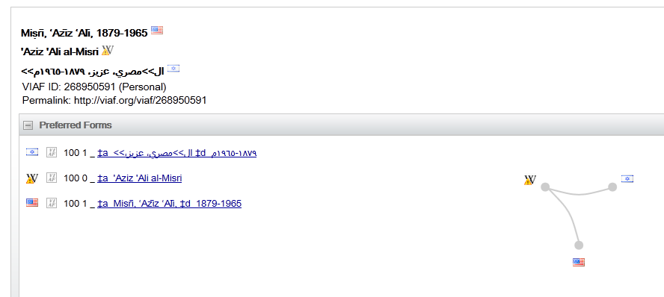
Example VIAF Structure
Wikipedia

Slide 3
Example VIAF Structure
http://en.wikipedia.org/wiki/%27Aziz_%27Ali_al-Misri

Slide 4
One Direction
VIAF
English Wiki

Slide 5
Enter VIAFBot: Wikipedia Robot
VIAF
English Wiki

Slide 6
Idea: Reciprocate
VIAF
English Wiki

Slide 7
But, Deutsche Wiki has done part of this manually
VIAF
Deutsche Wiki

Slide 8
Verify where English – Deutsche agree
English
VIAF
Deutsche

Slide 9
& without Deutsche infromation
English
VIAF
Deutsche

Slide 10
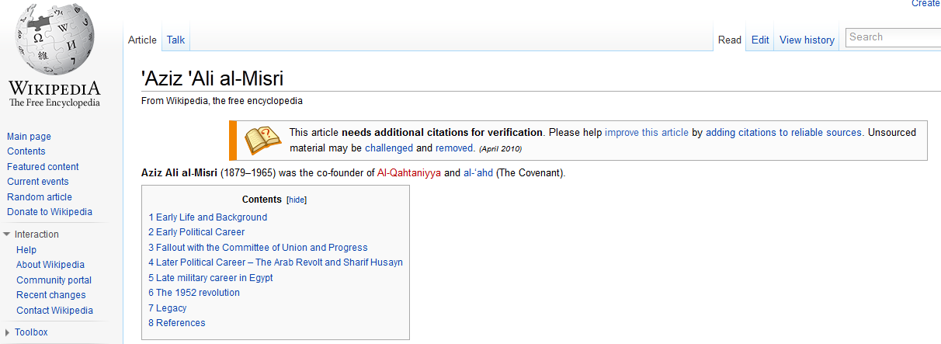
Final Product
.
.
.

Slide 11
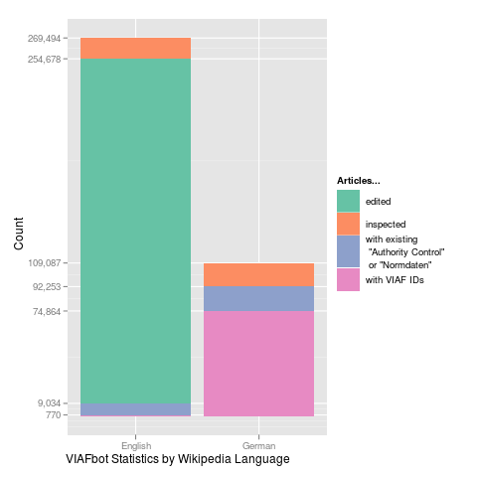
Statistics
Conflicts
14,816
Modified
269,494

Slide 12
Statistics
Full report at
hangingtogether.org

Slide 13
How precise is the Algorithm?
~99% (From random sampling)
But not perfect

Slide 14
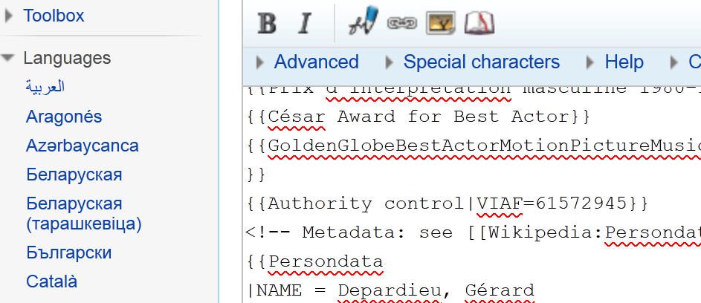
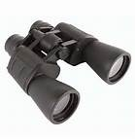
VIAF is watching
VIAF

Slide 15
Fixing links
If a human ameliorates Wikipeda
VIAF.org watches the change,
and VIAF incorporates the corrected data.

Slide 16
Other Wikipedias
French Wikipedia?
All other Wikipedias?

Slide 17
Information Virus
1 month after VIAFBot
User:Jarekt copies VIAFbot’s links into
Wikimedia Commons
Italiano Wikipedia

Slide 18
Copying is a “Hack”
Wikidata was created to resolve this elegantly

Slide 19
What is Wikidata?
Wikidata item is a collection of Wikipedia articles
En
En
WD
De
De
Fr
Fr

Slide 20
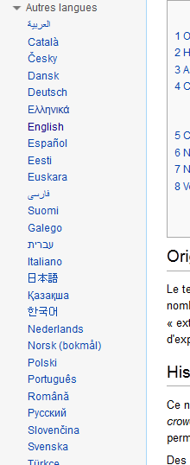
What will not change
Language links will look same

Slide 21
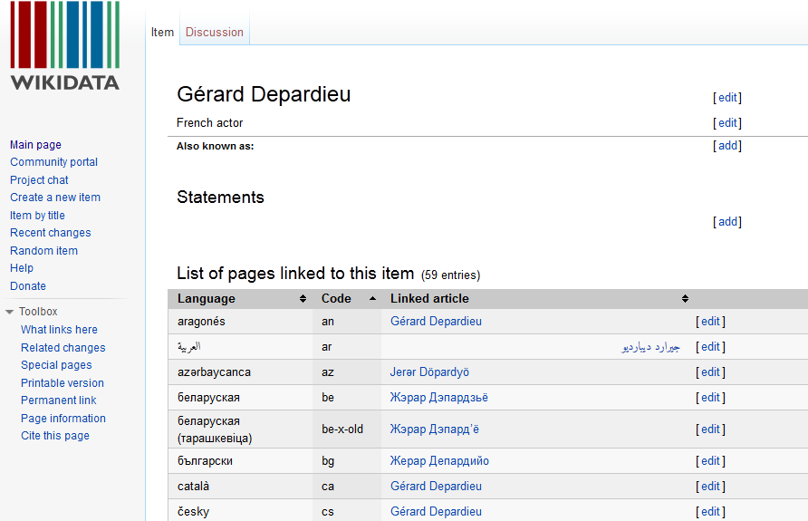
But you can edit centrally

Slide 22
New: Declarations
Semantic triple

Slide 23
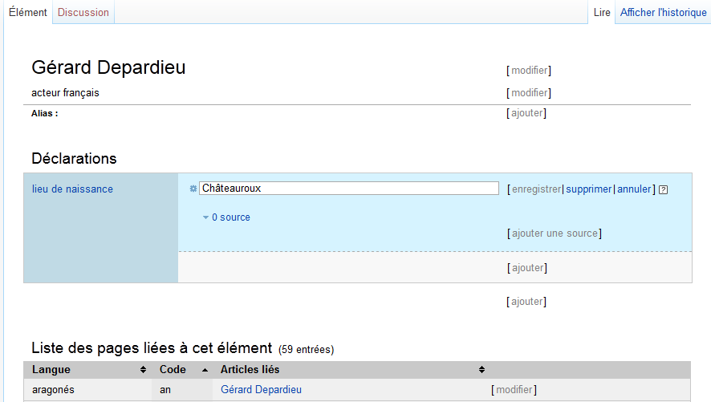
New: Declarations

Slide 24
New: Declarations
Property
Value

Slide 25
Inclusion Syntax
In Wikitext write
{{ propriété:lieu de naissance}}

Slide 26
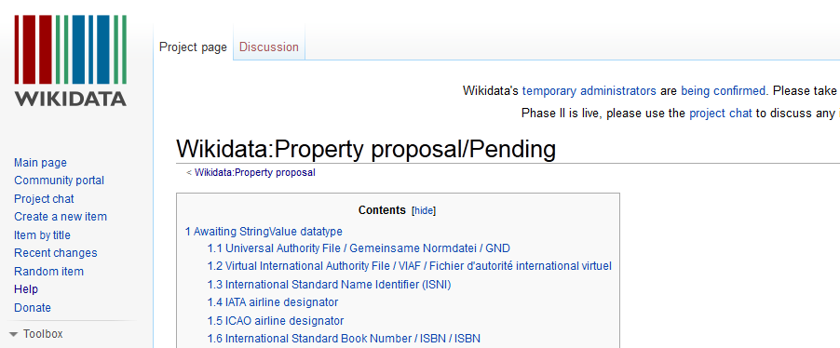
Surprise! VIAF Wikidata Property Approved

Slide 27
Wikidata VIAFbot
Very soon.

Slide 28
VIAF Data in Wikipedia & Wikidata
Maximilian Klein
Wikipedian in Residence at OCLC
25th February 2013
@notconfusing

