Slide 1
Cooperative Authority Control: Virtual International Authority File (VIAF)
Thomas Hickey
Chief Scientist
2013 December 4
NISO/DCMI Webinar
Notes:
I’ve been involved in VIAF for more than 10 years, at first leading the implementation, then later the project, and more recently helping transition it to production
Need to thank Ted Fons, Executive Director in charge of many things, including VIAF, some of whose slides I’ve borrowed

Slide 2
Outline
Background and Philosophy
Visible VIAF
Challenges
New directions
Relationship with other identifiers
Coping with ambiguity
Notes:
And I’ve got a couple of other topics we could cover, depending on the time.

Slide 3
Why do we like authorities?
1. To enable a person to find a book of which either
(A) the author
(B) the title
(C) the subject
2. To show what the library has
(D) by a given author
(E) on a given subject
(F) in a given kind of literature
3. To assist in the choice of a book
(G) as to its edition (bibliographically)
(H) as to its character (literary or topical)
is known.
Charles A. Cutter: Rules for a printed dictionary catalog, 1876
Notes:
Why? Why to make our catalogs work! To collocate things together.
These were put forth when librarians had little more than ink and paper, when card catalogs were a new technology, but the basic principles remain valid (possibly with some modification of what is meant by ‘the library’)
Of course, the world is changing and different trends push catalogs in slightly different directions, but I think it will always be desirable to be able to tell what an author has written and be able to understand relationships between various expressions of a work

Slide 4
What do authority files control?
Names!
Persons
Corporations
Places
Uniform Titles
Families
Trademarks
Concepts
Notes:
The only thing here out of scope for VIAF is ‘concepts’’, although I don’t think we have and trademarks yet.

Slide 5
But we also control
Collective authors
Pseudonyms
Imaginary characters
Deities, saints, angels
Whales, horses, dinosaurs
Buildings
Ships, telescopes, space ships, missiles
Kings, Popes, Presidents
Cities, lakes, mountains
Notes:
Carolyn Keene, author of Nancy Drew books is an example of a collective author
VIAF is mainly people, corporations, jurisdictional geographics, works and expressions
With the RDA related changes for moving fictional characters into names file in NACO VIAF can expect to get many more of these classes

Slide 6
A changing world
Libraries
Local library
Library consortia
National cooperation
Within languages
Global
Technology
Handwritten
Typed
Printed
Online
Pervasive
EVERYBODY WANTS
TO CHANGE THE WORLD
BUT NOBODY WANTS
TO CHANGE
Notes:
Change is hard!
Parts of our collections have become more remote. When compared to Web pages, even our digitized material can seem hard to access. The catalog are, if anything, have become more important, even if the catalog the user encounters is part of Google. Remote access to many things, including our catalogs has not just be come instant, but available anywhere.
VIAF is part of making libraries work at the global level

Slide 7
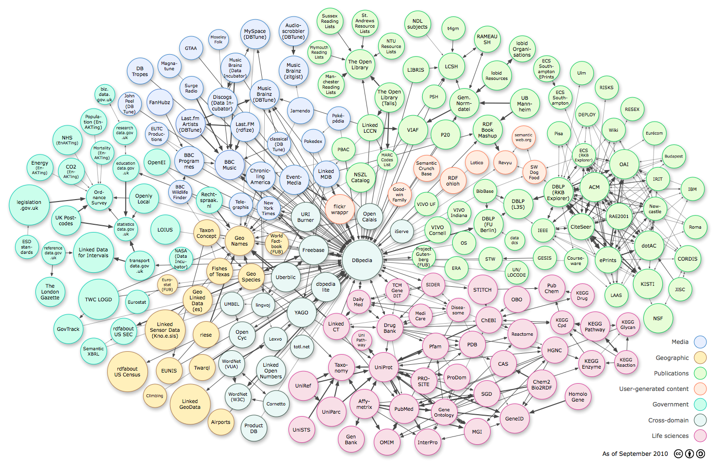
A world of linked data
http://www.w3.org/DesignIssues/diagrams/lod/2010-color.png
Notes:
You’ve probably seen this. This was done some 3 years ago and would –much- bigger now. Libraries are not a big part of it, but at least we are in it.

Slide 8
Notes:
VIAF supported linked data early, so it made the chart, but linked data is all about clear links and libraries have more to contribute to this than is usually recognized.

Slide 9
Challenges to libraries
Reflect these links in our catalogs
RDA
Link to external resources
Have non-library resources link to us
Promote our links
Be integrated in our users workflow
Notes:
At OCLC we call promoting our links ‘syndication’

Slide 10
Library data is
Trusted
Understood
Reasonably interoperable
Complex
Within the community, linked data of limited help
Notes:
We do have some advantages Trust, etc.
Within the community, ‘linked data’ of limited help. We already have mechanisms, although they could be used to a greater extent. If we want to share metadata, however, out traditional approaches do not work well

Slide 11
Shareable metadata
Public
Simple
Supply data rather than APIs
Avoid idiosyncratic protocols
Z39.50
MARC-21
ISO2709
Notes:
It needs to be shareable between communities, which is a real challenge. Lately OCLC has been working with Schema.org

Slide 12
Brief history of VIAF
VIAF Council holds 1st meeting (Helsinki)
VIAF
Proof-of-concept project launched
After considering multiple options, consensus to transition VIAF to an OCLC service
VIAF
Consortium formed
(Berlin)
BnF
joins
1998
2003
2007
2011
2012
Library of Congress
Die Deutsche Bibliothek
OCLC Research
4 Principals
+
18 Contributors
in
18 countries
VIAF
becomes an
OCLC service
Notes:
Virtual International Authority File history: http://www.oclc.org/viaf/history.en.html

Slide 13
VIAF’s Goals
Reduce cost of authority control
Increase the utility of library authority files
Provide links between equivalent names
Make the information Web friendly
Open API
Bulk downloads
Open Linked Data

Slide 14
Applications
FRBR matching
Better matching of non-English metadata
Uniform identifier across all languages
Authority control for cataloging
Better regionalization of catalogs
Minimize differences across languages of cataloging
More intelligent linking and searching

Slide 15
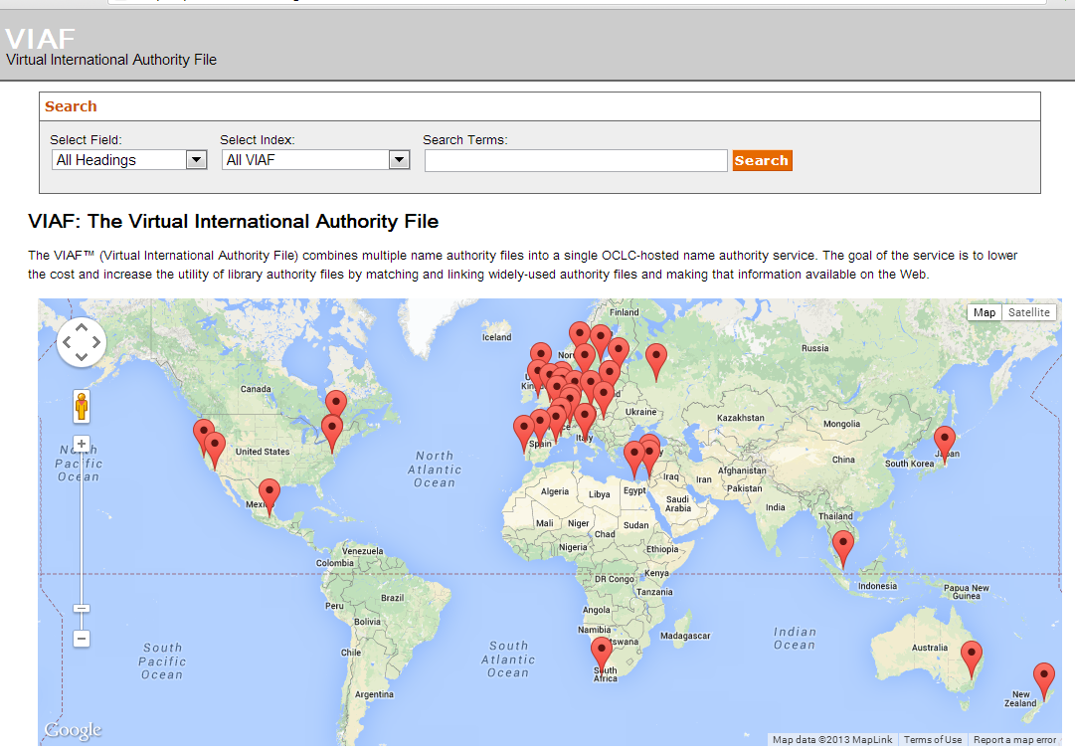
Notes:
Contributors:
34 Agencies
28 Countries
23 National libraries
+10 via consortia
15 Agencies joined in 2012-1013

Slide 16
VIAF authority record counts
Notes:
In addition to ~ 34 million authorities, also process ~107 million bibliographic records to find titles of resources, coauthors, publication dates, publishers, etc.

Slide 17
Web interface and usage
Notes:
98% of VIAF access is viaf the API, but the Web browser/HTML presence is still important

Slide 18
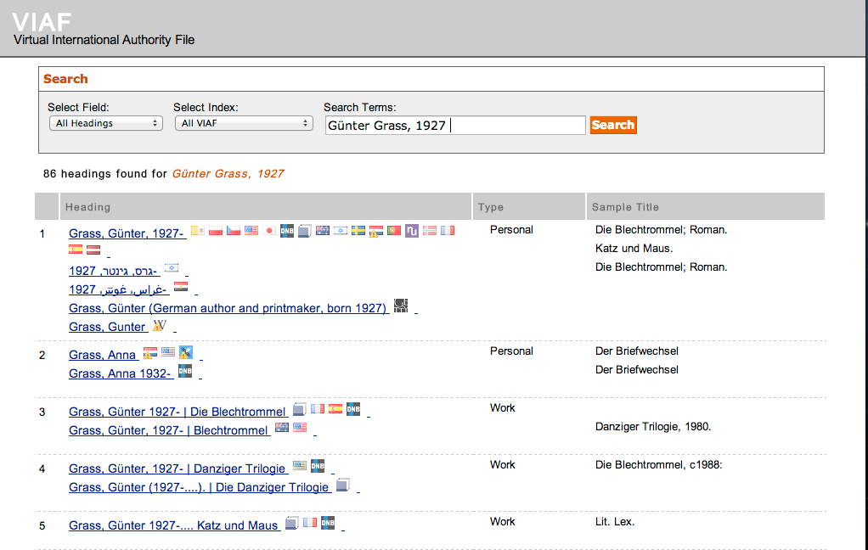

Slide 19
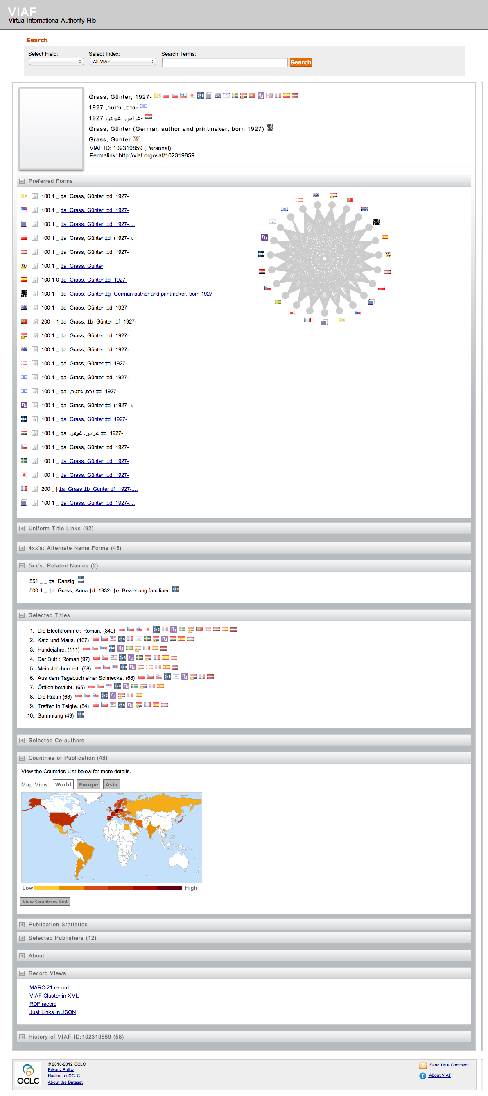

Slide 21
VIAF Use
Notes:
Here is a typical late morning view of VIAF through Google Analytics. ~ 50-60 users
We get quite a bit of use from S. America even thought we don’t have a source coming from there. Asian use is growing, but comes in at a different time of day.

Slide 22
Usage
Browser usage for past year
953,020 visitors
1,531,493
5,448,910 pages
API usage
Went from 90% of usage to 98%
Peaks at ~20/second
~ 5 million searches/week
Downloads
~150/week for links, 150 for clusters
Notes:
After doubling and tripling each year, we are seeing modest growth in browser usage
5 million searches/week is 8/second 24 hours a day
Links file is ~350 Mbytes, cluster files ~6 Gbytes

Slide 23
Notes:
Some use from all over

Slide 24
Notes:
Nearly 2/3 from Europe (again this is browser use) Germany and France vie for most usage, although Switzerland might have highest per capita use

Slide 25
Building VIAF
Notes:
Just a little bit about how the VIAF database is build

Slide 26
Enhancing authorities
Bibliographic
Record
Derived
Authority
Authority
Record
Processed
Authority
Notes:
For every personal name used in either a 100 or a 700 field, a derived authority record is created. In addition to the name, the derived authority record includes a coded summary of the material published. A bibliographic record with multiple personal names will generate multiple derived authority records.
In the bibliographic data we find co-authors, publishers, publication dates, titles, identifiers such as ISBNs and LCCNs to put into the derived authority records
All of the derived authority records for a particular person will be clustered with the authority record for the individual.
The contents of the all the derived authority records for the name are added to form the processed authority record.

Slide 27
Record Flow
SWNL Bib & Authority
BnF Bib & Authority
LC Bib & Authority
VIAF
37 million authority records
30 million links between authorities
Notes:
~110 million bibliographic records also processed
Processing done in batch on our 41-node (300+ core) cluster. After data is ingested, we can regenerate the database overnight. Same computation on a single processor would take 1200 hours, or nearly two months.
Actually redo all the matching each month. Gives us flexibility at the cost of more computation.
Have a public test site (http://test.viaf.org) for pre-releases of the database/indexing/interface, etc.
If we have time I will talk about our disambiguation process that handles conflicts in the data

Slide 28
Machine access to VIAF
Notes:
As mentioned, well over 95% of VIAF’s access is non-browser
Lots of ‘bots harvesting, plus people pulling information into other applications

Slide 29
Background
VIAF is available in bulk downloads
All online interaction with VIAF is RESTful
Using SRU
http://www.loc.gov/standards/sru/
http://www.oclc.org/developer/documentation/virtual-international-authority-file-viaf/using-api

Slide 30
Bulk downloads
Go to http://viaf.org/viaf/data
Variety of formats
Just links
RDF (XML and N-Triples)
MARC-21
Native XML clusters
Notes:
If you are going to look at a lot of records it can be faster to pull the whole file down.
Updated monthly
Exactly what VIAF runs from

Slide 31
SRU
Search/Retrieve via URLs
http://viaf.org/viaf/search?query=dempsey
http://viaf.org/viaf/search?query=local.names+all+dempsey&sortKeys=holdingscount
http://viaf.org/viaf/search?query=local.names+all+cervantes+and+local.sources+any+%22bnc+bne%22&sortKeys=holdingscount
Notes:
The last restricts the search to the BNE (National Library of Spain). We also have an abbreviation for all of Spain that includes the National Library of Catalonia.

Slide 32
SRU Tricks
RSS feed
http://viaf.org/viaf/search?query=dempsey&http:accept=application/rss%2bxml
Exact with truncation
http://viaf.org/viaf/search?query=local.names+exact+%22cervantes*%22&sortKeys=holdingscount

Slide 33
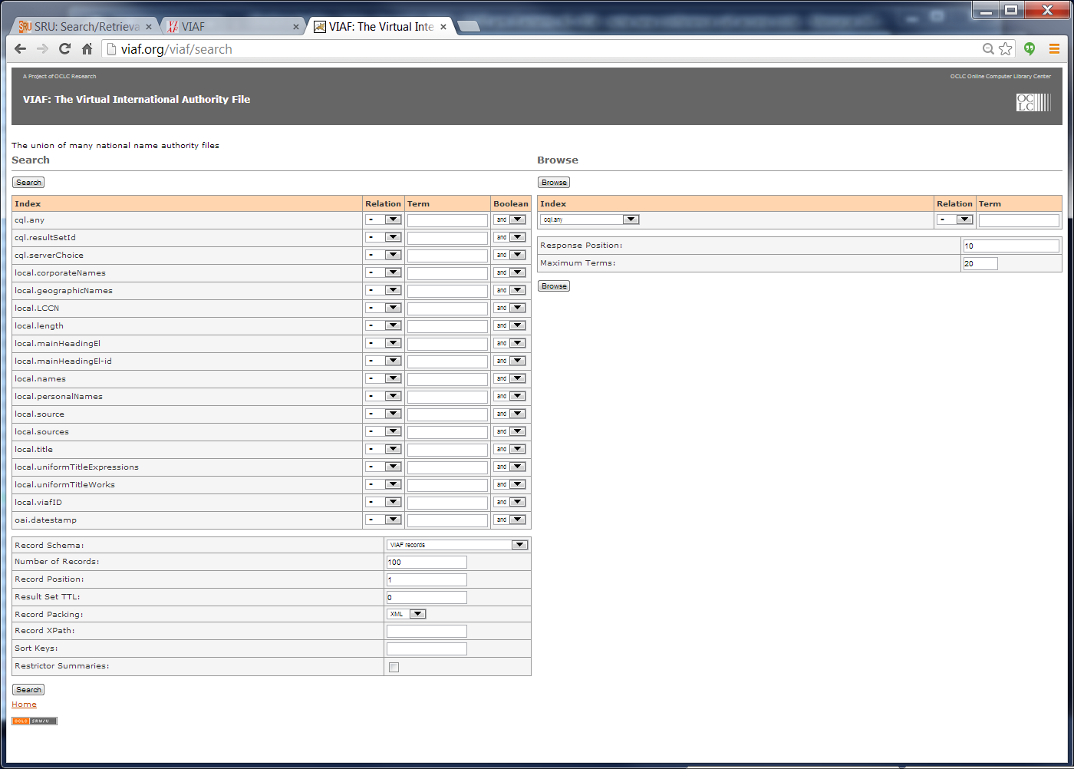
http://viaf.org/viaf/search
Notes:
Shows all the indexes, how to browse
All URL based REST services

Slide 34
URL Patterns
http://viaf.org/viaf/95216565
http://viaf.org/viaf/sourceID/BNF%7C11926133
http://viaf.org/viaf/sourceID/LC%7Cn++79130807
http://viaf.org/viaf/95216565/viaf.xml
http://viaf.org/viaf/95216565/justlinks.json
http://viaf.org/viaf/95216565/marc21.xml
http://viaf.org/viaf/95216565/rdf.xml

Slide 35
New Directions for VIAF
Non-library sources
Information from WorldCat
Integration with WorldCat

Slide 36
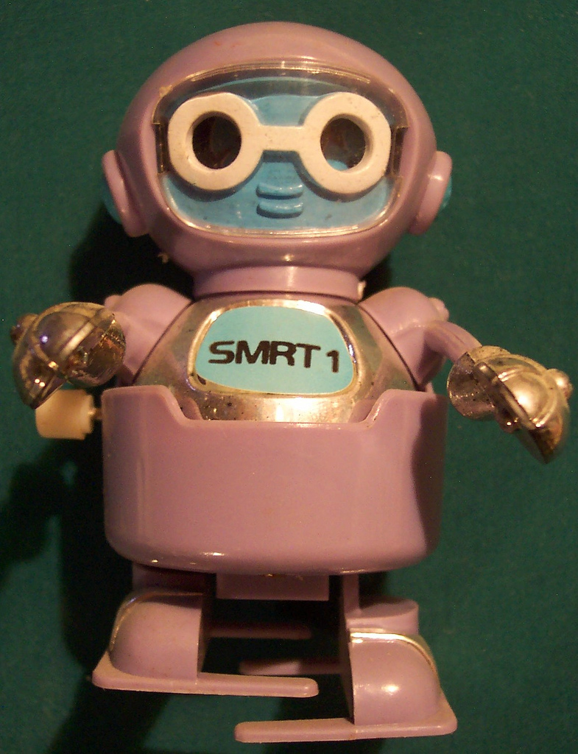
VIAFbot – The Wikipedia Connection
OCLC Wikipedian in residence Max Klein
Automatic comparison of VIAF and Wikipedia references
Initially English then German
Now working with WikiData
VIAFbot
http://www.flickr.com/photos/vintagehalloweencollector/480856825/
Notes:
Wikipedia. Relatively small (300K) names, but big impact on usefulness of VIAF
First step was to harvest the English Wikipedia, find names, match them to VIAF and add Wikipedia links
Then Max (after much discussion with Wikipedians) pushed VIAF IDs into the English version (with reference to the German which had many VIAF links)
We then made Wikipedia a ‘source’ to VIAF so that its information can affect VIAF clustering
VIAF data then pushed into WikiData
Making VIAF links available to all language editions of Wikipedia
Eventually we expect to work directly with Wikidata

Slide 37
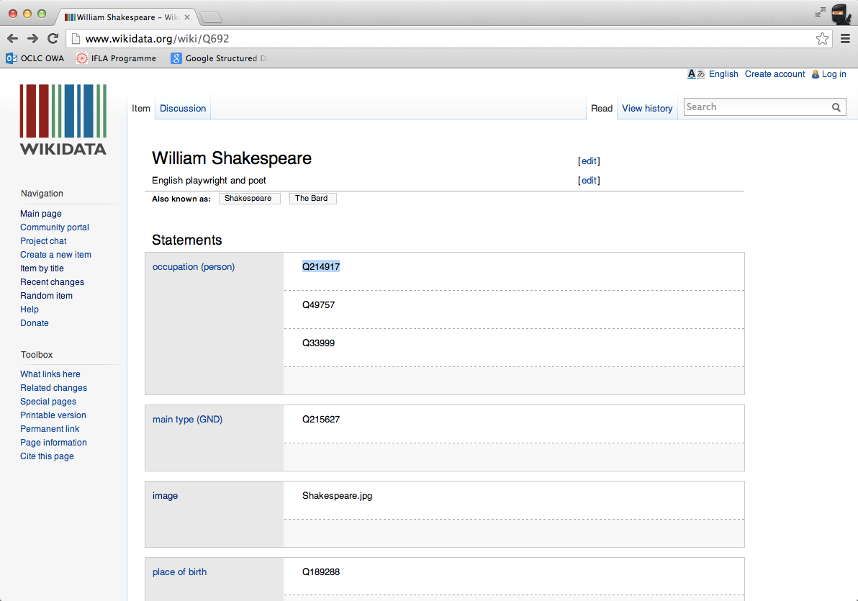
WikiData

Slide 38
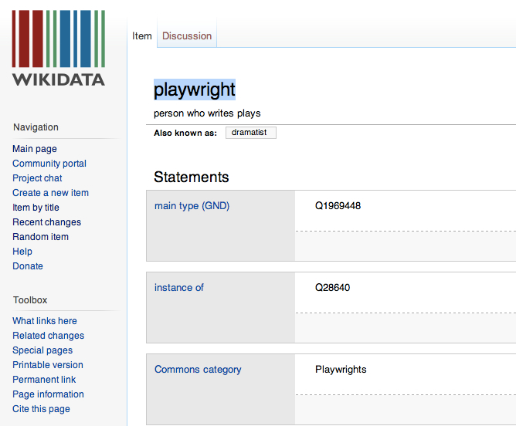
WikiData

Slide 39
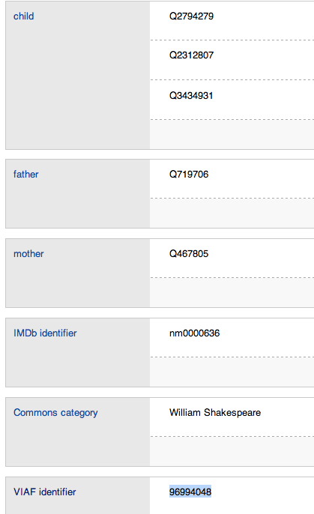
WikiData

Slide 40
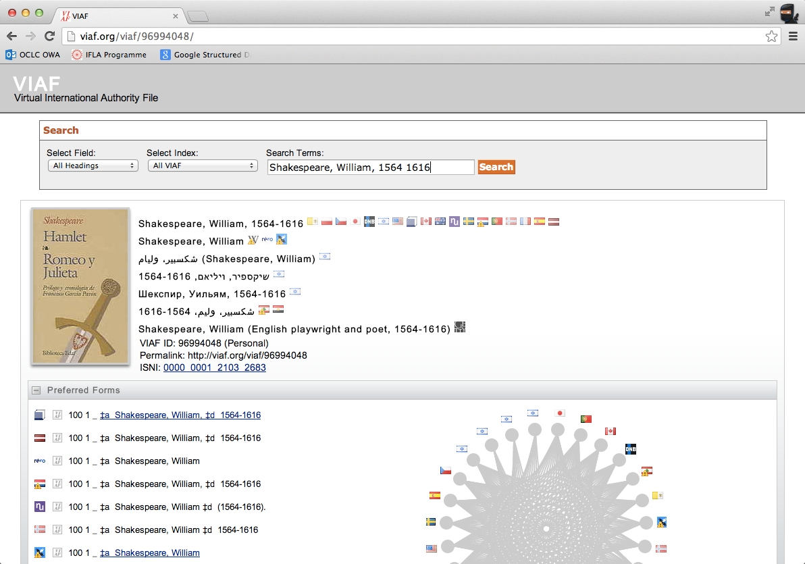
WikiData

Slide 41
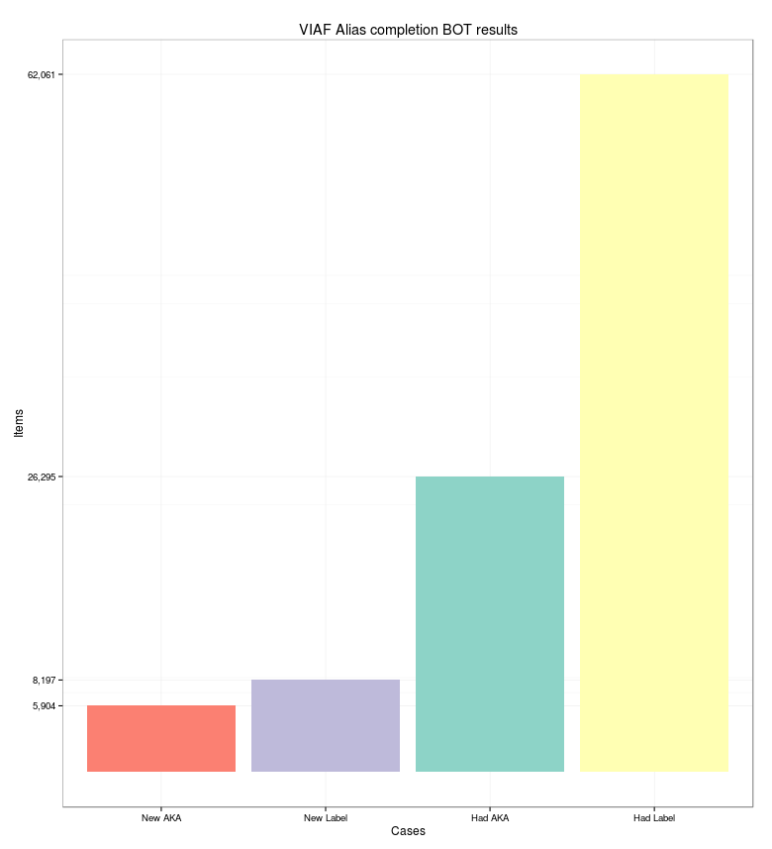
VIAF↔Wikidata Linking Benefits
14,000+
New labels/aliases added
VIAF Enhancing Wikipedia language coverage

Slide 42
VIAF – in the Web of Bibliographic Data
sameAs
http://www.wikidata.org/wiki/Q238514
Nawal El Saadawi
author
VIAF
http://viaf.org/viaf/84254254/
Nawal El Saadawi
sameAs
Worldcat.org/oclc/81453459
The Hidden Face of Eve
about
sameAs
http://isni-url.oclc.nl/isni/0000000120296695
Nawal El Saadawi
http://id.loc.gov/authorities/subjects/sh85120576
The Sex customs

Slide 43
Other non-library sources
ISNI
International Standard Name Identifier
Perseus Digital Library
Syriac project names
Fihirst Arabic names
Notes:
Just add Perseus to VIAF
Syriac is an old middle-eastern language still in use
Fihirst is an Oxford-Cambridge project to control ancient Arabic names
VIAF was the ‘seed’ database to help get ISNI started. We continue to exchange data

Slide 44
Information from WorldCat
Notes:
VIAF has long pulled some of its bibliographic records out of WorldCat, but until now we have not ‘mined’ WorldCat to otherwise enrich VIAF

Slide 45
Multilingual Bibliographic Structure Project
Majority of WorldCat about non-English works
Much of the metadata is non-English
Hybrid records
Parallel records
FRBR work-level algorithm plus GLIMIR manifestation/expression level
Identify 3 levels of FRBR
Can’t we do something with these?
Notes:
Janifer Gatenby’s vision has become a cross-divisional project at OCLC

Slide 46
Approach
Process at work-level when possible
Extract most reliable information
Use that to extract less reliable
Find
Languages, original language
Translators
Titles (by language)

Slide 47
Benefits
Localize metadata to various languages
Easier cataloging
Better cataloging
Merge
Fix
Better displays to fit the user
Linking of translations
Appropriate language
Use all appropriate data!
Better FRBR groupings
Notes:
Should be able to fix many missing/wrong language assignments
http://www.slideshare.net/JaniferGatenby/multilingual-presentation-ifla-2013-0819

Slide 48
Records for VIAF
Translated works
Work and expression records
More information about
Languages
Translators
Better links between work/expression records
Notes:
Should greatly expand VIAF’s coverage of important works and expressions

Slide 49
Other possibilities
Variant forms of names
More titles
Coauthors
FAST subject headings
Notes:
There is lots of information in WorldCat that would enhance VIAF displays
PAUSE HERE FOR QUESTIONS? Next slide is Identifier Relationships

Slide 50
Identifier relationships
Notes:
VIAF is in a somewhat crowded field. There are at least two other major international identifier systems under development: ISNI and ORCID. OCLC is involved with both

Slide 51
ISNI International Standard Name Identifier
Draft ISO standard:
… aspires to provide a means to uniquely identify creators, including authors, composers, artists, cartographers and performers, among others. Such an authoritative identifier will serve to provide a link for occurrences of the identity across databases on the web
Driven by rights-holders
Publishers
Rights agencies representing authors, artists
Active disambiguation program
Notes:
Wants to provide an identifier for all sorts of creators to form a link across databases on the web

Slide 52
Started with Thomson-Reuter’s Researcher ID
Most ‘social’
Claiming IDs
Interactive verification of associated works
Pulling together several current initiatives
Driven by STM, university communities
Primarily interested in researchers
Large number of participants
Mostly concerned with present and future names
Notes:
ORCID may offer the best chance for institutional repositories to quickly get an ID for use in their systems. You can expect to see ORCIDs on published material soon

Slide 53
Cooperation Challenges
What data can be shared?
How to fund the efforts?
Established by different types of institutions:
Libraries, Standards Organization, STM Publishers
Different
Technologies
Time scales
What does the name represent?
People, personas, organizations
Who is in charge?
Notes:
Historical reasons, including differing policies and procedures in different communities
Who creates the names? Who can update and maintain them?
Who is in charge? Who sets priorities, resolves issues, sets standards?
Systems
Organization, revenue
Not just between the projects themselves, but also challenges in cooperation within the projects. We have worked through some of these issues in VIAF.
Person: Eleanor Marie Robertson
Personas: Nora Roberts, J.D. Robb, Jill March, Sarah Hardesty

Slide 54
Commonalities
All centered in not-for-profits
All interested in data exchange
All interested in global systems
All have an understanding of the problem
Personal author disambiguation and identification
Central to their operations
Notes:
But all three of the projects have a striking number of important things in common and I’m optimistic about cooperation
ANOTHER PAUSE? Next slide starts Coping with Ambiguity

Slide 55
Coping with Ambiguity
1,520 headings found for smith, john
Notes:
Even if we look for clusters with the exact name ‘smith, john’ we find 67 of them, and 824 for ‘smith, john*’

Slide 56
The problem
Two names in single source for same identity
Mixed identities
Different granularity
Pseudonyms
Presidents, Kings
Chains of matches
VIAF has ~ ½ million ambiguous groups

Slide 57
Goal
99+% sure of pair-wise assertions
Includes all pairs of records in resulting clusters
Notes:
Even though the NL of Australia and Royal L of the Netherlands are not directly connected, VIAF is claiming a link there and those need to be 99+ % correct

Slide 58
Another common issue

Slide 59
Harvest and ingest
Coping with
Duplicate identifiers
Deletes

Slide 60
Matching Authorities to Bibs
Sometimes identifier
Often ambiguity with just names
Multiple possibilities
May mix and identity

Slide 61
Cross references within sources
Strings can be ambiguous
Links not necessarily resolvable

Slide 62
Enhance the authority records
Pull information from bibs, authority notes
Cope with
Mistagged fields
Ambiguous dates
Errors in pulling titles, etc.

Slide 63
Pair-wise matching between sources
Two dozen types of matches
Ranked by reliability/strength
Major problems
Missing information
Mixed identities
Can override the matching
xA

Slide 64
Duplicates within sources
Rely primarily on
String similarity
Complexity of the preferred form
Also look for multiple links from other sources
Lonely names

Slide 65
Pulling together groups
Only keep strongest links between records in different sources
A record in source A may match several records in source B
E.g. keep a double-date match over a coauthor match

Slide 66
Generate coherent clusters
Look for cliques
Merge subgraphs
Strength of the best link between the pair
Number of links between the pair
A metric based on
Strength of the match
Title closeness
Node type (corporate, personal, etc.)
Name closeness
Whether the nodes are personal names or not

Slide 67
Coherent clusters
Avoid
Date conflicts
Incompatible names
Names that are cross references to each other
Names that differ only in a number
Notes:
Incompatible names, e.g. Name and Name’s spirit
Names with number: John V vs. John VI

Slide 68
Assign VIAF IDs
Minimize moves of source records
Redirect unused VIAF IDs if possible

Slide 69
Create links between clusters
Cross references
Uniform titles
Coauthors
Other bibliographic titles
In general, link only if not ambiguity
Notes:
Always

Slide 70
Lonely names
Notes:
Just starting to look at these
ISNI has concept of unique names
Sometimes these get more complicated with multiple records from one or more sources
NEXT SLIDE IS THE END!

