Slide 1
VIAF Update
T. Hickey, OCLC
Chief Scientist
Strasbourg 2013-02-25

Slide 2
Virtual International Authority File
Merge of 27+ national level authority files
34 million authority records
103 million bibliographic records
23 million merged clusters
Personal, corporate, geographic, works and expressions
Updated monthly
Open license, bulk downloads

Slide 3
Example
Louis Pasteur
Professor of Chemistry at the University of Strasbourg, in 1848
Notes:
Married the rector’s daughter in 1849
3 of 5 children died of typhoid, which inspired his work on diseases

Slide 4
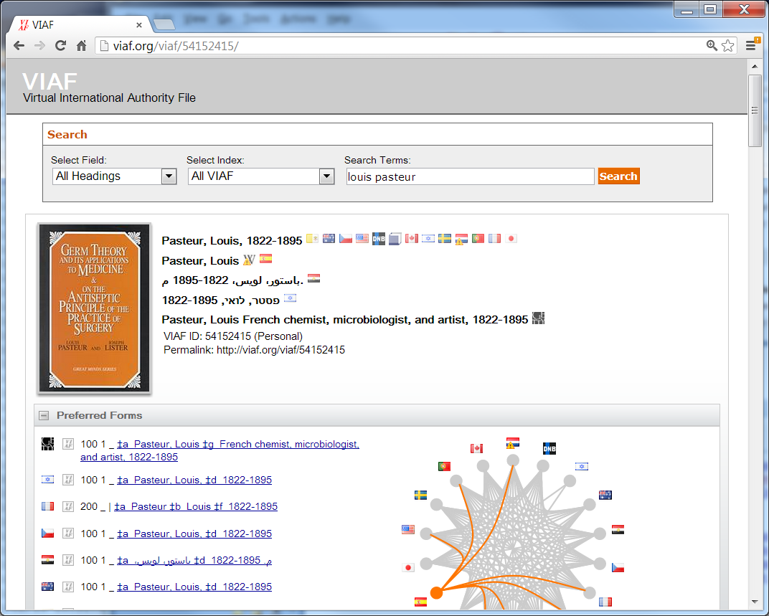

Slide 5
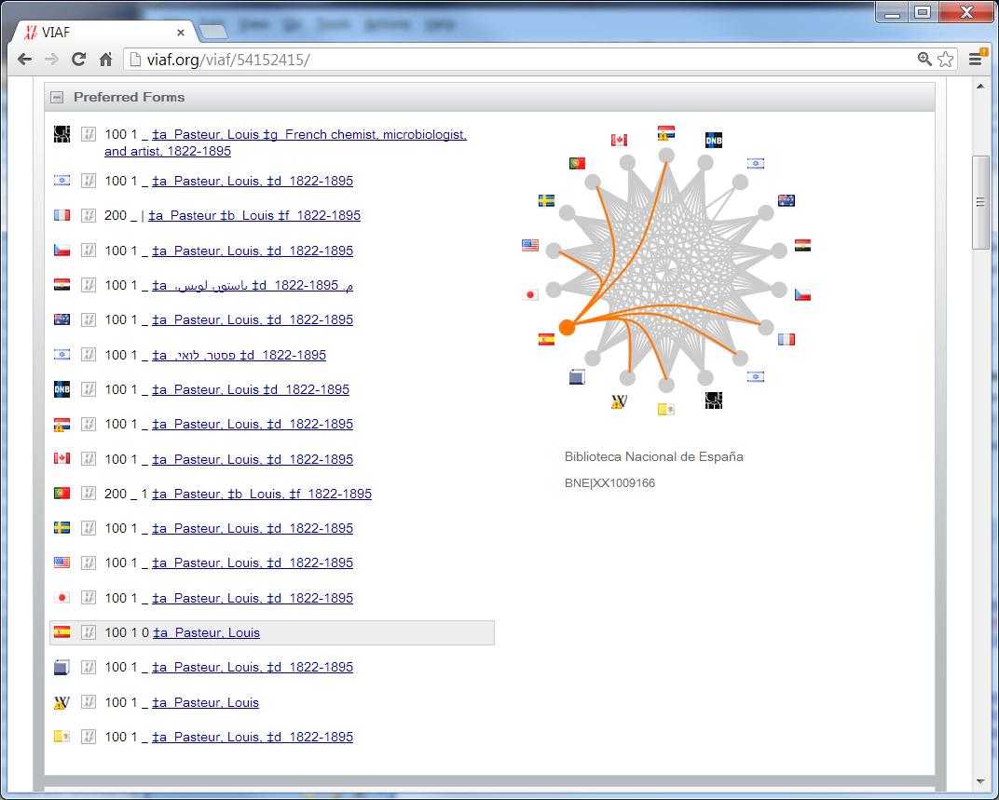

Slide 6
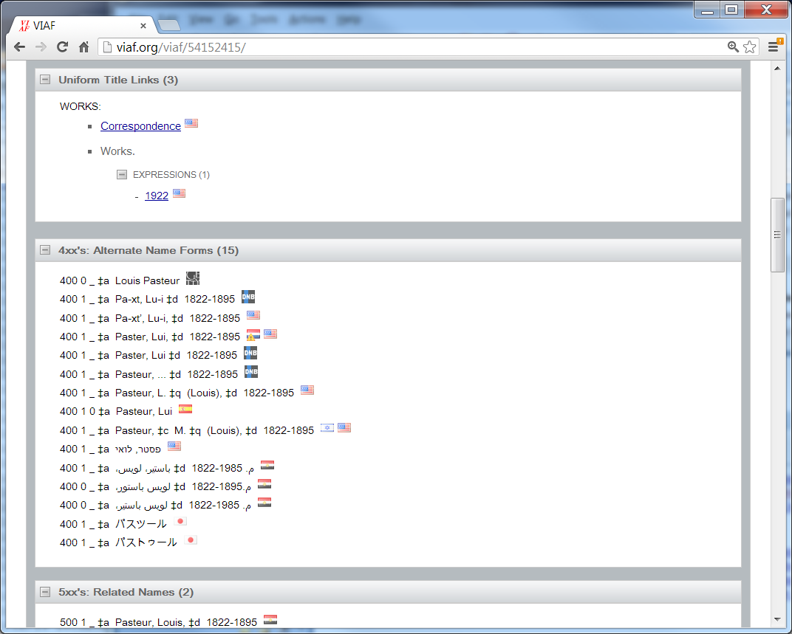

Slide 7
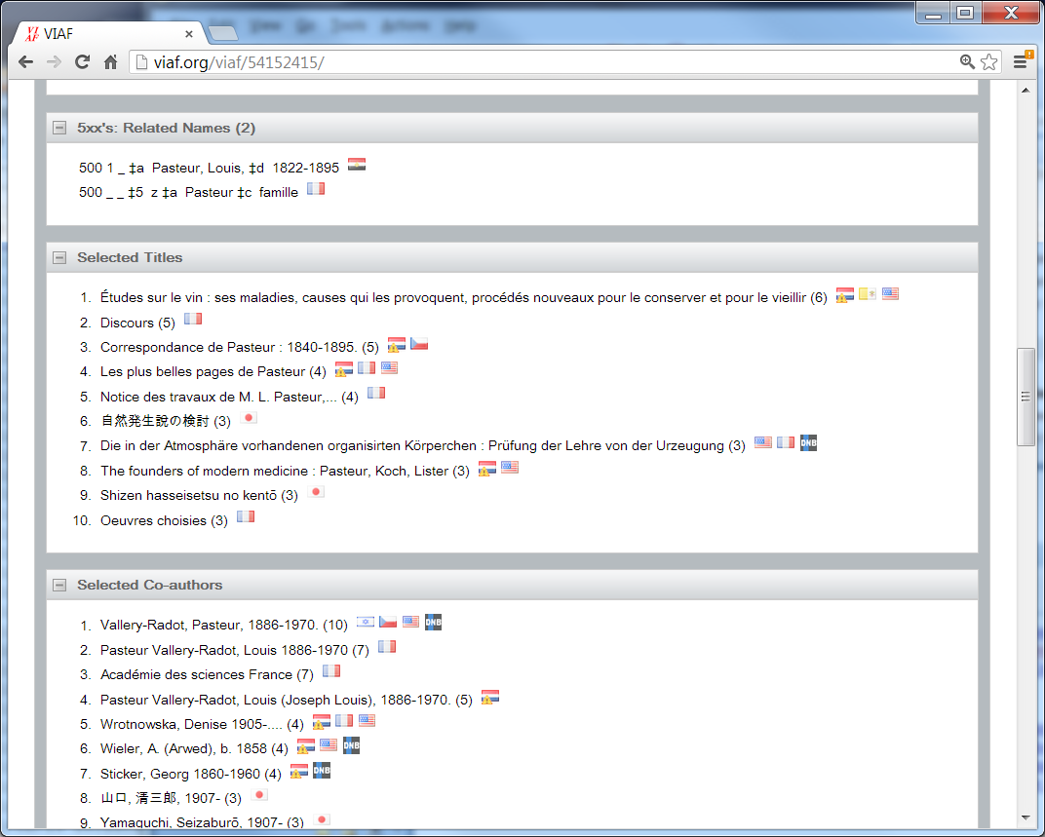

Slide 8
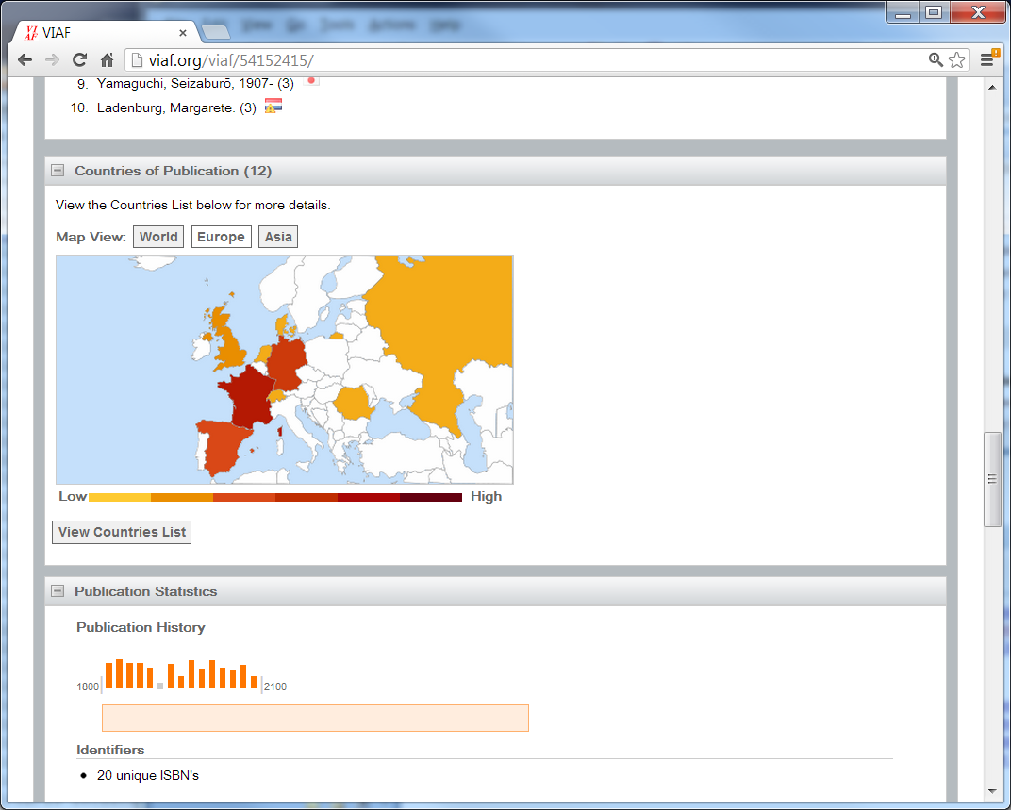

Slide 9
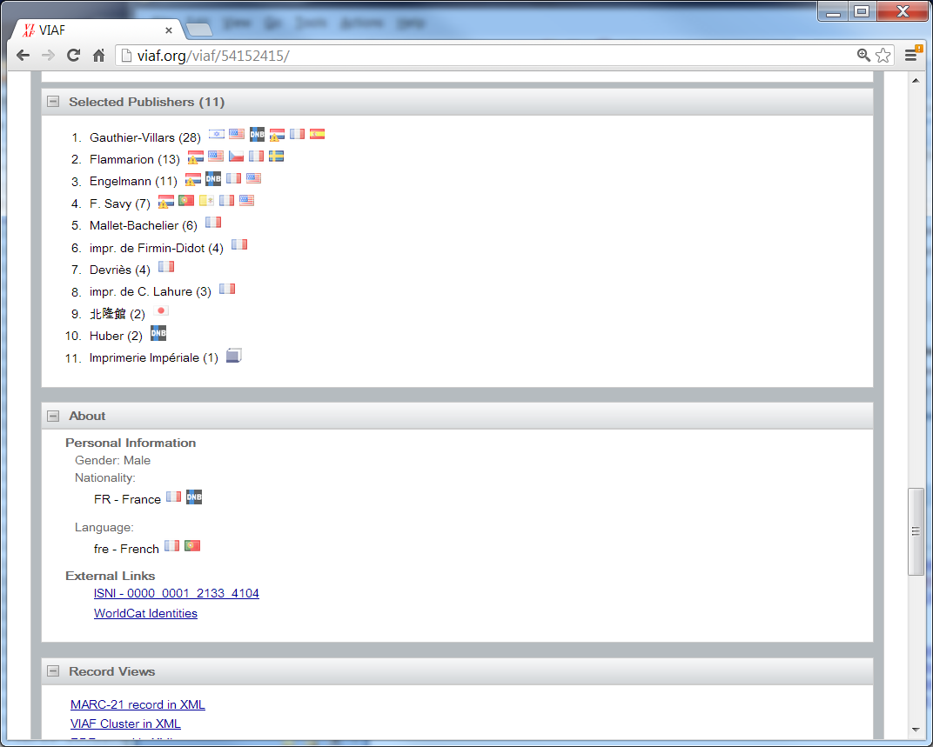

Slide 10
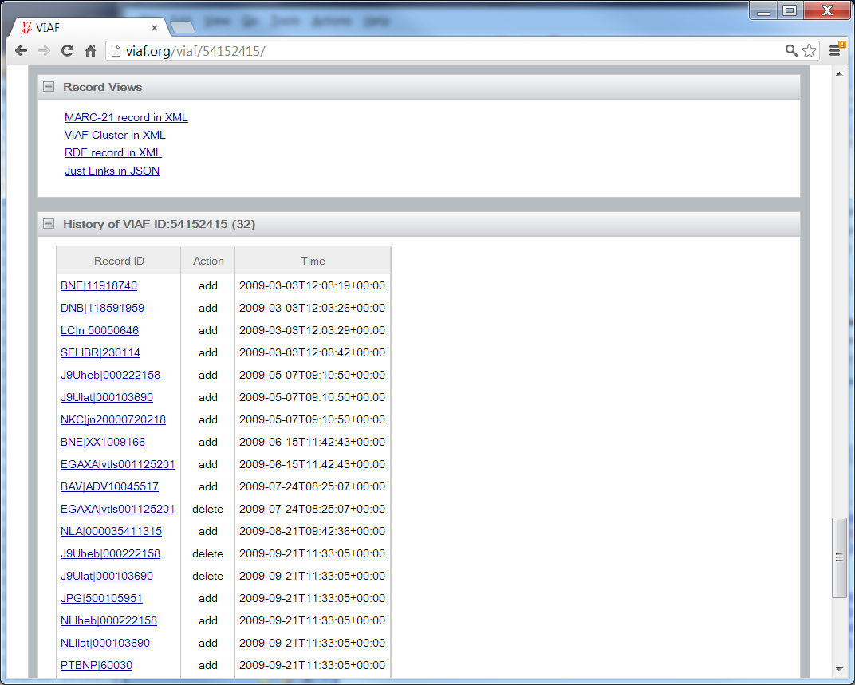

Slide 11
New Participants
National Diet Library
DBC (Denmark)
National Library of the Netherlands
National Library Board of Singapore
Coming:
National Library of Poland
National Library of Latvia
National Library of Croatia

Slide 12
Statistics
Online (browser) Usage
Had 3 days with substantial problems in 2012
Now over 1 million transactions/day (12/sec)
 | 2011 | 2012
Visits | 364K | 882K
Visitors | 139K | 491K
Pageviews | 2M | 3.7M

Slide 13
Changes
Wikipedia
Now treated as a ‘source’
ISNI
1.3 million links
Should it be treated as a source?
Matching improvements
Notes:
Matching
much harder on undifferentiated names; they can no longer pull together other records
Improved use of DNB information for corporate names
Recognize VIAF IDs in source files and use them as strong hints in matching
ISNI should shortly have 5 million links

Slide 14
VIAF Directions
Expanding view of where names come from
More sources
Scholars’ funnel
WorldCat*
More types of names
More fictional characters
Ships, animals, deities, …*
Production level servers
More reports to participants
Notes:
* Yet to be decided

